Slide 1
Quickbooks Part 2:
Curriculum Overview & Demo
Presented by: Emily Watkins-Daigle

Slide 2
Emily Watkins-Daigle
Emily has worked for Intuit for 16 years. Emily contributes to our Strategic Partner Group’s education initiatives as a Strategic Account Manager. Often is involved with many parts of our go-to-market strategies from supporting the integration of our products within industry partners. She is passionate about personal finance, design thinking and career readiness.​
Notes:
Ryan Slide
Jared bio -
Jared leads Intuit’s Financial Readiness program aiming to empowering students to make smart money decisions and own their financial futures. As an Innovation Catalyst with deep expertise in Personal Finance Jared serves as a Board Member for the Jump$tart Coalition, a committee member for the NY State Comptroller on Personal Finance, and has been tasked with designing the Congressional Award’s first ever Personal Finance Program.”
Elaine bio -

Slide 3
Agenda Slide
Quickbooks Part 1 Recap
Live Demo of Educator Portal and QBO
Q&A | Thank you!

Slide 4
Powering Prosperity
Around the World
$ 7.7B
650+
46M
5.1M
37M
600k⁺
95M⁺
FY20 Revenue
Active QBO Apps
TurboTax
Global Customers
QuickBooks Global Customers
MINT + Turbo Users
Tax Pros and Experts
Credit Karma
Customers

Slide 5
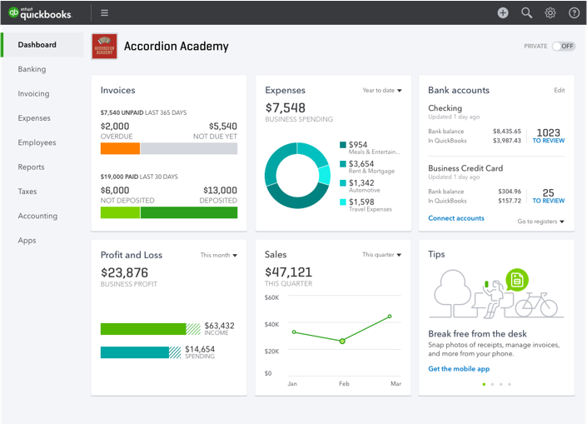
What is QuickBooks?
QuickBooks Online is a small business accounting software used by businesses to manage income and expenses and keep track of the financial health of their business.​
Provides Real-Time Financial Information
Ideal for the Virtual Teaching Environment
Easy to Learn
Convenient (saves time and money)
Ability to Collaborate
Most Importantly: Builds Life and job Skills
Notes:
Use this divider when using Title Option 2

Slide 6
Quickbooks
Curriculum & Simulation Demo

Slide 7
Next Week's Webinar, February 3
Integrating QBO into the classroom
- Guest High School Educator, Mr. Rich

Slide 8
Educator Resources & Portals
https://www.intuit.com/partners/education-program/products/quickbooks/
https://www.intuit.com/partners/education-program/
education@intuit.com

Slide 9
Thank You!

