Slide 1
National Personal Finance Challenge Webinar Series Standard 6: Protecting and Insuring Lesson 2: Managing Risk Presented by Susan McNamara, January 2021 mcnamarasa@vcu.edu

Slide 2
Standard 6: Protecting and Insuring
People make choices to protect themselves from the financial risk of lost income, assets, health, or identity. They can choose to accept risk, reduce risk, or transfer risk to others. Insurance allows people to transfer risk by paying a fee now to avoid the possibility of a larger loss later. The price of insurance is influenced by an individual’s behavior.

Slide 3
Warm-Up
Ask students what they know about insurance or if they have seen any insurance advertisements. Have students look at this picture and discuss what “risk” the climber is taking.
Notes:
In this warm-up activity, students will be discussing in groups what they know about insurance. More than likely you may have to prompt them to commercials they have seen on TV. Possible responses would include State Farm, Allstate’s Mayhem Commercials etc.

Slide 4
Warm up Activity Possible Responses
Lack of awareness Wildlife
Lack of knowledge Poisonous Plants
Lack of experience Dehydration
Falling Equipment Failure
Insufficient training Getting lost
Notes:
Here are some of the responses you may hear.

Slide 5
What is Risk?
Risk involves uncertainty and the possibility something may or may not happen.
When you sign up for a school sport you run the risk of a potential injury.
This Photo by Unknown Author is licensed under CC BY-NC-ND

Slide 6
Objectives
Identify key types of insurance such as health, auto, homeowner’s, renter’s, life, and disability.
Explain the costs and benefits of purchasing key types of insurance.

Slide 7
Low Risk, High Risk and Choices
Low Risk Choices
High Risk Choices
Riding the school bus
Using cellphones
Eating a sandwich
Turning on a light
Taking a walk
Texting while driving
Using drugs
Riding a motorcycle
Smoking
Drinking
Riding wild horses

Slide 8
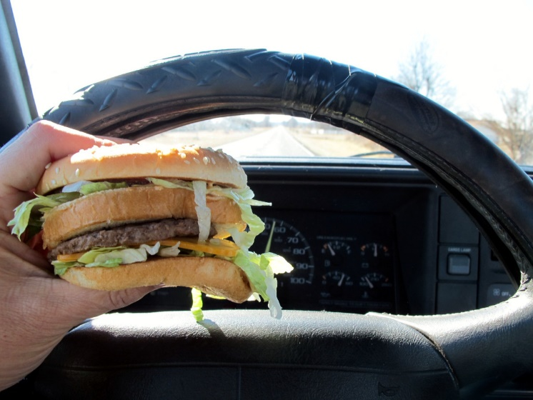
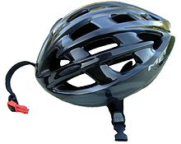
How can risk change?
Risk Reduction
Increased Risk
Riding a bike or motorcycle with a helmet reduces the risk of a head injury.
Eating while driving a car may increase the potential for an accident.
This Photo by Unknown Author is licensed under CC BY-SA
This Photo by Unknown Author is licensed under CC BY-SA

Slide 9
Key Terms
What is meant by risk? Uncertainty about the future
Why do people buy insurance? To reduce potential financial loss from risk associated with accident, theft, health, etc.
What is the purpose of pooling risk? To spread risk over more than one person or incident.
What is a premium? The fee paid for insurance protection.

Slide 10
Key Types of Insurance
AUTO
HEALTH
RENTER’S
HOMEOWNER’S
LIFE
DISABILITY
EXTENDED WARRANTY
WORKER’S COMPENSATION

Slide 11
Auto Insurance
Collision: provides for repair or replacement of the policy owner’s care damaged in an accident.
Liability: covers the cost of property damage or injuries to others caused by the policy owner.
Comprehensive: covers the cost of damage to an auto as a result of fire, theft, or storms.
Uninsured/Underinsured: covers the cost of property damage or injuries to the policy holder when the driver at fault is uninsured or underinsured to cover all the expenses related to the accident.
Provides financial protection against losses caused by an auto accident or other damage to a car.

Slide 12
Health Insurance
Traditional Health: provides reimbursement for hospital, surgical, medical, and other expenses; plans can include deductible and co-payments (20%+)
HMO’s: cover hospital, surgical, and medical services through a group of physicians; fees based on a monthly charge whether or not services are used.
High Deductible Plans : covers hospital, surgical, and medical services through either an HMO or traditional plan; much higher deductibles in exchange for lower premiums (usually used to insure against catastrophic health events.
Health Savings Accounts (HSA’s): tax sheltered account where consumers can save for their medical expenses
Provides payment for certain health care costs including coverage for dental and vision care.

Slide 13
Renter’s Insurance
Provides financial protection in case of loss of personal possessions in a rental unit, as well as injury to others on the property.
Reimburses the policy owner for loss of possessions in a rental unit caused by fire, theft, water damage, etc. Also provides liability protection for bodily injuries of guests that occur in the rental unit.

Slide 14
Homeowner’s Insurance
Protects against financial loss from damage to your home or its contents, as well as injury to others on the property.
Physical damage: reimburses for fire or water damage to the house, its contents, or other structures on the property.
Loss or theft: reimburses for personal property damaged or stolen.
Liability: protect against loss from a lawsuit for injuries to invited or uninvited guests.

Slide 15
Life Insurance
Term: offer protection for a specified period of time.
Cash Value Life: Combines financial protection with a savings or investment component. Cost many times more than term because of the investment feature. Three types are:
Whole Life: provides cash value and financial protection during the lifetime of the policy holder.
Universal Life: provides term policy protection with an investment feature of a whole life policy; face value can change during the time of the policy.
Variable Life: similar to universal life but allows the policyholder some choice in the investments for the cash-value portion of the policy.
Provides financial protection to dependents of policy owner when policy owner dies. Help to cover expenses such as income replacement, debt repayment, funeral expenses, and education expenses.
Notes:
Mention “fund me” pages and how they may be associated with a lack of proper or no insurance.

Slide 16
Disability Insurance
Policy owner selects a replacement income for lost wages if an illness or accident prevents the person from working.
It is paid for a specified time after a waiting period.
Disability is more important for young, single person than life insurance because the likelihood that a person in his/her 20’s will become disabled is seven times greater than his/her chance of dying.
Provides income over a specified period of time when a person is ill and unable to work; most of these policies end at retirement age of 65-70.

Slide 17
Extended Warranty
Provides a warranty on consumer goods beyond the standard warranty date.
Allows a longer time for the consumer to hold the company liable for a product such as a car, television, computer, etc.
Generally offered by merchants or companies upon purchase or when the standard warranty is near to expire.
Prices and length of time vary greatly
Also knows as a service or maintenance agreement.

Slide 18
Worker’s Compensation
Provides benefits for employees who are injured on the job.
Regulations for coverage are determined by each individual state but basic features are similar.
By law, an individual is entitled to compensation and other benefits for injuries incurred at work, whether or not the employer or employee is negligent.
Benefits may be paid to the family in cases of accidental death.

Slide 19
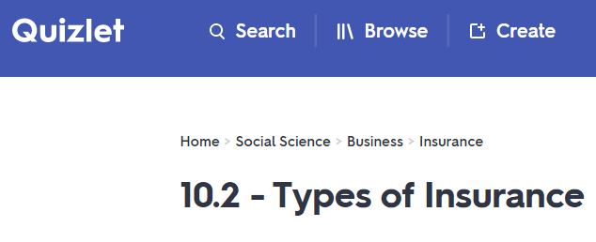
More Activities
https://quizlet.com/412033177/102-types-of-insurance-flash-cards/
https://create.kahoot.it/share/choices-and-risks/22c589be-90e6-4336-8ada-88fdc0d858c9
Notes:
Exercise 10.3 will assist students in assessing Insurance needs for case studies for the NPFC.

Slide 20
Questions?

Slide 21
References
National Standards for Financial Literacy
https://www.councilforeconed.org/resource/national-standards-for-financial-literacy/#sthash.11CbykLO.dpbs
Managing Risk
https://www.econedlink.org/resources/managing-risk/?view=teacher
Financial Fitness for Life, Lesson 10 Managing Risk

Slide 22
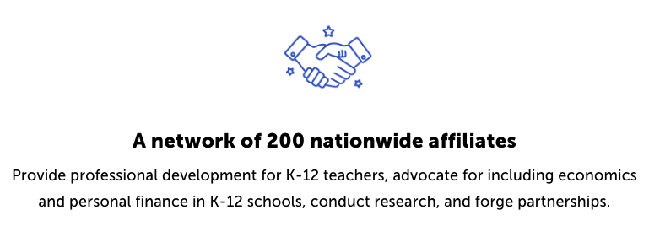
CEE Affiliates
https://www.councilforeconed.org/resources/local-affiliates/

