Slide 1
National Personal Finance Challenge Webinar Series
Standard 5: Financial Investing
Lesson 2: The Five Stages of Investing
Presented by
Susan McNamara, January 2021 mcnamarasa@vcu.edu

Slide 2
Standard 5: Financial Investing
Financial investment is the purchase of financial assets to increase income or wealth in the future. Investors must choose among investments that have different risks and expected rates of return. Investments with higher expected rates of return tend to have greater risk. Diversification of investment among a number of choices can lower investment risk.

Slide 3


Warm-Up
  Imagine your friend’s parents just inherited a little extra money to invest but have no experience. They want to find reasonably safe investments but hope to receive a return better than paid by checking accounts. What is your advice?
This Photo by Unknown Author is licensed under CC BY
This Photo by Unknown Author is licensed under CC BY
Notes:
In this warm-up activity, students will be discussing in groups what they would say to their friend. . This activity should generate conversation to talk about various investment terms and what they know about investing.

Slide 4
Introduction to Risk and Return
https://www.youtube.com/watch?v=xAWxKk9tUME

Slide 5
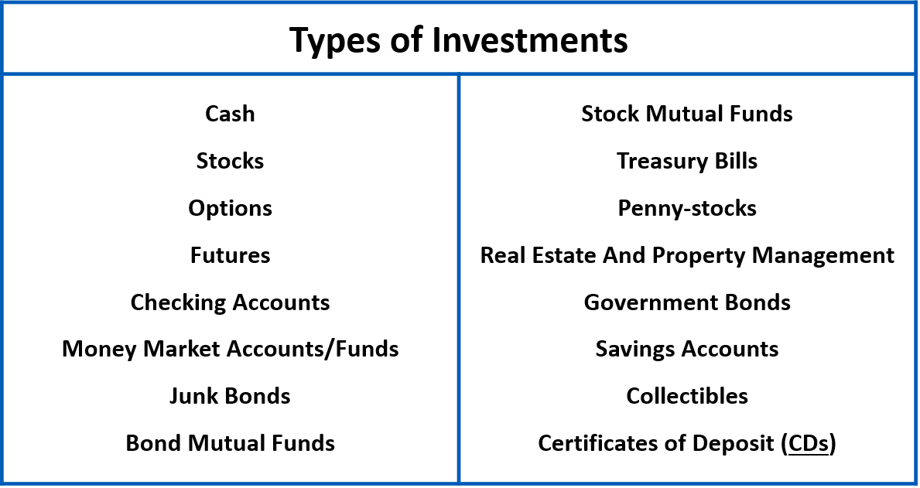
Warm up Activity Possible Responses
Notes:
Here are some of the responses you may hear. Students typically hear of some of these terms but may not consider them investments.

Slide 6
Objectives
Apply risk and return information using the five stages of investing to life situations.
Understand the risk and return rankings of a variety of financial investments.
Analyze and make financial decisions based on risk and return.

Slide 7
The 5 Stages of Investing
Step 1: Put-and take account
Step 2: Beginning to Invest
Step 3: Systematic Investing
Step 4: Strategic Investing
Step 5: Speculative Investing

Slide 8
Step 1 of the 5 Stages: Put-and-take account
This is the first type of financial instrument you should establish when you begin earning income. This account is for meeting your daily money needs rather than for saving and investing. For most people, the put-and-take account is a checking account. A checking account is the money that you're going to need immediately (or soon) plus a little extra for emergencies. You can take money out of this account by writing checks, for example, for car payments or clothes. Experts recommend that you set aside three to six months of net pay in your checking account, but always leave a safe cushion above the minimum requirements set by the bank for the account. You want to avoid payments to the bank for dropping below the minimum required for the account. So if you're making $50 a week working at the movie theater, your goal for the put-and-take account should be $600 to $1,200. This first stage is very low-risk because you don't want to gamble with the money you're counting on to pay the electric bill!

Slide 9
Step 2 of the 5 Stages: Beginning to Invest
After you're established a stable put-and-take account (meaning that you're NOT running out of money in your checking account each pay period), you can move on to considering beginning investments. These first investments should be low-risk instruments, for example, savings accounts, certificates of deposit, money market funds and perhaps treasury bills. You probably will earn a relatively low rate of return on these investments, but giving up the potential of higher returns for more security is important at this stage. Most people begin this stage in their twenties or thirties, when their budgets and spending are stable and they begin to have excess cash. Getting an early start is important because your investment will have more time to earn returns for you! That's why it's important to get your put-and-take account established as soon as you can. If you are a seventeen year-old and have your put-and-take account under control, you can get a head start on the next stages and a head start on other investors!

Slide 10
Step 3 of the 5 Stages: Systematic Investing
When you have established your beginning investments, you can move on to investing on a REGULAR and PLANNED basis. For most people, this is a commitment to invest a predetermined dollar amount every pay period, usually in bonds, stocks, mutual funds, or annuities, the middle risk categories. Goals for this stage are long-range; you're going to see the best return from this kind of investment if you continue with it for over twenty years. Typically, people enter this stage in their thirties and forties, when their earning potential is the highest. Here again, starting early is important. The seventeen year-old who has a stable put-and-take account and begins investing early might be ready to jump into systematic investing in his or her twenties. The financial investments are a combination of bonds, fixed income investments, and stocks. The key here is carrying out a consistent plan.

Slide 11
Step 4 of the 5 Stages: Strategic Investing
The fourth stage is for investors who have set up a stable put-and-take account, built safe beginning investments, and established a systematic investing plan. When you have assets above and beyond those commitments, you can begin strategic investing, which is managing your portfolio (your collection of assets) with a goal of balancing out losses and gains in different investment instruments. The key here is DIVERSIFICATION: making sure you're not keeping all your eggs in one basket. Since stocks and bonds often respond in opposite ways to market conditions, many people invest in both to balance losses in one with gains in the other. Goals in this stage are medium-term: five to ten years.

Slide 12
Step 5 of the 5 Stages: Speculative Investing
The fifth and final step is speculative investing, for example, investing in penny stocks, junk bonds, or collectibles. Speculative investing involves high levels of risk, but it also has the potential to yield high returns. This type of investing should only be done by people who can afford to lose the investment amount. Many people never do engage in speculative investment, preferring to avoid the heightened level of risk that it involves.
Notes:
In speculative investments, only invest that which you can afford to lose.

Slide 13

Put Your Knowledge to Work!
You are now an expert financial adviser. Let’s go back to your friend whose parents came into some unexpected money, how would you advise on their next step in investing. They're at different stages of saving and investing, and they don't know where to go from here. Using what you've just learned about the stages of saving and investing, give them sound financial advice.
This Photo by Unknown Author is licensed under CC BY-NC-ND

Slide 14
Your advice to your friend’s parents
My friend’s parents should invest their small inheritance in; ________________________________________________________________________________________________________________________
Because;
________________________________________________________________________________________________________________________

Slide 15
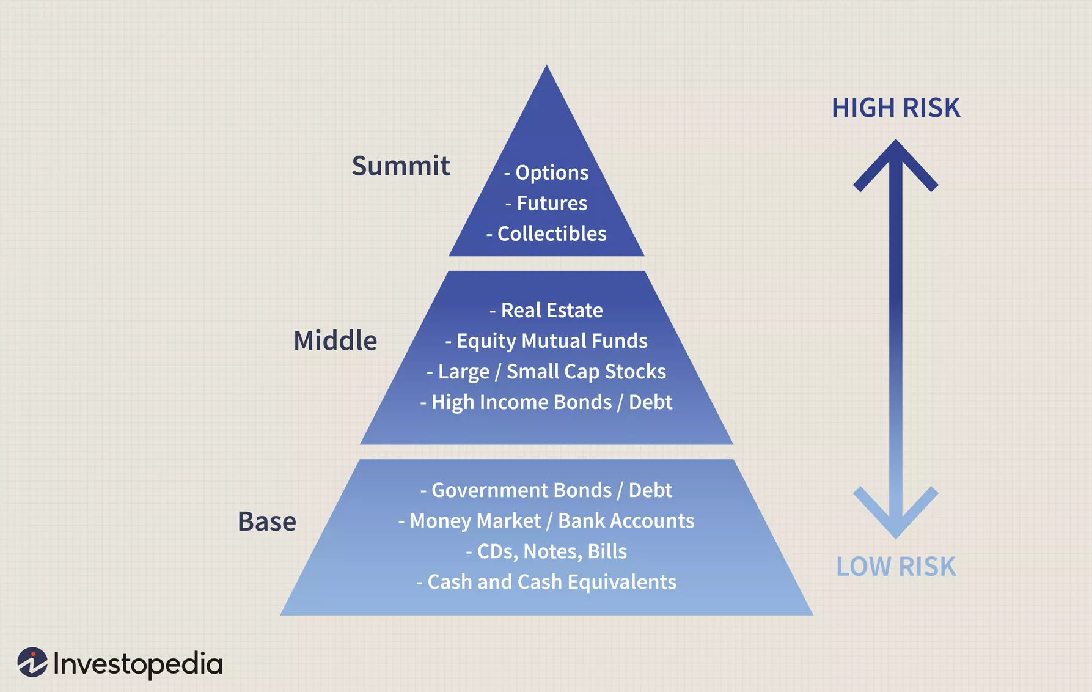
Investment Risk Pyramid

Slide 16
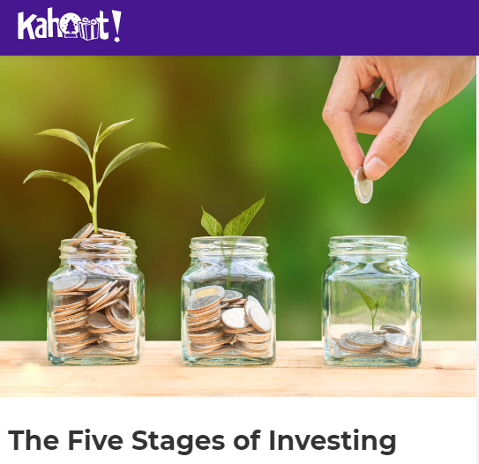
More Activities
https://create.kahoot.it/share/7ecba66f-7795-4724-8744-e0f5341614d9

Slide 17
Activity: Thinking into the Future
Have students make a timeline of their expected lives from now until age 80, mapping out prospective dates of milestones like retirement, job promotions, having children, etc.
The students can then split their timeline into the five stages of saving and investing. Of course, they can’t know for sure when they will buy their first home, switch jobs, etc. but it is worthwhile for them to think about a timeline for their goals.
It is important to share with students that most investors do not get to stage 5, and it may not necessarily be a good thing to do so.
Notes:
Stage 5 investing makes sense only for people who are, financially and psychologically, comfortable with high levels of risk.

Slide 18
Questions?

Slide 19
References
National Standards for Financial Literacy
https://www.councilforeconed.org/resource/national-standards-for-financial-literacy/#sthash.11CbykLO.dpbs
The Five Stages of Investing
https://www.econedlink.org/resources/the-five-stages-of-investing/

Slide 20

CEE Affiliates
https://www.councilforeconed.org/resources/local-affiliates/

