Slide 1
National Personal Finance Challenge Webinar Series Standard 4: Use of Credit Lesson 2: Credit Reports and Scores Presented by Susan McNamara, January 2021 mcnamarasa@vcu.edu

Slide 2
Standard 4: Use of Credit
Credit allows people to purchase goods and services that they can use today and pay for those goods and services in the future with interest. People choose among different credit options that have different costs. Lenders approve or deny applications for loans based on an evaluation of the borrower’s past credit history and expected ability to pay in the future. Higher-risk borrowers are charged higher interest rates; lower-risk borrowers are charged lower interest rates.

Slide 3
Warm-Up
Can I borrow some money?
Imagine an individual has approached you and asked to borrow a substantial sum of money. What would you want to know about this person before you determine whether to lend the money?
This Photo by Unknown Author is licensed under CC BY-NC-ND
Notes:
Students will be discussing in groups of two their experiences with loaning someone money. When taking into consideration whether to decide loaning someone money, a natural discussion of the C’s of credit will emerge.

Slide 4
Objectives
Describe what a credit report is and how it is used
Summarize the information used to calculate a credit score
Explain how credit scores affect creditworthiness and the cost of credit
Explain the factors that improve a credit score
Determine the cost of financing based on credit scores

Slide 5
Key terms
Credit- The opportunity to borrow money or to receive goods or services in return for a promise to pay later.
Credit Report: A credit report is a record of an individual’s personal credit history. It is probably a good indicator of the applicant’s character and whether he or she will repay borrowed money as agreed.
Credit Score- A single number assigned to a person used by lenders to predict the risk that borrowers will not repay.
Notes:
Define the key terms for the unit. Be sure to mention other key terms may come up in the discussion as part of instruction for the lesson.

Slide 6
Warm up Activity 2
Ask students to take the pre-survey question on “Earning Credit” at this site:
http://councilforeconed.org/earningcredit
Notes:
Ask students to take pre-survey. There are 5 questions that will be asked and then they will submit the survey and a fictitious “credit score” will be generated based on their responses. Some students will have higher scores and some will have lower scores.

Slide 7
Warm up Activity 2 Responses
Explain that being responsible is the key to having good credit as an adult—paying bills on time, borrowing only amounts that can be repaid, etc. In high schools, students demonstrate their responsibility by doing well in school and other ways. The survey questions (5) focus on activities that represent some of these responsible behaviors.

Slide 8
The 3 C’s of Credit
Capacity: is your ability to repay debt
Character: is your likelihood of paying your debt
Collateral: are assets that could be sold to pay off your debt
Notes:
Refer back to slide 3 in the warm-up activity and ask students if their responses on whether to loan someone money reflect any of the 3 C’s of Credit.

Slide 9
Credit Scores
Notes:
Have students look at the image above. Note to the student that credit scores range from 300-850.

Slide 10
Information Used to Calculate a Credit Score
35% Payment History
30% Managing your Debt
15% Length of Credit History
10% Diversity of Accounts
10% Number of Credit Applications

Slide 11
35% Payment History
Consumers are rated on whether they make regular on-time payments on car loans, student loans, home loans and credit cards.
Missing one credit card payment may not have a significant impact-although it will remain on the credit report for up to 7 years.
Missing multiple payments is far more damaging.
Notes:
Test scores were used for this category in the pre-survey because they represent a consistent long-term effort.

Slide 12
30% Managing Your Debt
Consumers are rated on how large their credit balances are relative to their available credit (Credit Limit); according to credit professionals, it is best to use less than 10% of available credit.
Notes:
Homework Completion was used for this part of the initial pre-survey because it represents your ability to keep track of obligations.

Slide 13
15% Length of Credit History
Consumers are rated on how long they have managed credit.
Notes:
Saving was used in the pre-survey for this category because making the decision to save your own money represents the first step in financial responsibility.

Slide 14
10% Diversity of Accounts
Consumers are rated favorably for having a variety of types of credit—credit cards, a car loan, a home loan, etc.
Notes:
Activities were used for this category because they represent balancing competing obligations.

Slide 15
10% Number of Credit Applications
Consumers are rated negatively if they frequently seek new loans and credit cards.
However, if they seek multiple estimates for a car loan, these are grouped together so they are not hurt by them.
Notes:
Asking your parents for money was used in the pre-survey for this category because borrowing from parents is similar to borrowing from other sources.

Slide 16
Analyzing Credit Reports and Scores
Let’s log into our Intuit Education Account from our previous lesson.
https://www.youtube.com/watch?v=69Ws7A_Zgh8&feature=youtu.be
Let’s look at Isaiah Lomora’s credit score and report.

Slide 17
Factors to Improve Your Credit Score
Always pay bills on time
Never borrow more than you can comfortably pay back
Borrow only the amount you need
Know how much you owe at all times
Contact lenders immediately if you expect to have a payment problem
Develop good savings habits so you can handle financial emergencies without borrowing

Slide 18
Factors to Improve Your Credit Score, cont.
Report lost or stolen credit cards immediately
Never give your credit card number or personal information over the phone or on the internet unless you initiated the transaction
Open a checking and a savings account
Do not apply for too many credit cards. Even if you don’t use them, the credit limits are taken into consideration when you apply for new credit.

Slide 19
Credit Scores, Credit Worthiness and the Cost of Credit
Your credit score (and your history) will impact your future credit worthiness. The information on your credit report is used to calculate a credit score and may be used by stores, credit card companies, banks, etc. to determine if a person is credit worthy.
Your credit score will also affect your cost of credit, meaning that if you maintain better credit, the cost of borrowing will likely result in a lower interest rate and conversely, a lower credit score will result in a higher interest rate.

Slide 20
Questions?

Slide 21
References
National Standards for Financial Literacy
https://www.councilforeconed.org/resource/national-standards-for-financial-literacy/#sthash.11CbykLO.dpbs
Credit Reports and Credit Scores
https://www.econedlink.org/resources/credit-reports-and-credit-scores/
Financial Fitness for Life, Lesson 13, Credit Reports and Credit Scores

Slide 22
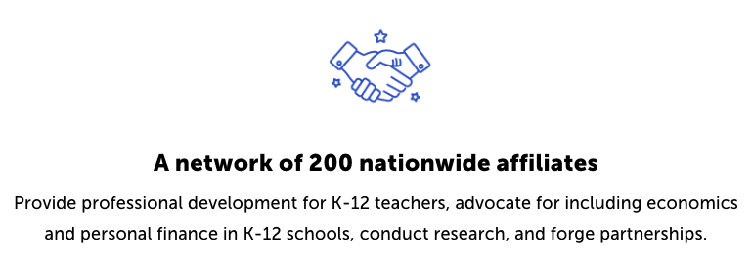
CEE Affiliates
https://www.councilforeconed.org/resources/local-affiliates/

