Slide 1
National Personal Finance Challenge Webinar Series
Standard 2: Buying Goods and Services
Lesson 1: Income and Choices
Presented by
Dr. Julie Heath julia.heath@uc.edu

Slide 2
Standard 2: Buying Goods and Services
People cannot buy or make all the goods and services they want; as a result, people choose to buy some goods and services and not buy others. People can improve their economic well-being by making informed spending decisions, which entails collecting information, planning, and budgeting.

Slide 3
Setting Goals
Ask students what some of their goals are (could be anything, not necessarily about finance).
Tell students that we typically categorize goals into three types, depending on how far into the future the goal is

Slide 4
Short-term goals: goals that can be achieved in the next 2-3 months
Medium-term goals: goals that can be achieve in 3 months-3 years
Long-term goals: goals that take 3+ years to achieve
Ask students for examples of each and/or ask them to categorize the goals they have already given you
Tell students that while not all goals concern finances, some do, and you can help them with achieving those kinds of goals.

Slide 5
A Secret
Tell students that you are going to let them in on a secret, a secret so powerful that you will guarantee that if they do it, they will be financially successful.
Ask students if they know what that secret is.
With the appropriate amount of drama, drum roll, etc., reveal that it is…

Slide 6
Spend less than you receive

Slide 7

Tell students that while that sounds easy, a lot of people struggle with it.
Ask them: What are the two ways you can spend less than you receive?
Receive more
Spend less

Slide 8
1. Receive More
Short activity to demonstrate how productivity determines pay
Baseball draft (you could pick any sport)
Assign 3 students to be baseball draftees. The class will be team owners who want to draft the players

Slide 9
Players
Player 1 | Player 2 | Player 3
Right field | Center field | Shortstop
Batting Avg 120 | Batting Avg 108 | Batting Avg. 355
40-yard dash 8.0 | 40-yard dash 7.9 | 40-yard dash 5.1
Who do you want to draft?

Slide 10
Productivity/Education and Earnings
Point out that most chose Player #3 because of his higher productivty.
While most of us are not baseball players, higher productivity usually leads to higher earnings for all of us

Slide 11
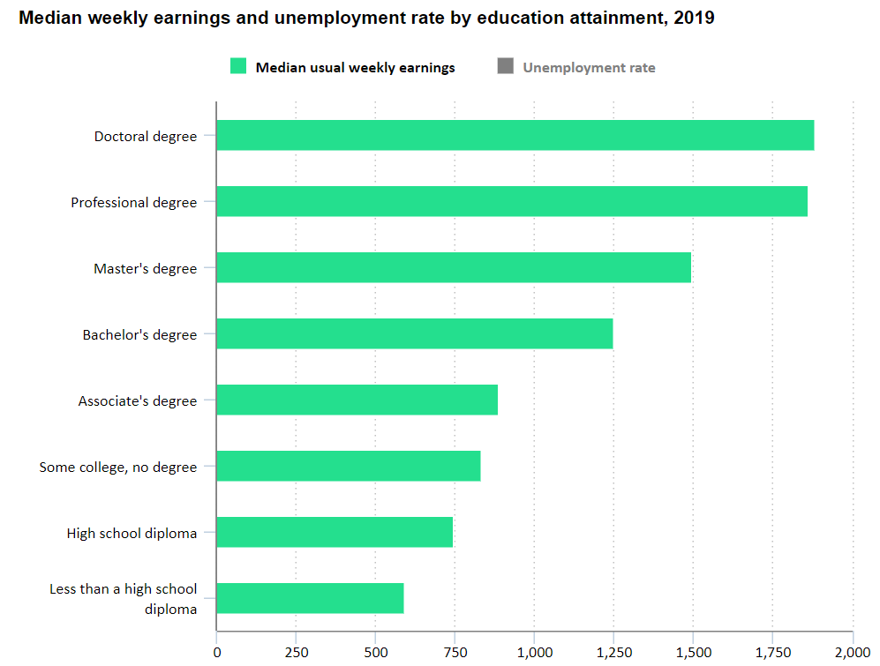
Usually…
higher education =
higher productivity =
higher earnings

Slide 12
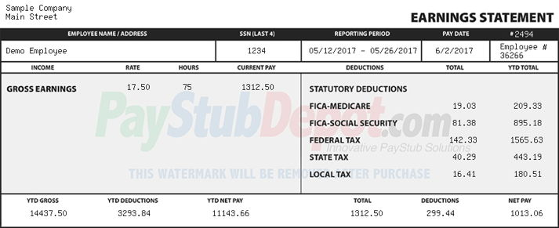
Speaking of Earnings…
Walk students through an example of a paystub, pointing out the deductions from gross pay to get to net, explaining categories (e.g., FICA)

Slide 13
2. Spend Less
Set goals
Find out where money is going/create a budget
“Find” money and save

Slide 14
Goals
In addition to categorizing goals by how long it will take to achieve them, any goal should be SMART:
Specific
Measurable
Achievable
Realistic
Time-bound

Slide 15
Budget
Student activity (group or individual) with check register—categorize spending
Create budget categories (housing, food, transportation, entertainment, etc.) and give students a monthly income to allocate among these using amounts that make sense for your location—include “Savings” as a category
Go over fixed (rent, cell phone bill) and variable (food, entertainment) expenses

Slide 16
“Find” Money
Using their responses to the budget exercise, tell students that even small saved amounts can add up to a lot over time—tee up the next standard: saving

Slide 17
References
National Standards for Financial Literacy
https://www.councilforeconed.org/resource/national-standards-for-financial-literacy/#sthash.11CbykLO.dpbs
Income and Choices
Found on Virtual Economics, Lesson 1 of Your Credit Counts

Slide 18

CEE Affiliates
https://www.councilforeconed.org/resources/local-affiliates/

