Slide 1
National Personal Finance Challenge Webinar Series
Standard 1: Earning an Income
Lesson 2: Uncle Sam Takes a Bite + Tax Math
Presented by
Susan McNamara, January 2021 mcnamarasa@vcu.edu

Slide 2
Standard 1: Earning an Income
Income for most people is determined by the market value of their labor, paid as wages and salaries. People can increase their income and job opportunities by choosing to acquire more education, work experience, and job skills. The decision to undertake an activity that increases income or job opportunities is affected by the expected benefits and costs of such an activity. Income also is obtained from other sources such as interest, rents, capital gains, dividends, and profits.

Slide 3

Warm-Up
Congratulations on getting
your first job!
You have been hired to work a part-time job for
15 hours/week at $10/hour.
  Calculate your first paycheck amount
  Is this value correct or incorrect? Why?
  Will this be the amount you see on your first paycheck?
Notes:
Students will be calculating Gross Pay. The amount is correct but confusing as it does not reflect any deductions. This causes a surprise the first time you see the difference between your expected income of $150 versus your take home pay because of taxes and various additional deductions that may occur.

Slide 4
Warm-Up Answers
You have been hired to work a part-time job for 15 hours/week at $10/hour.
  Calculate your first paycheck amount (15 hours X $10 hour=$150)
  Is this value correct or incorrect? Why?
  Yes and no; the value of $150 reflects your gross pay, but it won’t likely be what you will see on your first paycheck.
  Will this be the amount you see on your first paycheck?
  No, it does not reflect any taxes and other deductions removed from the gross pay.
Notes:
Answers

Slide 5

Warm up #2: Tax Math
A new CD that Janice has wanted to buy is on sale for $12.99. The sales tax where she lives amounts to 6.5%. With tax included, how much will Janice pay for her the CD?
Notes:
Review for math concepts that involve taxes.

Slide 6
Warm up #2: Tax Math Answer
A new CD that Janice has wanted to buy is on sale for $12.99. The sales tax where she lives amounts to 6.5%. With tax included, how much will Janice pay for her the CD?
$12.99 X 6.5%= .84 (tax)
Total Cost of the CD: $12.99 + $0.84= $13.83
Notes:
Note to students that sales tax varies from state to state. Also note that states determine what items are taxed (food, clothing, etc.)

Slide 7
Warm up #3: Freddie, Elissa, and Velma
 | Taxable Income | Income Tax Paid | Tax Paid as a Percent of Taxable Income
Freddie | $17,000 | $2554
Elissa | $51,000 | $10,940
Velma | $102,000 | $26,399
Notes:
Have students look at the table above. What initial thoughts/predictions do they have about Freddie, Elissa, and Velma as taxpayers?
Answers could include: Freddie may work part-time, Elissa makes more money than Freddie but half that of Velma. What type of career does Velma have that her taxable income is twice that of Elissa? Tie these back to the standard 1: Earning an income

Slide 8
Warm-up #3: Practice Makes Permanent
Let’s calculate the total tax paid by each person as a percent of his/her taxable income; enter the percentage in the last column of the table. This percent is known as the average tax rate.
Who pays the largest share of taxable income in the form of income taxes? Who has the lowest average tax liability?
Our federal income tax is known as a progressive tax (the average rate of taxation is higher for higher-income earners than it is for lower income earners). How does the table on the previous slide indicate that we have a progressive tax system?
Notes:
Math practice to reinforce ( Pre-Algebra/Algebra1 level)

Slide 9
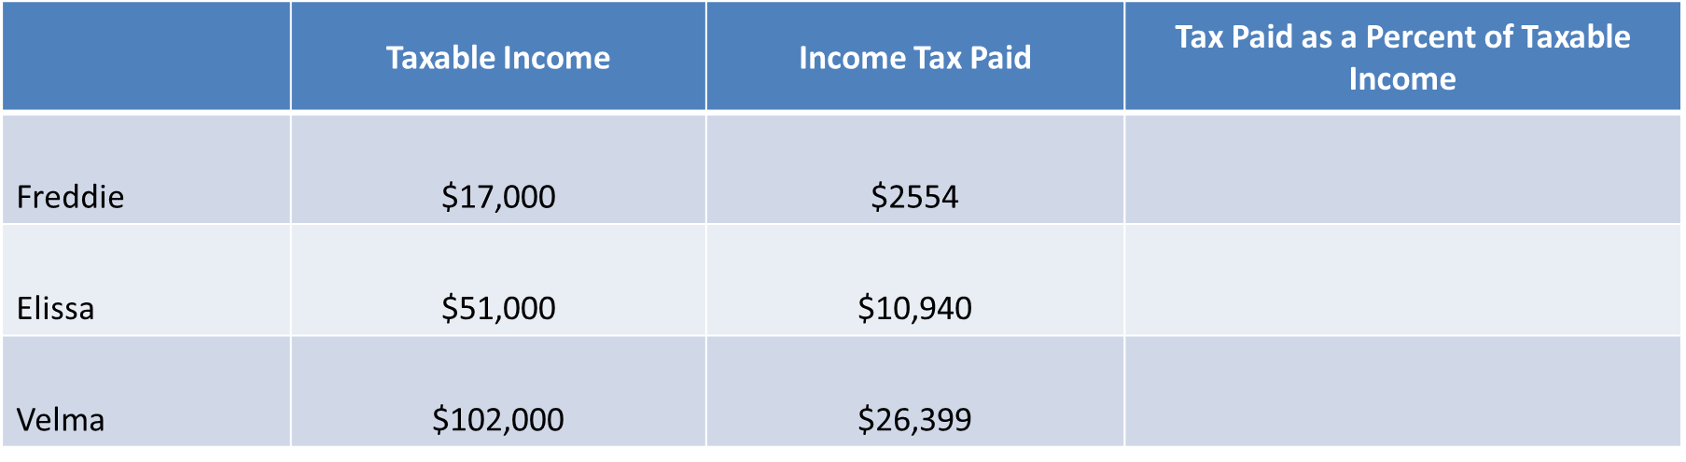
Answers to Warm-up #3
Freddie: 15%, Elissa 21.5%, and Velma 25.9%
Ex. Freddie: $2554/$17,000=15%
2. Velma pays the largest share of her income in the form of taxes. Freddie has the lowest average tax liability.
3. The table on the previous slide shows that the average tax rate for the individuals increased as the taxable income increased. Since the average rate increased, the marginal rates must have increased for various increments of income to make the average rates higher for higher levels of income.

Slide 10
Key Concepts
Income
Gross Pay
Income Tax
Net Pay
Taxation
Notes:
Ask students to again consider the first question from the warm-up: Why did I not get $150 on my paycheck amount? This is the introduction to wages earned and then what is taken home, often referred to as ‘take-home pay’ or Net pay on the pay stub.

Slide 11
Key Terms
Gross Pay
Net Pay
FICA
Deductions
Federal, state, and local taxes
W-4
Benefit payments
  Benefit payments
    Health, dental, vision
    Retirement savings
    Union dues

Slide 12
Key Terms, cont.
Pay Stub
Tax Brackets
3 basic types of taxes
  Progressive
  Regressive
  Proportional (flat)

Slide 13
Example of a Pay Stub
Employee Name: John R. Doe
Pay Period: 06/02/19 to 06/16/19
Earnings: This Period and YTD
Gross Pay: Hours X Rate (50 hours X $9=$450)
Required Deductions
Other Deductions
Net Pay
Review Check
Notes:
Review the contents of the pay stub with your students. Note the hours worked multiplied by the rate of pay (50 hours X $9 = $450). Next point out the relationship between “this period” and “YTD” values. Next, discuss what the required deductions are that appear on this stub. Note also that in this example, there are no state income taxes withdrawn. Also note to your students that there is another section labeled “Other Deductions” listed below the “Required Deductions.” For this example, John Doe does not have any health insurance, 401K, or parking deductions coming out of his gross pay. It is recommended for you to review the contents of the check, the check number, date, net pay amount, etc.

Slide 14
Check for understanding
What is gross pay?
What is net pay?
Name at least three mandatory deductions taken out of gross pay.
Name three other (not mandatory) possible deductions.
Notes:
Time for a formative assessment to check students understanding of the materials.

Slide 15
Check for understanding Answers
What is gross pay?
  Total amount of money earned before any deductions are made.
What is net pay?
  The amount left after tall deductions for taxes and benefits payments are taken out of gross pay.
Name at least three mandatory deductions taken out of gross pay?
  Federal, state (if required), Social Security, Medicare, and local taxes.
Name three other (not mandatory) possible deductions ?
  Life, disability, medical, and dental insurances, retirement savings, any other contribution.
Notes:
There may be other answers generated by students for the possible deductions question.

Slide 16
Mandatory Deductions
Deduction | What does it pay for? | Who pays?
Federal Income Tax | Defense (military), human services, monitoring and regulation of trade | Employee
State Income Tax | Services provided by state govt’s such as roads, safety and health (not all states levy a state tax) | Employee
Local Income Tax | Pays for services by local govt’s such as schools, police and fire protection | Employee
FICA: Social Security tax | This tax provides for old-age , survivors, and disability insurance | Employee/Employer
FICA: Medicare tax | This tax provides for medical insurance for the elderly | Employee/Employer
Notes:
It is important to note to the students that the first 3 taxes listed are the employee's responsibility, but the last 2 related to FICA are a shared responsibility with the employee and the employer.

Slide 17
Other possible deductions
Deduction | What do you get? | Who pays?
Life Insurance | Pays a beneficiary in the event the employee dies. | Employee or employer or shared
Long-term disability insurance | Provides benefits in the event the employee becomes completely disabled. | Employee or employer or shared
Medical | Provides employee and family insurance coverage for medical care expenses including hospitalization, physician services, surgery and major medical expenses. | Employee or employer or shared
Dental | Provides employee and family insurance coverage for dental care expenses including preventive diagnostic, basic, major and orthodontic services. | Employee or employer or shared
Retirement saving plan | A tax-deferred savings plan for retirement. | Employer or employee (there may be an employer match)
Charity | A donation to a specific charity. | Employee (employer may match a percentage of the employee contribution)
Notes:
Although these deductions may not be required, students should be informed about how these deductions will impact the net pay amount.

Slide 18
What’s Your Bracket?
So, what does this mean? Federal Income tax is a progressive tax, which means that the percentage of income paid in taxes increases as income increases.
Ex. If someone earns $50,000 and they pay $5000 in taxes, they paid 10% if their income in tax.
Ex. If someone earns $150,000 and they pay $15000 in taxes, they paid 15% of their income in tax.
With a progressive tax, not all income is taxed at the same rate, because the amount of taxes is based on marginal tax rates (you pay an additional amount of taxes on an additional amount of income). Marginal tax rates are often referred to as the “tax bracket.”

Slide 19
Meet the Green Family
The Green family (married without children or dependents) is paying taxes on income earned jointly that was $184, 800. They are filing taxes jointly and taking the standard deduction for tax year, 2020 of $24,800.
Income earned: $84,800-$24,800(standard deduction for married filing jointly)= Taxable income of $160,000.
What is the Green Family’s tax obligation for 2020?
Notes:
Important to note to teachers that these numbers can change from year to year. Refer students to the IRS.gov website for current and former year’s information.

Slide 20
Let’s practice with the Green Family!
What was their total tax obligation for year 2020?
Taxable Income Range | Marginal Tax Rate | Taxes Paid on $160,000 Income
$0 to $19,750 | 10% | ?
$19,751 to $80,250 | 12% | ?
$80,251 to $171,050 | 22% | ?
$171,051 to $326,600 | 24% | ?
$326,601-$414,700 | 32% | ?

Slide 21
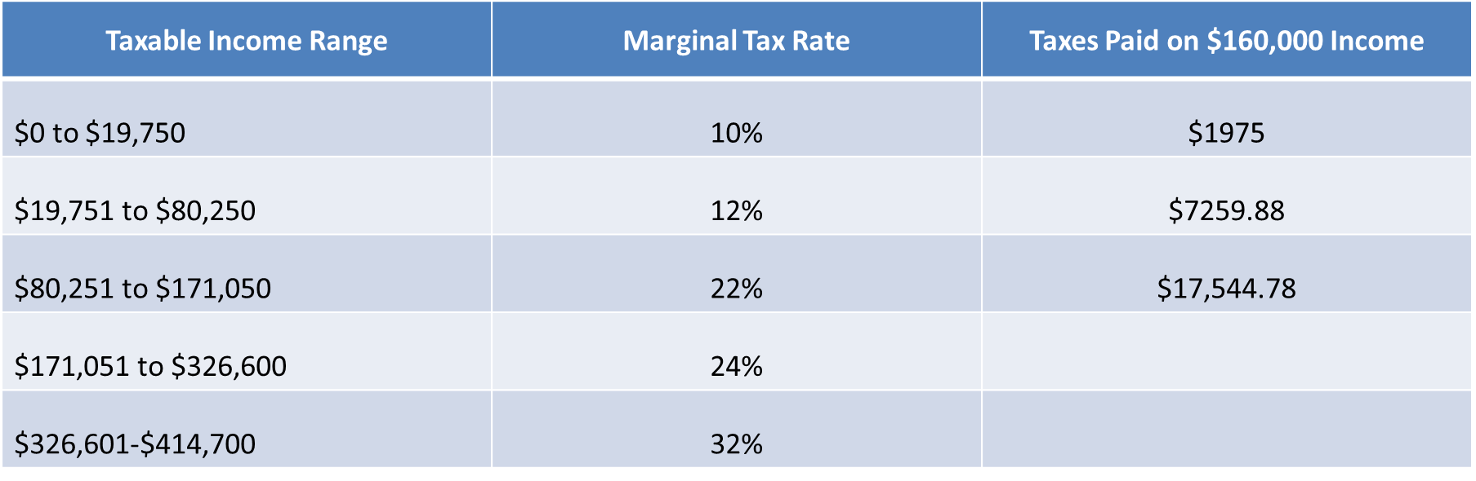
Green Family Calculations and Answers
Total Taxes Due for 2020 are: $26,779.66
Notes:
Teachers need to explain the calculations to students. For tax year 2020, the first $19,750 are taxed at 10%, the range of $19751 to $80, 250 is taxed at 12% and the remaining balance up to 160,000 is taxed at 22%. The illustration of the marginal tax rate and brackets illustrates what a progressive tax looks like as someone’s income increases.

Slide 22
Tax Savings Strategies
Itemizing vs. Using the Standard Deduction
  Itemizing may be a better option for those who have total deductions greater than the standard amount. (Use Schedule A, form 1040)
  Itemizing tax deductions: https://www.youtube.com/watch?v=eO4BX8dLgXk
  The standard deduction is the same for everyone, however, not everyone has the same income or possible deductions.

Slide 23
More Tax-Saving Strategies
Lowering your taxable income
  If you make a percentage of payment for a health insurance or retirement accounts, those payments are deducted from your gross income and may be used to reduce your overall taxable income.
Maximizing your retirement account
  401 (k) or 403 (b) matches
Opening an IRA
  You may be able to use payment made to your IRA as a tax deduction
Keeping good financial records

Slide 24
Tax Tables and Forms
Tax tables for 2020
https://www.irs.gov/pub/irs-pdf/i1040tt.pdf
Tax forms for 2020:
https://www.irs.gov/pub/irs-pdf/f1040.pdf

Slide 25
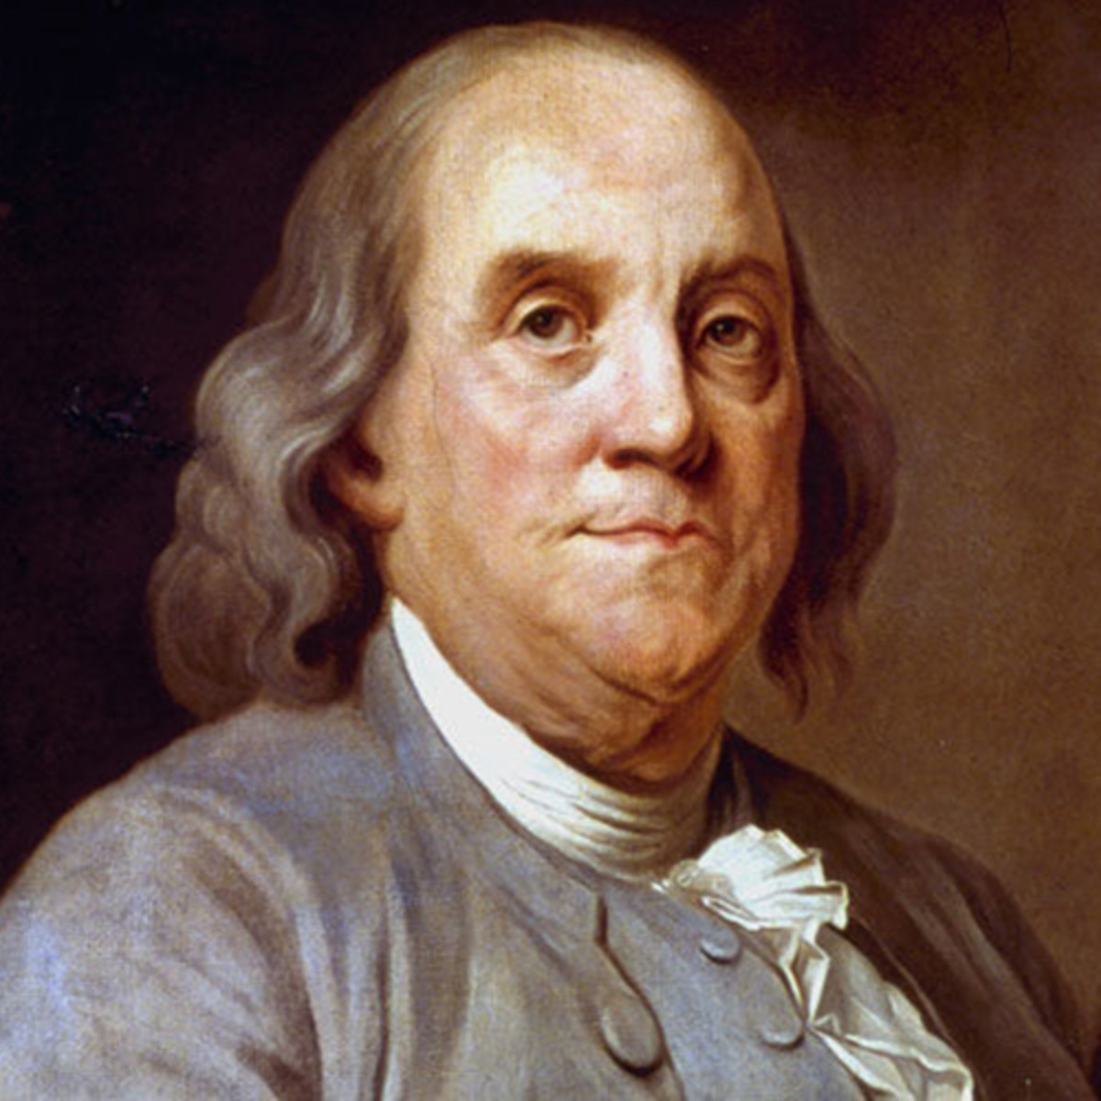
In this world, nothing can be said to be certain except death and taxes.
Benjamin Franklin, 1789
Notes:
Explain to students that Benjamin Franklin made this observation over 231 years ago in 1789. Help students understand that personal income tax is a responsibility and part of life in most countries because governments rely on taxes to provide various goods and services for its citizens. Remind students that a progressive income tax system increases the marginal tax rates as income increases but using the standard deduction or itemized deductions can help reduce the amount of taxes paid or what we refer to as our tax burden.

Slide 26
Questions?

Slide 27
References
National Standards for Financial Literacy
https://www.councilforeconed.org/resource/national-standards-for-financial-literacy/#sthash.11CbykLO.dpbs
Uncle Sam Takes a Bite
https://www.econedlink.org/resources/uncle-sam-takes-a-bite/
Tax Math, Virtual Economics

Slide 28

CEE Affiliates
https://www.councilforeconed.org/resources/local-affiliates/

