Slide 1
National Personal Finance Challenge
Webinar Series
Standard 2: Buying Goods and Services
Lesson 2
Budgeting for Income and Expenses
Presented by
Susan McNamara mcnamarasa@vcu.edu

Slide 2
Standard 2: Buying Goods and Services
People cannot buy or make all the goods and services they want; as a result, people choose to buy some goods and services and not buy others. People can improve their economic well-being by making informed spending decisions, which entails collecting information, planning, and budgeting.
Notes:
Review the standard.

Slide 3
Objectives
Teachers will be able to:
  Explain the purpose of creating a personal budget, also known as a spending plan.
  List common personal expenses that may appear on an income and expense statement.
  Analyze a personal budget and make recommendations for improved financial well-being.

Slide 4
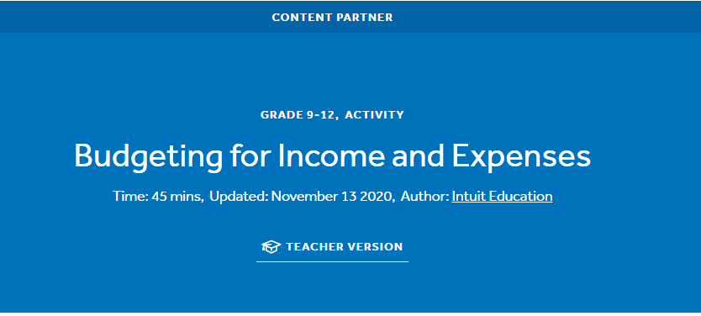
Econedlink Lesson
Budgeting for Income and Expenses

Slide 5

Budget
  A plan for income, spending, and savings. It is one of the most important ways to successfully manage finances.
This Photo by Unknown Author is licensed under CC BY-SA

Slide 6
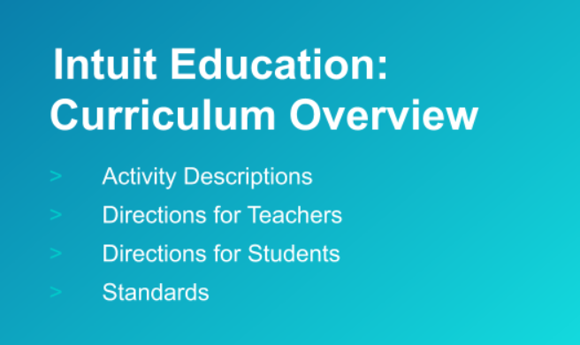
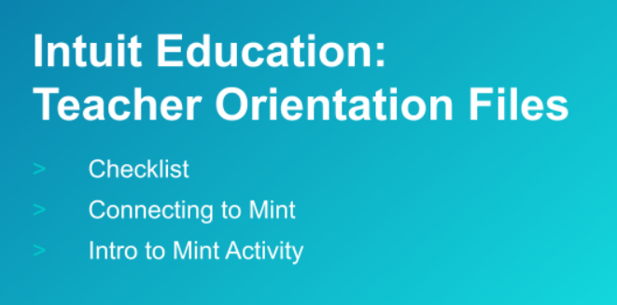
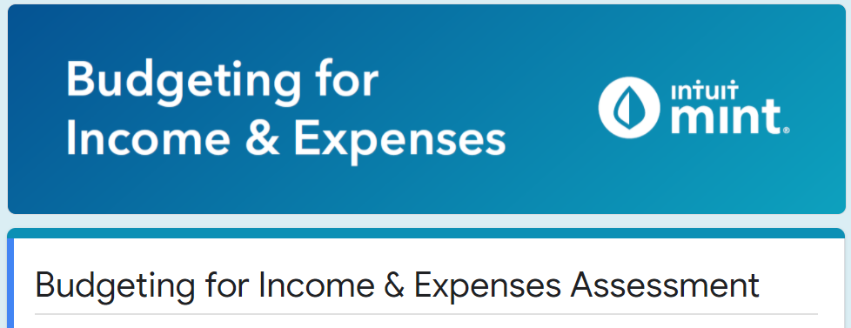
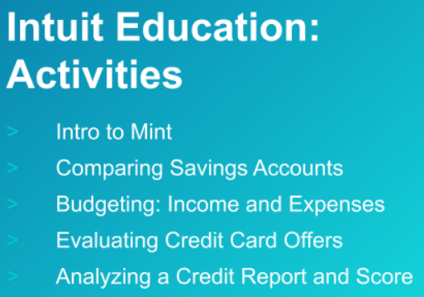
4 Documents to Have Ready
There are 4 documents you want to read and familiarize yourself with that will explain how to navigate the site for instruction.
Intuit Education: Curriculum Overview
Intuit Education: Teacher Orientation Files
Budgeting for Income and Expenses Assessment
Intuit Education Activities

Slide 7
Intro to mint.intuit.com
Mint is a financial tool used by millions of individuals to help manage their finances. Mint will hook up to your bank account to help you track your monthly spending and monitor your credit score.
The fictional character in this video, Isaiah Lamora, needs your help to manage both. Let’s take a look:
https://www.youtube.com/watch?v=qowo0-5jNYY&feature=youtu.be

Slide 8
Next Steps
  Go to https://mint.intuit.com/
  Click on orange tab: Sign Up Free
  Create an Intuit Account
  Enter an email (must end in @intuiteducation.com)
  Remember username and password to come back to your work
  Password: select one you will not forget
  Next screen, select United States and then Enter 78501 for zip code
Notes:
susanmc@intuiteducation.com
Econedtraining1234!

Slide 9
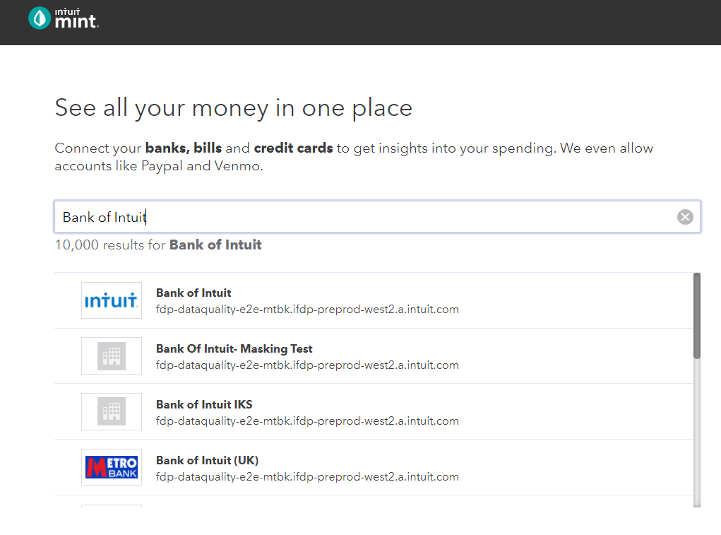
Next Steps, cont.
Select Bank of Intuit
Enter the Username and Password contained within the lesson plan found on page 4.
Login: Intuit Education
Password: Mint1234!

Slide 10
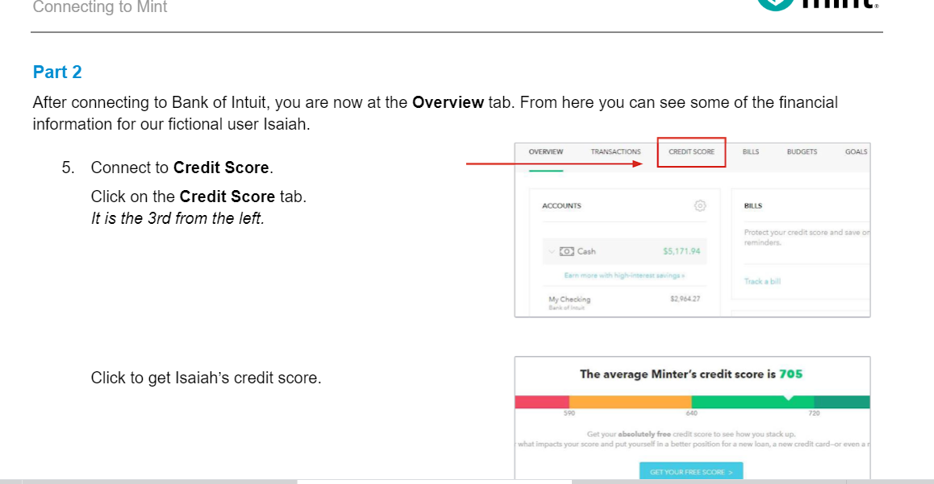
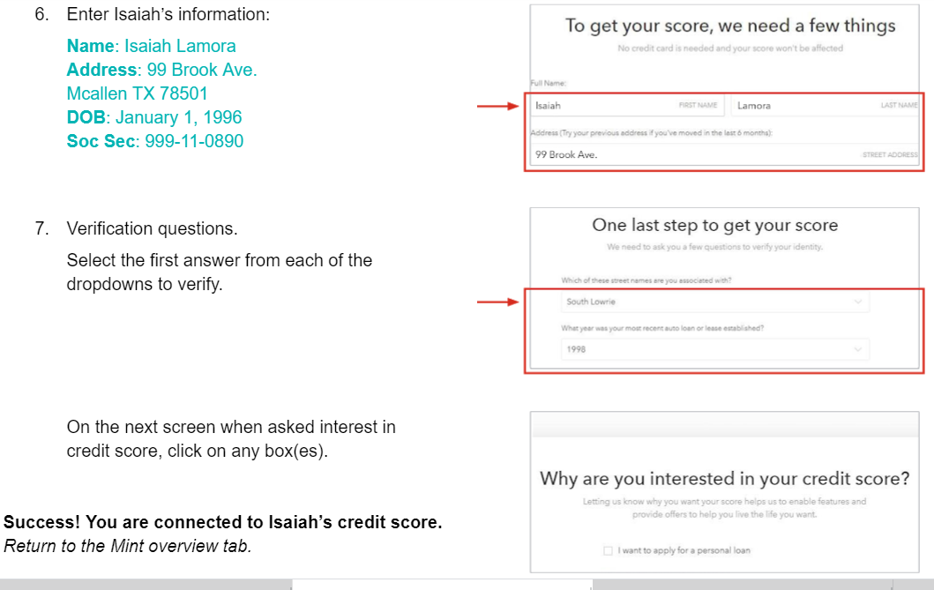
Last Steps for Set up

Slide 11
Take the tour around the Intuit Website
Once you have set up the ‘training account’, I would suggest you take the virtual tour offered to see how best to navigate the website for instructional purposes.

Slide 12
How To Create A Budget to Fit Your Lifestyle
https://www.youtube.com/watch?v=aLnj75nNSsQ&feature=youtu.be
Great talking points within this video to share with your students.

Slide 13
Learning about Isaiah Lamora
Our Fictional Intuit Budget Case Example
Isaiah is in his 20’s
College graduate, full-time salary paying job
Has side gigs to supplement his income
Has a checking account and uses his debit card to spend money daily
Has a savings account
Developed savings habit while younger and transfers money into his saving account each month.

Slide 14
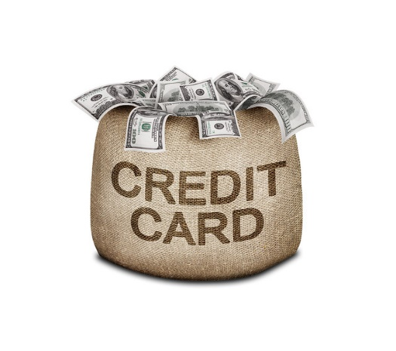


Isaiah Lamora Info cont.
Carries a credit card balance, sometimes making a minimum payment, sometimes more
Uses credit card for gas and groceries
Has an auto loan
Has student loans
This Photo by Unknown Author is licensed under CC BY
This Photo by Unknown Author is licensed under CC BY-SA-NC
This Photo by Unknown Author is licensed under CC BY-SA

Slide 15
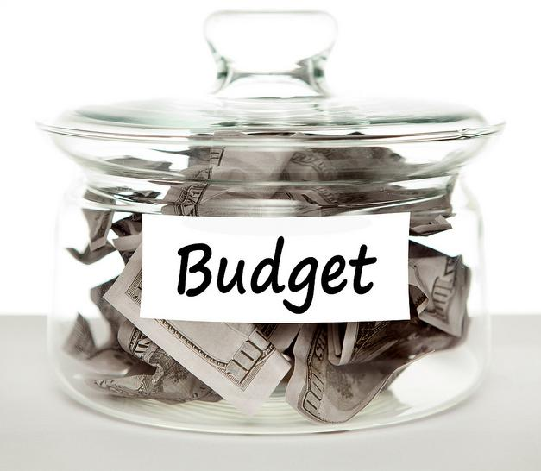
More information on Isaiah
Isaiah has not made much of a plan for his financial life—he does not budget or think about the consequence of his spending habits. He keeps an eye on his checking account balance and knows about how much he can spend each month based on his income.
This Photo by Unknown Author is licensed under CC BY-SA-NC

Slide 16
Let’s Log Into Isaiah’s Account Together
We will look at Isaiah’s account
We will review all tabs located in Isaiah’s account, specifically the “Budget Tab”
We will review Isaiah’s spending
We will review Isaiah’s income stream
We will look at Isaiah’s spending habits and trends
We will look at Isaiah’s overall financial status

Slide 17
Reviewing Key Elements
This lesson is comprehensive and will most likely need 90-120 minutes for execution and proper instruction.
Exit slips are a great way to check for understanding prior to class ending.
3-2-1 Activity is another way to check for understanding and predict areas for instruction reinforcement.

Slide 18
Practice Makes Permanent
Prepare students to assess where Isaiah needs to improve
  Ask student to identify Isaiah’s areas of strength
  Ask students to identify Isaiah’s areas of weaknesses
  What recommendations would you provide to Isaiah to get him better on track?
  What SMART goal (s) would you recommend Isaiah set in this account?

Slide 19
Review Key Vocabulary and terms
Budget
Income
Expenses
Fixed
Variable
Disposable Income

Slide 20
Questions?

Slide 21
References
National Standards for Financial Literacy
https://www.councilforeconed.org/resource/national-standards-for-financial-literacy/#sthash.11CbykLO.dpbs
Budgeting for Income and Expenses
https://www.econedlink.org/resources/budgeting-for-income-and-expenses/

Slide 22

CEE Affiliates
https://www.councilforeconed.org/resources/local-affiliates/

