Slide 1
Multipliers and Fiscal Policy Responses to COVID-19

Slide 2
Objectives
Evaluate fiscal policy responses to the COVID-19 pandemic
Apply fiscal policy multipliers

Slide 3
What to do with $100?
If someone gave you $100, how much of it would you spend?
Think about what you would spend it on
Write/Type your answer [number between 0 and 100]
How does your answer compare to your classmates?
Notes:
Bell-ringer/warm-up activity to get students thinking about MPC

Slide 4
MPC and MPS
Marginal Propensity to Consume (MPC): proportion of additional income that is spent on goods and services
If MPC = .7 then consumers would spend 70% of additional income, and save the rest
Marginal Propensity to Save (MPS): proportion of additional income that is saved
All additional income is either spent or saved, so MPC + MPS = 1

Slide 5
MPC Factors
MPC will be higher for those with
Lower income
Lower taxation level
More consumer confidence
Notes:
Lower income: People with lower incomes spend a large percent of their income on necessities; saving can be considered a luxury.
Lower taxation level: High income and consumption taxes discourage spending. Therefore tax holidays would encourage spending.
More consumer confidence: If consumers are optimistic, they feel comfortable spending. If they are uncertain or worried, they tend to save more.

Slide 6
MPC and Fiscal Policy
When the government spends money and/or cuts taxes to help us recover from a crisis, there will be a multiplying effect which is influenced by the size of the MPC
Notes:
Essential question/thesis of the lesson

Slide 7
Fiscal Policy Review
Who: President and Congress
What: Government Spending and/or Taxes
Why: Dampen business cycle
Macroeconomic goals are sustainable growth, stable prices, and full employment
How: Changing government spending and/or taxes shifts aggregate demand
Expansionary: increase G and/or decrease taxes → AD increase → economic growth and inflation
Contractionary: decrease G and/or increase taxes → AD decrease → economic decline and disinflation
Notes:
Use expansionary fiscal policy to close a recessionary gap. Use contractionary fiscal policy to close an inflationary gap.

Slide 8
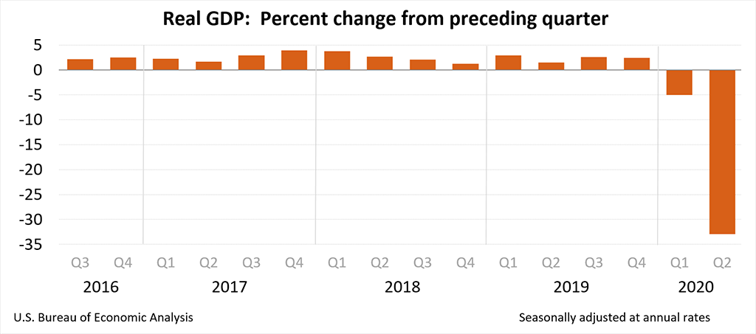
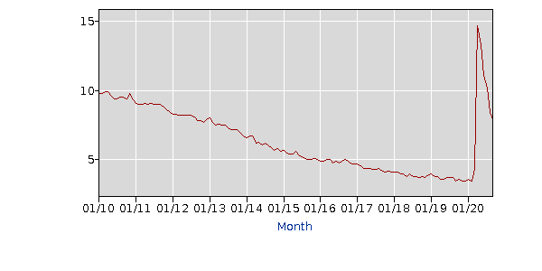
COVID-19 Economy
Economic Growth, according to BEA.gov
Unemployment, according to BLS.gov
Notes:
RGDP data: https://www.bea.gov/news/2020/gross-domestic-product-2nd-quarter-2020-advance-estimate-and-annual-update#:~:text=Real%20gross%20domestic%20product%20(GDP,real%20GDP%20decreased%205.0%20percent.
Unemployment data: https://data.bls.gov/timeseries/LNS14000000?amp%253bdata_tool=XGtable&output_view=data&include_graphs=true

Slide 9
Time for Fiscal Policy?
Economic decline and rising unemployment while inflation never got over 1%… a good time for Expansionary Fiscal Policy?
Notes:
CPI data: https://data.bls.gov/timeseries/CUSR0000SA0&output_view=pct_1mth

Slide 10
COVID-19 Fiscal Policy
Coronavirus Preparedness and Response Supplemental Appropriation - 3/6/2020
$8.3 billion
Treatment and vaccine research
Testing
Families First Coronavirus Response Act - 3/18/2020
$192 billion
Delay tax filing deadline
Paid leave if: sick, caring for someone sick, child care closed, etc.
Notes:
Summary of Coronavirus Preparedness and Response Supplemental Appropriation : https://www.congress.gov/bill/116th-congress/house-bill/6074
Summary of Families First Coronavirus Response Act: https://www.congress.gov/bill/116th-congress/house-bill/6201

Slide 11
COVID-19 Fiscal Policy [2]
Coronavirus Aid, Relief, and Economic Security (CARES) Act – 3/27/2020, amended 4/24/2020
$2.5 trillion (10% GDP)
Small business loans/grants
Large business loans
Stimulus checks
Expanded unemployment
Notes:
Summary of CARES Act: https://www.congress.gov/bill/116th-congress/house-bill/748
This is a great brief article from NPR for further investigation into the CARES Act: https://www.npr.org/2020/03/26/821457551/whats-inside-the-senate-s-2-trillion-coronavirus-aid-package
Students are likely most familiar with the $300 billion spent on stimulus checks to individuals: Most individuals earning less than $75,000/year got a $1200 stimulus check. Checks tapered down for those earning between $75,000 and $99,000 per year. Children got $500 checks. Most college students did not receive a check.

Slide 12
Limits of Fiscal Policy
Effective fiscal policy is
Timed
Targeted
Temporary
[7 min] https://mru.org/courses/principles-economics-macroeconomics/ fiscal-policy-limitations
Notes:
Showing the video is optional given the summaries in the following 3 slides

Slide 13
Timed
Recognition lag
Takes time to calculate macro stats and quantify the size of the gap
Administrative lag
Difficult for president and congress to agree, especially if different political parties
Implementation lag
Economy does not begin to grow until people receive and spend
Notes:
Government spending is heavily debated: how much to spend, what to spend money on, who should allocate the funds (individuals, businesses, or government)

Slide 14
Temporary
Too much expansionary fiscal policy contributes to national debt https://www.usdebtclock.org/
Assistance should help with recovery while maintaining market incentives
Notes:
Maintaining market incentives: for example, the $600 supplemental unemployment checks caused some people to earn more on unemployment than they were earning while working. It is important for this to be temporary.

Slide 15
Targeted
Target benefits toward
those that are hurt most by the crisis
those in most financial distress
Individuals with the largest MPC in order to have the largest impact on the economy
Notes:
Those with the largest MPC: This transitions to the next slide on multipliers.

Slide 16
Multipliers
Government spends $100.
If MPC = .8, you spend $80 at stores → $64 spending…
If MPC = .5, you spend $50 at the store → $25 spending …
When the MPC is higher (.8 > .5), fiscal policy has a larger multiplying effect ($244 > $175 after just 3 rounds of spending)
Notes:
Government spends $100.
If MPC = .8, you spend $80 at stores. When those stores pay their employees, they spend $64. And so on. After just 3 rounds, that’s $100 + $80 + $64 = $244 circulating in the economy.
If instead, the MPC = .5, the same government spending of $100 would lead to you spending $50 at the store. When those stores pay their employees, they spend $25. And so on. That would mean that after the same 3 rounds, only $175 would be circulating in the economy.
Therefore when the MPC is higher (.8 > .5), there is a larger fiscal policy multiplying effect ($244 > $175).
Note that this process continues which is what causes the multiplying effect of fiscal policy.

Slide 17
*G Multiplier Calculation
Government spending multiplier = 1/(1-MPC)
Larger MPC → Larger multiplier
If MPC = .8
G multiplier = 1/(1-.8) = 1/.2 = 5
G increase $1 mil → Y increase $5 mil
If MPC = .5
G multiplier = 1/(1-.5) = 1/.5 = 2
G increase $1 mil → Y increase $2 mil
Notes:
*This slide is for AP students &/or teacher reference

Slide 18
*Tax Multiplier Calculation
Tax multiplier = -MPC / (1-MPC)
Larger MPC → Larger multiplier
If MPC = .8
Tax multiplier = -.8/(1-.8) = -.8/.2 = -4
Taxes decrease $1mil → Y increase by $4 mil
If MPC = .5
Tax multiplier = -.5/(1-.5) = -.5/.5 = -1
Taxes decrease $1 mil → Y increase $1mil
Notes:
*This slide is for AP students &/or teacher reference
Cutting taxes indirectly puts more money in the hands of consumers

Slide 19
Multipliers
Increasing G and/or cutting taxes increases aggregate demand in the economy. The multiplier causes further increases in aggregate demand. These cause the economy to expand.
Getting money in the hands of people who will spend it (higher MPC) will result in a bigger bang for your buck (larger multiplier).

Slide 20
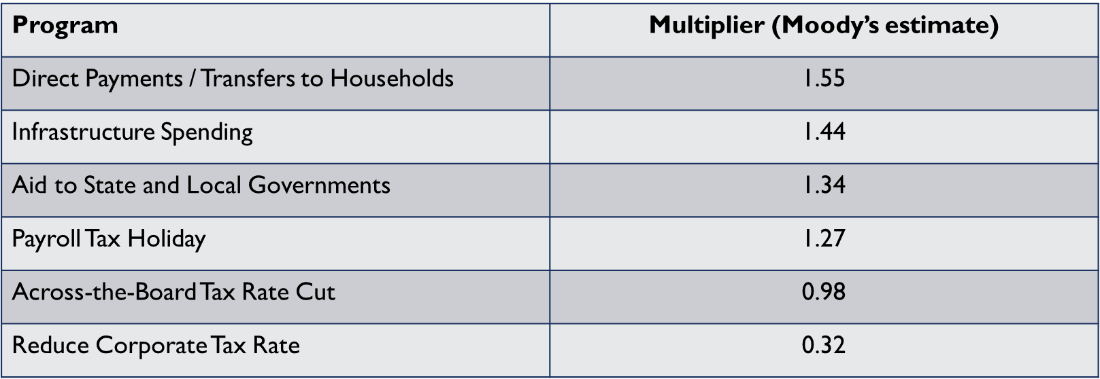
Policy Multiplier Estimates
Multiplier is estimated by the one-year dollar change in GDP for a given dollar reduction in federal tax revenue or increase in spending.
Notes:
Economists are not flying blind in terms of multiplier estimates; with each recession and stimulus, estimates are made.
Fiscal Policy Considerations for the Next Recession, CRS, https://crsreports.congress.gov/product/pdf/R/R45780
Tax Cuts and Economic Stimulus: How Effective are the Alternatives?, CRS, https://crsreports.congress.gov/product/pdf/RS/RS21126

Slide 21
In-class Activity
In small groups
Read the policy proposal summaries
Evaluate each policy based on the four factors
Individually
Choose the most effective policy and explain
Notes:
Not all G is equal. Consider the impact of payments to wealthy vs low income households, small vs large businesses, individuals vs local governments, etc

Slide 22
Wrap-up
Which policy do you think would be most effective?
PPP
FPUC
Liability Protection
State Gov Aid
Meals
Stimulus Checks
Notes:
Reiterate that effective policies have high multipliers (high MPC) and are timed, targeted, and temporary. Differences in opinion regarding how to prioritize those factors will lead to different policy choices.

