Slide 1
AP Macroeconomics Bootcamp Unemployment Theresa Fischer February 2021 ecofisch@gmail.com

Slide 2
How is employment measured?
The U.S. Bureau of Labor Statistics measures employment and unemployment for individuals over the age of 16.
The Current Population Survey (CPS): also known as the “household survey” the CPS is conducted based on a sample of 60,000 households. The survey measures the unemployment rate based on the ILO definition.
The Current Employment Statistics Survey (CES): also known as the “payroll survey” the CES is conducted based on a sample of 160,000 businesses and government agencies that represent 400,000 individual employees.
The unemployment rate is also calculated using weekly claims reports for unemployed insurance. The government provides this data. The unemployment rate is updated on a monthly basis.

Slide 3
Who is considered Unemployed?

Slide 4
People are classified as unemployed if they …
do not have a job
have actively looked for work in the prior 4 weeks
are currently available for work
Actively looking for work may consist of any of the following activities:
either contacting an employer directly
having a job interview

Slide 5
What is the condition of the US unemployment numbers? (- 6.7%)
https://www.bls.gov/charts/employment-situation/civilian-unemployment-rate.htm

Slide 6
U-6-+-U5-+-: The Official Unemployment Rate https://www.macrotrends.net/1377/u6-unemployment-rate
This interactive chart compares three different measures of unemployment. U3 is the official unemployment rate. U5 includes discouraged workers and all other marginally attached workers. U6 adds on those workers who are part-time purely for economic reasons. The current U6 unemployment rate as of Dec 2020 is 11.7.

Slide 7
United States Participation Rate

Slide 8
Who is NOT counted in the Employment numbers?
Military
Retired people
Children and individuals under the age of 16 years
People NOT seeking employment
People on disability
People working in a shadow economy in the USA
Stay at home moms
People taking care of family members
Farmers
Discouraged Workers

Slide 9
Discouraged workers

Slide 10
What are the different types of unemployment?
Cyclical
Structural
Frictional
Seasonal

Slide 12
Scenarios
Someone who leaves his job and take another job in two weeks.
HS graduate who lacks skills for the job market he faces.
Recession hits, factory closes and 800 people lose their jobs.
George has a skill to repair 8 track cassette players.
Elaine relocates and moves from Chicago to New York, looking for work.
Retail workers are fired because of declining sales.

Slide 13
Lessons
https://www.weareteachers.com/9-awesome-classroom-activities-that-teach-job-readiness-skills/
9 Awesome Classroom Activities That Teach Job Readiness Skills
Students need these skills to succeed in the workplace

Slide 14
Unemployment Game https://www.econedlink.org/resources/the-unemployment-game/
Students will be able to:
Understand the unemployment rate statistic and how it is determined.
Understand the labor force participation rate statistic and how it is determined.
Demonstrate their understanding of labor markets through a market activity.
Activity 1. Have the students find the U.S. unemployment rate and labor force participation rate for years in the 1960s, 1970s, 1980s, 1990s, 2000s and the current decade. Have a discussion about how these have changed.

Slide 16
Labor Formulas to Know
Participation Rate —
The rate is calculated by taking the number employed, divided by the total adult population and multiplying by 100 to get the percentage
Unemployment Rate —
The number of unemployed persons / labor force (knowing who is in the labor force!!!)

Slide 17
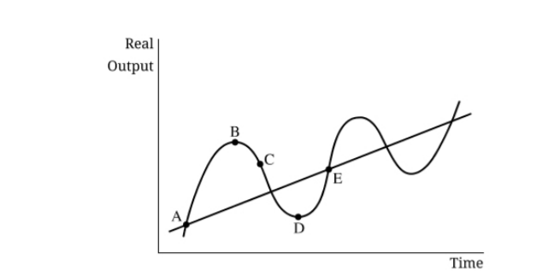
Business Cycles
What is the correct order of the business cycles?
Expansion, Peak, Contraction, Trough,
Trough, Peak, Contraction, Expansion
Peak, Expansion, Trough, Contraction
Contraction, Peak, Expansion, Trough
High Unemployment is in which part of the business cycle?
A b D c. C d. B
Natural Rate of Unemployment is at …?
A B. B C. C D. D
Below the natural rate of unemployment rate is at…?
A B. B C. D E. E

Slide 18
Scenario
Population | 250
Frictional | 3%
Cyclical | ?
Structural | 2%
If the unemployment rate for this country is 10%, what is the cyclical and natural rate of unemployment?
Cyclical is 5% and Natural rate of UE is 5%
Cyclical is 3% and Natural rate of UE is 5%
Cyclical is 2 % and Natural rate of UE is 3%
Cyclical is 5% and Natural rate of UE is 2%
Cyclical is 8% and Natural rate of UE is 5%

Slide 19
Let’s Calculate!

Slide 20
Answers
Correctly calculating the unemployment rate as 10 percent (20,000/200,000 × 100 = 10%)
Correctly calculating the labor force participation rate as 66.67 percent (200,000/300,000 × 100 = 66.67%)

Slide 22
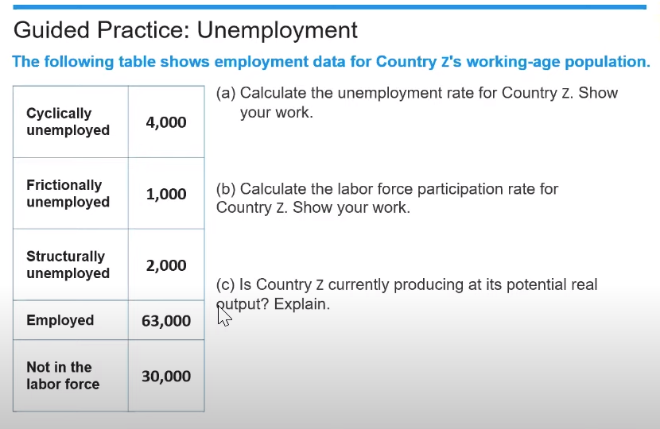

Slide 24
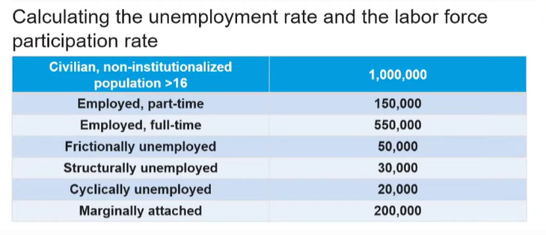

Slide 25
Answer

Slide 29
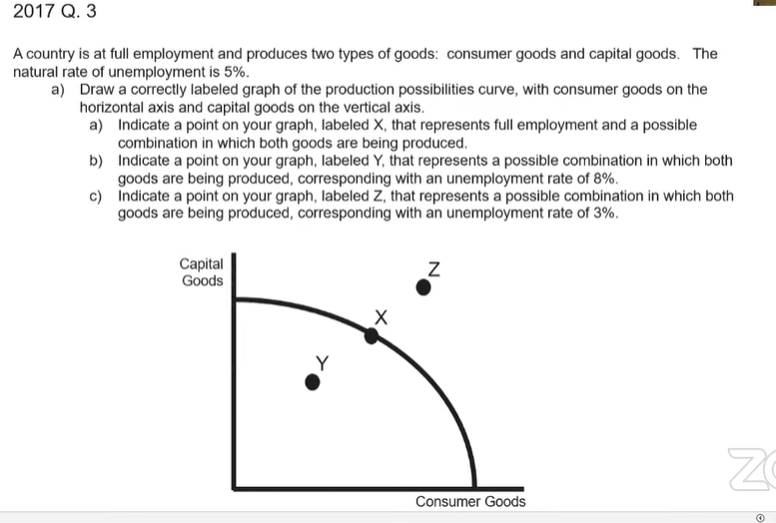

Slide 30
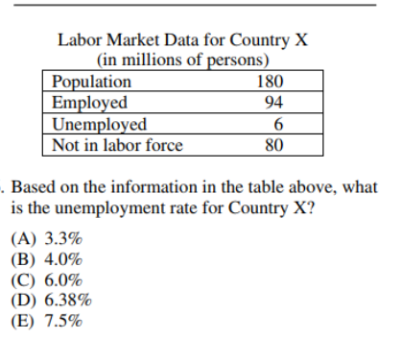
Answers: C C

Slide 31
Macro 2006

Slide 32
Answers to Macro 2006

Slide 33
Scenario
Population | 200 million
Full time students | 20 million
People not working and not looking | 25 million
Full time workers | 20 million
Part time workers | 40 million
People unemployed and looking for work | 40 million
What is the UE rate and the participation rate in this country?
UE rate is 40% and participation rate is 24.5%
UE rate is 30% and participation rate is 30%
UE rate is 40% and participation rate is 35%
UE rate is 40% and participation rate is 40%

Slide 34
Where are the highest unemployment lowest unemployment rates?
https://www.usnews.com/news/best-states/articles/unemployment-rate-by-state#:~:text=New%20Jersey%20had%20the%20highest,state%2C%20according%20to%20BLS%20data.

Slide 35
Minimum Wage
https://www.deputy.com/blog/list-of-u-s-minimum-wage-increases-in-2018?hsCtaTracking=0063c629-5041-4413-9c6b-21da26f5dd37%7C750166be-07ba-4bb6-a1c7-a1dbab69e783

Slide 36
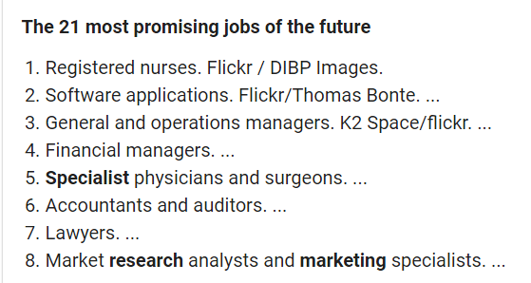
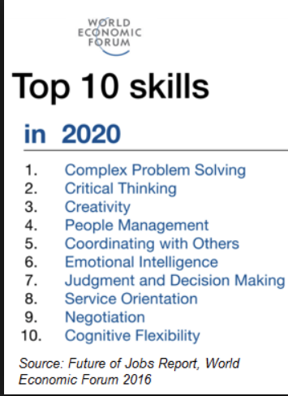
What are the jobs of the future?
https://www.businessinsider.com/best-jobs-future-growth

Slide 37
Job Activity
Have students research the current job market. Select a job or career that they are interested in.
What educational background is necessary for this career?
What is the growth potential for this type of job/career?
What is the payscale for this job/career in this area of the country?
Are company internships a path to success?
Have students research how to create a resume for a job.

Slide 38
https://www.econedlink.org/resources/the-unemployment-game/
Objective
Students will be able to:
Understand the unemployment rate statistic and how it is determined.
Understand the labor force participation rate statistic and how it is determined.
Demonstrate their understanding of labor markets through a market activity.
Individual Activity
Have the students log-on to the https://www.bls.gov/ and determine the unemployment rate and labor force participation rate in the United States, the state you live in, and the metropolitan area closest to where you live. Ask the students to consider why the unemployment rate in your area is higher or lower than the rate in other parts of the country. Review the answers as a class.

Slide 42
Thank you
We will take a 5-minute break AND THEN TALK ABOUT The National Economics Challenge.

Slide 43
Thank You to Our Sponsors!

Slide 44
We’ve gone Virtual!
Teach Economics?
Your students may have what it takes to compete in the nation’s only high school economics competition!
Why Play?
• Fun team learning experience
• Great for college applications
• No other challenge like this
• Online participation makes access easy
• Chance for cash prizes
How it Works
Teams register
Teachers enroll team(s) of 3- 4 high school students from the same school. Multiple teams allowed.
Teams compete within their state
Compete to win your state competition for a chance to advance to the National Semi-Finals.
National Semi-Finals: May 3-20, 2021
Teams answer multiple-choice questions on macroeconomics, microeconomics, and international & current events.
National Finals: May 22-24, 2021
Teams analyze an economic issue and present their solution. Top teams engage in the Finals Quiz Bowl where they face-off answering questions to claim the National Title.
Two divisions based on experience level
David Ricardo for first-time competitors who have taken no more than one economics course.
Adam Smith for returning competitors, AP, International Baccalaureate, and honors students.
Register Today at NationalEconomicsChallenge.org

Slide 45
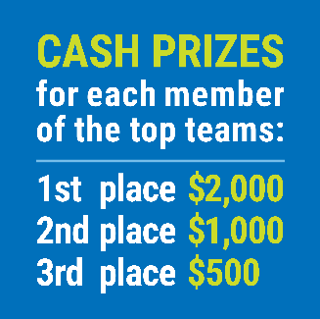
FIND YOUR LOCAL COMPETITION AND REGISTER TODAY!
The National Personal Finance Challenge is a competition that provides high school students with an exciting and motivating opportunity to build, apply, and demonstrate their knowledge of money management.
Through online exams and a personal finance simulation, teams showcase their expertise in earning income, buying goods and services, saving, using credit, investing, as well as protecting and insuring.
Teams of up to four students, with one teacher/coach, can qualify to represent their state at the National Personal Finance Challenge by winning their local competition.
NATIONALS
Semi-Finals: First round elimination via online multiple-choice questions.
Finals: Case study round virtually co-hosted by the Cleveland Fed on June 3.
personalfinancechallenge.org

Slide 46
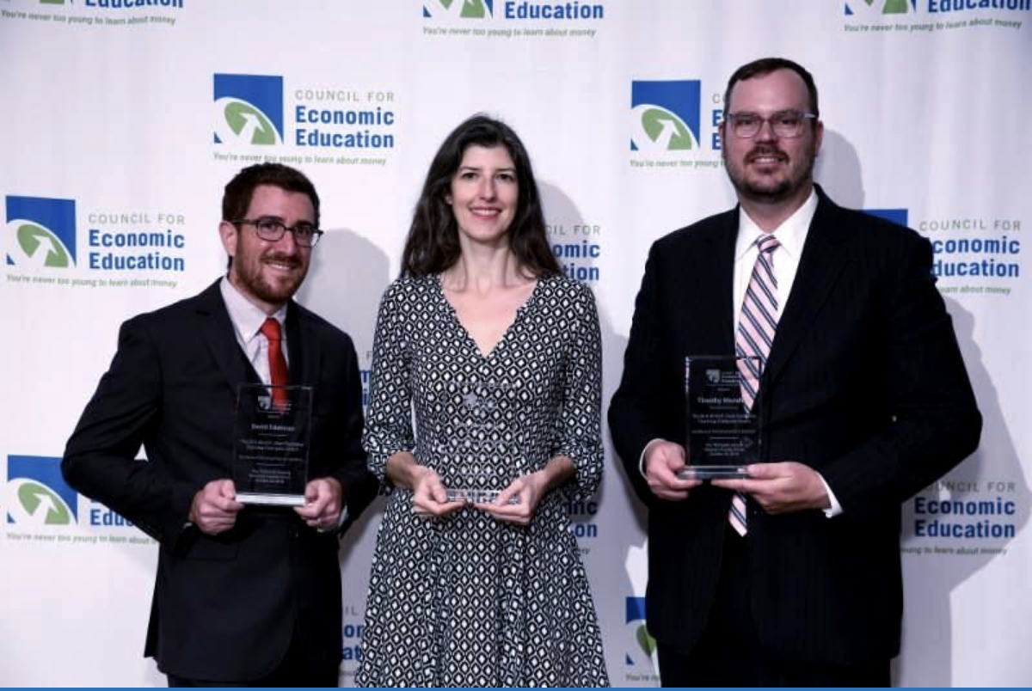
The 2021 Sloan Teaching Champion Award
Winners receive:
A cash award of $5,000
A cash award of $2,500 for their school to support economic education
Recognition at our annual Visionary Awards convening.
This award promotes economic education by honoring three outstanding teachers who incorporate exemplary teaching techniques that improve their students’ economic understanding in and out of the classroom.
This award is open to New York metropolitan area high school teachers of all subjects, not just teachers of economics. Applicants must demonstrate how they integrate economics into their teaching.
Sound like you or someone you know?
Applicants must teach in one of the
Twelve New York state counties (New York, Kings, Bronx, Richmond, Queens, Nassau, Suffolk, Westchester, Putnam, Rockland, Orange and Dutchess)
Eight New Jersey counties (Bergen, Passaic, Essex, Hudson, Middlesex, Union, Morris, Monmouth), or the
Two Connecticut counties (Fairfield and New Haven)
Application will be launched on Friday February 19th 2021
You can access the application here.
CONTACT
Please feel free to e-mail us at rrivera@councilforeconed.org
with any questions you have.

