Slide 1
AP
Macroeconomics Bootcamp
Inflation
Theresa Fischer
February 2021 ecofisch@gmail.com

Slide 2
National Standards
Standard: 19
Students will understand that: Unemployment imposes costs on individuals and the overall economy. Inflation, both expected and unexpected, also imposes costs on individuals and the overall economy. Unemployment increases during recessions and decreases during recoveries.
Students will be able to use this knowledge to: Make informed decisions by anticipating the consequences of inflation and unemployment.
NATIONAL STANDARDS IN FINANCIAL LITERACY
Name: Buying Goods and Services
Standard:
Students will understand that: People cannot buy or make all the goods and services they want; as a result, people choose to buy some goods and services and not buy others. People can improve their economic wellbeing by making informed spending decisions, which entails collecting information, planning, and budgeting.

Slide 3
Who Measures Inflation in the USA?
BUREAU OF LABOR STATISTICS
Consumer Price Index (CPI) - A measure of price changes in a basket of consumer goods and services such as gasoline, food, clothing and automobiles. The CPI measures price change from the perspective of the purchaser.
Producer Price Indexes (PPI) - A family of indexes that measure the average change over time in selling prices by domestic producers of their basket of goods and services.
PPIs measure price change from the perspective of the seller.

Slide 4
WHICH INDEX DO YOU FEEL INFLUENCES THE OTHER?
CPI influences PPI
or
PPI Influences CPI

Slide 5
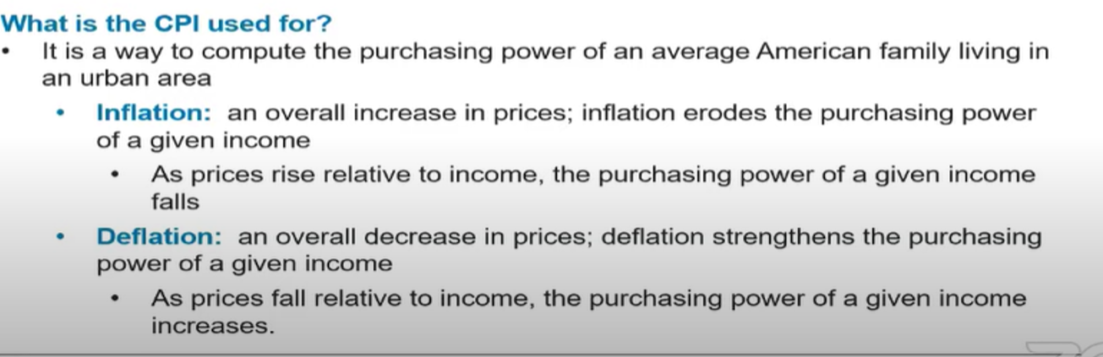

Slide 6
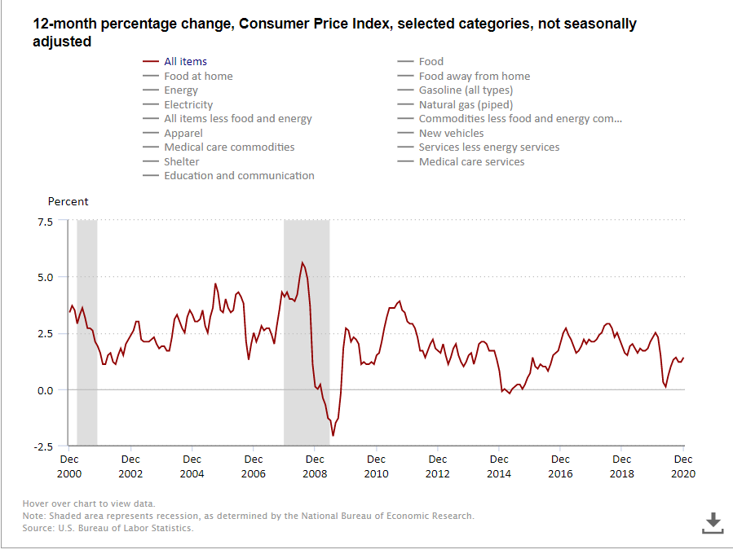
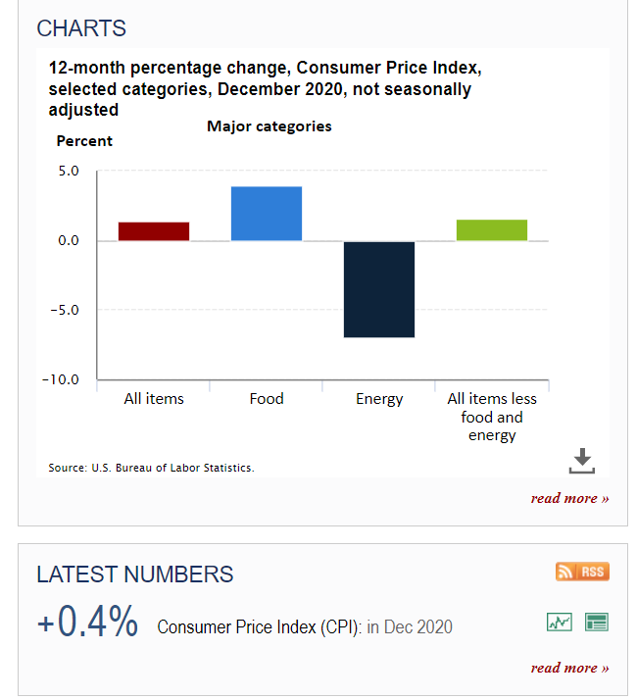
Consumer Price Index Dec 2020

Slide 7
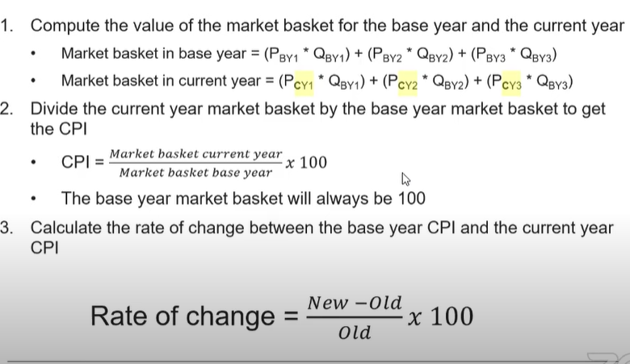
Calculating CPI

Slide 8
How do we calculate inflation?
Market Basket | Units | Price per Unit Yr1 | Cost of the Market Basket | Price per Unit Yr 2 | Cost of the Market Basket | Price per Unit yr 3 | Cost of the Market Basket
Cheese | 2 lbs | $1.75 | $3.50 | $1.50 | $3.00 | $1.50 | $3.00
Jeans | 2 pair | 12.00 | 24.00 | 15.50 |  | 20.00
Gasoline | 10 gals | 1.25 | 12.50 | 1.60 | 16.00 | 2.70
Total Expenditure |  |  | $40.00 |  | $50.00
If year 1 is selected as the base year, the index number for Year 1 is ($40/40) x 100 = 100.
Then the index for year 2 is _____________________
Year 3 is _________________

Slide 9
Answers to Inflation calculations!
Basic market basket item | # of units | Price of market basket Yr 1 | Cost of market basket Yr 1 | Price of Basket Yr 2 | Cost of market basket Yr 2 | Price of Basket Yr 3 | Cost of market basket Yr 3
Cheese | 2 lbs | $1.75 | $3.50 | $1.50 | $3.00 | $1.50 | $3.00
Blue Jeans | 2 pair | $12.00 | $24.00 | $15.50 | $31.00 | $20.00 | $40.00
Gasoline | 10 gallons | $1.25 | $12.50 | $1.60 | $16.00 | $2.70 | $27.00
Total |  |  | $40.00 |  | $50.00 |  | $70.00
If Yr 1 is selected as the base year, calculate the price indicate for each year. Show your work.
Year 1 is (40/40)100= 100 Year 2 is (50/40)100 = 125 Year 3 is (70/40)100= 175
What is the percentage increase between Year 1 and Year 3? 75%
What is the % increase between Yr 2 and Yr 3? 40%

Slide 10
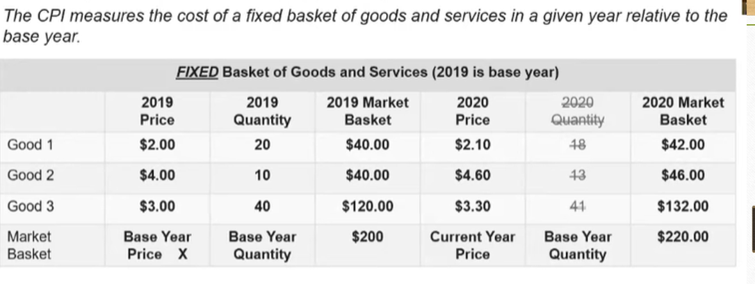

Slide 11
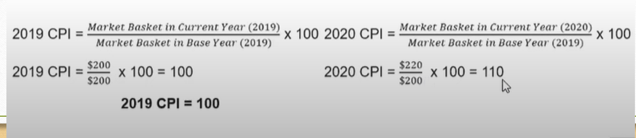
Answers

Slide 12
What is the inflation rate from 2019 to 2020?

Slide 13
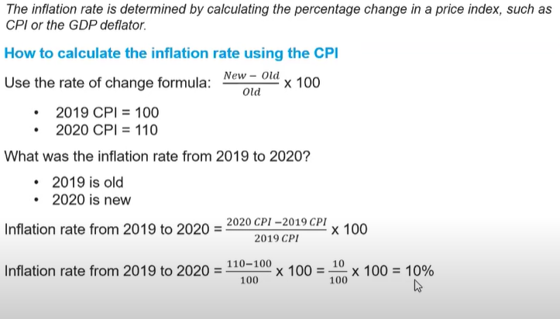

Slide 14
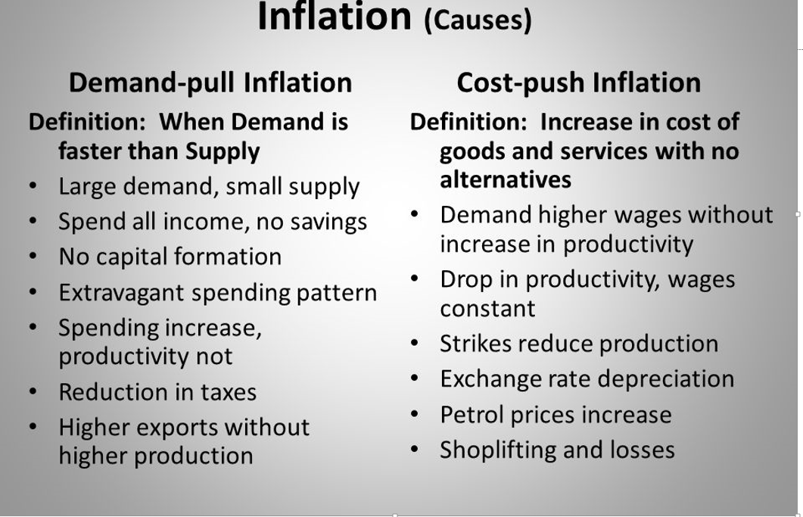
What are the two different types of Inflation?

Slide 15
What is Stagflation?
Stagflation is a seemingly contradictory condition described by slow economic growth and relatively high unemployment, or economic stagnation, which is at the same time accompanied by rising prices (i.e. inflation). Stagflation can also be alternatively defined as a period of inflation combined with a decline in gross domestic product (GDP).
Causes?
In October 1973, the Organization of Petroleum Exporting Countries (OPEC) issued an embargo against Western countries.
Gold Standard removed by Nixon
Harsh regulations in the market
https://www.investopedia.com/terms/s/stagflation.asp

Slide 16
Which type of inflation is more difficult to correct?

Slide 17
Scenario
Decide whether this is a demand-pull inflation, or cost- push inflation:
1. Property prices have increased greatly______________________
2. Gasoline prices have increase 30%_________________________
3. The dollar has depreciated against the won___________________
4. The Federal Reserve Bank has increased the MS 25%__________

Slide 18
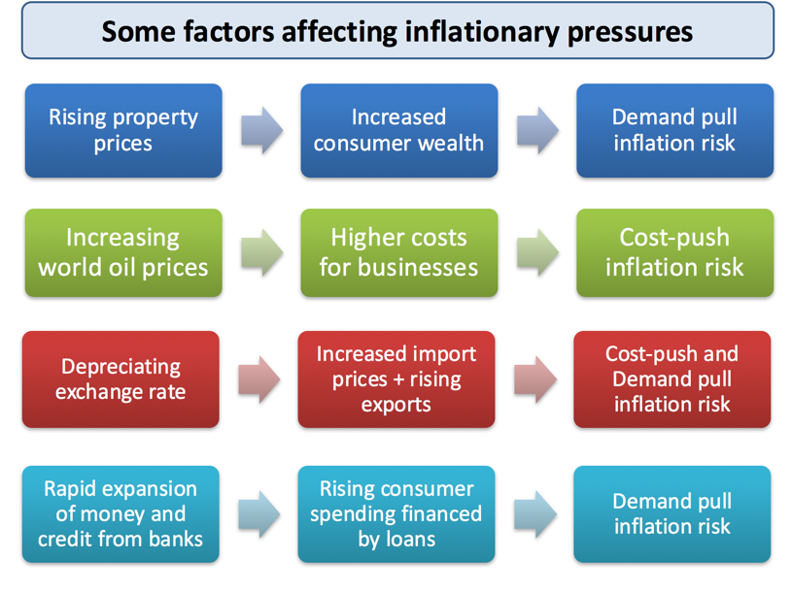
What are the factors that affect prices?

Slide 19
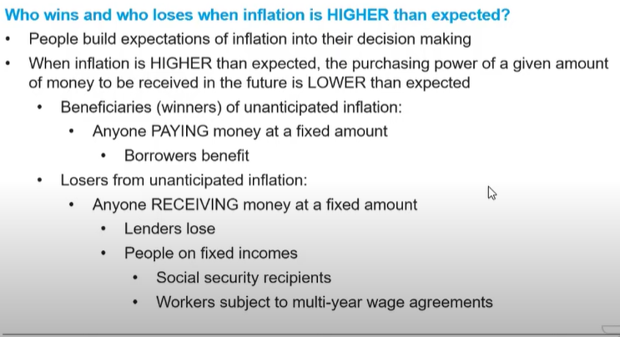

Slide 20
Negative Effects of Inflation
Stuff Costs More. With inflation, prices of pretty much everything start to rise…
Borrowing Money Is More Expensive…
Adjustable-Rate Mortgage Rates Might Go Up…
Hoarding Could Result…
Long-Term Savings Might Erode…
Cannot Plan in the Near Future…

Slide 21
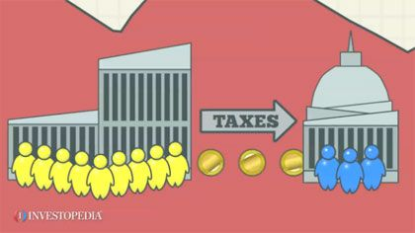
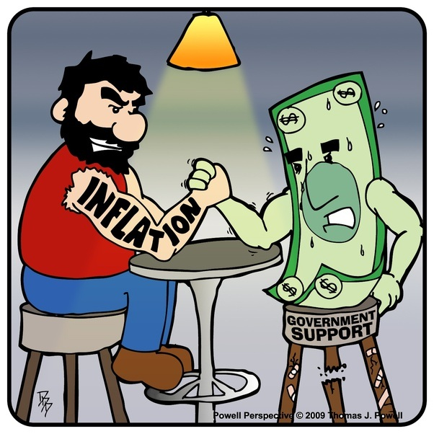
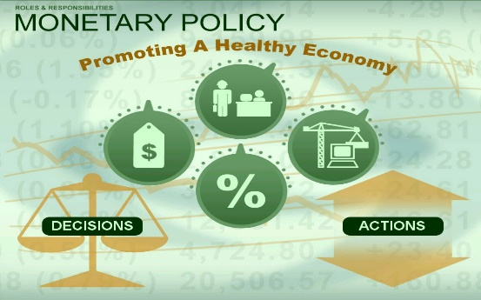
How can Inflation be controlled?
Fiscal Policy
Monetary Policy

Slide 22
Scenario
2015 | 100
2016 | 120
2017 | 130
2018 | 150
The price levels changes from 2015 to 2018 :
a. 20% b. 30% c. 50% d. 10% e. 15%
Who would be hurt by this change in inflation? Who would be helped?

Slide 23
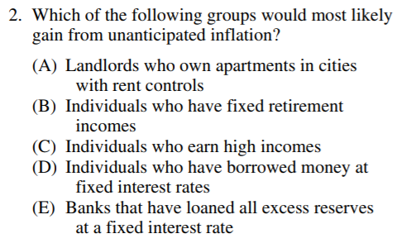
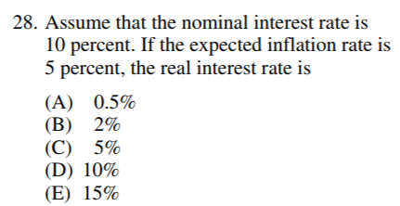
NIR = RIR+ rate of inflation

Slide 24
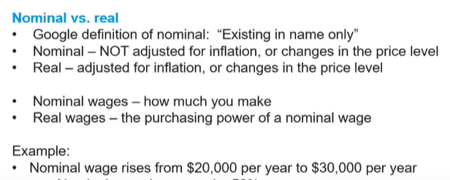
What was in the increase in wages ?
If CPI rises from 100 to 175, did this person get a raise?

Slide 25
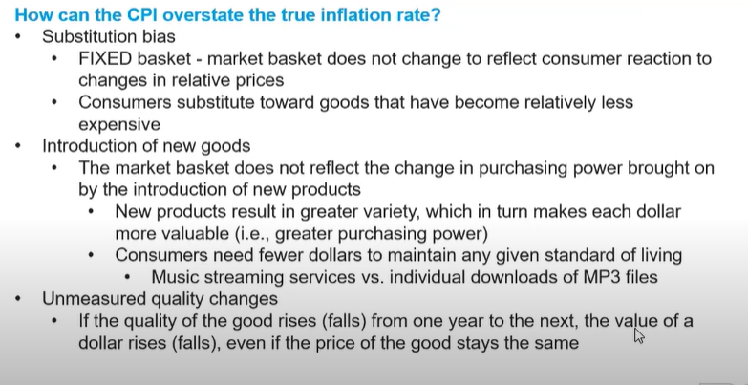

Slide 26
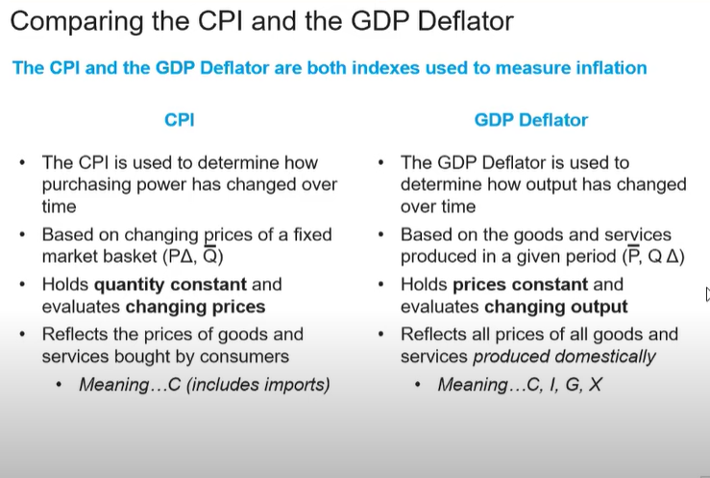

Slide 27
The Trial of Ms. Ann Flation (Stage Play) http://economicsondemand.weebly.com/uploads/4/0/5/0/40509201/unit_3_-_lesson_-_infaltion_-_debate_-_duke.pdf
A wonderful play that describes the people who admire her and who really cannot stand her
Gets the class involved with the different characters and therefore can understand the challenges of inflation

Slide 28
Inflation Spectrum
You are given 12 people who have financial situations that are very different from each other
You create 4-5 groups in your class and have them categorize these people resulting from inflation as
Hurt, Neutral or Helped?
Have a contest in the class who can get these people in the correct order.

Slide 29
Resources
Consumer Price Index: Frequently Asked Questions
www.bls.gov/cpi/cpifaq.htm
7-Eleven: Students can estimate the cost of a Big Gulp
https://www.7-eleven.com/
MarketPlace.org: Audio transcript of news broadcast of December 14, 2001. Begins shortly above the Rundown.
marketplace.publicradio.org/shows/2001/12/14_mpp.html
CPI Calculator: Online Consumer Price Index Calculator
https://data.bls.gov/cgi-bin/cpicalc.pl
Time-Warp: Students can explore the technology innovations that were created during any decade they choose.
www.time-warp.org/

Slide 30
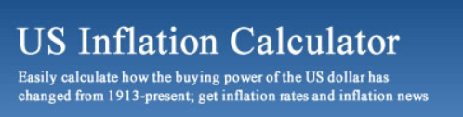
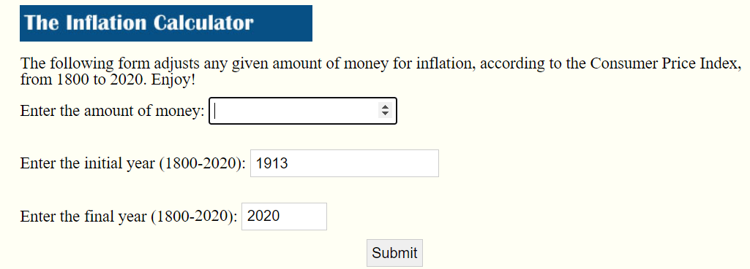
https://westegg.com/inflation/

Slide 31
Did the Presidential salary in the 1913 keep up with inflation?
1913 - $75,000
2021 - $400,000

Slide 32

Keeping up with Inflation
If you bought a home in 2009 and paid $75,000…
What would that home cost now in 2020? Did the price increase greater than inflation?

Slide 33
Thank you
We will take 5-minute break and then continue.

Slide 34




Thank You to Our Sponsors!

Slide 35



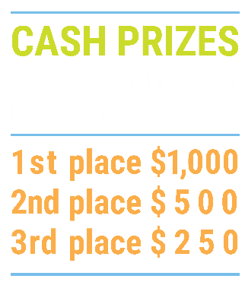

We’ve gone Virtual!
Teach Economics?
Your students may have what it takes to compete in the nation’s only high school economics competition!
Why Play?
• Fun team learning experience
• Great for college applications
• No other challenge like this
• Online participation makes access easy
• Chance for cash prizes
How it Works
Teams register
Teachers enroll team(s) of 3- 4 high school students from the same school. Multiple teams allowed.
Teams compete within their state
Compete to win your state competition for a
chance to advance to the National Semi-Finals.
National Semi-Finals: May 3-20, 2021
Teams answer multiple-choice questions on macroeconomics, microeconomics, and international & current events.
National Finals: May 22-24, 2021
Teams analyze an economic issue and present their solution. Top teams engage in the Finals Quiz Bowl where they face-off answering questions to claim the National Title.
Two divisions based on experience level
David Ricardo for first-time competitors who have taken no more than one economics course.
Adam Smith for returning competitors, AP, International Baccalaureate, and honors students.
Register Today at NationalEconomicsChallenge.org

Slide 36



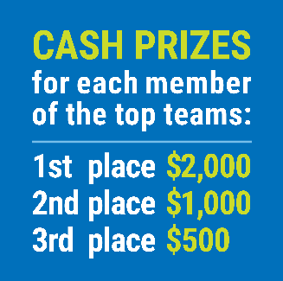

FIND YOUR LOCAL COMPETITION
AND REGISTER TODAY!
The National Personal Finance Challenge is a competition that provides high school students with an exciting and motivating opportunity to build, apply, and demonstrate their knowledge of money management.
Through online exams and a personal finance simulation, teams showcase their expertise in earning income, buying goods and services, saving, using credit, investing, as well as protecting and insuring.
Teams of up to four students, with one teacher/coach, can qualify to represent their state at the National Personal Finance Challenge by winning their local competition.
NATIONALS
Semi-Finals: First round elimination via online multiple-choice questions.
Finals: Case study round virtually co-hosted by the Cleveland Fed on June 3.
personalfinancechallenge.org

Slide 37
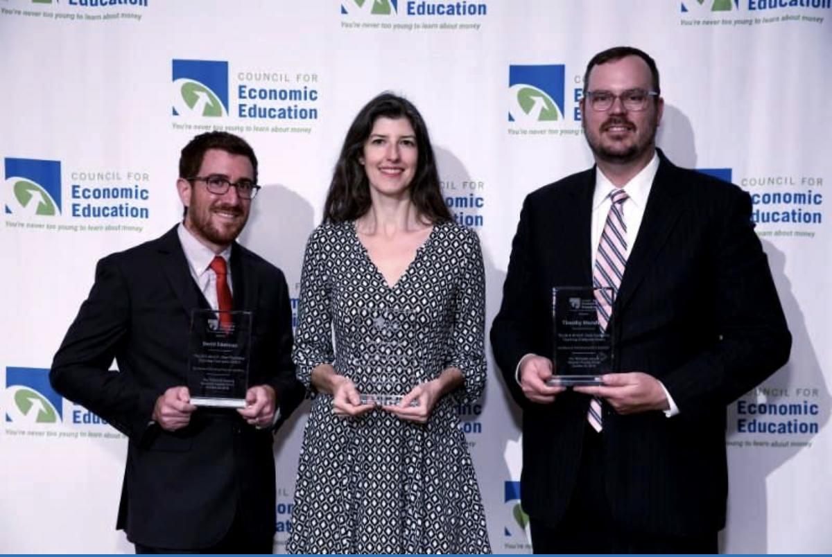
The 2021 Sloan Teaching Champion Award
Winners receive:
A cash award of $5,000
A cash award of $2,500 for their school to support economic education
Recognition at our annual Visionary Awards convening.
This award promotes economic education by honoring three outstanding teachers who incorporate exemplary teaching techniques that improve their students’ economic understanding in and out of the classroom.
This award is open to New York metropolitan area high school teachers of all subjects, not just teachers of economics. Applicants must demonstrate how they integrate economics into their teaching.
Sound like you or someone you know?
Applicants must teach in one of the
Twelve New York state counties (New York, Kings, Bronx, Richmond, Queens, Nassau, Suffolk, Westchester, Putnam, Rockland, Orange and Dutchess)
Eight New Jersey counties (Bergen, Passaic, Essex, Hudson, Middlesex, Union, Morris, Monmouth), or the
Two Connecticut counties (Fairfield and New Haven)
Application will be launched on Friday February 19th 2021
You can access the application here.
CONTACT
Please feel free to e-mail us at rrivera@councilforeconed.org
with any questions you have.

