Slide 1
AP Macroeconomics Bootcamp Circular Flow, GDP, Unemployment and Inflation Theresa Fischer February 2021 ecofisch@gmail.com

Slide 2
EconEdLink Membership
You can now access CEE’s professional development webinars directly on EconEdLink.org! To receive these new professional development benefits, become an EconEdLink member. As a member, you will now be able to:
Automatically receive a professional development certificate via e-mail within 24 hours after viewing any webinar for a minimum of 45 minutes
Register for upcoming webinars with a simple one-click process
Easily download presentations, lesson plan materials and activities for each webinar
Search and view all webinars at your convenience
Save webinars to your EconEdLink dashboard for easy access to the event
You may access our new Professional Development page here

Slide 3
Professional Development Certificate
To earn your professional development certificate for this webinar, you must:
Watch a minimum of 45-minutes and you will automatically receive a professional development certificate via e-mail within 24 hours.
Accessing resources:
You can now easily download presentations, lesson plan materials, and activities for each webinar from EconEdLink.org/professional-development/

Slide 4
Agenda
We will share Unit Two in the CED by the College Board
GDP – NGDP, RGDP, Economic Growth, Business Cycles
Inflation – Why some people are hurt and some love it!
Unemployment – Measurements and different types of UE
National Economic Challenge Kahoot

Slide 6
Objectives
Challenges in this unit for teachers
Review the CED on Unit 2 Macroeconomics
Understand what students need to know about GDP, Inflation and UE
Calculations of GDP, Inflation and UE
Challenges in this unit for students

Slide 7
GROSS DOMESTIC PRODUCT

Slide 8
GDP—WHAT DO YOU NEED TO KNOW
1. Components of GDP
2. Expenditure Approach— vs — Income Approach
3. What is excluded from GDP
4. Nominal GDP vs Real GDP
5. % Change of RGDP
6. Per Capita GDP
7. What does GDP NOT measure?
8. Strengths and Weaknesses of the measurements of GDP

Slide 9
Schiller- Economics

Slide 10
Circular Flow

Slide 11
Calculating GDP

Slide 12
TOP TEN COUNTRIES’ GDP? (5:47) https://www.youtube.com/watch?v=UEPMyYgUk2Q

Slide 13
What is GDP?
A. Is it everything produced and sold in one year?
B. Is it everything produced in one year?

Slide 14
GDP
GDP is the dollar amount of final goods and services produced in a nation in one year
Simon Kuznets 1901-1985
Income inequality and economic growth
On a quarterly basis, GDP is often presented on an annualized percent basis. Most of the individual data sets will also be given in real terms, meaning that the data is adjusted for price changes, and is therefore net of inflation.

Slide 15
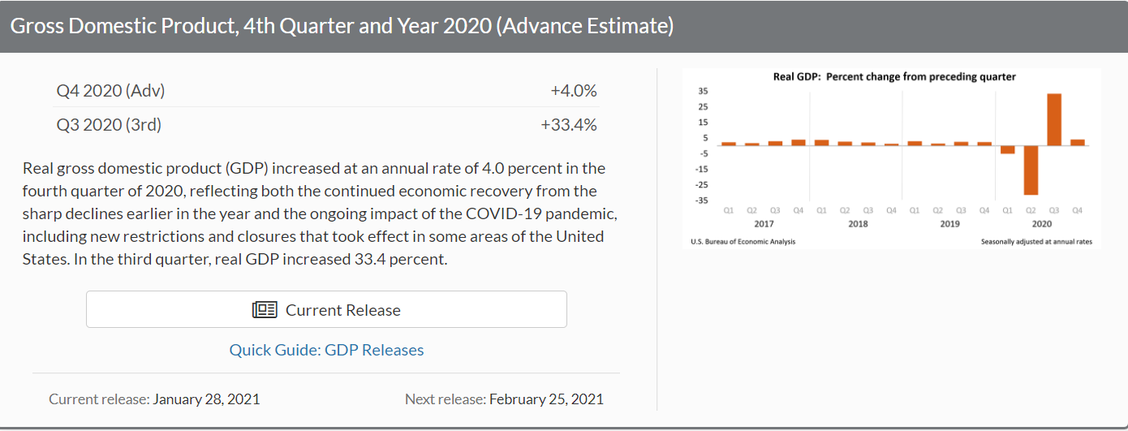
What is GDP in the USA?
The GDP value of the United States represents 31.28 percent of the world economy
19.39 trillion USD in 2019 https://www.bea.gov/news/glance

Slide 18
Ten Facts about the Pandemic and the US Economy

Slide 19
https://www.brookings.edu/research/ten-facts-about-covid-19-and-the-u-s-economy/

Slide 20
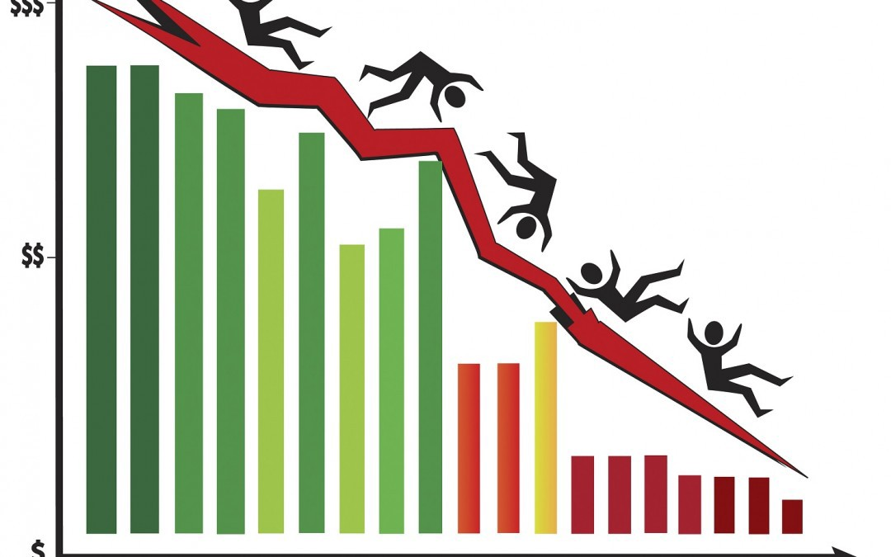
Depression? Recession?
Depressions are often identified as recessions lasting longer than three years or resulting in a drop in annual GDP of at least 10 percent.
Recessions are a period of temporary economic decline during which trade and industrial activity are reduced, generally identified by a fall in GDP in two successive quarters.

Slide 21
Why does the Expenditure Approach have to equal the Income Approach?

Slide 22
Components of GDP: Consumption
70 % of GDP
Durable (auto and furniture) and nondurable goods (fuel)
Retailing is a critical component of the economy
Services (Banking and Healthcare)
Commodities are measured in this category

Slide 23
Geo Fred https://news.research.stlouisfed.org/2021/02/teaching-the-economics-of-consumption-bring-fred-into-the-classroom-february-2021/#Using-GeoFRED-to-Compare-Per-Capita-Personal-Consumption-Expenditures
As of 2020, which is the largest category of real personal consumption expenditures?
As of 2020, which is the smallest category of real personal consumption expenditures?

Slide 24
Investment
This consists primarily of business equipment, such as software, capital goods and manufacturing equipment
New home construction
Inventory
Depreciation
Net Investment vs Gross Investment

Slide 25
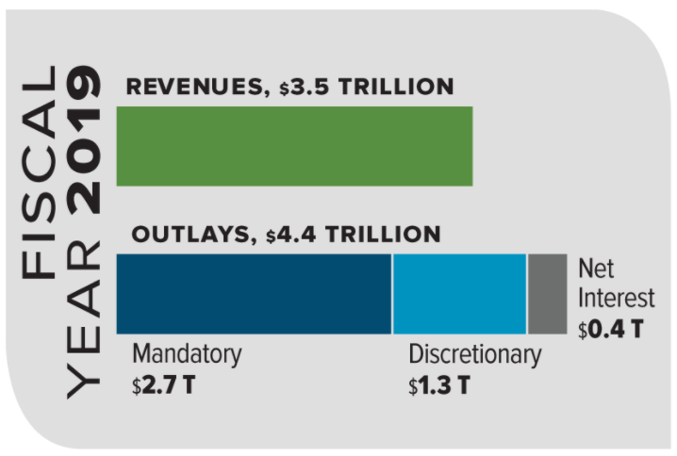
The federal budget for the 2019 fiscal year is at $4.407 trillion. The three primary national spending categories are: 1.mandatory spending 2. discretionary spending 3 interest on the total national debt https://www.whitehouse.gov/omb/fact-sheets/ https://www.thebalance.com/u-s-federal-budget-breakdown-3305789
Government Spending

Slide 26
Net Exports
Exports/Imports of Goods and Services
Transfer payments
Investment in capital stock in the USA and abroad
Investment in financial assets in the USA and abroad
Currency

Slide 27
Check Your Understanding: Included or Not in GDP?
1. Cashing a US government bond
2. Chevrolet purchases tires to put on the cars they are producing
3. Government buys new submarine for the Navy
4. Income received from the sale of Nike stock
5. A farmer’s purchase of a new tractor
6. Construction of a new home built in 2021
7. A service of a barber cutting his own hair
8. Social Security check cashed by a senior citizen
9. A plumber purchases a two year old truck
10. A monthly check received by an economics student who was granted a scholarship

Slide 28
GDP: Is it Counted and Where?
1. You spend $10 to go to the movies
2. A family pays $150,000 to build them a new home in 2021
3. A family pays $75,000 for a two-year-old home
4. Government increases it defense spending by 10 billion dollars
5. Parents work hard to raise their children
6. You pay %+$500 a month for rent
7. You buy a new Toyota that was made in Japan
8. You pay tuition to attend college
9. Ford motors buys new auto-making robots
10. You buy McDonald's stock for $1,000

Slide 29
What is NOT included the measurement of GDP?
Non-Market Activity—Mom baking cookies for her kids! Community service! Fixing your car! Taking care of a relative!
Intermediate Goods—Thread for a t shirt, zipper for a jacket!
Non-Production Transactions — Selling and buying stock! Transferring payments (Social Security or Unemployment insurance)! Donations & monetary gifts!
Secondhand Sales – Used homes, cars, antiques and paintings!
Illegal economic activity

Slide 30
What Else Does GDP NOT Measure?
Happiness
Quality of goods and services
Income equality or inequality
Standard of Living

Slide 31
What is the difference between RGDP and NGDP?
Real GDP is equal to the economic output adjusted for the effects of inflation.
Nominal GDP is economic output without the inflation adjustment.
Nominal GDP is usually higher than real GDP because inflation is typically a positive number.
Which calculation will show you growth?
Check out ACDC: https://www.youtube.com/watch?v=iV4DS9aAQqM

Slide 32
PER CAPITA GDP
This is the measurement of GDP divided by the population. What does it tell us about the country?
Per capita GDP is sometimes used as a standard of living indicator, with a higher per capita GDP equating to a higher standard of living
B. Per capita GDP can also be used to measure the productivity of a country's workforce, as it measures the total output of goods and services per each member of the workforce in a given nation

Slide 35
MACRO 2007

Slide 36
Macro 2010B

Slide 37
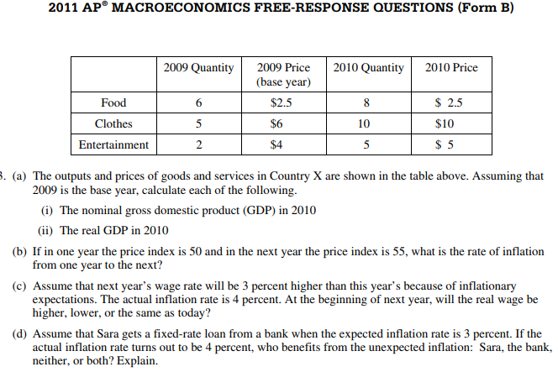
Macroeconomics 2011B

Slide 38
MACRO 2008B

Slide 39
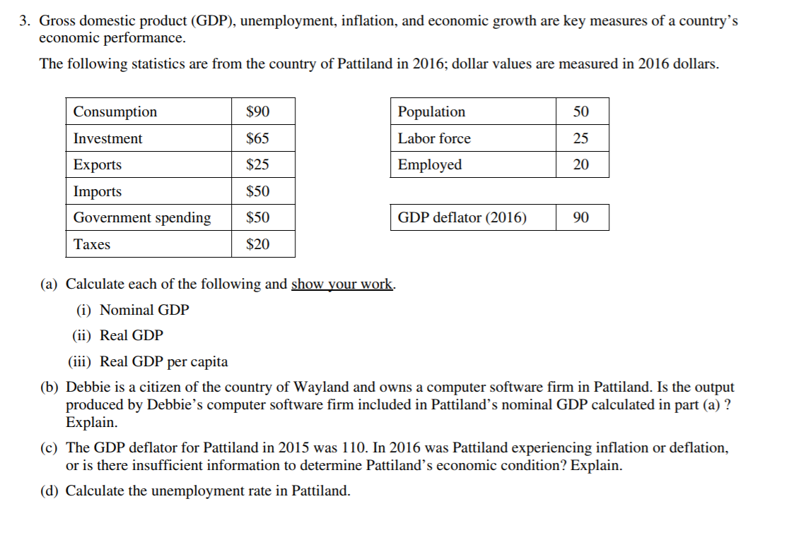

Slide 41
References
College Board Site
Macroeconomics Videos on College Board site
My AP Classroom videos
Advanced Placement Instruction Program by CEE (APIP Macroeconomics)
McConnell & Brue - Economics
Krugman’s Economics textbook
Reffonomics.com – Just came out and it is FREE!!

Slide 42
CEE Affiliates
https://www.councilforeconed.org/resources/local-affiliates/

Slide 43
Thank You to Our Sponsors!

Slide 44
We’ve gone Virtual!
Teach Economics?
Your students may have what it takes to compete in the nation’s only high school economics competition!
Why Play?
• Fun team learning experience
• Great for college applications
• No other challenge like this
• Online participation makes access easy
• Chance for cash prizes
How it Works
Teams register
Teachers enroll team(s) of 3- 4 high school students from the same school. Multiple teams allowed.
Teams compete within their state
Compete to win your state competition for a chance to advance to the National Semi-Finals.
National Semi-Finals: May 3-20, 2021
Teams answer multiple-choice questions on macroeconomics, microeconomics, and international & current events.
National Finals: May 22-24, 2021
Teams analyze an economic issue and present their solution. Top teams engage in the Finals Quiz Bowl where they face-off answering questions to claim the National Title.
Two divisions based on experience level
David Ricardo for first-time competitors who have taken no more than one economics course.
Adam Smith for returning competitors, AP, International Baccalaureate, and honors students.
Register Today at NationalEconomicsChallenge.org

Slide 45
FIND YOUR LOCAL COMPETITION AND REGISTER TODAY!
The National Personal Finance Challenge is a competition that provides high school students with an exciting and motivating opportunity to build, apply, and demonstrate their knowledge of money management.
Through online exams and a personal finance simulation, teams showcase their expertise in earning income, buying goods and services, saving, using credit, investing, as well as protecting and insuring.
Teams of up to four students, with one teacher/coach, can qualify to represent their state at the National Personal Finance Challenge by winning their local competition.
NATIONALS
Semi-Finals: First round elimination via online multiple-choice questions.
Finals: Case study round virtually co-hosted by the Cleveland Fed on June 3.
personalfinancechallenge.org

Slide 46
The 2021 Sloan Teaching Champion Award
Winners receive:
A cash award of $5,000
A cash award of $2,500 for their school to support economic education
Recognition at our annual Visionary Awards convening.
This award promotes economic education by honoring three outstanding teachers who incorporate exemplary teaching techniques that improve their students’ economic understanding in and out of the classroom.
This award is open to New York metropolitan area high school teachers of all subjects, not just teachers of economics. Applicants must demonstrate how they integrate economics into their teaching.
Sound like you or someone you know?
Applicants must teach in one of the
Twelve New York state counties (New York, Kings, Bronx, Richmond, Queens, Nassau, Suffolk, Westchester, Putnam, Rockland, Orange and Dutchess)
Eight New Jersey counties (Bergen, Passaic, Essex, Hudson, Middlesex, Union, Morris, Monmouth), or the
Two Connecticut counties (Fairfield and New Haven)
Application will be launched on Friday February 19th 2021
You can access the application here.
CONTACT
Please feel free to e-mail us at rrivera@councilforeconed.org
with any questions you have.

