Slide 1
Corporate and Personal Debt
Jay LeBlanc (with thanks to Dr. Dale DeBoer from UCCS) jay.leblanc@econlitco.org
Economic Literacy Colorado
May 5, 2021

Slide 2
EconEdLink Membership
You can now access CEE’s professional development webinars directly on EconEdLink.org! To receive these new professional development benefits, become an EconEdLink member. As a member, you will now be able to:
Automatically receive a professional development certificate via e-mail within 24 hours after viewing any webinar for a minimum of 45 minutes
Register for upcoming webinars with a simple one-click process
Easily download presentations, lesson plan materials and activities for each webinar
Search and view all webinars at your convenience
Save webinars to your EconEdLink dashboard for easy access to the event
You may access our new Professional Development page here

Slide 3
Professional Development Certificate
To earn your professional development certificate for this webinar, you must:
Watch a minimum of 45-minutes and you will automatically receive a professional development certificate via e-mail within 24 hours.
Accessing resources:
You can now easily download presentations, lesson plan materials, and activities for each webinar from EconEdLink.org/professional-development/

Slide 4
Agenda for Today’s Session
Household Debt – What are the economic theories, what does the data tell us, and has the pandemic strengthened or changed the existing patterns?
Corporate Debt – How and why have levels of corporate debt changed over the past 20 years, and what are the risk and rewards for companies and stockholders for those decisions?
Government Debt – A very short look at the potential impact of government spending on the first two groups

Slide 5
Objectives
Teachers will understand similarities and differences in types of household debt and their risks/rewards.
Teachers will understand some of the positive and negative impacts of the COVID-19 pandemic on personal and corporate debt levels and risks
Teachers will learn about lessons/activities related to personal and government debt and the tradeoff decisions typically made for each type of debt.

Slide 6
Colorado State Standards
Preschool, Standard 3 Economics, “Individuals have many wants and have to make choices”, specifically identify choices that individuals can make and explain how they earn money and use it to make choices among their various wants
Kindergarten, Standard 3 Economics, “Individuals make choices based on wants”, specifically identify the costs and benefits of a choice an individual makes when acquiring an item
2nd Grade, Standard 3 Economics, “Resources are scarce, so individuals may not have access to the goods and services they want”, specifically being able to explain scarcity, give examples of choices people make when resources are scarce, and identifying possible solutions when there are limited resources and unlimited wants
4th Grade, Standard 3 Economics, “Determine the opportunity cost when making a choice”, specifically defining choice and opportunity cost, determining the relationship between long-term goals and opportunity cost, and analyzing scenarios of choices including opportunity cost
5th Grade, Standard 3 Economics, “Examine how individuals use financial institutions to manage personal finances”, specifically what risks and benefits are associated with spending versus saving and investing, and how individuals research, analyze, and make choices regarding their needs when using financial institutions

Slide 7
Colorado State Standards (con’t)
8th Grade, Standard 3 Economics, “Examine the role of consumer decisions and taxes within the market economies of early American history”, specifically explain factors that have impacted borrowing and investing over time.
High School, Standard 1 History, “Use the historical method of inquiry to formulate compelling questions, evaluate primary and secondary sources, analyze and interpret data, and argue for an interpretation defending by textual evidence”, specifically gather and analyze historical information from a range of qualitative and quantitative sources; for example: demographic, economic, social, and political data
High School, Standard 3 Economics, “Understand the allocation of scarce resources in societies through analysis of individual choice, market interaction, and public policy”, specifically how the business cycle affect the macroeconomy and how experts make predictions about the future course of the economy by interpreting economic data.
High School, Standard 3 Economics, “Apply consumer skills to spending, saving, and borrowing decisions”, specifically summarize factors to consider when selecting borrowing options, including costs, relevance, payoffs, and tradeoffs. For example: comparing student loan options, auto loan options, and payday lending options.

Slide 8
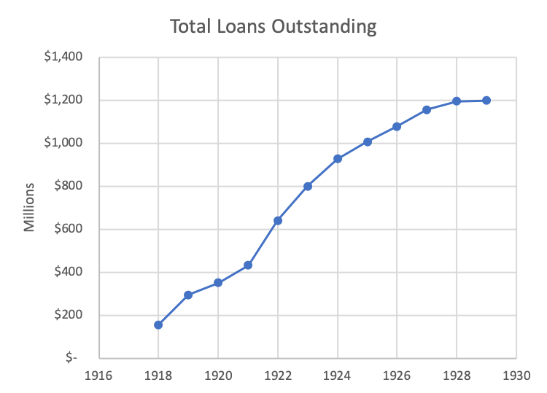
A cautionary tale
Debt and the Great Depression
Notes:
Average annual growth: 22%
Aggregate growth (1918 to 1929): 667%

Slide 9
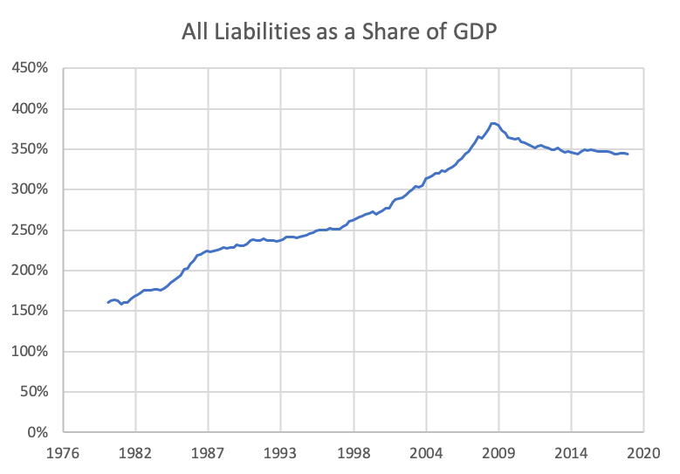
A cautionary tale
Debt and the Great Recession

Slide 10
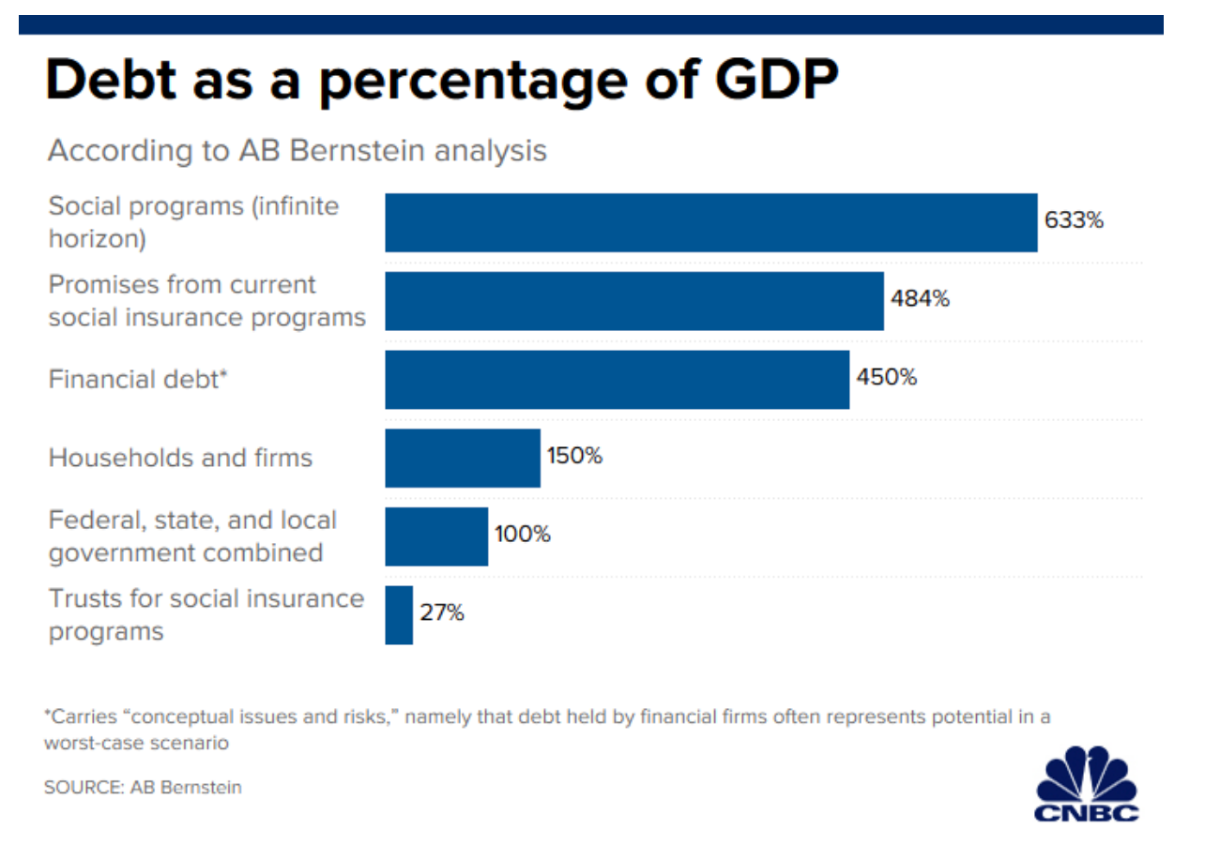
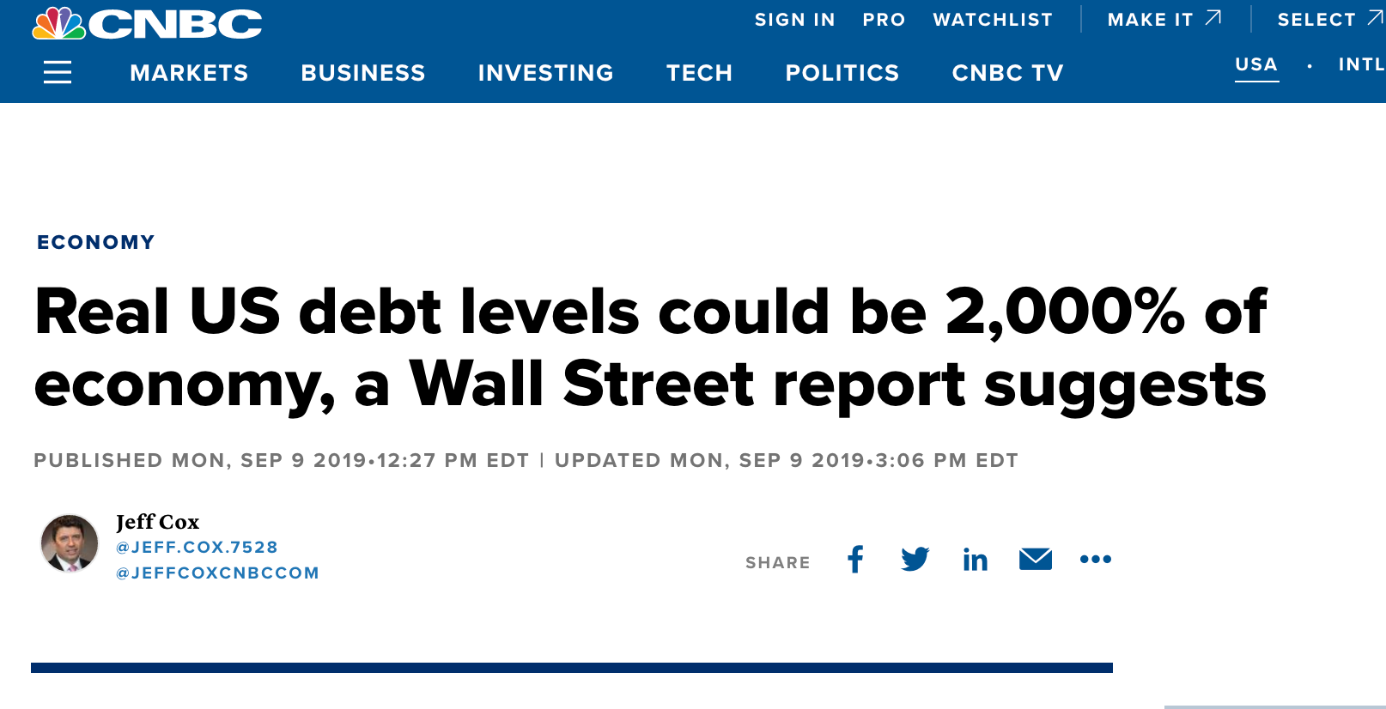
A cautionary tale
What the future may hold

Slide 11
Economic Concept #1
Personal (Household) Debt

Slide 12
Individual debt
The rich rule over the poor, and the borrower is slave to the lender.
Proverbs 22:7
Neither a borrower nor a lender be, For loan oft loses both itself and friend, And borrowing dulls the edge of husbandry.
Hamlet, Act 1 Scene 3

Slide 13
Individual debt
Debt in economic theory
Permanent Income Hypothesis (PIH)
- Milton Friedman
Life Cycle Hypothesis (LCH)
- Franco Modigliani

Slide 14
Economic Theory #1
Permanent Income Hypothesis
Basic Idea: Assumes that consumer behavior is based on individual preferences and unpredictable. Consumer spending may not gather momentum until workers are optimistic about their future incomes.
For example, an individual who expects a bonus or raise at the end of a particular year may either increase spending or may put the additional income into savings.
On the other hand, a surprise windfall is more likely to be spent quickly before it disappears, since it was not planned for in advance.

Slide 15
Economic Theory #2
Life Cycle Hypothesis
Basic Idea: Assumes that individuals seek to smooth consumption over the course of a lifetime – borrowing in times of low-income and saving during periods of high income.
As a student, it is rational to borrow to fund education.
Then during your working life, you pay off student loans and begin saving for your retirement.
This saving during working life enables you to maintain similar levels of income during your retirement.

Slide 16
Individual debt
Saving
Consumption smoothing
$
Dissaving
Desired Consumption
Income
Childhood
Retirement

Slide 17
Individual debt

Slide 18
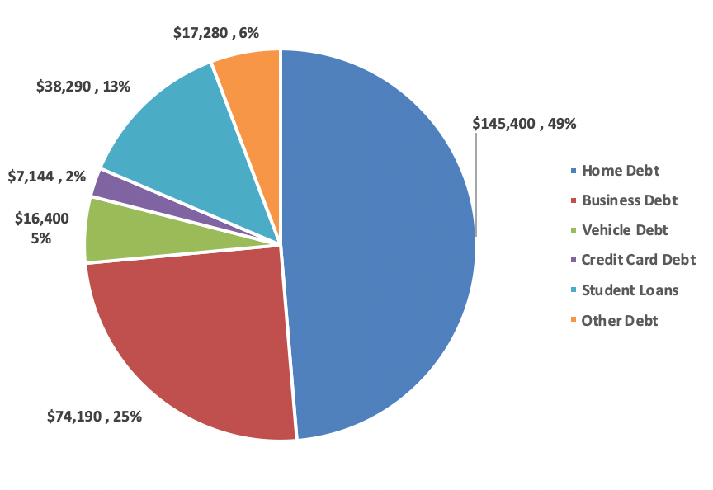
Individual debt
Current household debt
Notes:
Mean Household Debt 2015

Slide 19
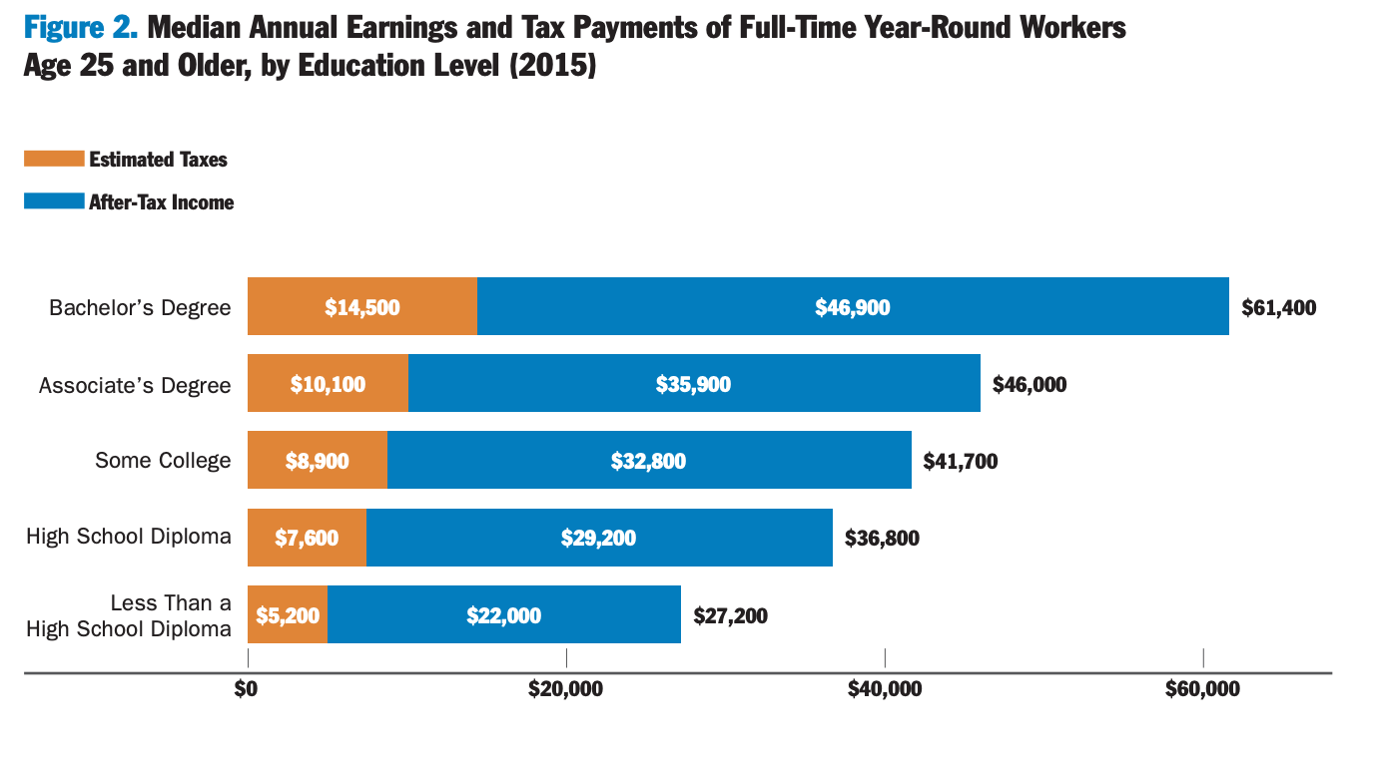
Individual debt
Not all debt is created equal
Income increasing debt
Return on education

Slide 20
Individual debt
Not all debt is created equal
Return on education – Georgetown University Center on Education and the Workforce
Their website attempts to quantify the value of a college degree down the road
Net Present Value (NPV) - The net present value is how much a sum of money in the future is valued today. This metric includes costs, future earnings, and the length of time it would take to invest and earn a certain amount of money over a fixed horizon.
NOTE: This does NOT attempt to quantify the opportunity cost of not investing in postsecondary education

Slide 21
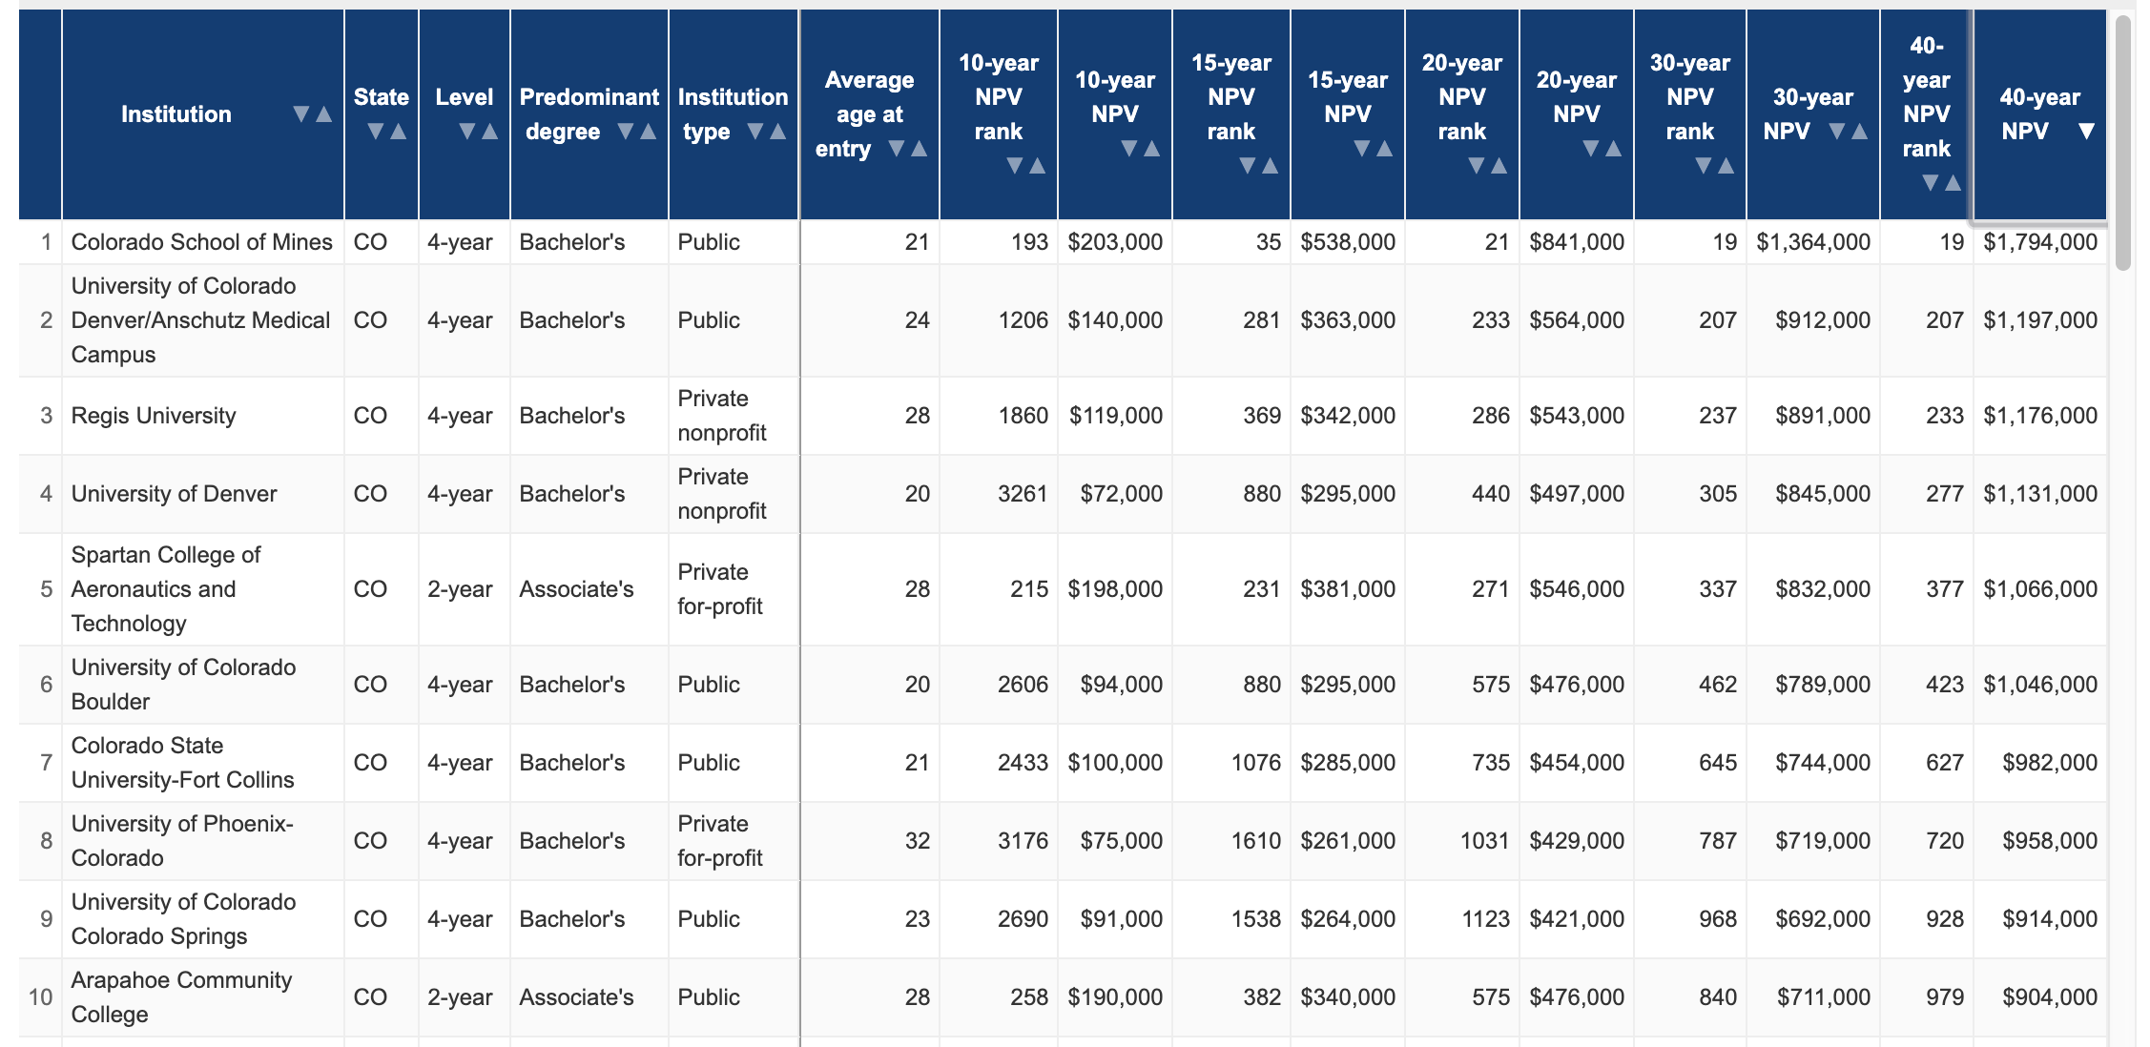
Individual debt
Not all debt is created equal
Income increasing debt
Return on education
https://cew.georgetown.edu/cew-reports/collegeroi/

Slide 22
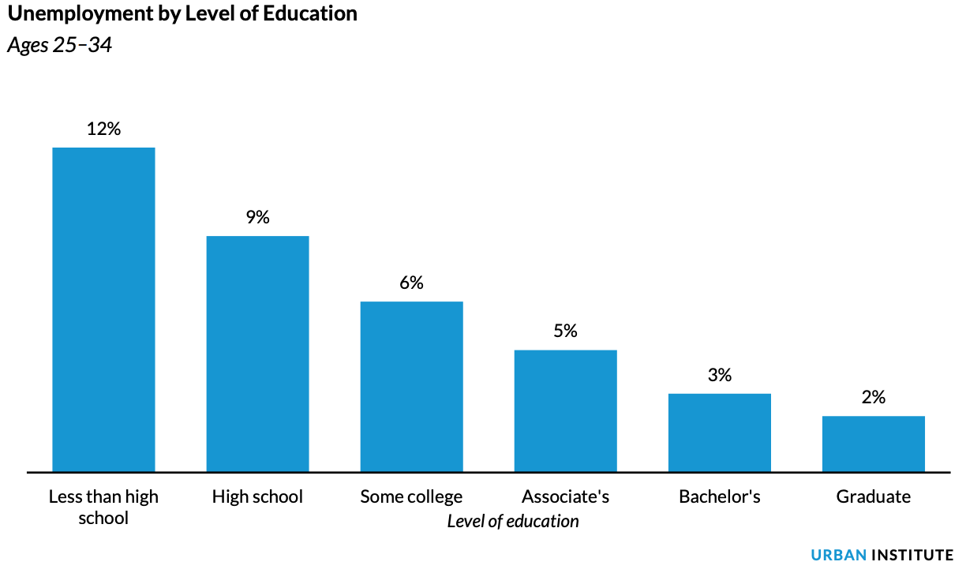
Individual debt
Not all debt is created equal
Income increasing debt
Return on education

Slide 23
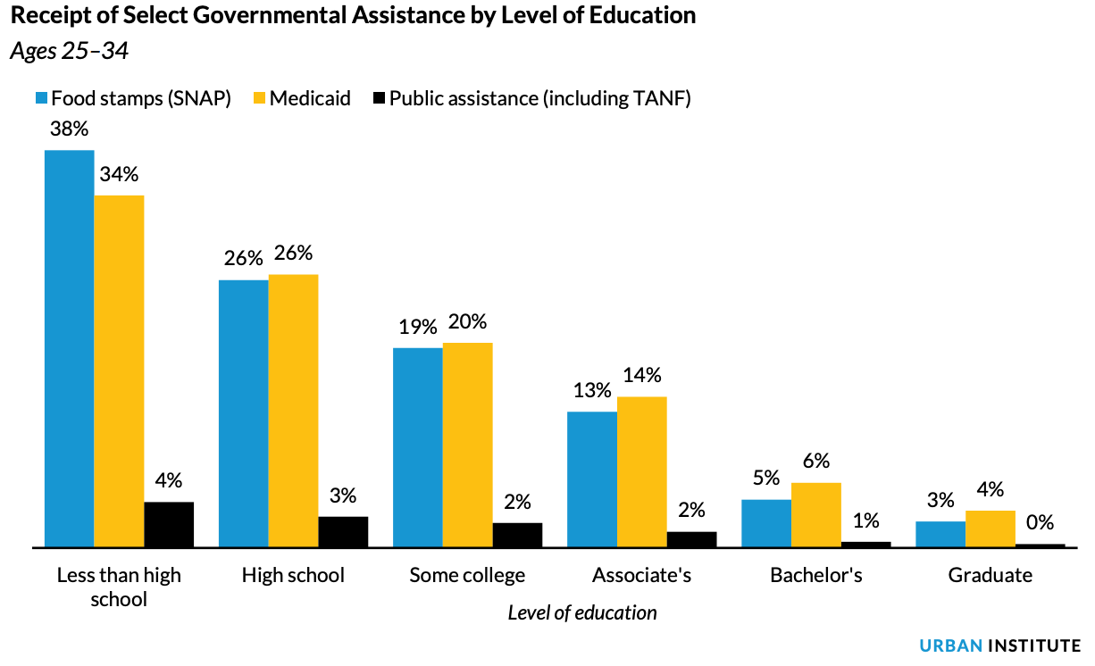
Individual debt
Not all debt is created equal
Income increasing debt
Return on education

Slide 24
Individual debt

Slide 25
Individual debt

Slide 26
Individual debt

Slide 27
Individual debt

Slide 28
Individual debt

Slide 29
Individual debt

Slide 30
Individual debt

Slide 31
Individual debt

Slide 32
Individual debt

Slide 33
Individual debt

Slide 34
Individual debt

Slide 35
Individual debt

Slide 36
Individual debt

Slide 37
Individual debt

Slide 38
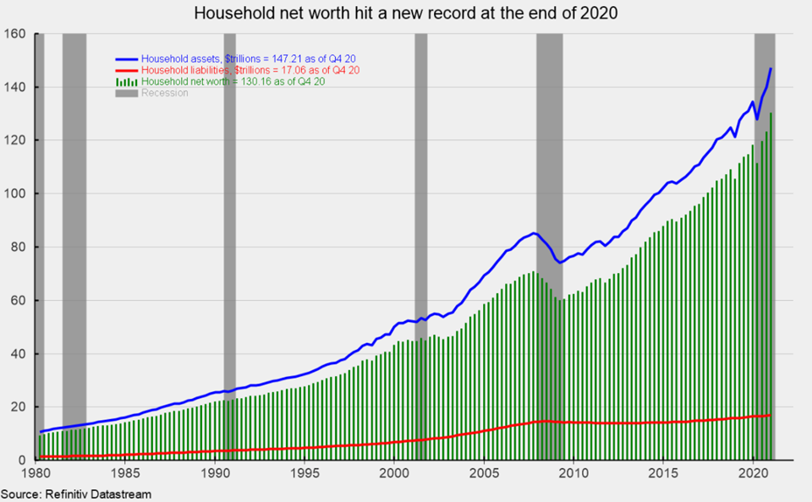
Individual debt

Slide 39
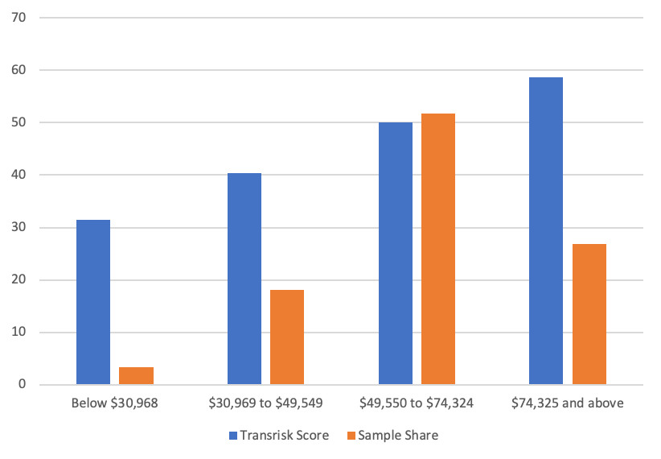
Individual debt
Debt and inequality
Back to the Life Cycle model

Slide 40
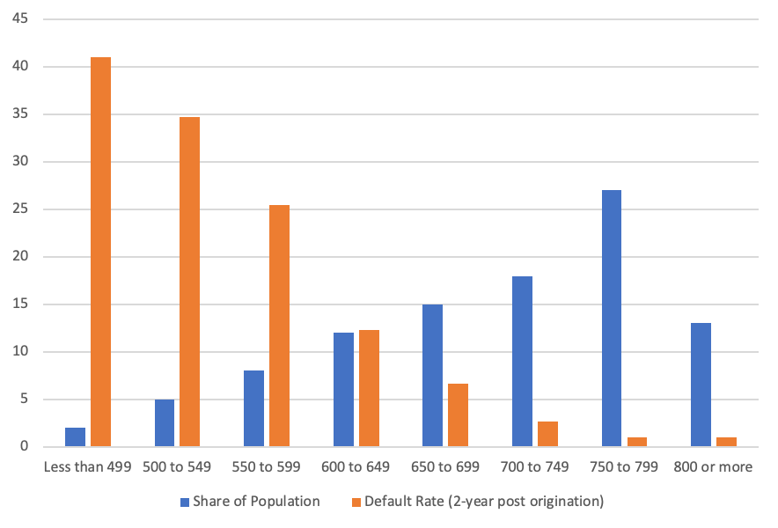
Individual debt
Debt and inequality
Back to the Life Cycle model

Slide 41
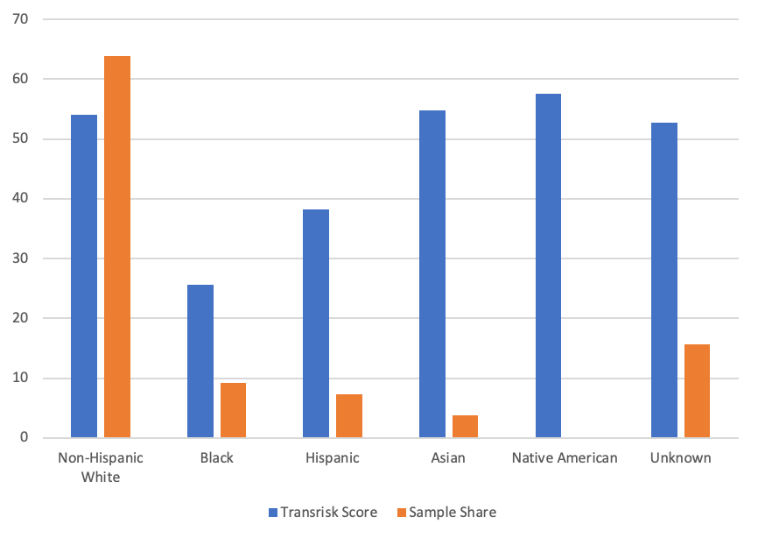
Individual debt
Debt and inequality
Back to the Life Cycle model

Slide 42
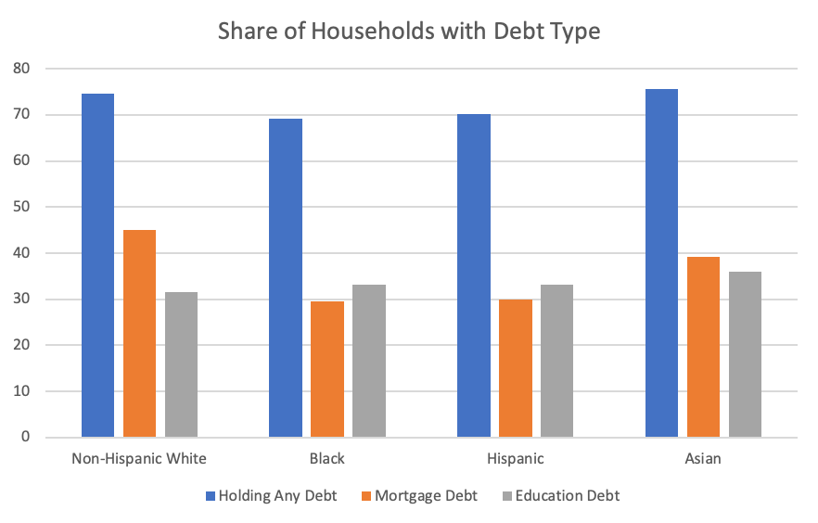
Individual debt
Debt and inequality
Back to the Life Cycle model

Slide 43
Individual debt
Lessons on individual debt
Is debt “bad?”
How much is too much?
Leverage increases rewards and risks
Financial markets likely contribute to inequality

Slide 44
Individual debt

Slide 45
Individual debt

Slide 46
Individual debt

Slide 47
Individual debt

Slide 48
Individual debt

Slide 49
Economic Concept #2
Corporate Debt

Slide 50
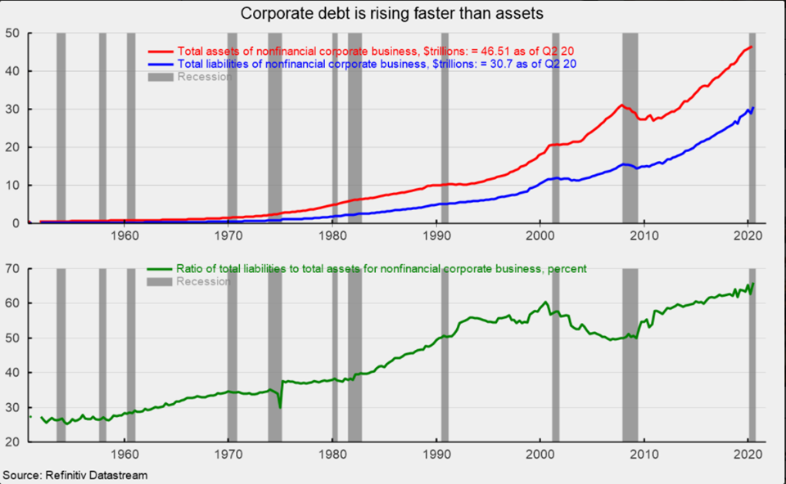
Business debt

Slide 51
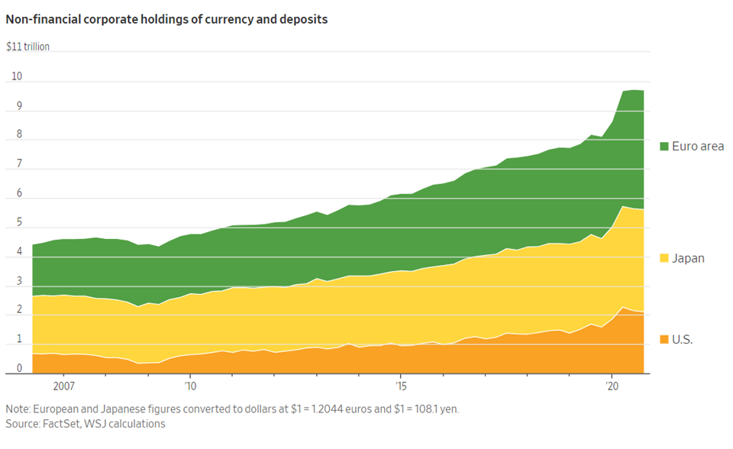
Business debt

Slide 52
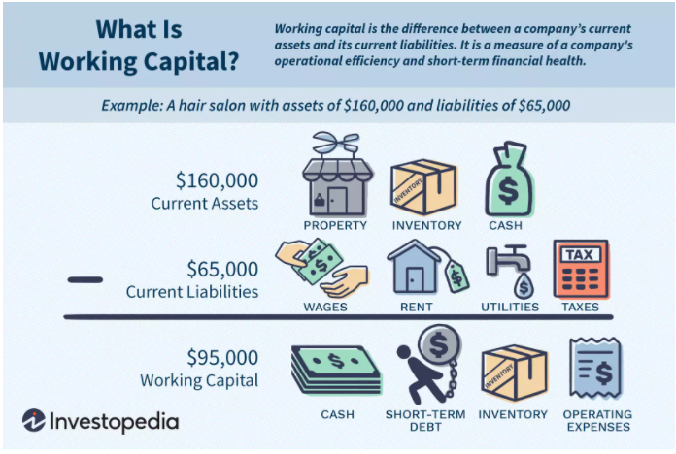
Business debt

Slide 53
Business debt
Debt Capital
Debt financing is capital acquired through the borrowing of funds to be repaid at a later date. Common types of debt are loans and credit.
The benefit of debt financing is that it allows a business to leverage a small amount of money into a much larger sum, enabling more rapid growth than might otherwise be possible.
In addition, payments on debt are generally tax-deductible.
Equity Capital
Equity financing refers to funds generated by the sale of stock. The main benefit of equity financing is that funds need not be repaid.
Shareholders purchase stock with the understanding that they then own a small stake in the business. The business is then beholden to shareholders and must generate consistent profits in order to maintain a healthy stock valuation and pay dividends.
Since equity financing is a greater risk to the investor than debt financing is to the lender, the cost of equity is often higher than the cost of debt.

Slide 54
Business debt
Why is “operating” debt needed?
Sally’s Widget Emporium
Monthly expenses
$50,000 employee compensation
$20,000 fixed facility expense
$100,000 purchase of inputs
Monthly sales
$200,000
Is Sally’s profitable?
$200,000 – ($50,000 + $20,000 + $100,000)
Monthly operating profit = $30,000

Slide 55
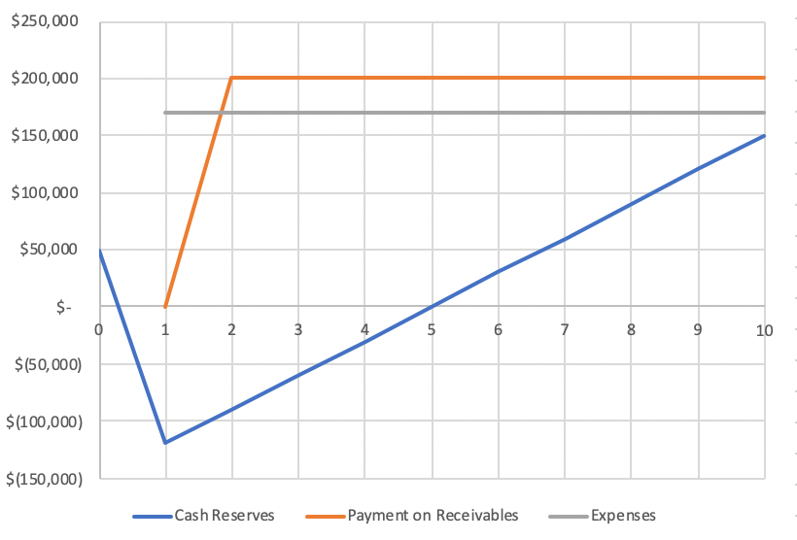
Business debt
Why is “operating” debt needed?
The timing problem
Notes:
Business starts with $50,000. Expenses per period $170,000. Revenue per period $200,000. Business profitable, but startup funds needed.

Slide 56
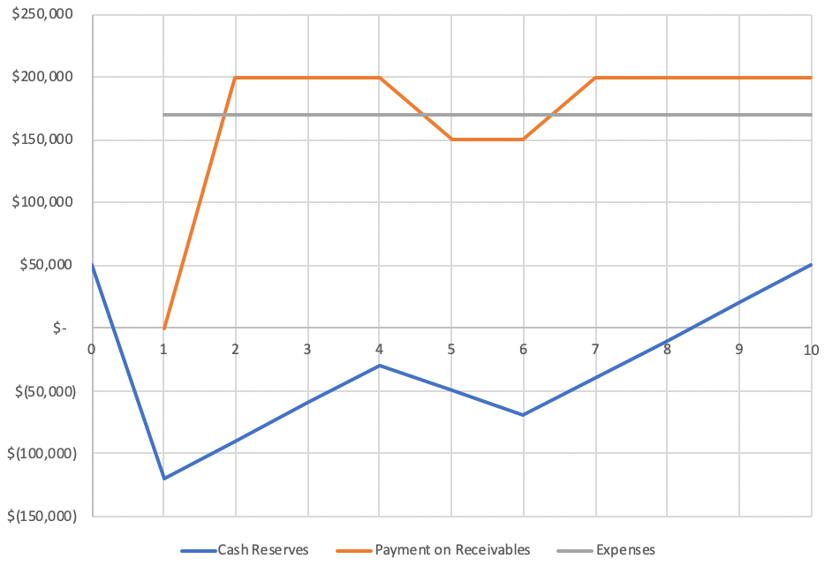
Business debt
Why is “operating” debt needed?
Short-term downturn
Notes:
Business starts with $50,000. Expenses per period $170,000. Revenue per period $200,000. Business profitable, but startup funds needed.

Slide 57
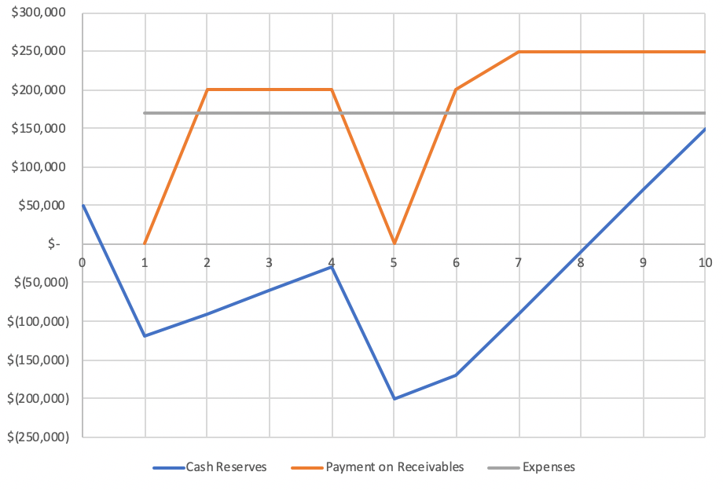
Business debt
Why is “operating” debt needed?
Delayed payment
Notes:
Business starts with $50,000. Expenses per period $170,000. Revenue per period $200,000. Business profitable, but startup funds needed.

Slide 58
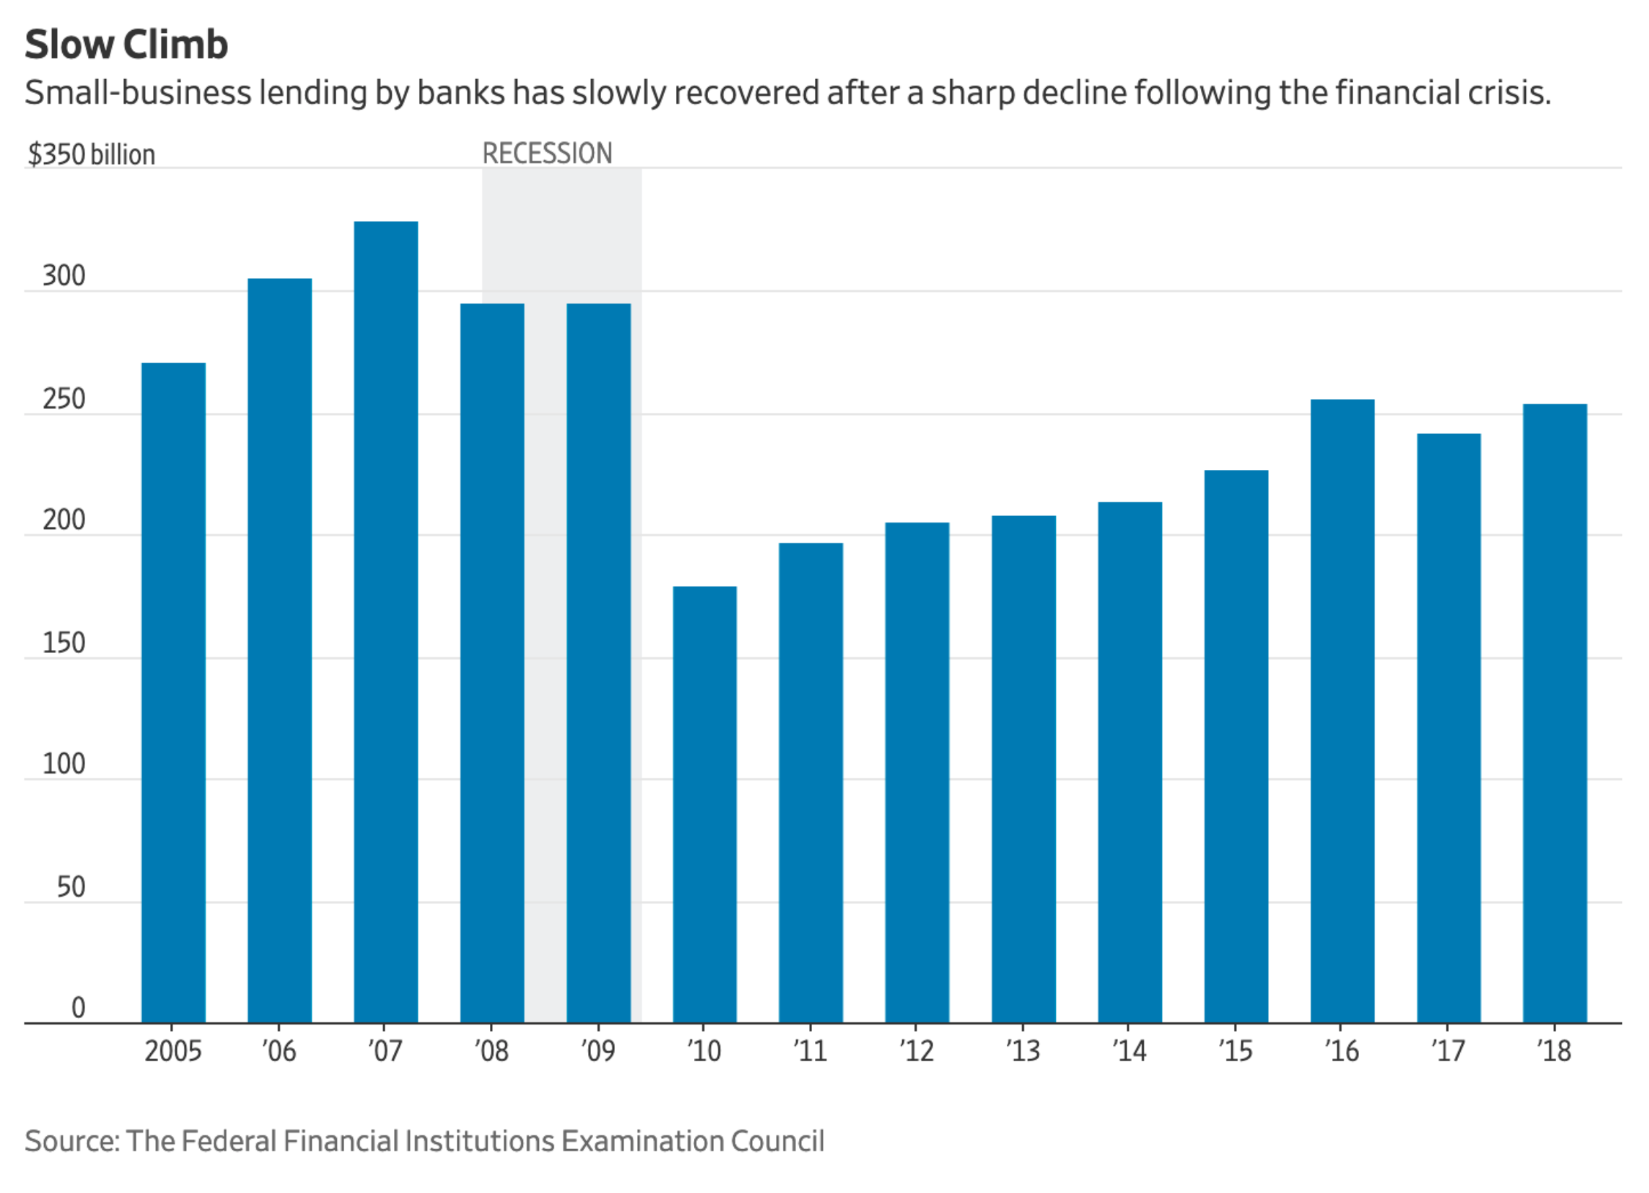
Business debt
Why is “operating” debt needed?

Slide 59
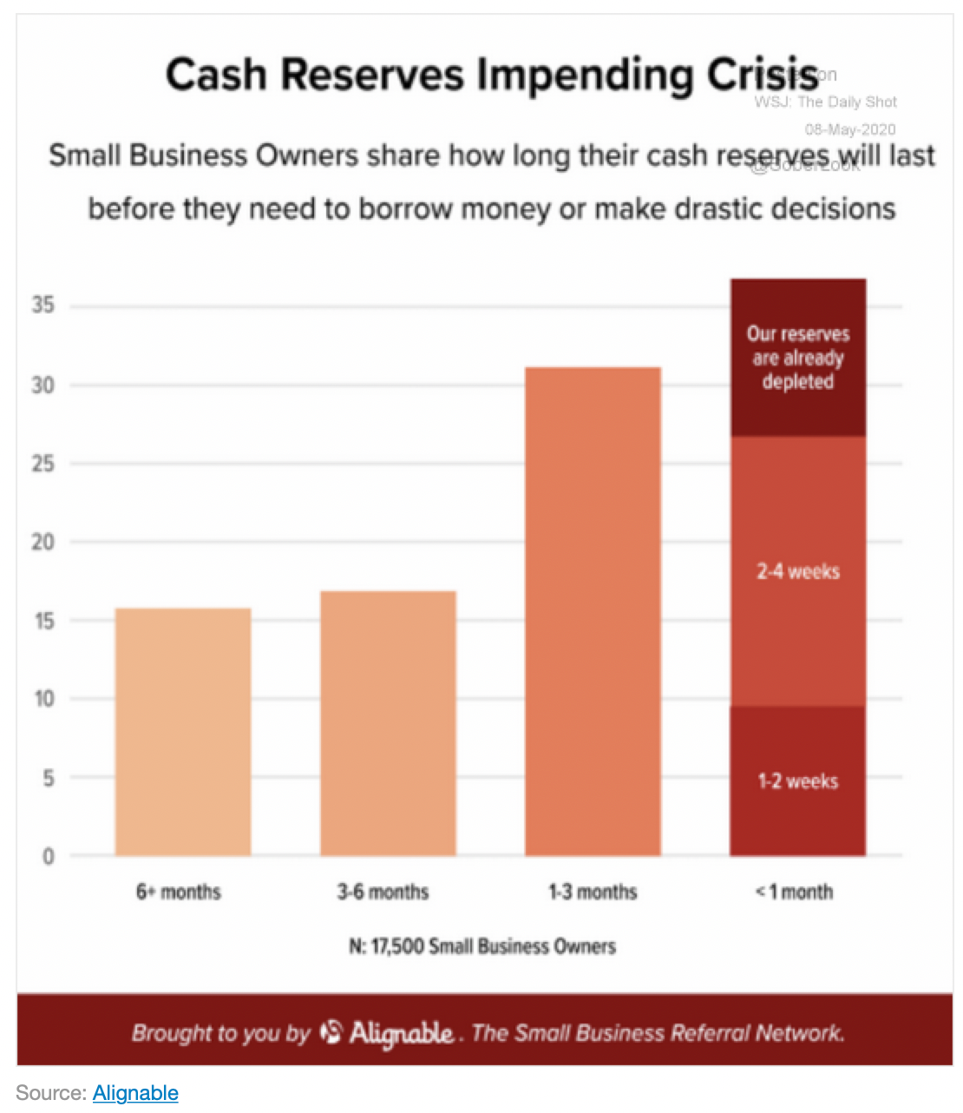
Business debt
Why is “operating” debt needed?
Notes:
Bernanke conclusion: severity of recession linked to erosion of business financing more than demand side shock
Evidence from spike in short-term lending rates for non-capital expansion

Slide 60
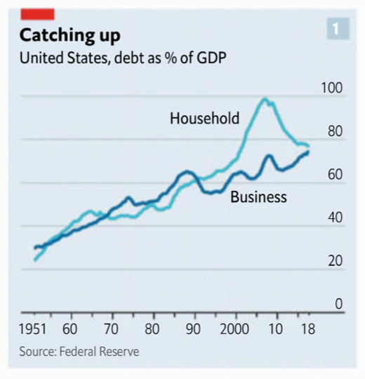
Business debt
Recent business debt history
Aggregate debt (relative to GDP)

Slide 61
Business debt
Forms (terminology) of debt
Loans
Secured vs. unsecured
Operating loans are often unsecured
Bonds
A “marketable” loan
Secondary market is an “over the counter” market
Less transparent
Less liquid
Counterparty risk

Slide 62
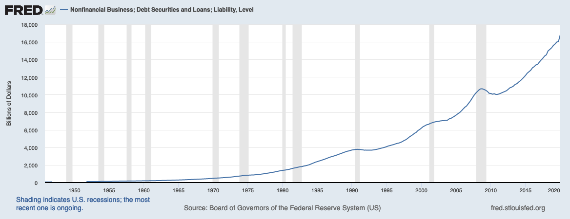
Business debt
Recent business debt history
Aggregate debt (total)

Slide 63
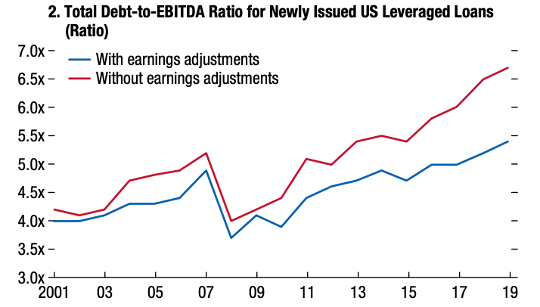
Business debt
Recent business debt history
Growth in risky business lending
Notes:
Earnings before interest, taxes, depreciation, amortization (cash flow)

Slide 64
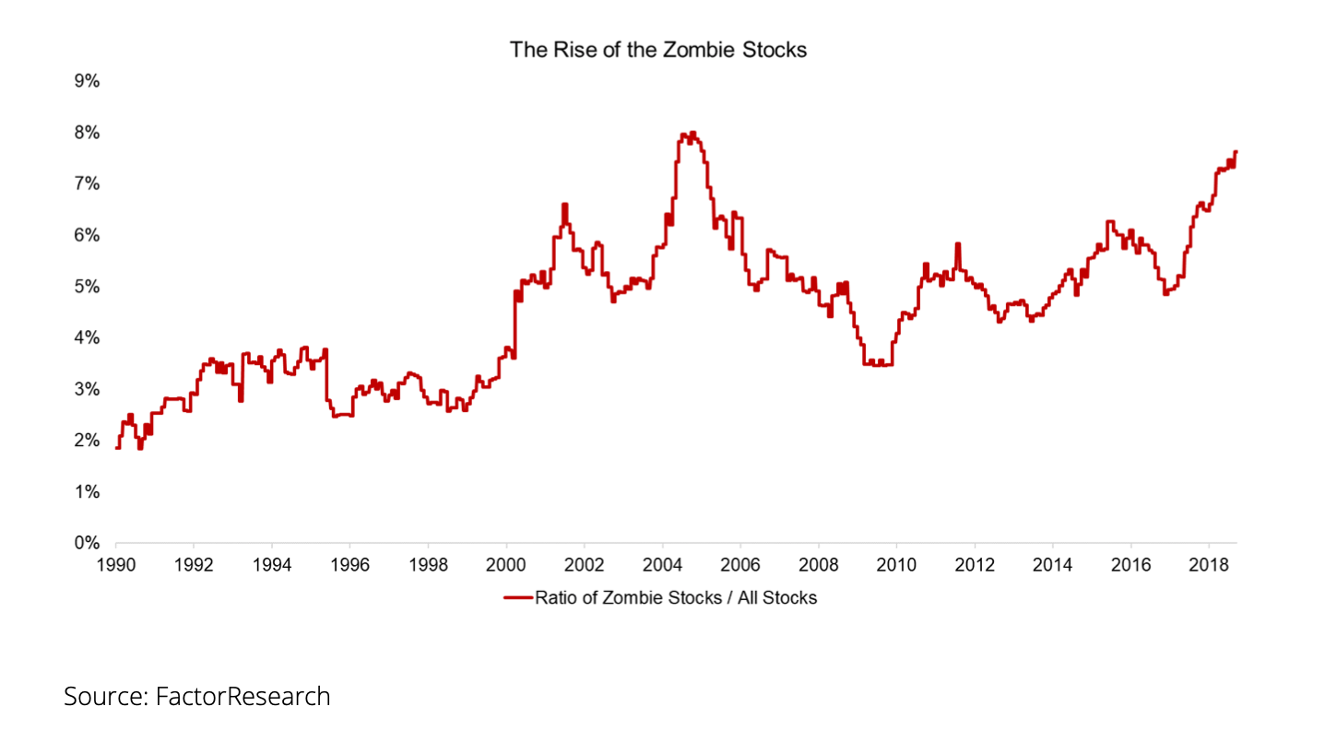
Business debt
Recent business debt history
Zombie companies

Slide 65
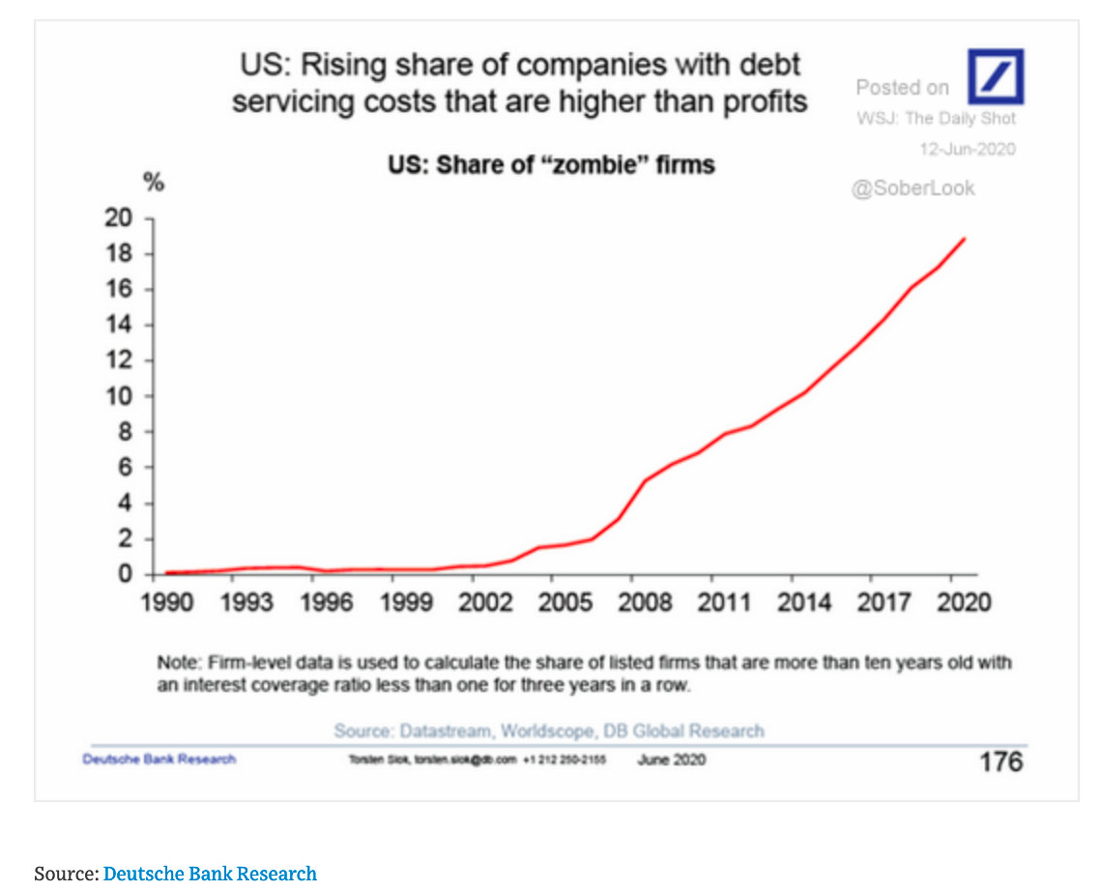
Business debt
Recent business debt history
Zombie companies

Slide 66
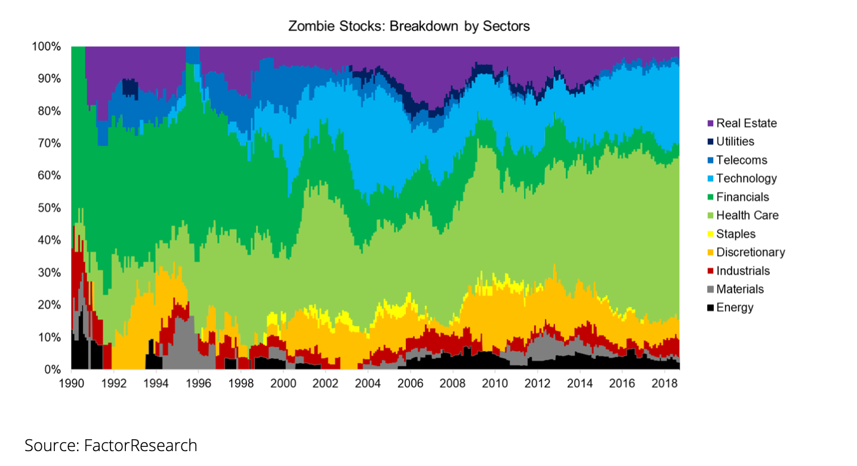
Business debt
Recent business debt history
Zombie companies

Slide 67
Business debt
Forms (terminology) of debt
Mortgage backed securities (MBSs)
Package of mortgages sold in the secondary mortgage market
Generally sell at a premium to the “face value” of the bundled mortgages

Slide 68
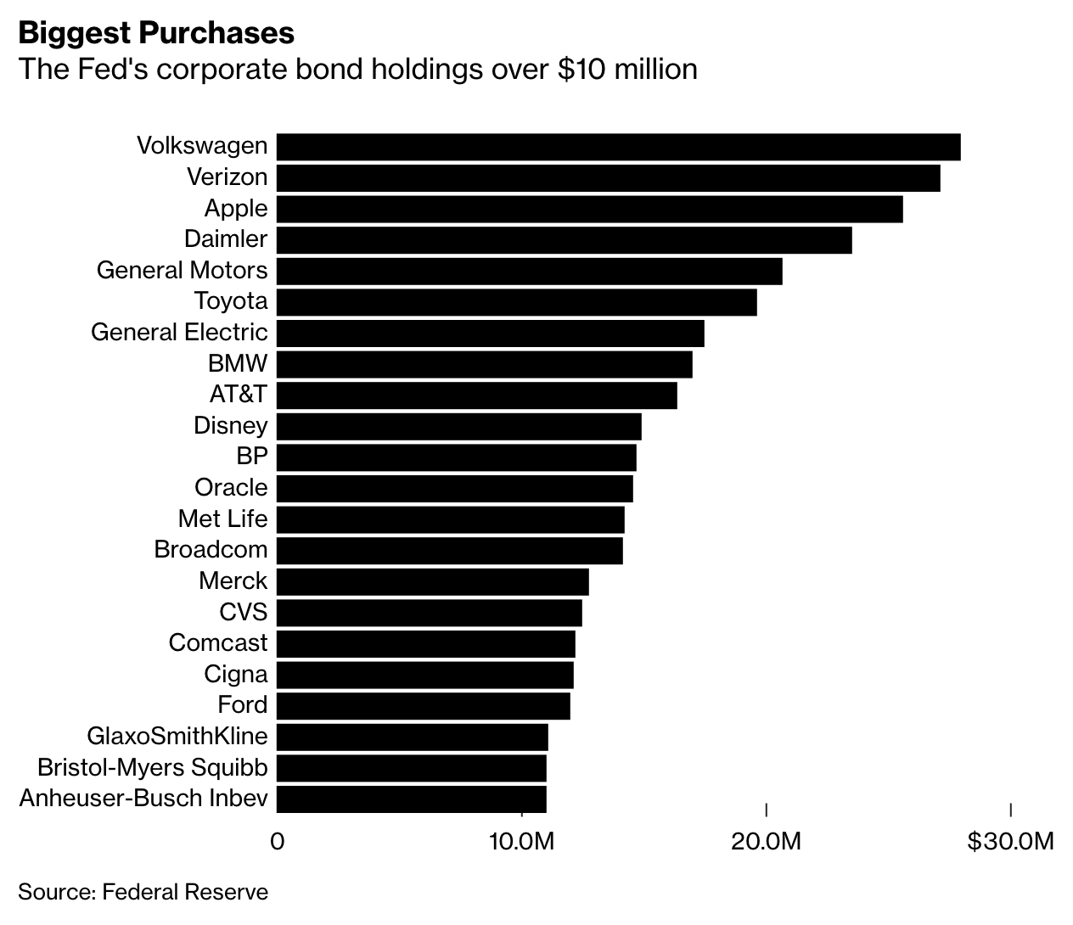
Business debt
And now the COVID-19 crisis….

Slide 69
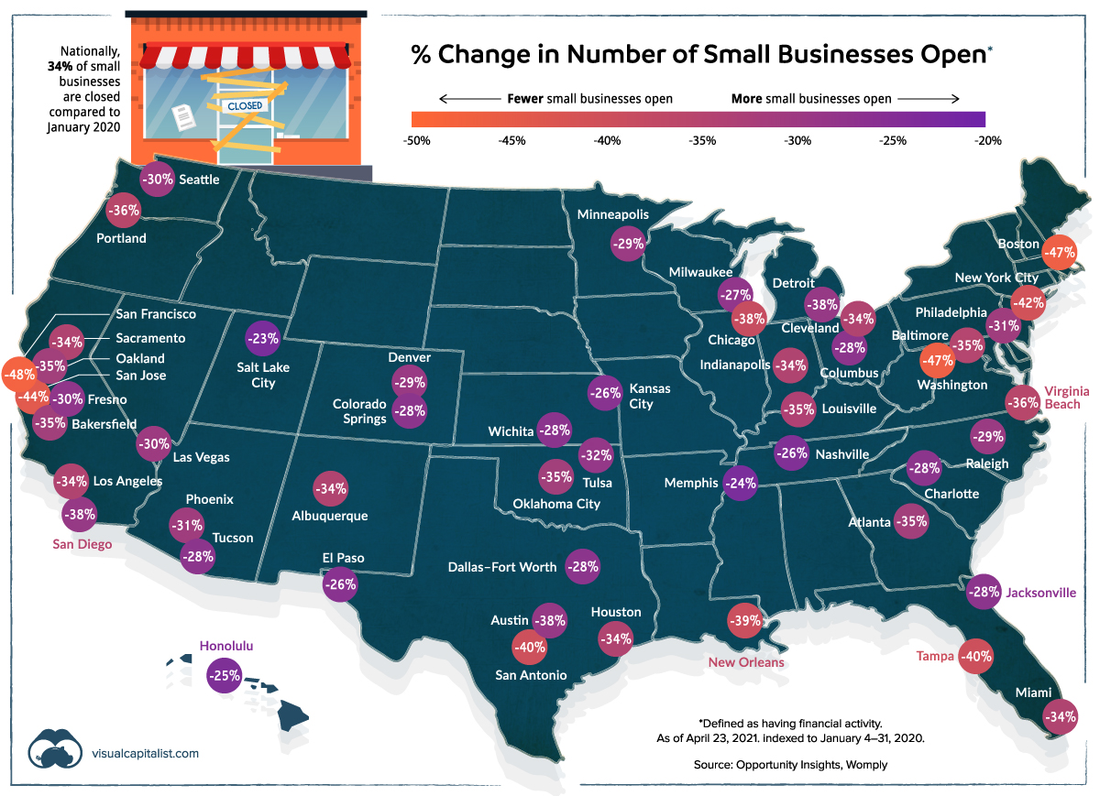
Business debt

Slide 70
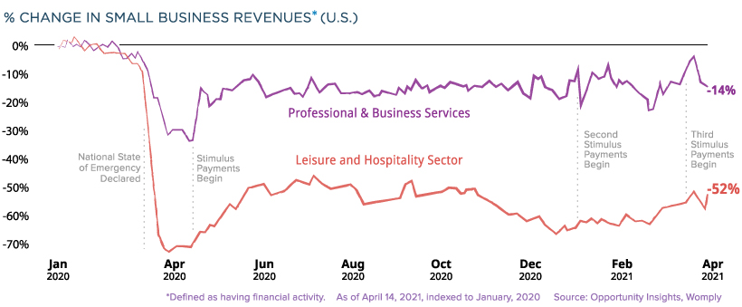
Business debt

Slide 71
Business debt
Lessons on business debt
Corporate debt is necessary
Ongoing operations
Growth/expansion
Extension—regulation will likely constrain growth
Corollary—the finance industry is required for economic functioning
Business investment is unstable
Corollary—monetary policy will often fail
Corporate finance is subject to speculative cycles
Extension—financial sector regulation may contain speculative bubbles

Slide 72
Business debt

Slide 73
Economic Concept #3
Government Debt

Slide 74
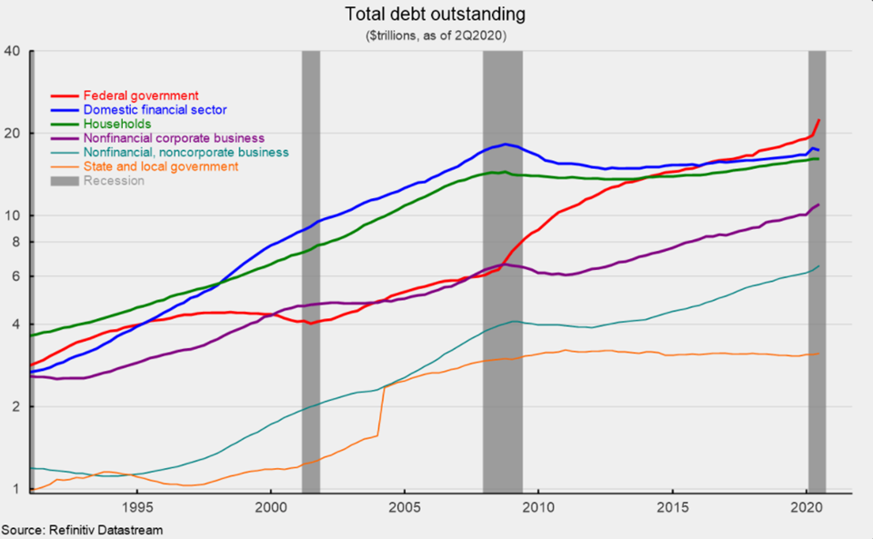
Government debt

Slide 75
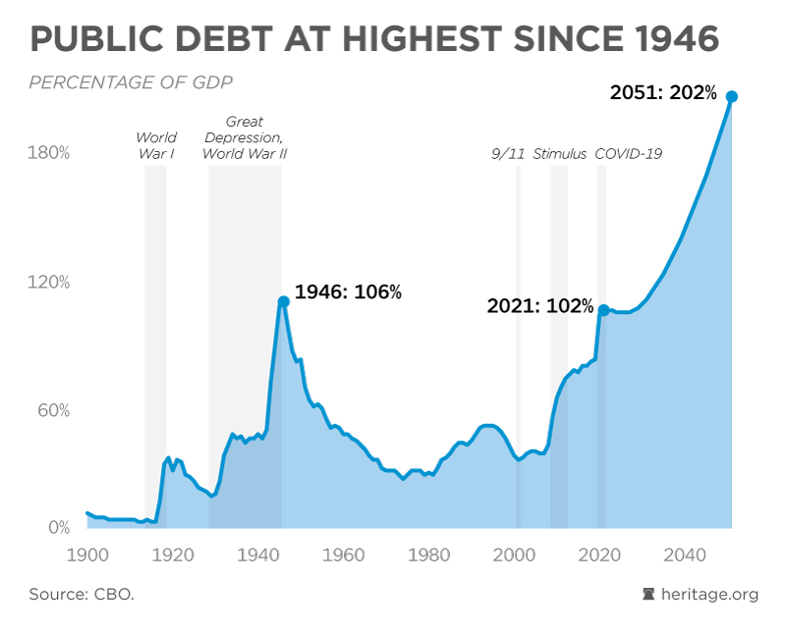
Government debt

Slide 76
Government debt
Impact of the COVID-19 crisis on Government Spending….
Families First Coronavirus Response Act - Mar 2020
$0.25 trillion
Coronavirus Aid, Relief, and Economic Security (CARES) Act – Mar 2020
$2.2 trillion
Paycheck Protection Program – Apr 2020
$0.5 trillion
Consolidated Appropriations Act (Stimulus check #2) – Dec 2020
$1.0 trillion
American Rescue Act (Stimulus check #3) – Mar 2021
$1.9 trillion
American Jobs Act (Infrastructure bill) – Proposed Apr/May 2021
$2.0 trillion
TOTAL - $7.85 Trillion in 15 months

Slide 77
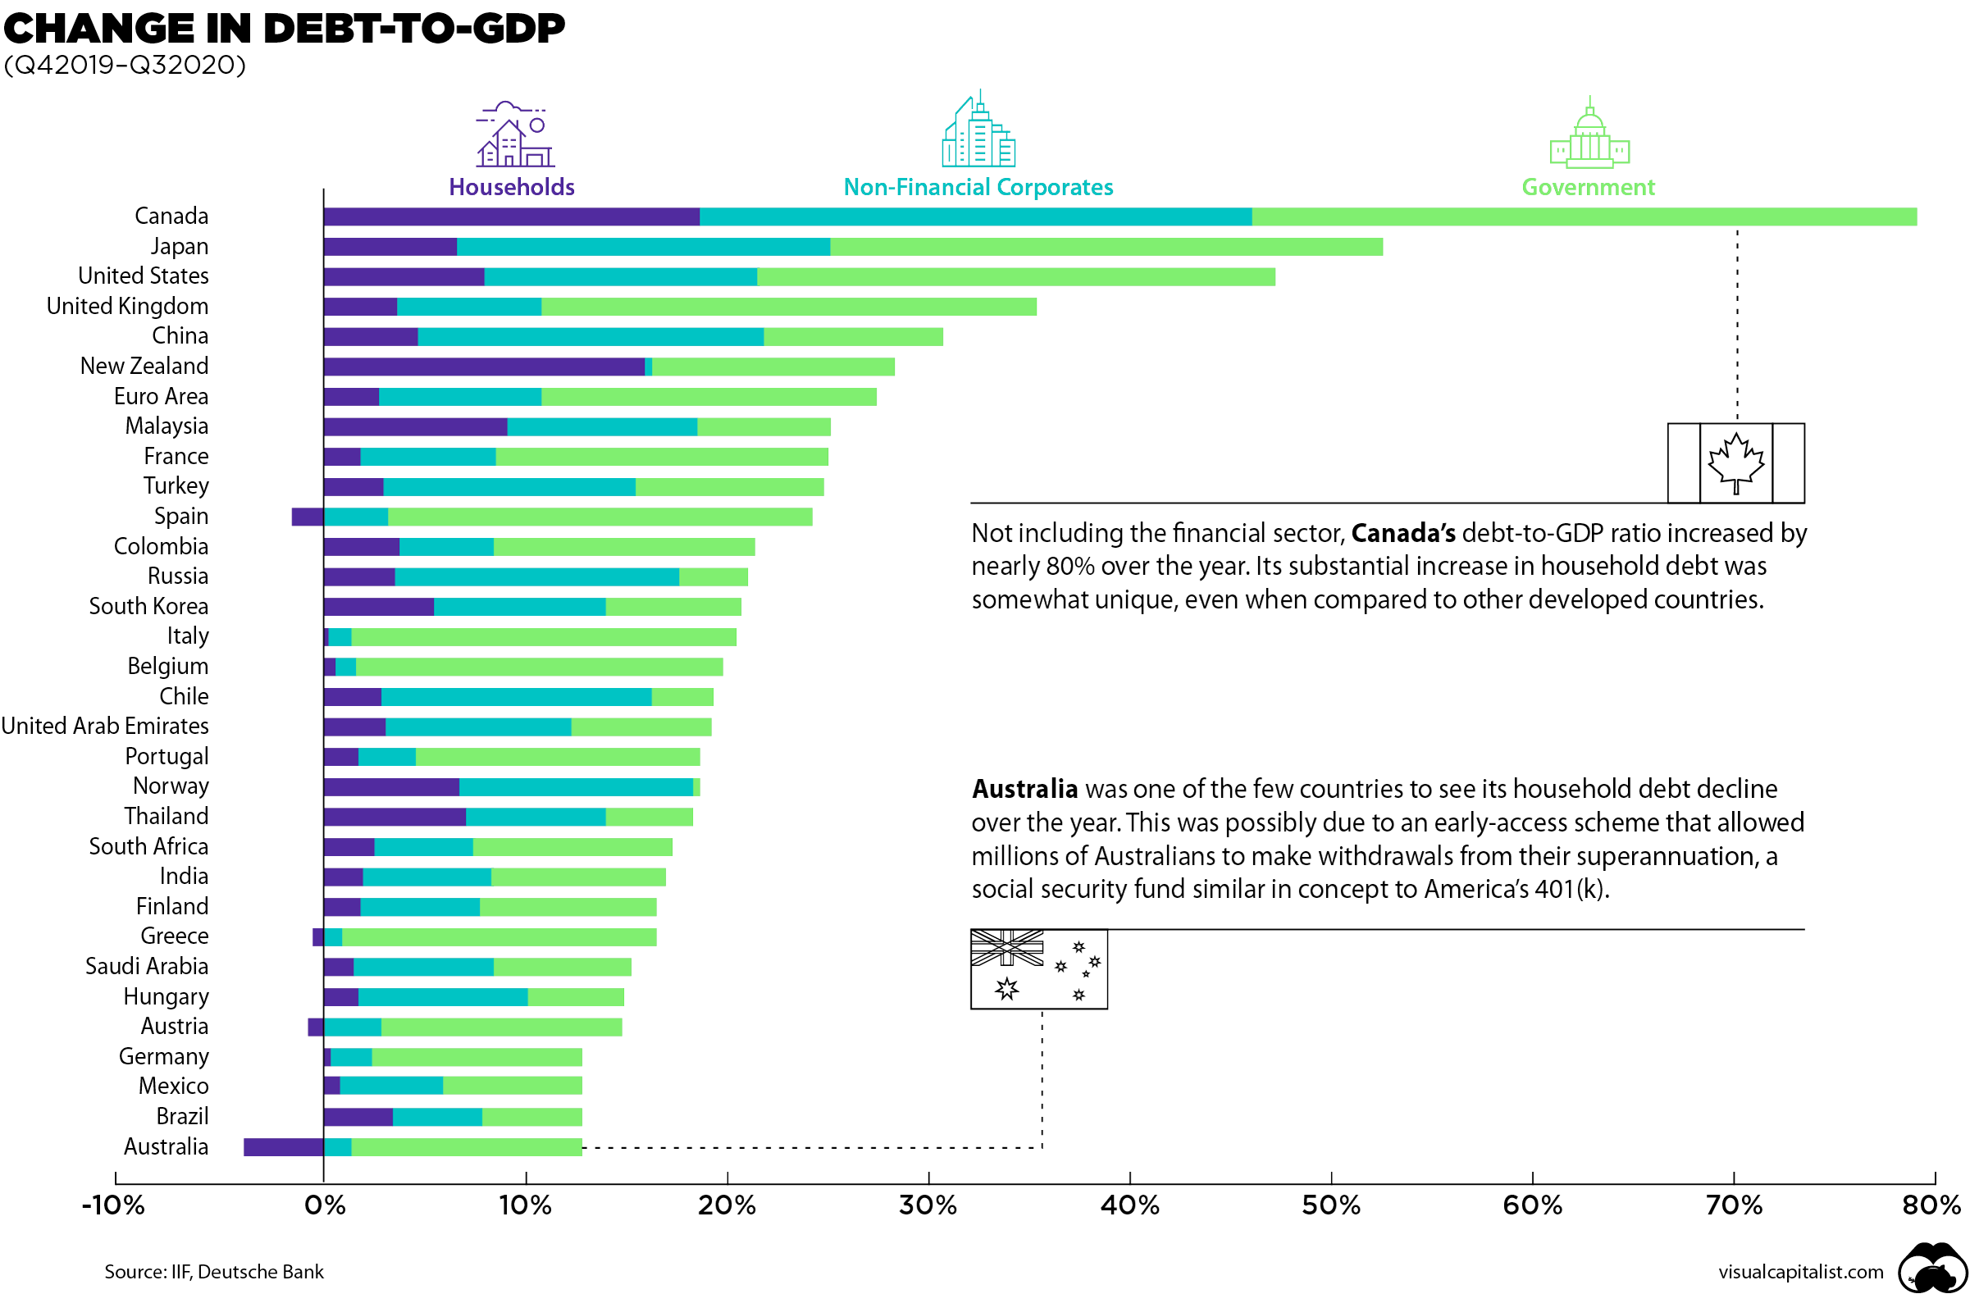
Government debt

Slide 78
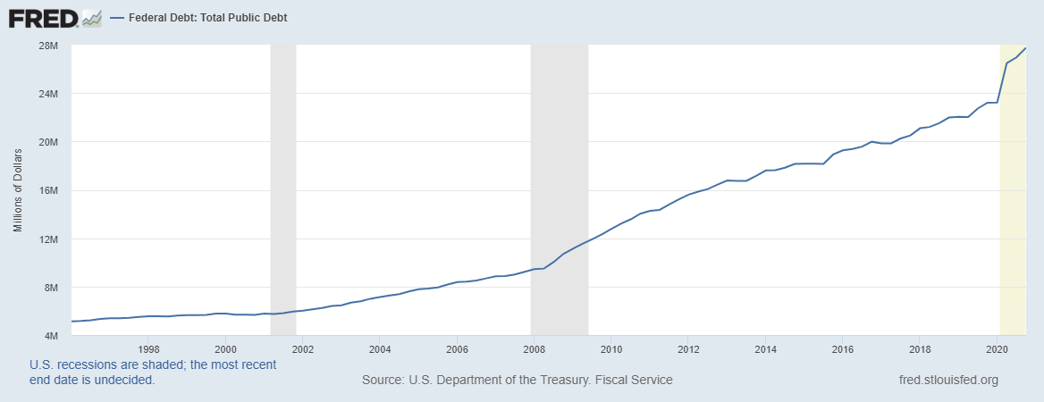
Government debt

Slide 79
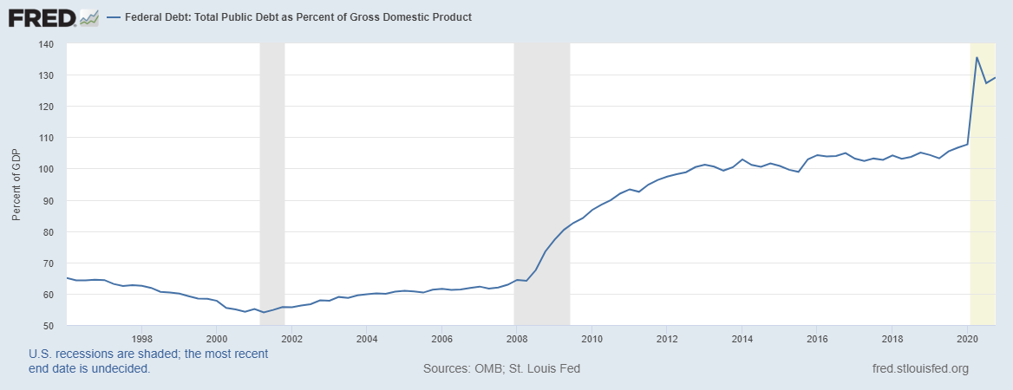
Government debt

Slide 80
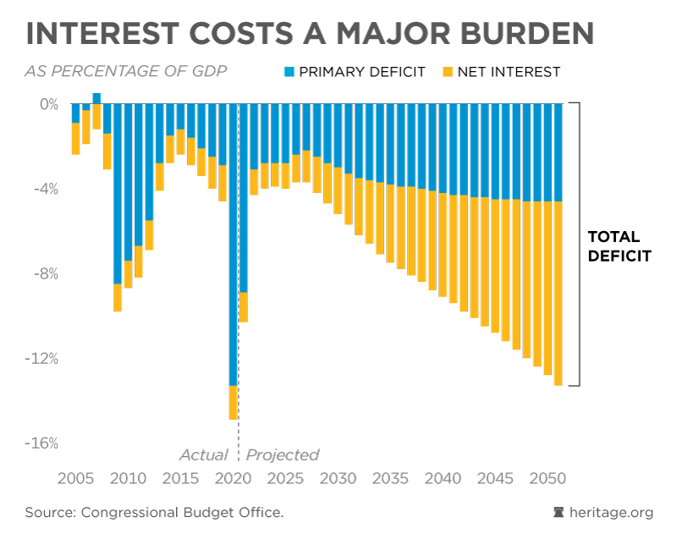
Government debt

Slide 81
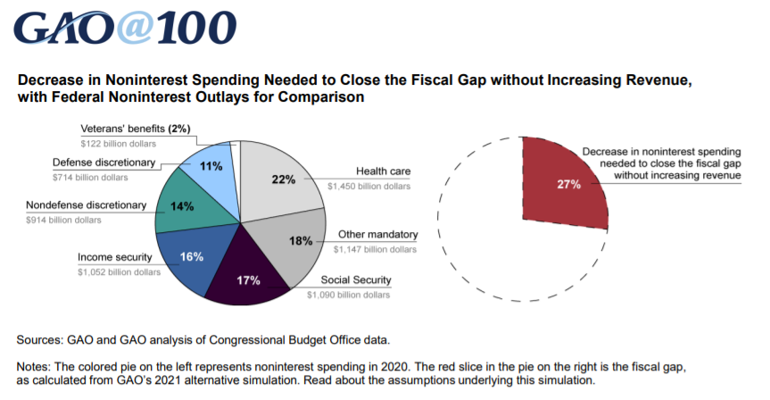
Government debt

Slide 82
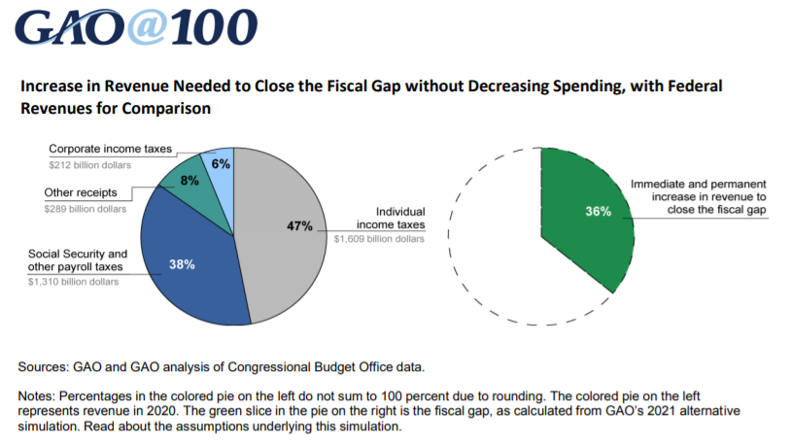
Government debt

Slide 83
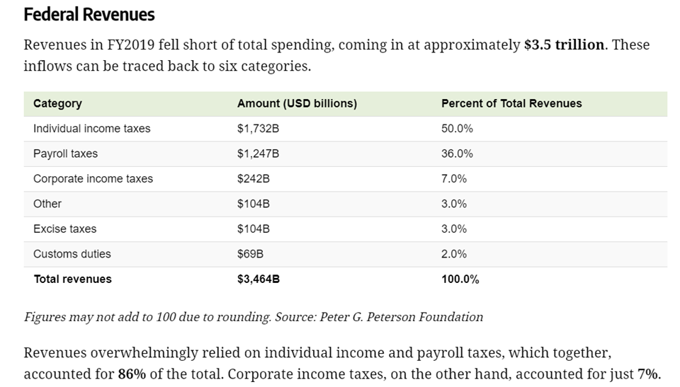
Government debt

Slide 84
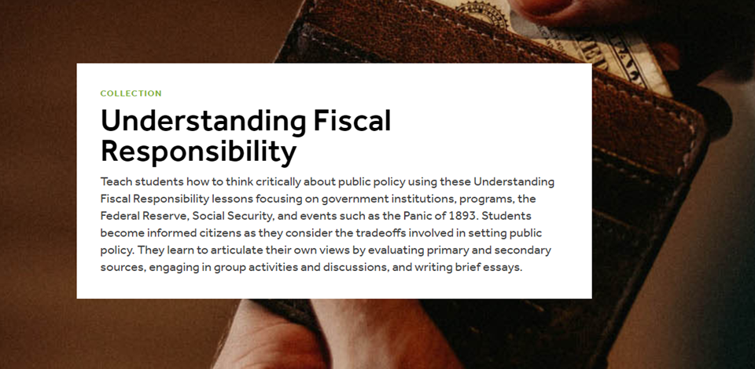
Government debt
https://www.econedlink.org/resources/collection/understanding-fiscal-responsibility/

Slide 85
Government Debt
What concerns does government debt raise?
Default and systemic collapse
Burden shifting
Growth and distributional equity
Interest rate burden on the government budget
Crowding out and growth
The role of investment
Monetization and inflation
Does the debt even matter?
Debt in context
The “new” debt theory: Modern Monetary Theory (MMT)

Slide 86
Parting Shots
Future Professional Development Sessions with NGPF:
Wed, May 19th – Using NGPF Arcade Games, 6-7pm ET
Many different ELC summer classes coming up:
June – MoneyWi$er PFL workshops
June-July – Teaching PFL in the Elementary Grades virtual class
July – Methods of Teaching PFL with Economic Reasoning
Late July-Early August – 1-day classes with NGPF and CEE

