Slide 1
Financial Fitness for Life, Chapter 17: What Does It Cost to Own A Car? Theresa Fischer ecofisch@gmail.com March 2021

Slide 2
EconEdLink Membership
You can now access CEE’s professional development webinars directly on EconEdLink.org! To receive these new professional development benefits, become an EconEdLink member. As a member, you will now be able to:
Automatically receive a professional development certificate via e-mail within 24 hours after viewing any webinar for a minimum of 45 minutes
Register for upcoming webinars with a simple one-click process
Easily download presentations, lesson plan materials and activities for each webinar
Search and view all webinars at your convenience
Save webinars to your EconEdLink dashboard for easy access to the event
You may access our new Professional Development page here

Slide 3
Professional Development Certificate
To earn your professional development certificate for this webinar, you must:
Watch a minimum of 45-minutes and you will automatically receive a professional development certificate via e-mail within 24 hours.
Accessing resources:
You can now easily download presentations, lesson plan materials, and activities for each webinar from EconEdLink.org/professional-development/

Slide 4
https://store.councilforeconed.org/

Slide 5
Agenda

Slide 6
Objectives
To compare the costs of different loans and choose the loan with the lowest cost
Demonstrate how to shop for a loan online
Explain the factors that reduce the cost of a loan
Identify costs of automobile ownership over and above the purchase price and credit cost

Slide 8
What is your ideal car?
Do you know how much it costs to buy?
Do you have this money to buy a car? Or will you have to buy it on credit?
Do you know where the best deals are for loans on a car? Why is that important?

Slide 9
To Lease or Own? Which car owner type are you…
How much in monthly payments can I make?
Is there a down payment to lease a car?
How long do I expect to own the car?
How much mileage will I make with this car?
Can I afford the repairs on this car down the road?
How important is it for you to drive a fancier car?

Slide 10
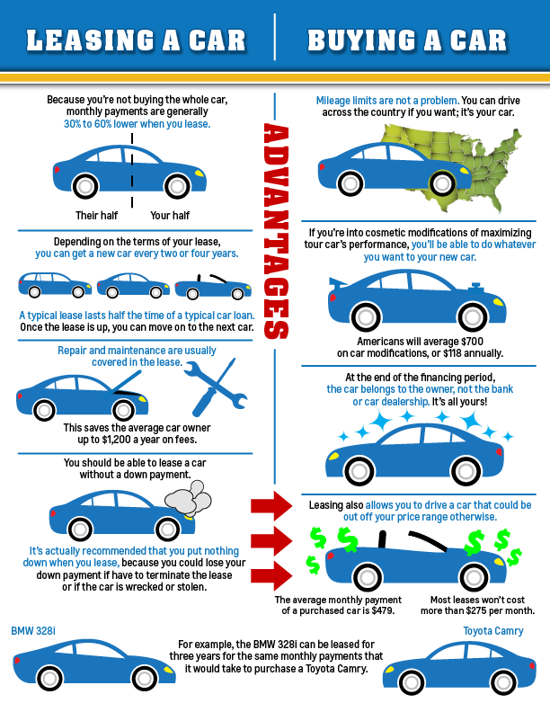

Slide 11
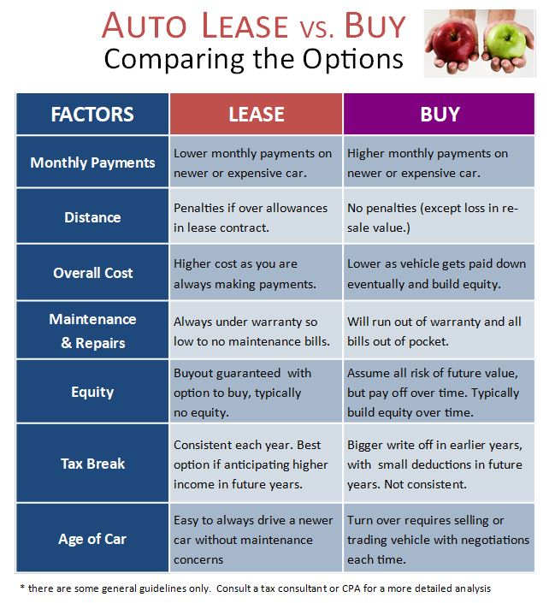

Slide 12
Should I Buy a Used Car?
What can you afford?
Where should I look for a used car?
How will I know it is in good condition?
Will my monthly payments be higher due to repairs?
I’ll need this car for……..?

Slide 13
Where can I find information about a used car?
Car Fax (online guide)
“Search Over 25 Billion Vehicle Records. Be Confident In Your Next Used Car Purchase. Search CARFAX for Used Cars, Vehicle History, Maintenance Tools, and Car Values. Get Reports Instantly. 100,000+ Data Sources.
Just put in the VIN number of the car and you can get all the info you need!”

Slide 14
Costs
https://bettermoneyhabits.bankofamerica.com/en/auto/cost-of-owning-a-car
https://www.usatoday.com/story/money/cars/2019/01/09/car-shopping-5-things-you-should-never-say-when-buying-new-vehicle/2512757002/

Slide 15
So I bought a used car…
Title and Registration
When you buy a used car from a private seller, you have to go to your state’s DMV to transfer the title and register the vehicle to your name. To do so, you’ll need to bring proof of insurance, your license and a form of payment. In total, I owed $322.89 at the DMV. Here’s the breakdown of the fees:
Registration fee: $36
Certificate of Title: $52
Highway-use tax (HUT): $142.5
Property tax: $67.39
Vehicle fee: $20
Notary fee: $5 (I had to pay this in cash)

Slide 16
2. Insurance
“This seems like an obvious expense now, but having lived in New York City, where you don’t need a car, for the past five years I’d never had to deal with car insurance as an adult (I was on my parents’ plan in high school)…”
I got a few quotes from different providers and settled on one that met my needs for $60 a month.

Slide 17
3. Gas
Again, this cost seems obvious, but gas adds up quickly. It costs me about $45 to fill up a tank, and I expect to do that twice monthly, meaning I’ll spend close to $100 a month on gas…

Slide 18
4. Maintenance
$310 a year, minimum
I already got my first oil change, which set me back $70. I’ll do this every four months, which will add up to $210 over the course of a year. I’ll also get my car inspected once a year, which costs about $100.
Besides these recurring expenses, other maintenance costs may arise, like tire rotation or fluid changes, which could tack on an extra couple hundred dollars.

Slide 19
5. Parking
$64 per ticket, plus parking meters
Currently, I’m parking on the street overnight for free, but there are times throughout the day when I have to pay a meter or an hourly rate to leave my car in a parking deck. The rates aren’t egregious but will add up over time.
Plus, there are parking tickets. I already overlooked “street cleaning,” an established time on a specific day when you can’t park in a certain area. It ended up being a $64 blunder.

Slide 20
Grand Total: $2,497
Between one-time costs like registration fees and monthly expenses like insurance and gas, I’ll spend close to $2,500 on my car this year — and that’s if I don’t rack up any more parking violations.
https://www.cnbc.com/2019/08/16/hidden-costs-of-car-ownership.html

Slide 21
When Leasing is Better
“Probably the main advantage to leasing is a lower payment,” says Jerry Love, a member of the National CPA Financial Literacy Commission.
“If you plan to keep the car only a few years — say three years max — then leasing allows you a smaller payment, and you don’t have to worry about the trade-in value.”

Slide 22
When Buying is Better
Love notes that if the dealership is offering 0% financing, and you plan on driving the car for a long time, buying is the way to go.
If the financing terms are higher, “Frequently, credit unions will have a favorable rate. And if you have an established banking relationship, you should absolutely check with them for their rate.”

Slide 23
FYI
The average new vehicle costs nearly $8,500 a year, according to a new study by AAA.

Slide 24
Assessment Questions
What is the best way to purchase a car?
How much insurance do I really need for the coverage of a car?
What is my total payments per month for the ownership of a car?
Can I afford the car of my dreams?

Slide 25
References
Financial Fitness for Life Grades 9-12 -3rd Edition-CEE
Edmunds.com
https://northeast.aaa.com
www.Bankrate.com

Slide 26
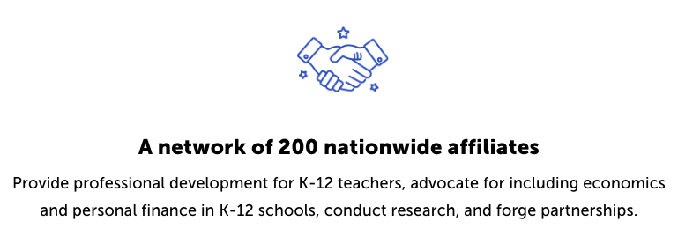
CEE Affiliates
https://www.councilforeconed.org/resources/local-affiliates/

Slide 27
Thank You to Our Sponsors!

Slide 28
We’ve gone Virtual!
Teach Economics?
Your students may have what it takes to compete in the nation’s only high school economics competition!
Why Play?
• Fun team learning experience
• Great for college applications
• No other challenge like this
• Online participation makes access easy
• Chance for cash prizes
How it Works
Teams register
Teachers enroll team(s) of 3- 4 high school students from the same school. Multiple teams allowed.
Teams compete within their state
Compete to win your state competition for a chance to advance to the National Semi-Finals.
National Semi-Finals: May 3-20, 2021
Teams answer multiple-choice questions on macroeconomics, microeconomics, and international & current events.
National Finals: May 22-24, 2021
Teams analyze an economic issue and present their solution. Top teams engage in the Finals Quiz Bowl where they face-off answering questions to claim the National Title.
Two divisions based on experience level
David Ricardo for first-time competitors who have taken no more than one economics course.
Adam Smith for returning competitors, AP, International Baccalaureate, and honors students.
Register Today at NationalEconomicsChallenge.org

Slide 29
FIND YOUR LOCAL COMPETITION AND REGISTER TODAY!
The National Personal Finance Challenge is a competition that provides high school students with an exciting and motivating opportunity to build, apply, and demonstrate their knowledge of money management.
Through online exams and a personal finance simulation, teams showcase their expertise in earning income, buying goods and services, saving, using credit, investing, as well as protecting and insuring.
Teams of up to four students, with one teacher/coach, can qualify to represent their state at the National Personal Finance Challenge by winning their local competition.
NATIONALS
Semi-Finals: First round elimination via online multiple-choice questions.
Finals: Case study round virtually co-hosted by the Cleveland Fed on June 3.
personalfinancechallenge.org

Slide 30
The 2021 Sloan Teaching Champion Award
Winners receive:
A cash award of $5,000
A cash award of $2,500 for their school to support economic education
Recognition at our annual Visionary Awards convening.
This award promotes economic education by honoring three outstanding teachers who incorporate exemplary teaching techniques that improve their students’ economic understanding in and out of the classroom.
This award is open to New York metropolitan area high school teachers of all subjects, not just teachers of economics. Applicants must demonstrate how they integrate economics into their teaching.
Sound like you or someone you know?
Applicants must teach in one of the
Twelve New York state counties (New York, Kings, Bronx, Richmond, Queens, Nassau, Suffolk, Westchester, Putnam, Rockland, Orange and Dutchess)
Eight New Jersey counties (Bergen, Passaic, Essex, Hudson, Middlesex, Union, Morris, Monmouth), or the
Two Connecticut counties (Fairfield and New Haven)
Application will be launched on Friday February 19th 2021
You can access the application here.
CONTACT
Please feel free to e-mail us at rrivera@councilforeconed.org
with any questions you have.

