Slide 1
NCCEE
Presents: “Using Podcasts to Teach Economics” Stephanie Cales stephanie.cales@nccee.org

Slide 2
NCCEE
Who We Are

Slide 3
Objectives
Teachers will be able to:
Identify podcasts with economics themed content.
Design unique learning opportunitites using podcasts in the classroom.

Slide 4
Agenda
Why should I use podcasts in the classroom?
How to tell a “good” podcast from a “bad” podcast
How to use podcasts in the classroom
Economics podcasts to explore
Standards

Slide 5
What kind of podcasts do you already listen to?

Slide 6
How NCCEE has used podcasts

Slide 7
Why should I use podcasts in the classroom?

Slide 8
Why should I use podcasts in the classroom?
Listening Skills
Active listening skills
Reflective thinking

Slide 9
Why should I use podcasts in the classroom?
Variety
Current statistics show there are more than 1 million active podcasts and more than 30 million podcast episodes
Students learn differently

Slide 10
Why should I use podcasts in the classroom?
Student independence
Choice in podcasts
Choice in when/where/how to listen

Slide 11
Why should I use podcasts in the classroom?
Accessibility
Free to you and your students
Almost everyone has access to them already

Slide 12
How to tell a “good” podcast from a “bad” podcast

Slide 13
“Good” vs “bad” podcast
Focus on topic
Episode description
Do I have to spend 30 minutes waiting to get to the point?

Slide 14
“Good” vs “bad” podcast
Show structure
Is it short enough to use with students?
OR can it be clipped to only use the segment I want?

Slide 15
“Good” vs “bad” podcast
Quality of content
Who is producing it?
Who is speaking on the topics?

Slide 16
“Good” vs “bad” podcast
Political neutrality
Either presents information in an unbiased manner OR presents both sides equally

Slide 17
How to use podcasts in the classroom

Slide 18
How to use podcasts in the classroom
4 main avenues
Individual/ independent listening
Group discussions/listen in small groups
Whole class
Projects

Slide 19
How to use podcasts in the classroom
Bellringers/discussion
Podcasts shorter than 10 minutes
Clips from longer podcasts
Homework
Projects

Slide 20
Economics podcasts to explore

Slide 21
How/where to find podcasts
Apple podcasts
Google podcasts
Spotify
Web presence

Slide 22
Daily updates
Marketplace
The Economist
The Indicator from Planet Money
Wall Street Journal, New York Times, NPR

Slide 23
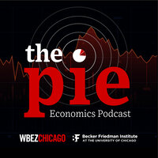
1. The Pie
WBEZ Chicago and Becker Friedman Institute
Hosts talk with economists from University of Chicago and other economics experts about current events and how they relate to the economic pie
20-minute episodes

Slide 24
1. The Pie
Episode highlight
“The Surprising Results of Pandemic Unemployment Benefits”
National standard 2: Decision Making
National standard 4: Incentives
National standard 16: Role of Government
National standard 19: Unemployment & inflation

Slide 25
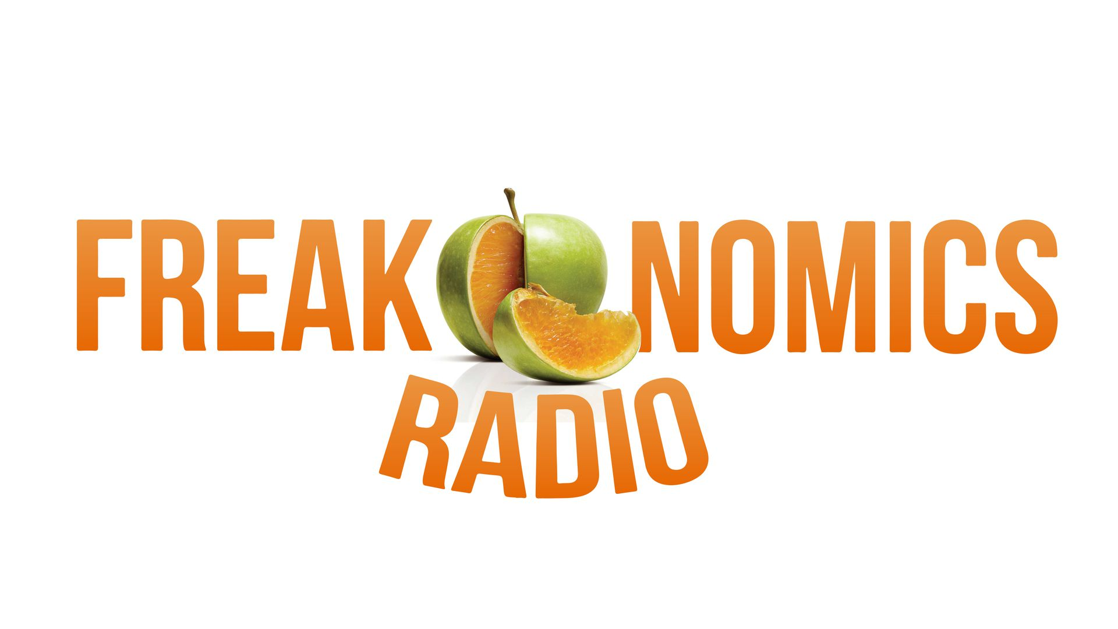
2. Freakonomics
Stephen J. Dubner, author of both Freakonomics books, speaks with a variety of guests about real-world economics

Slide 26
2. Freakonomics
Episode Highlight
“Why Uber Is an Economist’s Dream”
National standard 7: Markets and Prices
National standard 8: Role of Prices
National standard 9: Competition and Market Structure

Slide 27
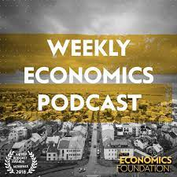
3. Weekly Economics Podcast
Comes from the New Economics Foundation
Discuss the economic forces shaping our world
30–40-minute episodes on average

Slide 28
3. Weekly Economics Podcast
Episode highlight
“The Rise of the Data Oligarchs”
National standards 9: Competition and Market Structure
National standard 10: Institutions
National standard 16: Role of Government and Market Failure

Slide 29
4. Planet Money
NPR podcast explaining the economy
20- 30-minute episodes on average

Slide 30
4. Planet Money
Episode highlight
Summer School 1-9
“Economics education you always dreamed of, but never quite got around to.”
Standards

Slide 31
Closing and Questions

Slide 32
Sources
https://www.teachcreatemotivate.com/using-podcasts-in-the-classroom/
https://blog.edpuzzle.com/edtech/podcasts-in-the-classroom/
https://musicoomph.com/podcast-statistics/
https://artsintegration.com/2019/05/31/podcasting-in-the-classroom/
https://www.podcastmotor.com/what-separates-a-great-podcast-from-a-mediocre-one/
https://learn.g2.com/what-makes-a-good-podcast
https://medium.com/@AlexCartaz/what-makes-a-podcast-good-part-1-c2145de5f51f
https://bfi.uchicago.edu/podcast/the-pie/
https://www.npr.org/2020/07/15/884827691/planet-money-summer-school

