Slide 1
WELCOME
Housekeeping Items
Please use the chat function to ask questions or to notify moderator of issues
Session will be recorded and emailed to participants following the webinar
Attendance certificates can be accessed following webinar
The webinar will begin shortly

Slide 2
How to Teach Entrepreneurship Online
Curriculum Written By: Martha Rush
Live Webinar: March 3, 2021

Slide 3
MINNESOTA COUNCIL ON ECONOMIC EDUCATION (MCEE)
Our Vision
To equip all Minnesotans with the economic and personal financial understanding needed to succeed in today's complex economy.
Teaching Teachers, Engaging Students, and Reaching Communities
mcee.umn.edu | mcee@umn.edu | 612.625.3727

Slide 4
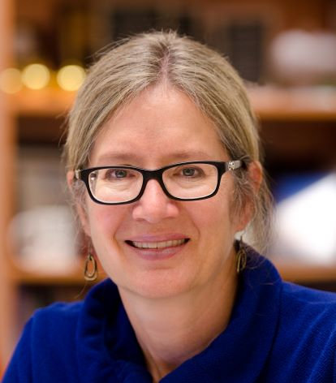
Instructor Bio
Picture if you want
Martha Rush teaches AP Micro, AP Macro and AP Psych at Mounds View High
School, where she has taught since 1997.
She has coached six teams to the National Economics Challenge (they have
won twice) and three teams to the National Personal Finance Challenge (no wins!).
In addition to working as an MCEE master teacher, Martha is the lead College Board consultant for AP Microeconomics and serves on the AP Micro Test Development Committee.
She has also contributed to AP Econ textbooks and teacher materials produced by Cengage, McGraw-Hill and Bedford Fellows Worth, and she is currently serving on the Minnesota Social Studies Standards Review Committee.

Slide 5
Webinar Objectives
Introduce you to online resources for teaching/fostering entrepreneurship
Experience entrepreneurship lessons
Encourage you to learn more about teaching entrepreneurship -- online or FTF!

Slide 6
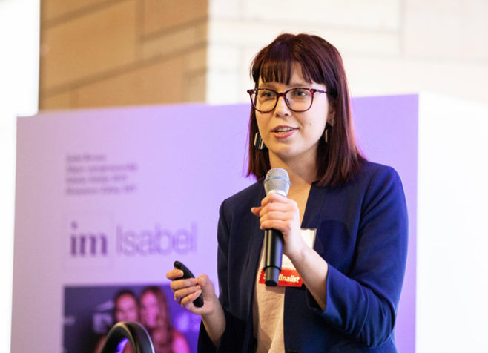
My philosophy for teaching entrepreneurship
Students learn more when they become entrepreneurs, when they actually identify problems, ideate solutions, talk to customers, pitch to investors and bring products to market.
This is not a class “about entrepreneurship” -- it’s an opportunity to experience entrepreneurship.

Slide 7
Why is this important?
“I was very shy, very nervous when I first started. My voice would shake, and I didn’t know what to do with my hands. .. Now I will pitch you anything, and I’m willing to talk to anyone about anything. Becoming more self-confident was one of my biggest successes.”
– Amy Helgeson

Slide 8
Why is this important?
“I feel like entrepreneurship is the best way to actually make a change or a difference in the world.”
- Aryan Sehgal

Slide 9
Why is this important?
“A lot of times you think entrepreneurship is just for people who are business-minded. But that’s not necessarily true. You need a lot of different skill sets.”
- Nandini Avula

Slide 10
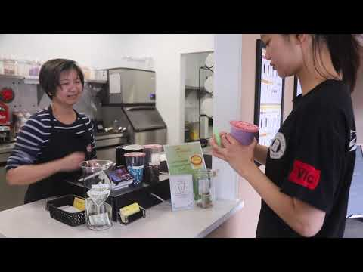
A student-run venture

Slide 11
Resources
Quarter Zero Handbook (*FREE)
Startup Sim
Teen Startup Trainers
https://www.quarterzero.com/handbook/
https://startupsim.glacierpeak.io/#/
Notes:
Sign into Glacier Peak with martharush67

Slide 12
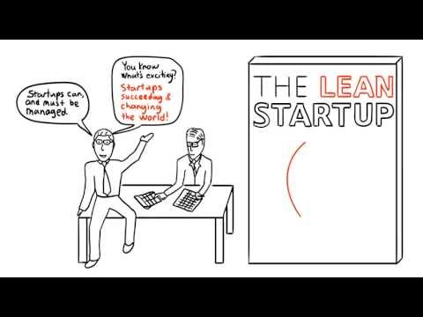
The Lean Startup Process

Slide 13
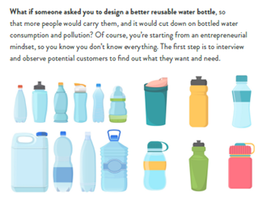
Lean Startup for Students
1
Design Thinking
2
Problem Discovery
3
Customer Interviews

Slide 14
Lean Startup for Students
4
Team Building
5
Solution Ideation
6
Market Testing

Slide 15
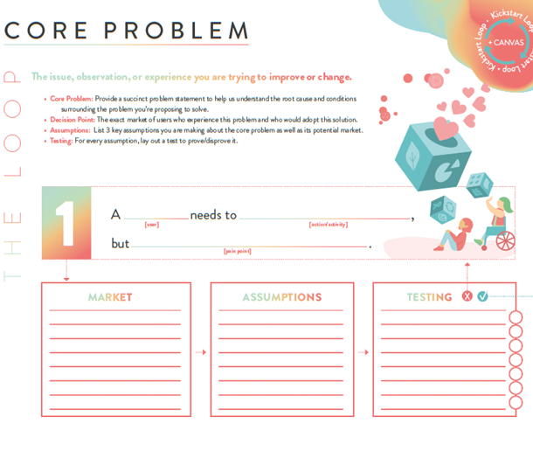
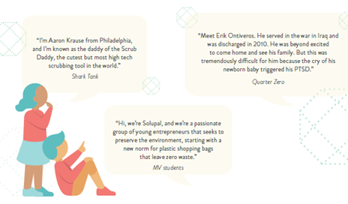
Lean Startup for Students
7
Sales
8
Business Plan
9
Pitch Presentation

Slide 16
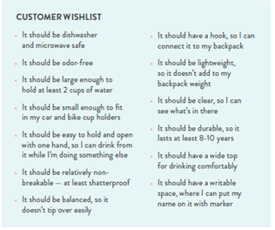
Design Thinking & Design Challenges
http://bit.ly/H20chall
Use in small groups/breakout rooms
Lots of options/resources
Handbook, pp. 22-24

Slide 17
Problem Discovery
https://startupsim.glacierpeak.io/#/
SG1-499
Practice problem discovery
Also works through the entire process
What problems do we find?

Slide 18
Problem Discovery
Strategies:
#1 Keep a list
#2 Listen to (and observe) other people
#3 Interview other people
#4 Narrow the list
Pp 28-31 of the handbook

Slide 19
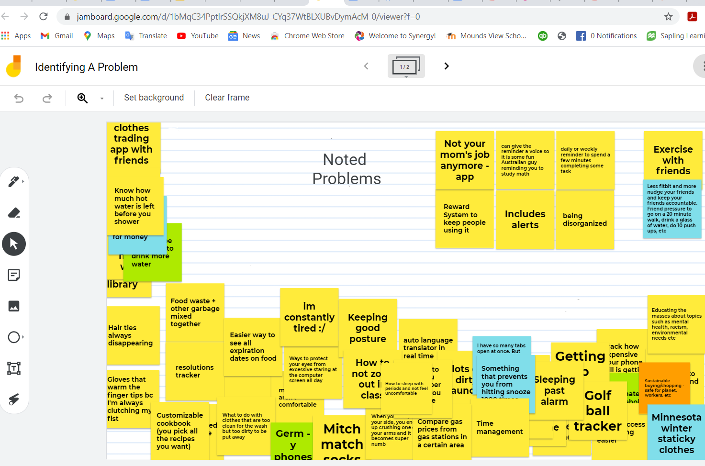
Problem Discovery
Post ideas
Ask questions/discuss
Dot voting
Problem Validation
http://bit.ly/Problem0111

Slide 20
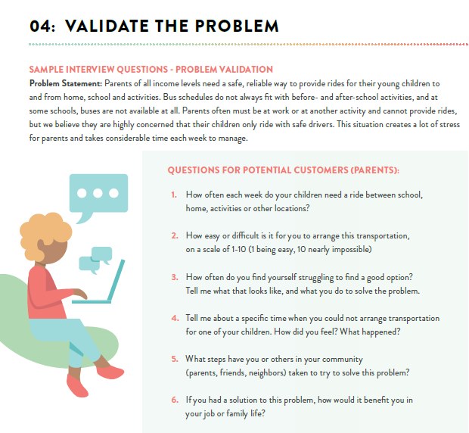
Customer Interviews
Develop interview questions
Create a customer profile -- so you interview the right people
Handbook, pp. 37-43

Slide 21
Problems students have identified
Plastic waste
Food waste
Communication problems
Procrastination
Laziness
Challenge of drawing diagrams with online notes

Slide 22
Why do they need to go to market?
The real experience is where the learning happens
Do customers really want your product?
Will they pay for it?
How can you get it made?
How can you get it from production to customers?
Is it scale-able?
Is your product unique in the market?
http://bit.ly/3p3XKHo

Slide 23
Pitch Example

Slide 24
Questions?

Slide 25
Thank You
Martha Rush | Martha.Rush@moundsviewschools.org
mcee.umn.edu | mcee@umn.edu | 612.625.3727

