Slide 1
AP Macroeconomics Bootcamp
Fiscal Policy, the Federal Reserve, Trade & Exchange
Tawni Ferrarini
February 2021 tferrarini@lindenwood.edu tawni.org

Slide 2
Session 1
Monetary Policy Matters
1-1:50

Slide 3
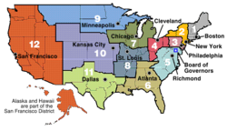
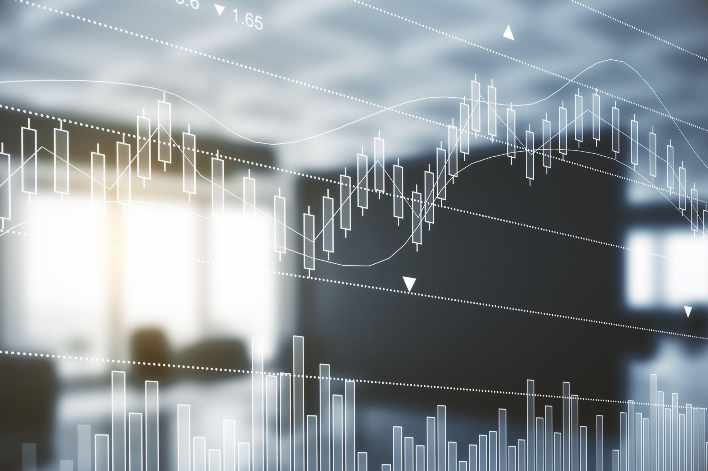
Monetary Policy Matters
This Photo by Unknown Author is licensed under CC BY-SA
Imagine a world without stable money. How would you complete transactions? Measure the value of the goods, services, and resources in your and others’ possession? Store value for the future?

Slide 4

Macro courses require…
1. Define the three functions of money.
2. Define assets and order them based on degrees of liquidity.
3. Identify an example of money as commodity money or fiat money.
4. Differentiate between various money aggregates.
5. Present the organizational structure of the Fed.
6. Explain how open market operations impact the money supply.
7. Examine the role of monetary policy in influencing an economy.
8. Calculate how much money fractional reserve banking can create in different scenarios.
9. Determine the impact of a change in reserve requirements on the money supply.
10. Given data on a bank's balance sheets, evaluate the bank's reserve situation.
11. Calculate the value of the money multiplier using the reserve ratio.
12. Given a bank's balance sheet, calculate the leverage ratio.
13. Explain how the discount rate impacts the money supply.
14. Describe the Current Central Banking Framework: Monetary Policy with Ample Reserves.

Slide 5
Segment
Objectives
Define the three functions of money.
Define assets and order them based on degrees of liquidity.
Identify an example of money as commodity money or fiat money.
Differentiate between various money aggregates.
Present the organizational structure of the Fed.
Examine the role of monetary policy in influencing an economy.

Slide 6

Which statistic is used by economists to track changes in real income per person?
GDP deflator
Current GDP
Consumer Price Index
Real GDP per capita
Personal Consumption Expenditures Index

Slide 7
Which statistic is used by economists to track changes in real income per person?
GDP deflator
Current GDP
Consumer Price Index
Real GDP per capita
Personal Consumption Expenditures Index

Slide 8
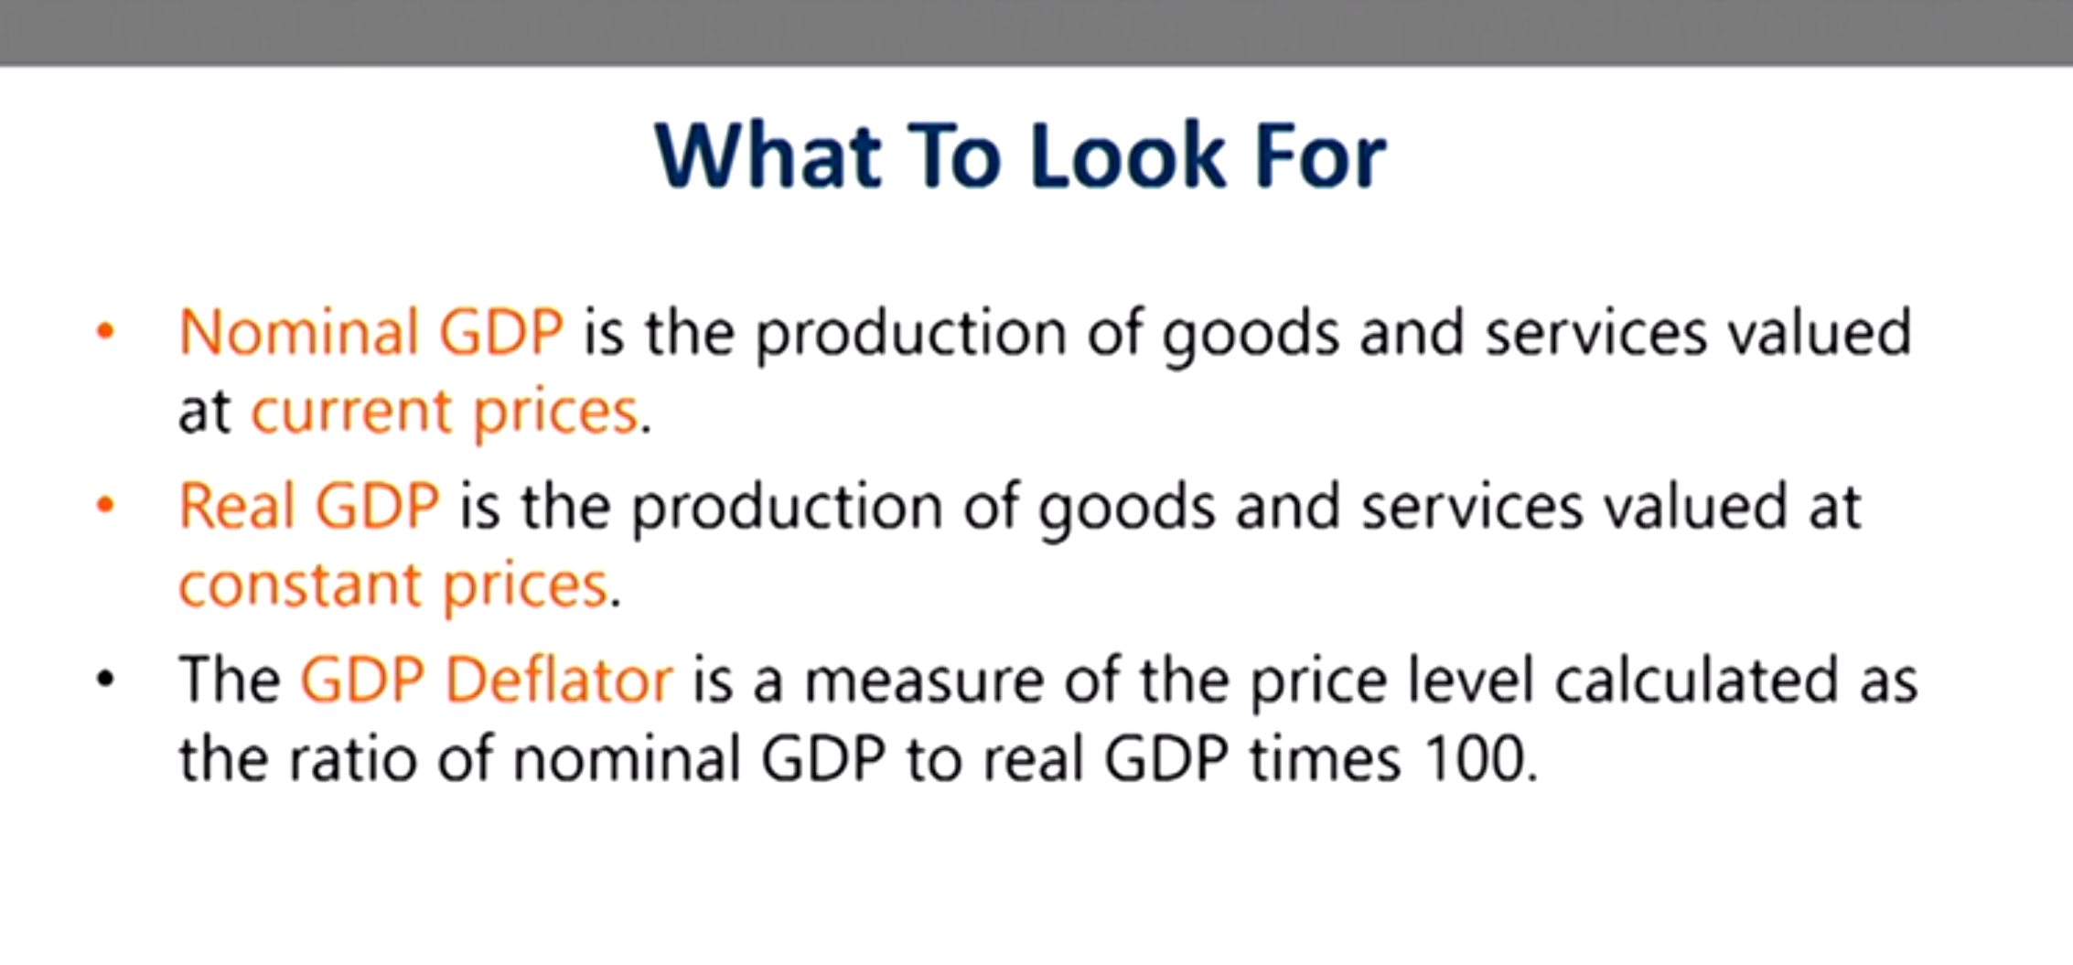
Quick review: NGDP, RGDP, GDP Deflator and other price indexes
C + Ig + G + NX (nominal or current dollars)
C + Ig + G + NX (prices are constant, base year, or chained weighted dollars)
GDP Deflator is (NGDP/RGDP)*100
Other price indexes:
Consumer Price Index (CPI)
Producer Price Index (PPI)
Personal Consumption Expenditures Index (PCEI)

Slide 9


Suppose you are going to lend $1000 to someone in this class. Which provided the optimal return in one year?
A basket of groceries of the borrowers choosing
A nominal return of 10 percent
A basket of items selected by your federal congress people
A real return of 10 percent
Nothing

Slide 10
Suppose you are going to lend $1000 to someone in this class, which provided the optimal return in one year?
A basket of groceries of the borrowers choosing
A nominal return of 10 percent
A basket of items selected by your federal congress people
A real return of 10 percent
Nothing

Slide 11
Connections to Money
Why do your students value money?
How can you connect them to money earned through future interest payments?

Slide 12

Money, money, money…
Anything that serves three functions is money:
Medium of exchange
Unit of account
Store of value

Slide 13
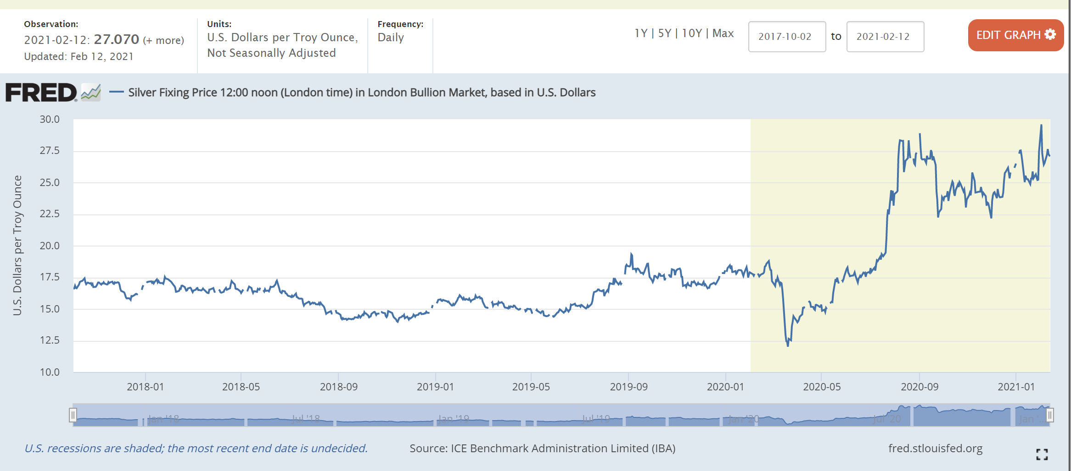
Money, Money, Money…
Does silver serve these three functions serves as money?
Medium of exchange
Unit of account
Store of value

Slide 14
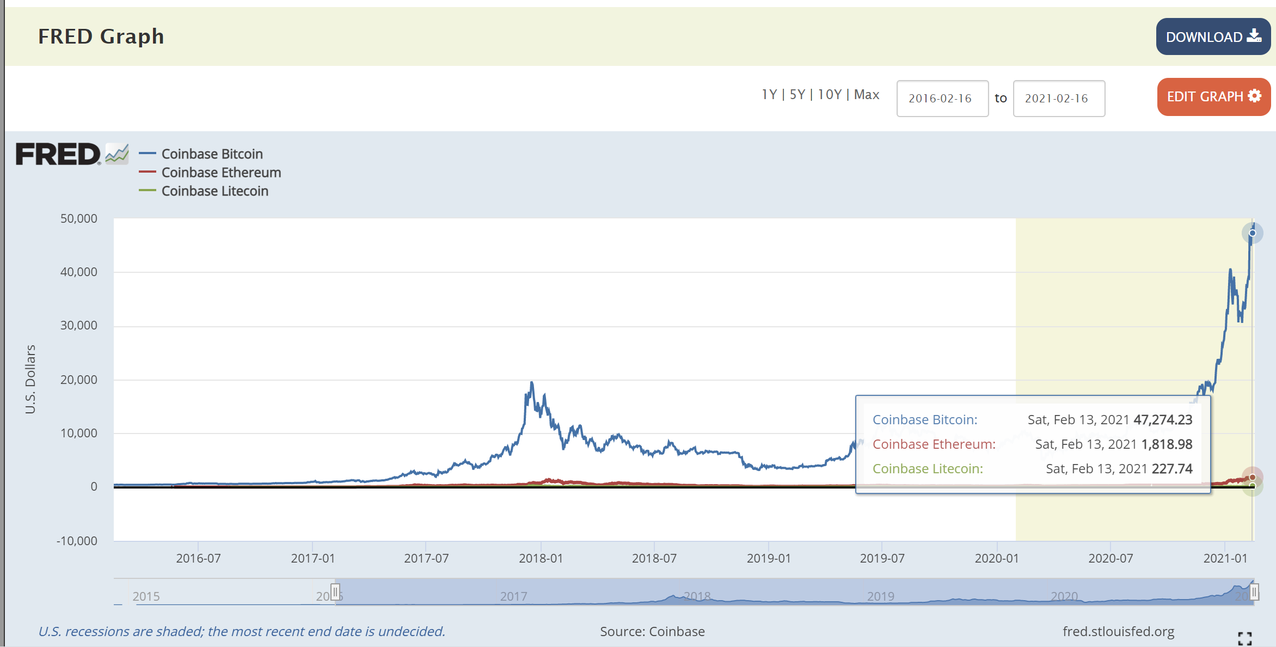
Money, Money, Money…
Does crypto currency serve these three functions serves as money?
Medium of exchange
Unit of account
Store of value

Slide 15
No…
Silver and gold (which once backed commodity money) and cryptocurrencies do not serve in these capacities consistently over time.

Slide 16
We are all about assets and their varying degrees of liquidity…
Economics highlights that, in a world of scarcity people face trade-offs. The trade-off that is most relevant for understanding financial decisions is the trade-off between risk and return.
An asset gets its value from a contractual right or ownership claim that is protected. Cash, stocks, bonds, mutual funds, and bank deposits are all are examples of financial assets. These are non-tangible assets. They will be our focus.
Liquidity is the ease with which an asset can be converted into the economy’s medium of exchange.
These vary with respect to liquidity, risks and returns…

Slide 17
Liquidity and Money
Money is the most liquid asset. It can immediately be used to make purchases because the people who use it have faith in it, and its ability to serve the three functions.
Fiat money or Commodity money
  There is no precious metal backing fiat money. It is money by government decree.
  It is legal tender whose value is backed by the issuing government.
  There is no physical good like gold or silver backing fiat money.
  It is not commodity money.
The most important aspect of a currency is the relative stability of its value.

Slide 18
Explain which you’d rather have, if presented the option today…
$1000 USDs
$1000 in gold
(~$1818 USD per ounce on 02/15/21)
Medium of exchange
Store of value
Unit of account
Medium of exchange
Store of value
Unit of account

Slide 19
Explain which you’d rather have, if presented the option today.
$1000 USDs
$1000 in gold
(~$1818 USD per ounce on 02/15/21)
Medium of exchange
Store of value
Unit of account
Medium of exchange
Store of value
Unit of account

Slide 20
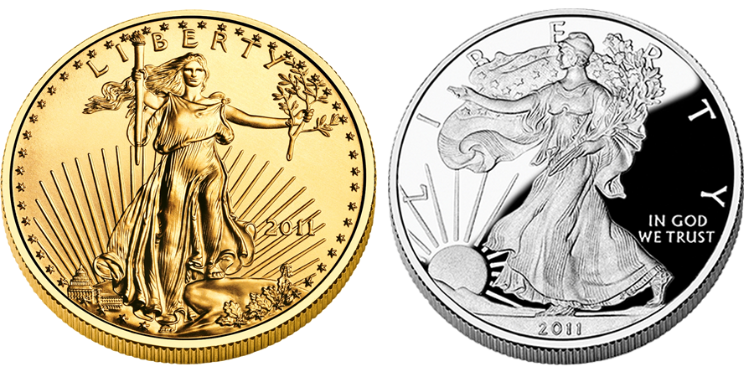
Commodity Money
  There is a precious metal backing commodity money. It is historically gold and/or silver.
  In the U.S. a person could exchange U.S. currency -- as well as many public and even some private debts -- for gold as late as 1971.
The most important aspect of a currency is the relative stability of its value.
This Photo by Unknown Author is licensed under CC BY-NC-ND

Slide 21
Liquidity and Money
Money is the most liquid asset. It can immediately be used to make purchases.
Savings in a depository institution is the next most liquid asset. In exchange for business interest payments, savers agree to maintain balances, limited their total number of withdrawals, and so forth.
Saving is an essential component of building wealth.
Wealth, also called net worth, is the total value of a person's assets, such as liquid assets (cash or something you can easily turn into cash), real estate, businesses, and cars, minus any liabilities (money owed; debt).

Slide 22
Connecting your savings to others’ investments
Disposable income in households is used for consumption (C) and savings (Sp).
Write this down twice.
Savings can be put to work in the fractional reserve banking system.

Slide 23
Monetary Aggregate M1 – Most Liquid
Monetary funds readily accessible for spending.
M1 stock consists of:
currency outside the U.S. Treasury, Federal Reserve Banks, and the vaults of depository institutions;
traveler's checks of nonbank issuers;
demand deposits; and
other checkable deposits (OCDs)
Board of Governors of the Federal Reserve System (US), M1 Money Stock [M1], retrieved from FRED, Federal Reserve Bank of St. Louis; https://fred.stlouisfed.org/series/M1, February 15, 2021.

Slide 24
M2 (includes M1 and…)
M2 includes M1 plus:
savings deposits (which include money market deposit accounts, or MMDAs);
small-denomination time deposits (time deposits in amounts of less than $100,000); and
balances in retail money market mutual funds (MMMFs).

Slide 25
Other important monetary aggregates mentioned in the news
M3 = M2 plus + all other CDs (large time deposits, institutional money market mutual fund balances), deposits of eurodollars and repurchase agreements.
Currency consists of Federal Reserve notes and coin outside the U.S. Treasury and Federal Reserve Banks.
Reserve balances are balances held by depository institutions in master accounts and excess balance accounts at Federal Reserve Banks.
Monetary base equals currency in circulation plus reserve balances.
Total reserves equal reserve balances plus, before April 2020, vault cash used to satisfy reserve requirements.

Slide 26
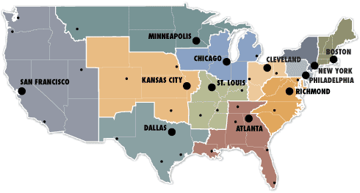
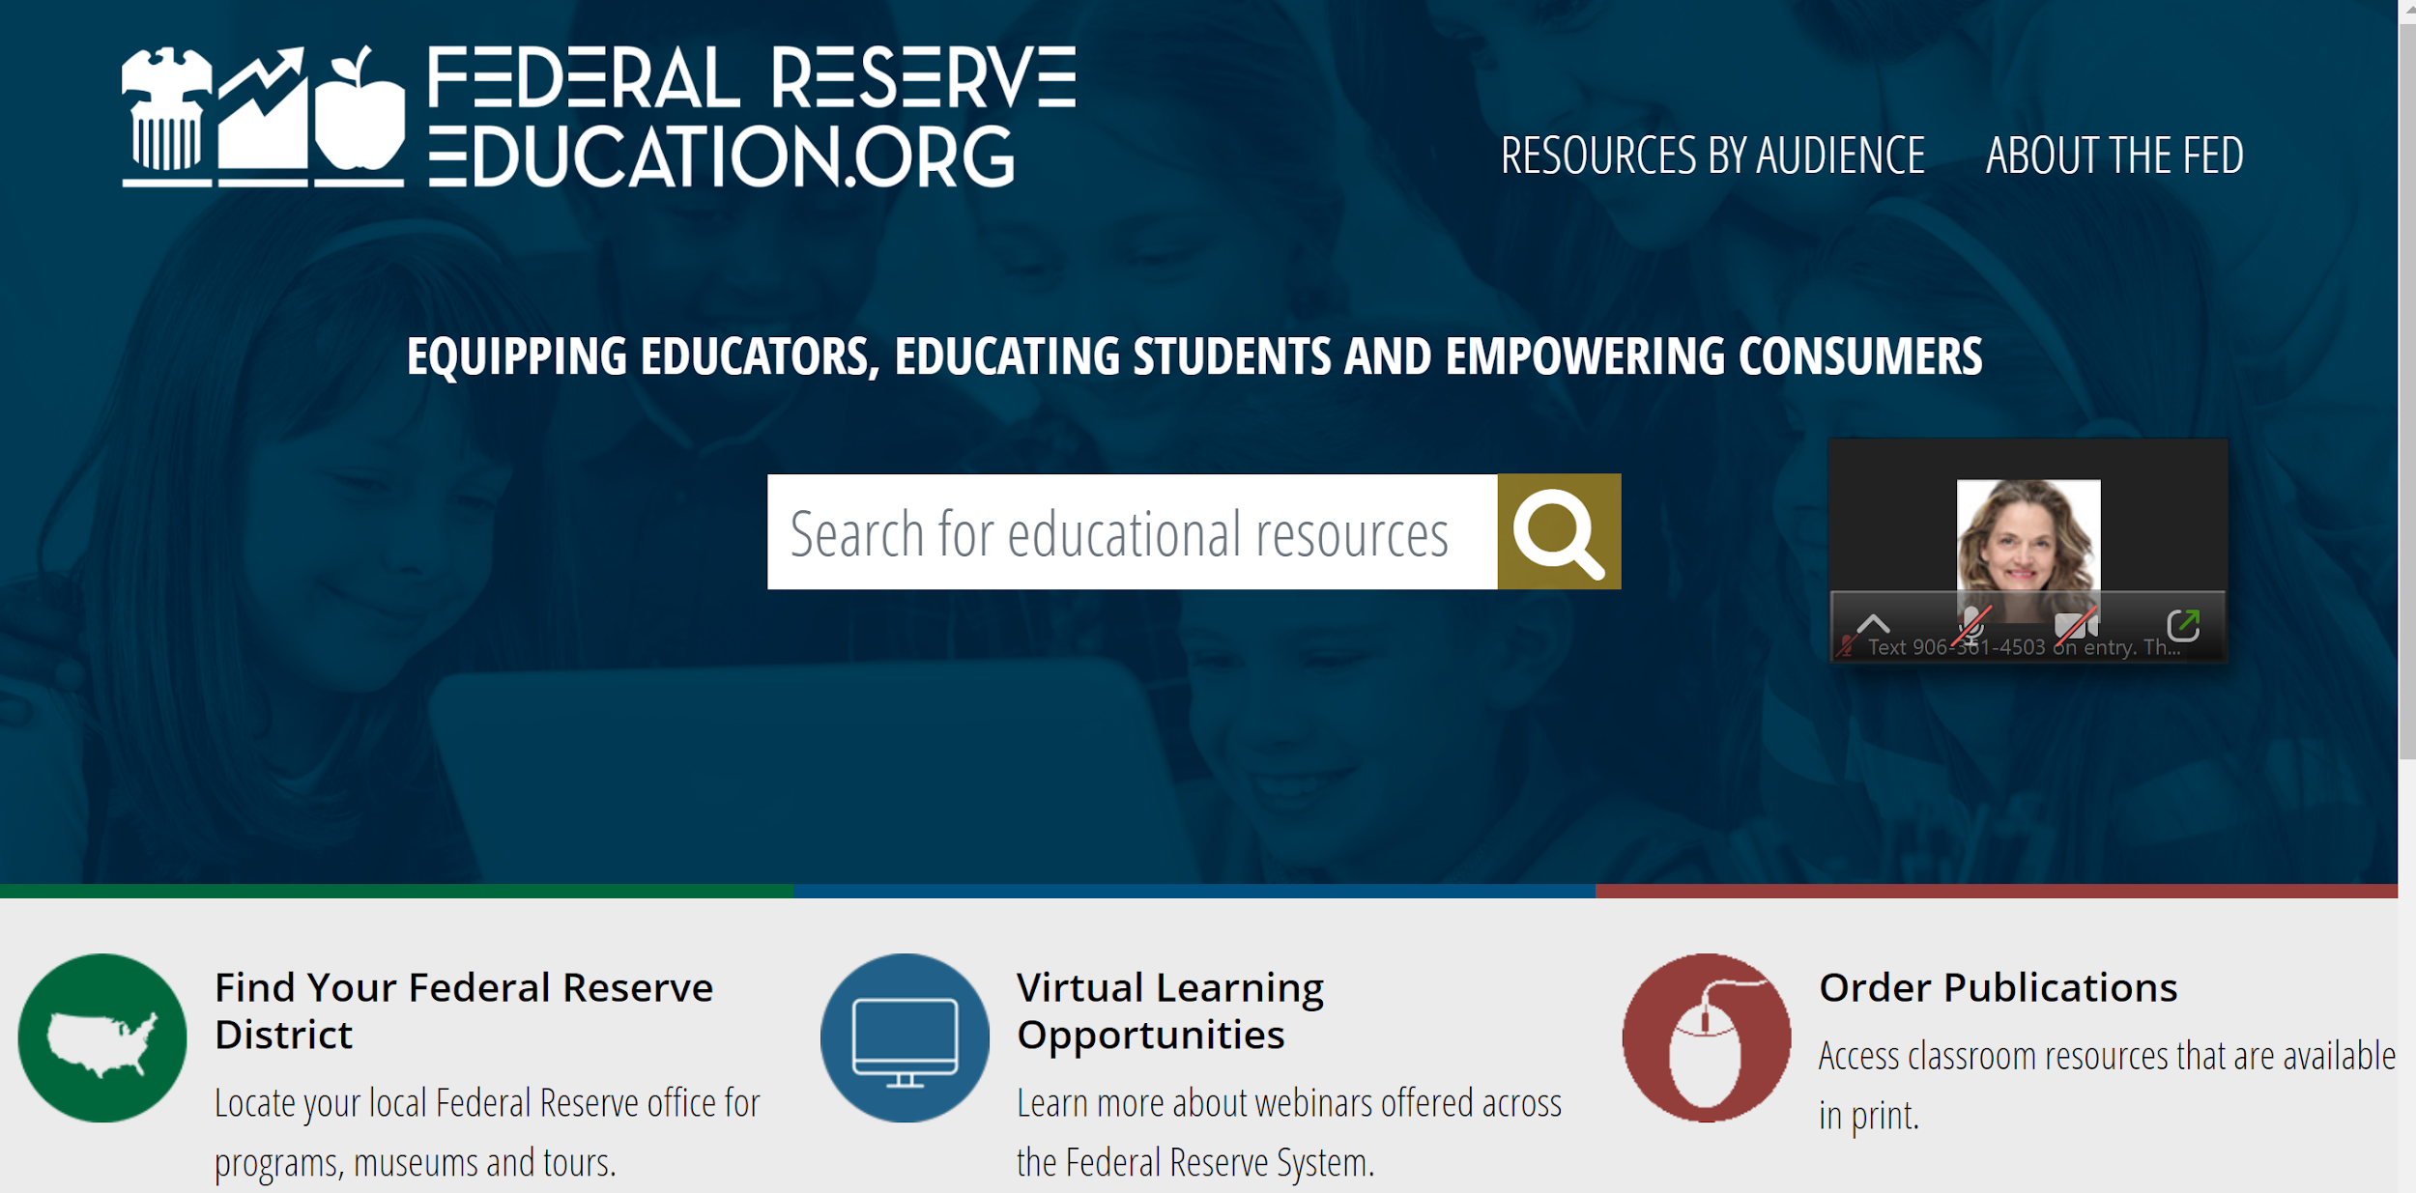
A quasi-public institution made up decentralized banks

Slide 27
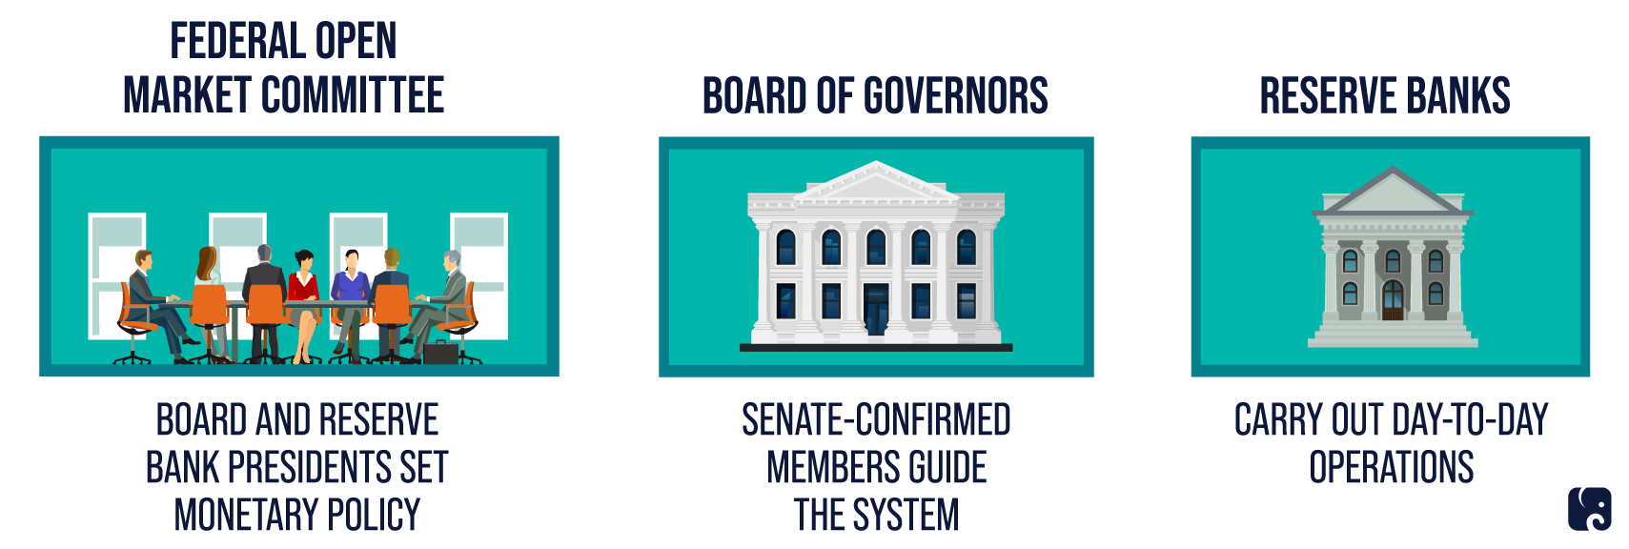
FOMC, Board of Governors and Reserve Banks

Slide 28
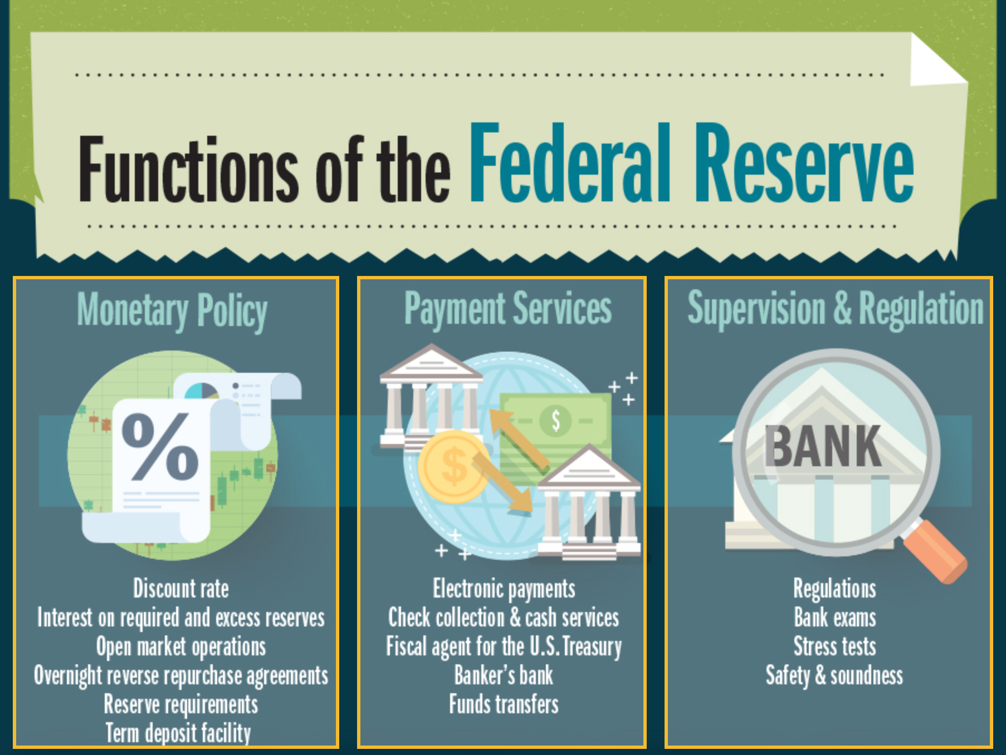
3 Main Functions

Slide 29
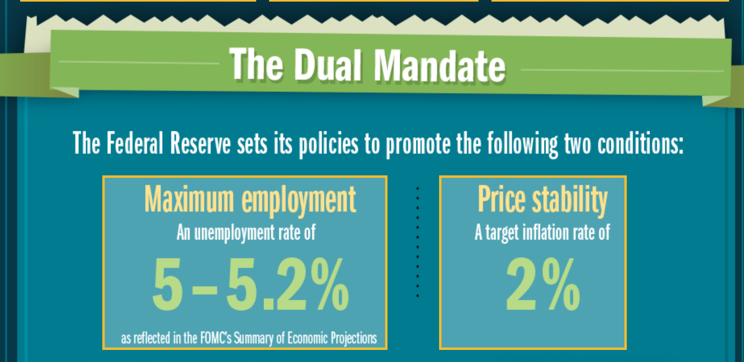
Dual Mandate

Slide 30
Warm-up to introduce students to the Fed:
What is your relationship with the Fed?

Slide 31
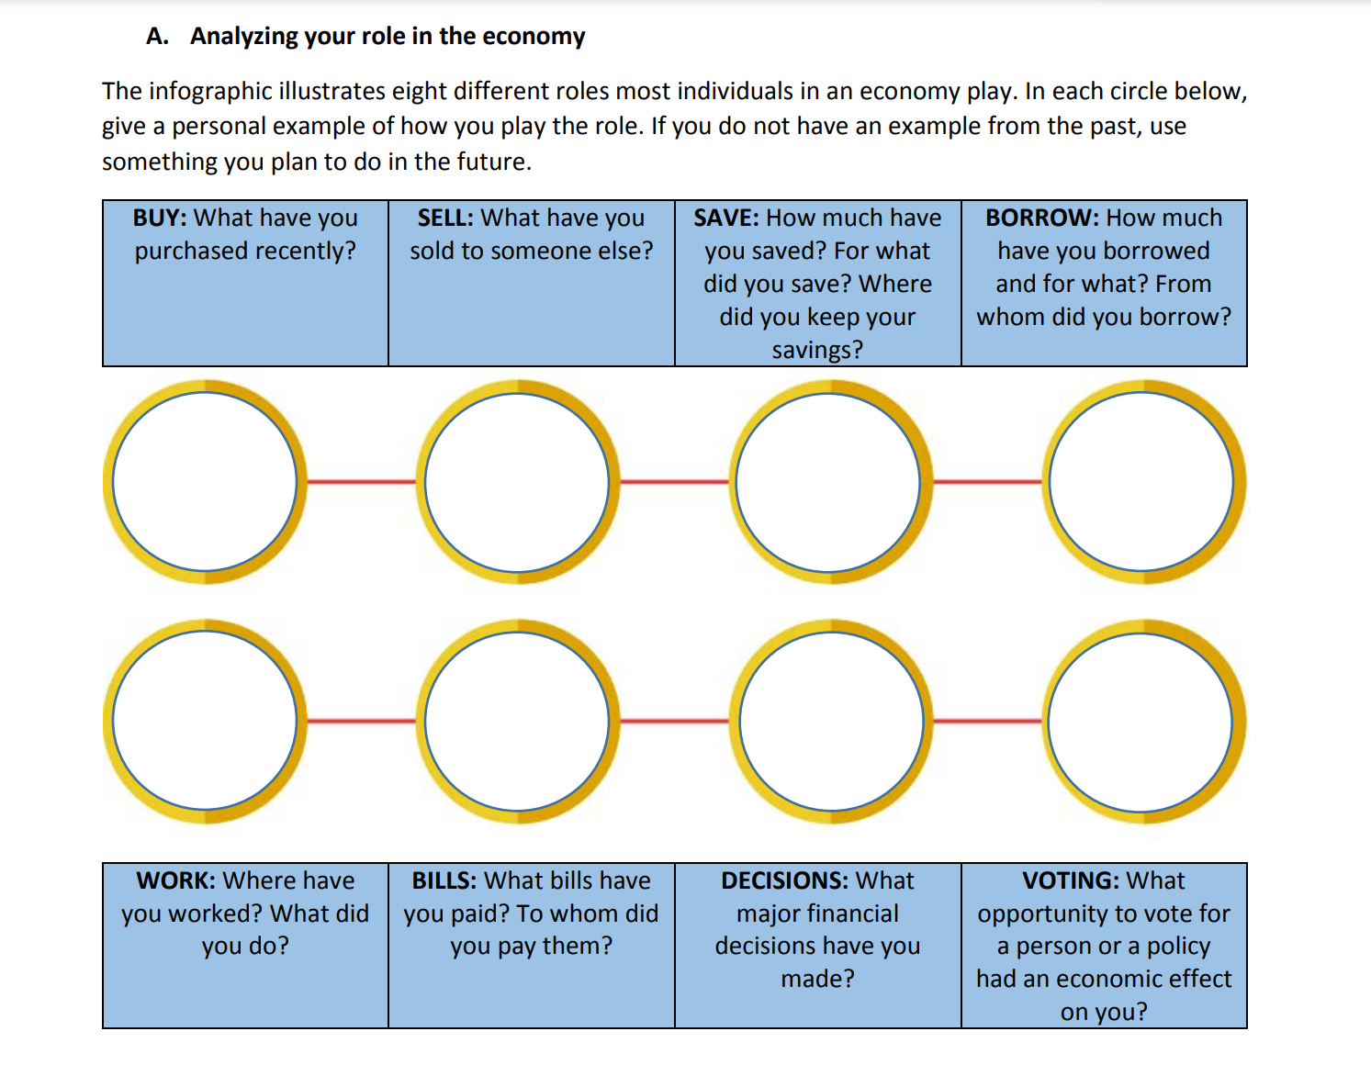
Establish your relationship with the Fed…

Slide 32
Fractional Reserve Banking and You
Your checkable deposits in banks empower these lending specialists to make loans to borrowers
Borrowers who use funds for strategic investments (with net positive returns) can help the community, region and economy grow
Fractional reserve banking boosts investment (Ig)

Slide 33

Turning to Quality Resources to Teach How Banks Create Money
Review the FTE Activity 6: Show Me the Money! A Fractional Reserve Banking Simulation.
Identify the two economic agents featured in the activity.
State their goals and describe their risks and returns.
Link the role of each to the health of the macroeconomy.

Slide 34
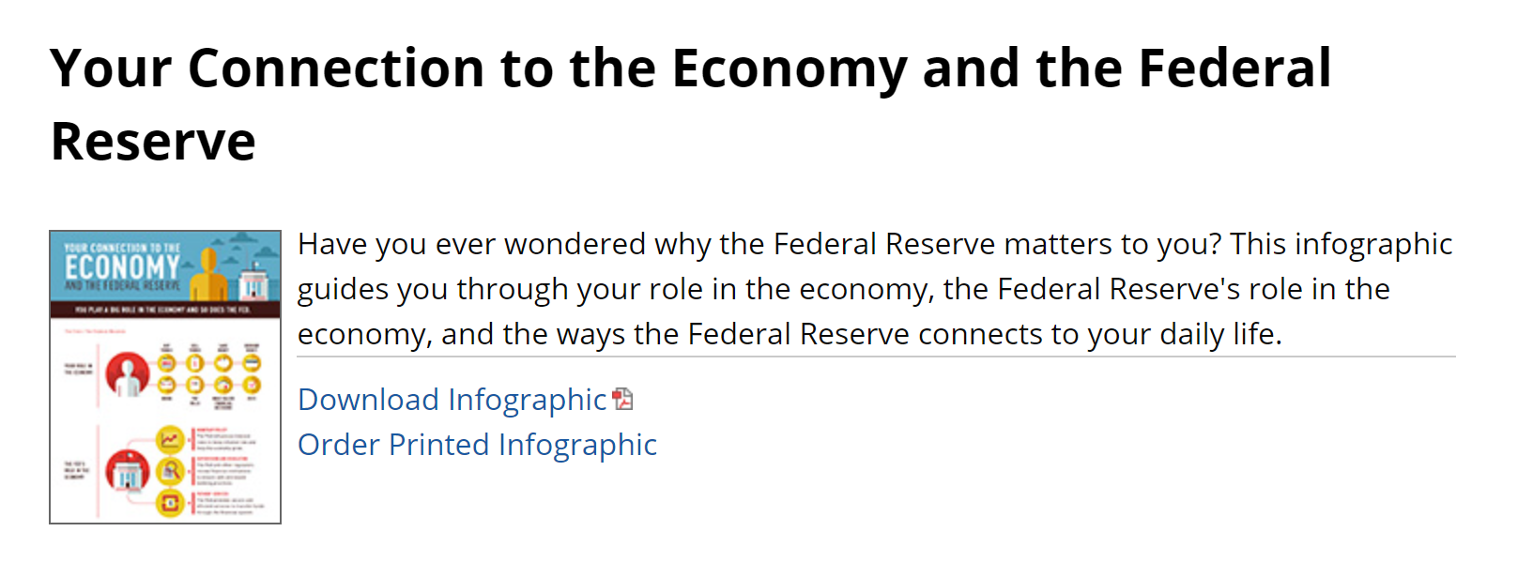
Exit Ticket (example)
Your Connection to the Economy and the Fed Infographic Activity
Make the Fed more relevant to your students' lives with an activity using the Richmond Fed's infographic

Slide 35
Session 2
Fiscal Policy Matters
2-2:50

Slide 36
Segment
Objectives
Define the three functions of money.
Define assets and order them based on degrees of liquidity.
Identify an example of money as commodity money or fiat money.
Differentiate between various money aggregates.
Present the organizational structure of the Fed.
Examine the role of monetary policy in influencing an economy.

Slide 37
Using Active Learning Techniques to Explore Fiscal Policy and Tackle the Deficit Controversies

Slide 38
Agenda
Welcome
Macroeconomics objectives
Define fiscal policy
Deep dive into the macroeconomic topics (budget deficit, federal debt, financing the debt, and consequences)
Review
Conclusion and references

Slide 39
Main Macro Objectives
Define fiscal policy
Distinguish between deficits and debt
Explain that federal deficits are financed through higher taxes, the sale of government securities, the issuance of new government securities and purchase of bonds held by the public with new money
Analyze the impact of each on real output and price levels

Slide 40


Good Online Teaching Practices
peardeck.com (Level 1, $0)

Slide 41
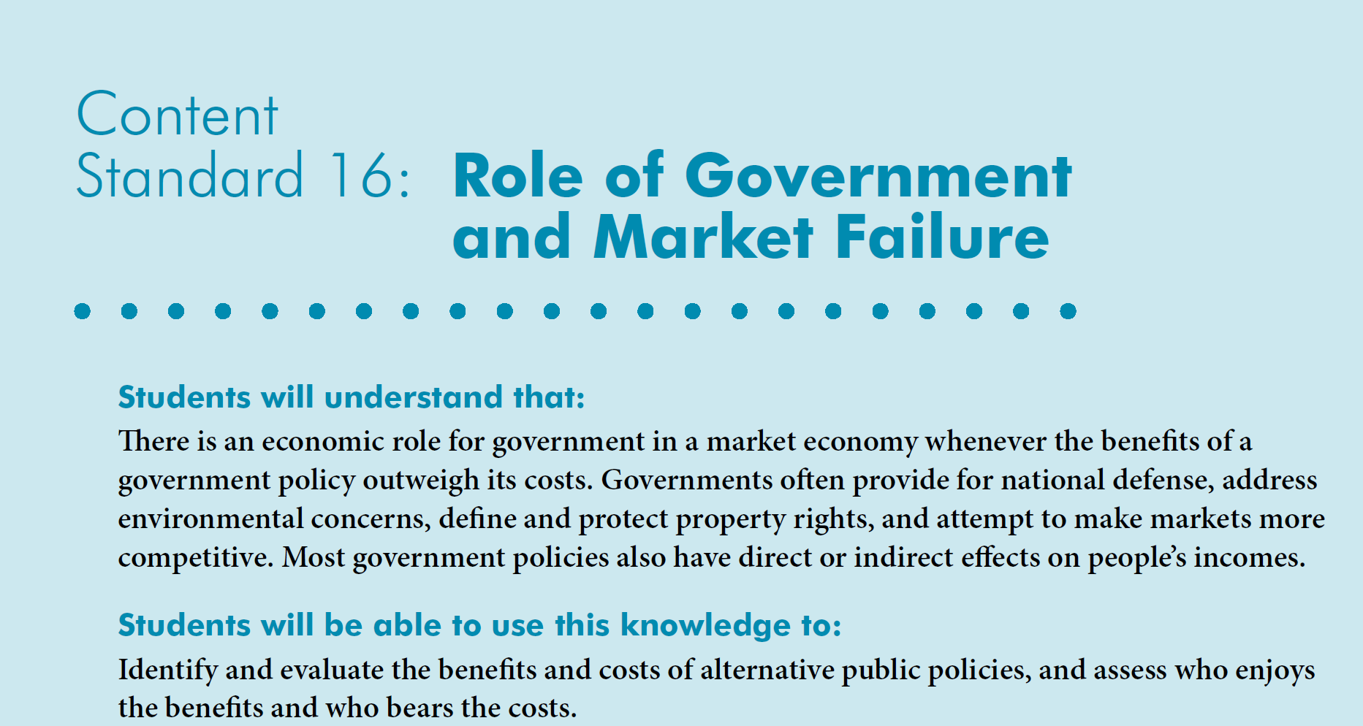
Voluntary National Content
Standards in Economics

Slide 42
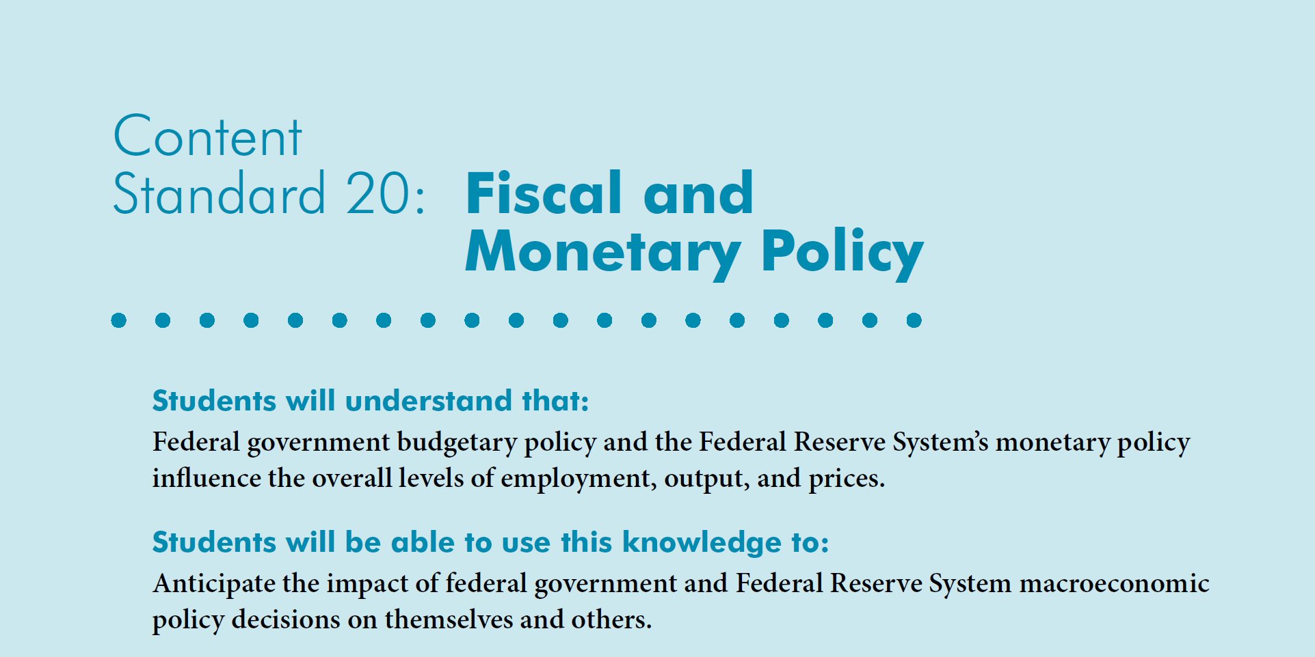
Voluntary National Content
Standards in Economics

Slide 43
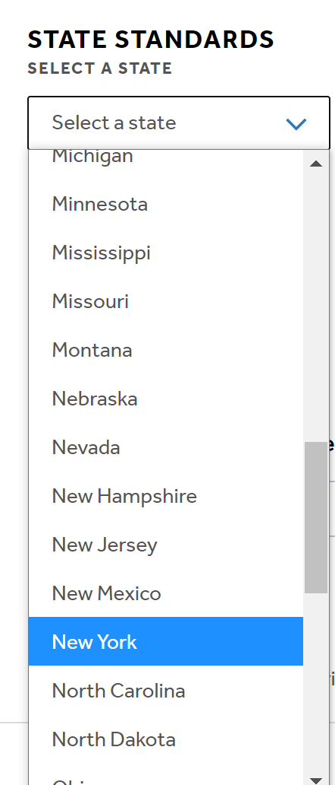
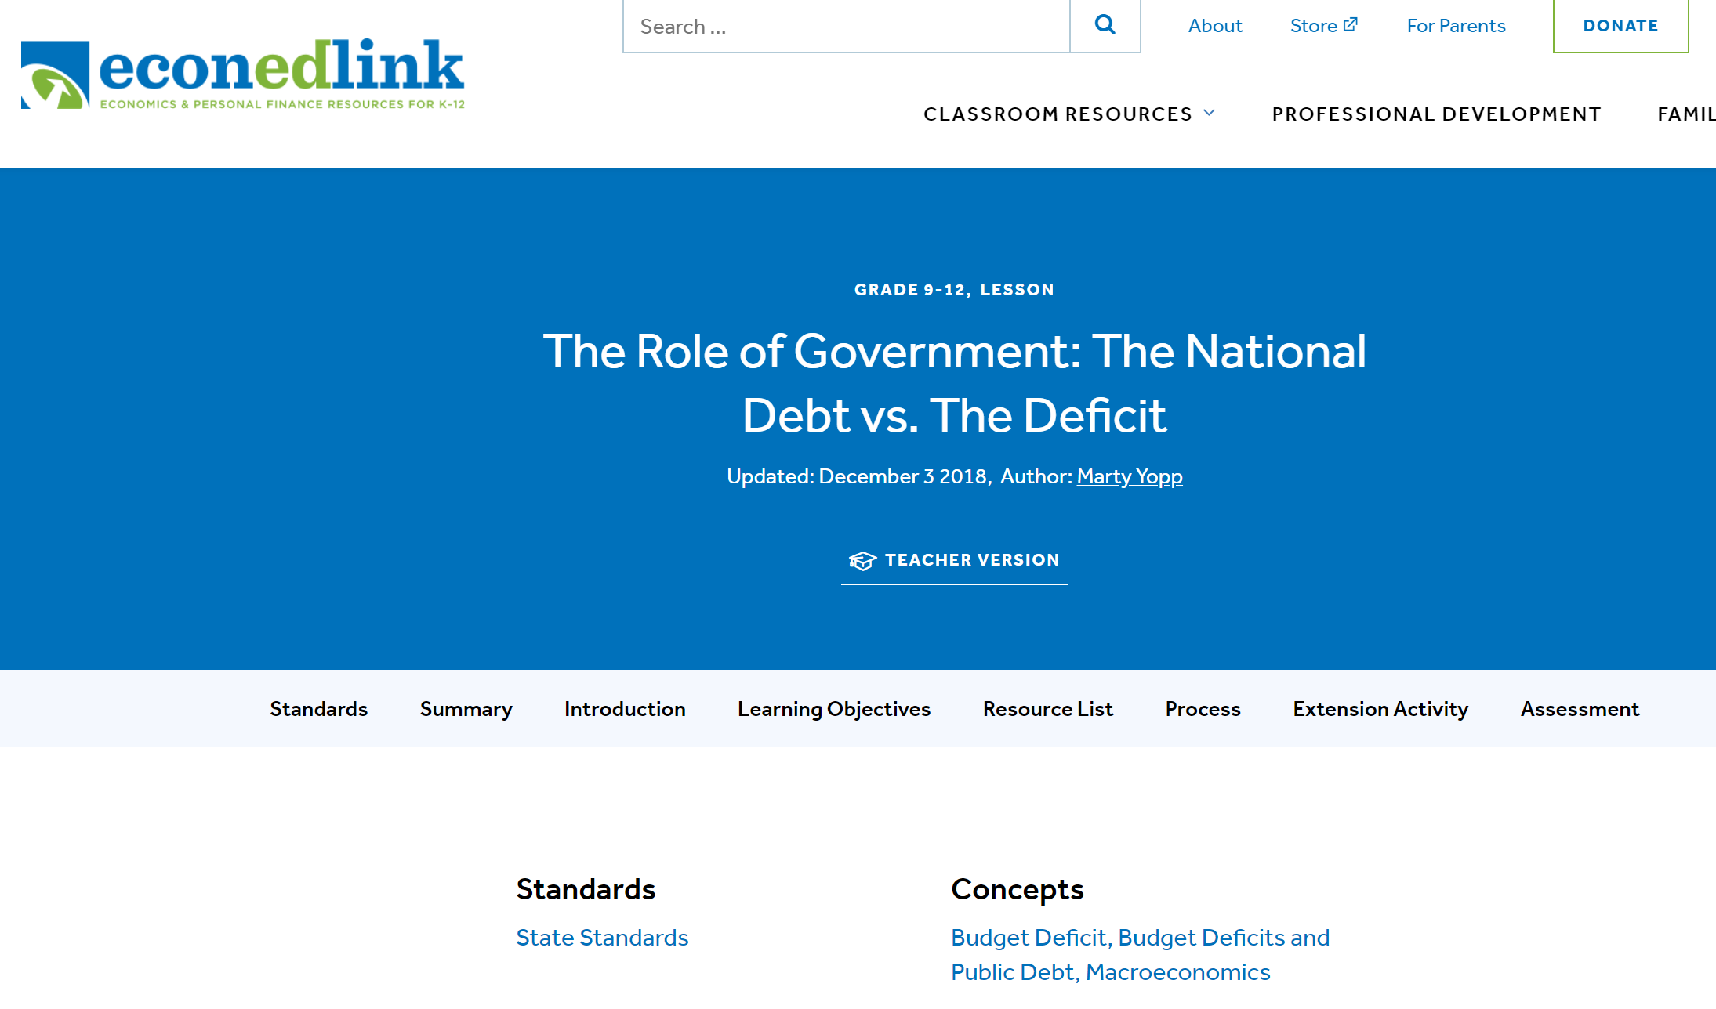
State Standards
Connect to regional and state standards at EconEdLink.org
Search for “deficit”
Choose a lesson
Click on State Standards
NYSed.gov

Slide 44
Bell Ringer
Do the benefits of deficit spending today outweigh the future costs during a recessions?
(Yes, no, it depends based on weighing one positive against one negative aspect of deficit spending.
SEE BITMOJI. TAKE ACTION!!!!
Notes:
🍐 This is a Pear Deck Multiple Choice Slide. Your current options are: A: Yes, B: No, C: It depends, D: I don't have a clue.
🍐 To edit the type of question or choices, go back to the "Ask Students a Question" in the Pear Deck sidebar.

Slide 45
Active Learning
Activities will lead you to do the following:
  Identify relevancy
  Define a fiscal policy, budget deficit, budget surplus and federal debt
  Distinguish between the federal debt and a budget deficit or budget surplus
  Describe options to fund the deficit and debt
  Investigate the long-run consequences with respect to production, employment, and prices

Slide 46

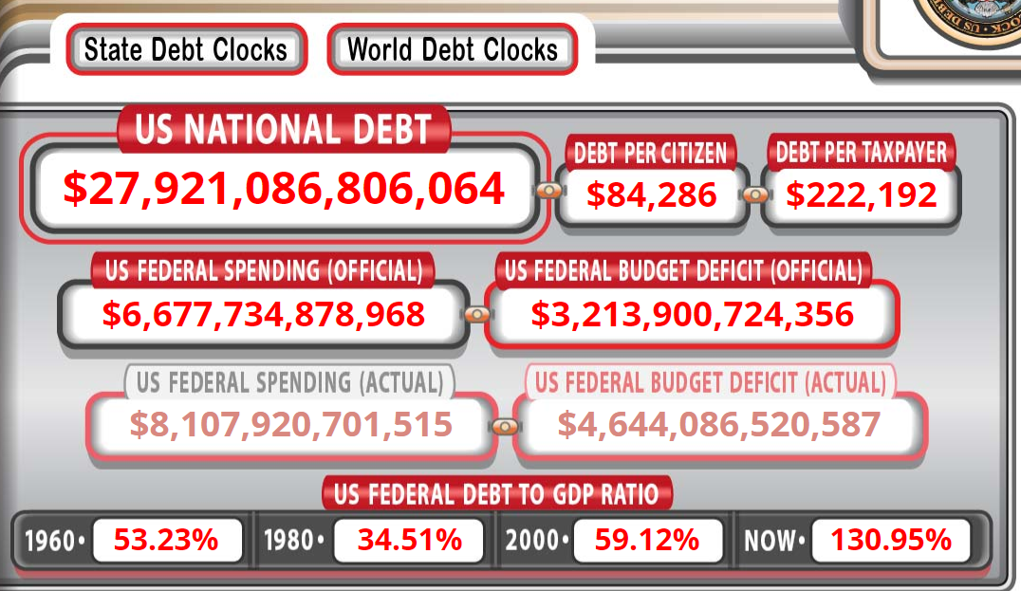
Did You Know?
6:18 AM EDT 2021 Feb 17

Slide 47

That’s $28 Trillion in Debt!!!

Slide 48
Putting these trillions into perspective
Webster’s Dictionary defines a trillion as “a really, really big number”
Trillion = 1,000 Billion
What happened
  1 million seconds ago took place 12 days ago
  1 billion seconds ago took place 32 years ago
  1 trillion seconds ago took place 32,000 years ago

Slide 49

10 Minute Activity
Instructions: Grab a pencil and paper or use your device to take notes.
Watch the EconEdLink “Fiscal Policy Video and Quiz”
While watching:
  Define (1) fiscal policy, (2) a balanced budget, (3) budget deficit, and (4) budget surplus.
  Investigate what contributes to the increase or decrease of each.
  Describe two ways in which the government can reduce the budget deficit. Discuss one tradeoff.

Slide 50

Read & Write Activity
List the two primary tools of discretionary fiscal policy (Assume only discretionary policy exists.)

Slide 51
Read & Write Activity
The two primary tools of discretionary fiscal policy are government spending (G) and taxes (T).
G vs T
*Assume just discretionary policy

Slide 52
Read & Write Activity
When government spending (G) aligns with tax revenues decrease (T), the federal budget is:
Operating with a deficit
Balanced
Operating with a surplus

Slide 53
Read & Write Activity
When government spending (G) aligns with tax revenues decrease (T), the budget is balanced.
Balanced Budget
G = T

Slide 54
Read & Write Activity
When government conducts expansionary fiscal policy to counteract a recession or the negative effects of a pandemic, government spending (G) and taxes (T) can
Both increase
Both decrease
Government spending decreases/Taxes increase
Government spending increases/Taxes decrease

Slide 55
Expansionary policy effects on the deficit
Provide details here.

Slide 56
Read & Write Activity
When government conducts expansionary fiscal policy to counteract a recession, government spending increases (G ) and/or taxes decrease (T ).
Budget Deficit
G > T

Slide 57
Read & Write Activity
When the government conducts contractionary fiscal policy to alleviate inflationary pressures, government spending decreases (G ) and/or taxes increase (T ).
Budget Surplus
G > T

Slide 58
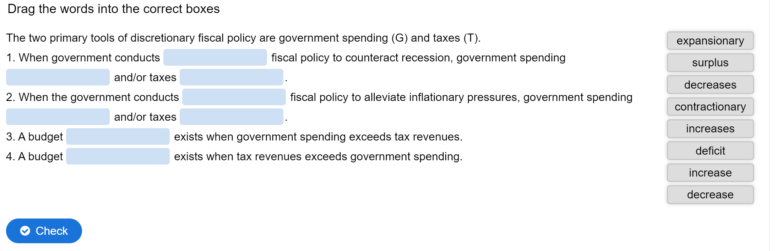
Practice
Time on Task
Visit: https://h5p.org/node/975657 ($0, Level 1)
Notes:
https://h5p.org/node/975657

Slide 59
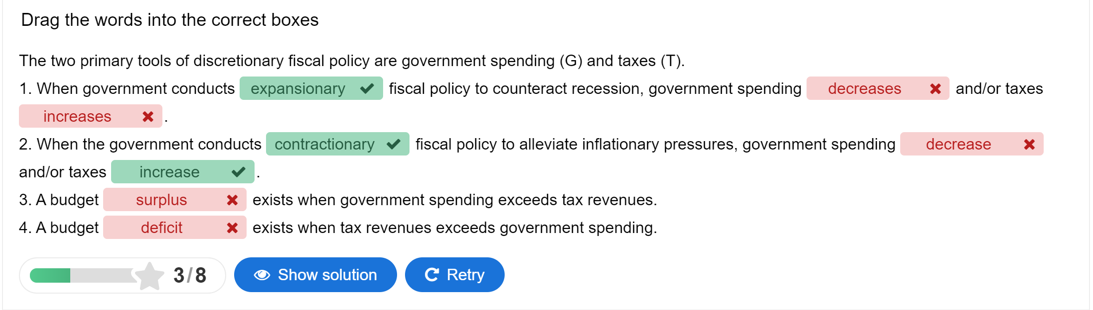
Practice
Time on Task

Slide 60
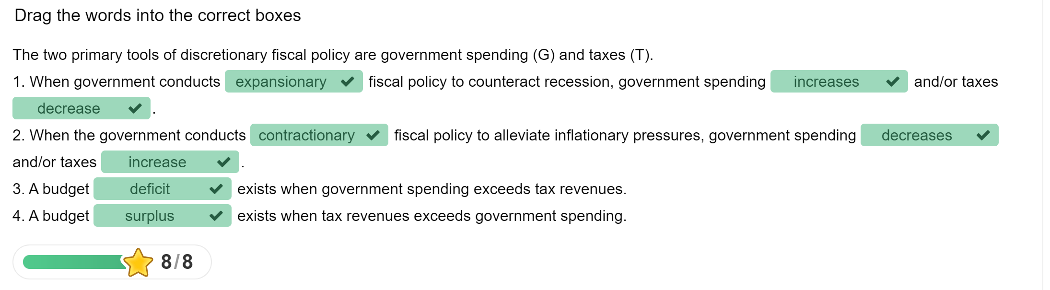
Practice
Time on Task

Slide 61
Definitions
Definition | Government spending versus tax revenues | Duration (Fiscal Year)
Balance budget | Government’s budget is balanced when | G = T
Budget deficit | Government spending increases and/or tax revenues decrease | G > T
Budget surplus | Government spending decreases and/or tax revenues increase | G < T

Slide 62
Transition
From the budget deficit or surplus to the public debt…

Slide 63
Public Debt
Public debt, also known as the government’s debt or sovereign’s debt, is a flow. It is the amount government owes its lenders plus interest.
Deficits add to the debt.
Surpluses help pay it off.

Slide 64

Demonstrate
Analyze the federal surplus [+]/deficit [-] data retrieved from the Federal Reserve Economic Database (FRED).
Look at the data that provides the amount in which the government ran a budget deficit or surplus in a specific year.
Identify whether it will contribute to the debt and interest due or will help pay down the debt.
Notes:
🍐 This is a Pear Deck Multiple Choice Slide. Your current options are: A: Surplus, decrease taxes, B: Surplus, decrease government spending elsewhere, C: Surplus, buy back government bonds, D: Constant, E: Deficit, increase taxes, F: Deficit, decrease government spending elsewhere,
🍐 To edit the type of question or choices, go back to the "Ask Students a Question" in the Pear Deck sidebar.

Slide 65
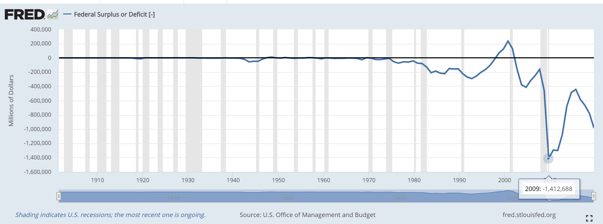

Federal Surplus [+] or Deficit [-]
Notes:
🍐 This is a Pear Deck Text Slide
🍐 To edit the type of question, go back to the "Ask Students a Question" in the Pear Deck sidebar.

Slide 66
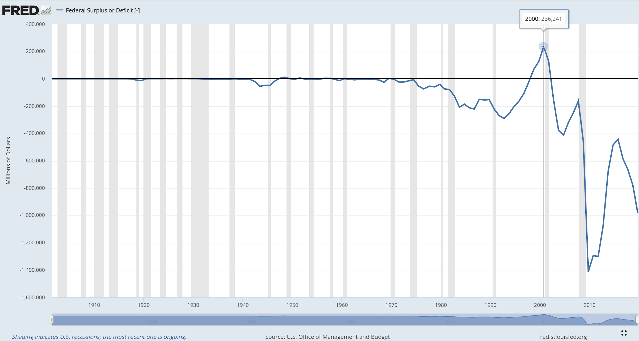
Budget Deficits and Surpluses
Describe what you see and state how it impacts the public debt.
Notes:
🍐 This is a Pear Deck Text Slide
🍐 To edit the type of question, go back to the "Ask Students a Question" in the Pear Deck sidebar.
The U.S. government has run a budget _____________ since 1970 for all but four years (1998–2001). During this period, ____________ was greater than __________________. During this period Bill Clinton (Democrat) was president. His term ran from January 20, 1993 – January 20, 2001

Slide 67
Summary
Definition | Government spending versus tax revenues | Impact on National Debt
Balance budget | Government’s budget is balanced when spending and revenues align | No change
Budget deficit | Government spending increases and/or tax revenues decrease | Adds to the debt
Budget surplus | Government spending decreases and/or tax revenues increase | Pays down the debt

Slide 68
How can governments deficit spend?
Federal deficits are financed through:
Higher taxes
The sale of government securities
The issuance of new government securities
Purchase of bonds held by the public with new money (Federal Reserve Bank)

Slide 69
How does government do that?
Government deficit spends (G > T) by issuing bonds or promises to repay in the future plus interest.
The sum of past deficits is the U.S. national debt.
The debt incurs annual interest charges.
A government budget deficit results in an increase in the demand for loanable funds.
A surplus does the opposite.

Slide 70
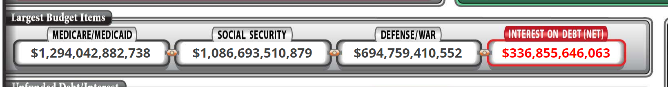
Public Debt
As stated previously, the U.S. public debt is almost $27 trillion
Biggest contributors to the deficits that add to the debt are Medicare/Medicaid, social security and military defense

Slide 71
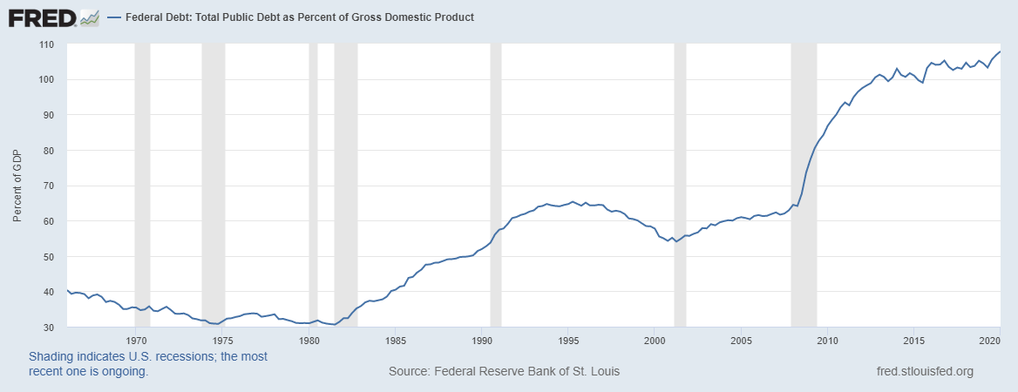
Public Debt to GDP
The nation’s debt is now bigger than its gross domestic product (GDP)

Slide 72
Debtors and Creditors
Creditors (buyers of bonds) allow deficit spending by government (sellers of bonds)
Creditors channel funds to the bond issuer
Bond issuer (government in this case) pays face value on maturity plus interest

Slide 73
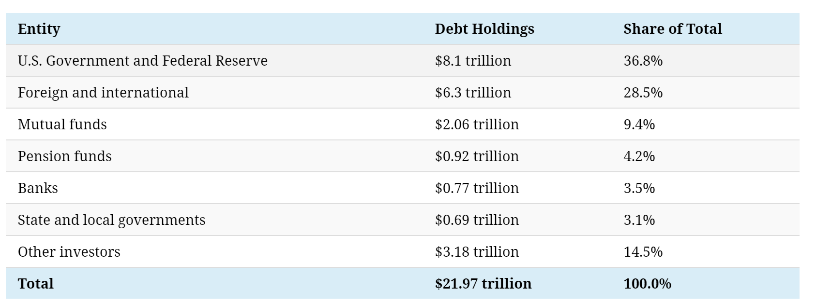
Who holds our debt?
2018/19
Source: https://www.visualcapitalist.com/foreign-countries-holding-most-u-s-debt/

Slide 74
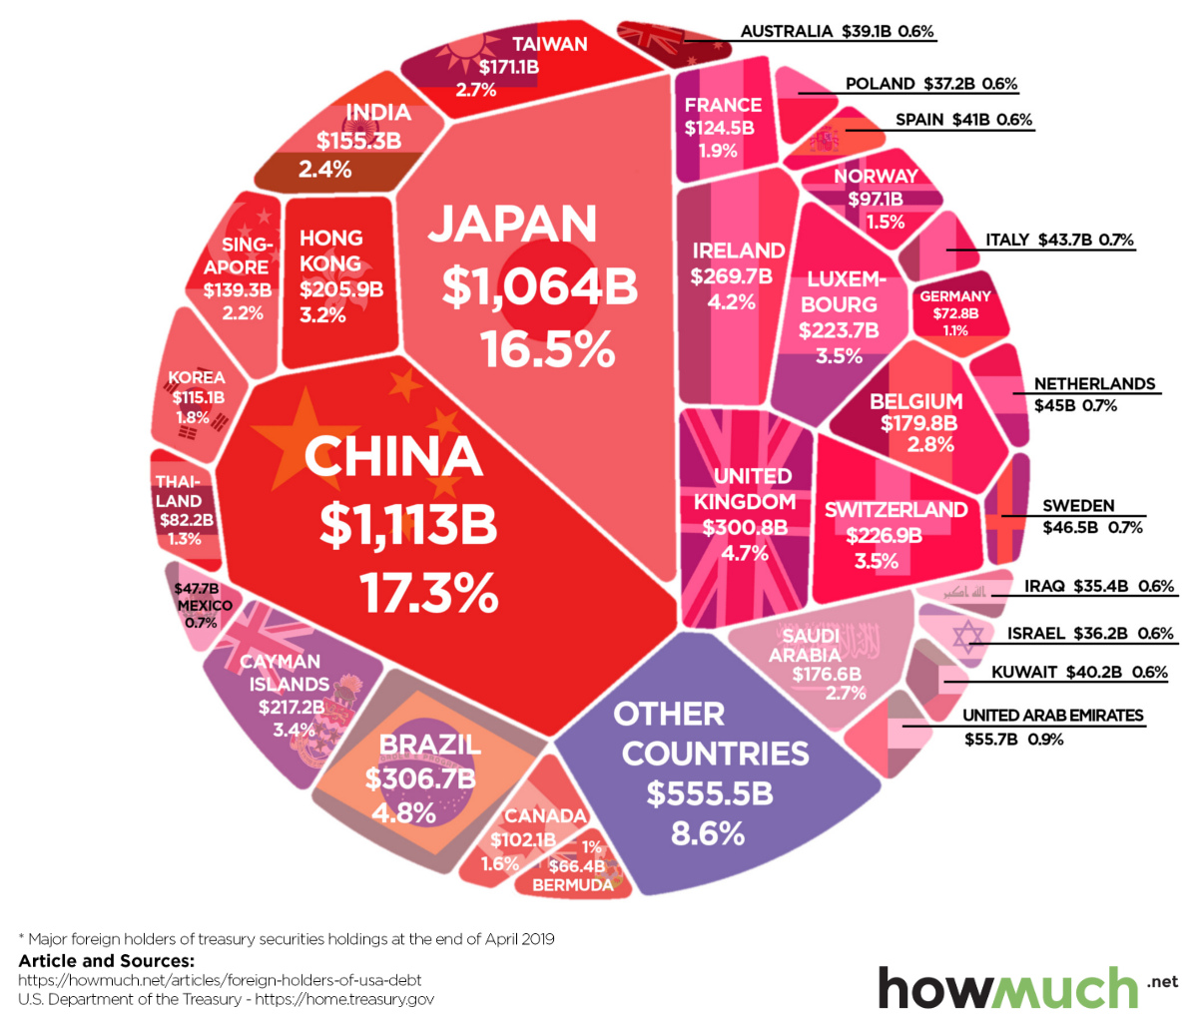
Which Countries Own the Most U.S. Debt?
Citation: Jeff Desjardins
Notes:
https://www.visualcapitalist.com/foreign-countries-holding-most-u-s-debt/

Slide 75
U.S. Economy Today?
Real GDP
Real income
Employment
Industrial production
Wholesale-retail sales

Slide 76
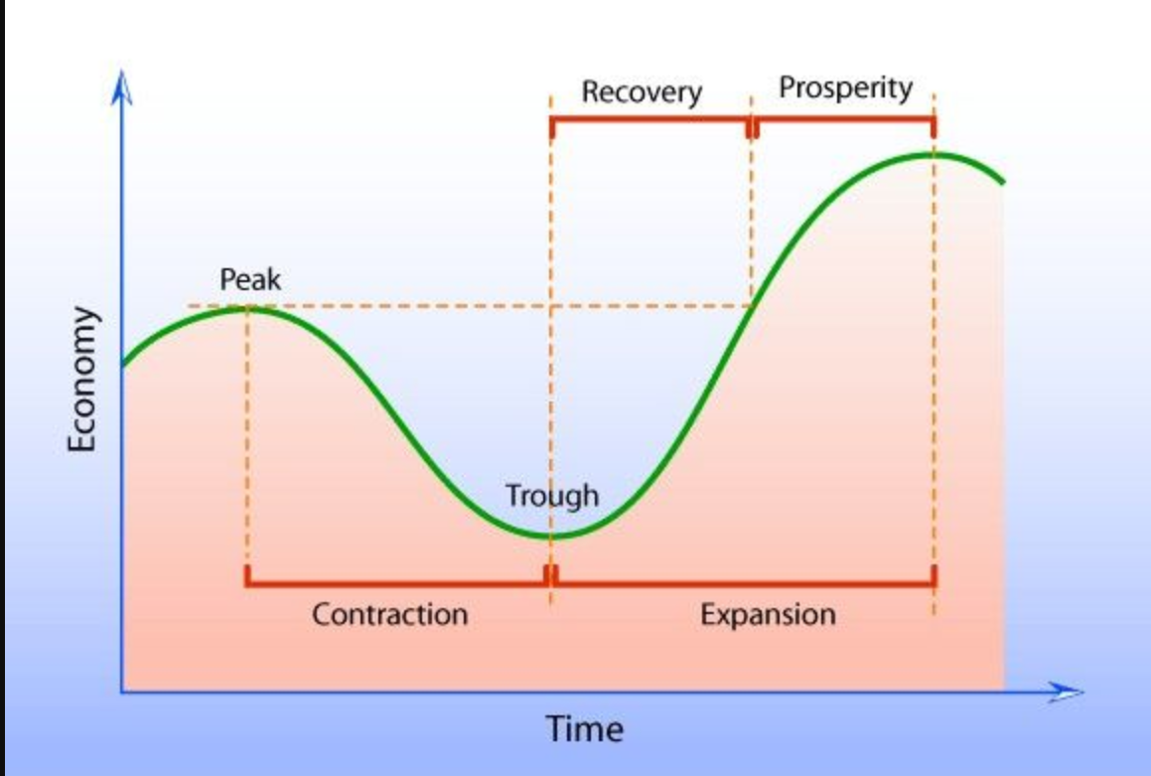
Business Cycle
Citation: https://www.pinterest.com/pin/570549846513119766/ (Seeking permission to use from Mindlever Education.)

Slide 77
The Business Cycle
Business cycles are recurrent expansions and contractions that are common to large parts of the economy. The National Bureau of Economic Research (NBER)—the private organization that is the de facto arbiter of U.S. business cycle dating—defines a recession as “a significant decline in economic activity spread across the economy, lasting more than a few months, normally visible in real GDP, real income, employment, industrial production, and wholesale-retail sales.”
Philadelphia FED

Slide 78
Deficit Spending…
Deficit spending, for better or worse, is in our present and future because of non-discretionary and discretionary spending.

Slide 79
Reasons for deficit-spending now
Government spends more than it receives in tax revenue for multiple reasons including:
  Recessions
  Falling tax revenue due to aging population
  Unfunded promises made by Congress
  Inefficiencies associated with bureaucracies, red-tape, etc

Slide 80
Short- run
Economic Impact
Production, employment, investment and prices?
GDP
= C + Ig + G XN
Employment
Investment (Ig)
Prices (GDP Defl, CPI, PPI, PCEI)

Slide 81

Depends on assumptions…
Keynesian model - prices and wages are sticky. Deficit spending involves increased government spending or decrease taxes
Either or both boost production, employment and government investment in the short-run. Surpluses in the future pay down the deficits and debt of the recessions

Slide 82
Depends on assumptions
Neoclassical model - prices and wages are not sticky. They are flexible. Production and employment move toward full employment.
Increased government spending or decrease taxes, increases prices and/or interest-rates.
Deficit-spending fuels inflation and distorts decisions, increasing problems and causing them to linger.

Slide 83
Depends on assumptions
External debt - This debt is not to be confused with internal debt owed to domestic lenders. It is debt help by other governments, corporations or citizens
Deficit spending in the U.S. is made possible by the budget surpluses and net savings in other countries
Changes in exchange rates and/or increase prices and interest rates impose costs on U.S. producers and households.
Future payments and interest go to other countries, not domestic citizens
U.S. production, employment, and investment are sacrificed in the long- run

Slide 84
Depends on assumptions
Monetize the debt - The Federal Reserve Bank buys the bonds, creating loanable funds for businesses and households
Production, employment, spending and investment increase in the short- run
They are not increased because of sustainable opportunities but government stimulus. When that stimulus goes away, problems emerge

Slide 85
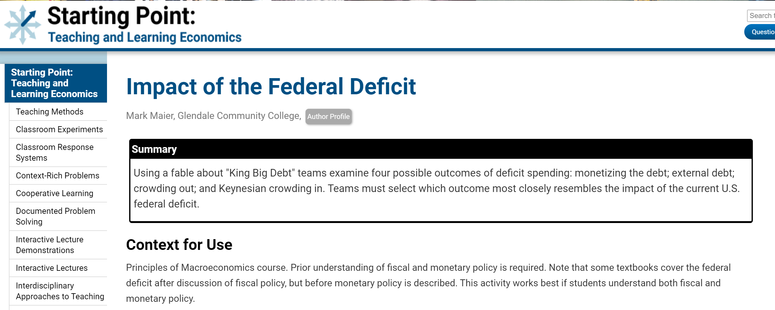
Teaching and Learning Econ Resource Hub
Notes:
🍐 This is a Pear Deck Web Slide.
🍐 To edit the type of question, go back to the "Ask Students a Question" in the Pear Deck sidebar.

Slide 86
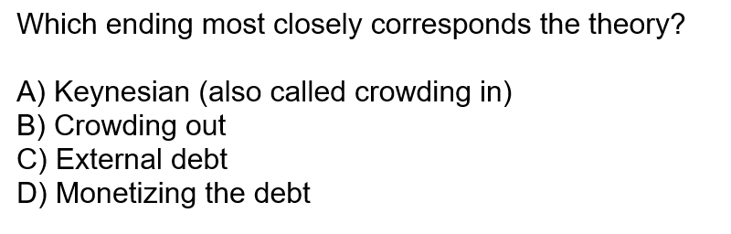
Read a Story
Question to be asked at the “End” of the story with answers…

Slide 87
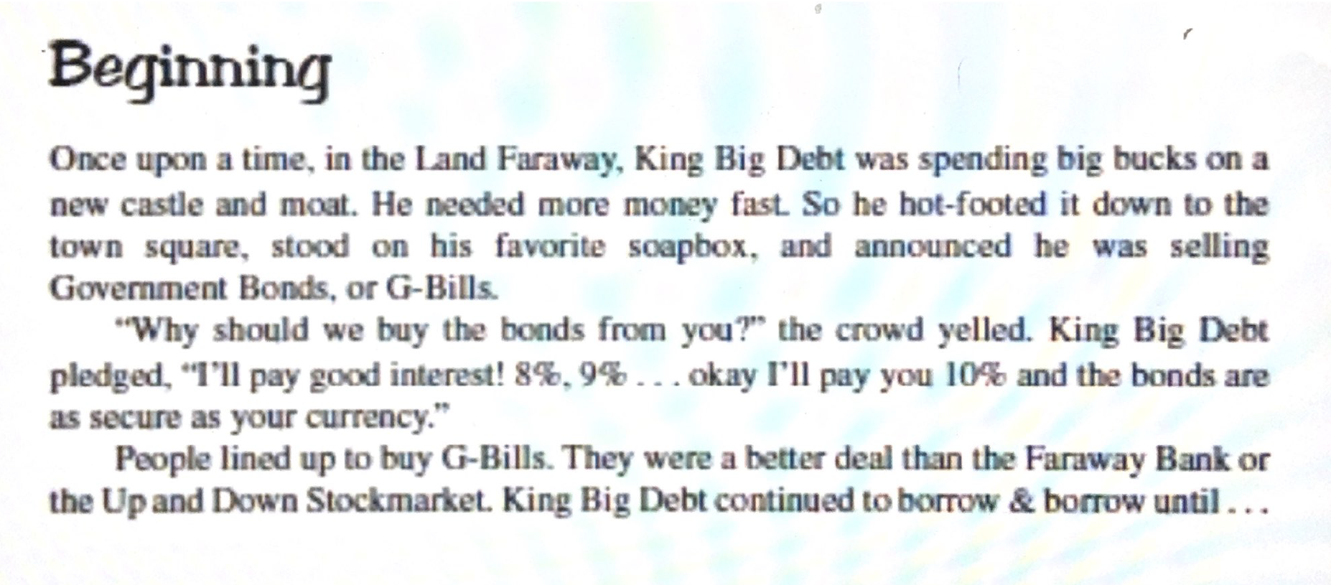

Summative Assessment
Citation: Maier, Mark. Glendale Community College. Impact of the Federal Deficit. Retrieved from https://serc.carleton.edu/econ/tbl-econ/activities/197778.html

Slide 88
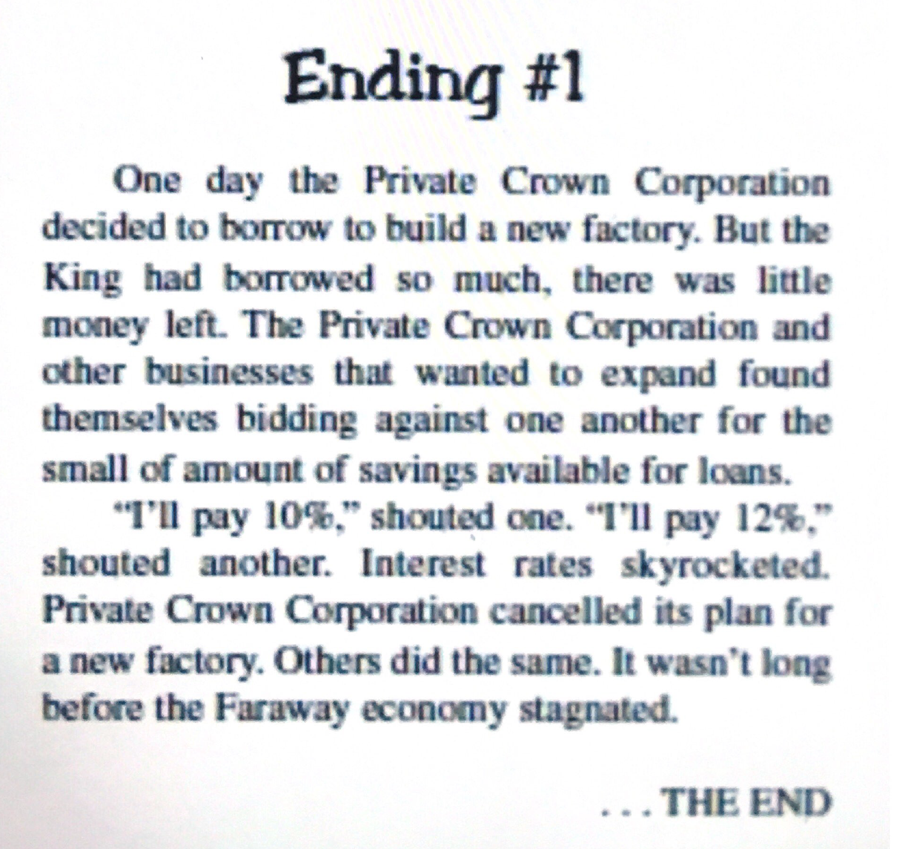
Which ending?
Notes:
🍐 This is a Pear Deck Multiple Choice Slide. Your current options are: A: Keynesian (also called crowding in), B: Crowding out, C: External debt, D: Monetizing the debt,
🍐 To edit the type of question or choices, go back to the "Ask Students a Question" in the Pear Deck sidebar.
Which ending most closely corresponds the U.S. economy today?
A) Keynesian (also called crowding in)
B) Crowding out
C) External debt
D) Monetizing the debt

Slide 89
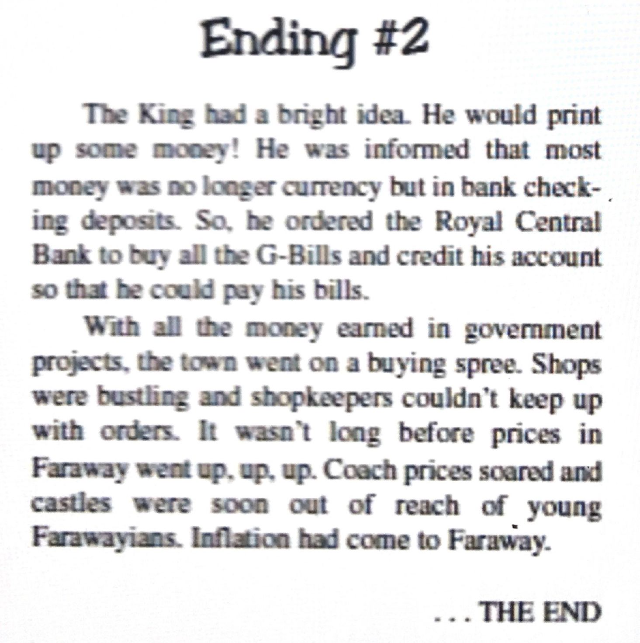
Which ending?
Notes:
🍐 This is a Pear Deck Multiple Choice Slide. Your current options are: A: Keynesian (also called crowding in), B: Crowding out, C: External debt, D: Monetizing the debt,
🍐 To edit the type of question or choices, go back to the "Ask Students a Question" in the Pear Deck sidebar.
Which ending most closely corresponds the U.S. economy today?
A) Keynesian (also called crowding in)
B) Crowding out
C) External debt
D) Monetizing the debt

Slide 90
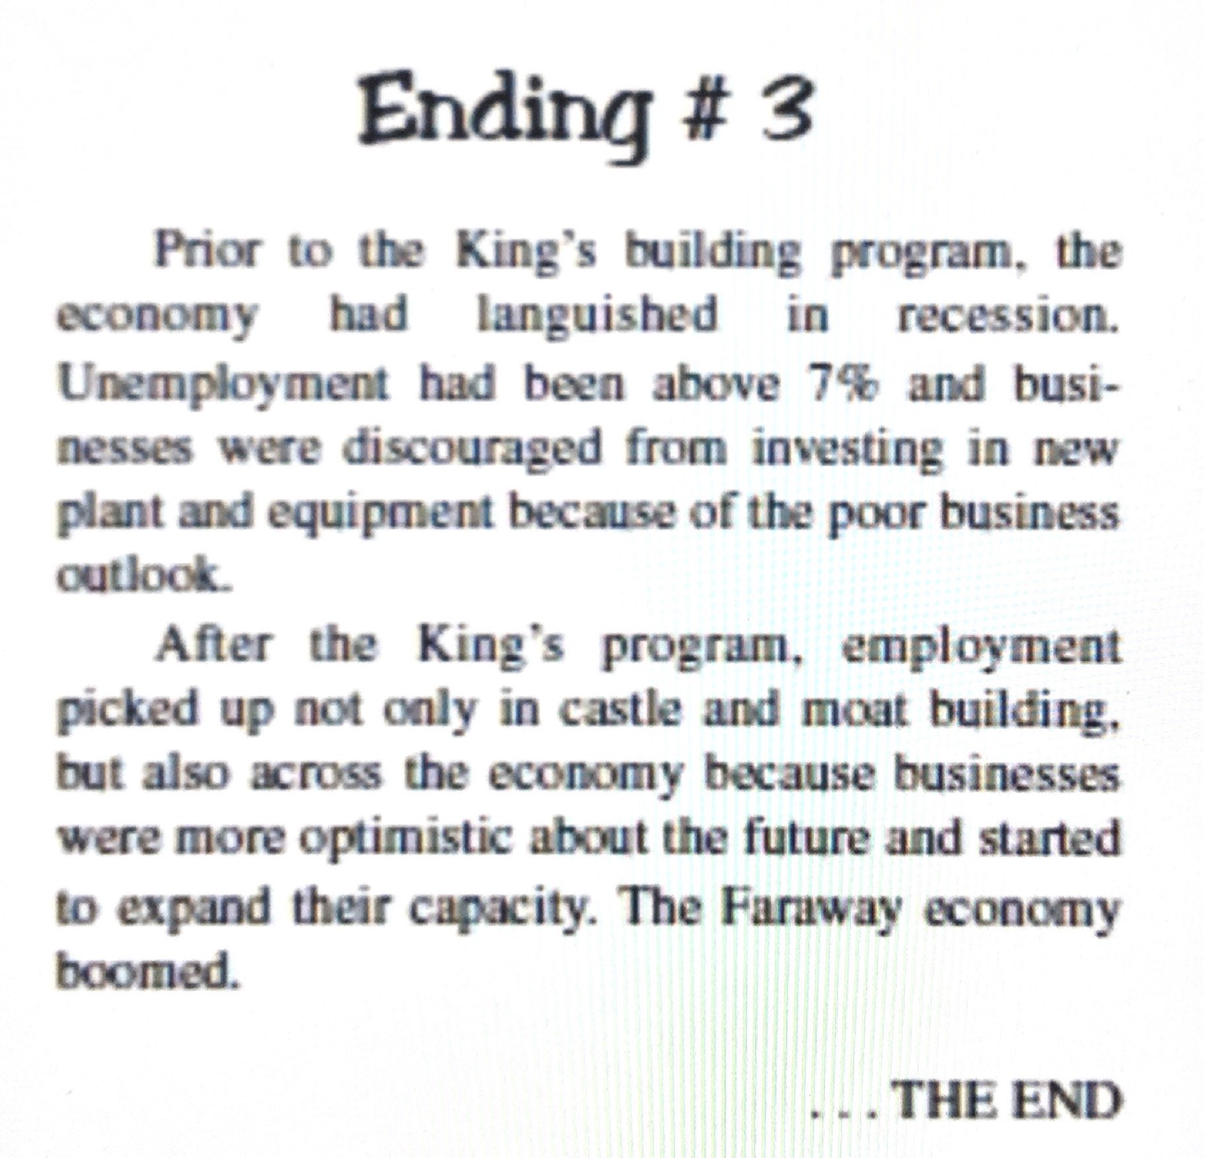
Which ending?
Notes:
🍐 This is a Pear Deck Multiple Choice Slide. Your current options are: A: Keynesian (also called crowding in), B: Crowding out, C: External debt, D: Monetizing the debt,
🍐 To edit the type of question or choices, go back to the "Ask Students a Question" in the Pear Deck sidebar.
Which ending most closely corresponds the U.S. economy today?
A) Keynesian (also called crowding in)
B) Crowding out
C) External debt
D) Monetizing the debt

Slide 91
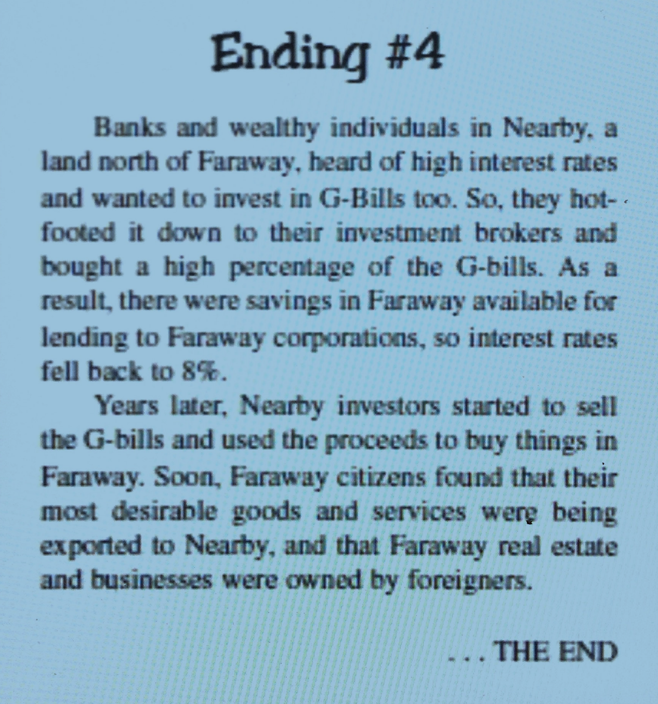
Which ending?
Notes:
🍐 This is a Pear Deck Multiple Choice Slide. Your current options are: A: Keynesian (also called crowding in), B: Crowding out, C: External debt, D: Monetizing the debt,
🍐 To edit the type of question or choices, go back to the "Ask Students a Question" in the Pear Deck sidebar.
Which ending most closely corresponds the U.S. economy today?
A) Keynesian (also called crowding in)
B) Crowding out
C) External debt
D) Monetizing the debt

Slide 92
References
Audio Does the Deficit Matter @ PlanetMoney (09:27)
Interactives (Virtual classroom activities, preparatory interactives, or follow-up reinforcements) H5P Deficits, surpluses, and debt** EconEdLink Resources AP Macroeconomics – The Deficit and the Debt * SERC Teaching and Learning ECON Impact of the Federal Deficit
Learning Activity Suggestions Critical Review of a Podcast ** Short Essay Assignment Summarizing the Controversies on How Economic Booms and Busts Contribute to the Public Debt ** Case Study – Compare and Contrast Budget Surpluses and Budget Deficit Years
Videos Intro to Fiscal Policy @ Marginal Revolution University (03:26) ** Deficits and Debts @ Kahn Academy (07:40)
Visuals and Data FRED St. Louis, FED (Current) ** MeasuringWorth.com (Historic Data) ** Visual Capitalist US Debt: Who Owns It?
Notes:
https://www.investopedia.com/terms/b/bureau_of_public_debt.asp
https://h5p.org/
https://www.treasurydirect.gov/govt/resources/faq/faq_publicdebt.htm#DebtMakeup
https://www.pgpf.org/national-debt-clock
https://www.pewresearch.org/fact-tank/2019/07/24/facts-about-the-national-debt/

Slide 93
Wrapping Up
Covered our macroeconomics objectives
Used the most of the six online practices for good teaching applied to economics using PearDeck (EdTech tool)
Took a deep dive into the macroeconomic topics (budget deficit, federal debt, financing the debt and consequences)
Provided references
Time to conclude and give thanks

Slide 94

More questions to answer through EconEdLink…
Why are some people mad about trade?
What are the benefits/costs of trade (XN)?
How does this anger lead to trade policies that discriminate and harm the most marginalized in our communities?

Slide 95




Thank You to Our Sponsors!

Slide 96



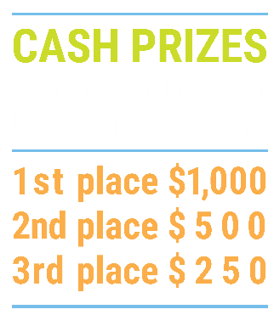

We’ve gone Virtual!
Teach Economics?
Your students may have what it takes to compete in the nation’s only high school economics competition!
Why Play?
• Fun team learning experience
• Great for college applications
• No other challenge like this
• Online participation makes access easy
• Chance for cash prizes
How it Works
Teams register
Teachers enroll team(s) of 3- 4 high school students from the same school. Multiple teams allowed.
Teams compete within their state
Compete to win your state competition for a
chance to advance to the National Semi-Finals.
National Semi-Finals: May 3-20, 2021
Teams answer multiple-choice questions on macroeconomics, microeconomics, and international & current events.
National Finals: May 22-24, 2021
Teams analyze an economic issue and present their solution. Top teams engage in the Finals Quiz Bowl where they face-off answering questions to claim the National Title.
Two divisions based on experience level
David Ricardo for first-time competitors who have taken no more than one economics course.
Adam Smith for returning competitors, AP, International Baccalaureate, and honors students.
Register Today at NationalEconomicsChallenge.org

Slide 97

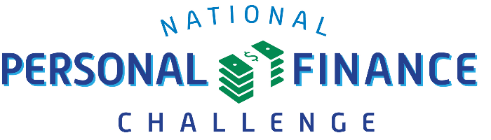

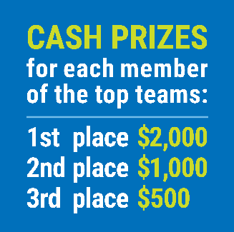

FIND YOUR LOCAL COMPETITION
AND REGISTER TODAY!
The National Personal Finance Challenge is a competition that provides high school students with an exciting and motivating opportunity to build, apply, and demonstrate their knowledge of money management.
Through online exams and a personal finance simulation, teams showcase their expertise in earning income, buying goods and services, saving, using credit, investing, as well as protecting and insuring.
Teams of up to four students, with one teacher/coach, can qualify to represent their state at the National Personal Finance Challenge by winning their local competition.
NATIONALS
Semi-Finals: First round elimination via online multiple-choice questions.
Finals: Case study round virtually co-hosted by the Cleveland Fed on June 3.
personalfinancechallenge.org

Slide 98

The 2021 Sloan Teaching Champion Award
Winners receive:
A cash award of $5,000
A cash award of $2,500 for their school to support economic education
Recognition at our annual Visionary Awards convening.
This award promotes economic education by honoring three outstanding teachers who incorporate exemplary teaching techniques that improve their students’ economic understanding in and out of the classroom.
This award is open to New York metropolitan area high school teachers of all subjects, not just teachers of economics. Applicants must demonstrate how they integrate economics into their teaching.
Sound like you or someone you know?
Applicants must teach in one of the
Twelve New York state counties (New York, Kings, Bronx, Richmond, Queens, Nassau, Suffolk, Westchester, Putnam, Rockland, Orange and Dutchess)
Eight New Jersey counties (Bergen, Passaic, Essex, Hudson, Middlesex, Union, Morris, Monmouth), or the
Two Connecticut counties (Fairfield and New Haven)
Application will be launched on Friday February 19th 2021
You can access the application here.
CONTACT
Please feel free to e-mail us at rrivera@councilforeconed.org
with any questions you have.

