Slide 1
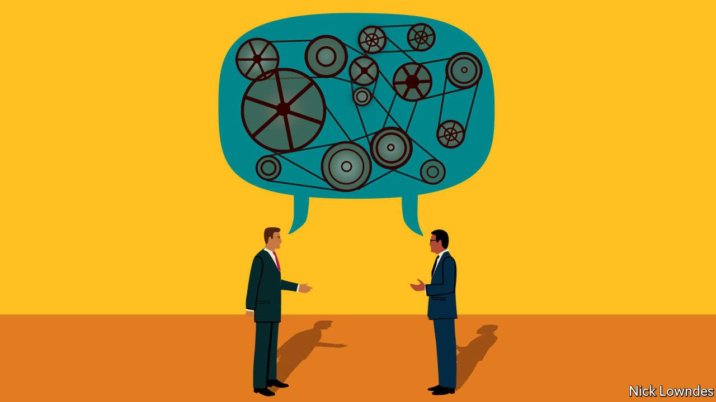
Access these slides: bit.ly/theartofconvo
The art
of conversation
In personal finance
@AlexMLamon
CEE Master teacher
10th - 12th grades -- AP Econ, Fin Lit, Investing

Slide 2
EconEdLink Membership
You can now access CEE’s professional development webinars directly on EconEdLink.org! To receive these new professional development benefits, become an EconEdLink member. As a member, you will now be able to:
Automatically receive a professional development certificate via e-mail within 24 hours after viewing any webinar for a minimum of 45 minutes
Register for upcoming webinars with a simple one-click process
Easily download presentations, lesson plan materials and activities for each webinar
Search and view all webinars at your convenience
Save webinars to your EconEdLink dashboard for easy access to the event

Slide 3
Professional Development Certificate
To earn your professional development certificate for this webinar, you must:
Watch a minimum of 45-minutes and you will automatically receive a professional development certificate via e-mail within 24 hours.
Accessing resources:
You can now easily download presentations, lesson plan materials, and activities for each webinar from EconEdLink.org/professional-development/

Slide 4
My Teaching context / about THIS SESSION
Teaching in 2020-21 is wild, isn’t it?
Notes:
My background/experience
About LHS
About hybrid/online

Slide 5
This is a toolbox session
You know your students.
Take what you like, and leave the rest.
I don’t know how best to teach your students, we’re all equals sharing what we know.

Slide 6
** venting is okay right now ** Good teaching still Prevails ** you don’t have to be amazingly creative **
School today is like if you walked out of the building because there was a small fire, and were welcomed back as every window had flames coming out of it.
And all your teachers are wearing gas masks.
Still, let’s move forward and be positive.
Be real, but positive.
Notes:
We’re already doing so much extra. You’re here to learn even more. Let’s keep it great for our students but keep it simple, too. We don’t need to be remarkable. We just need to facilitate good learning opportunities.

Slide 7
Why conversation?
Notes:
Explanation on why I wanted to present on the power of conversation to teach fin lit. Inspired bc some of the best “lessons” were unplanned, ‘teachable moments’ that came from genuine questions or moments.
-“Her mom said she maxed out her CC” -- GASP :o -- What’s that mean?
There’s also such a stigma about talking about money, but that’s really bad. It keeps us in the dark, less informed, underpaid.
Convos really set the culture to one of inquiry, curiosity, learning. And less direct teacher talk and taking the class for a grade.

Slide 8
01. Anonymous questions
Create a culture of curiosity and inquiry that drives your class’ motivation.
Notes:
Do it as part of a station rotation, during the week students submit questions, each friday you can start/end classes this way.
This opens up the class and sets an important value if you start early - questions are good and valid and this is a safe space. Model how there is no judgement on any questions, despite everyone’s personal finance situation being different.
Gives you a great idea also of what is on student’s mind, going beyond the curriculum, can help you extend and differentiate based on students’ interests.

Slide 9
02. Question of the day
NGPF QOTD Bank
Notes:
I use this as a conversational lesson in the hall before class. Question is posted outside, students chat w/each other and with me - submit a guess before they answer. Convo continues in class - were you surprised? For those that were close, why did you suspect? Get other teachers, passerbys involved as well. Encourage Ss to ask their parents at night

Slide 10
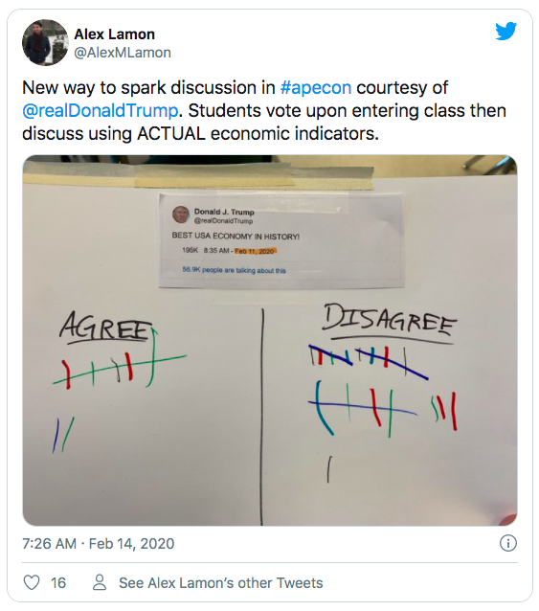
Question of the day getting stale? Try a quick poll (zoom has polls now!) with a tweet of the day.

Slide 11
03. Personal stories
Teacher shared stories make personal finance real, and make you real, too.
Notes:
Sharing your own mistakes, bank statements, CC statements, student loans, first home/car/apartment stories are invaluable.
Best practice to share these stories and have time for questions during it - including predictive - what do you think I should do? And reflective - did I make the right decisions?

Slide 12
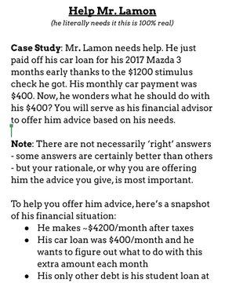
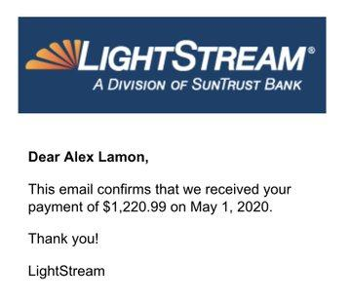

Slide 13
04. Chats with family
Example: Discuss Paying for College
Notes:
Set expectations for a partnership with parents, because fin lit can and should be learned at home too. Habits, behaviors, actions Ss observe at home will be huge to how they learn. It may or may not match what we teach.
One student helped her mom make a family budget.

Slide 14
05. Chats with each other
World Cafe Methodology

Slide 15


Slide 16
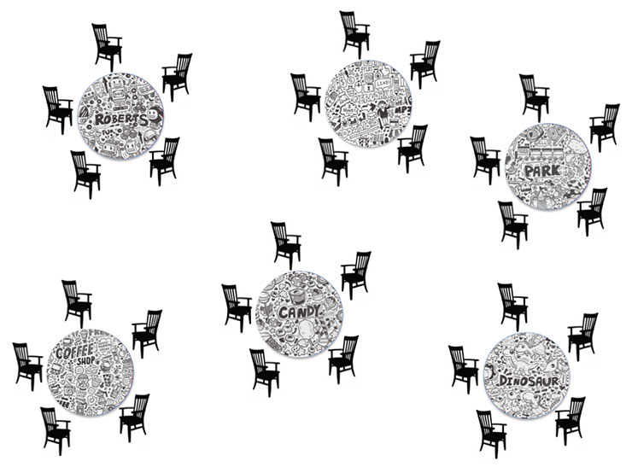
Students prepare their own question
Teacher selects questions - students act as hosts
Facilitate multiple rounds of conversations on topic at the table
Students move after 7 minutes of conversation
Resource: my slides for a personal finance cafe day

Slide 17
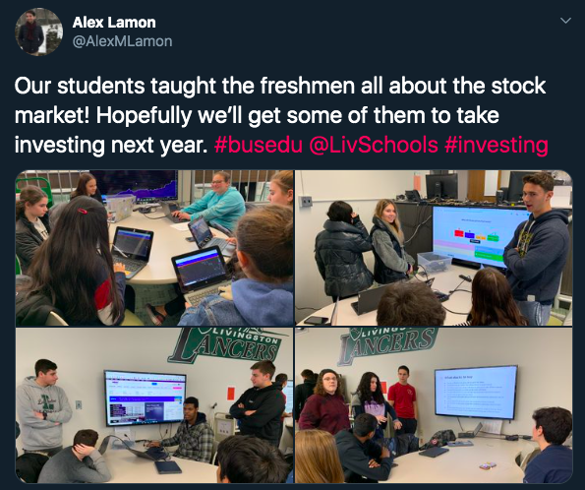

Slide 18
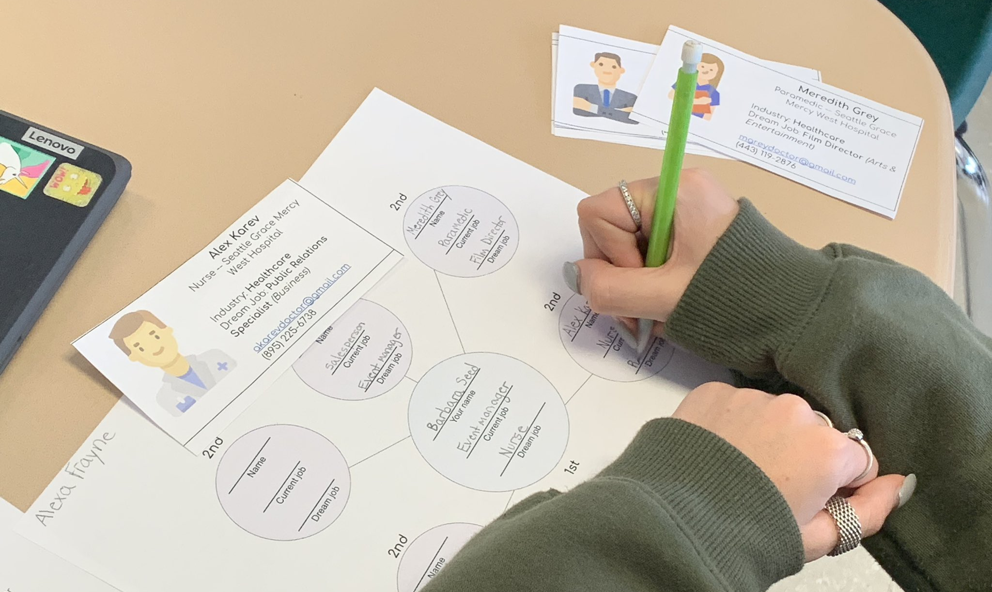
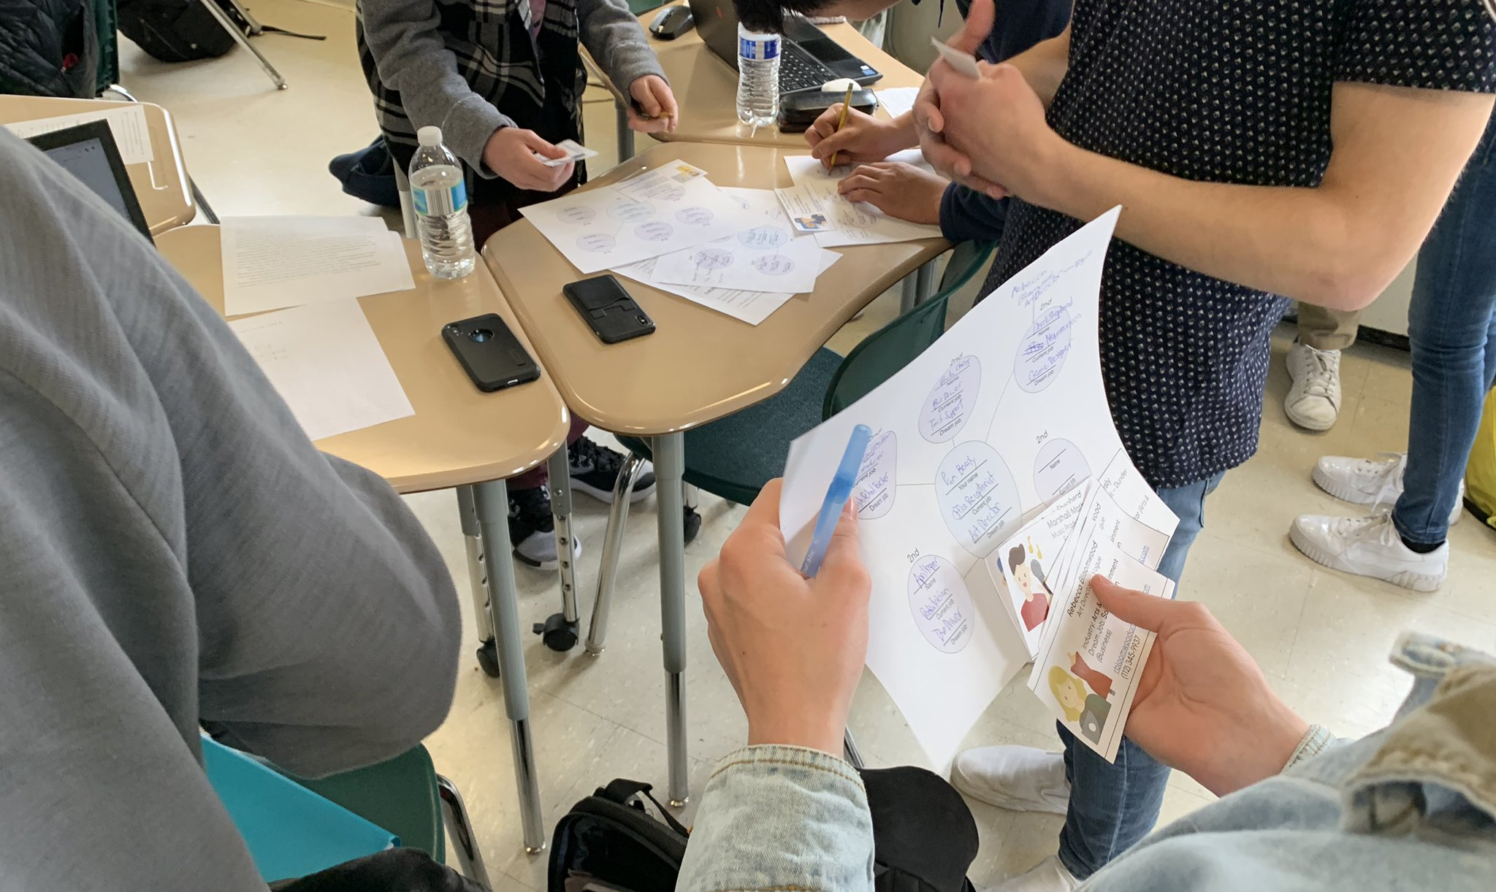
Networking simulation
Overview -- Connections -- Career Cards

Slide 19
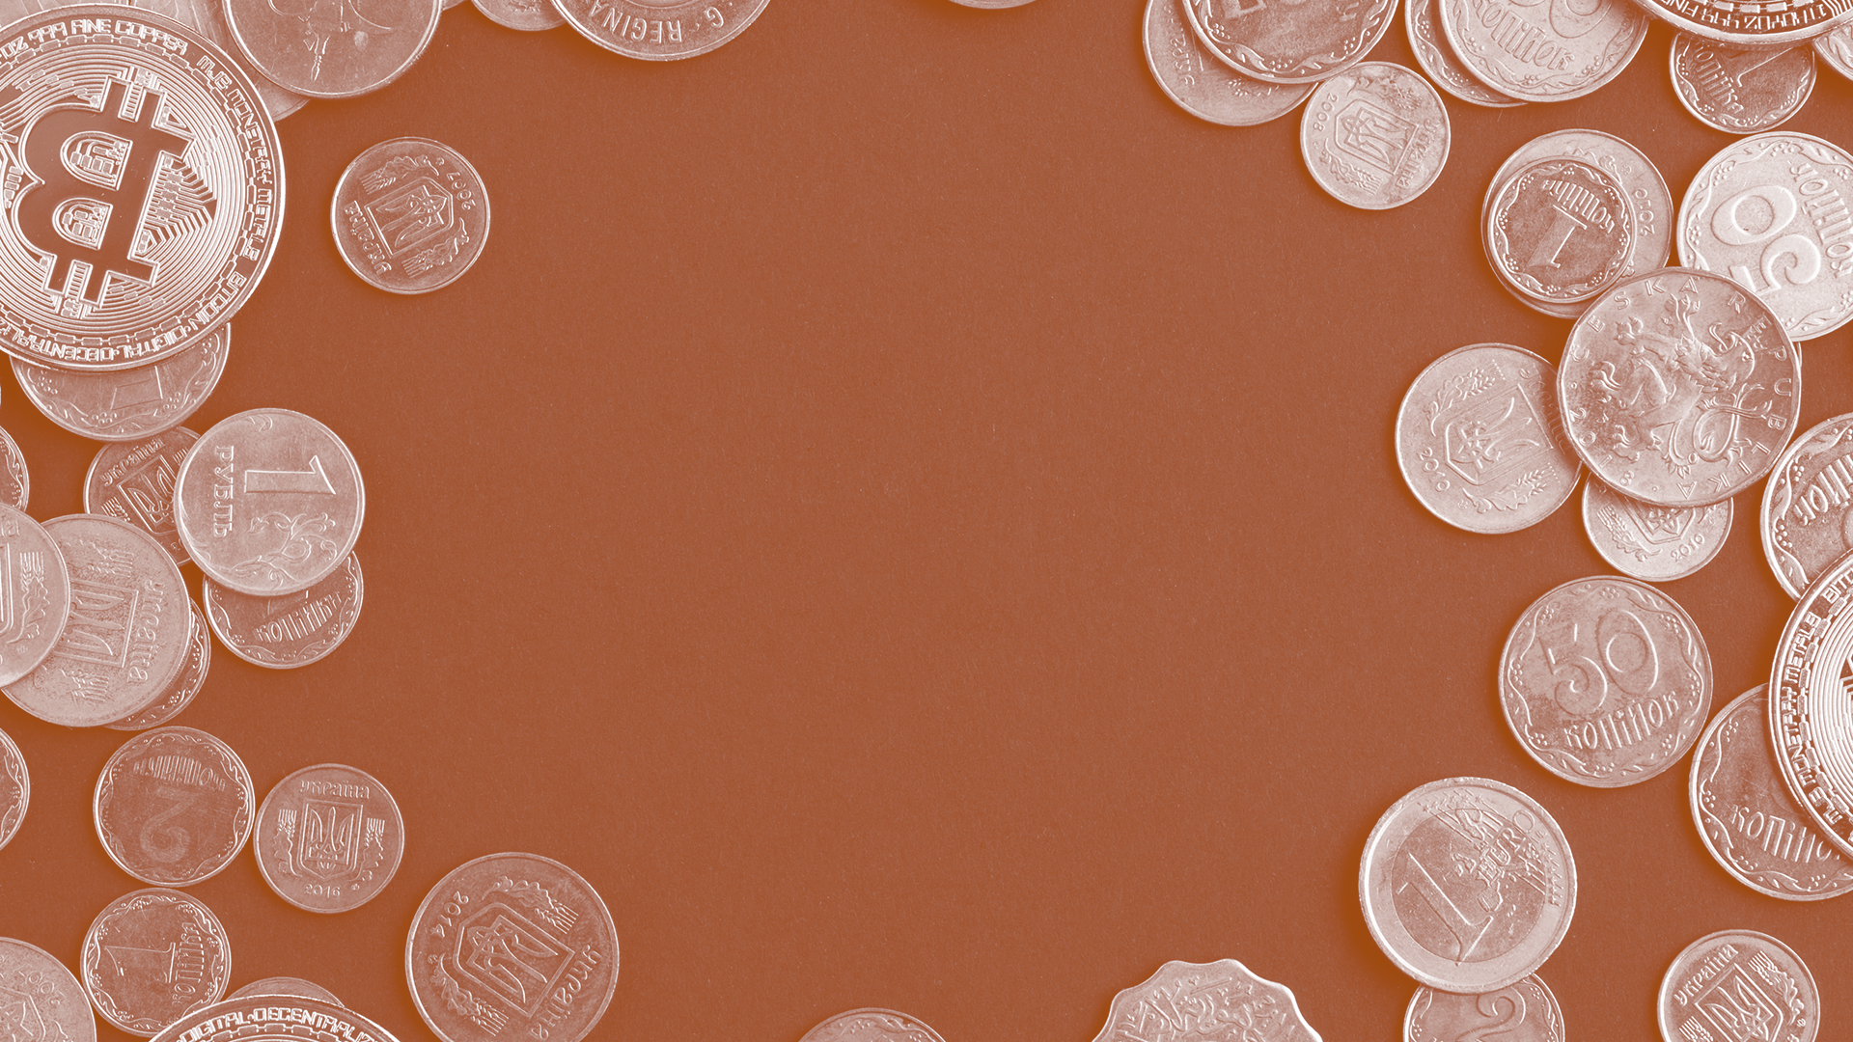
Money talks.
So why shouldn’t we?

Slide 20
THANK you!
Money talks, so let’s keep in touch.
lamonteach@gmail.com
@AlexMLamon
linkedin.com/in/alexlamon/

Slide 21

CEE Affiliates
https://www.councilforeconed.org/resources/local-affiliates/

Slide 22




Thank You to Our Sponsors!

