Slide 1

Teaching Macroeconomics with Games & Simulations
Presented by:
Alex Lamon, CEE Master Teacher
@AlexMLamon
10/9/19
Notes:
About me

Slide 2
Agenda
Today’s Goal: Showcase games and simulations, with best practice usage, for your CP or AP Economics classroom.
Teachers will leave today with new games they can implement in their classrooms, understanding some of the pitfalls and peaks of these games as learning tools.

Slide 3

Fiscal Ship
Topic: Fiscal Policy
Econ Ed Lesson
Teaching Resources

Slide 4
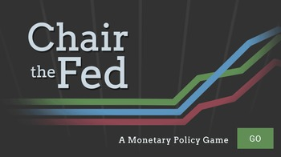
Chair the Fed
Topic: Monetary Policy
FAQs / Reflection Questions
Video Question Guide

Slide 5

People's Pie
Topic: Taxation
Player Guide

Slide 6
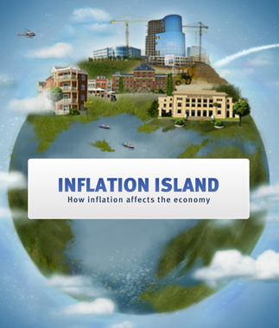
Inflation Island
Topic: Inflation, Economic Indicators
Reflection & Assessment

Slide 7
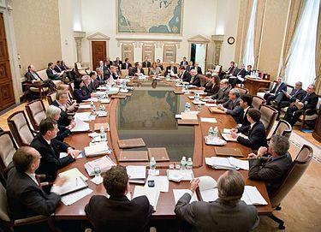
Take A Seat At The Table
Topic: Federal Open Market Committee Meeting
Simulation Slides
Beige Book
FOMC Districts

Slide 8
Summing Up
These games are tools to introduce or enhance understanding
Present them meaningfully, with a clear goal and purpose
Provide opportunity for all students to reflect

Slide 9
Summing Up
Thank you! Feel free to connect:
lamonteach@gmail.com
@AlexMLamon

