Slide 1






Reading Makes Cents:
Using Children’s Literature to Teach Personal Finance
Lynne Farrell Stover
January 26, 2021 stoverlf@jmu.edu

Slide 2
Professional Development Certificate
To earn your professional development certificate for this webinar, you must:
Watch a minimum of 45-Minutes and you will automatically receive a professional development certificate via e-mail within 24 hours.
Accessing resources:
You can now easily download presentations, lesson plan materials, and activities for each webinar from EconEdLink.org/professional-development/

Slide 3
EconEdLink Membership
You can now access CEE’s professional development webinars directly on EconEdLink.org! To receive these new professional development benefits, become an EconEdLink member. As a member, you will now be able to:
Automatically receive a professional development certificate via e-mail within 24 hours after viewing any webinar for a minimum of 45 Minutes
Register for upcoming webinars with a simple one-click process
Easily download presentations, lesson plan materials and activities for each webinar
Search and view all webinars at your convenience
Save webinars to your EconEdLink dashboard for easy access to the event
You may access our new Professional Development page here

Slide 4
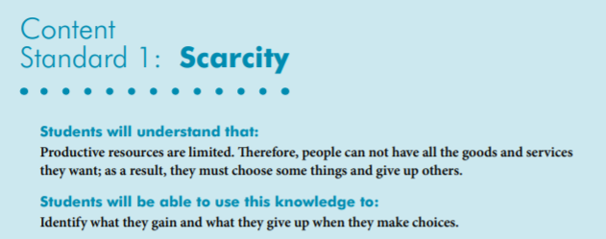

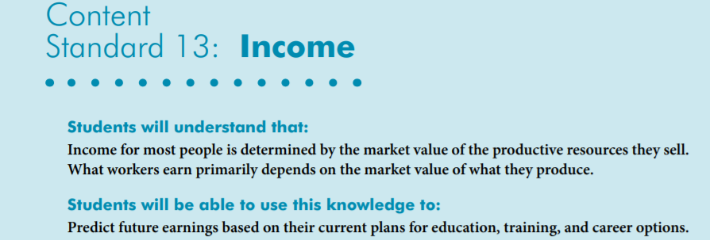
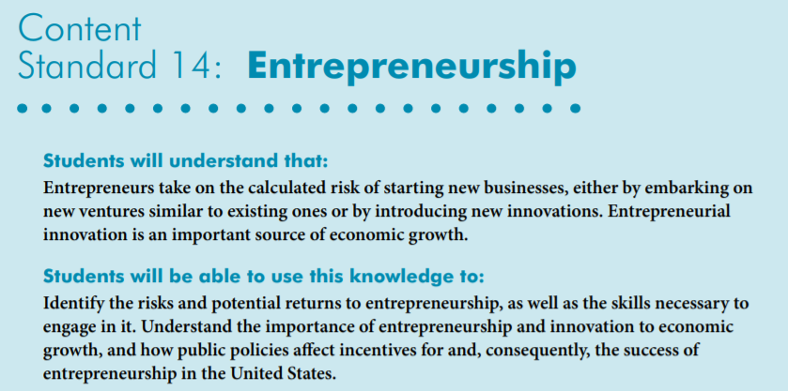
National Standards
https://www.councilforeconed.org/wp-content/uploads/2012/03/voluntary-national-content-standards-2010.pdf

Slide 5

State Standards
Virginia HISTORY & SOCIAL SCIENCE Standards of Learning
K.9 The student will
a) recognize that people make choices because they cannot have everything they want; and
explain that people work to earn money to buy the things they want.
1.9 The student will recognize that people save money for the future to purchase goods and services.
EPF. 4 The student will demonstrate knowledge that many factors affect income by
a) examining the market value of a worker’s skills and knowledge;
c) explaining the relationship between a person’s own human capital and the resulting income potential; and
EPF.10 The student will develop consumer skills by
a) examining basic economic concepts and their relation to product prices and consumer spending;

Slide 6
Agenda
In this webinar, we will discover children’s books that teach students about aspects of personal finance such as:
Compound Interest
Earned Income
Investing
Saving
Bank
Human Capital
Also provided:
Hands on lessons and activities
Websites providing support materials
Related standards
Annotated bibliography
Q & A opportunities

Slide 7
Objectives
Teachers will be able to:
Review related personal finance concepts.
Explore children’s books and identify the personal finance concepts found in them.
Learn how to use book content to teach age- appropriate lessons and activities based on the featured concepts.

Slide 8
Featured Personal Finance Concepts
Allowance- Money paid to a person, often a child, on a regular basis
Bank- A place to save money or to conduct other money business
Compound Interest- Interest paid on the principle and on interest earned previously
Consumer – A person who uses or buys goods and services
Earned Income – Money received for work performed
Entrepreneur- The person who organizes, operates, and assumes the risk for a business venture.
Human Capital- Intangible assets possessed by individuals, including knowledge, talent, skills, health, and values. (Also known as human resources)
Investing – Putting money someplace with the intention of making a financial gain
Opportunity Cost - The next best choice that is given up when you make a decision
Producer- A person who makes goods or provides services
Saving – Money not spent now so it can be spent in the future

Slide 9

Uncle Jed’s Barbershop
By Margaree King Mitchell
Publisher: Aladdin
Copyright Date: 1993
Reading Level: 3.8
Interest Level: K-3
https://www.youtube.com/watch?v=mPoDDTKaQMU
(Six Minutes)

Slide 10
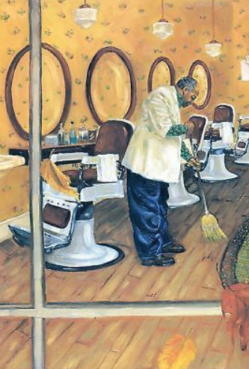
Uncle Jed’s Barber Shop
Story Synopsis: Told in the voice of young Sarah Jean, this tale of perseverance features her remarkable Uncle Jed. The story chronicles life in the segregated South as the reader learns of the hardships of segregation and the heartbreak of losing hard earned money when the banks fail on the outset of the Great Depression.
Finally, at the age of 79, Uncle Jed saves enough to achieve his goal of open his own barbershop.

Slide 11

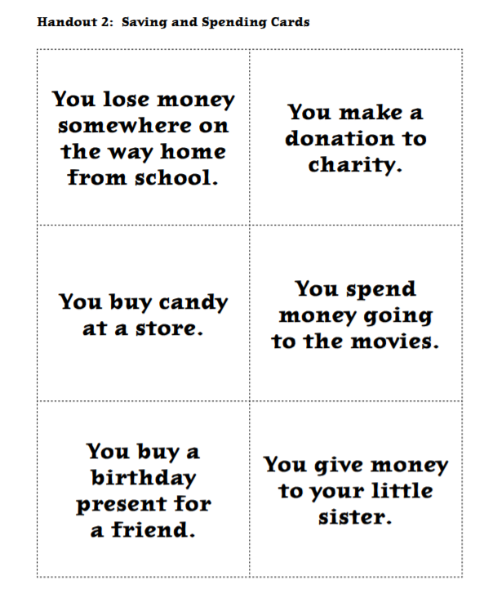
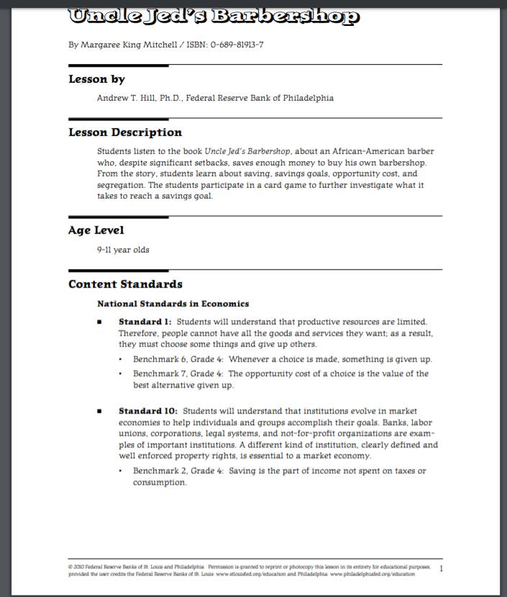
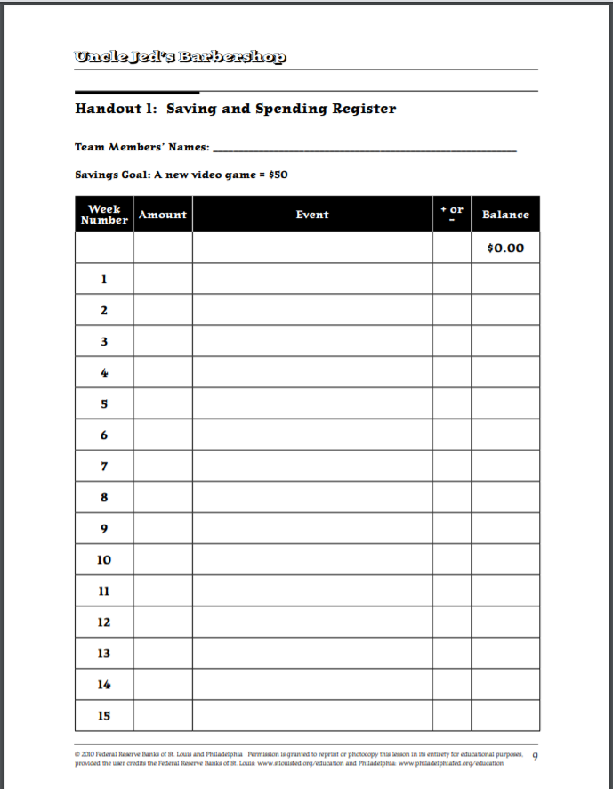
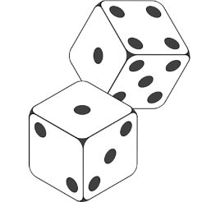
https://www.stlouisfed.org/education/uncle-jeds-barbershop
Savings Goal

Slide 12

Rock, Brock and the Savings Shock
by Sheila Bair
Publisher: Albert Whitman Copyright Date: 2006
Reading Level: 5.0
Interest Level: 1-4
https://www.youtube.com/watch?v=fbSOf2_jHc4
(Five Minutes)

Slide 13
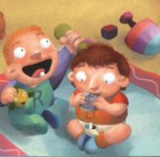
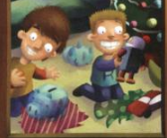
Rock, Brock, and the Savings Shock
Story Synopsis: Rock and Brock may be twins, but they are not alike when it comes to physical appearance, personalities, and spending habits. Neat and organized Rock cannot resist spending his money, while messy and free-spirited Brock has amazing restraint when it comes to saving his.

Slide 14
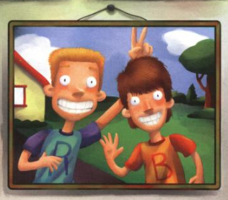
Synopsis cont’d: The brothers learn a valuable lesson when their grandfather pays them each a dollar for doing chores and promises that for each dollar they save, he will double it for the next ten weeks. Rock quickly spends his money on silly toys, gum, and used yard-sale items. Brock resists the temptation to spend, and amasses $512 by the end of the summer. All ends well when Brock shows his brother that it’s never too late to start a saving plan.

Slide 15
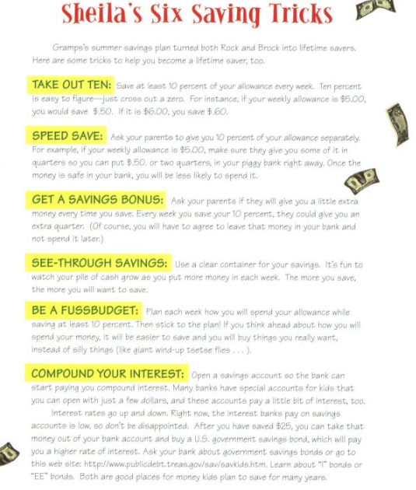
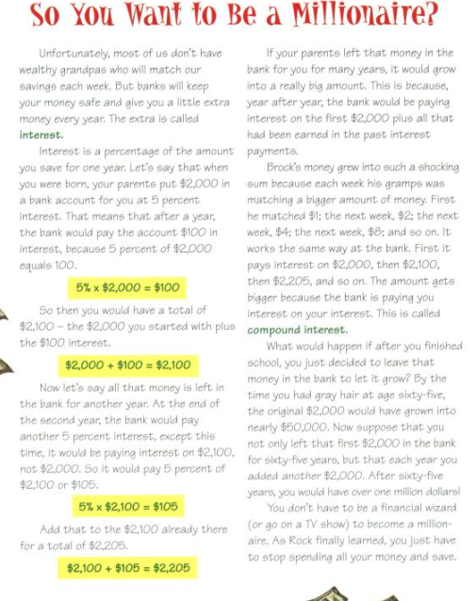
Author’s Notes:

Slide 16
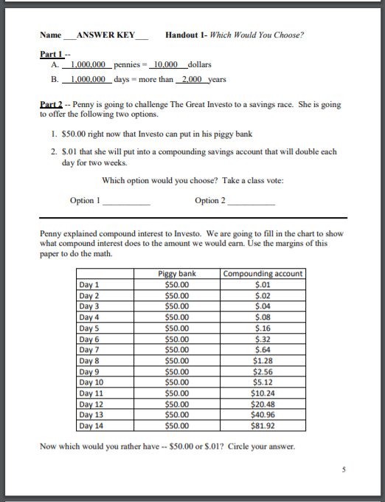
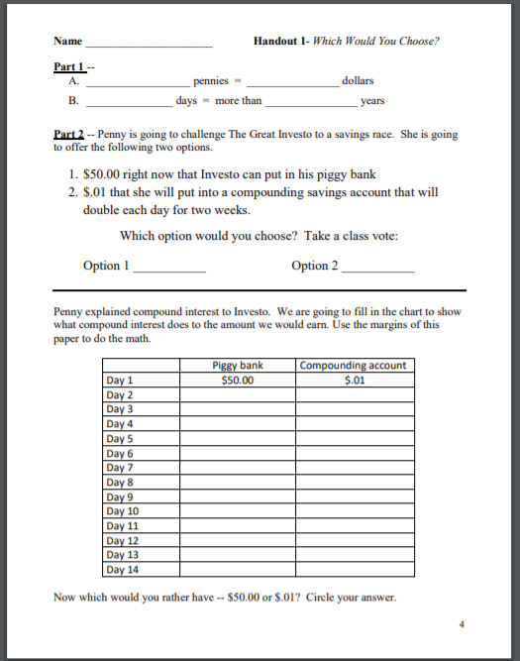
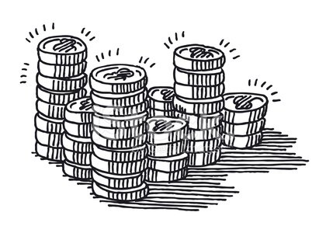
http://debankers.com/Assets/2017_TCTSD_Lesson_Investo_Million_Pennies.pdf

Slide 17

Isabel’s Car Wash
by Sheila Bair
Publisher: Albert Whitman
Copyright Date: 2008
Reading Level: 4.2
Interest Level: K-3
https://www.youtube.com/watch?v=PP8YXWX8txk
(10 Minutes)

Slide 18
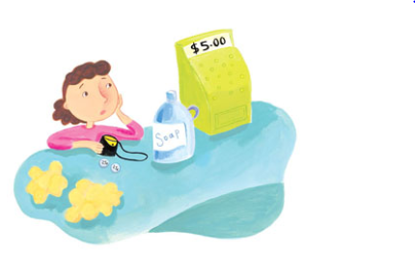
Story Synopsis: The Nelly Longhair doll is on sale at Murphy's Toys for ten dollars, but Isabel has only fifty cents. Isabel decides to start a car wash business --- she's sure she can make money! However, at the hardware store, she learns that her supplies will cost five dollars! If five of her friends will invest one dollar each, she'll have enough. Will Isabel be able to pay them back and have enough left over for the Nelly doll?

Slide 19
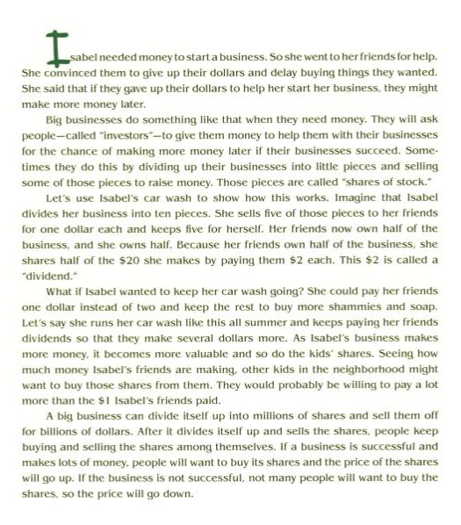
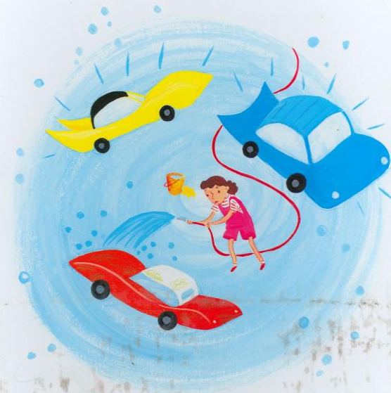
Author’s Note

Slide 20

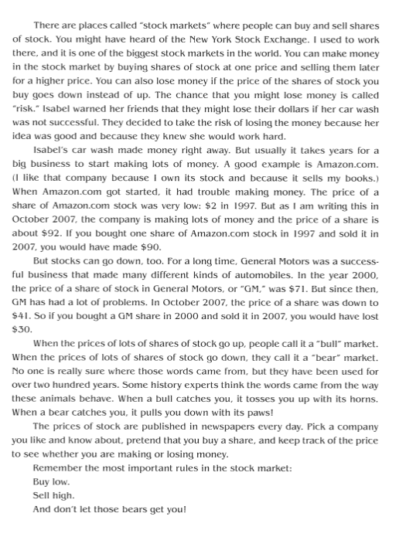
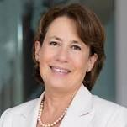
Sheila Colleen Bair was the 19th Chair of the U.S. Federal Deposit Insurance Corporation, during which time she assumed a prominent role in the government's response to the 2008 financial crisis. She was appointed to the post for a five-year term on June 26, 2006 by George W. Bush, through July 8, 2011.

Slide 21

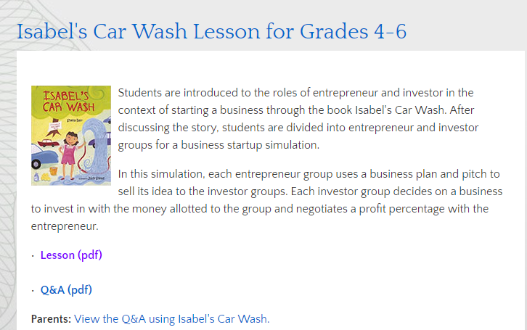
https://www.stlouisfed.org/education/isabels-car-wash
https://www.kansascityfed.org/education/resources/isabels%20car%20wash

Slide 22
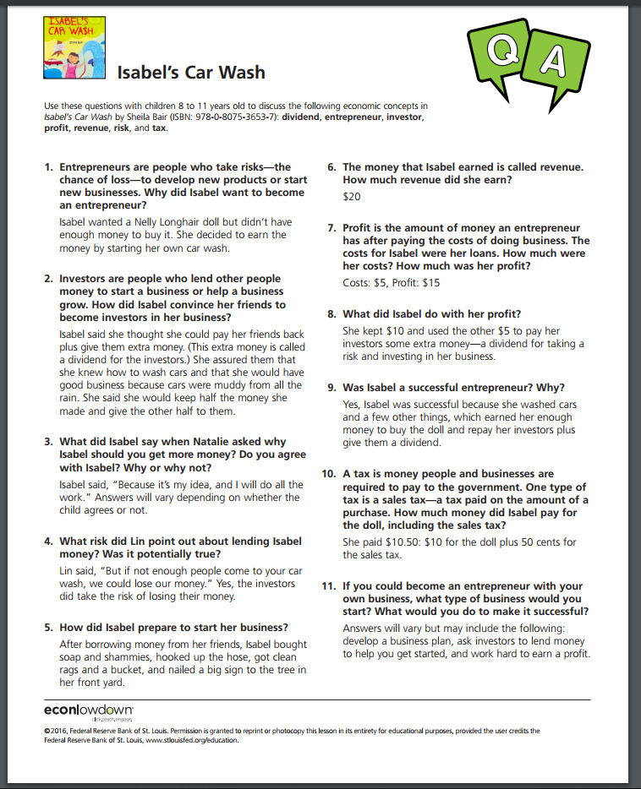

Slide 23
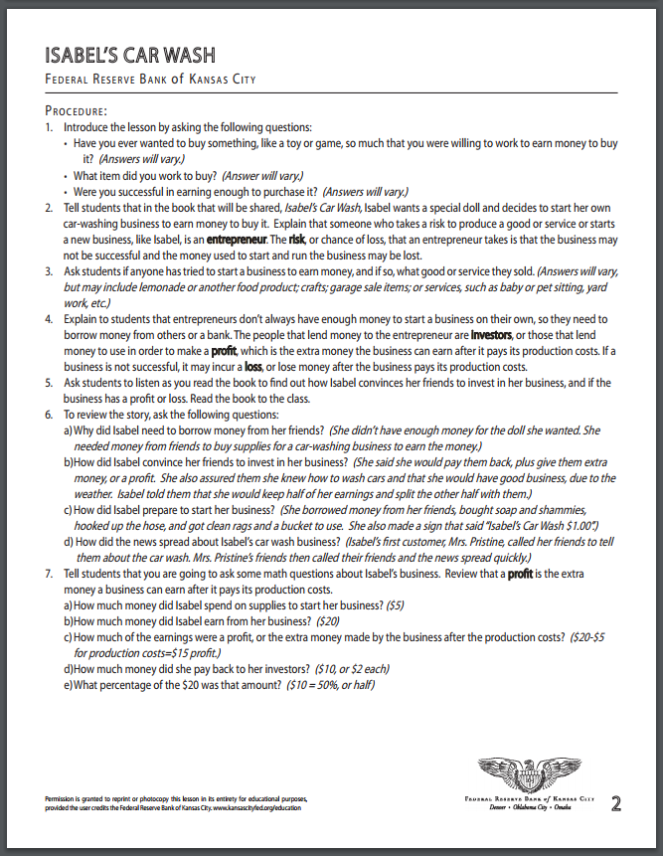
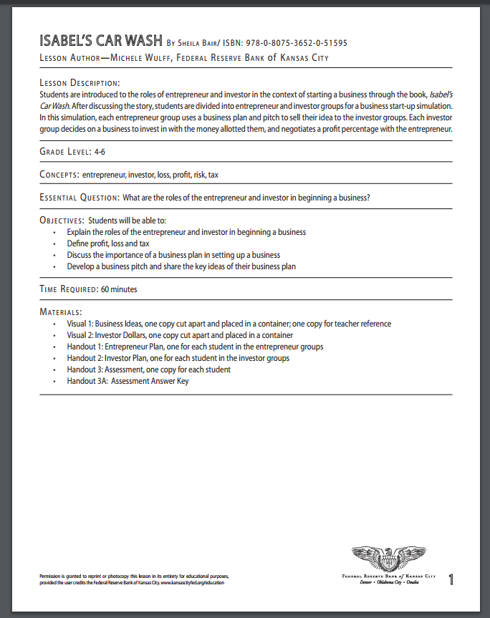
Lesson Plans

Slide 24
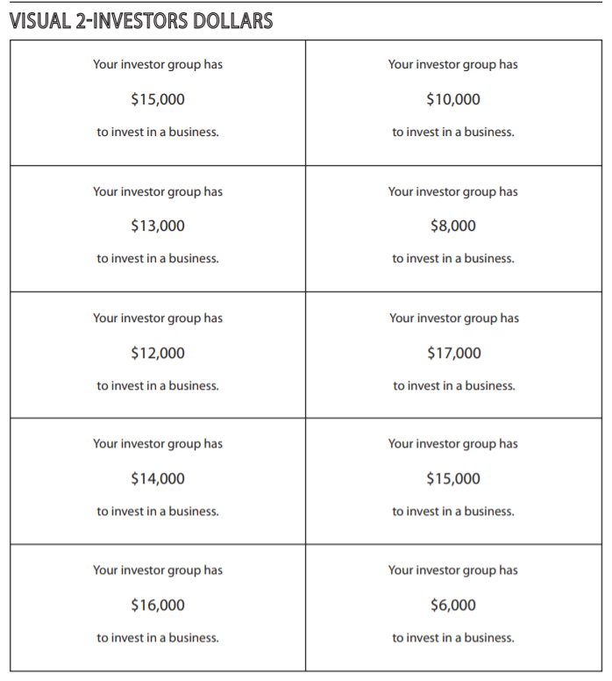
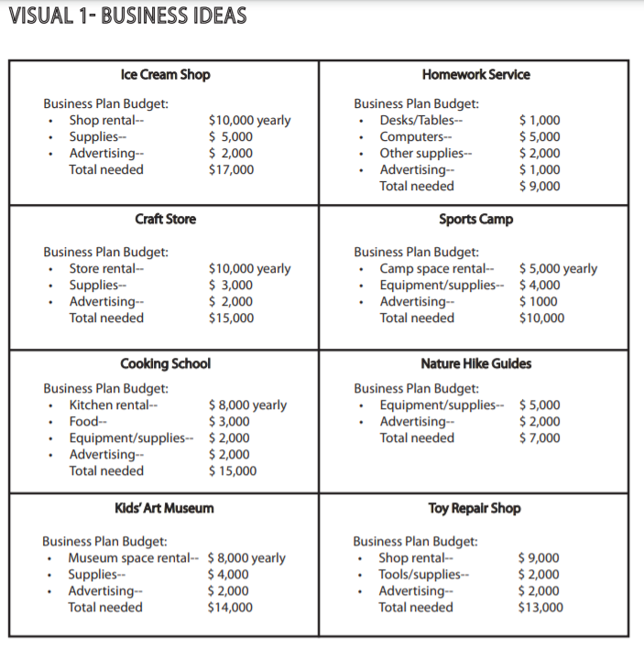

Slide 25

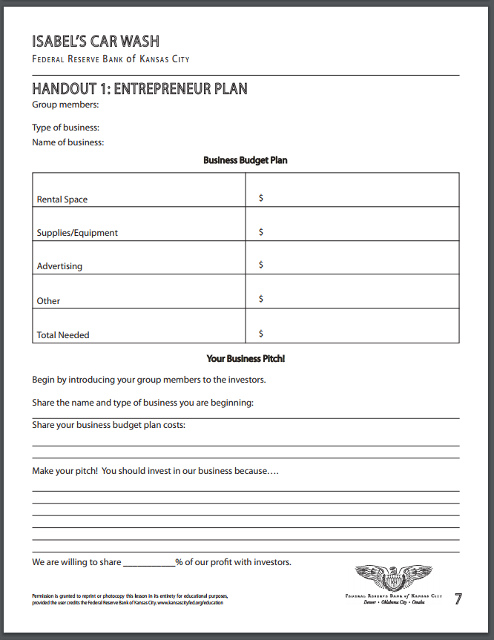
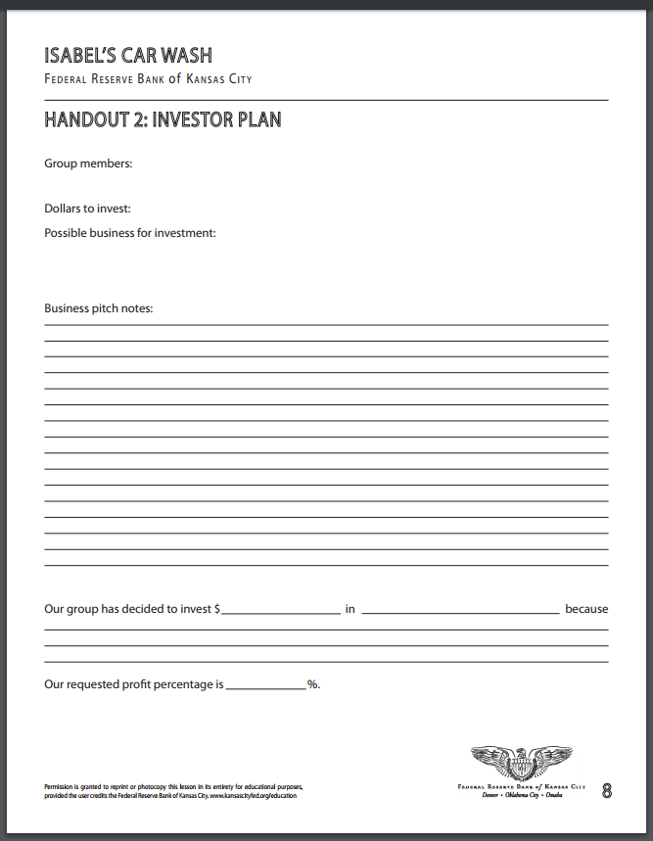
Handouts

Slide 26
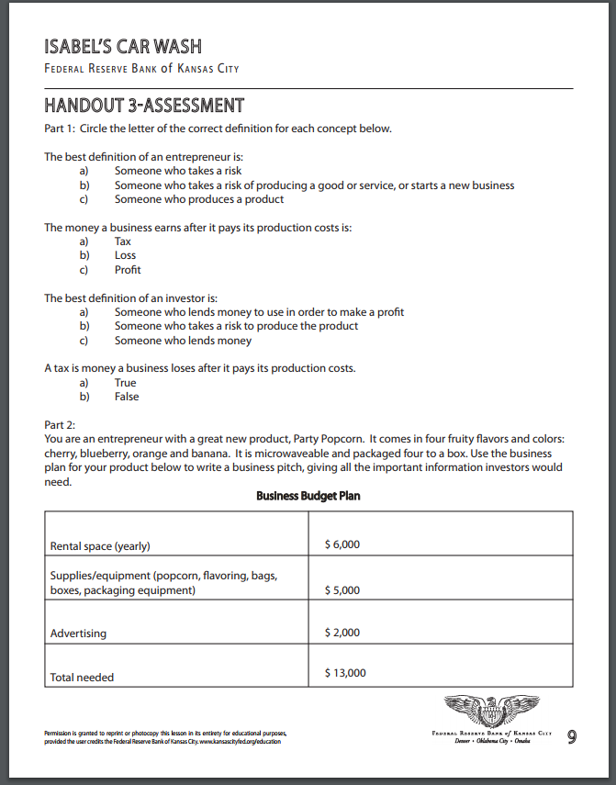
Assessment

Slide 27
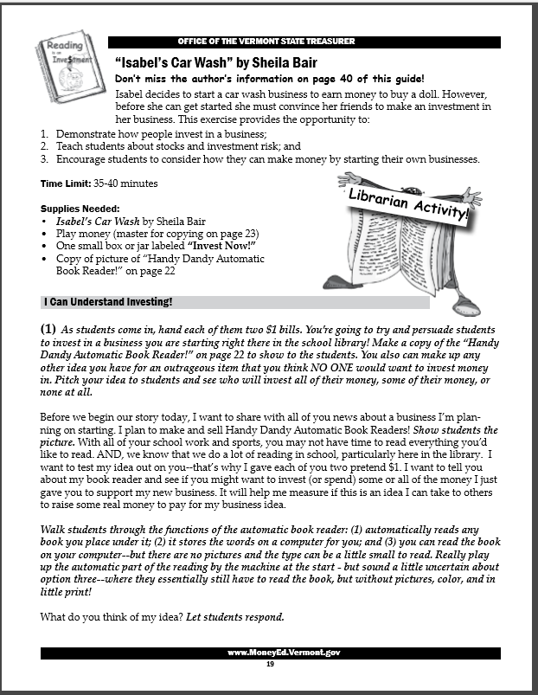
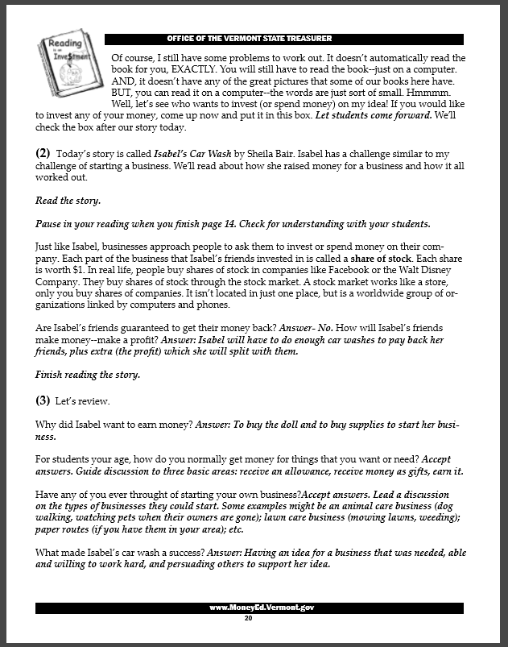
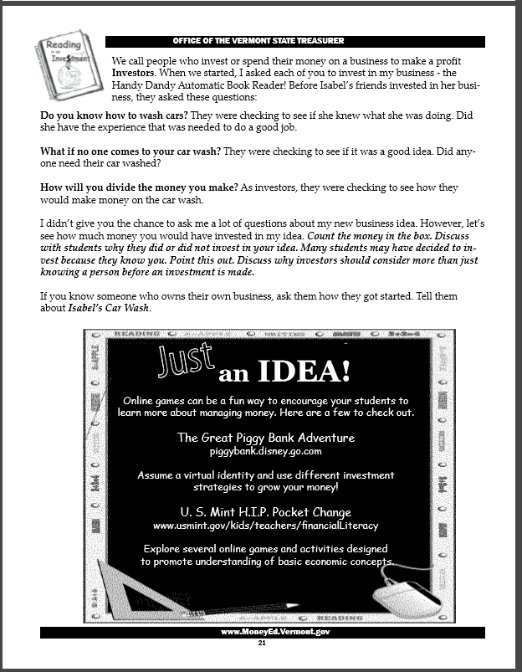
http://www.vermonttreasurer.gov/content/2012-2013-reading-investment

Slide 28


Tia Isa Wants a Car by Meg Medina
Publisher: Candlewick
Copyright: 2011
Reading Level: 3.0
Interest Level: P-2
https://www.youtube.com/watch?v=8K-MtzB62IU
(Ten Minutes)
Spanish
Edition

Slide 29
Story Synopsis: One hot Summer day, Tía Isa makes a bold statement; she wants a car. Her niece, the story’s narrator, thinks this is a grand idea. Saving the money to buy a car is not going to be easy. Most of the money Tía Isa earns at the bakery is sent to help family members who are living on a faraway island. (This island could be Cuba. The author is Cuban-American.)
The young girl wants to help her aunt. Resourcefully, she finds jobs in the neighborhood and puts all of her earnings in a saving sock that grows into a “giant money sausage.” When enough is saved and the car is purchased, the first thing Tía Isa does is tape a picture of the family on the dashboard.

Slide 30
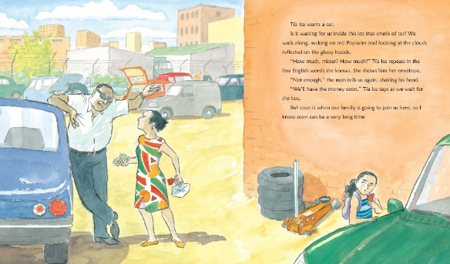
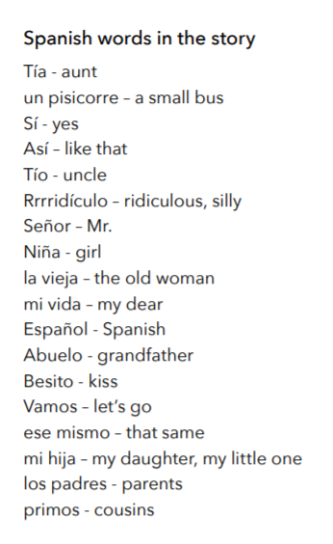
Lending a delightful Latin flavor are the Spanish words embedded throughout the text. This is not confusing, and a glossary is not needed. Claudio Munoz's animated illustrations, in watercolor and ink, add detail and humor.

Slide 31
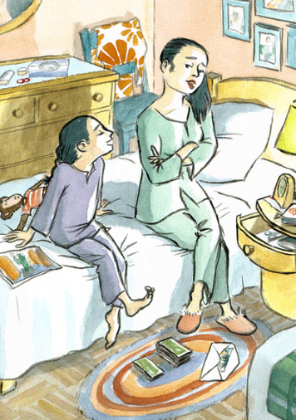
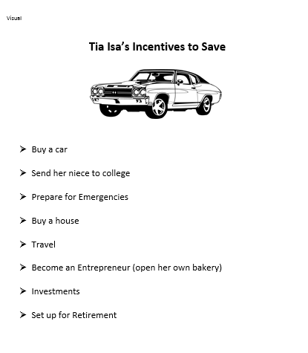

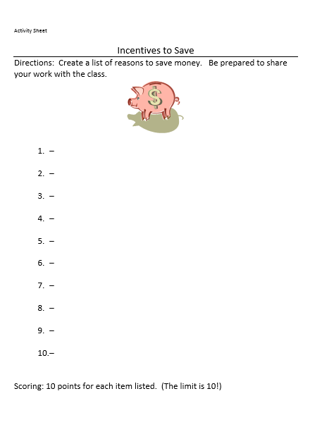
Incentives to Save

Slide 32

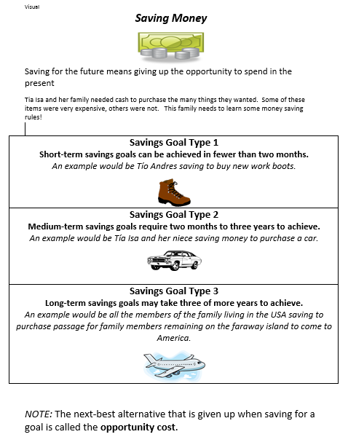
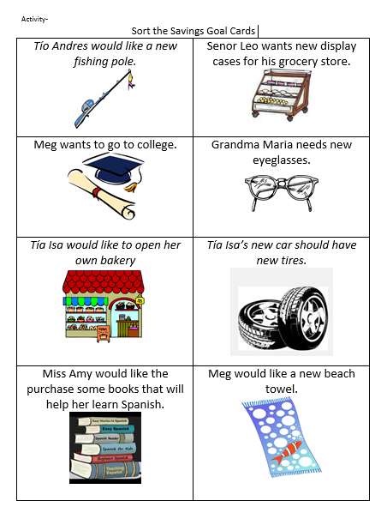
Savings Goals

Slide 33
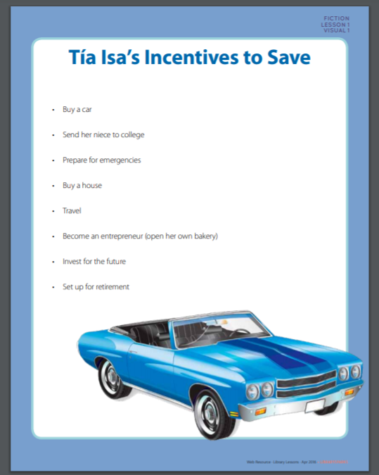
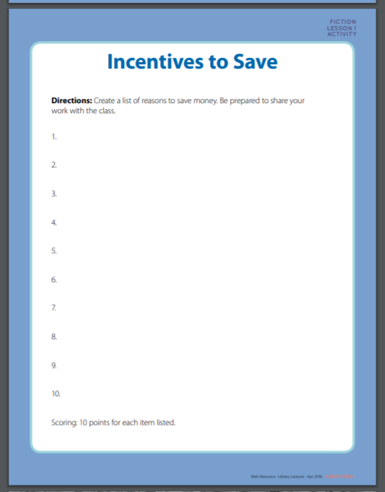
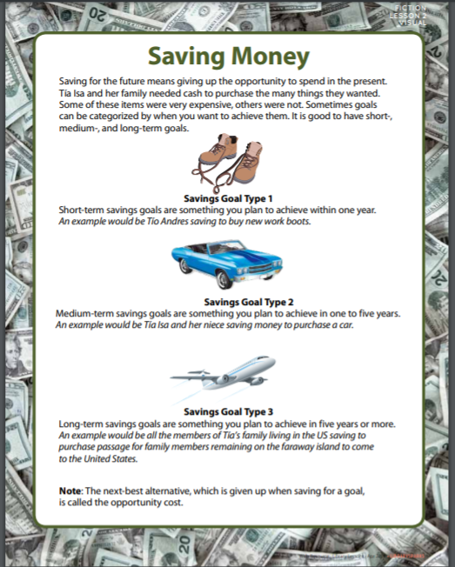
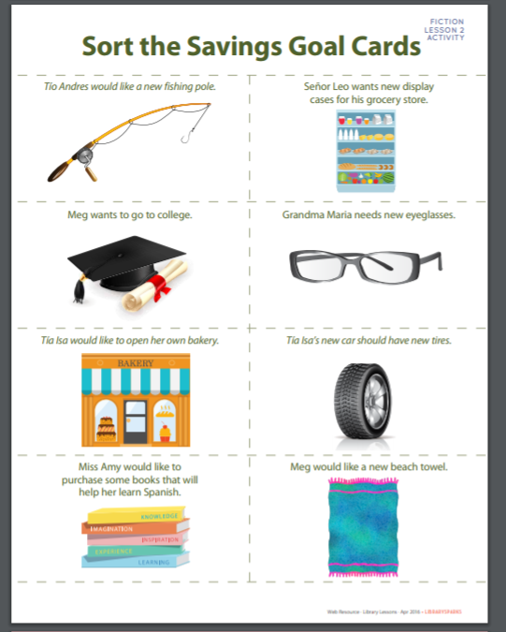
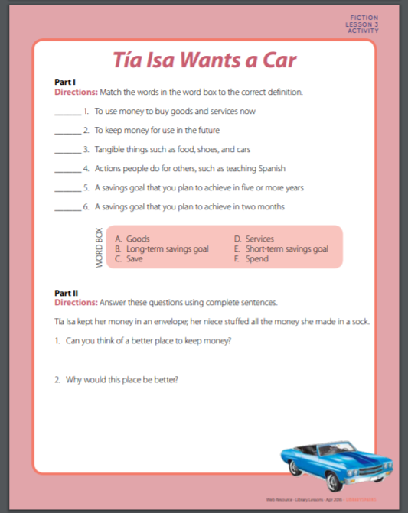
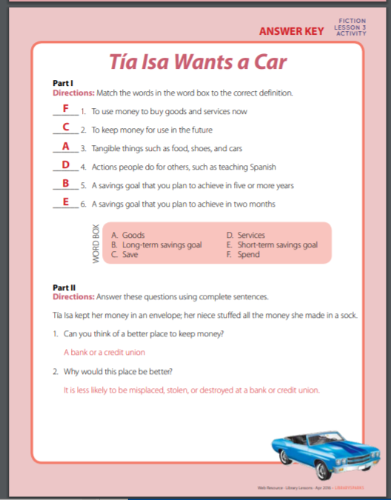
https://www.librarysparks.com/wp-content/uploads/2016/06/lsp_ll_fiction_apr16.pdf

Slide 34
Ella Earns Her Own Money
by Lisa Bullard
Publisher: Lerner
Copyright Date: 2014 Reading Level: 2.3
Interest Level: K-3
https://www.youtube.com/watch?v=rwhoFrYDFyg
(Ten Minutes)

Slide 35
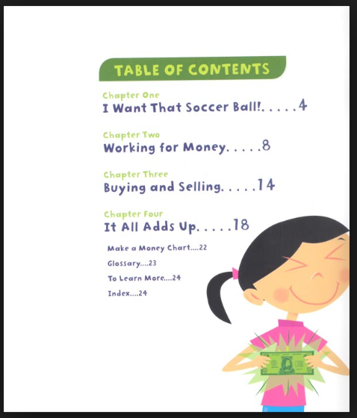
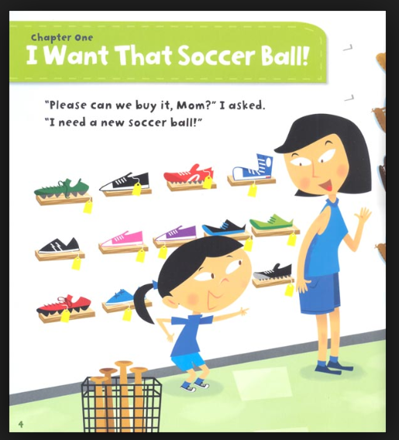
Story Synopsis: Ella really wants a soccer ball, but she doesn't have enough money to buy one. So she decides to earn her own money. Ella cleans the car for her mom, gives the neighbor's dog a bath and sells bracelets to her friends to earn cash. Will she have enough money to buy the ball in the end?

Slide 36
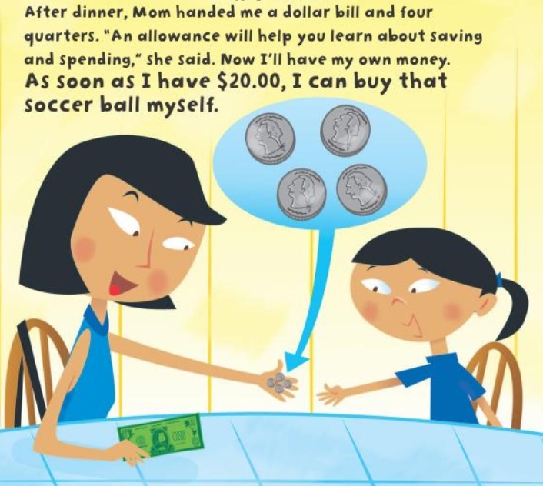
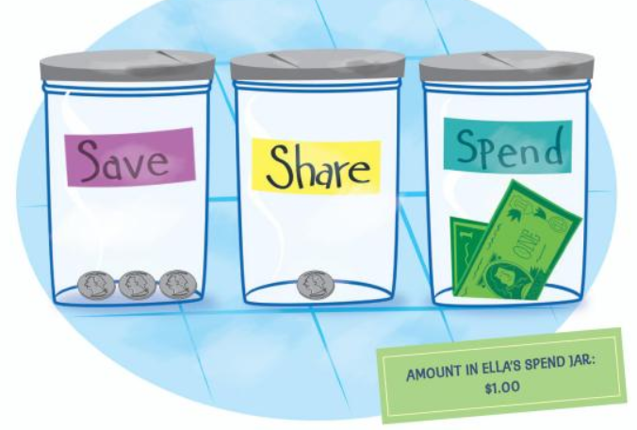



Thoughtful Saving!

Slide 37



Slide 38



Slide 39



Lesson – Move it!

Slide 40




Slide 41
Save It!
By Cinders McLeod
Reading Level: 1.0
Interest Level: PK-2
Publisher: Penguin Copyright Date: 2019
https://www.youtube.com/watch?v=-x97ApD-Cd0
(Three Minutes)

Slide 42



Slide 43
Assessment Framing Questions
What are the benefits of using children’s literature to teach personal finance?
Why is it important to teach young students about personal finance?
How can picture books be used with older students?
How can getting parents aware of the content and concepts help reinforce “lessons learned” in the featured books?

Slide 44

https://vcee.org/elementary-school/reading-makes-cents/

Slide 45



Publisher: Random House
Copyright Date: 2019
Reading Level: 3.3
Interest Level: P-2

Slide 46


Publisher: Nancy Paulsen Books
Copyright Date: 2019
Reading Level: 3.5
Interest Level: K-3

Slide 47






Slide 48
References
YouTube Book Readings
https://www.councilforeconed.org/wp-content/uploads/2012/03/voluntary-national-content-standards-2010.pdf
Title | Link
Uncle Jed’s Barber Shop | https://www.youtube.com/watch?v=mPoDDTKaQMU
Rock, Brock and the Savings Shock | https://www.youtube.com/watch?v=fbSOf2_jHc4
Isabel’s Car Wash | https://www.youtube.com/watch?v=PP8YXWX8txk
Tia Isa Wants a Car | https://www.youtube.com/watch?v=PP8YXWX8txk
Ella Earns Her Own Money | https://www.youtube.com/watch?v=rwhoFrYDFyg
Save It! | https://www.youtube.com/watch?v=-x97ApD-Cd0

Slide 49

CEE Affiliates
https://www.councilforeconed.org/resources/local-affiliates/

Slide 50




Thank You to Our Sponsors!

