Slide 1

Student Loans:
Don’t Be Afraid, Be Informed
Presented by John Hupalo
November 24, 2020 john@inviteeducation.com

Slide 2
EconEdLink Membership
You can now access CEE’s professional development webinars directly on EconEdLink.org! To receive these new professional development benefits, become an EconEdLink member. As a member, you will now be able to:
Automatically receive a professional development certificate via e-mail within 24 hours after viewing any webinar for a minimum of 45 minutes
Register for upcoming webinars with a simple one-click process
Easily download presentations, lesson plan materials and activities for each webinar
Search and view all webinars at your convenience
Save webinars to your EconEdLink dashboard for easy access to the event
You may access our new Professional Development page here

Slide 3
Professional Development Certificate
To earn your professional development certificate for this webinar, you must:
Watch a minimum of 45-minutes and you will automatically receive a professional development certificate via e-mail within 24 hours.
Accessing resources:
You can now easily download presentations, lesson plan materials, and activities for each webinar from EconEdLink.org/professional-development/

Slide 4
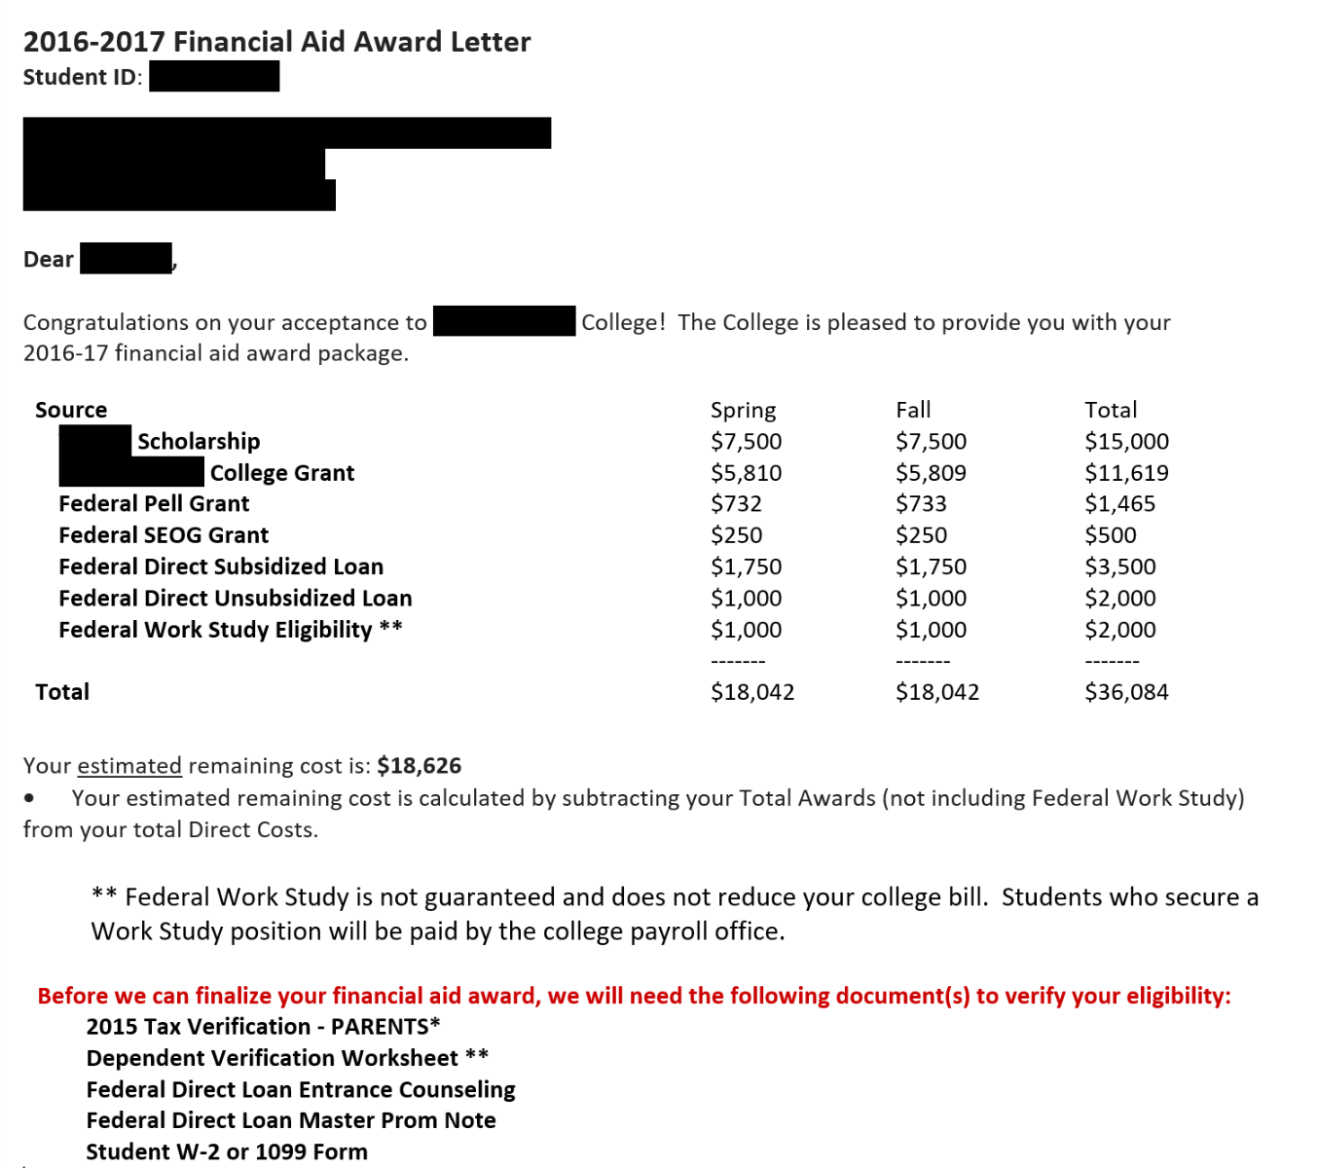
Question an Award Letter?
< ???
< ???
< ???

Slide 5



Sticker vs Net Price
₌
-
Sticker Price
Financial Aid
Net Price
($52,710)
($34,084)
($18,626)

Slide 6

Pop Quiz #1
Given financial aid of $36,084 and an unmet need of $18,626:
What is the student’s cost to attend this college?
$18,626
$52,710
$74,504
Need more info
Unmet need
Sticker price
Unmet need (x4)
Correct

Slide 7



College Costs Vary by Student
₌
+
+
Books & Miscellaneous
Travel
Net Price
Total: $20,926
($18,626)
($1,500)
($800)

Slide 8
Pop Quiz #2
Given financial aid (Free money, $28,584; Work-Study, $2k; Direct Loans, $5.5k), unmet need ($18,626) and other costs ($2.3k), how much cash does this family need?
A. $18,626
B. $20,926
C. $26,426
D. $28,200
Unmet need
Need + Other Costs
CORRECT: Need + Other + Loans

Slide 9

Managing Student Loans
  The last resort, not the first option
  Know before you owe
  Plan ahead for total college borrowing

Slide 10

Minimize Loans
Family Savings & Income
Scholarships & other Free Money
Payment Plans
Student Loan
Parent Loan

Slide 11
Loans: Know Before You Owe
Undergraduate Student
Parents
  Federal: subsidized & unsubsidized
  Federal PLUS
  Private
  Other
    Maximums by year of study
            Fixed Interest Rate (2.75%)
            Fee (1.057%)
                Flexible repayment terms
  Up to cost of attendance
  Minimal Credit Test
  Fixed Interest Rate (5.30%)
  Large Fee: (4.236%)
Private (w/parent co-signer)
  Banks, Credit Unions, States, Finance Companies
  Interest rate based on credit score
  Co-signer release
  Home Equity
  401 (K)

Slide 12

Federal Student Loans
The Good
  Everyone’s eligible
  Many repayment options
The Bad
  Amount you can borrow is capped
  It’s easy to rack up debt
The Ugly
  $1.7 trillion of student loan debt
  Complexity leads to confusion

Slide 13
Terminology
Bankruptcy likely will not wipe out student loans
Grace Period
Subsidized Loan
Non-dischargeable
Repayment begins 6 months after graduating, leaving school or dropping below half-time
Interest is paid by the government while in school and during grace period
Interest accumulates in-school
Borrower may pay or add it to the loan
Deferment
Forbearance
Unsubsidized Loans
Interest accumulates in-school
Borrower may pay or add it to the loan
Zero or reduced payments for up to 12 months
Discretionary or Mandatory

Slide 14

Federal Borrowing Maximums
Year | Unsubsidized | Subsidized | Total
1
$2,000
$3,500
$5,500
2
$2,000
$4,500
$6,500
3
$2,000
$5,500
$7,500
4+
$2,000
$5,500
$7,500
4+ Year Total: $31,000

Slide 15
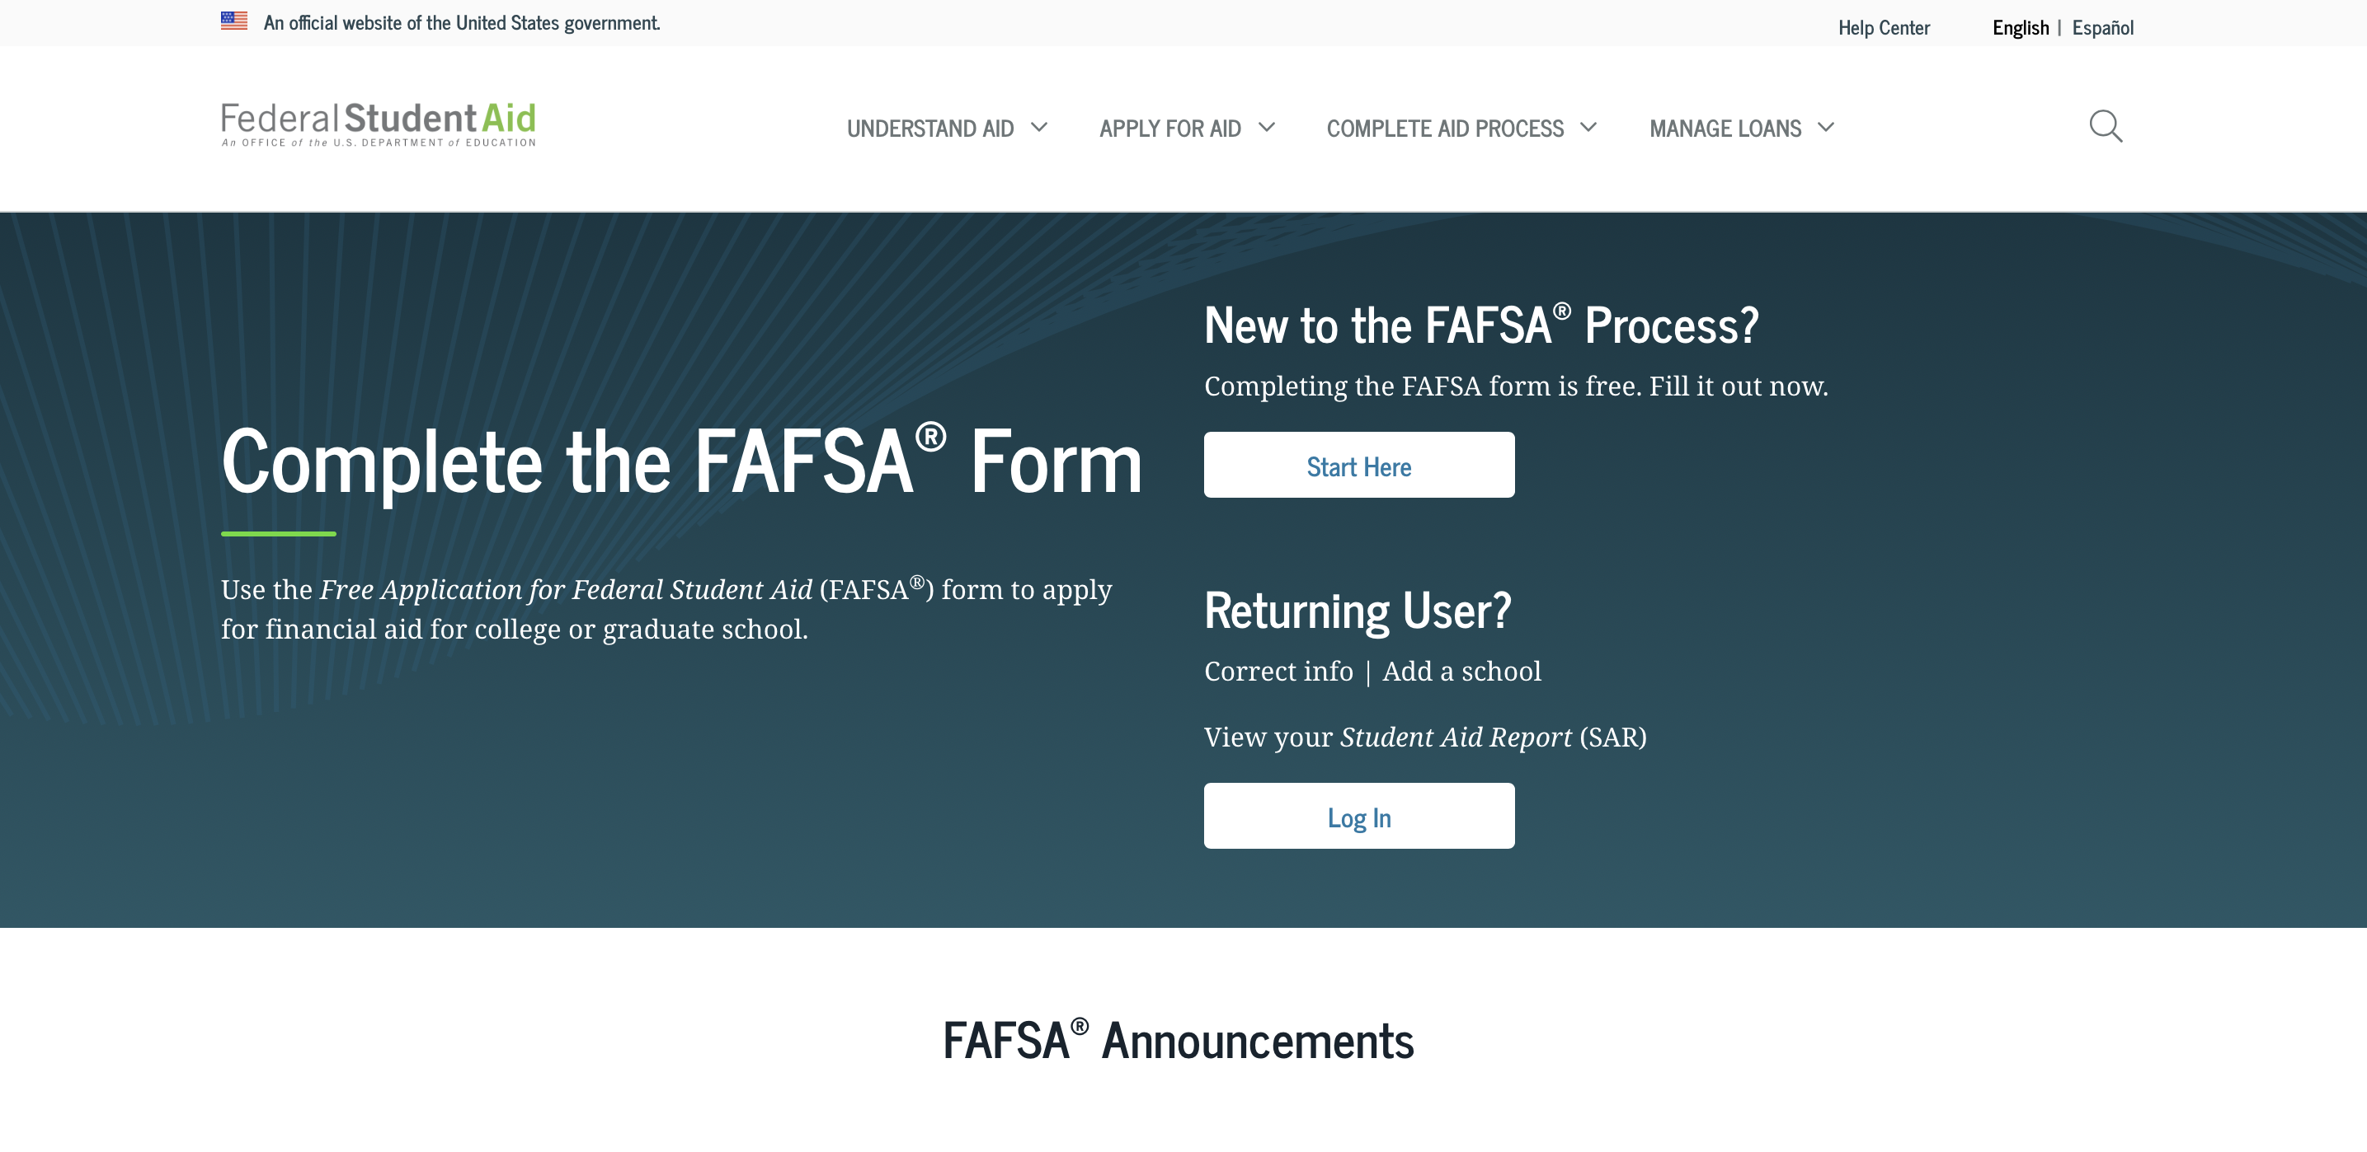
Applying for a Federal Student Loan
studentaid.gov

Slide 16
Student Loan Forgiveness
Public Service Loan Forgiveness
Teacher Loan Forgiveness
Total and Permanent Disability Discharge
Loans forgiven after 120 qualifying monthly payments
Employment Certification Form
Lots of red tape
For “Highly Qualified” teachers
Five yrs low-income school, up to $17,500
Proof of disability
U.S. Dept of Education approval

Slide 17
How & Why to Avoid Student Loans Defaults
Contacting the student loan servicer EARLY is very important
What happens?
Report to credit bureaus & lower score.
Federal government may garnish wage, seize income tax refunds and hold back social security payment.
Discharging in bankruptcy is very difficult.

Slide 18
Servicers Help Identify Best Payment Plan
Repayment Plan | Term | Amount
Standard
10 Years
Fixed
Graduated
10 Years
Payments increase
Extended
25 Years
Fixed/Increasing
Pay as You Earn (PAYE)
20 years
10% of income
Revised Pay as You Earn (REPAYE)
20 or 25 years
10% of income
Income Based
20 or 25 years
10-15% of income
Income Contingent
25 years
Adjusts annually
Income Sensitive
10 Years
Fixed % of income

Slide 19

Post-Graduation Options
Federal Direct Consolidation
Private Credit Refinance
Federal Government
Guaranteed approval
Interest rates calculated based on debt
Only eligible for Federal Loans
Payment term based on income 20+ years
Banks, credit unions, state agencies
Undergo credit check for approval
Interest rate based on credit history
Private and Federal loans are eligible
Merges Loans
May reduce monthly payments

Slide 20

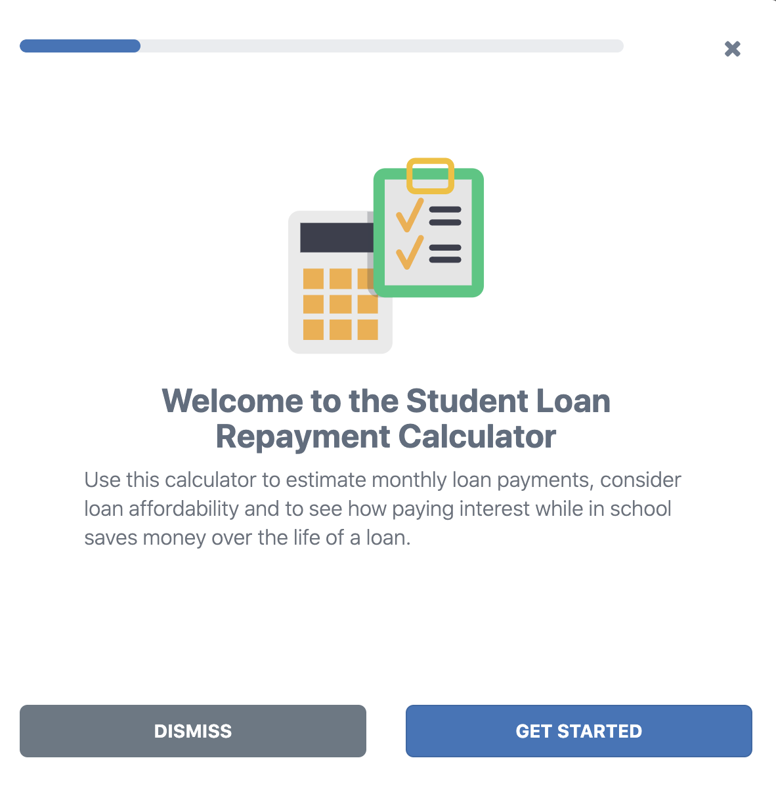
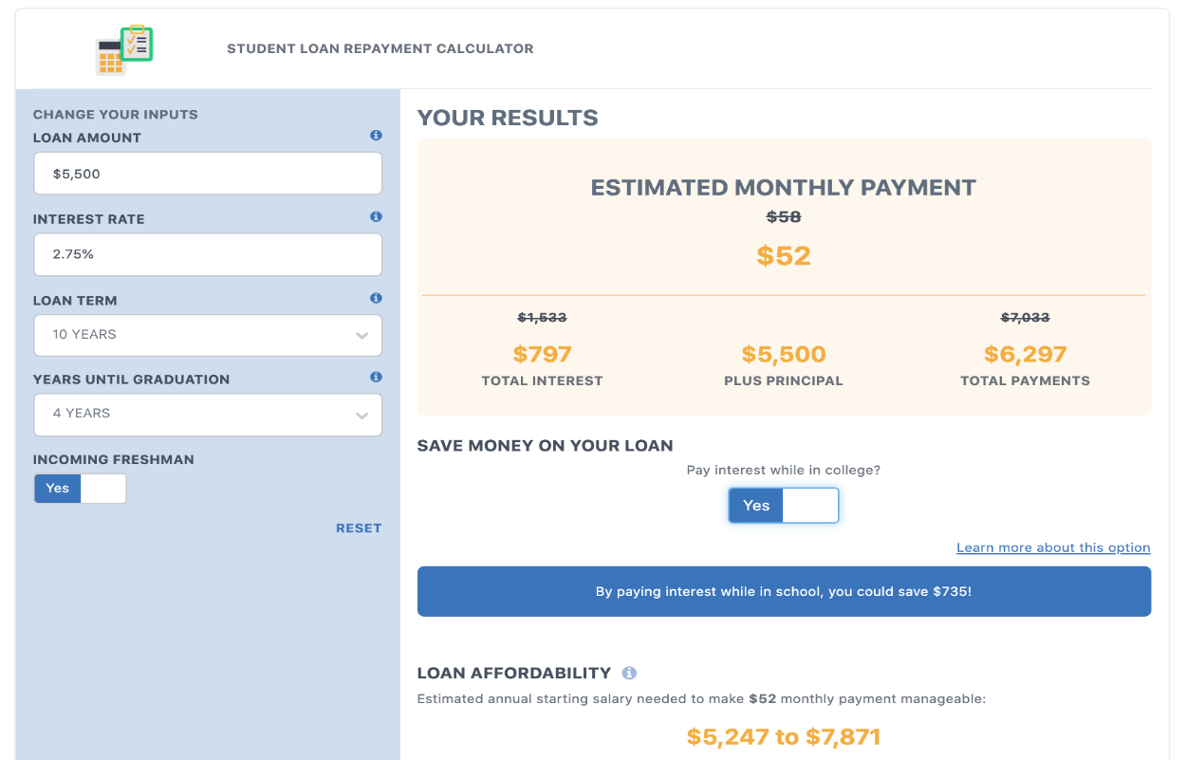
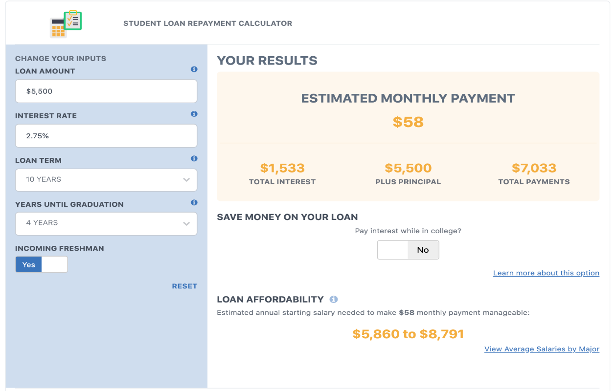
Activity: Calculate Payment for Freshman Year Loan
https://arcollegesaver.org/
Notes:
Client site to promote, animate
https://www.123test.com/career-test/id=KSSWQPWK8O9U&version=
https://www.yourfreecareertest.com/
https://www.yourfreecareertest.com/result/?id=1160276&set_id=6
https://www.whatcareerisrightforme.com/
http://www.educationplanner.org/students/career-planning/find-careers/career-clusters-activity.shtml
Lesson:
Lesson:
https://www.econedlink.org/resources/wages-and-me/

Slide 21
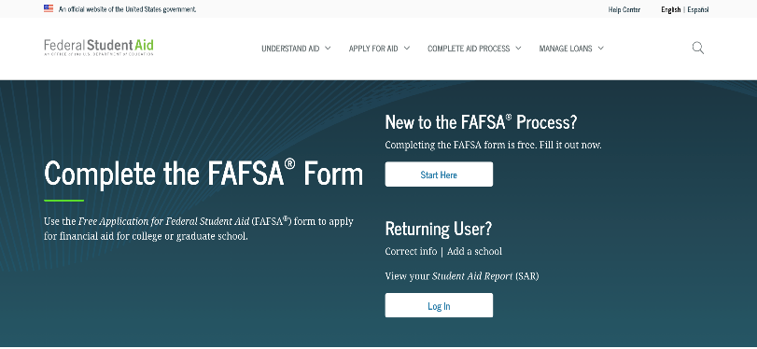

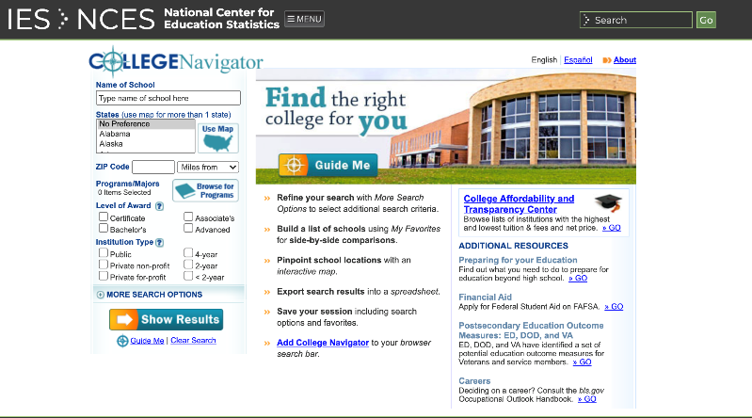
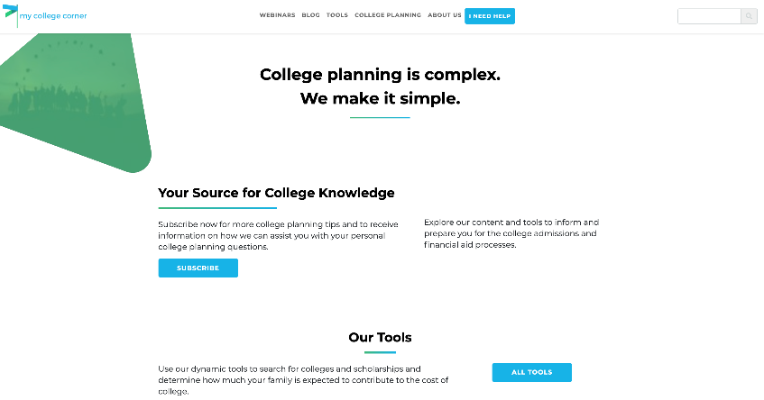
Resources
https://studentaid.gov/
arcollegesaver.org
https://nces.ed.gov/collegenavigator/
mycollegecorner.com

Slide 22
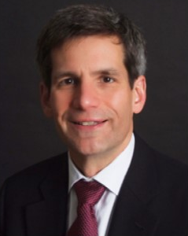




John Hupalo
john@inviteeducation.com
(617) 807-0320

Slide 23

CEE Affiliates
https://www.councilforeconed.org/resources/local-affiliates/

Slide 24




Thank You to Our Sponsors!

