Slide 1


How to Integrate Financial Fitness for Life and Intuit Simulations Within Your Curriculum​
Nov, 19th, 2019
Andrea Mozo, Director of Digital Products at CEE
Jared Davidove, Senior Manager of Education Partnerships at Intuit

Slide 2
Discover which Financial Fitness For Life Lesson Plans connect to the new Intuit Education Simulations
Discover how to find the Intuit Education Simulations on EconEdLink website
Learn how to setup your Mint student account
Today’s Webinar Goals
Notes:
Here’s our goals for today’s webinar: Read screen

Slide 3
Today’s Agenda
Financial Fitness for Life and EconEdLink Overview (10 mins)
Intuit Education Overview (10 mins)
Mint Simulation Demo (30 mins)
Educator Q&A (10 mins)
Notes:
Here’s our goals for today’s webinar: Read screen

Slide 4
Ground Rules
Please mute your mic
Type questions into the chat during non Q&A
During Q&A be careful not to talk over one another
Be present
HAVE FUN!
Notes:
Here’s our goals for today’s webinar: Read screen

Slide 5




Financial Fitness for Life (9-12)
Financial Fitness for Life (3rd edition) helps you prepare students for life
beyond the classroom by presenting lessons and activities based on real-world economics and personal finance concepts.
Updated lesson plans with slides
1 new lesson plan for Paying Post-Secondary Education
17 ready-to-use EdTech tools
6 new activities using real-world tools in partnership with Intuit
Notes:
Here’s our goals for today’s webinar: Read screen

Slide 6
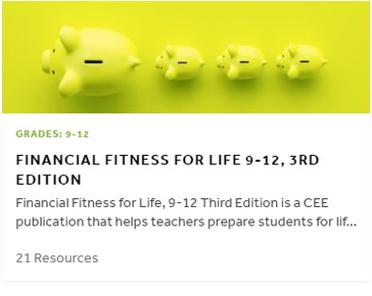
Visit the collection on EconEdLink
econedlink.org/resources/collection/fffl-9-12/
Notes:
Here’s our goals for today’s webinar: Read screen

Slide 7
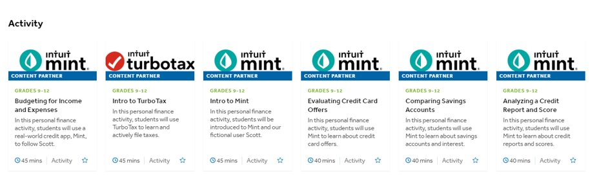
6 new activities using Mint & TurboTax
econedlink.org/resources/collection/fffl-9-12/
Notes:
Here’s our goals for today’s webinar: Read screen

Slide 8


Jared Davidove
Sr. Manager, Strategic Education Partnerships

Slide 9






Meet the Intuit Team
Emily Watkins- Daigle
  Account Manager,
  K-12
Victoria Makol
  Manager,
  Education Partnerships
Ryan McAllister
  Global GTM Leader
Jared Davidove
  Sr. Manager,
  Education Partnerships
Josh Phelon
  Account Manager,
  Higher Ed
David Cook
  Intuit Educator
Notes:
This is a sample CAPTIONED VISUAL using the Subtitle 3-Column layout.
By using the 3-Column layout as a starting point for building this slide, three text placeholders are available to enter content into. These were then modified by dragging their top edges below the image. Using layouts to help organize your content keeps your presentation consistent.
Note: If the same layout is reapplied, the placeholder boxes reset to their default positions. Your content will all still remain but would need to be readjusted from the default (again).

Slide 10
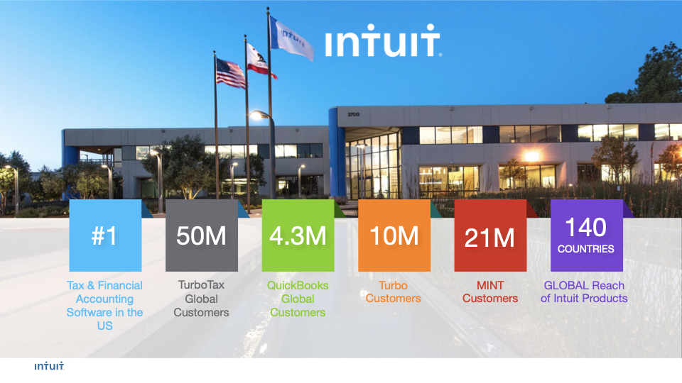

Slide 11


Slide 12
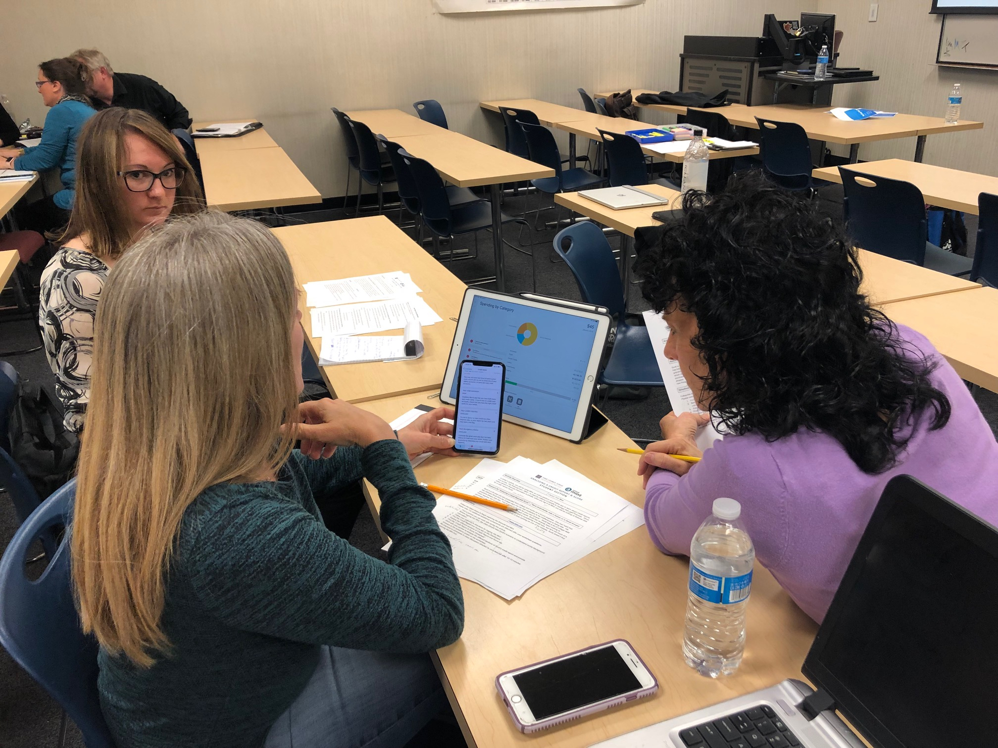
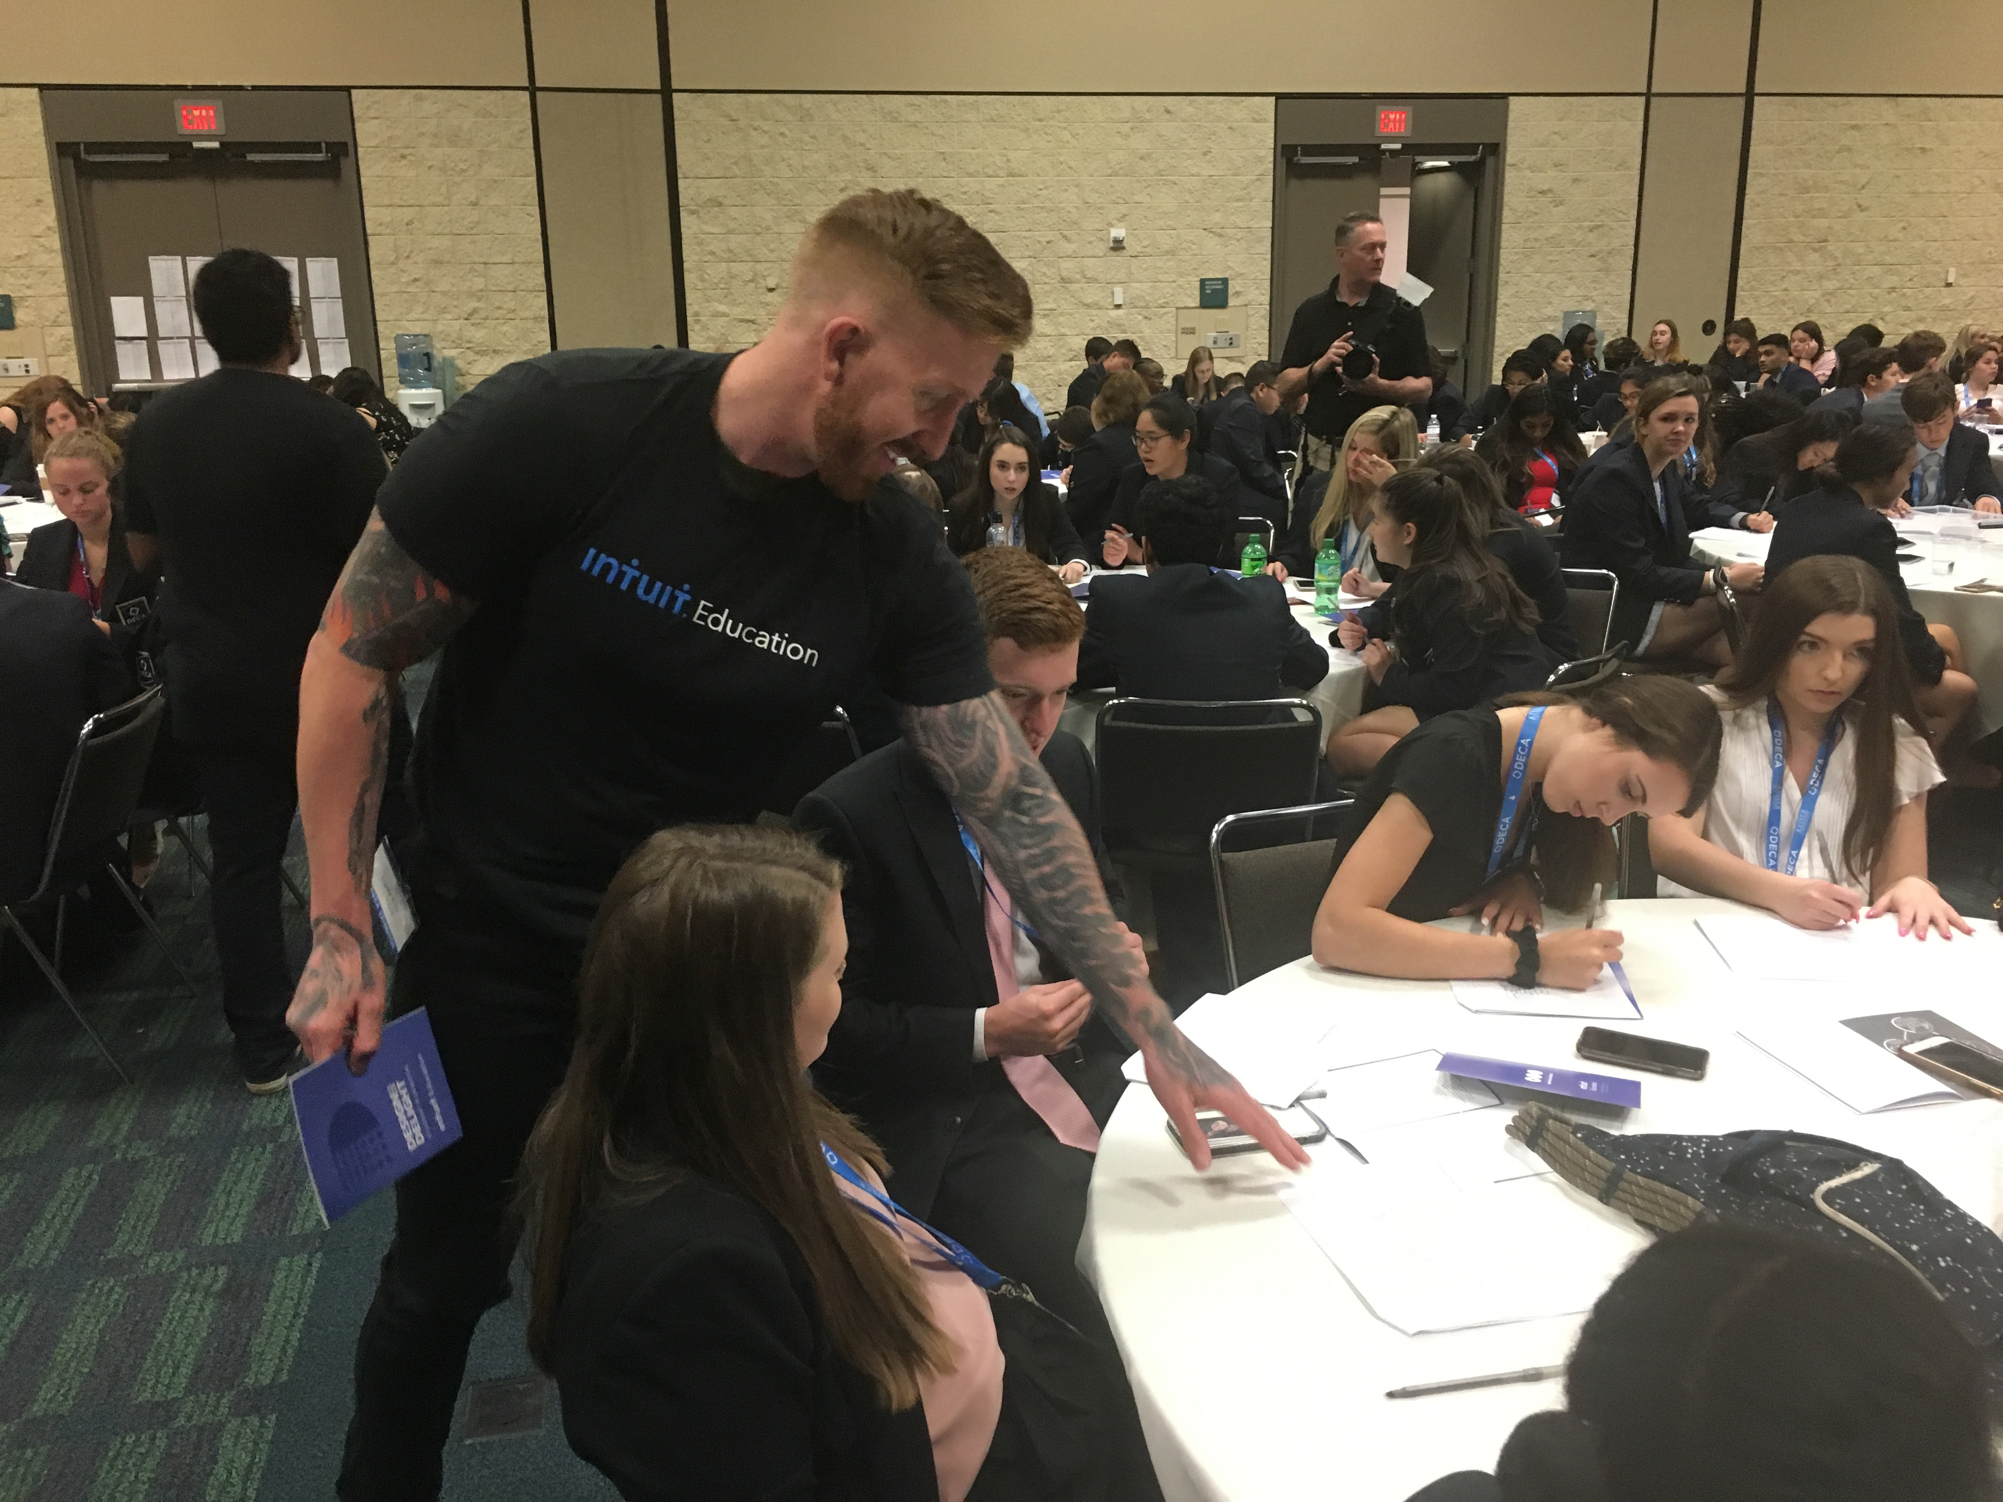
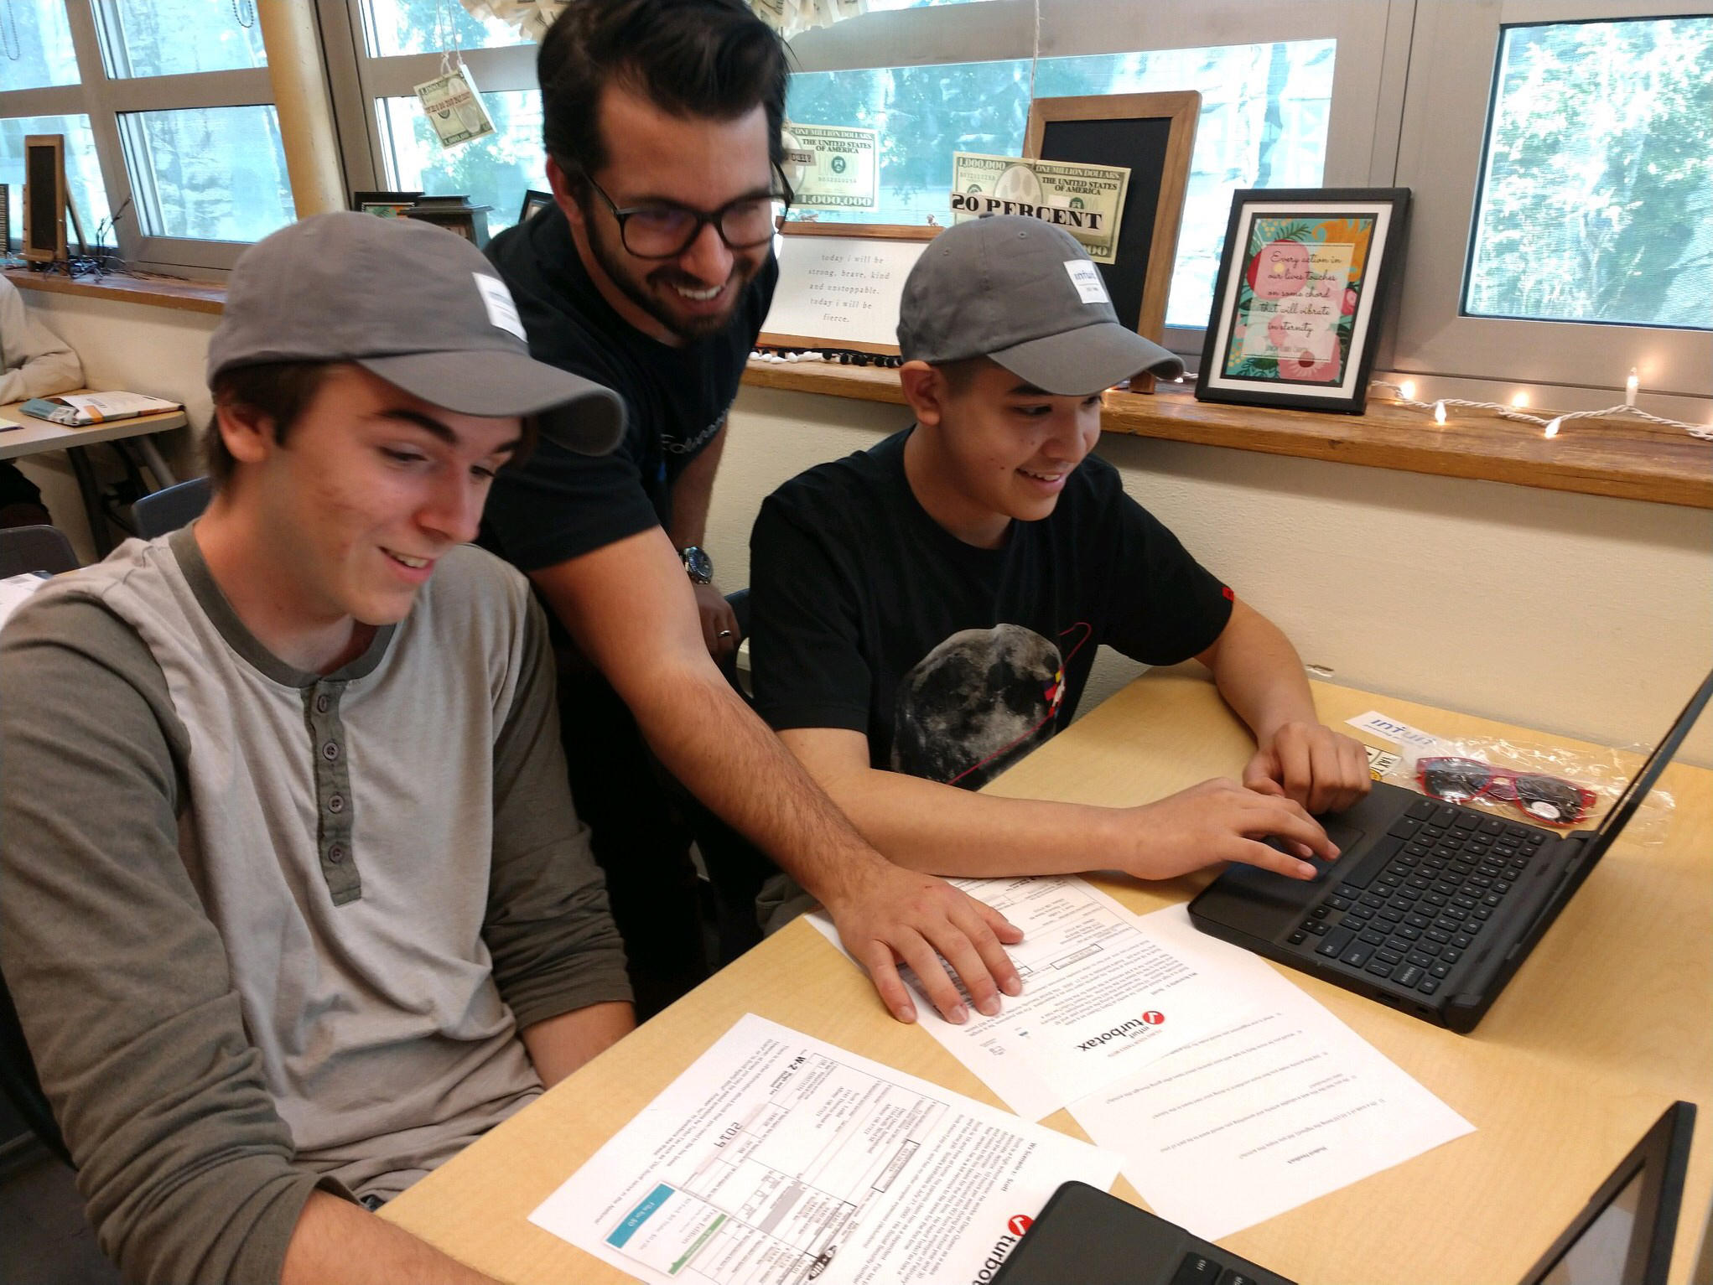




Introducing Mint & TurboTax Simulations
MINT AND TURBOTAX SIMULATIONS TESTED
KEY LEARNINGS FROM EXPERIMENTS APPLIED
STRATEGIC PARTNER
SUPPORT
Developing financial behaviors using real world tools
Experience needs and wants to delight teachers
Drive impact through program adoption

Slide 13
Introducing Mint & TurboTax Simulations
7.4 of 10
8.2 of 10
90% of Students
81% of Students
96% of Students
Confident in managing their personal finances
Discuss personal finances & taxes with their parents
Mint & TurboTax as part of their curriculum
*Surveys taken from ~350 educators and ~350 students

Slide 14
What did students say about the pilot?
Introducing Mint & TurboTax Simulations from TCT
“Mint can really help prepare me for life after school.”
“This lesson helped me open my eyes to options for credit cards.”
“I love taxes, is that weird to say?”
“…I feel more confident in doing my own taxes in the future.”

Slide 15
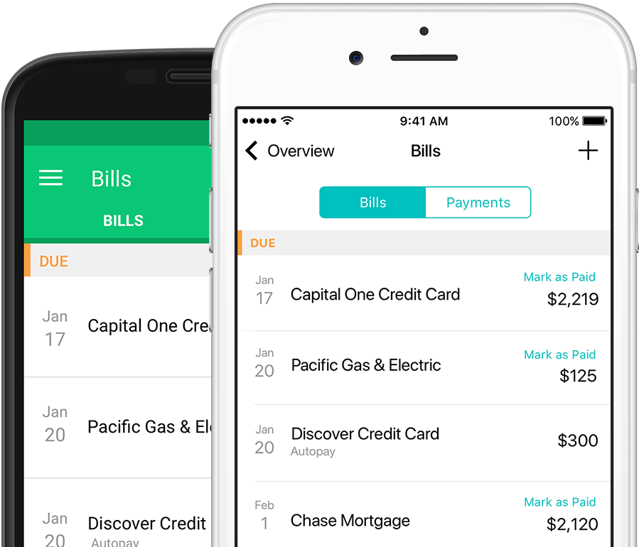
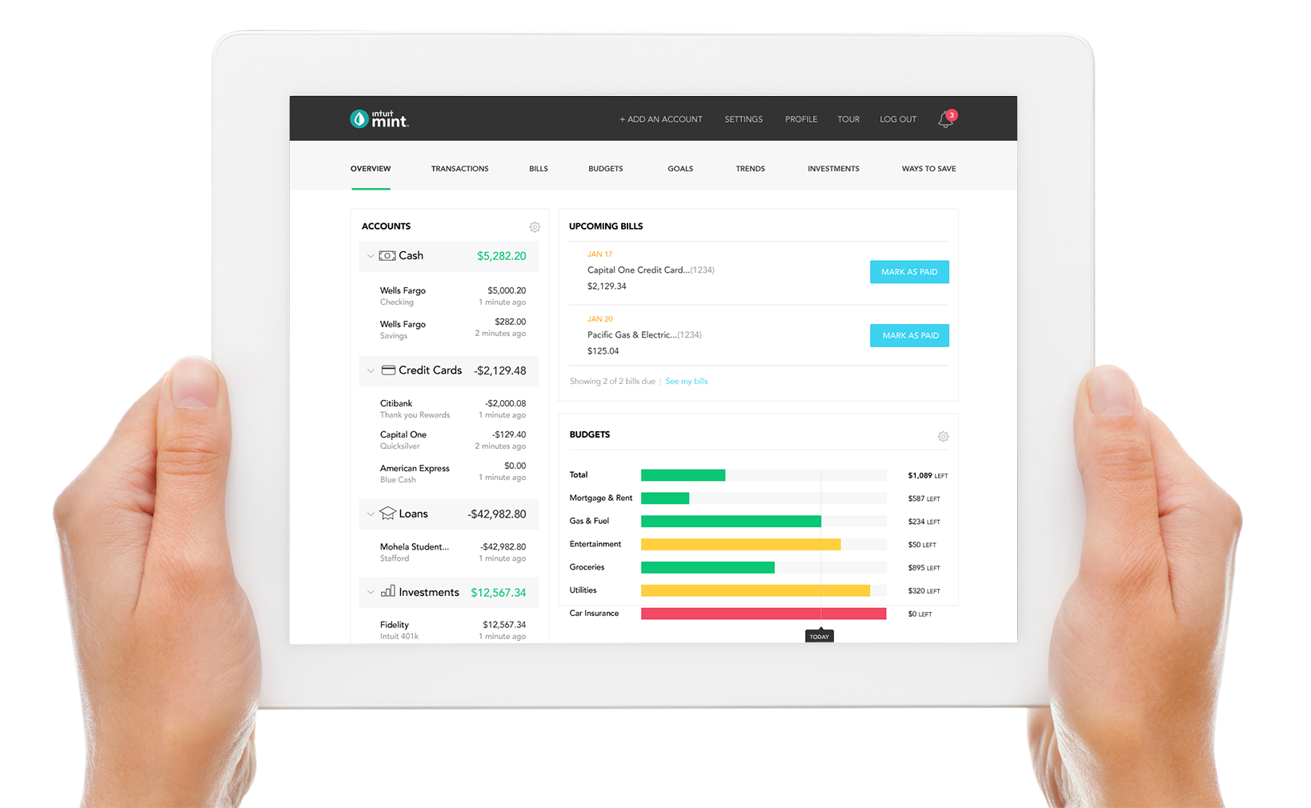

Your fictional financial life, in one place that’s easy to understand
Easily create budgets
Set life goals and monitor your progress
Track and pay bills
Understand your credit score and receive tips for improvement
Analyze and develop spending behaviors

Slide 16
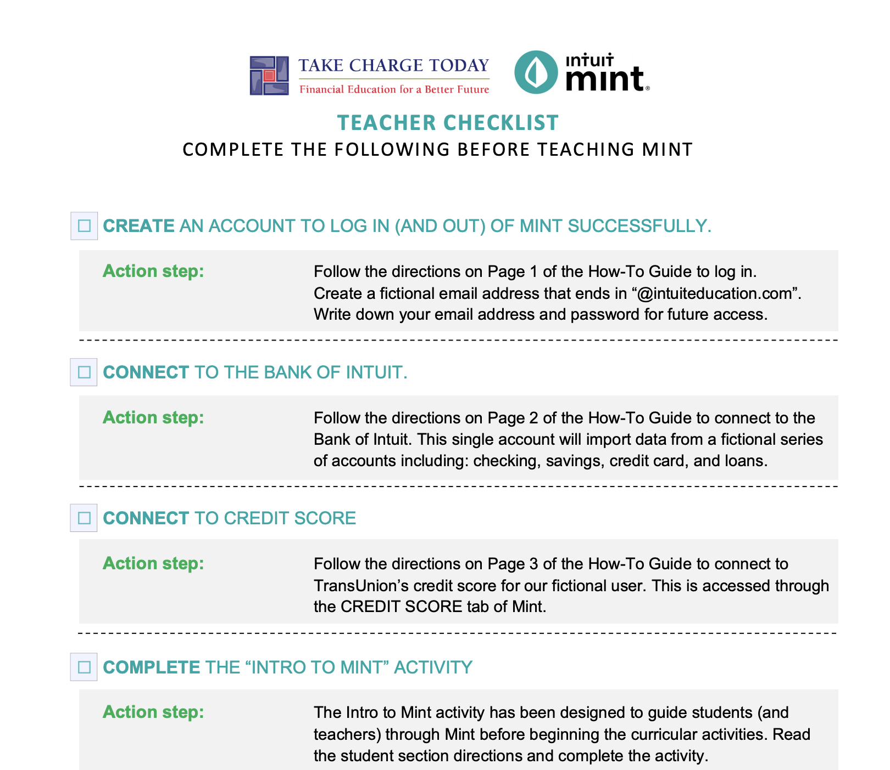
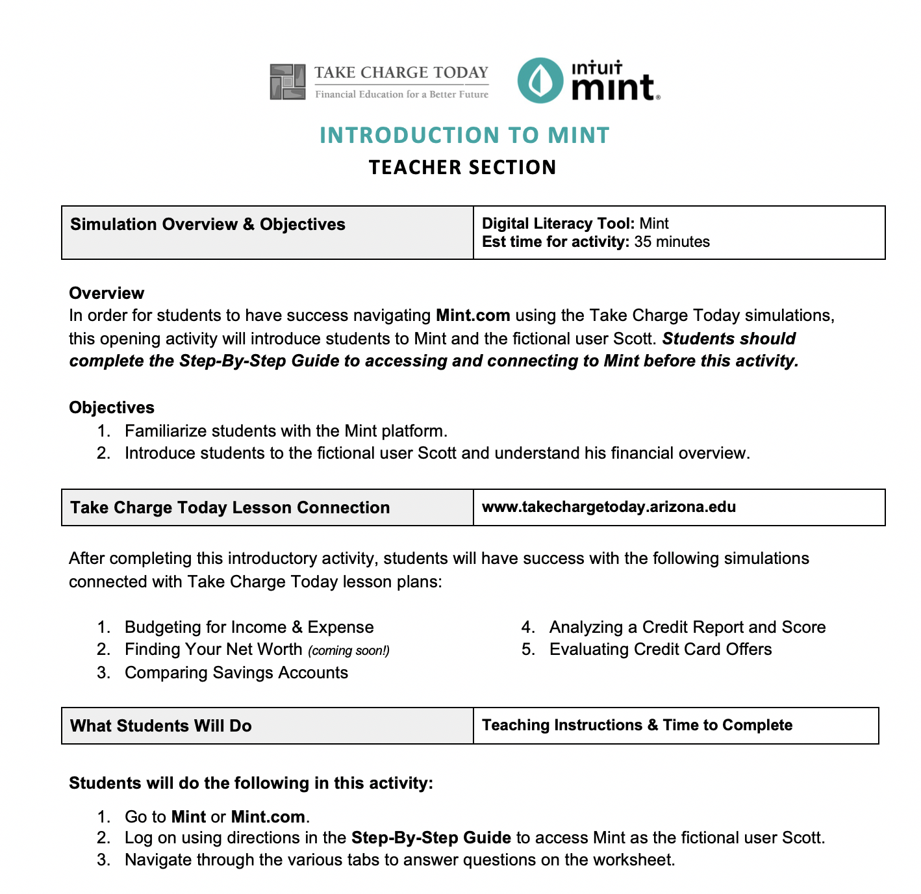

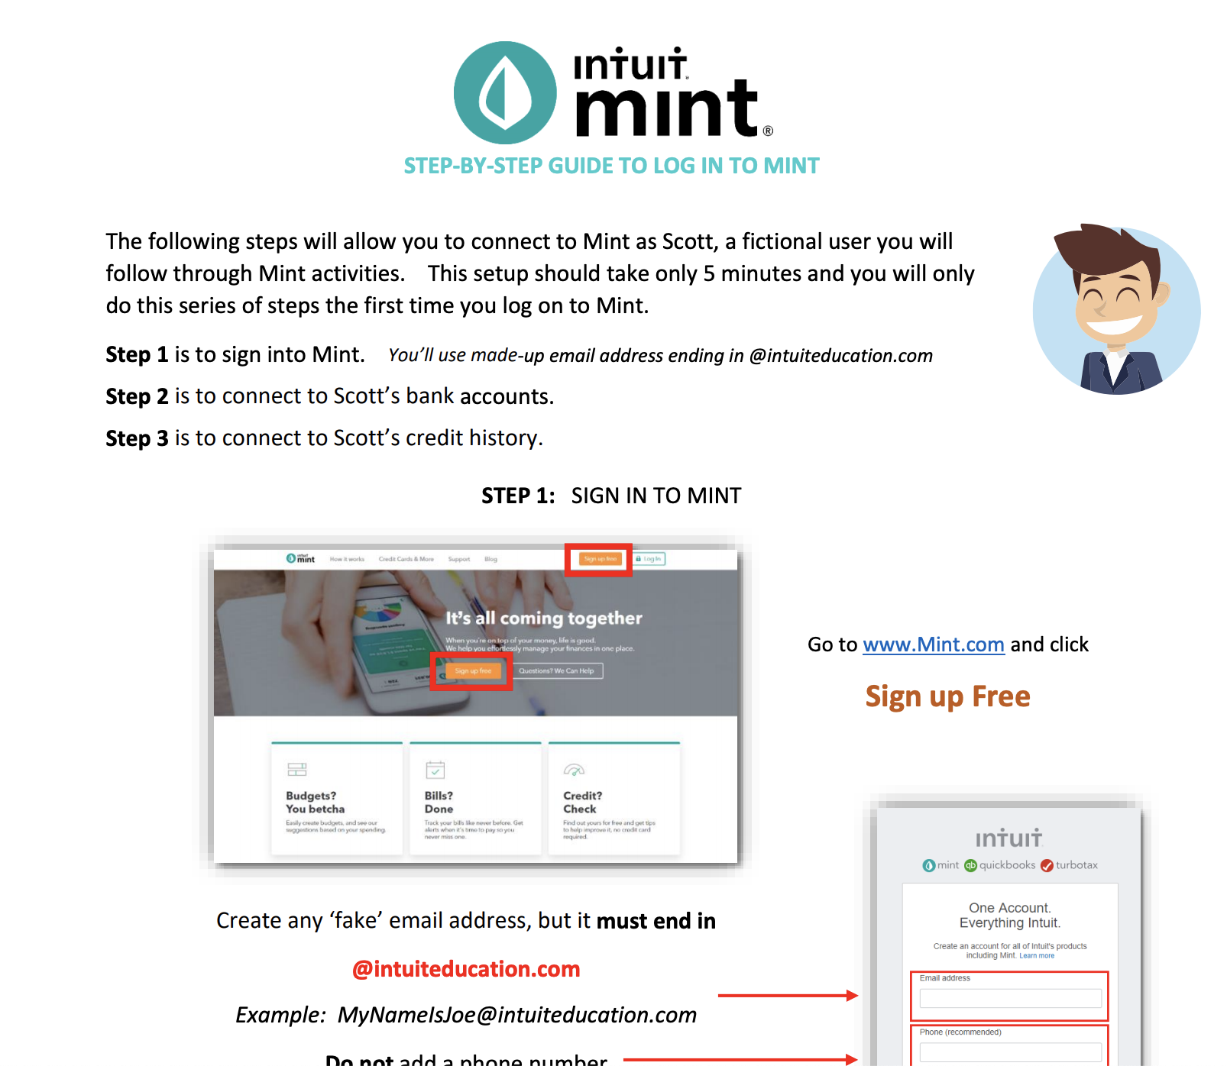
Materials for Mint Activity
Teacher Checklist: https://www.econedlink.org/wp-content/uploads/2019/10/Teacher-Checklist-for-Mint_CEE.pdf
How-to Guide: https://econedlink.org/wp-content/uploads/2019/09/Mint-Login-Directions.pdf
Intro Simulation: https://econedlink.org/wp-content/uploads/2019/09/Student-Mint-Simulation-Worksheet.pdf
Teacher Checklist
Intro Simulation
Step-by-step Guide

Slide 18

Available for purchase today!
store.councilforeconed.org
Notes:
Here’s our goals for today’s webinar: Read screen

