Slide 1
Google Classroom
March 23rd, 2020
Andrew Menfi

Slide 2
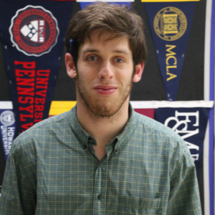
Andrew Menfi Bio
Binghamton University
-Bachelors of Arts in Social Studies
Columbia: Teacher College
-Master's of Arts in
Secondary Social Studies Education
New Visions Charter High School for Advanced Math & Science in the Bronx, New York
Subjects Taught: Economics, Government, Legal Studies, Global Studies, Independent Research, and Advanced Placement U.S. History
Independent Senior Project Project Team Leader

Slide 3

Learning Objective
How To Use Google Classroom
Beginners & Advanced Guide

