Slide 1
Social Security, Governance and the National Debt Inquiry Based Lesson Presented by Amanda Stiglbauer December 7, 2020 astiglbauer@richland2.org

Slide 2
EconEdLink Membership
You can now access CEE’s professional development webinars directly on EconEdLink.org! To receive these new professional development benefits, become an EconEdLink member. As a member, you will now be able to:
Automatically receive a professional development certificate via e-mail within 24 hours after viewing any webinar for a minimum of 45 minutes
Register for upcoming webinars with a simple one-click process
Easily download presentations, lesson plan materials and activities for each webinar
Search and view all webinars at your convenience
Save webinars to your EconEdLink dashboard for easy access to the event
You may access our new Professional Development page here

Slide 3
Professional Development Certificate
To earn your professional development certificate for this webinar, you must:
Watch a minimum of 45-minutes and you will automatically receive a professional development certificate via e-mail within 24 hours.
Accessing resources:
You can now easily download presentations, lesson plan materials, and activities for each webinar from EconEdLink.org/professional-development/

Slide 4
Agenda
Political Cartoon Introductions
Introduction to Inquiry Based Learning and Compelling Questions
Staging: Major issues with Social Security Video Clips
Collaboration Board – Major issues with Social Security
Further Research – Social Security’s Challenges
Mentimeter – Word Cloud
Potential Solutions to Social Security Crisis: - Background - Cost-Benefit Analysis - Padlet
Assessment Ideas and Debrief

Slide 5
National Standards
National Standards for Economics
Role of Government and Market Failure Standard: 16
Students will understand that: There is an economic role for government in a market economy whenever the benefits of a government policy outweigh its costs. Governments often provide for national defense, address environmental concerns, define and protect property rights, and attempt to make markets more competitive. Most government policies also have direct or indirect effects on people's incomes.

Slide 6
Objectives
I can:
Analyze graphs, tables, and charts.
Examine sources for information and interpretations, and for cases where they corroborate, complement, or contradict each other.

Slide 7
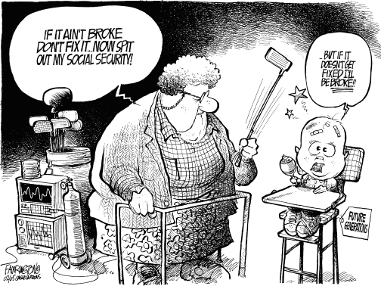

Slide 8
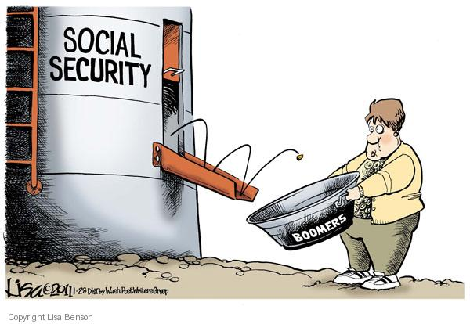

Slide 9
Inquiry Based Learning Overview
Students develop questions they are curious about.
Students use time in class to research the topic.
Students present their learning.
Students reflect on what worked and what did not.
Notes:
For more information, check out this article from Edutopia: https://www.edutopia.org/blog/what-heck-inquiry-based-learning-heather-wolpert-gawron

Slide 10
Why Inquiry Based Learning (IBL)?
Reinforces content
Warms up the brain for learning
Deeper understanding
Makes learning rewarding
Builds initiative and self-direction
Works in almost any classroom
Differentiated instruction

Slide 12
Compelling Questions
How should we reform Social Security?
What challenges does US Social Security face?
What changes could improve Social Security?

Slide 13
Prior Knowledge
Implementation of the Social Security Act and program
Current use of Social Security and its role in the current economy
Legislative process

Slide 14
10 Global Challenges to Social Security Social Security Projected to be Depleted in 2035
As you watch, consider the major issues with Social Security…

Slide 15
Identify: What are some of the major concerns with the sustainability of Social Security across America?

Slide 16
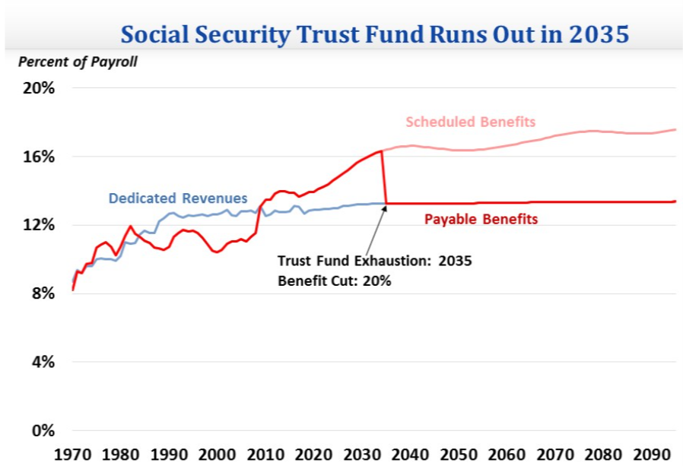
Notes:
Source: http://www.crfb.org/blogs/quick-take-social-security-medicare-headed-insolvency-16-7-years

Slide 17
What challenges does US Social Security face?
Source A: Five Facts: The New Social Security Board of Trustees Report (Financial Fitness for Life Textbook)
Source D: Social Security is Drying Up (CNN)
Notes:
Source D

Slide 18
Mentimeter Word Cloud
What are the most pressing concerns facing Social Security?
https://www.menti.com/ewjpoqpsko
www.menti.com
Enter code: 11 34 29 7

Slide 19
What changes could improve Social Security?

Slide 20
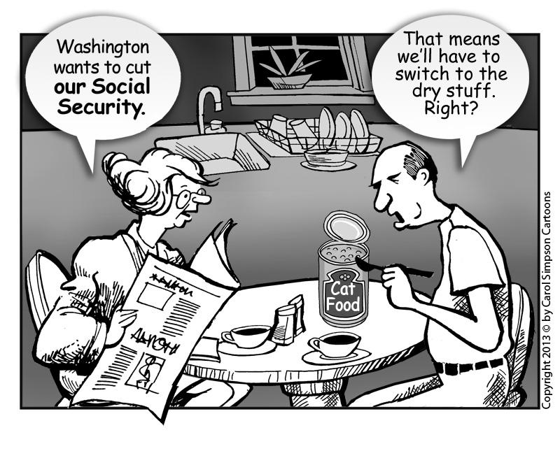

Slide 21
Americans are Uncertain
When asked which solutions they are comfortable with, no single remedy received majority support from U.S. adults…
Eliminating Social Security tax cap (32%)
Eliminating Social Security benefits for individuals earning over $100K from non-SS sources (31%)
Raising retirement age to 70 for those born after 1980 (24%)
Increasing payroll taxes by 1% a year on employees and employers (22%)
Partial or full privatization (18%)
Notes:
Source: https://www.veraquestresearch.com/veraspectives/fix-social-security-americans-do-not-have-the-answers/

Slide 22
What changes could improve Social Security?
Reading B: How the Next President Could Save Social Security (Bloomberg)
Reading C: How the 2020 Democrats Would Fix Social Security (Yahoo! Finance)
Reading D: Three New Plans to Fix Social Security (The Fiscal Times)
Notes:
https://www.bloomberg.com/graphics/2016-saving-social-security/
https://finance.yahoo.com/news/what-the-democratic-contenders-are-saying-about-social-security-153848300.html
https://www.thefiscaltimes.com/2019/04/23/3-New-Plans-Fix-Social-Security

Slide 23
Cost-Benefit Analysis
What is it? Weighing pros and cons (of seen and unseen factors) when making a decision…
Economists use cost-benefit analysis to judge whether a decision is rational or not.
Consider the potential solutions to the Social Security crisis. List one of the potential solutions and evaluate at least one potential cost and one potential benefit associated with this action.

Slide 24
Assessment
Address the compelling question:
How should we reform Social Security?
Letter to the Editor - Students will present their own individual arguments, using multiple claims supported by evidence

Slide 25
Assessment Questions
In what year in Social Security projected to be depleted? (2035)
When Social Security and Medicare costs exceed their annual income, how will the government fund these programs? (By dipping into their trust funds and/or going into debt)
When was the last time Social Security Act was amended? (1983)
What is the current Social Security payroll tax? (6.2% for employees and 6.2% for employers)
List three plans that have been proposed to fix Social Security. (Raise the payroll cap and tax investment income, payroll cap increase, phasing in a higher tax rate)

Slide 26
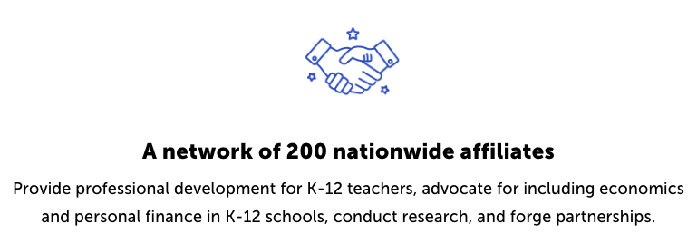
CEE Affiliates
https://www.councilforeconed.org/resources/local-affiliates/

Slide 27
Thank You to Our Sponsors!

