Slide 1
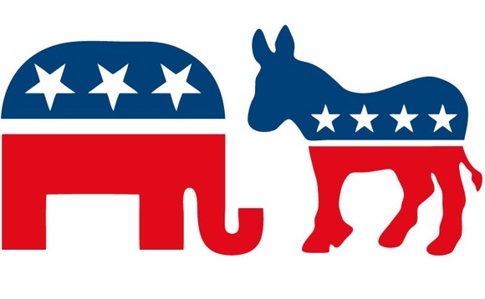
Political Beliefs and the Federal Budget

Slide 2
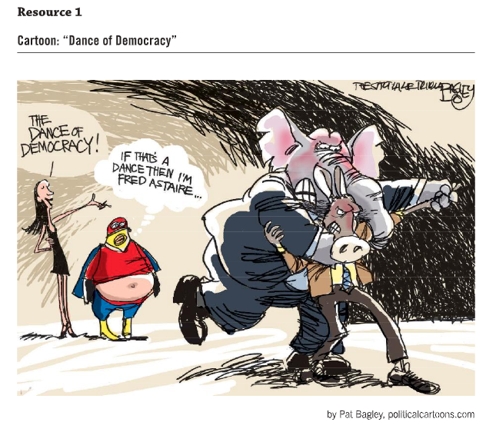
Cartoon: Dance of Democracy

Slide 3
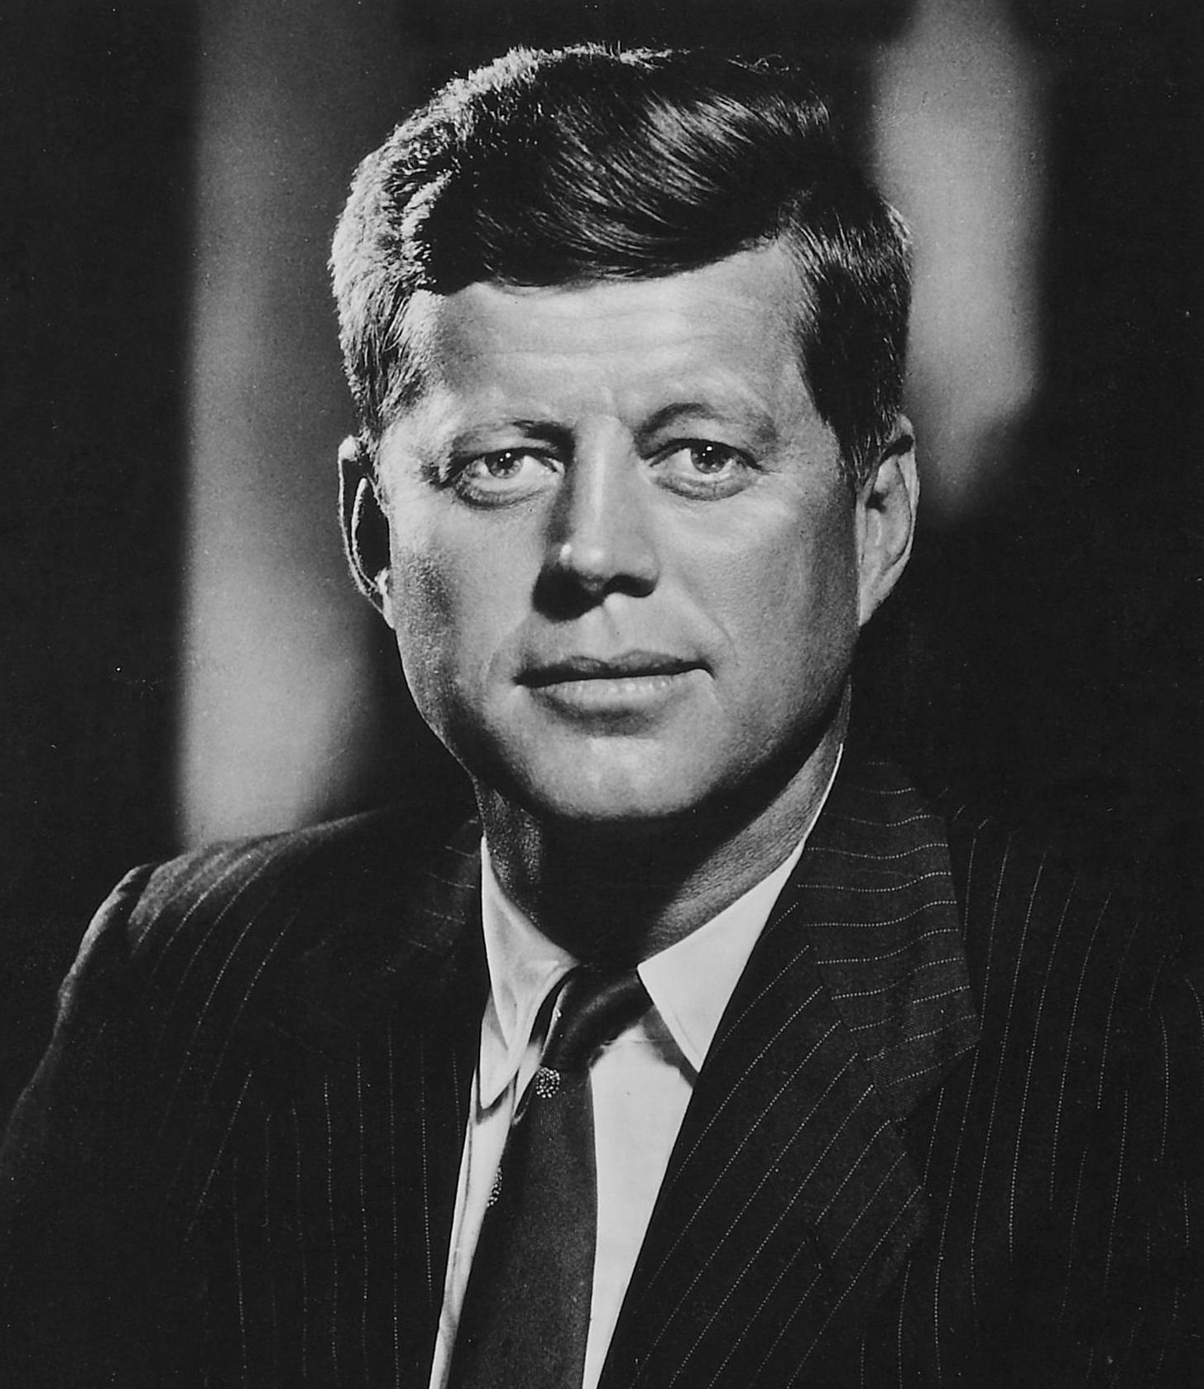
“Let us not seek the Republican answer or the Democratic answer but the right answer. Let us not seek to fix the blame for the past—let us accept our own responsibility for the future.”
—John F. Kennedy, 1958 (John F. Kennedy Presidential Library, n.d.)

Slide 4
Problems with Political Partisanship
Creates gridlock which can shut down political processes
Prevents a willingness to compromise or reach consensus
Fuels greater partisanship and division
Entrenched by political action groups, partisan think-tanks, and other ideologically-driven organizations

Slide 5
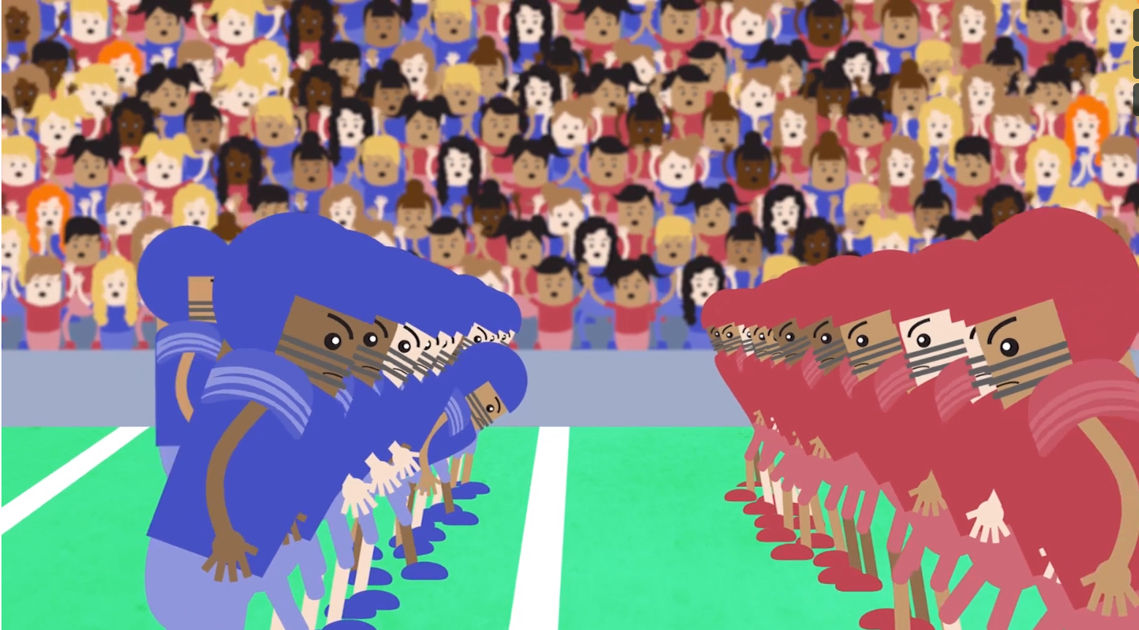
Video: Overview of the Budget Process
As you watch the video, notice where political parties exert influence over the federal budget process.
Notes:
https://www.econedlink.org/resources/overview-of-the-budget-process-animated-video/

Slide 6
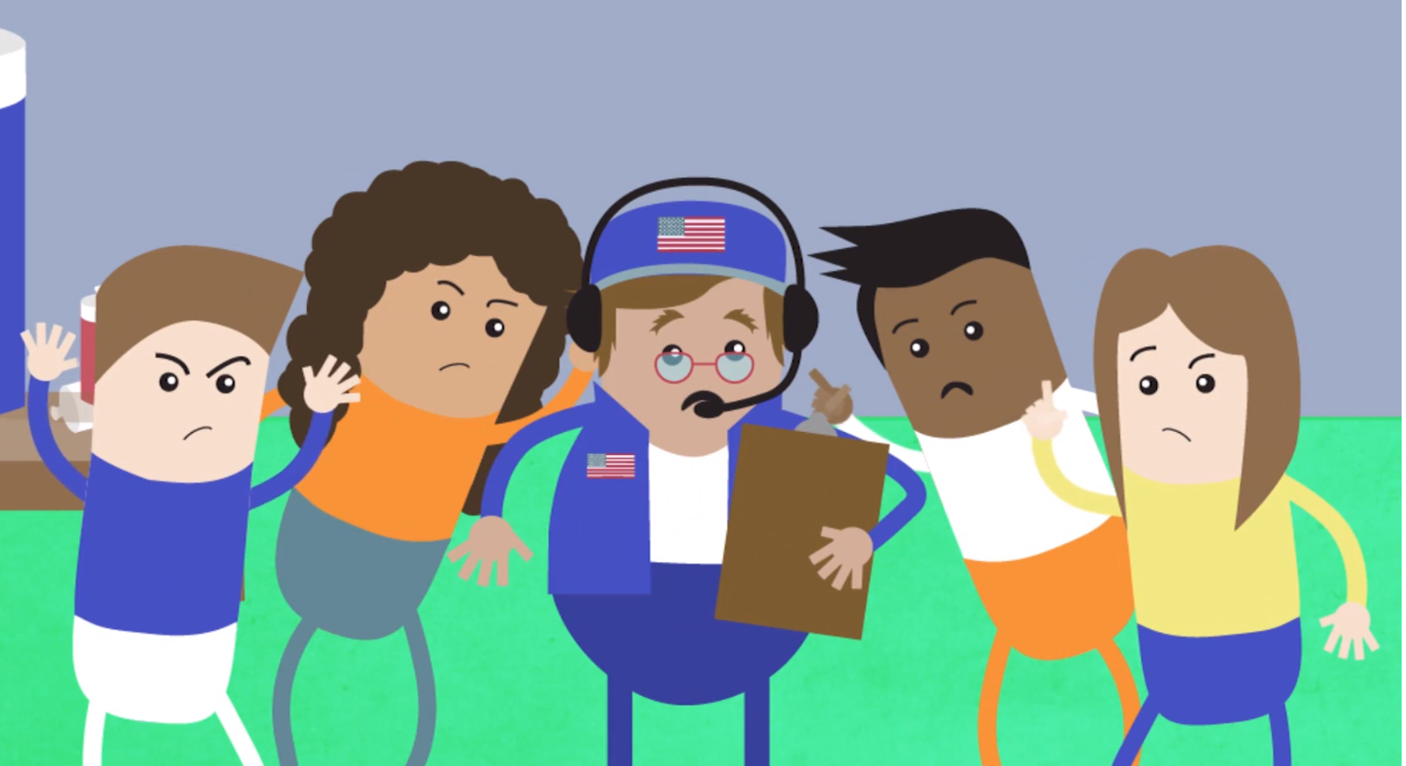
Video Questions
Who is exercising political power?
How are they getting what they want?
What is influencing them?
How can I influence this process?

Slide 7
Political Terms
Conservative
Liberal
Republican
Democrat

Slide 8
Political Terms
Conservative: A political philosophy favoring free enterprise, private ownership, and socially traditional ideas. Common political views include support for small government, less regulation, lower taxes, and the idea that private business can better address the needs of the people in a market economy.
Liberal: A political and social philosophy advocating individual freedom, representational forms of government, progress and reform, and protection of civil liberties. Common political views include a stronger role for government and regulations, and the idea that government intervention in the market is needed to address the needs of the people.
Republicans: Politicians and individuals tend to be more aligned with the conservative perspective
Democrat: Politicians and individuals tend to be more aligned with the liberal perspective

Slide 9
Working Definitions
Republican Party – Republicans tend to be politically conservative and believe, “We are the party of maximum economic freedom and the prosperity freedom makes possible. Prosperity is the product of self-discipline, work, savings, and investment by individual Americans, but it is not an end in itself. Prosperity provides the means by which individuals and families can maintain their independence from government, raise their children by their own values, practice their faith, and build communities of self-reliant neighbors.” Read more at www.gop.com/platform/
Democratic Party – Democrats tend to be politically liberal and believe, “. . . wealth and status should not be an entitlement to rule. Democrats recognize that our country and our economy are strongest when they provide opportunity for all Americans—when we grow our country from the bottom up.” Read more at www.democrats.org/who-we-are/about-the-democratic-party/

Slide 10
Active Organizations in the Federal Fiscal Policy Debate

Slide 11
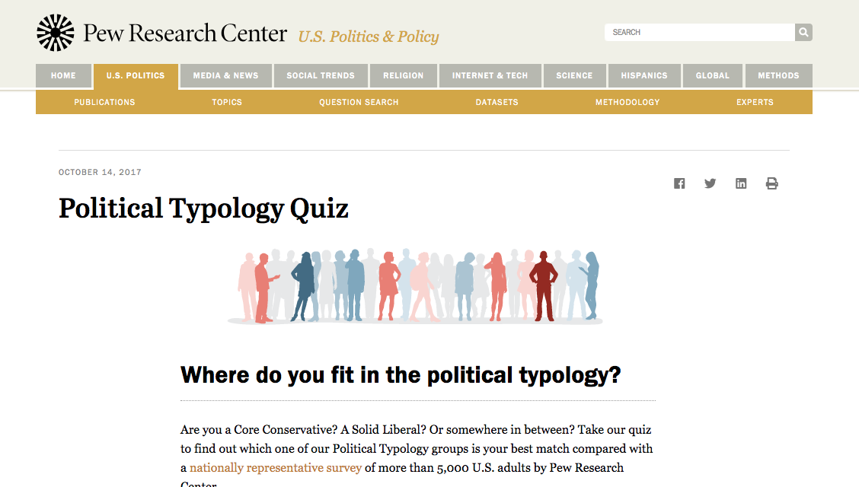
Pew Survey of Political Beliefs
http://www.people-press.org/typology/quiz/
Notes:
https://www.econedlink.org/resources/overview-of-the-budget-process-animated-video/

Slide 12
Pew Survey Results Discussion
Did the results of the Pew survey surprise you?
How did the results match up with how you think about your ideas?
Which questions did you have difficulty answering, and why?
Based on your own results, do you think this survey is a good way to find out more about how you think?
Did the survey cause you to think differently about your political philosophy or about any of the topics included?

