Slide 1
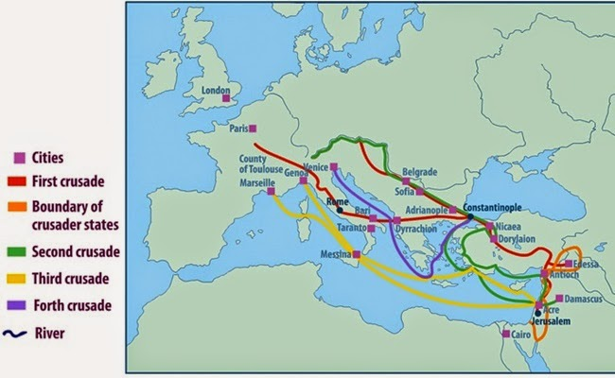
How the Crusades Led to the Expansion of Trade

