Slide 1
Hawaiian Economics: Barter for Fish & Poi

Slide 2
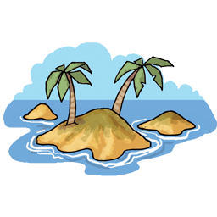
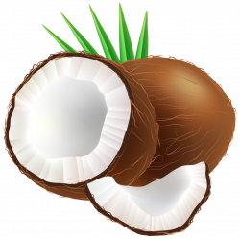
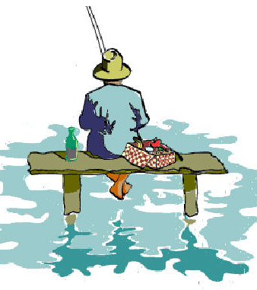

Slide 3
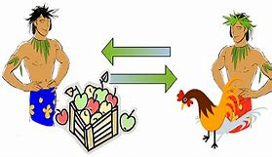
Bartering
Trading a good or service directly for another good or service, without using money or credit.

Slide 4
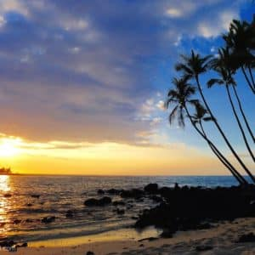
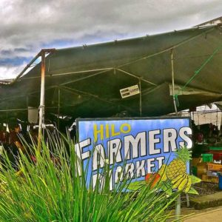
Photos of Hawaii

Slide 5
Background
The Ahupua’a traditional system of land division allowed the chiefs in ancient Hawaii to decide what, when, and how communities would produce food to feed the people. This system allowed everyone to have equal access to the natural resources of all the islands.
Bartering provided a way for communities to exchange goods and services without using money.

Slide 6
Some Hawaiian words
Taro (ta-row) – a plant grown for its starchy root
Poi (poy, rhymes with boy) – paste food made from steamed, pounded taro
Ahupua'a (ah-who-pu-ah-ah) – Hawaiian land district, a pie-shaped, or wedge-shaped piece of land that includes mountains, valleys, and shoreline

Slide 7
Hawaiian Traditional System: How to Feed the People
In order to feed the people fish, ancient Hawaiian families:
Traveled great distances and went up mountains to cut trees;
Carried the lumber home and built fishing canoes;
Identified the best fishing spots, carved fishhooks, made fishing nets, gathered shellfish, made salt, and prepared the fish they caught.

Slide 8
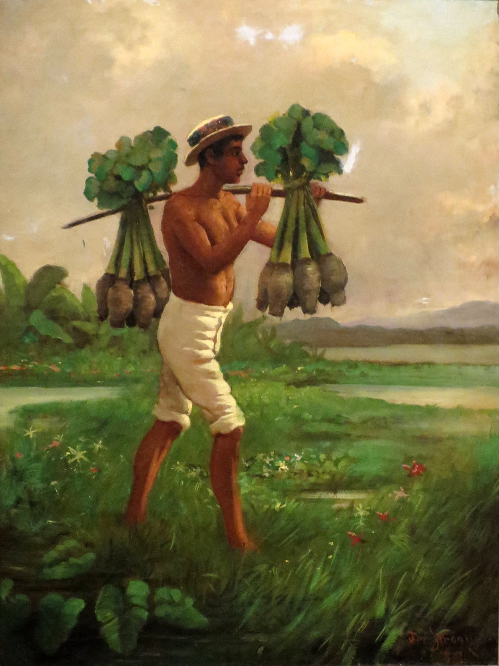
Hawaiian Traditional System: How to Feed the People
In order to produce poi to accompany the fish, ancient Hawaiian families also:
Planted and cared for taro gardens;
Harvested the taro;
Pounded the taro into poi.

Slide 9
Hawaiians Love “Fish and Poi!”
Many Hawaiians loved to eat fish and poi. Salted dried fish or fresh fish served with poi (made from mashed taro) were a delicious part of the Hawaiian diet. In the Ahupua’a system, all Hawaiians were able to go to the mountains to cut wood to make a fishing canoe, grow taro in the valleys, and go to the beach to catch fish, dry fish, and gather salt. The Ahupua’a system let all Hawaiians have the chance to get ”Fish and Poi”.

Slide 10
Let’s Get Fish and Poi!
In order to get fish and poi, Hawaiian families needed to use resources from the three regions and develop enough skills to do everything: cutting trees, building canoes, planting taro and tending the field. This took a lot of time and work. They needed to harvest the taro and pound it into poi. At the same time, they needed to learn about the best fishing spots, carve fishhooks, make and use a fishing net, gather shellfish, make salt, and catch and prepare the fish.

Slide 11
There’s a Problem…It’s Hard to be a Good Farmer and a Good Fisherman. Help!
Families were faced with making a trade-off between working in the mountains, in the valleys, and on the shore. If they took too much time fishing, the taro plants would die. If they spent too much time caring for the taro, they had no time to fish and gather salt. This made it difficult for Hawaiians to prepare “Fish and Poi”. Hawaiians began to specialize in certain areas of farming, fishing, and crafts such as woodcarving, canoe building, and lei making. Instead of trying to do many different things and not being able to give each job enough time and study, some Hawaiians focused on doing one job really well. By focusing on one area, they learned how to become very good at their jobs and produce more items, and better quality products.

Slide 12
Got Poi…But Where’s the Fish?
Some Hawaiians specialized in farming which means they focused on becoming really good farmers and spent less time on other tasks. They learned about the soil, weeding, planting, watering, harvesting, and pounding taro into poi. By specializing in farming, they became better farmers. They were able to grow high quality taro for poi. They were also able to increase their productivity, growing more taro to make more poi. But this also meant they didn’t have much time to walk to the shore to catch fish, dry fish, or gather salt and shellfish.
So they had Poi…but no Fish.

Slide 13
Got Fish…But Where’s the Poi?
Some Hawaiians specialized in fishing. They used their time to learn about the ocean and practice fishing skills. They needed to learn where the best fishing spots were, how to throw a fishing net, where to collect shellfish, how to navigate the ocean, how to paddle canoes for deep ocean fishing, and how to dry and prepare fish. Specializing allowed them to become good fishermen and catch wonderful seafood for their families. But this also meant they had no time to tend a garden in the valley or to hike into the mountains.
So they had Fish… but no Poi!

Slide 14
There’s Another Problem… Still No “Fish and Poi!”
Specializing helped Hawaiians improve the quality of the food they ate. Some Hawaiians became great fisherman, finding the best places to dive, collect shellfish, and catch fish. They ended up with lots of delicious seafood. Others who were farmers grew delicious taro and sweet potatoes. Still others who were craftsmen built great canoes, made homes, and carved fishhooks.
But still no “Fish and Poi!”

Slide 15
Let’s Trade for Fish and Poi!
Specializing made it easier for Hawaiian families to have good quality food. Fishermen caught lots of fish, sometimes more than their families needed. Farmers grew lots of taro for poi, sometimes more than their families needed. With no stores, no money, and no refrigeration, Hawaiians began to barter with each other as a way to get what they needed and to get rid of extra items they did not need and could not save for later. Trade made the communities interdependent because they needed each other to get everything for their favorite dinner.
Finally, a way to get “Fish and Poi!”
Barter for it!

Slide 16
Specialization, Interdependence, and Trade
The families were faced with making a trade-off between catching fish and growing taro.
The began to specialize by supplying a narrower range of goods and services instead of trying to provide everything they needed.
As they specialized, they created excess goods that could be traded with other communities.
By specializing and trading, they became interdependent on others. That is, they needed trade to get all the goods and services they needed for their families.

Slide 17
Group Questions
What was the purpose of the Ahupua’a?
How did the geography of Hawaii make it challenging for Hawaiians to gather the fish and poi that they loved?
Was it easy to farm, fish, and gather all the items a Hawaiian family needed? Why or why not?
What did the Hawaiians do to improve the quality of the food they grew, gathered, and caught?
What did they do to help solve the problem of getting both fish and poi?

Slide 18
Group Questions
What are the benefits of trading for food?
What are the costs of trading for food?
How did trade create interdependence in the Ahupua’a?
What other possible solutions would you recommend for the problem faced by the Hawaiians?
How do people in our community get their food?
Why don’t we use the barter system to get our food?
Identify one example of bartering.

