Slide 1
Costs and Benefits of The Three Little Pigs

Slide 2
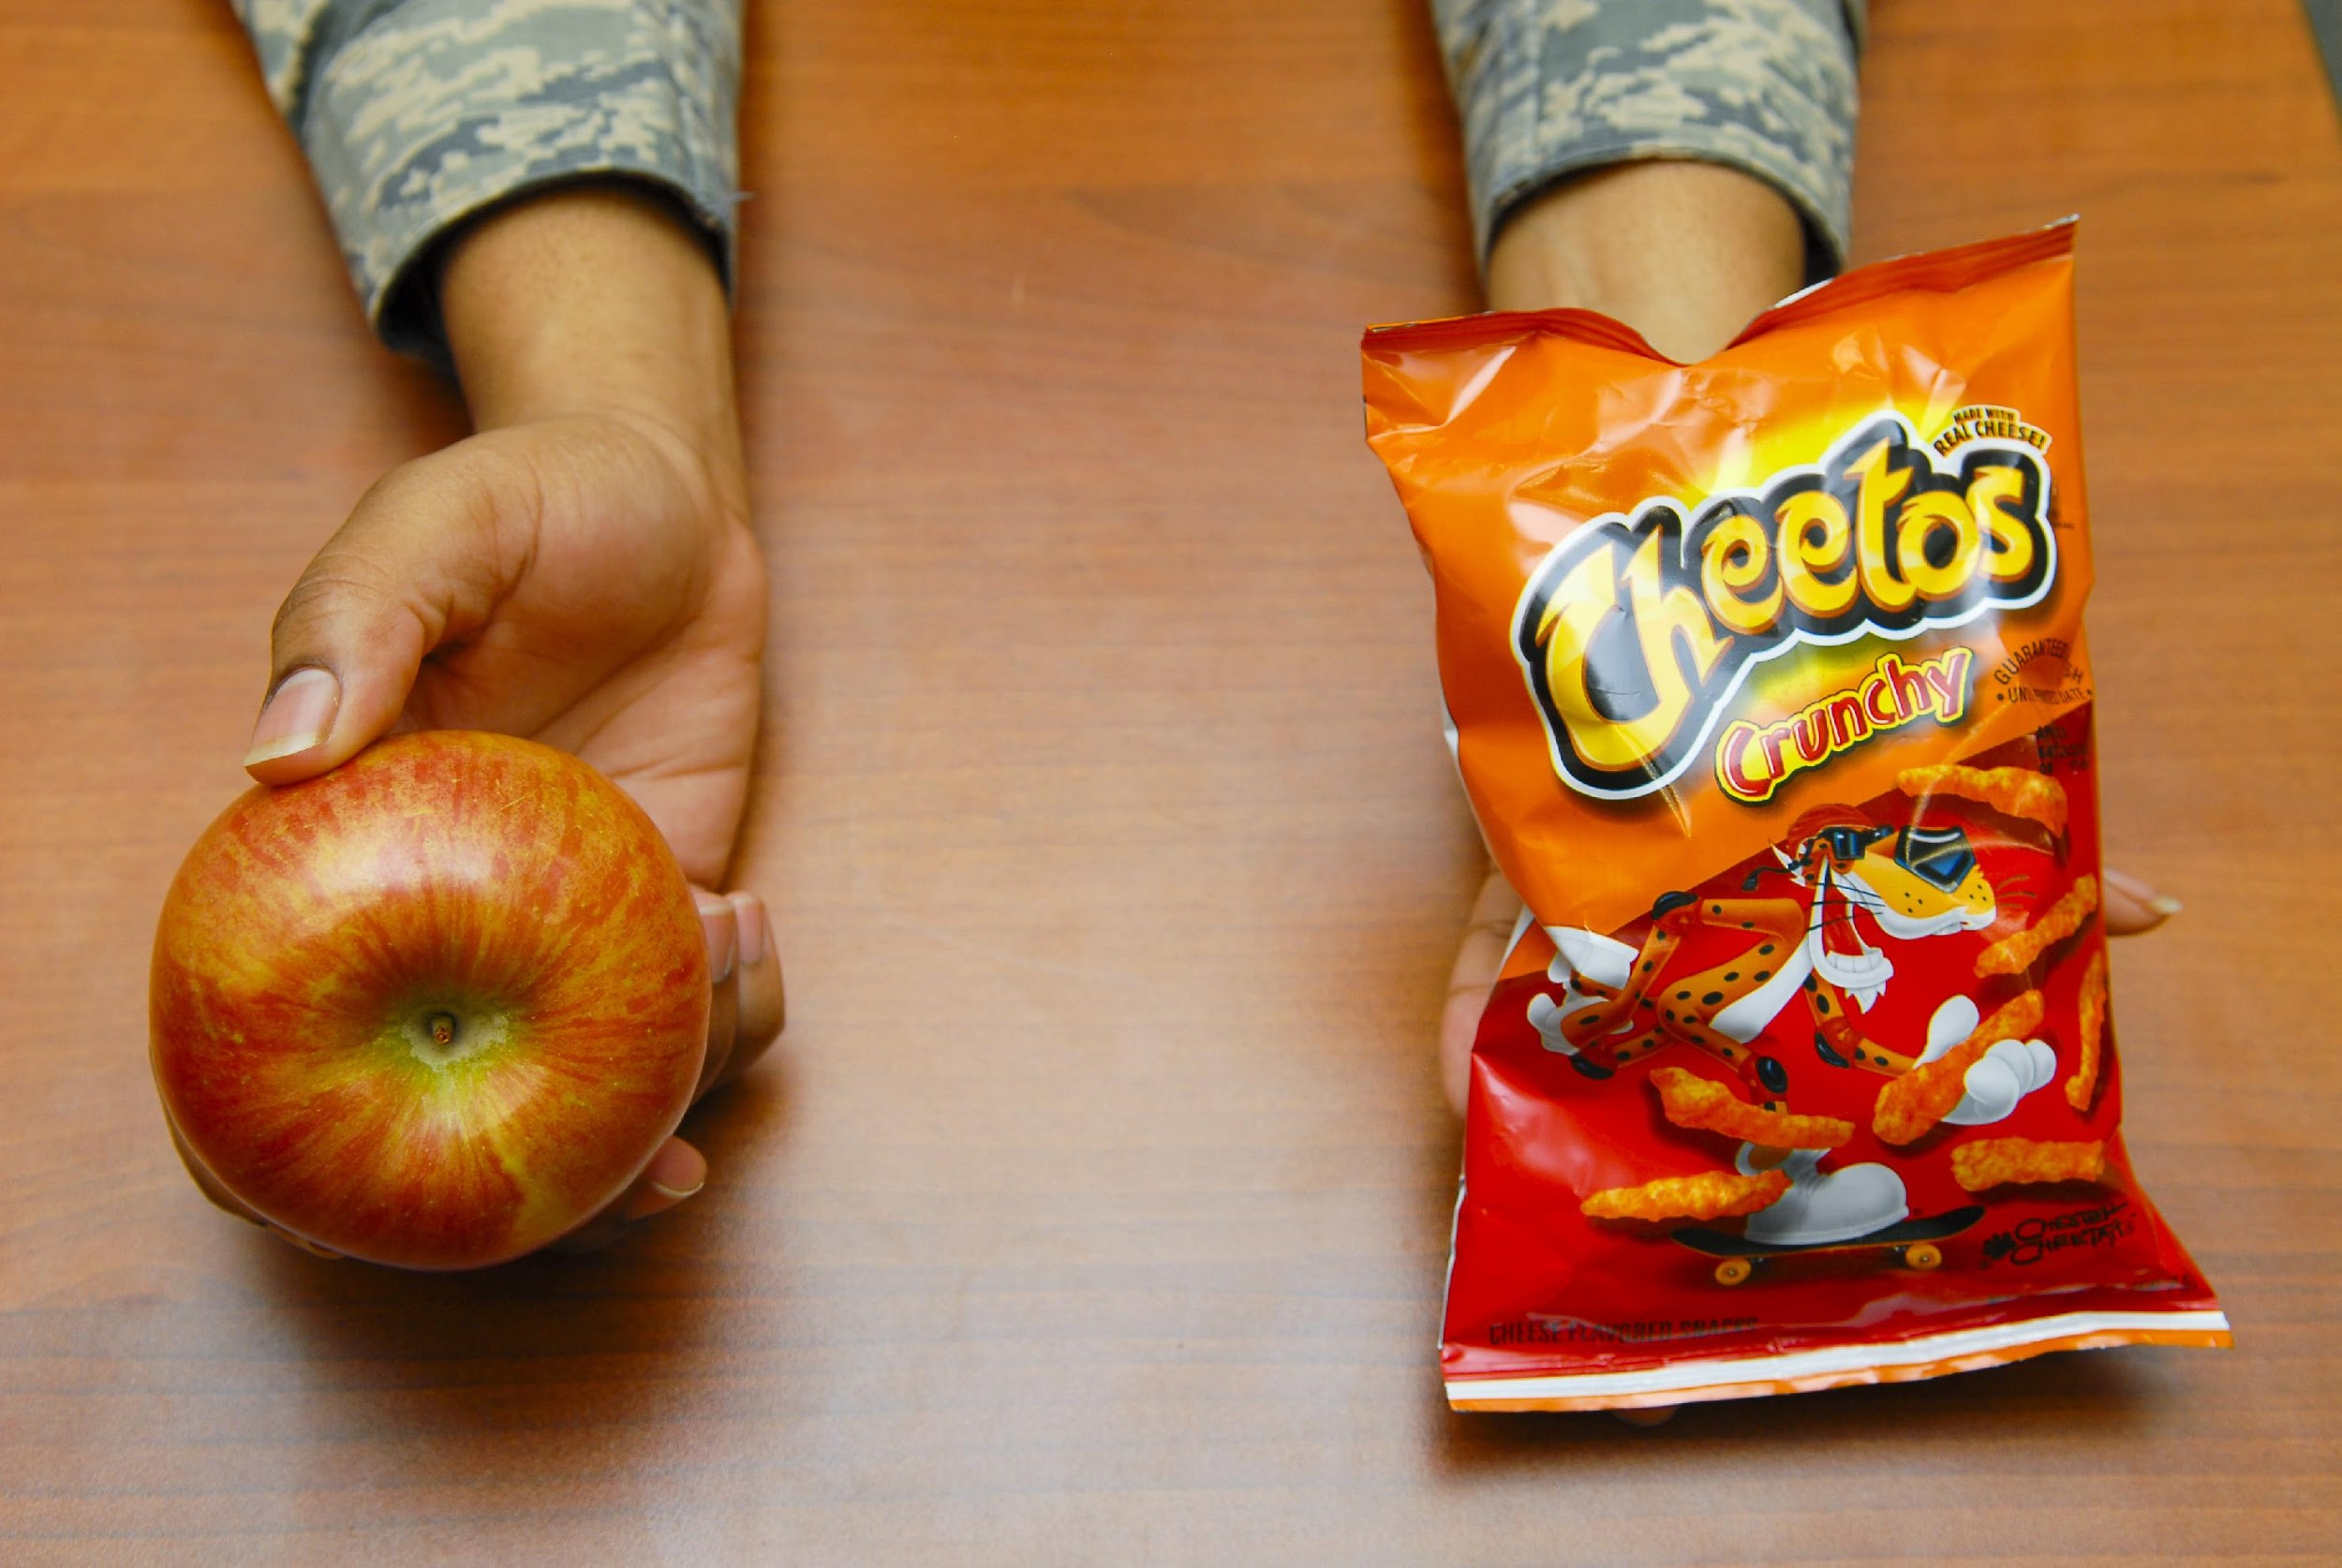
What Do You Choose?

Slide 3
What Should They Do?
 | Time to Build |  | Protection
 | Quick | Slow | Little | Lots
Straw
Sticks
Bricks

Slide 4
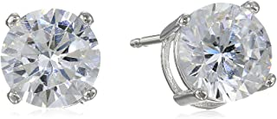
Assessment Question 1.
Andrea decides that she wants to have her ears pierced for her 8th birthday, like her mom and her Aunt Jane. Mom agrees and takes her to the store to select her earrings. Andrea wants her mom to buy her nice diamond earrings, like Aunt Jane’s. But Mom suggests she get a small stud to wear until she’s older and can take better care of them.
Which would be a better choice for Andrea?
A
B

Slide 5
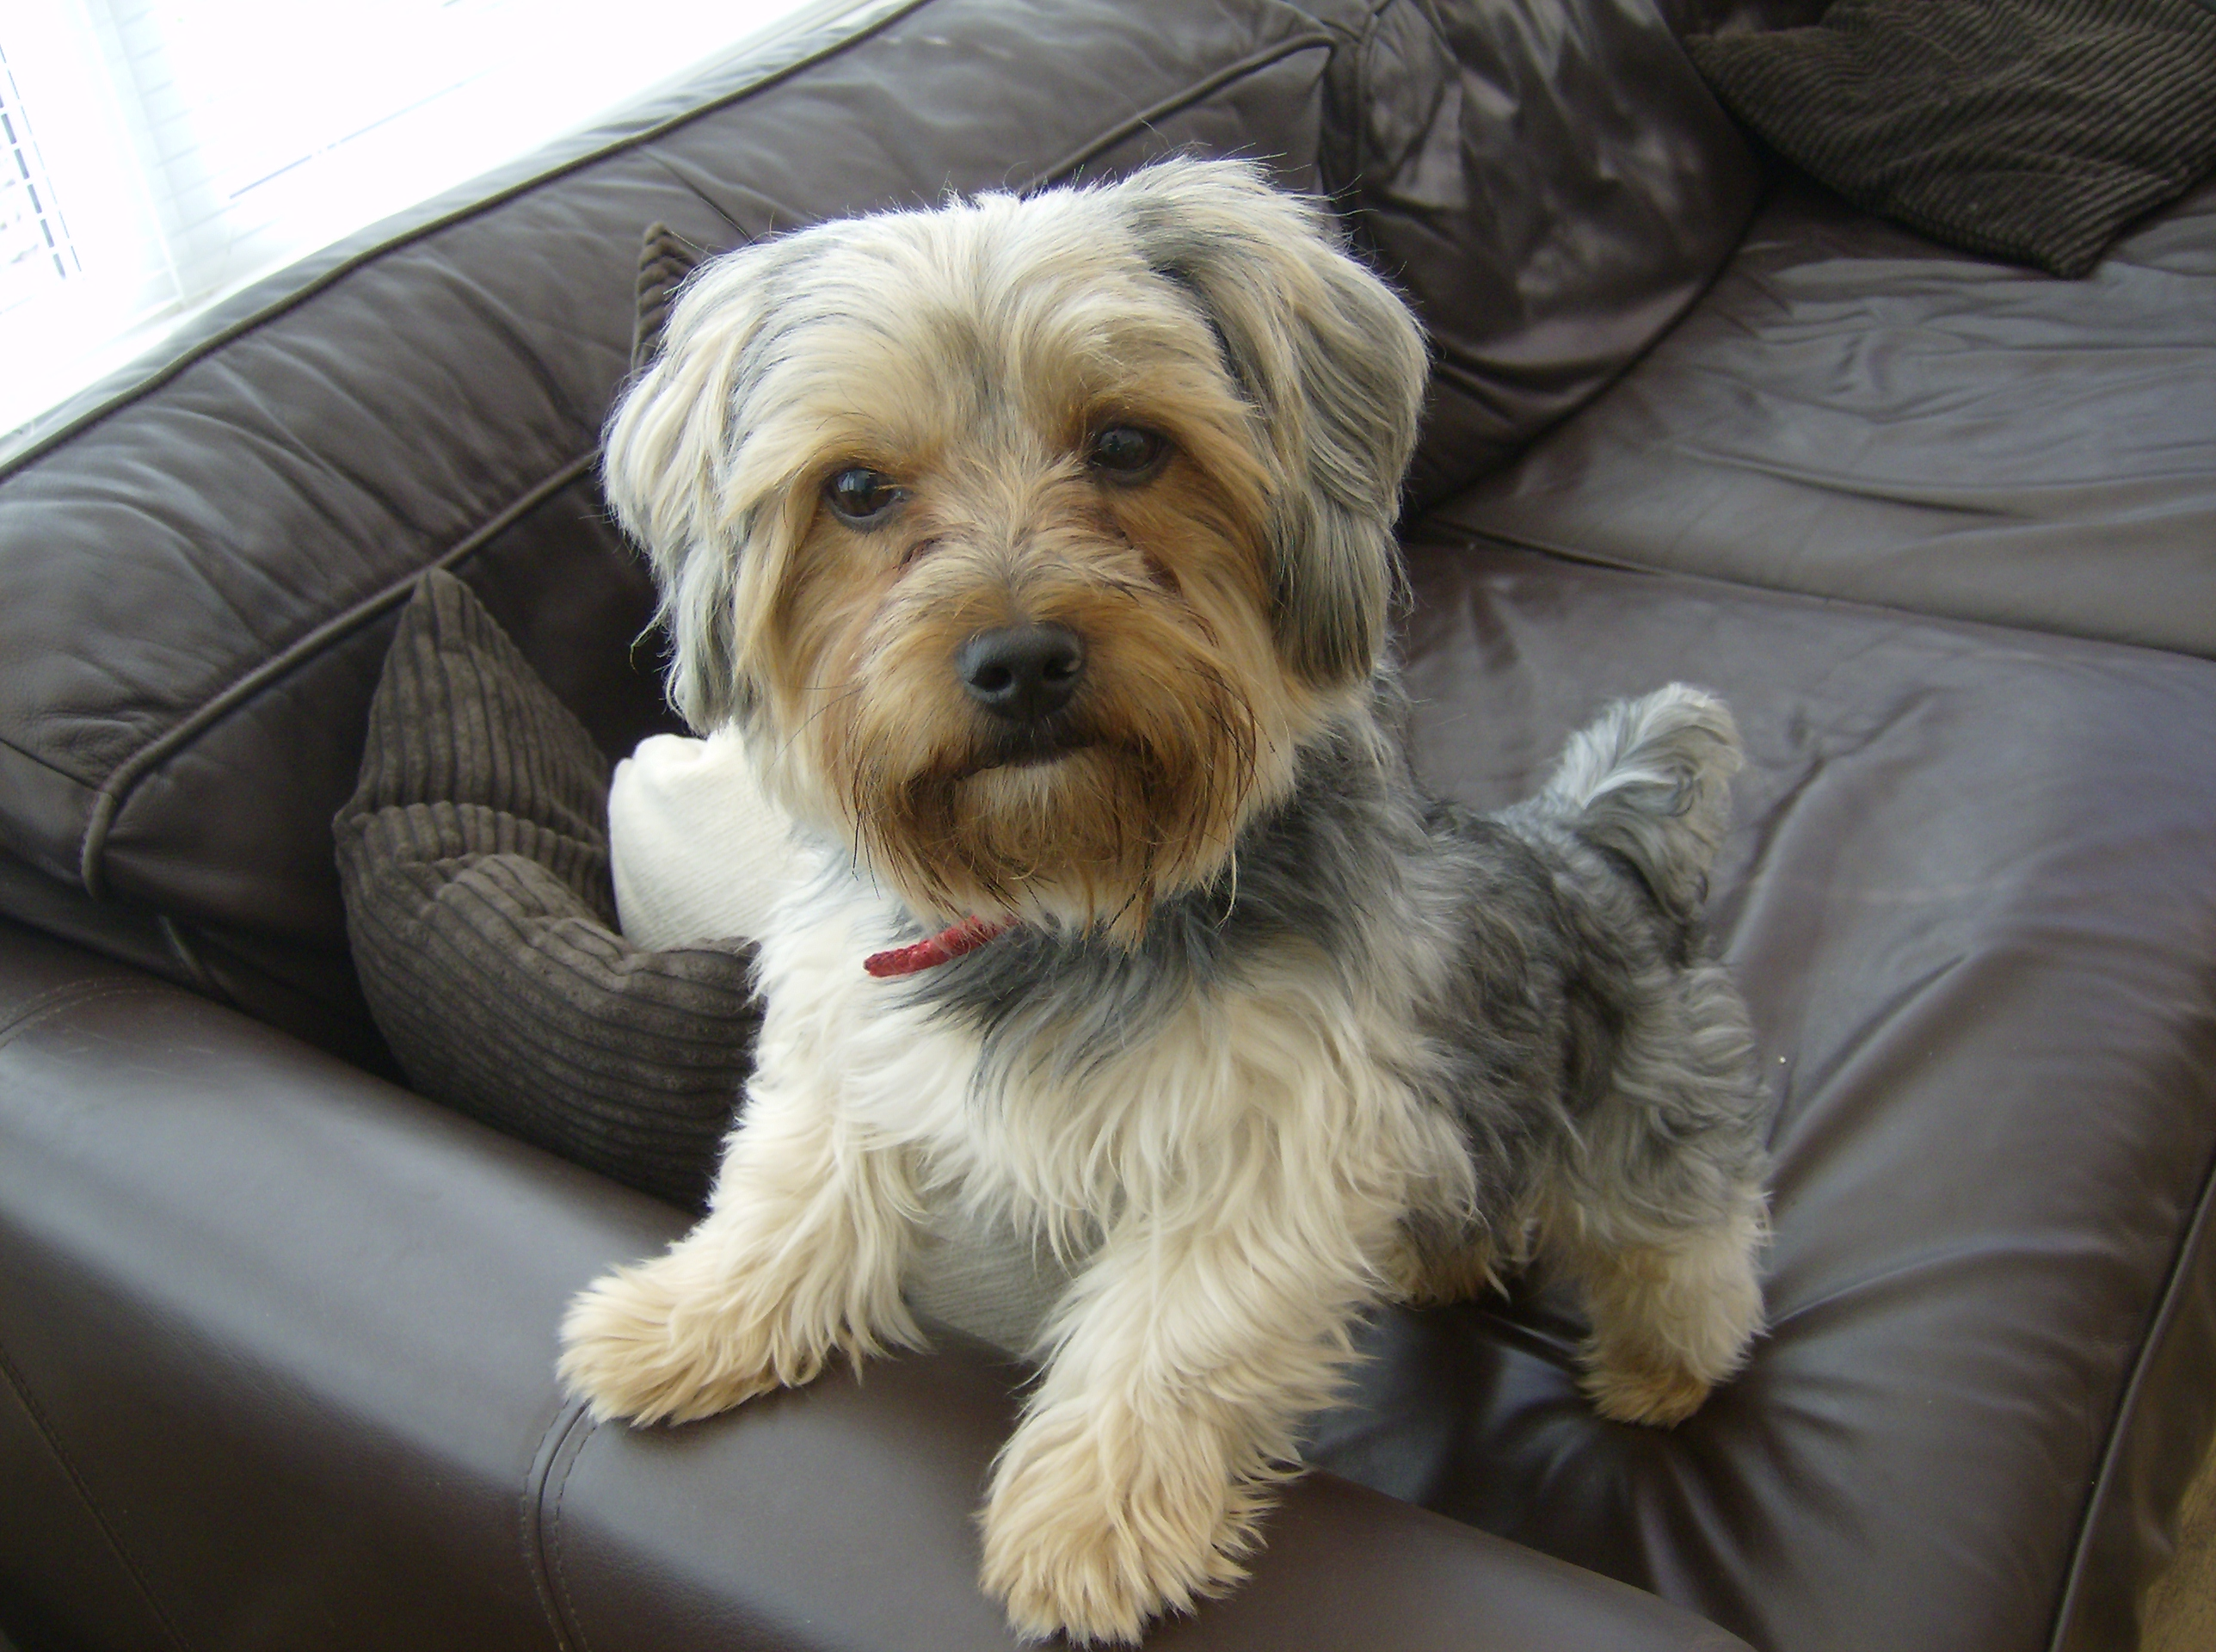
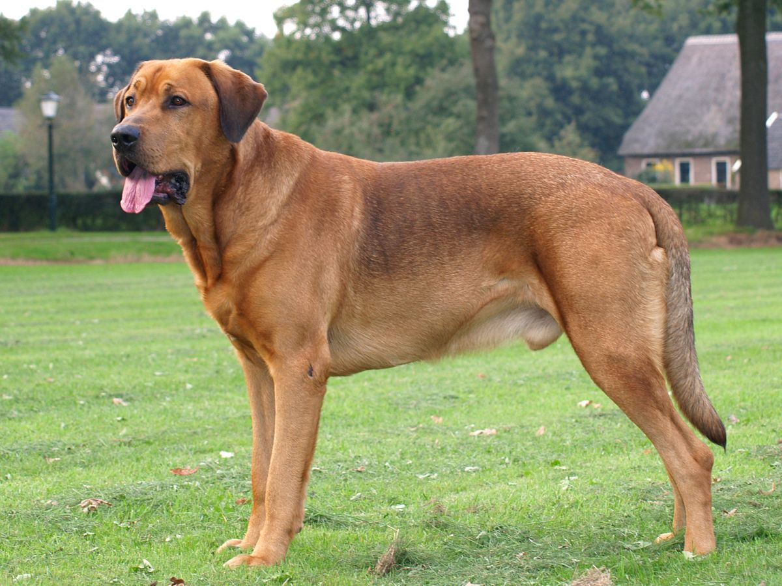
Assessment Question 2.
Mateo really wants to get a dog. After promising to take care of his new pet, his parents finally agree. But Mateo wants a big dog and his parents prefer a small dog. They are concerned that a big dog will be too much for him.
What would be the best choice for Mateo?
A
B

Slide 6
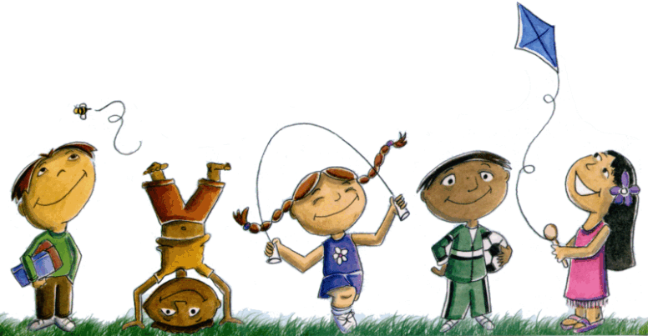
Assessment Question 3.
Tommy has plans to stay home to study for his spelling test tomorrow. He is saving money for a new bike and Mom says she will give him $5 if he gets a perfect grade on his test. Alesha calls and invites him to go to the park with her and her friends.
What choice should Tommy make?
A
B

