Slide 1
Climate Change and the Economy Challenges and Possibilities Presented by Theodore Opderbeck 12/8/20 opderbeckt@waldwickschools.org

Slide 2
EconEdLink Membership
You can now access CEE’s professional development webinars directly on EconEdLink.org! To receive these new professional development benefits, become an EconEdLink member. As a member, you will now be able to:
Automatically receive a professional development certificate via e-mail within 24 hours after viewing any webinar for a minimum of 45 minutes
Register for upcoming webinars with a simple one-click process
Easily download presentations, lesson plan materials and activities for each webinar
Search and view all webinars at your convenience
Save webinars to your EconEdLink dashboard for easy access to the event
You may access our new Professional Development page here

Slide 3
Professional Development Certificate
To earn your professional development certificate for this webinar, you must:
Watch a minimum of 45-minutes and you will automatically receive a professional development certificate via e-mail within 24 hours.
Accessing resources:
You can now easily download presentations, lesson plan materials, and activities for each webinar from EconEdLink.org/professional-development/

Slide 4
Agenda
Discuss climate change and its many effects (present and future) on the economy
Explore economic opportunities in light of climate change
Introduce and discuss lesson plan ideas, activities, and tech based formative assessments

Slide 5
Objectives
To explore the negative consequences and economic costs of climate change, both nationally and globally
To discuss the possible structural economic changes to cope with a present and future changing climate
To introduce dynamic lesson plans and project ideas to foster student critical thinking and problem solving regarding climate change and economics
To examine digital resources and formative assessment options

Slide 6
National Standards
1.2 Choices made by individuals, firms, or government officials often have long run unintended consequences that can partially or entirely offset or supplement the initial effects of the decision.
3.1 Comparing the benefits and costs of different allocation methods in order to choose the method that is most appropriate for some specific problem can result in more effective allocations and a more effective overall allocation system.
https://www.councilforeconed.org/wp-content/uploads/2012/03/voluntary-national-content-standards-2010.pdf

Slide 7
National Standards
16.4. Externalities exist when some of the costs or benefits associated with production and consumption fall on someone other than the producers or consumers of the product.

Slide 8
State Standards
NYS Social Studies 4.2: Economics requires the development and application of the skills needed to make informed and well-reasoned economic decisions in daily and national life.

Slide 9
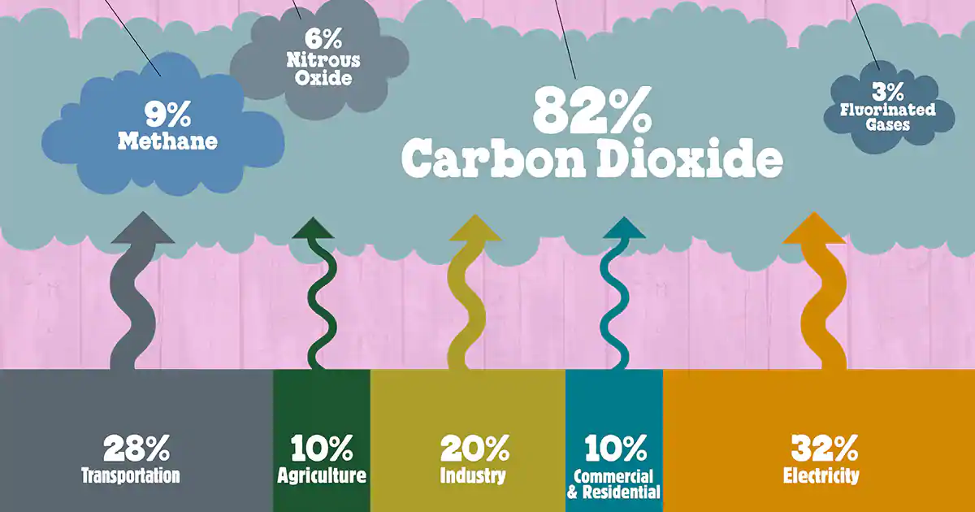
Question of the Day
As a nation, China emits the most carbon dioxide into the atmosphere, followed by the U.S. in second. Which nation ranks third?
Japan
Germany
India
Brazil

Slide 10
Economics and Cross Curricular Applications
Scarcity and Opportunity Cost
Fiscal Policy
Environmental Economics
Externalities and Market Failures
Energy Policy
Science/ Environmental Studies
Political Science
Math
History/ Global Studies

Slide 11
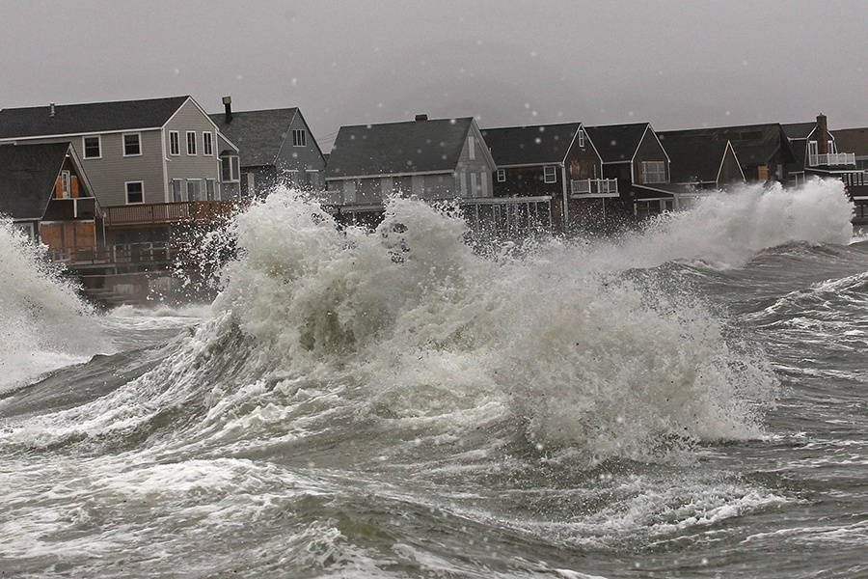
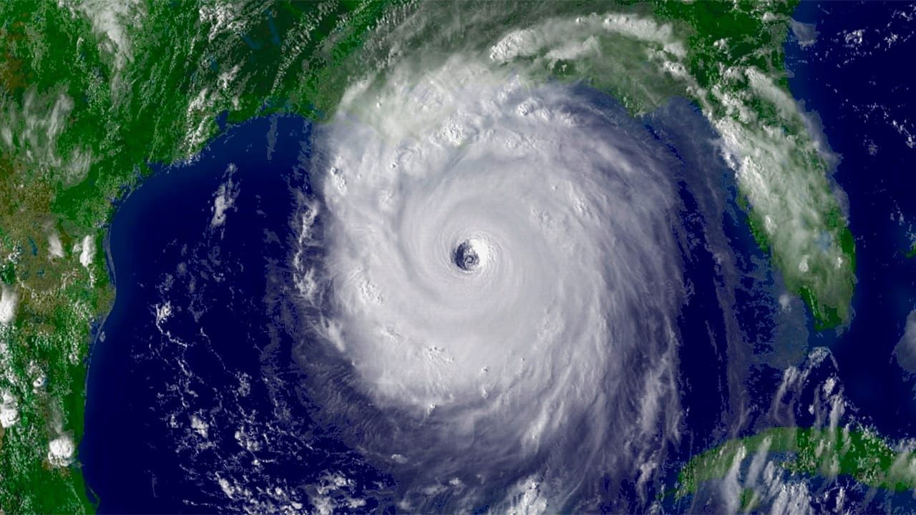
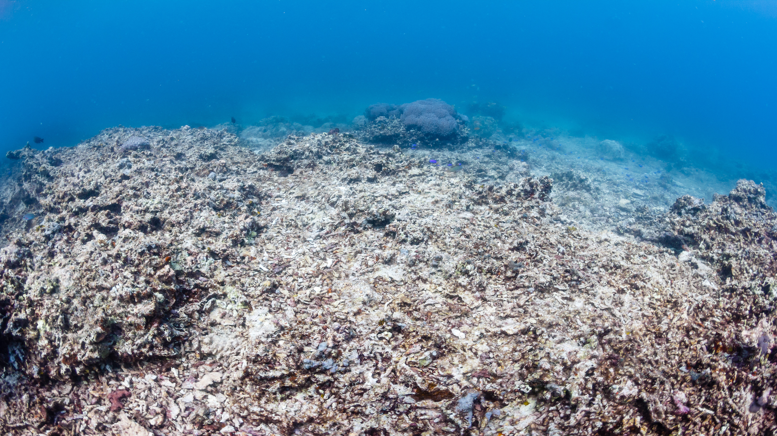
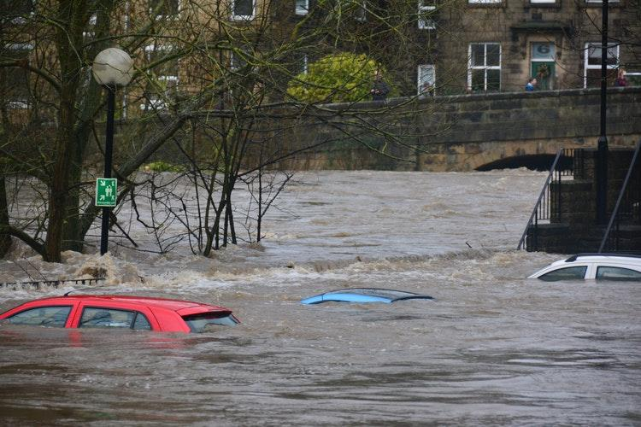
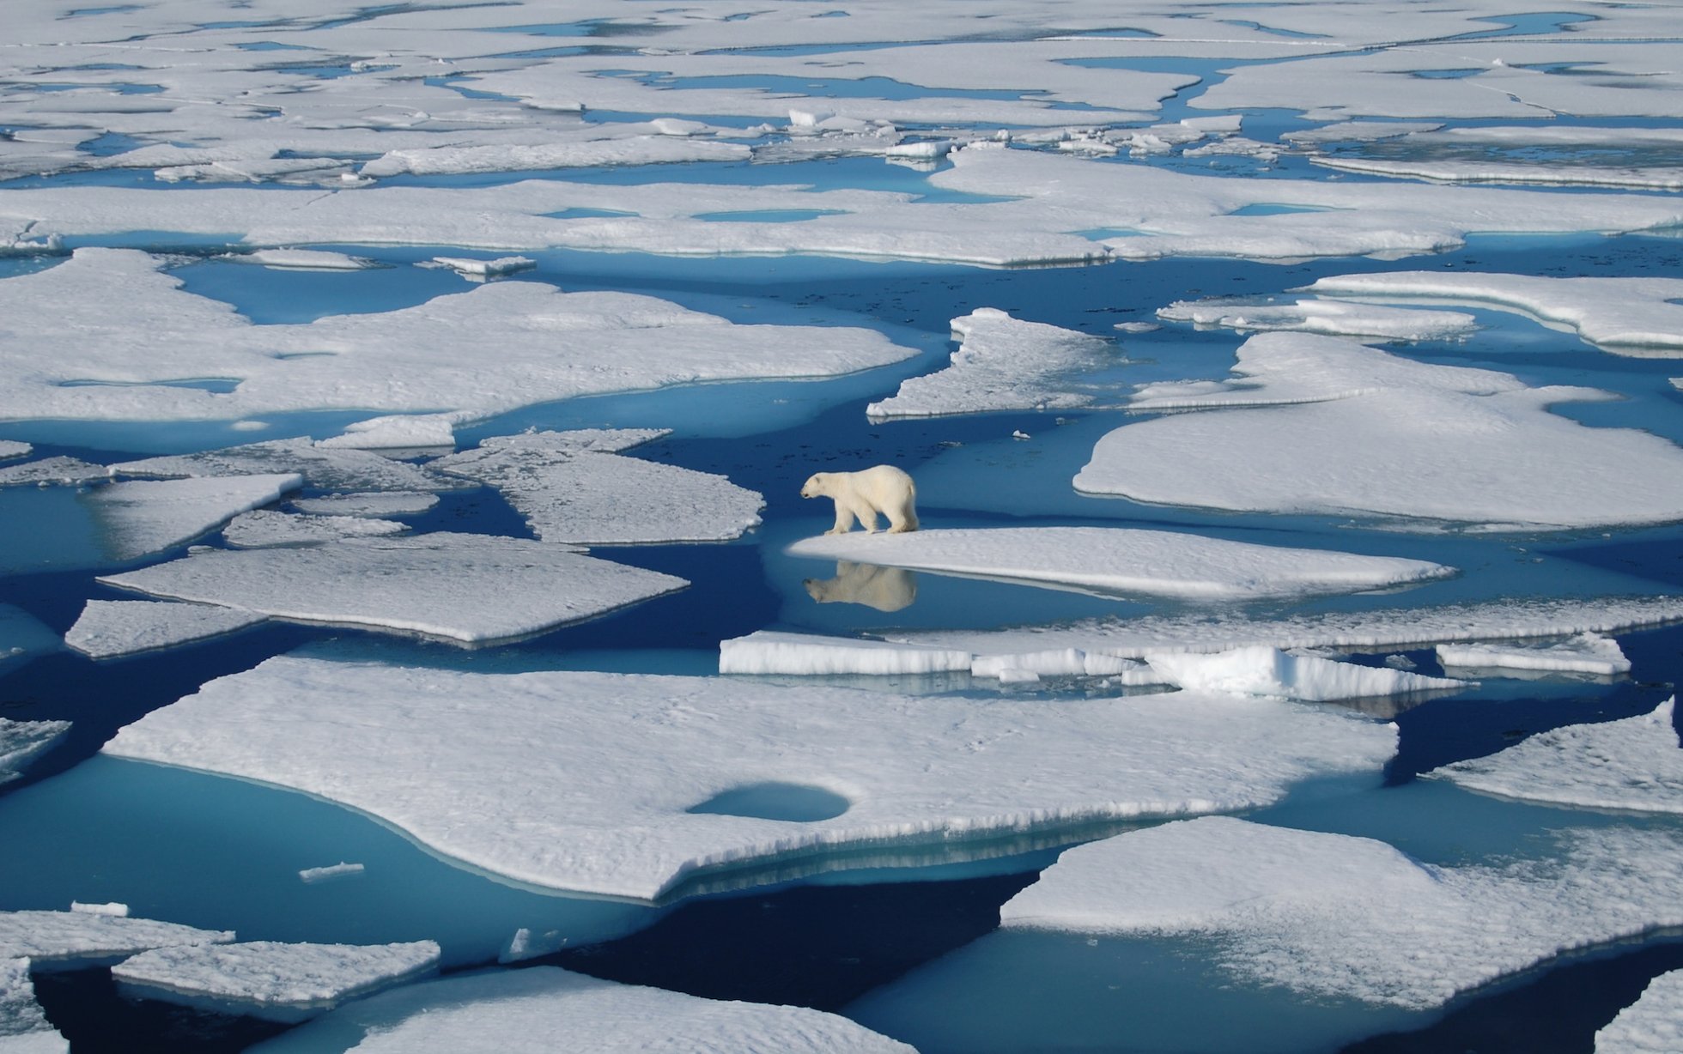
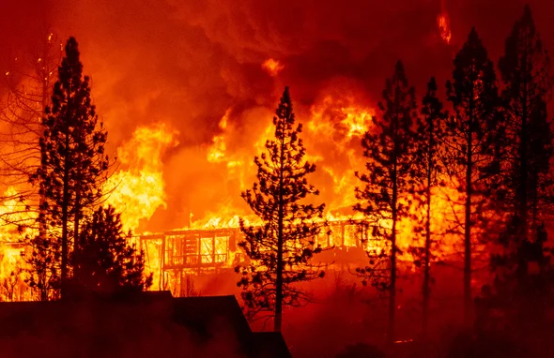
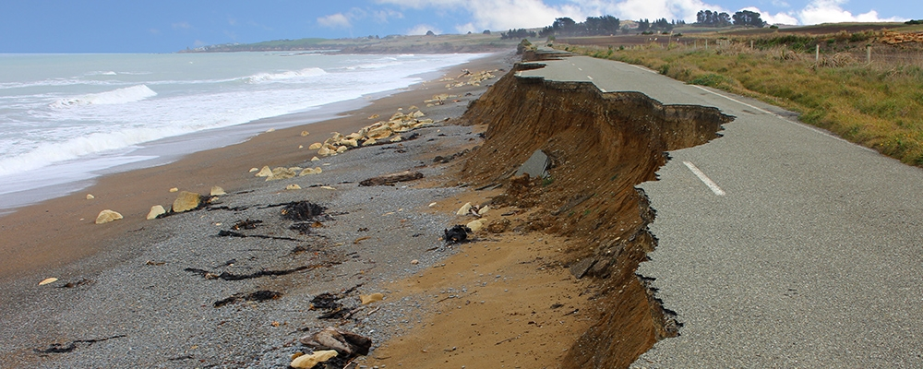
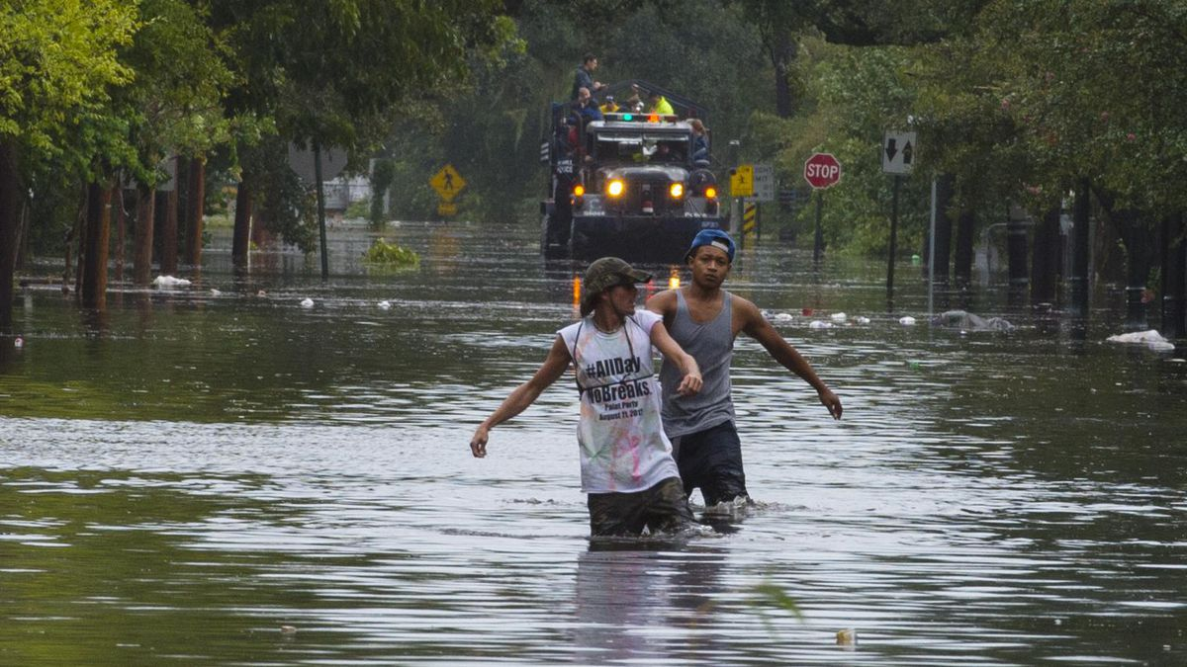
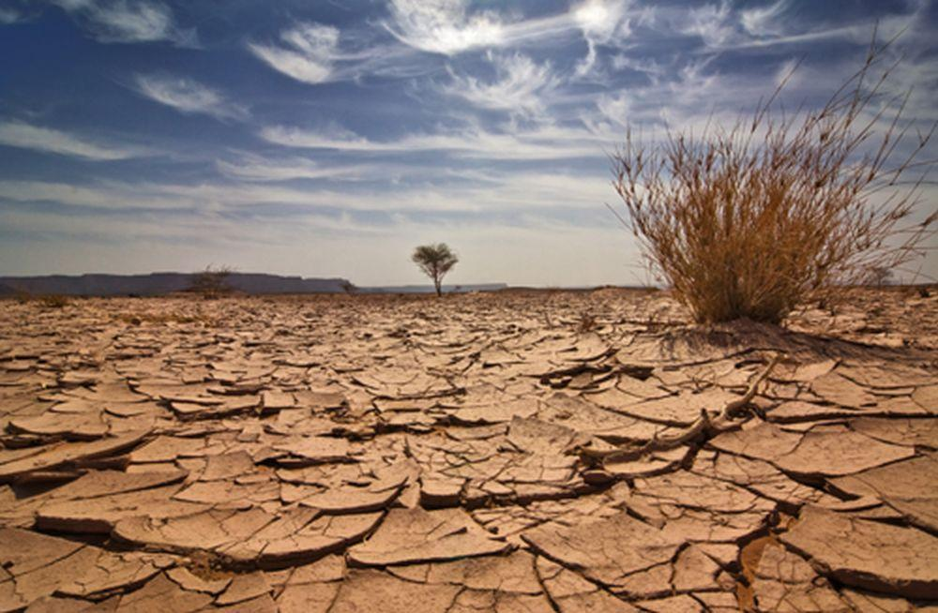

Slide 12
Climate Change Science
Global Temperature Increase:
Earth’s average surface temperature has risen 2.05 degrees (F) since the late 19th Century
Most of this warming has happened in the last 40 years
The pace is accelerating: the six warmest years on record are 2014 - 2020
Source: NASA https://climate.nasa.gov/evidence/
https://climate.nasa.gov/vital-signs/global-temperature/

Slide 13
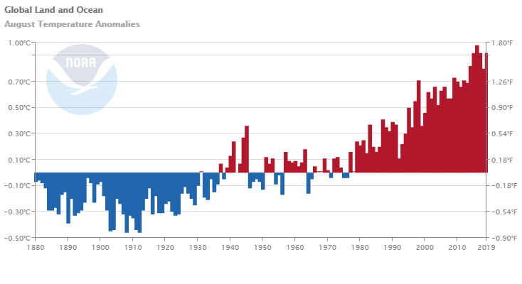

Slide 14
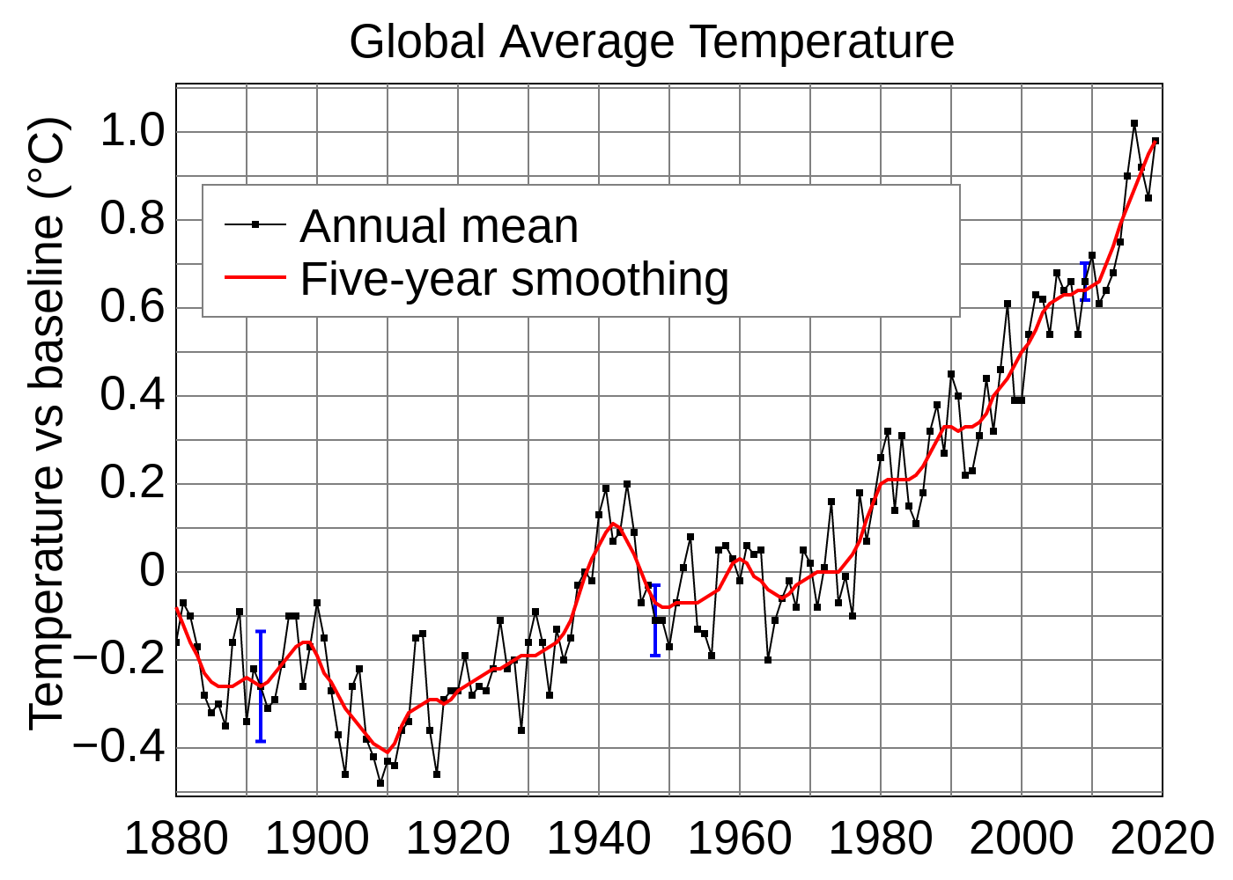

Slide 15
Climate Change Science
Increased Ocean Temperature
The ocean absorbs much of the increased heat
Average surface ocean temperature has increased 0.6 degrees (F) since 1969
Source: NASA https://climate.nasa.gov/evidence/

Slide 16
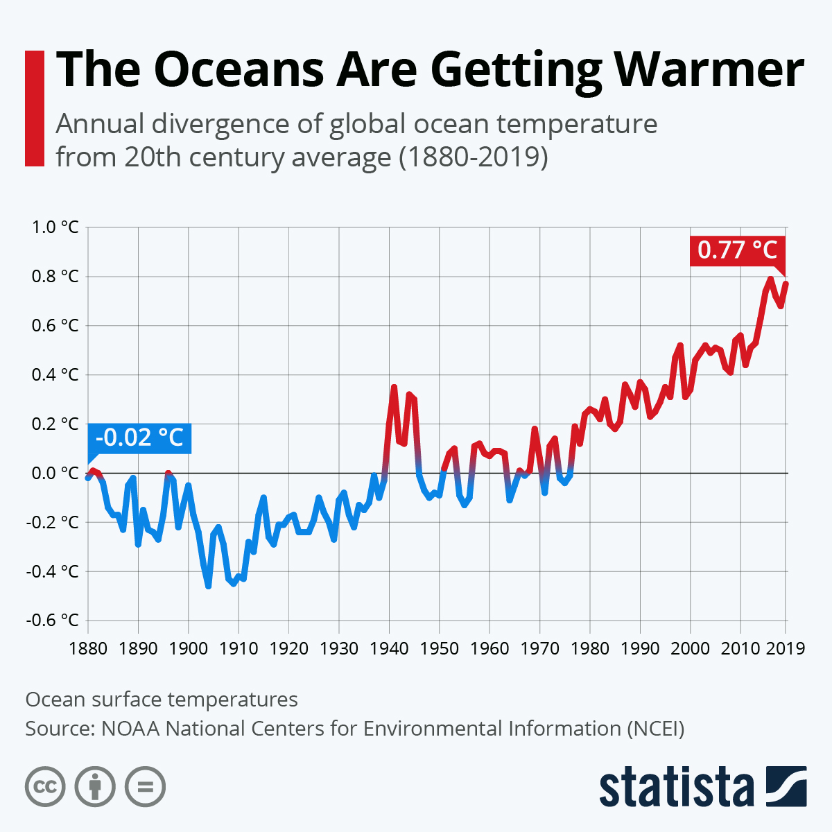

Slide 17
Climate Change Science
Shrinking Ice Sheets and Glacial Retreat
We are losing up to 280 billion tons of ice sheets per year on Greenland and 150 billion in Antarctica
Glaciers around the world are disappearing
Arctic sea ice is diminishing 13% per decade
Source: NASA https://climate.nasa.gov/evidence/

Slide 18
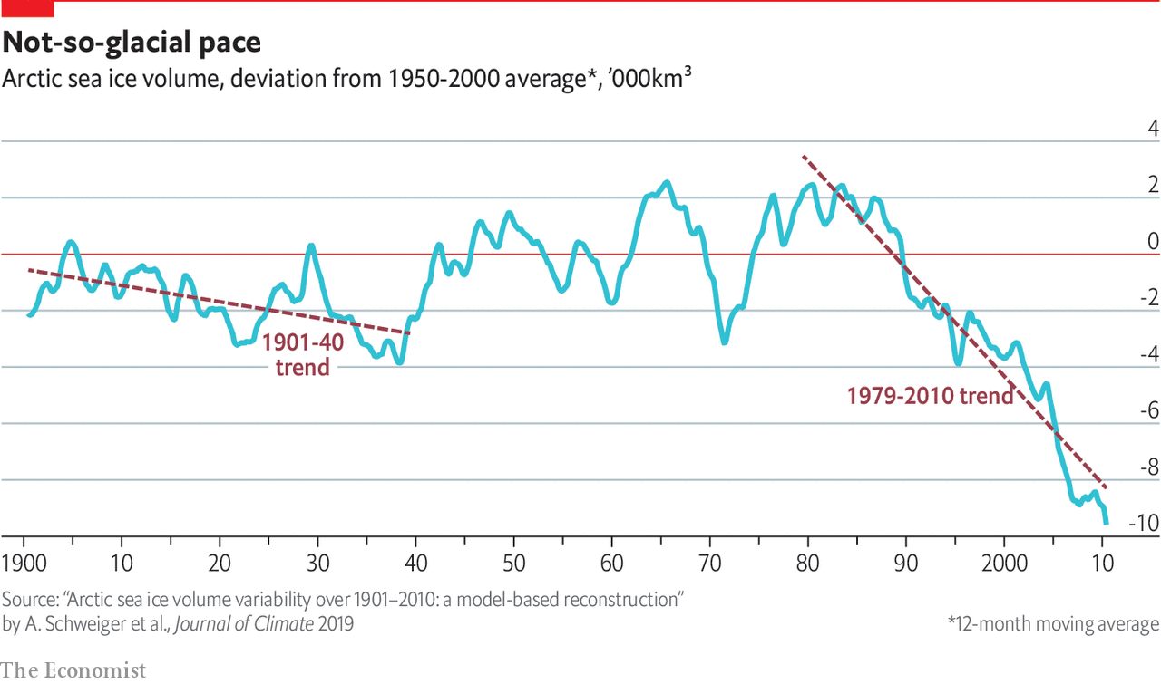

Slide 19
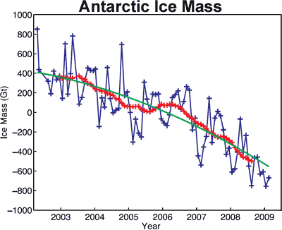

Slide 20
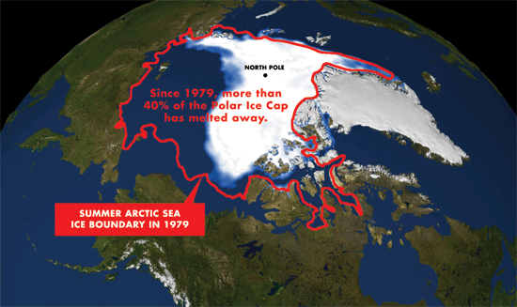

Slide 21
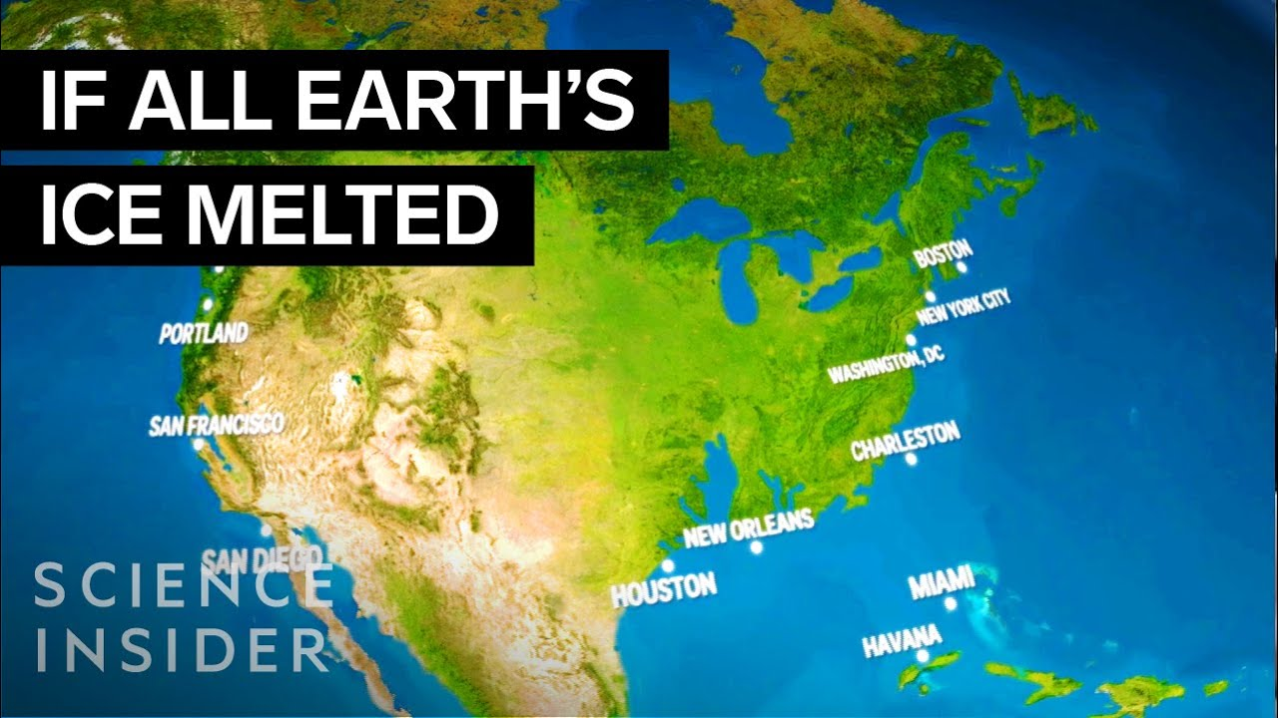

Slide 22
Climate Change Science
Sea Level Rise
Global sea levels rose 8 inches in the last century
Sea level rise has doubled in the last two decades and is accelerating every year
Predictions: 1 to 8 foot rise by 2100
Source: NASA https://climate.nasa.gov/evidence/

Slide 23
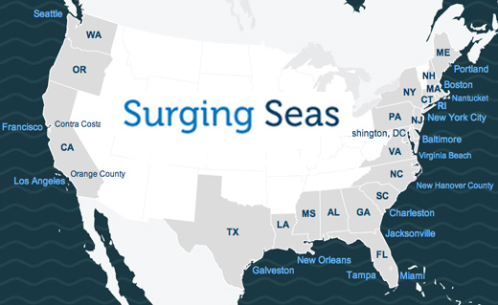

Slide 24
Climate Change Science
Ocean Acidification
Since the beginning of the Industrial Revolution, surface acidification in oceans has increased 30%
Oceans have absorbed 30% of carbon dioxide emitted from burning of fossil fuels
Source: NASA https://climate.nasa.gov/evidence/

Slide 25
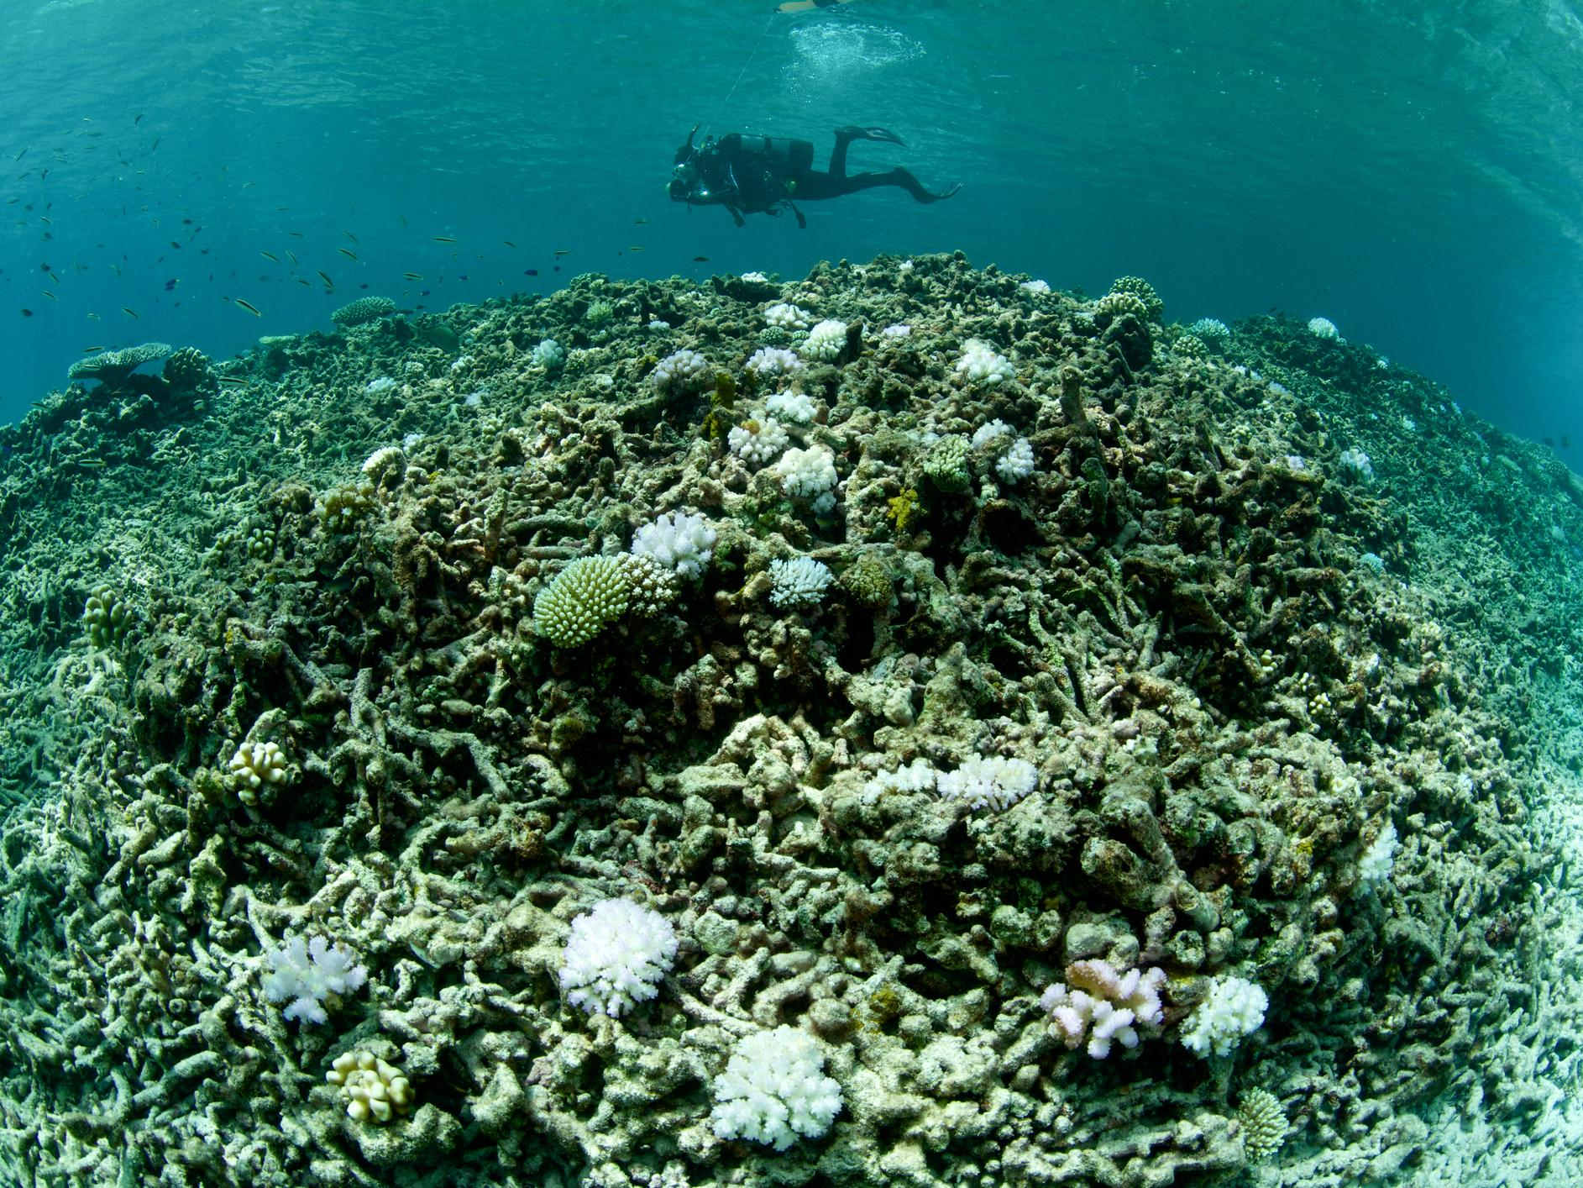

Slide 26
Climate Change Science
Extreme Weather Events
Increased frequency and intensity of hurricanes
Increased flooding rainfall
Increased droughts
Increase in wildfires
Increase in extreme heatwaves
Source: NASA https://climate.nasa.gov/evidence/

Slide 27
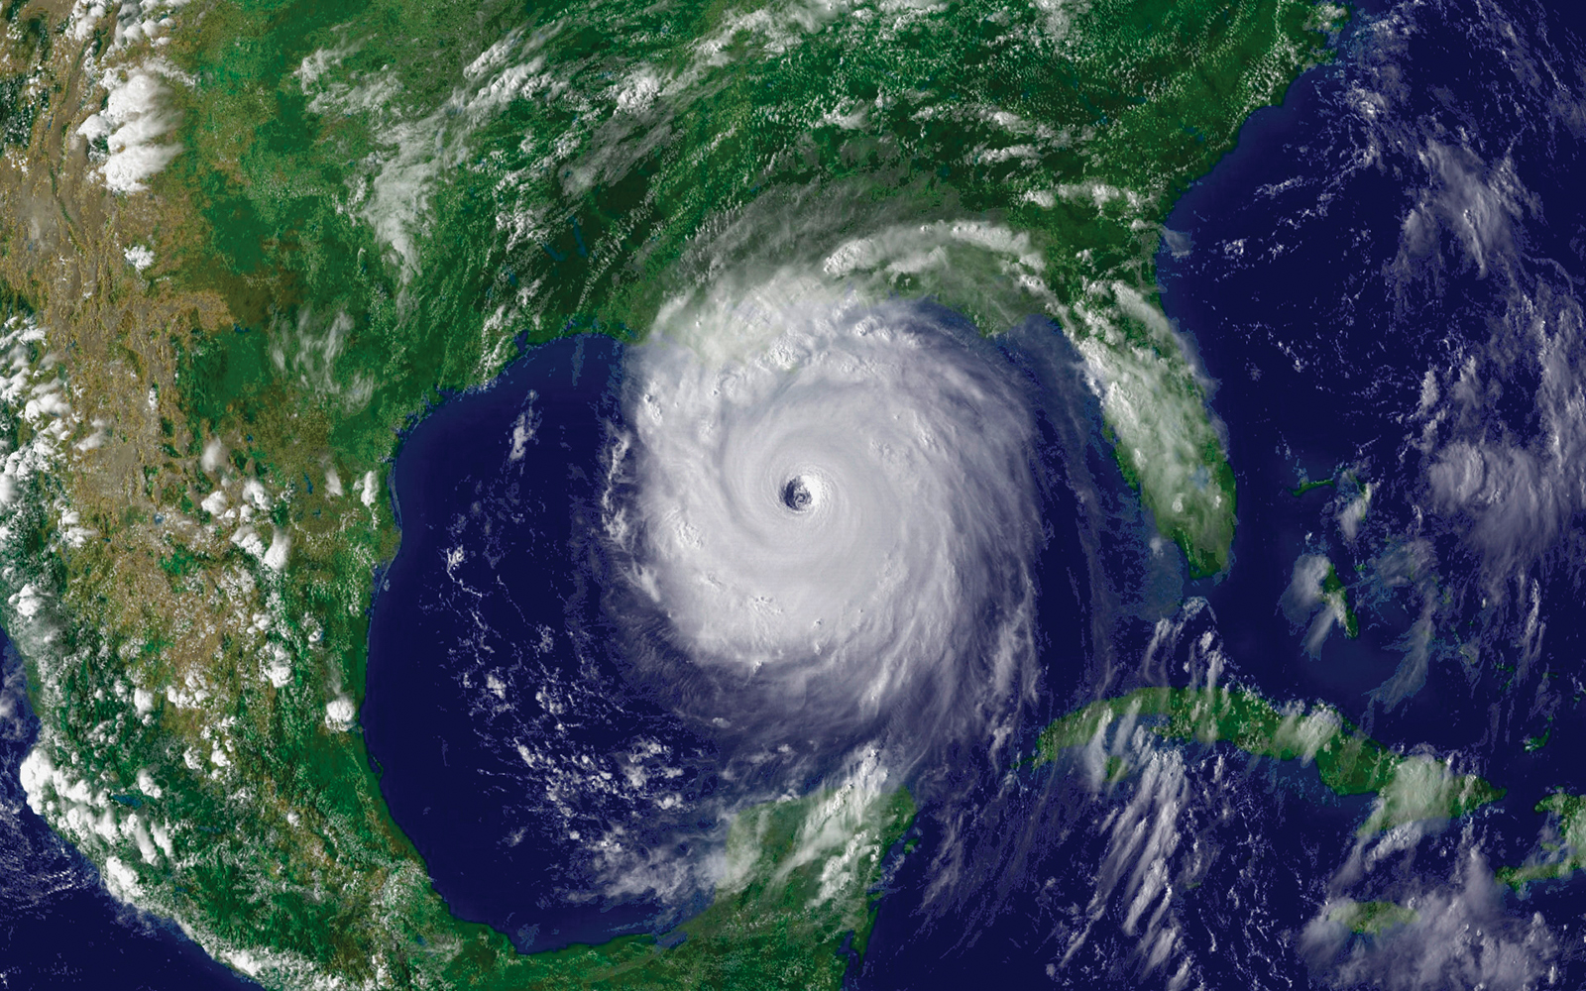
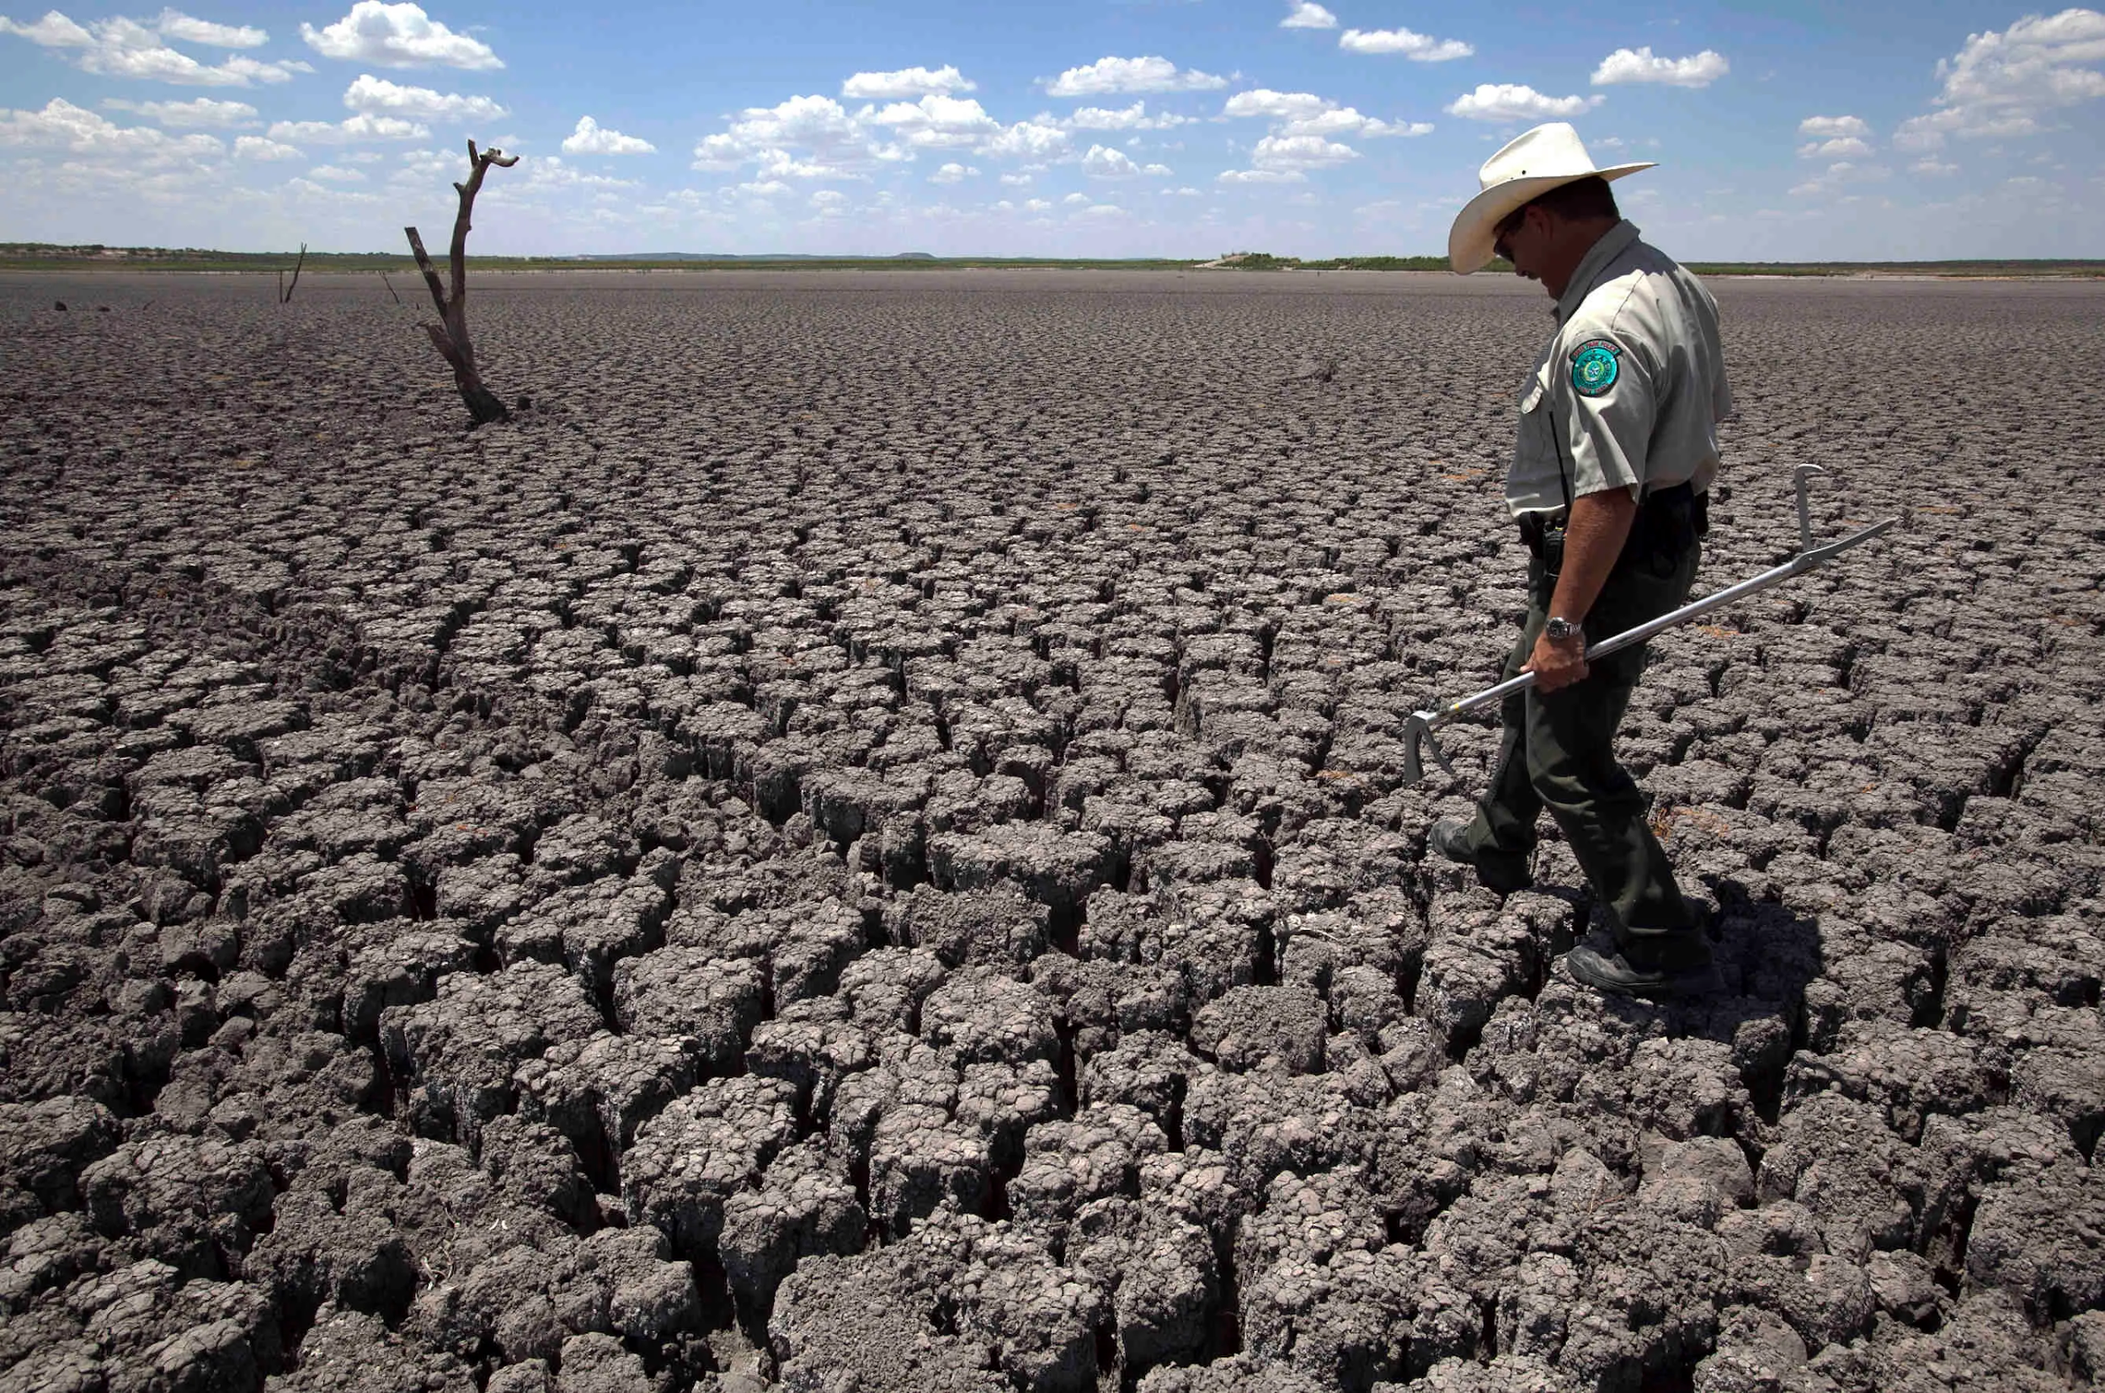
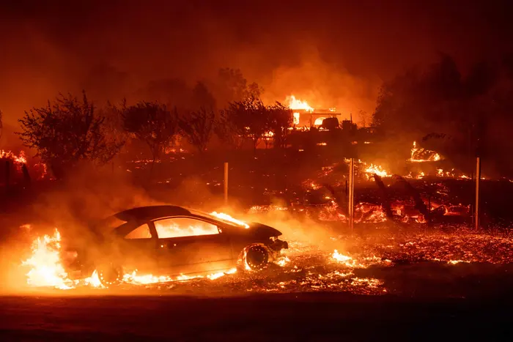
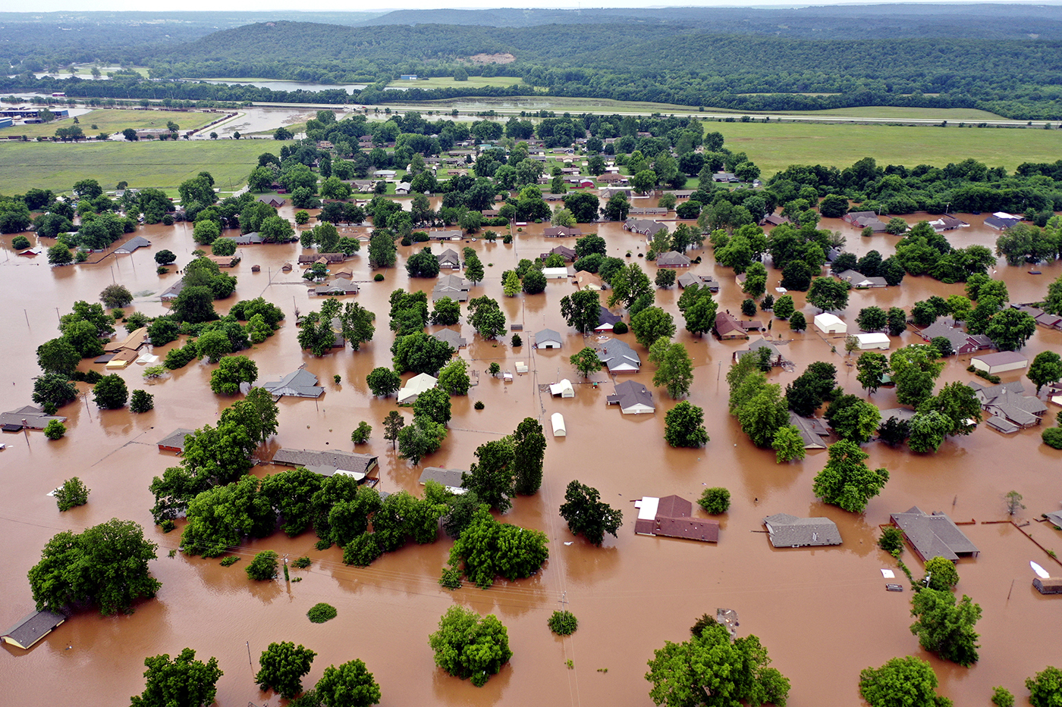

Slide 28
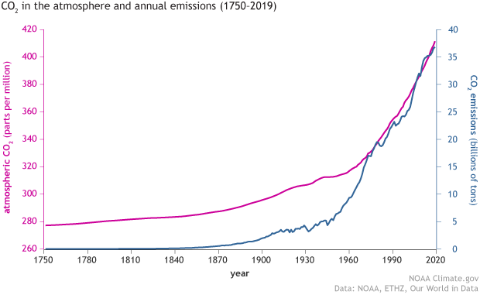

Slide 29
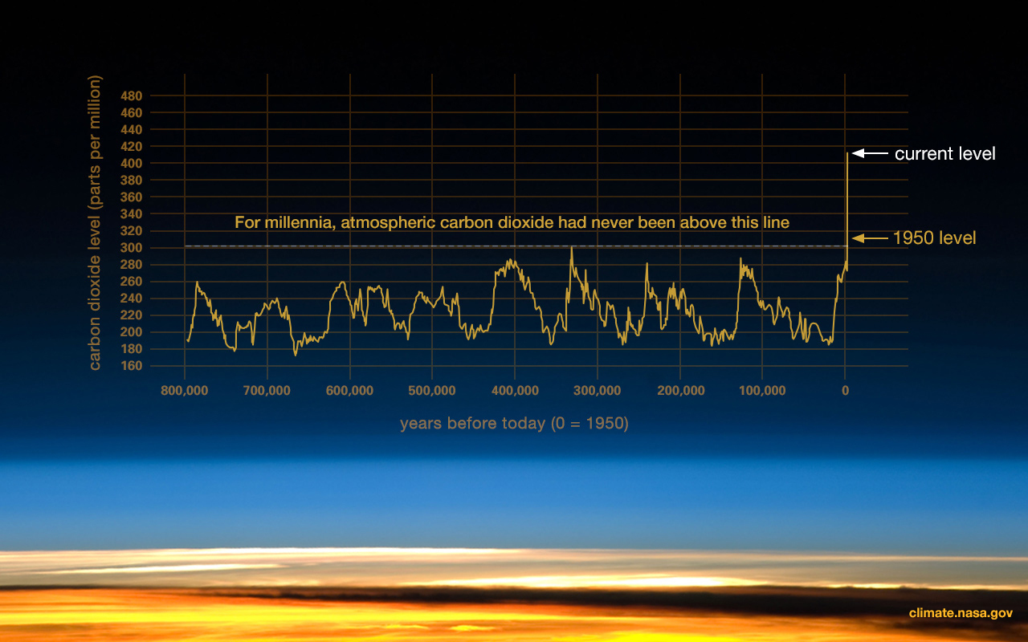

Slide 30
Digital Formative Assessment Options
Google Forms Poll: https://forms.gle/nMNTwsFSsJNUSHws9
Socrative: www.socrative.com

Slide 31
Economic Cost of Climate Change
Overview:
Current cost to U.S. Economy: $415 billion in last three years (hurricanes, wildfires)
Future Predictions: $300 - $520 billion per year through the year 2100
Possible 10% decrease in GDP by 2100
Source: Columbia University, Earth Institute: https://blogs.ei.columbia.edu/2019/06/20/climate-change-economy-impacts/

Slide 32
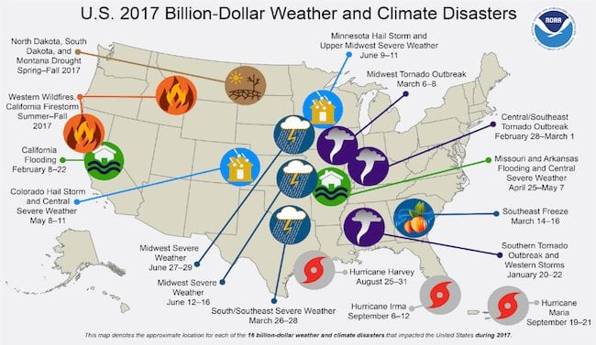

Slide 33
Economic Cost of Climate Change
Agriculture:
Most vulnerable economic sector to climate change
37% increase in extreme rainfall/flooding since 1950
Increased drought and heat: every one degree increase in temp = 5-15% decrease in crop production
Source: Columbia University, Earth Institute: https://blogs.ei.columbia.edu/2019/06/20/climate-change-economy-impacts/

Slide 34
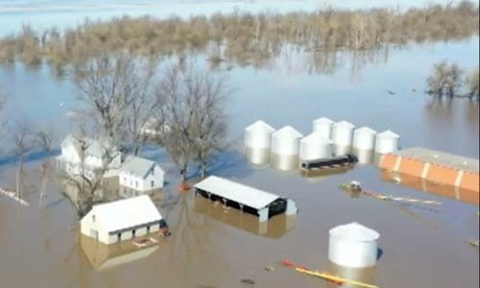
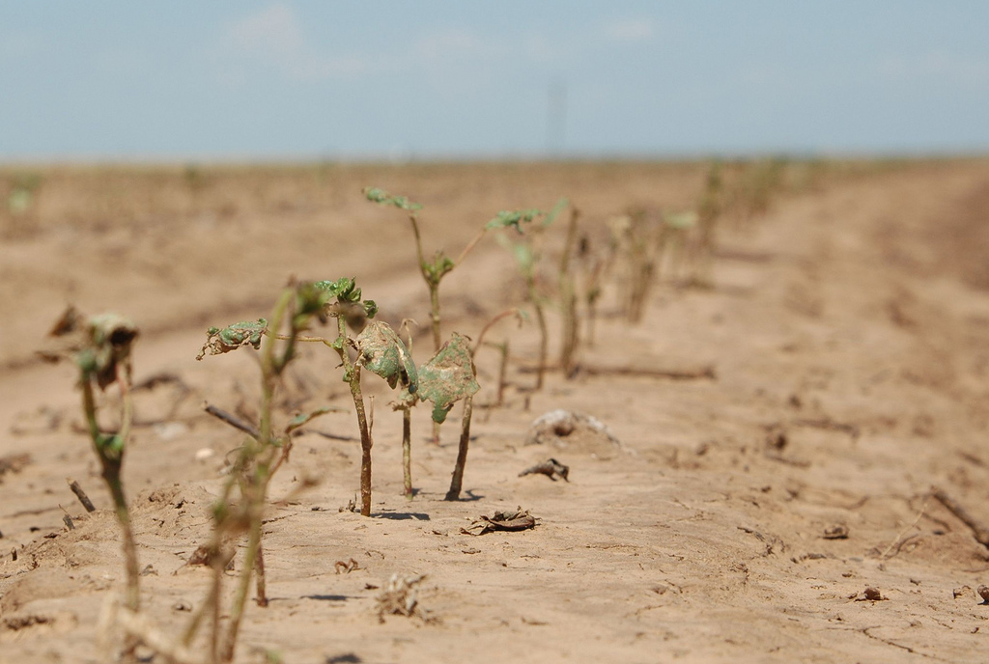
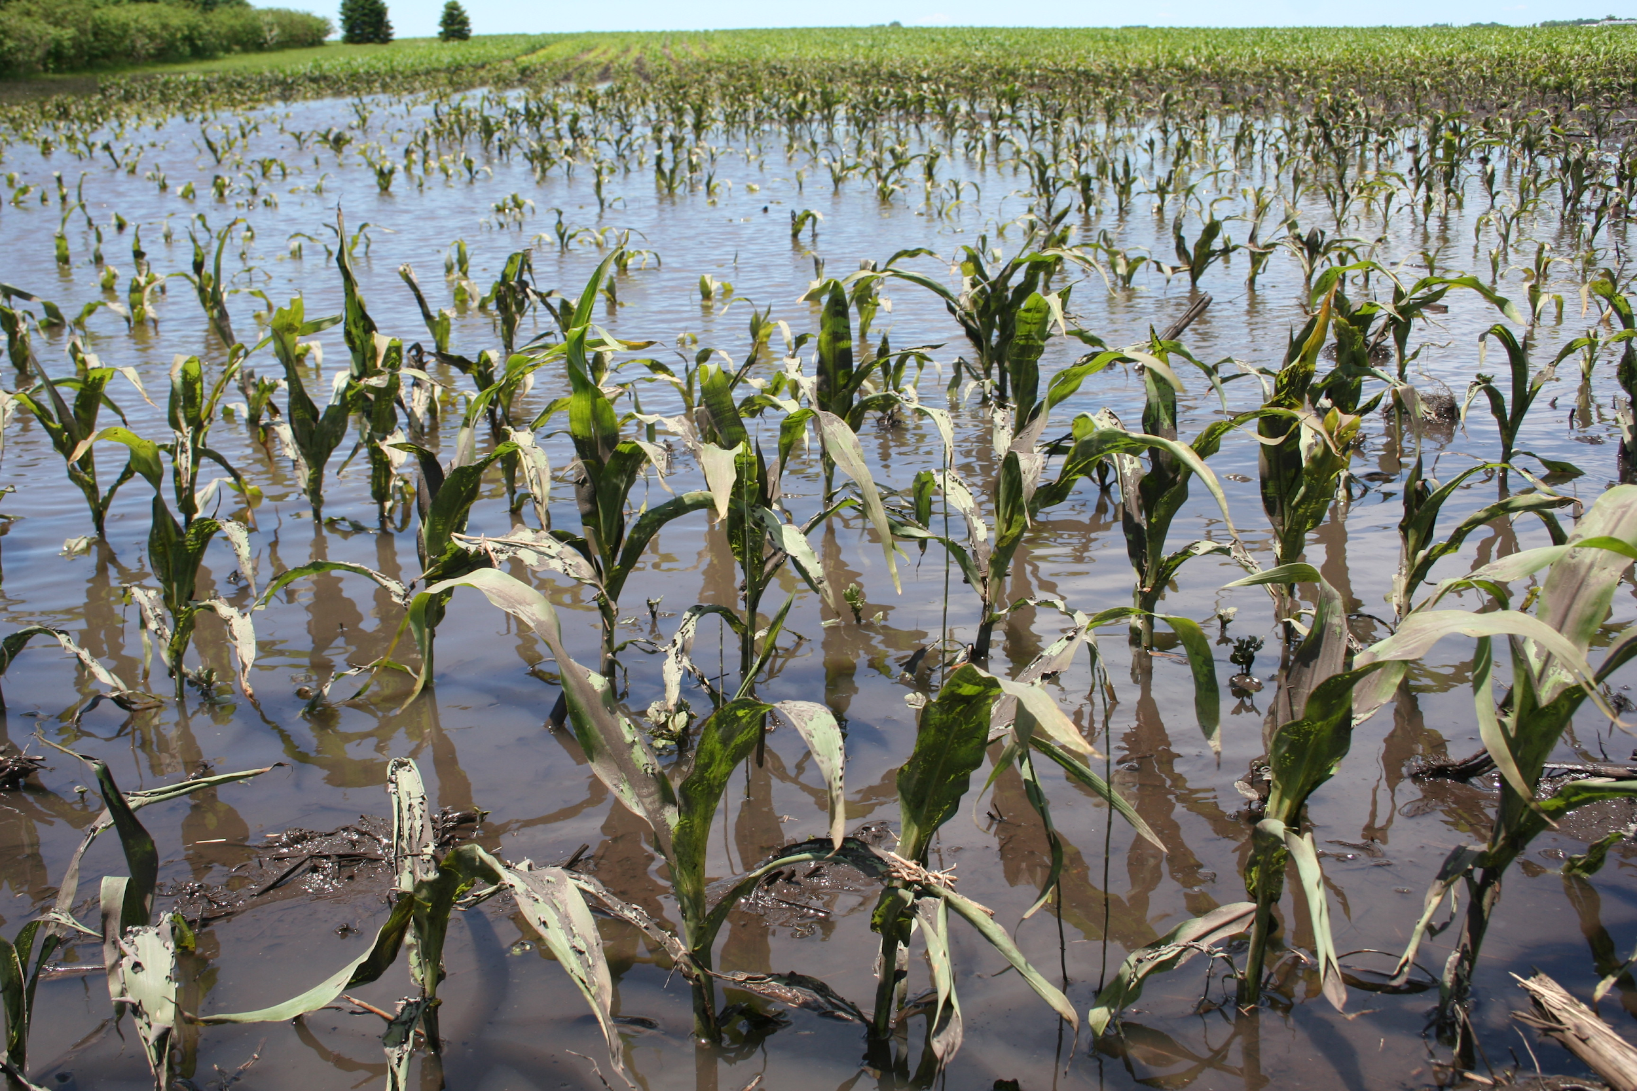
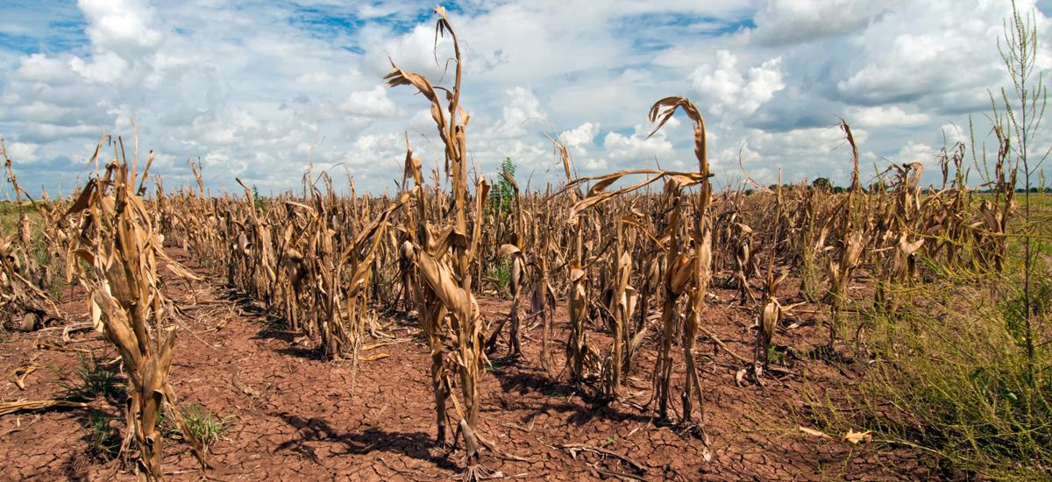

Slide 35
Economic Cost of Climate Change
Infrastructure:
Prediction: $2-5 Trillion destruction of infrastructure by end of century
Loss/damage to housing, airports, bridges, rail lines, subways
Threats to 4,000 miles of fiber optic cable
Source: Columbia University, Earth Institute: https://blogs.ei.columbia.edu/2019/06/20/climate-change-economy-impacts/

Slide 36
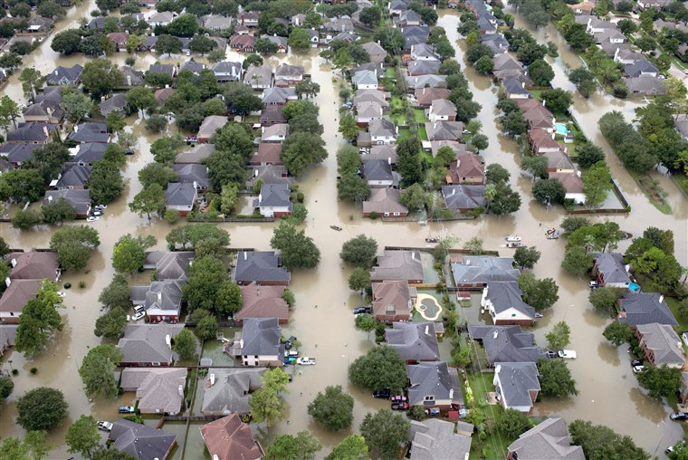
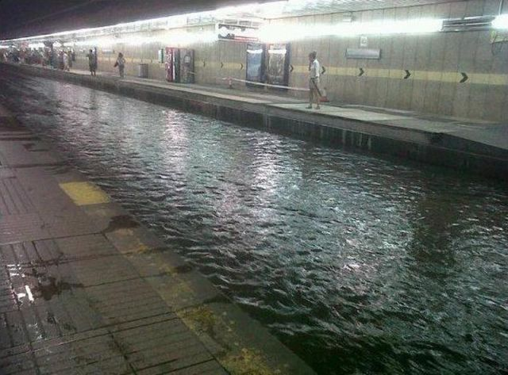
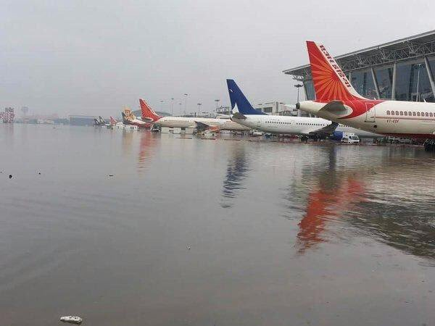
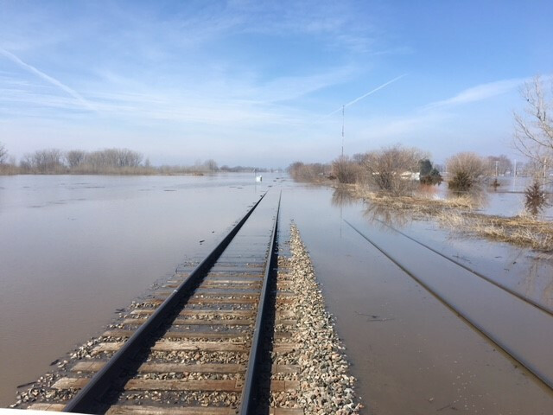
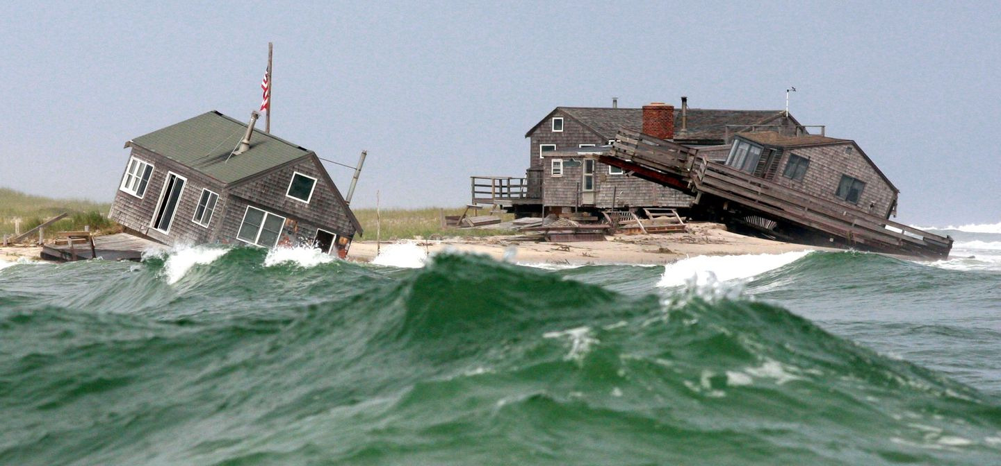

Slide 37
Economic Cost of Climate Change
Health, Loss of Life, and Productivity Declines:
Estimated that climate related deaths will cost the economy $140 billion annually
Loss of 2 billion labor hours per year, resulting in $160 billion in lost wages annually
Increase in insect borne diseases, waterborne, and food illnesses
Source: Columbia University, Earth Institute: https://blogs.ei.columbia.edu/2019/06/20/climate-change-economy-impacts/

Slide 38
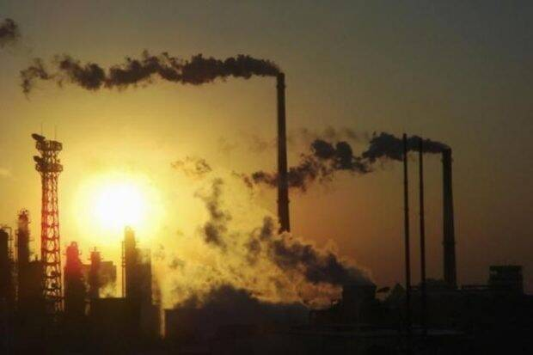
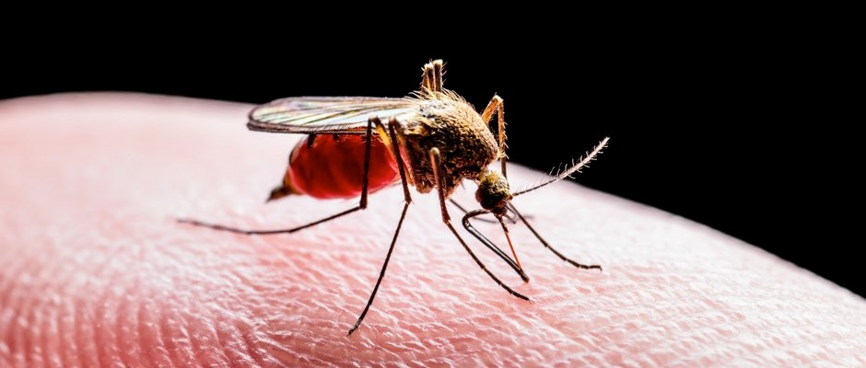

Slide 39
Economic Cost of Climate Change
Tourism:
Lost winter tourism (possible $2 billion annual loss)
Increased algae blooms in oceans and lakes
Diminished air quality due to wildfires
Erosion and submerged coastal beaches/ islands/ marshes
Source: Columbia University, Earth Institute: https://blogs.ei.columbia.edu/2019/06/20/climate-change-economy-impacts/

Slide 40
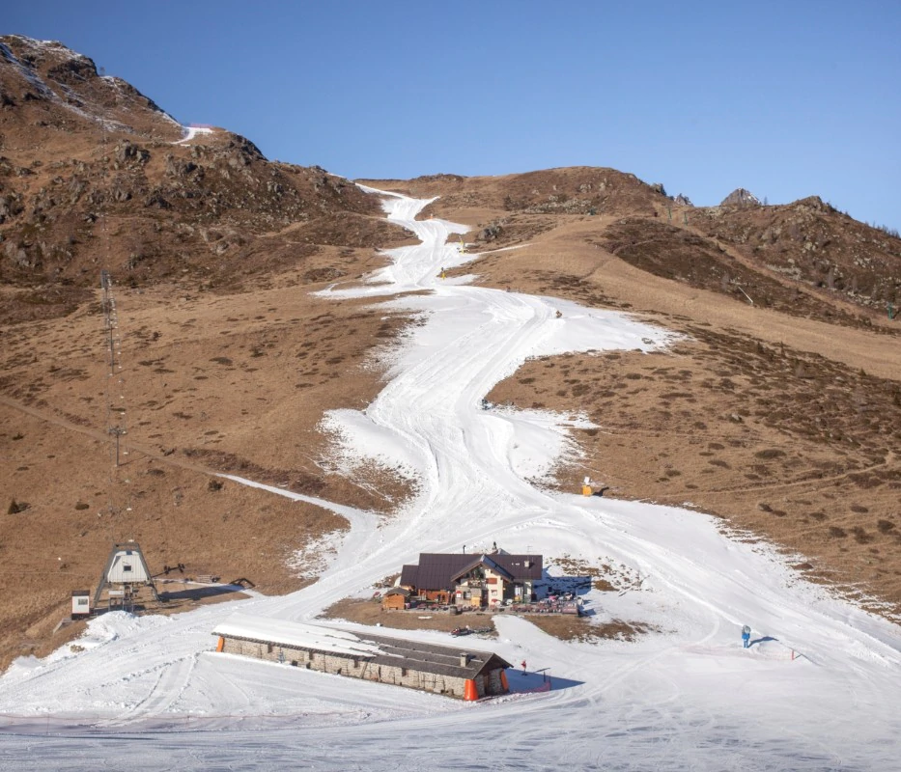
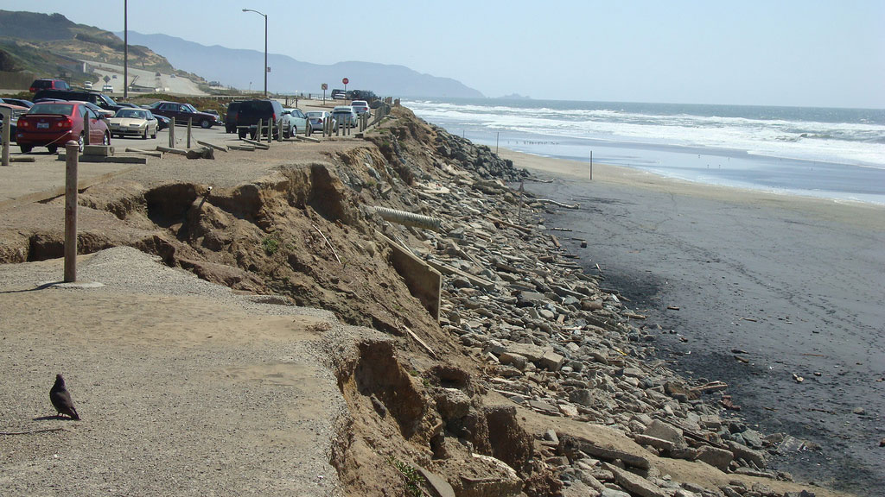
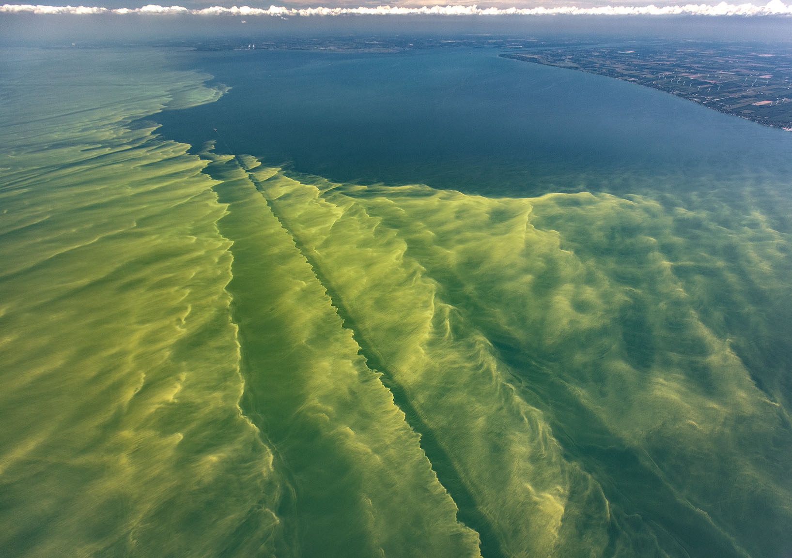
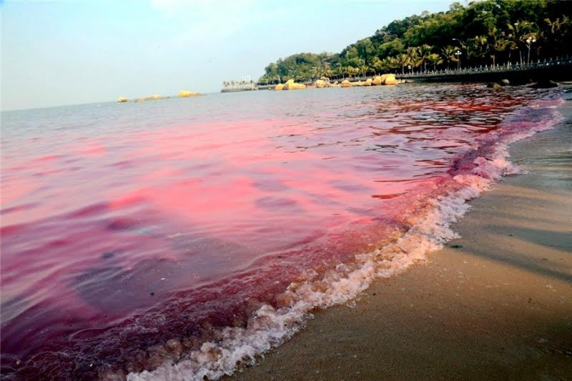

Slide 41
Economic Cost of Climate Change
Business Losses and Financial Instability/Volatility:
Damage to factories/ supply chains
Increase in raw material prices
Increase in carbon taxes, emission charges
Decline in real estate values in some areas
Source: Columbia University, Earth Institute: https://blogs.ei.columbia.edu/2019/06/20/climate-change-economy-impacts/

Slide 42
Economic Cost of Climate Change
Climate Migration (within the U.S. to “Climate Safe Cities”)
https://www.nytimes.com/interactive/2020/09/15/magazine/climate-crisis-migration-america.html
https://www.bloomberg.com/news/articles/2020-02-03/mapping-migration-in-the-face-of-climate-change
International Climate “Refugees” - U.S. Census estimate: 100 million climate refugees will enter the U.S. by 2100

Slide 43
Economic Cost of Climate Change
Economic Effects on Cities
https://www.scientificamerican.com/article/how-climate-will-change-in-cities-across-the-u-s/
https://www.wnyc.org/story/nyc-2050-climate-change-and-future-new-york/
https://nymag.com/intelligencer/2016/09/new-york-future-flooding-climate-change.html

Slide 44
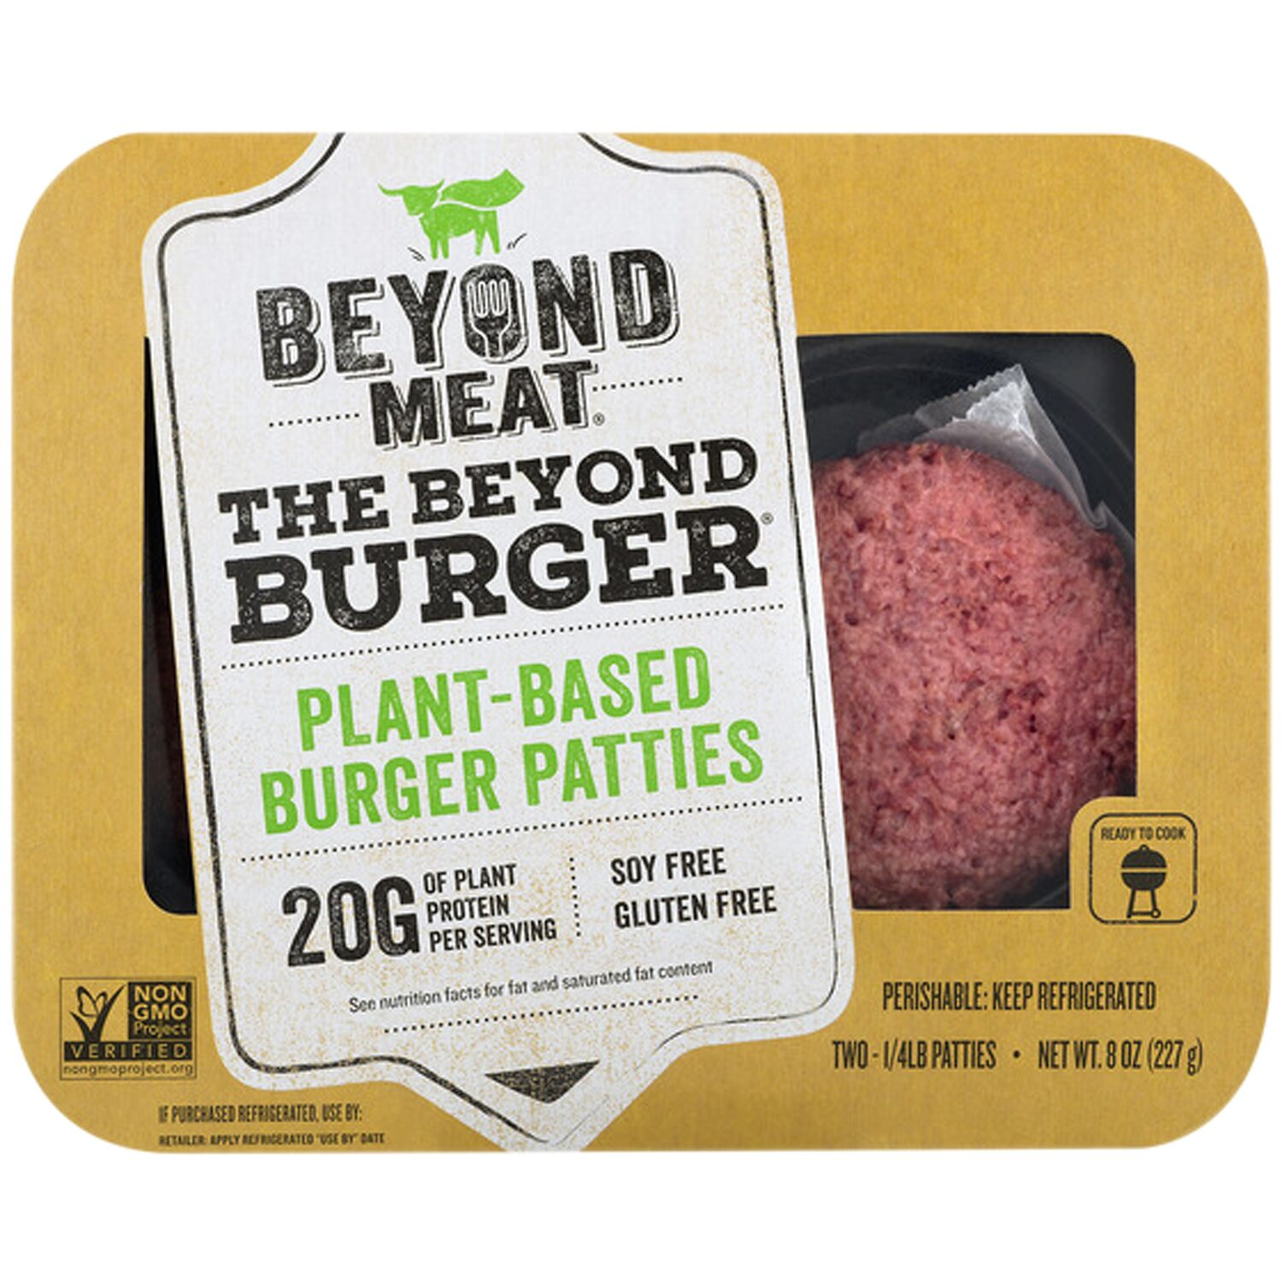
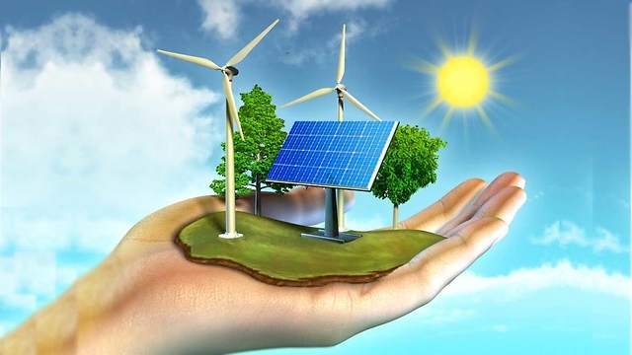
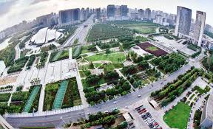
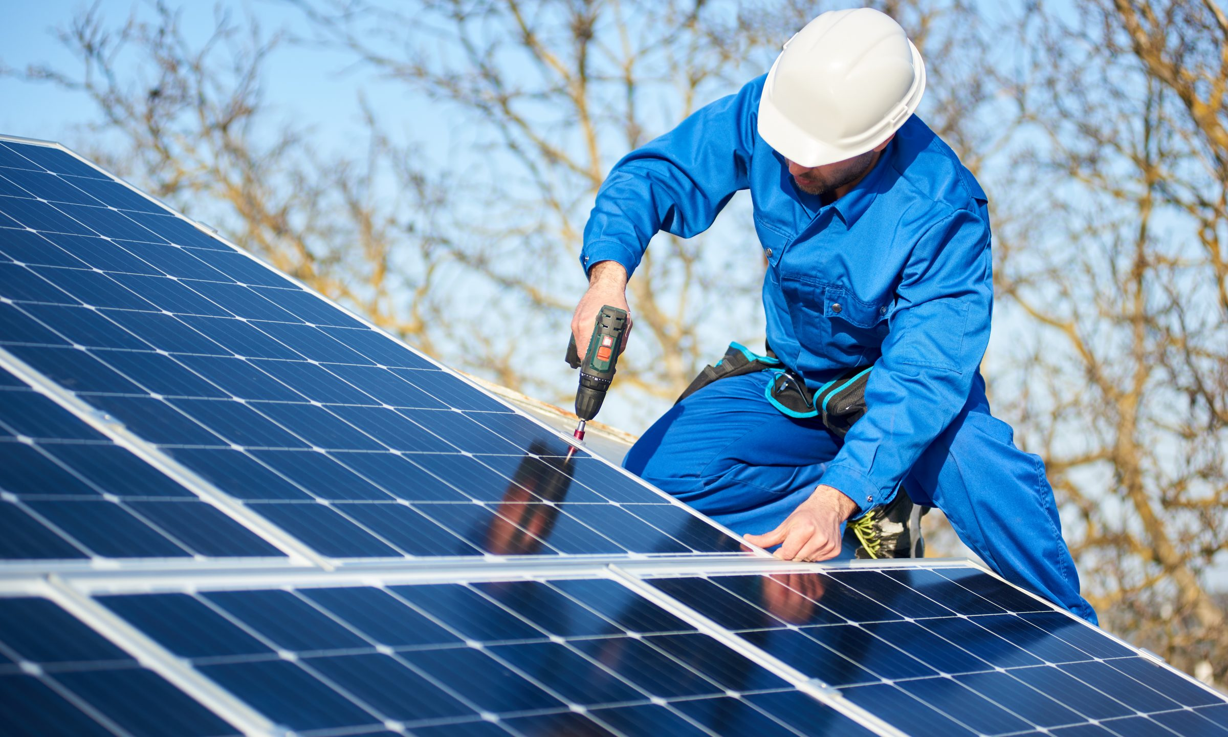
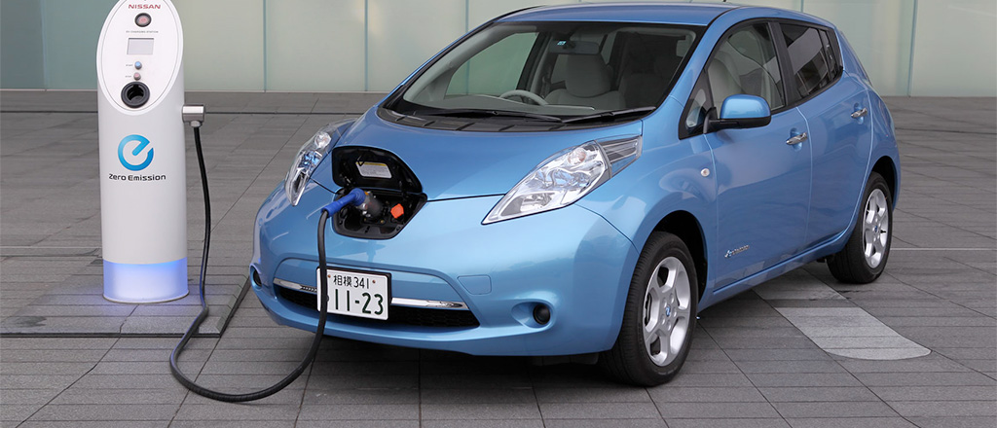
Economic Possibilities

Slide 45
Economic Possibilities of Climate Change
Over $2.1 Trillion in new business projects
Renewable energy infrastructure
Green buildings
Carbon capture/ Environmental engineering
Development of New Products
Ex: “Beyond Meat”
Electric cars
Saving Money for Consumers and Producers
Renewable energy lower costs
New Jobs
Renewable energy = currently over 3 million

Slide 46
Economic Possibilities of Climate Change
Shipping Lanes in the Arctic
Increase in international trade
Increased access to drilling/mining

Slide 47
Formative Assessment Options
Nearpod: www.nearpod.com
Quizlet Live: www.quizlet.com
Kahoot: www.kahoot.com
Gimkit: www.gimkit.com

Slide 48
Lesson Plans/ Project Ideas

Slide 49
Lesson Plan/ Project Ideas
Lesson #1: The Science of Climate Change and its Economic Consequences - Webquest
https://docs.google.com/document/d/1-BjTOdOBe2KE3Pj5lHlz-Of7oVnAmk3xT4c7H3s-hlE/edit?usp=sharing

Slide 50
Lesson Plan/ Project Ideas
Lesson #2: Critical Article Analysis and “Discussion Quiz”
Students closely read articles, answer critical thinking questions.
Teacher leads a “discussion quiz” - students are assessed by the quality of their participation.
https://docs.google.com/document/d/1SBvWeNzYN_rGawsJ6zv2Kv9nnTfZL94dOKVNn47DB6A/edit?usp=sharing

Slide 51
Lesson Plan/ Project Ideas
Lesson #3: Saving a City
Students choose a specific U.S. city that will be affected by climate change, research climate related difficulties it will likely face, and develop an action plan.
See here for more directions: https://docs.google.com/document/d/1CYhAKLtymK57BrcjX7BmIIYWilOBFanHQy-_PEABSKU/edit?usp=sharing

Slide 52
Lesson Plan/ Project Ideas
Lesson #4: City of the Future.
Students design a city that will survive and thrive the effects of climate change. They can use Google Sketchup, Minecraft, or other tech based modeling programs.
EX: Google Sketchup: www.sketchup.com

Slide 53
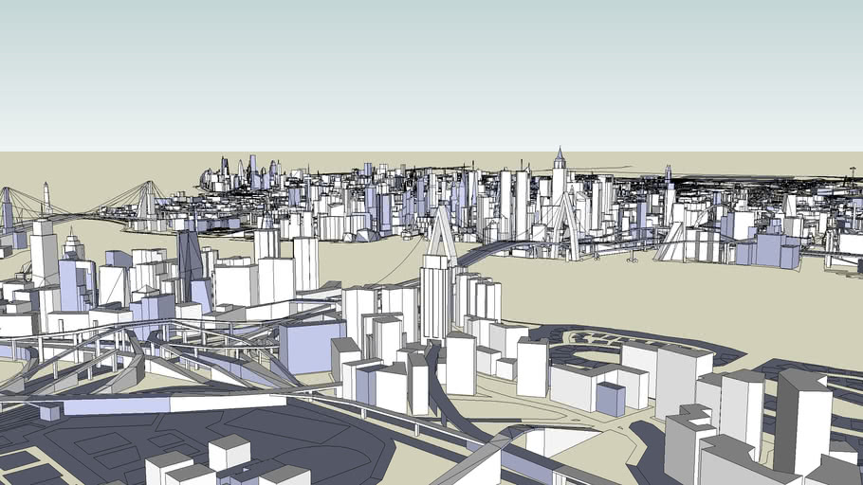

Slide 54
Lesson Plan/ Project Ideas
Lesson #5: Develop a National Climate Infrastructure Plan
Using PowerPoint, Google Slides, Prezi or other presentation tool, groups of students analyze current climate infrastructure ideas and suggest a course of action for the nation moving forward.
See assignment here: https://docs.google.com/document/d/1MKL57FkPmEgvcqupCseCwTA6NR50MiEoPfRaZ0uukW8/edit?usp=sharing

Slide 55
Lesson Plan/ Project Ideas
Lesson #6: Looking Back from the Future
Assume it is the year 2100.
Using Sutori (www.sutori.com) create a digital timeline of the last 80 years. You can take either an optimistic, pessimistic, or mixed perspective.
-

Slide 56
Lesson Plan/ Project Ideas
Lesson #7: Video Short/ Podcast Promoting the Economic Benefits of Climate Action
Use a movie making application (ex: iMovie, Windows Movie Maker, Google FilmMaker Pro) discussing the economic benefits of Climate Action and advocate for such action.
Alternative: Podcast - (ex: Garage Band, Anchor, Sound Trap, Audacity, WeVideo)
Sources: (see next slide)

Slide 57
Lesson Plan/ Project Ideas
Lesson #7: Video Short/ Podcast Promoting the Economic Benefits of Climate Action (cont’d)
Sources: (Examples)
https://www.wri.org/blog/2019/11/12-reasons-climate-action-good-united-states-economy
https://www.renewableenergymagazine.com/emily-folk/the-many-economic-benefits-of-renewable-energy-20190312
-

Slide 58
Other Lesson Plans
NY Times Learning Network: https://www.nytimes.com/2017/03/22/learning/lesson-plans/a-lesson-plan-about-climate-change-and-the-people-already-harmed-by-it.html
Stanford University (High School Curriculum): https://earth.stanford.edu/climate-change-ed/curriculum/high
EconEdLink: https://www.econedlink.org/resources/making-sene-with-paul-solman-climate-change-causes-insurers-to-rethink-price-of-risk-after-hurricane-sandy/

Slide 59
Learning Extensions
Interdisciplinary Projects (brainstorm with colleagues to develop meaningful projects)
Ex: pair up with a science teacher and have students research both the scientific and economic impact of climate change while also proposing policy solutions
Ex: students host a “symposium” of experts in the field
Ex: work with Entrepreneurship classes and have students develop innovative products that will both thrive economically and help mitigate the impact of climate change
Contact your Congressional representative and conduct a letter/email writing campaign

Slide 60
Additional Resources
https://projects.propublica.org/climate-migration/
https://www.edf.org/media/new-report-economic-cost-climate-change-strains-us-economy
https://yaleclimateconnections.org/2019/04/climate-change-could-cost-u-s-economy-billions/
https://www.wri.org/blog/2020/07/economic-benefits-climate-action-us

Slide 61
Additional Resources
https://www.iberdrola.com/environment/impacts-of-climate-change
https://www.un.org/development/desa/dpad/tag/climate-change/
https://www.mercycorps.org/blog/climate-change-poverty
https://www.globalcitizen.org/en/content/climate-change-is-connected-to-poverty/

Slide 62
Additional Resources
ttps://www.ozy.com/html/need-to-know/taking-the-heat/379607/?utm_term=OZY&utm_campaign=pdb&utm_content=Thursday_11.19.20&utm_source=Sailthru&utm_medium=email
https://www.goldmansachs.com/insights/pages/taking-the-heat.html
https://www.un.org/en/climatechange

Slide 63
Assessment Questions
What are the major economic costs of climate change? How will climate change affect the U.S. economy? What sectors will be hit especially hard?
What are some of the economic opportunities that will arise as a result of climate change?
Should the U.S. invest in climate change/green infrastructure? Are the costs worth the benefits?
How can investing in a green economy create more jobs than it destroys? Is the “creative destruction” worth it in the long run?
Should the costs of climate infrastructure be managed by the federal government or should it be a state/local issue?

Slide 64
References
CNBC News Segment, “How Climate Change Threatens to Wreck the Economy”: https://www.youtube.com/watch?v=SMBNWmQcRAc
PBS Frontline Movies on Climate Change: https://www.pbs.org/wgbh/frontline/topic/climate-and-environment/
CNN on Climate Change and Economic Chaos: https://www.cnn.com/2020/09/09/business/climate-change-economy-cftc-report/index.html

Slide 65
CEE Affiliates
https://www.councilforeconed.org/resources/local-affiliates/

Slide 66
Thank You to Our Sponsors!

