Slide 1
Project Based Economics and Remote Learning Activities
December 22, 2020
Matthew Gherman
Edward R. Murrow H.S.
mgherman@schools.nyc.gov

Slide 2
EconEdLink Membership
You can now access CEE’s professional development webinars directly on EconEdLink.org! To receive these new professional development benefits, become an EconEdLink member. As a member, you will now be able to:
Automatically receive a professional development certificate via e-mail within 24 hours after viewing any webinar for a minimum of 45 minutes
Register for upcoming webinars with a simple one-click process
Easily download presentations, lesson plan materials and activities for each webinar
Search and view all webinars at your convenience
Save webinars to your EconEdLink dashboard for easy access to the event
You may access our new Professional Development page here

Slide 3
Professional Development Certificate
To earn your professional development certificate for this webinar, you must:
Watch a minimum of 45-minutes and you will automatically receive a professional development certificate via e-mail within 24 hours.
Accessing resources:
You can now easily download presentations, lesson plan materials, and activities for each webinar from EconEdLink.org/professional-development/

Slide 4
Your Agenda
Examine Hands-On and Self-Guided Projects
Socio- Economic Issues Project
Personal Finance Project
Simple Sole Proprietorship Project

Slide 5
Project #1: Socio- Economics Project https://ermurrowhs.libguides.com/politics

Slide 6
Project #1: Socio- Economics Project, cont’d
Project Introduction:
“We have just examined the fundamental economic and theoretical differences between Republicans and Democrats. However, there are also Socio- Economic issues (issues that go across social, economic and political values) that divide us politically as well. This project aims to examine their importance, where political parties stand and where you ultimately stand.”

Slide 7
Socio- Economics Project, cont’d
Part I: Graphic Organizer
Complete the chart for each issue:
Universal Health Care
Higher Minimum wage
Drilling and Pipelines
Privatization of Social Security
Military Spending
Tariffs on Imports
Graphic Organizer Worksheet

Slide 8
Socio- Economics Project, cont’d
Part II: Essay
Which 2 issues are the most important to you as a future voter? (1 paragraph each issue.)
Which political party do you agree with more on these issues? (1 paragraph each issue.)
Based on your answers, if you were to fill out a voting card, which political party will you choose? (Explain in 1-2 paragraphs.)

Slide 9
Socio- Economics Project
Part III: Research Component
Find 4 scholarly articles about each side’s stance on two of your issues (2 that explain where Democrats stand and 2 that explain where Republicans stand).
Make sure to use these articles in your essay with proper MLA or APA citations and as a works cited page.

Slide 10
Murrow “Lib-Guide”
https://ermurrowhs.libguides.com/politics

Slide 11
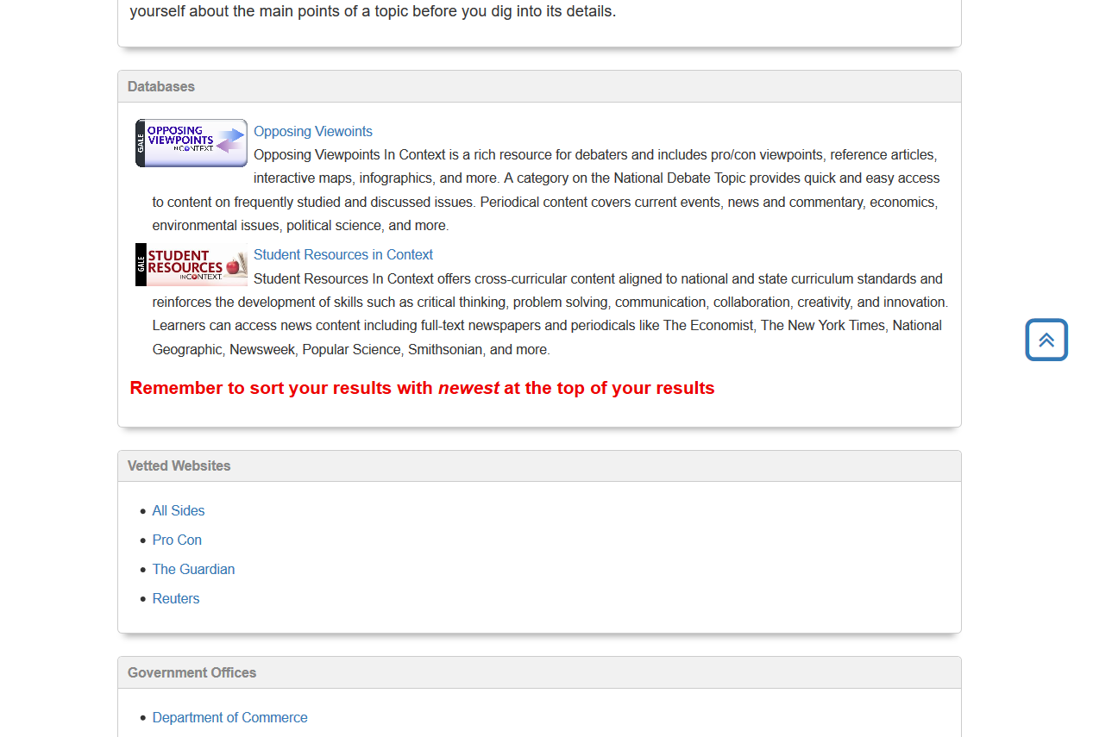
Research Tab

Slide 12
Opposing Viewpoints

Slide 13
Media Tab
Help students with video understanding

Slide 14
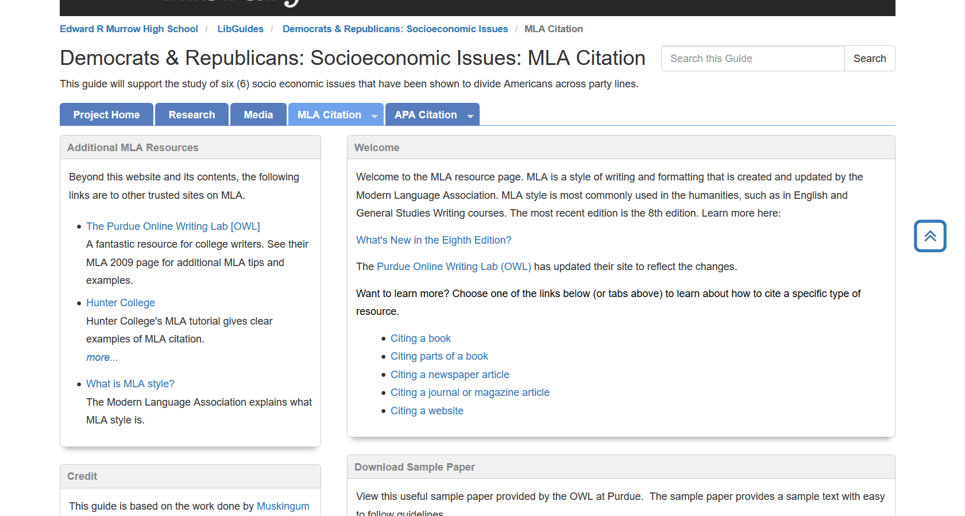
MLA Citation Tab

Slide 15
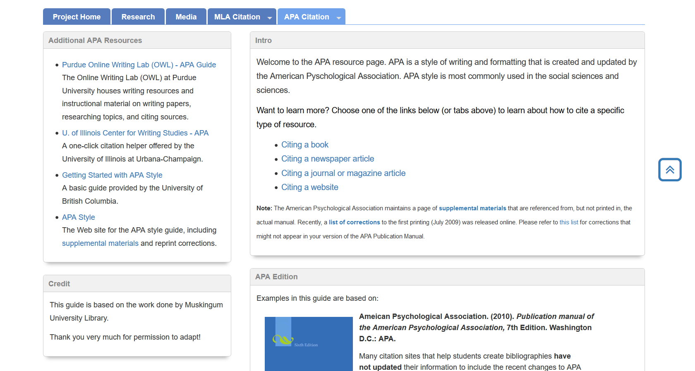
APA Citation Tab

Slide 16
Project #2: Personal Finance WebQuest
https://ermurrowhs.libguides.com/finance
https://apps.irs.gov/app/understandingTaxes/student/simulations.jsp

Slide 17
Personal Finance Project Part I: Guidelines
Find a partner to complete this project:
Use https://ermurrowhs.libguides.com/finance 2-3 sentences / bullet points per question
Use and properly cite at least one source per part
Submit your work through Google Classroom or Pupil Path
Due Dates:
Part I (A – F) _______
Part I (G – N) _______
Part II/ III _______
Part IV _______

Slide 18
Part 1A: Living on Your Own
What should you have in place, financially, before moving out on your own?
What is the difference between variable and fixed expenses?
What questions should you think about when looking for an apartment?
What does “living paycheck to paycheck” mean? Why is this not ideal?
Find an apartment rental listing in the city you would like to live in after you graduate from college. How much is your monthly rent?
Make an itemized list with prices of furniture you will need (go to the Ikea website). What else will you need to start out (microwave, hangers, curtains, etc.)? Overall, approximately how much money will you need?
What is the minimum wage in the state you would like to live in after college? How many hours of minimum wage will you need to work to pay for your rent?
What is good budgeting advice/practice for living comfortably/independently?

Slide 19
Part 1B: Banking
What is the difference between a checking account, savings account and certificate of deposit?
Why is it important to have all 3?
What are strategies for saving money? Offer specific advice.
Based on the information you researched about this topic, create 3 rules that young adults must follow.

Slide 20
Part 1C: Credit Cards
What is an APR? What is a grace period? Why is it important to pay your full bill within the grace period?
What other hidden fees are associated with credit cards?
What criteria should you use in choosing a credit card?
What are some different types of rewards programs for credit cars?
What is a department store credit card? How is it different than a mainstream credit card? What are the positives and negatives of owning one?
Choose one of the following companies: Bank of America, Capital One, Chase, American Express and Discover. Which of their credit cards is best for you?
Based on the information you researched about this topic, create 3 rules of advice that young adults must follow.

Slide 21
Part 1D: Credit Score
What is a credit score? Why is it important?
What is considered an excellent, good, bad credit score?
How is it calculated? What are the components of it? For each component: what is considered good/bad?
What is the consequence of a poor credit score?
How do you improve your credit score?

Slide 22
Part 1E: Taxes
What are the differences between a W2, W4, 1040 and 1099 tax form?
What are dependents, deductions, allowances and tax credits? What can each be used for?
Why might people put a smaller amount of dependents/allowances on their W4 than they actually have?
Why might people hold additional income on their W4?
How has the new Trump Tax Plan affected how people do their taxes?
How are people in New York State affected by the Trump Tax Plan?

Slide 23
Part 1F: Health Insurance
Why is having a comprehensive health insurance plan important?
What type of health insurance plans are there?
Go to the “NY State of Health” exchange website and choose a health insurance option. Why did you select this coverage? How much will your plan cost each year?
What do the cheaper plans fail to cover?
Based on the information you researched about this topic, create 3 rules of advice that young adults must follow.

Slide 24
Part 1G: Cars
What is the difference between leasing and buying? What are the advantages and disadvantages of each?
What is the minimum car insurance you must have in NYS? How much will insurance cost you?
What raises and lowers your car insurance?
Choose a car you want to buy in the next ten years – identify the lease and purchase payment differences.
What are other maintenance costs of owning a car?

Slide 25
Part 1H: Marriage and Kids
What are the financial advantages and disadvantages of being married?
What is the marriage tax penalty?
Why is it important to know your fiancé’s credit score before getting married?
How much does it cost raise a child in New York City? What are the main financial expenditures associated with raising a child? Per Year? Cumulative, until they turn 18?
Compare and contrast a 529 Plan and an UGMA for saving money for your kids’ college. Which is the better option? Explain.

Slide 26
Part 1I: Mixed Bag
Explain the difference between Good Debt and Bad Debt.
Add up rent, health insurance, car payments, car insurance and apartment startup costs. Not even including your day to day living expenses (food, utilities, clothing, entertainment, etc.), how much will it cost you to live on your own?

Slide 27
Part 1J: Homeownership
What is a mortgage? What is a pre-approval?
What percentage of the mortgage should the down payment be? Why?
What is an amortization schedule?
What is a PMI (private mortgage insurance)?
What fees/expenses besides the mortgage is involved in owning a home?
What should you financially have in place before you buy a home? (credit score, savings, etc.)

Slide 28
Part 1K: Life Insurance
What is a premium?
What is the difference between Whole, Universal and Term Life Insurance? Which do you think is better? Why?
When should you get life insurance? When do you need to get life insurance?
How much life insurance coverage do you need?
How are life insurance costs calculated?

Slide 29
Part 1L: Retirement
Define: IRA, Roth IRA and 401K. What are advantages and disadvantages of each?
What is compounding interest?
When should you begin investing for retirement? Why?
How much of your salary should you put toward retirement? Why?

Slide 30
Part 1M: Legal Documents
What is a Will? When should you make one?
What is an Estate Plan? When should you get one?
What is a Pre-Nuptial agreement? What does it do? What does it not do? Should people get it?

Slide 31
Part 1N: Investment Options (Extra Credit)
For each of the following:
penny stock common stock bonds mutual funds
Exchange Traded Fund (ETF) Unit Investment Trust (UIT)
define them in 2-3 sentences and explain how each is unique/the main differences
how is money made off each of them, and are there any associated costs?
explain the advantages and disadvantages of investing in each. rank them in order of what you think is the safest investment to the riskiest investment.
Do you think one of or more of these options are right for you? Why? If you don’t want to invest based on what you read, why not?

Slide 32
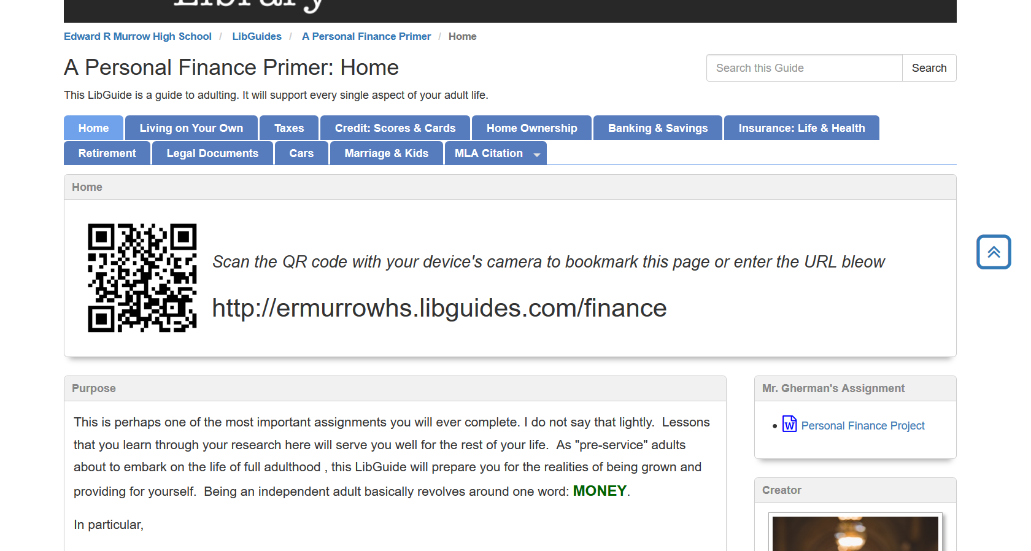

Slide 33
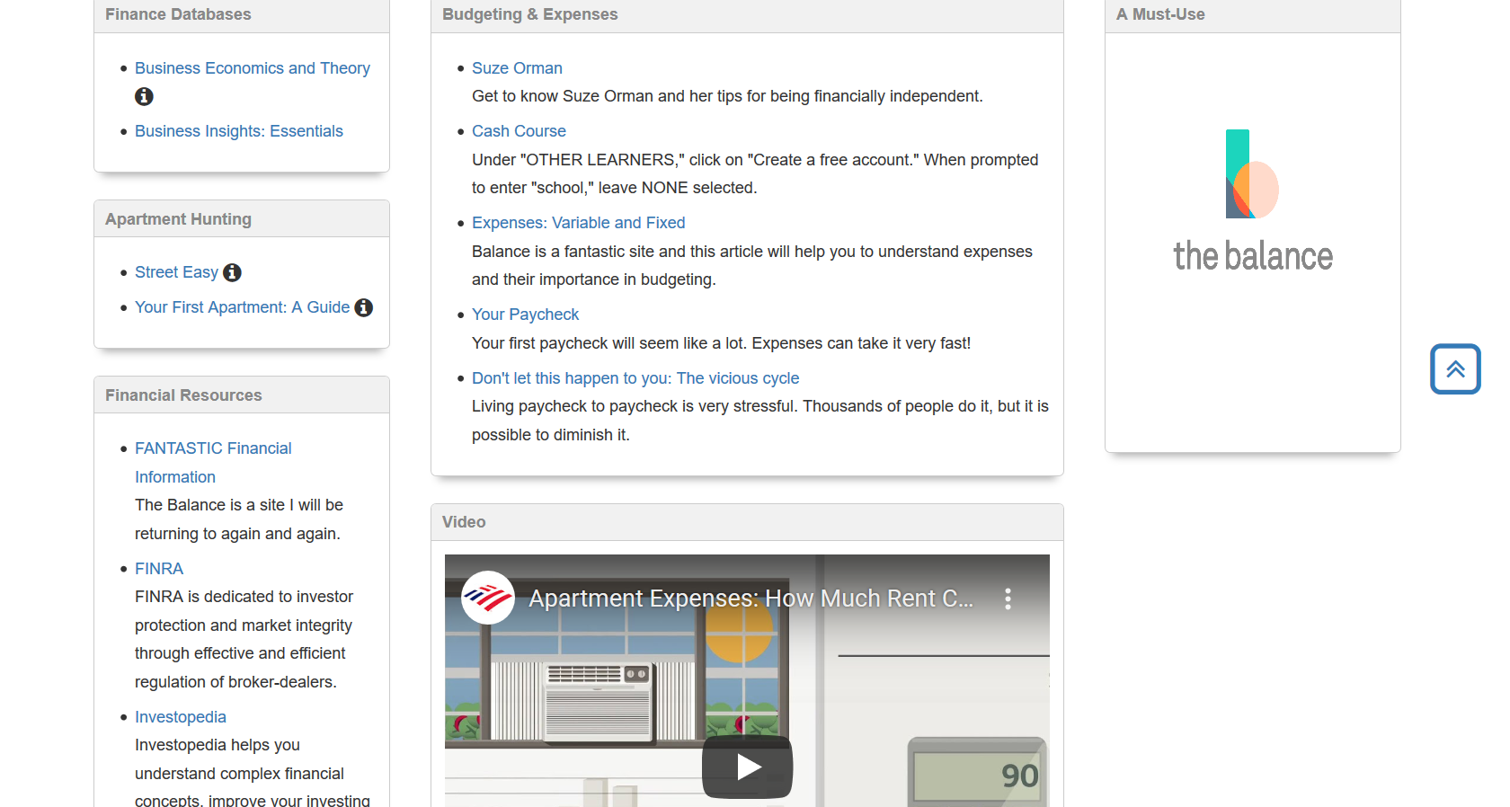
Living on Your Own

Slide 34
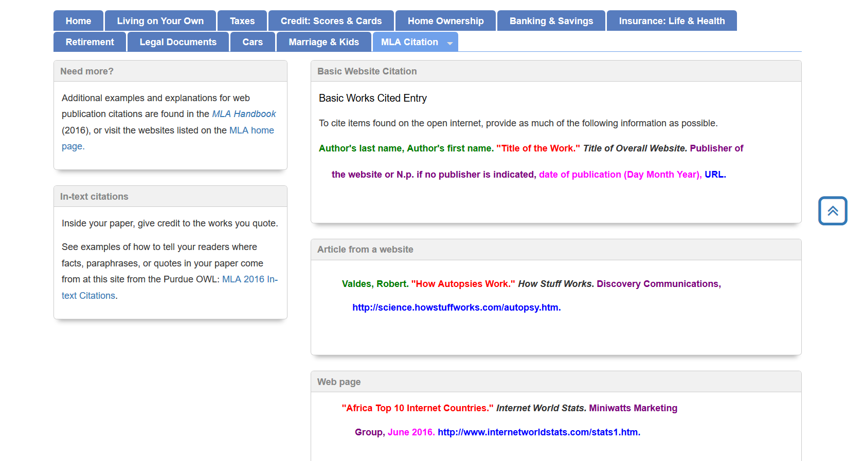
MLA Citation Websites

Slide 35
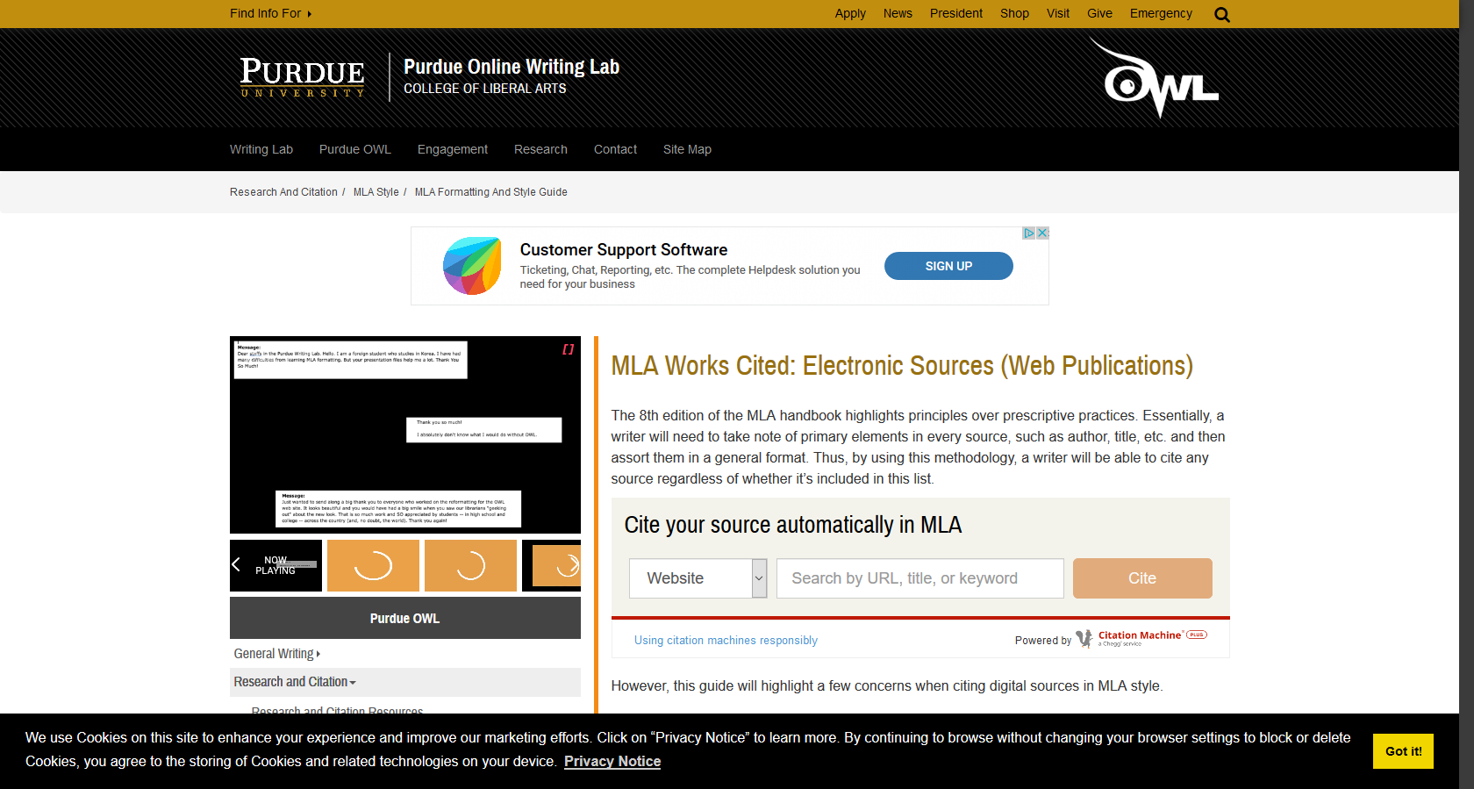
MLA Citation Videos

Slide 36
Personal Finance Project Part II: Navigating the IRS
https://apps.irs.gov/app/understandingTaxes/student/simulations.jsp
Complete the simulations for the following people:
Lawrence Red Owl Cicely King Tasha Miller
Monica Lindo John Stillman Seth Wiggins
Rita Bently James King
Write a brief paragraph about what you learned about the tax system for each person
What are some difficulties with navigating the tax system?
If you were the head of the IRS, how would you change America’s taxation system?

Slide 37
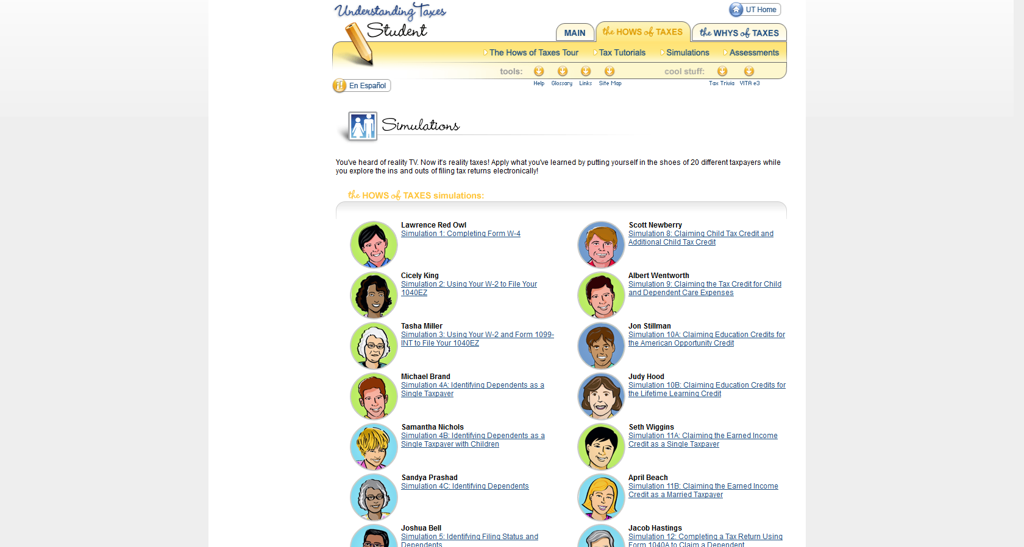
Website

Slide 38
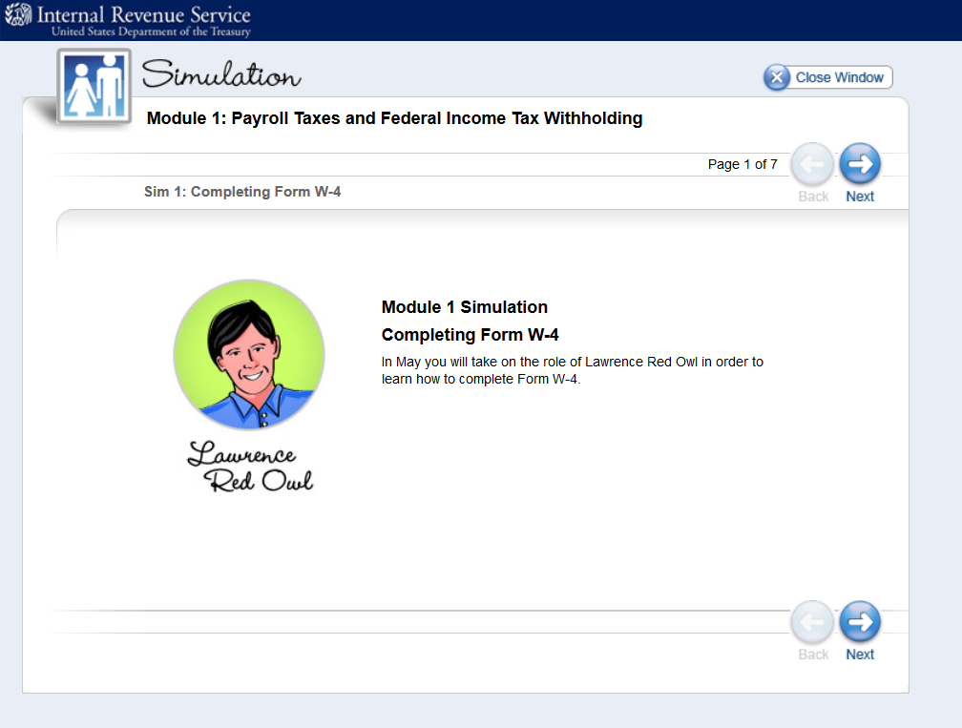
Lawrence Red Owl Example

Slide 39
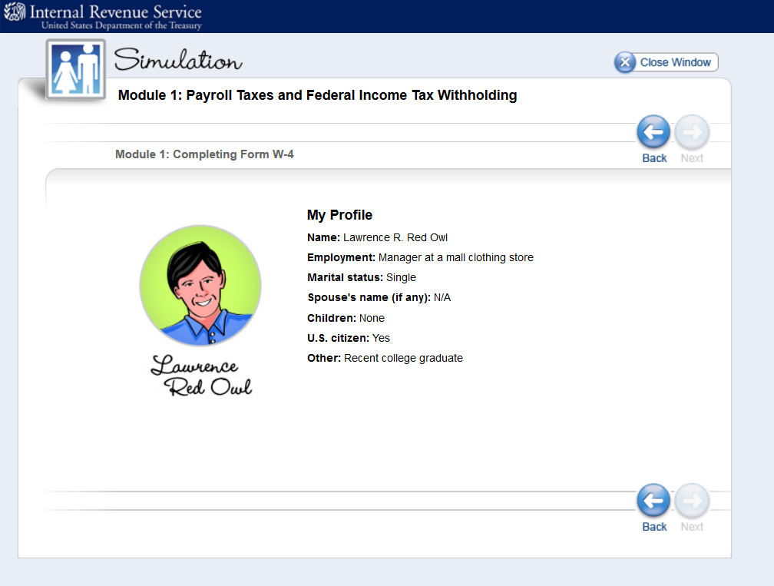
Lawrence Red Owl Example

Slide 40
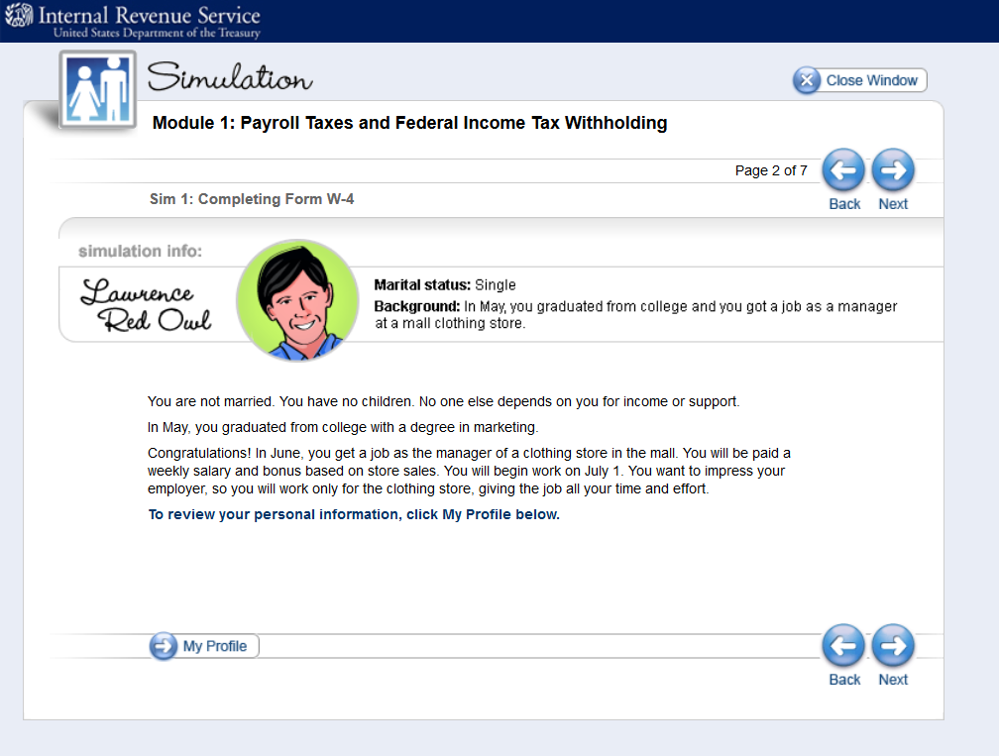

Slide 41
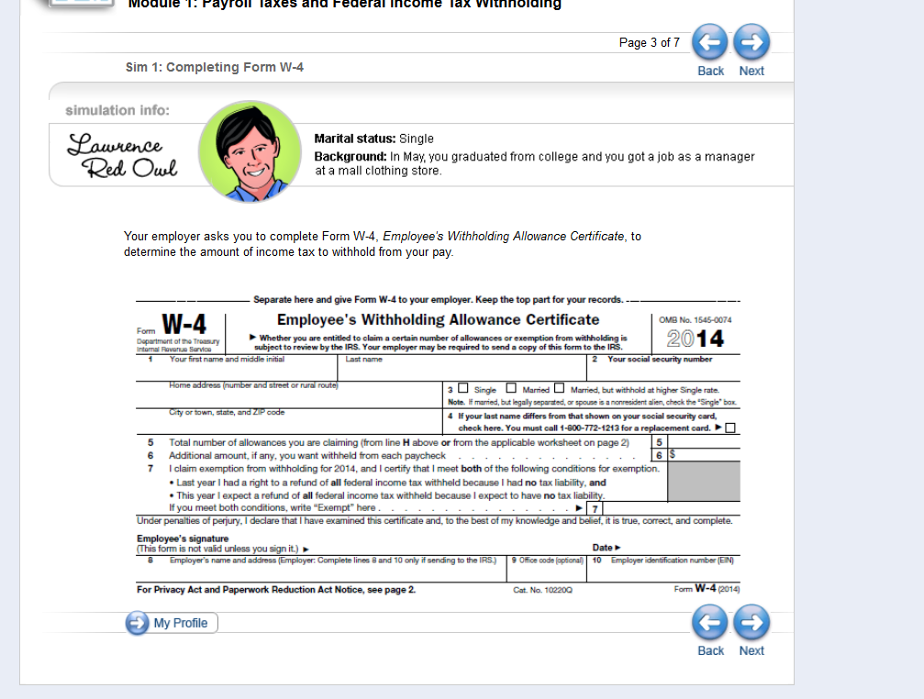

Slide 42
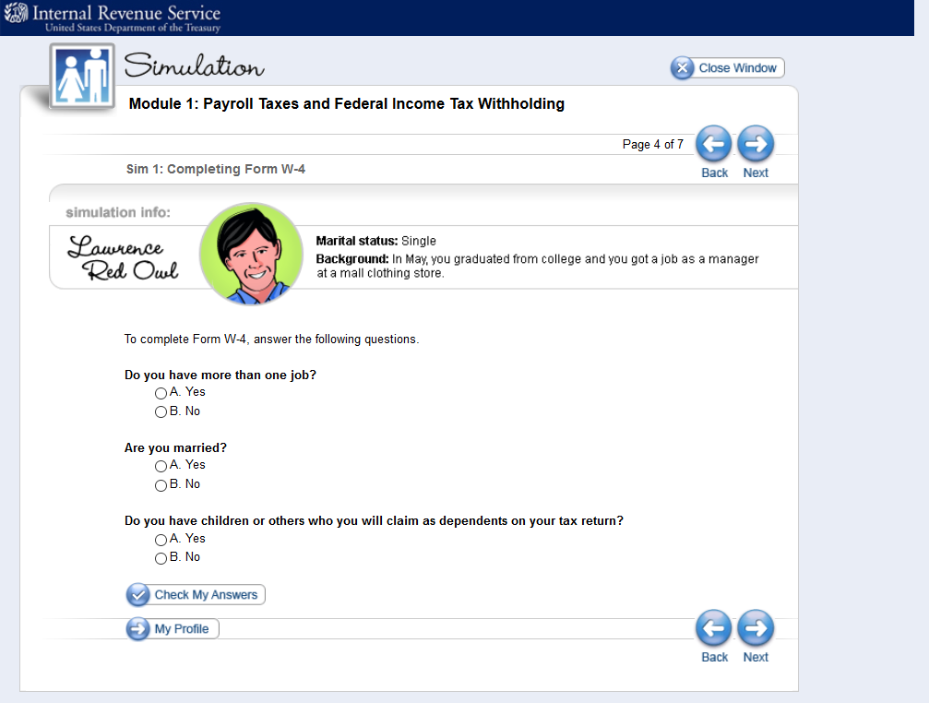

Slide 43
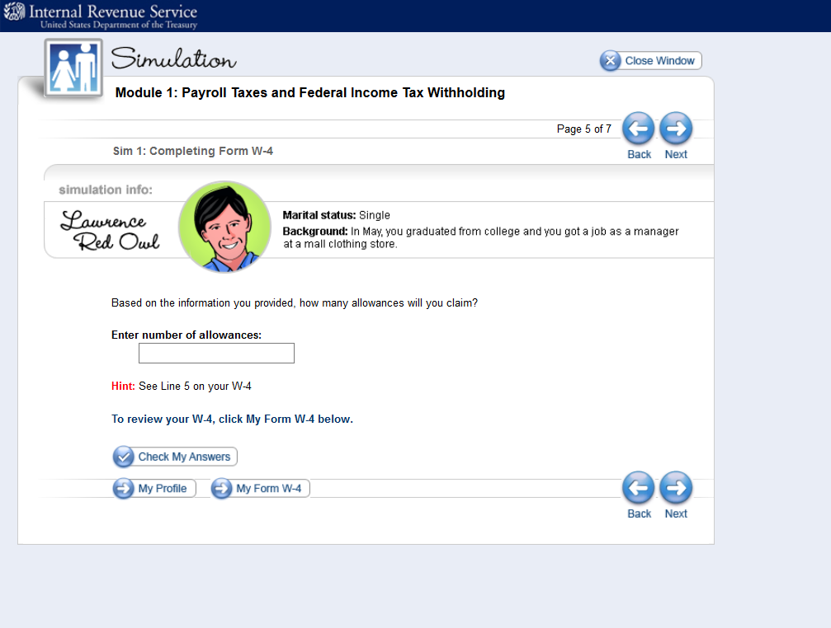

Slide 45
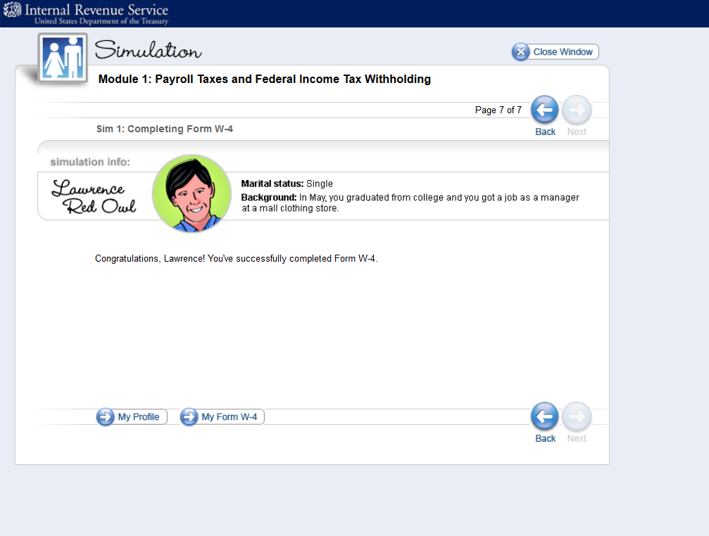

Slide 46
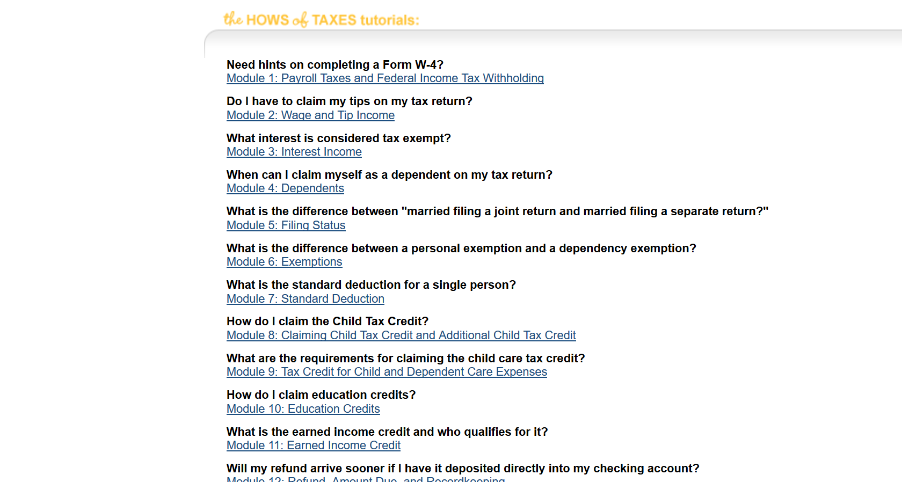
Tax Tutorial

Slide 47
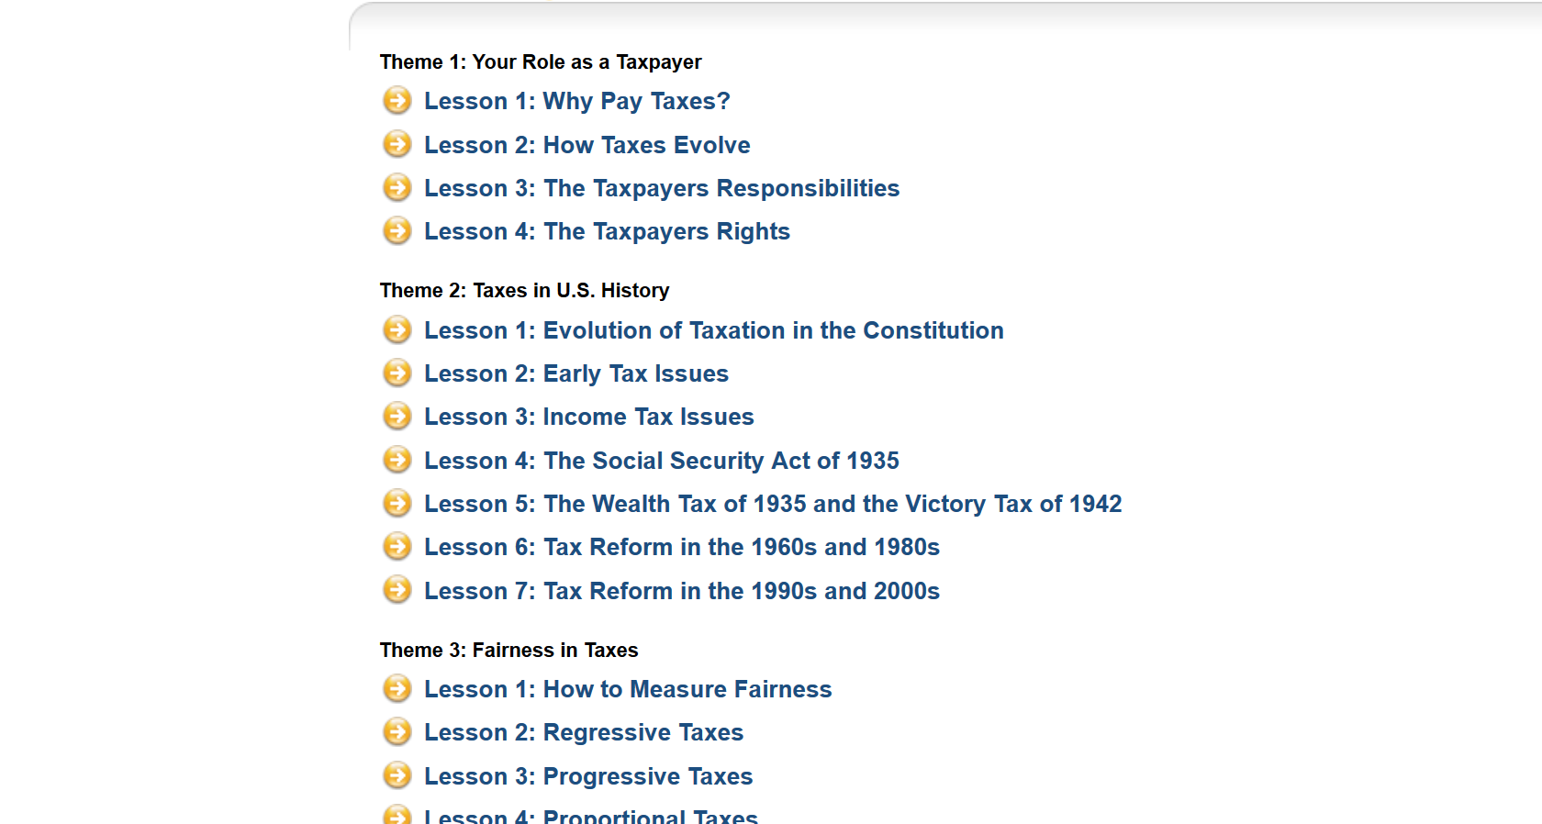
The Whys of Taxes

Slide 48
Personal Finance Project Part III: Personal Finance Commandments
Create 10 general “Personal Finance Commandments” for young adults

Slide 49
Personal Finance Project Part IV: PowerPoint or Jamboard
Create a personal finance pamphlet or PowerPoint giving brief information and advice for 18 year olds
Include important websites that students can use to further their knowledge of your topic
Include helpful quotes for your topic, and be creative

Slide 50
Project #3: Simple Sole Proprietorship Project

Slide 51
Objectives
Demonstrate understanding of Basics of Introductory Business and Marketing Concepts
Apply basics to a simple “brick and mortar” business
Demonstrate ability to analyze successful strategies within context of your industry component and SWOT.

Slide 52
Sole Proprietorship Project Part I: Type of Business
1. Would you pursue opening a business alone or with a partner(s)? Explain your answer.
2. Which form of ownership would you (and your partner(s) use in creating your business: sole proprietorship, partnership, LLC, S corporation…

Slide 53
Sole Proprietorship Part II: Business Ethics
Will your company follow the socioeconomic or the economic model of social responsibility?
Explain your choice and give one example of a choice your company would make that aligns with this model
(ex: give to charity = socioeconomic model OR cut costs/increase profit without thought to environmental impact = economic model)

Slide 54
Sole Proprietorship Part III: Industry Component
1. Managers use many types of resources. For information resources, include at least one link to a source of information about your given industry: an article about growth/decline in your industry, earning reports of a competitor, any regulations relevant to your business…
What does this article say about the current state of your industry and how a new company might be positioned in it?

Slide 55
Sole Proprietorship Part IV: Mission Statement
1. Create a mission statement for your organization. Feel free to look at the mission statements of major corporations (available on their websites) as examples for this activity.

Slide 56
Sole Proprietorship Part V: Human Resources
Describe the human resources used by your business. What are the number of employees required? The qualifications and skills for each position? Will jobs be full or part time?

Slide 57
Sole Proprietorship Part VI: Business Structure
Below are three types of firm structures [on project sheet]. Look over the three firm structures then…
1. Choose which type of firm will your company be and why?
2. Give detailed explanation of why you think this type of firm structure is best for company and your own style of management
3. Which will be best for your employees? Is what is best for your employees best for the company?

Slide 58
Sole Proprietorship Part VII: Marketing
Write a paragraph describing your target market. Remember, your target market CANNOT be ALL people- no matter what your business is. (Ex: Everyone may eat at a restaurant, but you know when you walk into a place with younger vs older people in mind, with income level in mind, with cultural considerations in mind how those businesses feel different)
Be as specific as possible. You are trying to describe the MAJORITY of your customers and who you most have in mind when making business decisions. You are not trying to describe 100% of who may walk into your business.
You may consider any or all of the following demographic categories: (gender, age, ethnicity, location (remember: think about how far you would travel for something- most businesses should not be citing the entire 5 boroughs as their target market), educational level, professions, needs, income, buying habits, influences on purchasing decisions, resistances to your product, whether your market is homogeneous or heterogeneous

Slide 59
Sole Proprietorship Part VIII: Pricing
Use the pricing strategies activity [different sheet].
Consider three pricing strategies.
Explain using 2-3 sentences for each strategy. You can consider strategies that may work together, or varied strategies to attempt over time.

Slide 60
Sole Proprietorship Part IX: Promotion
Choose 3 of the following promotion methods, and provide an example of how your company would use it.
You can consider strategies that may work together, or varied strategies to attempt over time.
• Selective-demand advertising • Institutional advertising • Primary-demand advertising • Personal selling | • Free sample • Coupon • Feature article • Press conference

Slide 61
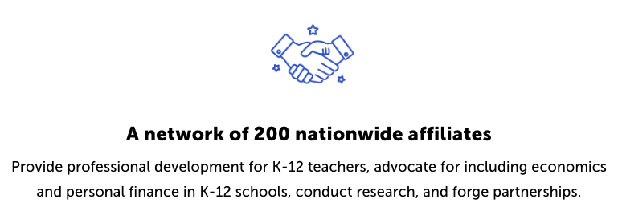
CEE Affiliates
https://www.councilforeconed.org/resources/local-affiliates/

Slide 62
Thank You to Our Sponsors!

