Slide 1
The History of Medicare
Presented by Amanda Stiglbauer
Blythewood High School
Blythewood, SC
December 14, 2020 astiglbauer@richland2.org

Slide 2
EconEdLink Membership
You can now access CEE’s professional development webinars directly on EconEdLink.org! To receive these new professional development benefits, become an EconEdLink member. As a member, you will now be able to:
Automatically receive a professional development certificate via e-mail within 24 hours after viewing any webinar for a minimum of 45 minutes
Register for upcoming webinars with a simple one-click process
Easily download presentations, lesson plan materials and activities for each webinar
Search and view all webinars at your convenience
Save webinars to your EconEdLink dashboard for easy access to the event
You may access our new Professional Development page here

Slide 3
Professional Development Certificate
To earn your professional development certificate for this webinar, you must:
Watch a minimum of 45-minutes and you will automatically receive a professional development certificate via e-mail within 24 hours.
Accessing resources:
You can now easily download presentations, lesson plan materials, and activities for each webinar from EconEdLink.org/professional-development/

Slide 4
Agenda
Overview of UFR Curriculum and Essential Dilemmas
Poverty Rates by Age – Graph and Collaboration Board
Video Clip – The Story of Medicare
Kahoot! With Content Synopsis
Content Overview
Historic Background – Primary Source Analysis
The American Way – Discussion, Resources, Polling
Wrap Up

Slide 5

Objectives
Analyze data and documents associated with the creation of Medicare.
Compare statements both for and against Medicare.

Slide 6
National Standards
National Standards for Economics
Role of Government and Market Failure Standard: 16
Students will understand that: There is an economic role for government in a market economy whenever the benefits of a government policy outweigh its costs. Governments often provide for national defense, address environmental concerns, define and protect property rights, and attempt to make markets more competitive. Most government policies also have direct or indirect effects on people's incomes.

Slide 7
The History of Medicare
ESSENTIAL DILEMMA
Medicare 1966: President Lyndon Johnson’s “American way” or Ronald Reagan’s “advance wave of socialism”?

Slide 8
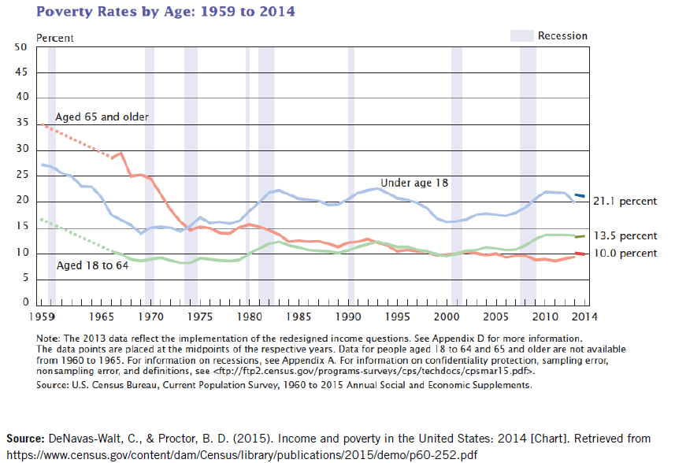
Resource 1
Poverty Rates by Age: 1959 to 2014

Slide 9
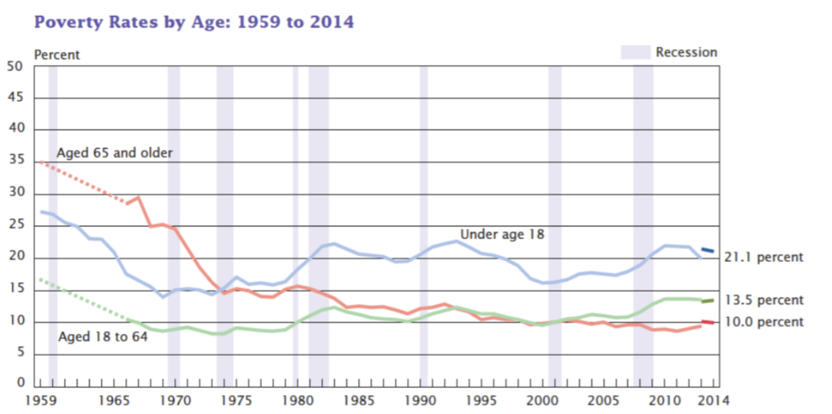
Notes:
DeNavas-Walt, C., & Proctor, B. D. (2015). Income and poverty in the United States: 2014 [Chart]. Retrieved from: https://www.census.gov/content/dam/Census/library/publications/2015/de mo/p60-252.pdf

Slide 10
Collaboration Board
What do you notice about the poverty rate during these years? Does anything stand out?

Slide 11
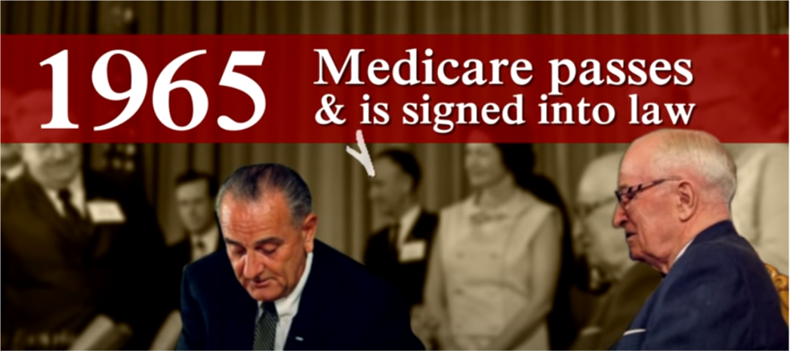
The Story of Medicare: A Timeline (2015)

Slide 12

Link to Kahoot
The History of Medicare

Slide 13
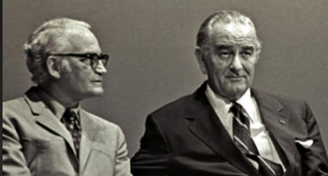
Resource 2
Points of View from Presidential Contenders
“Don’t ever argue with me [about health care]. I’ll go a hundred million or billion on health or education. I don’t argue about that any more than I argue with Lady Bird [Mrs. Johnson] about buying flour. You got to have flour and coffee in your house. Education and health. I’ll spend the … money. I may cut back some tanks. But not on health.”
  —Lyndon B. Johnson, 1965 (New York Times, 2009)
  ”Having given our pensioners their medical care in kind, why not food baskets, why not public housing accommodations, why not vacation resorts, why not a ration of cigarettes for those who smoke and of beer for those who drink?”
  —Barry Goldwater 1964 (Nichols, 2011, p.16)

Slide 14
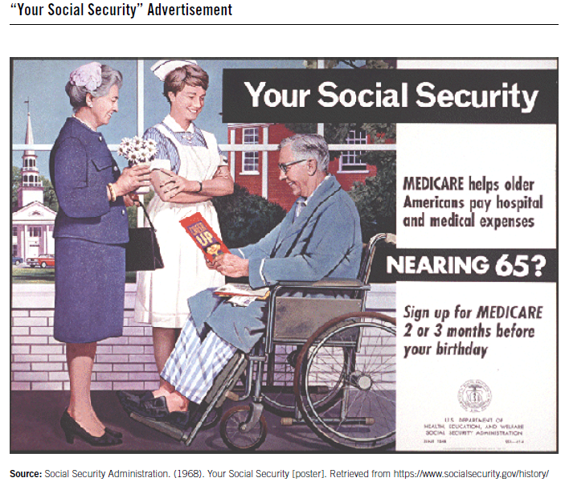
Resource 3
Your Social Security (Poster)

Slide 15
Collaboration Board
What is this poster telling us?

Slide 16
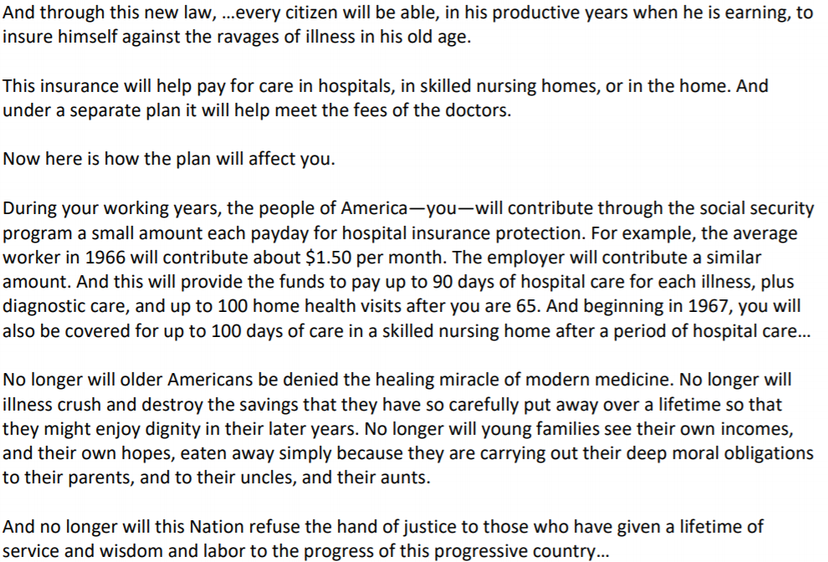
Notes:
Source: Lyndon Baines Johnson Library and Museum. (2007, June 6). President Lyndon B. Johnson’s remarks with President Truman at the signing in Independence of the Medicare bill, July 30, 1965. Retrieved from http://www.lbjlib.utexas.edu/johnson/ archives.hom/speeches.hom/650730.asp

Slide 17
Resource 4
President Lyndon B. Johnson’s Remarks on the Medicare Bill
Why might the older population need health insurance, such as Medicare?
How is the Medicare program going to be funded?
According to President Johnson, what will be the benefits of the program?
What role is the government playing in providing Medicare?
Why would President Johnson refer to this program as
“the American way”?

Slide 18

What does the “American Way” mean to you?

Slide 19
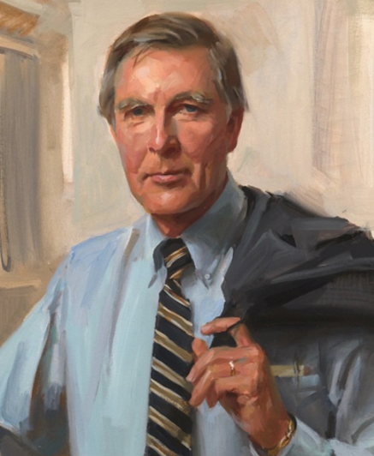
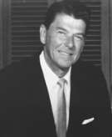
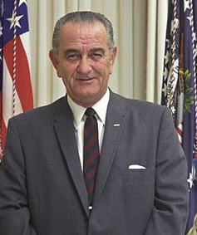
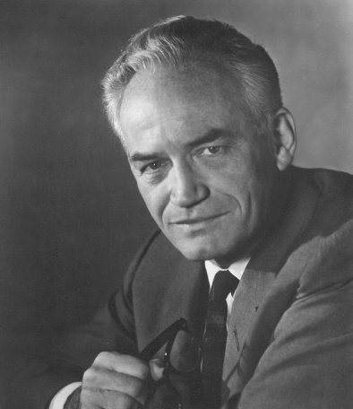
Resource 5
Varying Points of View
Congressman Morris Udall
President
Lyndon Johnson
Governor
Ronald Reagan
Senator
Barry Goldwater

Slide 20
Resource 6
The American Way: Two Perspectives
Perspective 1
The American way is:
allowing people to achieve as much as they can for themselves.
being free from government interference with individual rights.
being allowed to run a business free from government regulation.
allowing people to keep what they have earned.
helping poor people on a voluntary basis.
Perspective 2
The American way is:
making sure that laws and policies do what is best for the greatest number of people.
making sure that no one is allowed to be successful by taking unfair advantage of others.
knowing that poor people are not usually poor because they deserve to be poor and that rich people are not always rich because they deserve to be rich.
treating good health care and a good standard of living as basic human rights.
using tax money to help poor people.

Slide 21
Poll: Which do you most identify with?
Perspective 1 or Perspective 2?

Slide 22
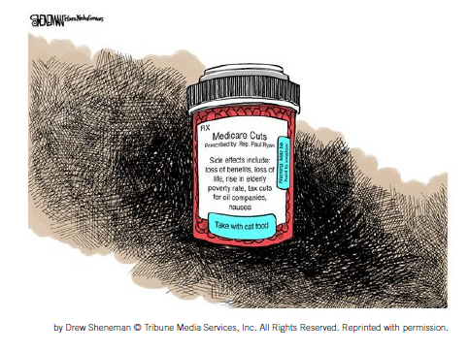
Resource 7
Medicare: Visualizing the Debate
Medicare Cuts
Prescribed by Rep. Paul Ryan
Side effects include:
loss of benefits, loss of life, rise in elderly
poverty rate, tax cuts for oil companies,
nausea
Take with cat food
Ol’ Rockin’ Chair

Slide 23
Wrap Up
RE-EXAMINE ESSENTIAL DILEMMA
Medicare 1966: President Lyndon Johnson’s “American way” or Ronald Reagan’s “advance wave of socialism”?

Slide 24
The History of Medicare
Presented by Amanda Stiglbauer
Blythewood High School
Blythewood, SC
December 14, 2020 astiglbauer@richland2.org

Slide 25

CEE Affiliates
https://www.councilforeconed.org/resources/local-affiliates/

Slide 26




Thank You to Our Sponsors!

