Slide 1
Where Did All The Money Go? The Great Depression Mystery Presented by Dr. Cindy Fitzthum Monday, November 30th, 2020 cjfitzthum@stcloudstate.edu

Slide 2
EconEdLink Membership
You can now access CEE’s professional development webinars directly on EconEdLink.org! To receive these new professional development benefits, become an EconEdLink member. As a member, you will now be able to:
Automatically receive a professional development certificate via e-mail within 24 hours after viewing any webinar for a minimum of 45 minutes
Register for upcoming webinars with a simple one-click process
Easily download presentations, lesson plan materials and activities for each webinar
Search and view all webinars at your convenience
Save webinars to your EconEdLink dashboard for easy access to the event
You may access our new Professional Development page here

Slide 3
Professional Development Certificate
To earn your professional development certificate for this webinar, you must:
Watch a minimum of 45-minutes and you will automatically receive a professional development certificate via e-mail within 24 hours.
Accessing resources:
You can now easily download presentations, lesson plan materials, and activities for each webinar from EconEdLink.org/professional-development/

Slide 4
Agenda
Objectives
Standards
Lesson Overview & Application Ideas
Assessments
Resources
Q and A

Slide 5
Reflection Journal
Written on Paper or as a Word Document
Pause and reflect:
Answer the questions
Make connections to your situation
Question what you want to research further

Slide 6
Objectives
Students will be able to analyze the relationship between increases and decreases in employment and consumer spending.
Define and identify interdependence within a market economy.
Describe how the policies of the Federal Reserve System during the 20s and 30s affected the Great Depression.

Slide 7
National Standards
Name: Economic Fluctuations
Standard: 18
Students will understand that: Fluctuations in a nation's overall levels of income, employment, and prices are determined by the interaction of spending and production decisions made by all households, firms, government agencies, and others in the economy. Recessions occur when overall levels of income and employment decline.
Students will be able to use this knowledge to: Interpret media reports about current economic conditions and explain how these conditions can influence decisions made by consumers, producers, and government policy makers.
Name: Role of Government and Market Failure
Standard: 16
Students will understand that: There is an economic role for government in a market economy whenever the benefits of a government policy outweigh its costs. Governments often provide for national defense, address environmental concerns, define and protect property rights, and attempt to make markets more competitive. Most government policies also have direct or indirect effects on people's incomes.
Students will be able to use this knowledge to: Identify and evaluate the benefits and costs of alternative public policies, and assess who enjoys the benefits and who bears the costs.

Slide 8
National Standards
Name: Unemployment and Inflation
Standard: 19
Students will understand that: Unemployment imposes costs on individuals and the overall economy. Inflation, both expected and unexpected, also imposes costs on individuals and the overall economy. Unemployment increases during recessions and decreases during recoveries.
Students will be able to use this knowledge to: Make informed decisions by anticipating the consequences of inflation and unemployment.

Slide 9
Lesson Overview
Students will identify conditions in the economy to learn about the Great Depression.

Slide 11
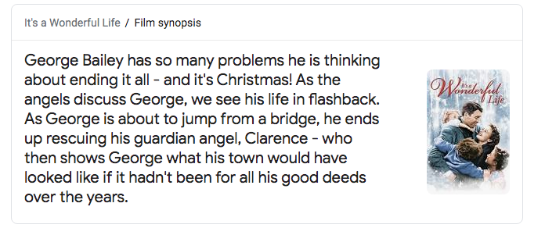
Summary

Slide 12
Warm-Up
YouTube Clip: “It’s A Wonderful Life” Bank Run
https://www.youtube.com/watch?v=iPkJH6BT7dM
What did you observe?
Highlight: Customers of the bank trying to get all of their money out of the bank at once- “bank run.”

Slide 13
Mystery…
Where did all the money go?

Slide 14
Brief Background
During the 1920’s, most people in the United States enjoyed prosperity (great to talk about equity and cultural changes here).
During the 1930’s, 12 million people were out of work and unprecedented misery. Why?
Reflect: What might students brainstorm as “why”? (Journal and/or use chat now.)

Slide 15
Brief Background, Cont.
Gregory Mankiw (2003): “There are repeated periods during which real GDP falls, the most dramatic being in the early 1930s. Such periods are called recessions if they are mild and depressions if they are more severe.”
History.com: In 1933 about 25% of the US Workforce is unemployed, “Use it up, wear it out, make do or do without” motto, potluck entertainment, thrift gardens, Scrabble & Monopoly introduced…

Slide 16
Background Continued…
Major Reasons: Overproduction, restrictive trade policy, speculation in the stock market based on buying stock on credit, problems with the banking system and tax policy.
Started as mild recession, soon became a depression.
The amount of money in circulation had drastically decreased.
Reflect: Why did this happen? (Emphasize Mystery!)

Slide 18
Group Activity
Cooperative learning instructional strategy to assess student understanding.

Slide 19
Jigsaw Group Actibity
Groups to help solve the mystery! (3 groups)
Read WHATDUNIT? (focuses on the 1920s and 1930s).
Then, refer to the Almanac: History and Government Website at https://www.infoplease.com/history

Slide 20
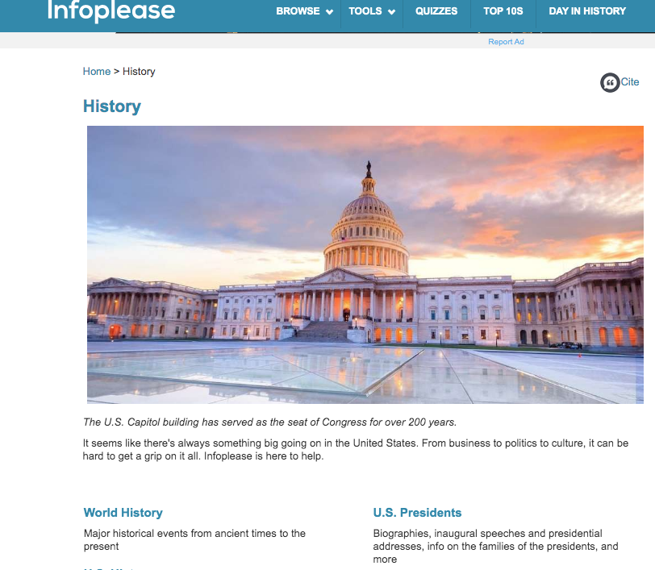

Slide 21
Jigsaw Groups
1920-1924
1925-1929
1930-1935
Each student researches 5 years on the site and completes the Clue Sheet #1 of that period (Handout)
There is a Teacher Guide for your reference ☺

Slide 23
Groups of Three
Place students in groups of three --- one per time period --- to share the information with one another, until each student has completed Clue Sheet #1.

Slide 24
Kahoot!
EdTech tool ready for you to use that will engage students in debriefing of the questions and assist you in checking for understanding.
https://create.kahoot.it/share/e944119a-b9c2-4a5d-9ae2-482997171592

Slide 25
Group Activity
Use the same groups of three and assign each person a section from Clue Sheet #2
Students will again research
Reflect: Students will examine factors and how they contributed to the Great Depression...
What might they say/think about labor/employment, poverty, income and government policies?

Slide 27
Group Share (To Class)
How are the overall employment trends related to income?
Why was farm income depressed throughout the 1920s?
What caused the trends in government spending during this time?

Slide 28
Reflect: Car Example
What businesses began or grew because of the mass production of the automobile?
Suppliers provide all the parts and materials needed to make a car and the car companies assemble those parts…
Capital Goods: factory, tools, machines
Complementary Goods: roads, gas stations, hotels

Slide 30
Individual Assessment
Understanding how businesses are related to each other.

Slide 31
Individual Activity
Understanding how business are related to each other…
What types of jobs does any business need to function?
When these workers earn income from their jobs, what are the three major things that workers do with their income?
When income declines, what happens to the three things you identified in the previous question?
When demand for cars declined in the late 20s, what kinds of companies’ business declined?

Slide 32
Quizlet
Assess students by engaging them with a Quizlet Review Game (already created for you on EconEdlink!) ☺
https://quizlet.com/354157902/where-did-all-the-money-go-the-great-depression-mystery-flash-cards/

Slide 33
Extension
Have students create an Interdependence Web that shows the businesses related to the smartphone revolution.
Have students explain the relationships among these businesses and predict what would happen in the economy if interest rates rose by 5% or more.

Slide 34
Assessments
Wonderful Life Bank Run Clip
WHATDUNIT Reading
Almanac: History & Government Website
Clue Sheet #1 and #2 (Handouts)
Kahoot Game and Quizlet Activities
Interdependence Activity
See original lesson on EconEdLink: https://econedlink.org/resources/where-did-all-the-money-go-the-great-depression-mystery/

Slide 35
Q and A
Thank you for attending!

Slide 36
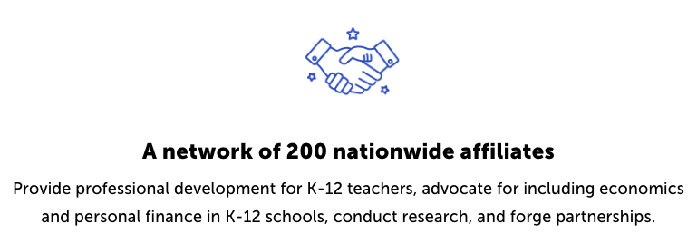
CEE Affiliates
https://www.councilforeconed.org/resources/local-affiliates/

Slide 37
Thank You to Our Sponsors!

