Slide 1
Making Presidential Elections Fun
Presented by Andrew Menfi
October 13th, 2020 amenfi3@gmail.com

Slide 2
EconEdLink Membership
You can now access CEE’s professional development webinars directly on EconEdLink.org! To receive these new professional development benefits, become an EconEdLink member. As a member, you will now be able to:
Automatically receive a professional development certificate via e-mail within 24 hours after viewing any webinar for a minimum of 45 minutes
Register for upcoming webinars with a simple one-click process
Easily download presentations, lesson plan materials and activities for each webinar
Search and view all webinars at your convenience
Save webinars to your EconEdLink dashboard for easy access to the event
You may access our new Professional Development page here

Slide 3
Professional Development Certificate
To earn your professional development certificate for this webinar, you must:
Watch a minimum of 45-minutes and you will automatically receive a professional development certificate via e-mail within 24 hours.
Accessing resources:
You can now easily download presentations, lesson plan materials, and activities for each webinar from EconEdLink.org/professional-development/

Slide 4

Objectives
Engaging and useable lessons
- Activities on the topic of the 2020 Presidential Election

Slide 5
Agenda
Walkthrough of five lessons/activities
  Electoral College Debate
  Campaign Finance Webquest
  Political Advertisements Analysis
  Presidential Candidate Political Pandering
  On The Issues

Slide 6
State Standards
National Standards
STANDARD 16: ROLE OF GOVERNMENT AND MARKET FAILURE
STANDARD 17: GOVERNMENT FAILURE
STANDARD 20: FISCAL AND MONETARY POLICY
New York:
  12.G4 POLITICAL AND CIVIC PARTICIPATION
  12.G5 PUBLIC POLICY

Slide 7
Lesson #1:
Electoral College Debate

Slide 8

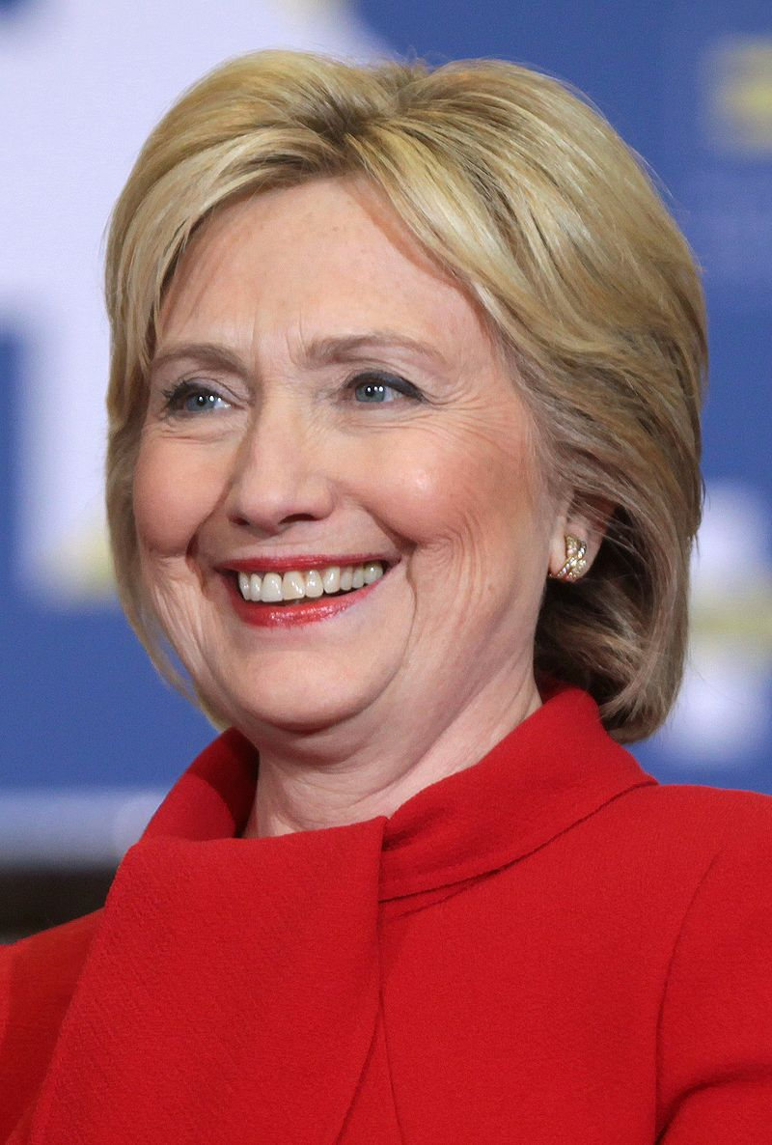
How many people voted for
Donald Trump/Hillary Clinton?

Slide 9
How many people voted for
Donald Trump/Hillary Clinton?
62,984,825

Slide 10
How many people voted for
Donald Trump/Hillary Clinton?
65,853,516

Slide 11
Why is Trump President? When Clinton Received...
2,868,691 More Votes

Slide 12
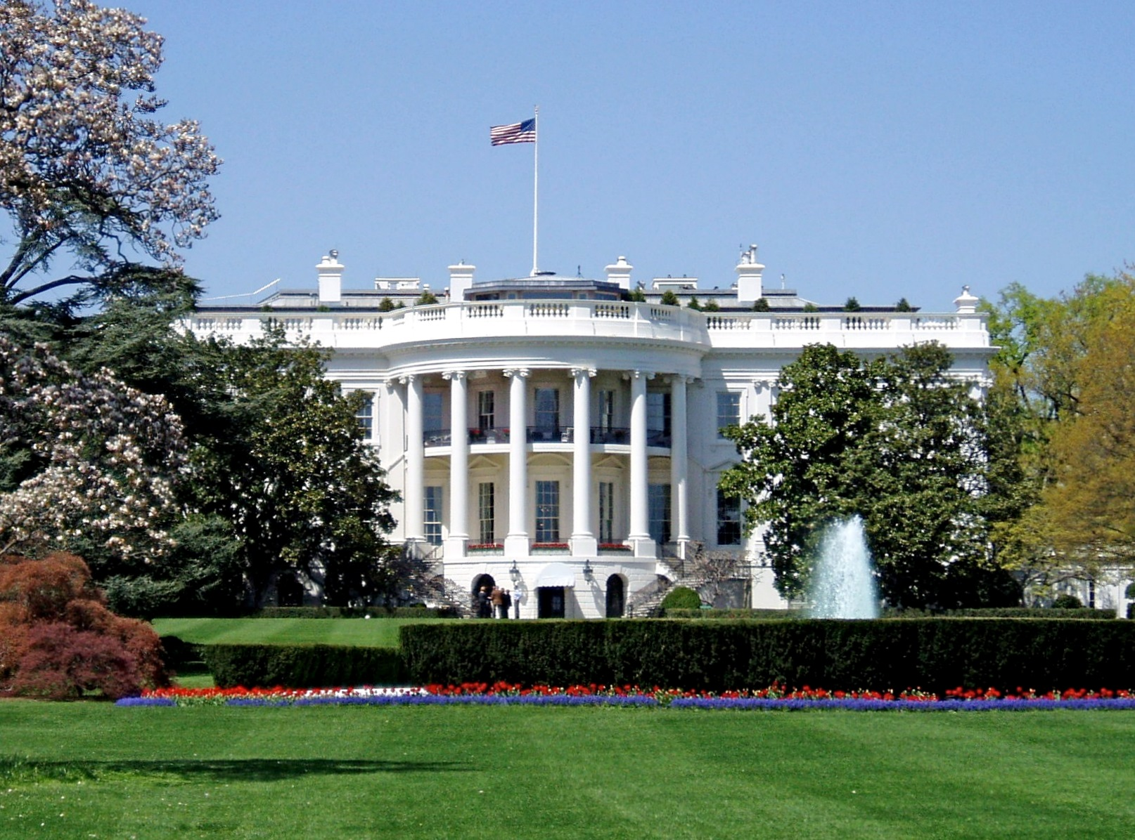
Electoral College:
The system by which we elect the President
Notes:
-The electoral college does not give votes to people, it gives votes to states
-States have electoral votes based on their population

Slide 13
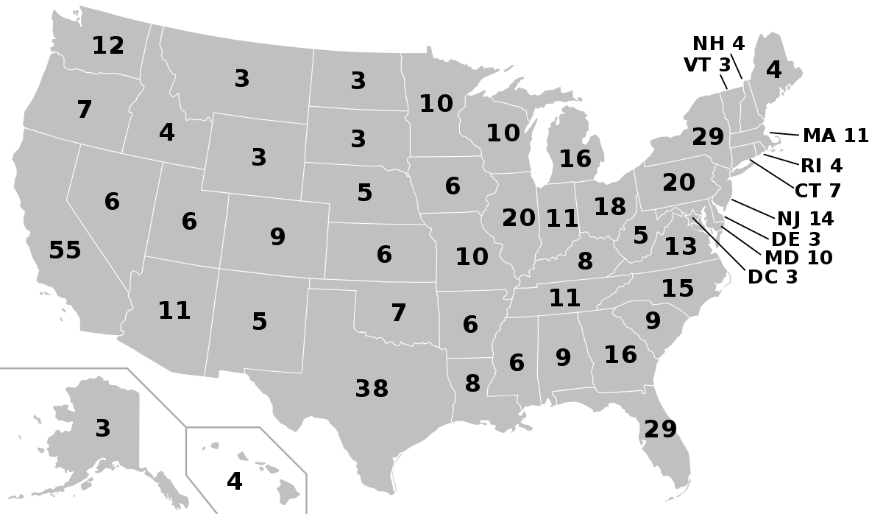
538 Electoral Votes
Notes:
-The electoral college does not give votes to people, it gives votes to states
-States have electoral votes based on their population

Slide 14
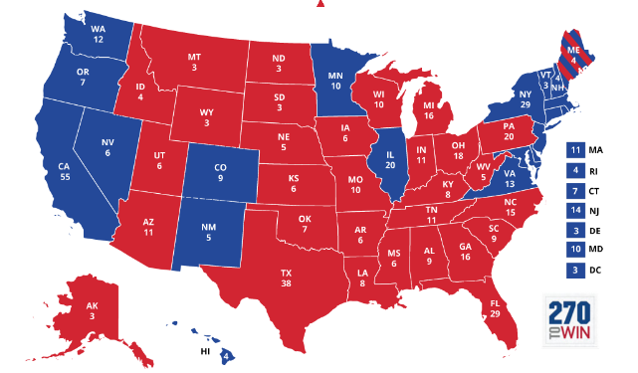
Clinton= 232 votes
Trump = 306 votes
Notes:
This is the electoral map for the 2016 Presidential Election

Slide 15
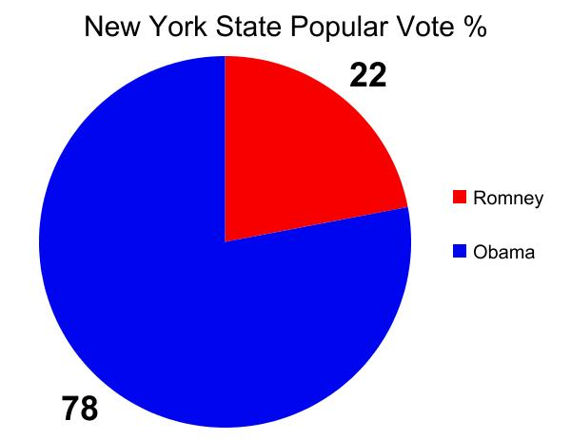
WINNER
TAKES ALL
New York has 29 Electoral Votes
Trump
Clinton
With 78% of the popular vote, Clinton wins all 29 of New York State’s electoral votes
Notes:
It’s winner takes all, as long as you get 51% of the popular vote in the states
It’s almost like every state has its own mini election for president

Slide 16
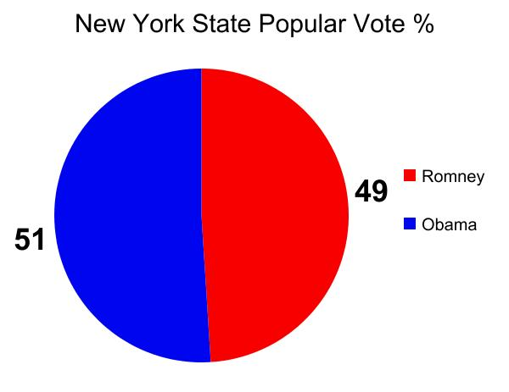
WINNER
TAKES ALL
New York has 29 Electoral Votes
Trump
Clinton
With 51% of the popular vote, Clinton wins all 29 of New York State’s electoral votes
Notes:
Because of this, you can lose the popular vote aka the majority vote but still win the electoral college vote

Slide 17
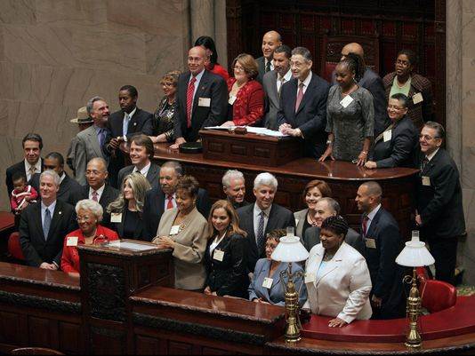
Electors: Why do we have them?
Notes:
-These are the Electors from NY State
-The votes are not automatically awarded
-This votes come from actual people
-Specifically 538 state electors
-They cannot hold a position of the government, and they cannot have committed treason against the government
-Usually people who are affiliated with politics but not holding an office
-It is a great position of respect
-You are not voting for a president, you are voting to tell your elector what to do, and he/she can ignore you if they want
-86 electors in history have gone against the wishes of their state
-They are supposed to carry out the will of the people of their state

Slide 18
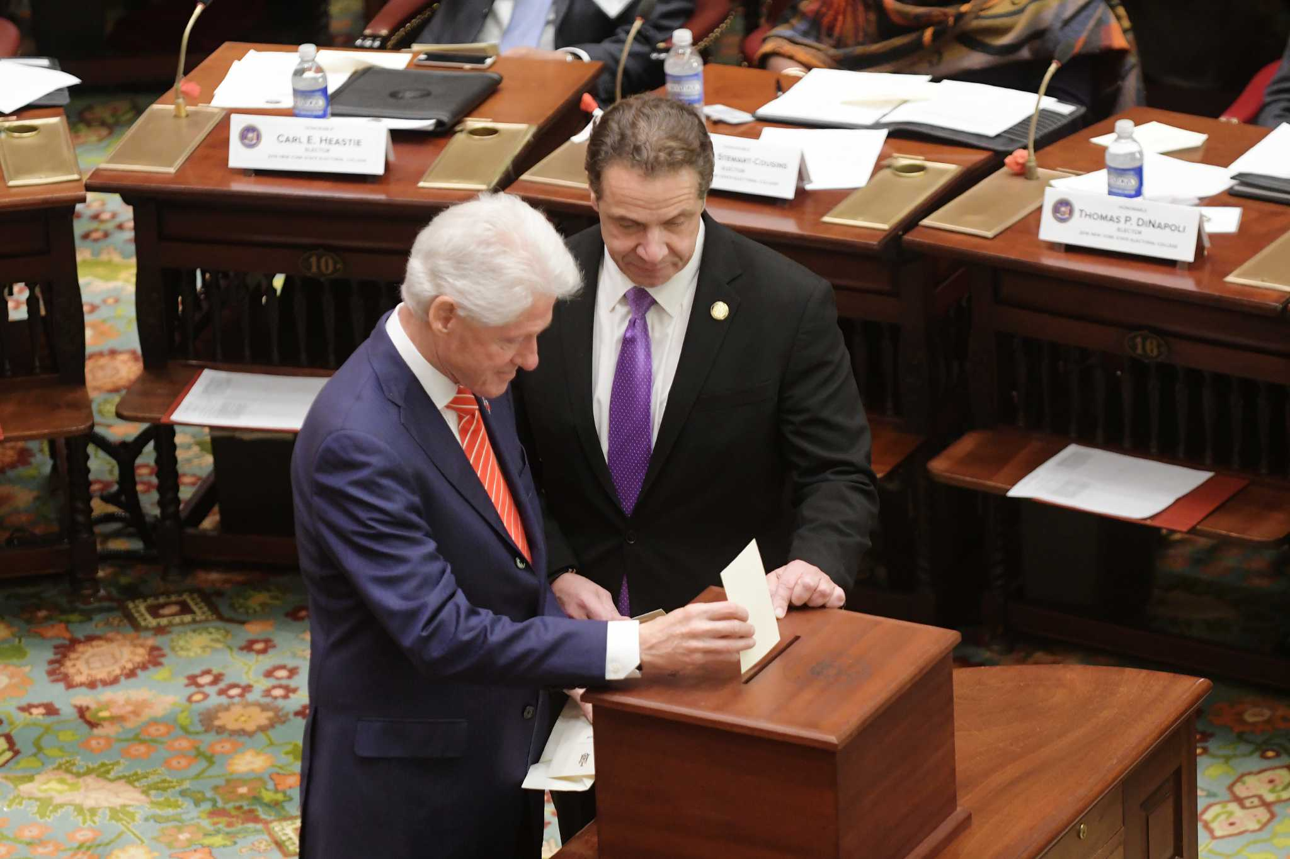
Electors: Why do we have them?
Notes:
-These are the Electors from NY State
-The votes are not automatically awarded
-This votes come from actual people
-Specifically 538 state electors
-They cannot hold a position of the government, and they cannot have committed treason against the government
-Usually people who are affiliated with politics but not holding an office
-It is a great position of respect
-You are not voting for a president, you are voting to tell your elector what to do, and he/she can ignore you if they want
-86 electors in history have gone against the wishes of their state
-They are supposed to carry out the will of the people of their state

Slide 19
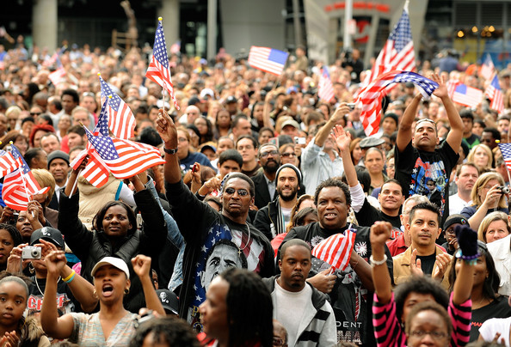
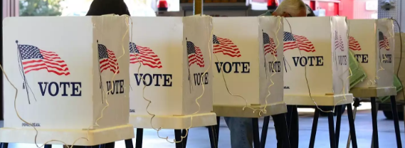
Notes:
-These are the Electors from Washington State
-The votes are not automatically awarded
-This votes come from actual people
-Specifically 538 state electors
-They cannot hold a position of the government, and they cannot have committed treason against the government
-Usually people who are affiliated with politics but not holding an office
-It is a great position of respect
-You are not voting for a president, you are voting to tell your elector what to do, and he/she can ignore you if they want
-86 electors in history have gone against the wishes of their state
-They are supposed to carry out the will of the people of their state

Slide 20
So, why do we use this system?

Slide 21


1. Do not trust the people

Slide 22
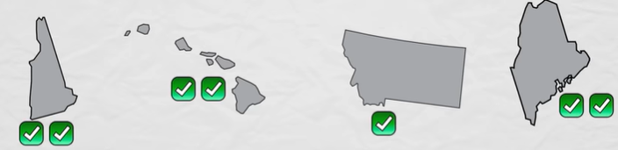
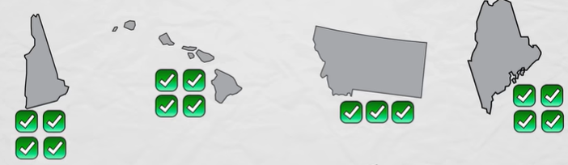
2. Power to small states

Slide 23

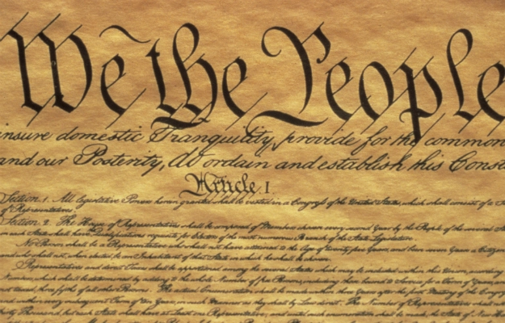
700 Proposed Amendments
Notes:
Most proposed amendment in US History

Slide 24
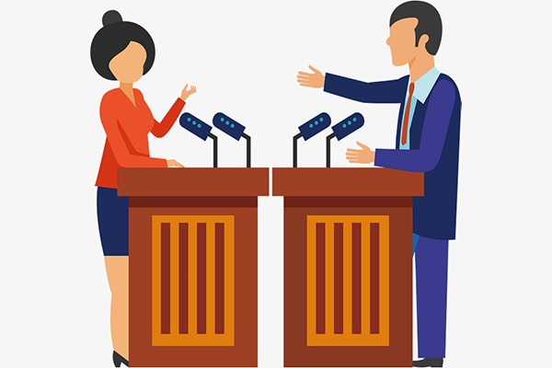
Activity #1:
Electoral College Debate

Slide 25
Lesson #2:
Campaign Finance Webquest

Slide 26
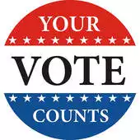



Do Now:
1. What are examples of things that politicians pay for to run election campaigns? (For Example: TV commercials)
2. How much money do you think Barack Obama spent running for President?
Notes:
750 million & 1.1 Billion

Slide 27

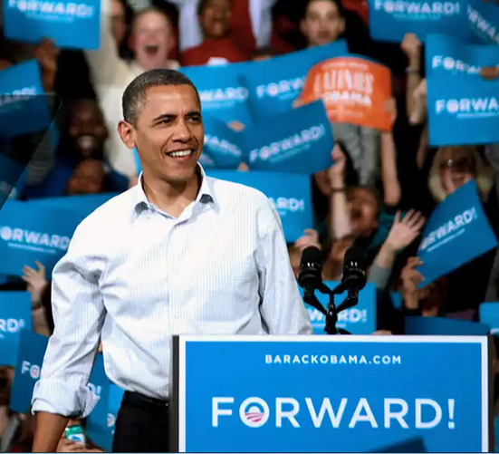

Who Can Donate The Most?
What Is The Effect Of This?
-Donations
-Few restrictions
Notes:
If groups and people can donate to politicians as much as they want, why is this problematic?
If politicians need this money, what will they do for it?
Who now has how more control over our government?
.01% of Americans (25,000 people) contributed ⅓ of all money to elections

Slide 28

Activity#2 :
Campaign Finance Webquest

Slide 29
Lesson #3:
Political Advertisements Analysis

Slide 30



Manipulation
  Under 1 Min
  Emotion
  One-Sided
What do we need to do when we watch them?

Slide 31
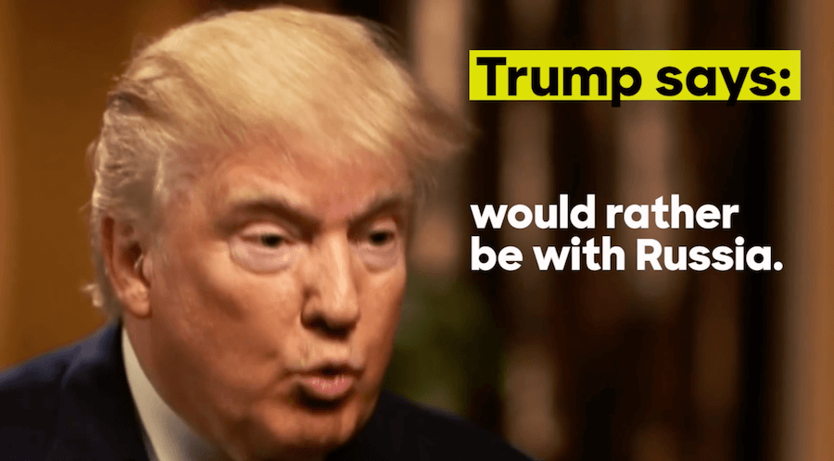

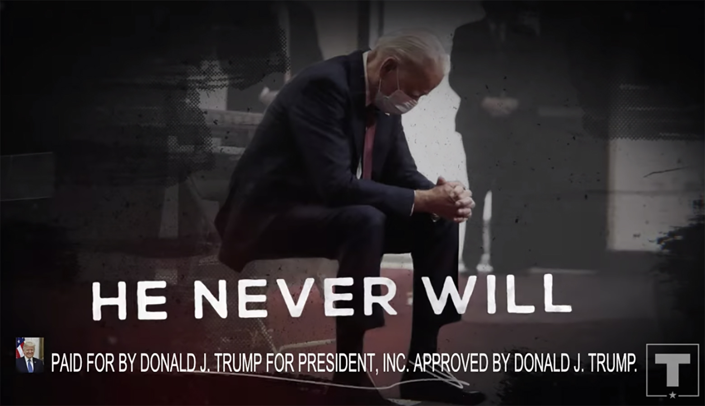
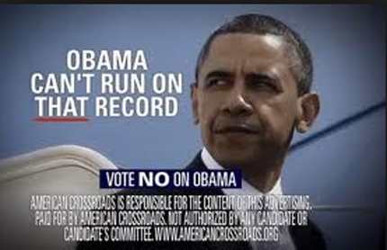
Attack Ad

Slide 32
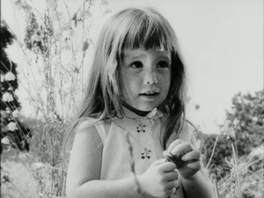
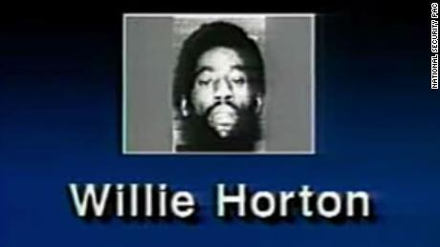
Activity #3:
Political Advertisements Analysis

Slide 33
“Daisy” & “Willie Horton”

Slide 34
Lesson #4:
Presidential Candidate Political Pandering

Slide 35
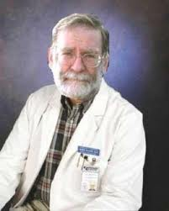
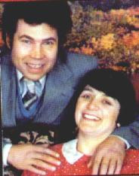
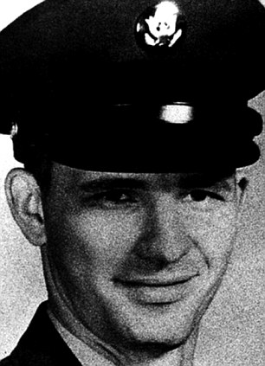
Do Now: Pick one of these three men and write a short story about what you think their life is like. You may want to include their job, friends/family, interests, personality etc.
Notes:
Also known as Dr. Death, Harold Shipman used his position as a doctor to inject people with diamorphine and then rule that they had died from natural causes. Although he has only been convicted of 15 murders, but is believed to have anywhere between 215 and 260 victims.
Fred and Rosemary West lured, raped and killed several young women, including several of their own daughters. Frank was convicted of 12 counts of murder, but hanged himself while awaiting trial, while rose was convicted of 10 and is currently serving a life sentence .
Dean Corll murdered raped and tortured 28 boys.

Slide 36
Look at their appearance
What are they trying to do?
What image are they trying to present?
Harold Shipman
Fred & Rosemary West
Dean Corll

Slide 37
DO OUR LEADERS DO THE SAME THING?
Harold Shipman
Fred & Rosemary West
Dean Corll

Slide 38
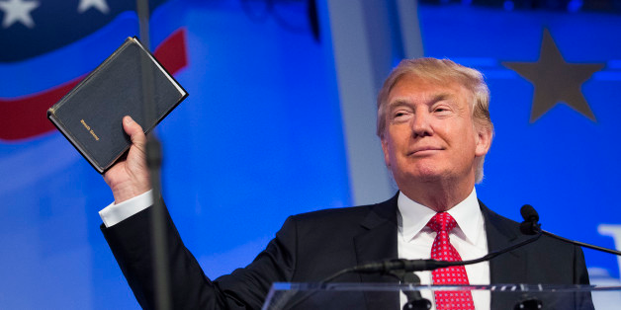
Video #1
How is the politician trying to “connect” with their voters? Why does it seem untrue?
Context: The following video was recorded in rural Iowa.

Slide 39
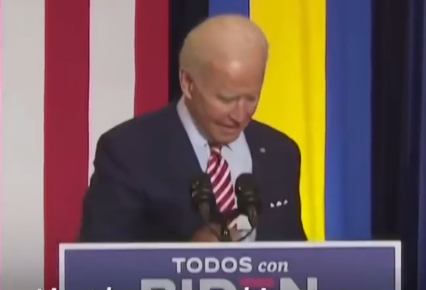
Video #2
Same questions
Context: The following video was recorded in front of a predominately Hispanic audience in Florida.

Slide 40
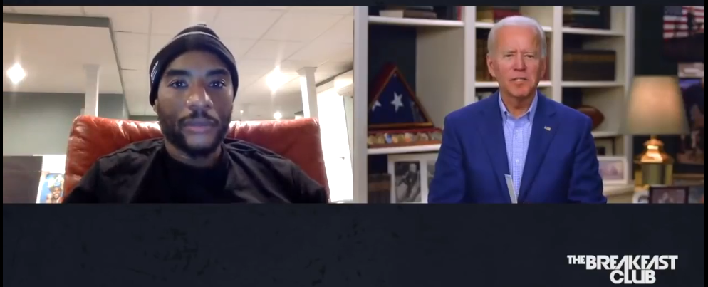
Video #3
Same questions
Context: The following video was recorded on the radio show the Breakfast Club.

Slide 41
Activity #4:
Presidential Candidate Political Pandering

Slide 42
Lesson #5:
Focusing on The Issues

Slide 43


What factors influence
why we would vote for someone?

Slide 44




Sports Results
Notes:
If a team wins the big game, the mayor and other incumbents are more likely to win

Slide 45


Facial Hair
Notes:
In general people find clean shaven more trustworthy Congressmen have clean faces

Slide 46
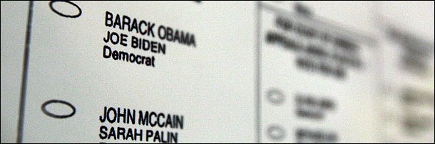
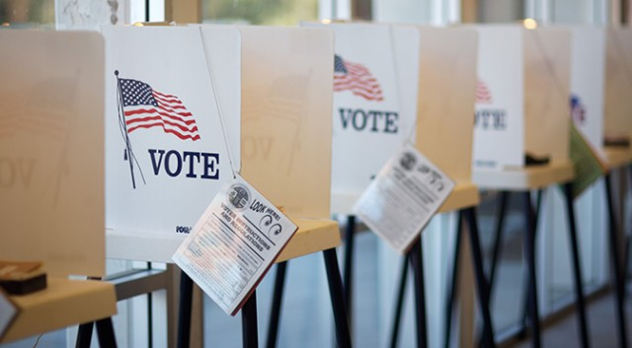
The Order Names Are Listed In
Notes:
First tends to get votes

Slide 47



Your Parents
Notes:
71% had similar viewpoints

Slide 48
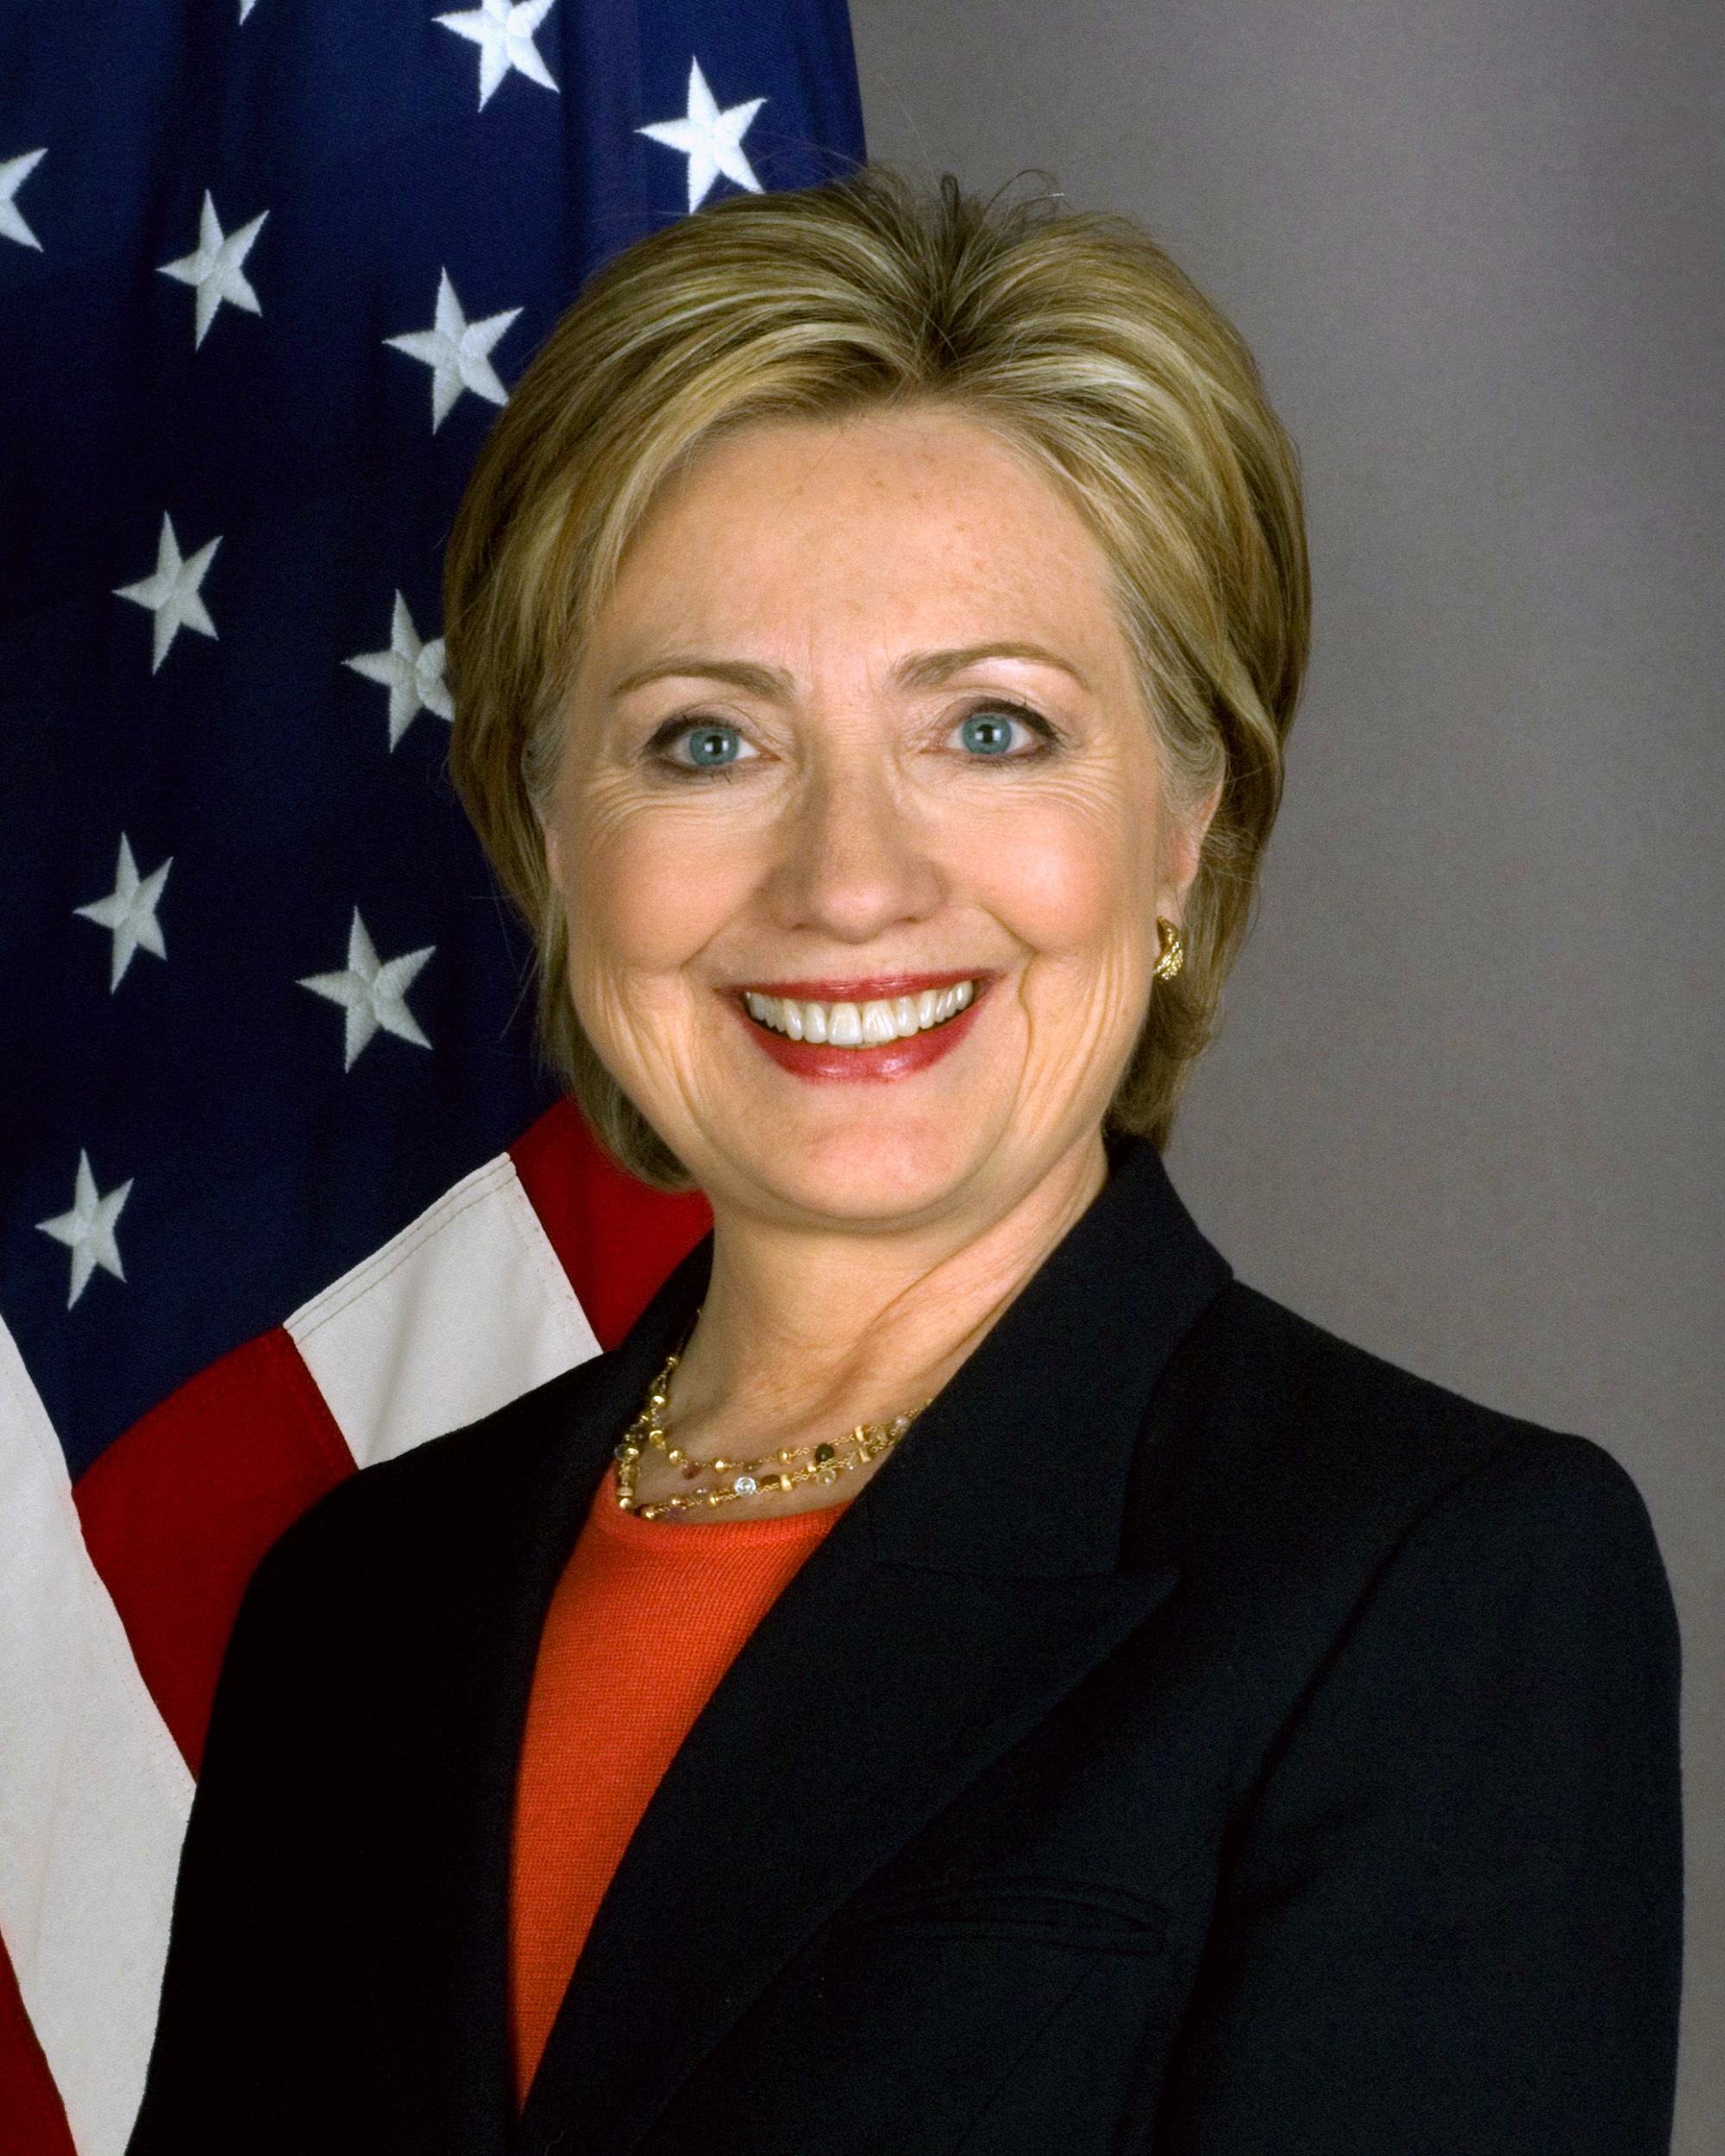
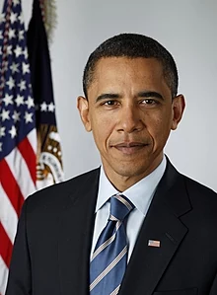
Voting
What does this say about how we vote?

Slide 49

CEE Affiliates
https://www.councilforeconed.org/resources/local-affiliates/

Slide 50




Thank You to Our Sponsors!

Slide 51

The Conference is your pathway to learn about the opportunities to incorporate personal finance and economics into your K-12 classroom and to exchange ideas with hundreds of peers.
Register by August 15, 2020 to receive the early bird special discount:
$79 Early Bird ($99 thereafter)
Register Today >>>
https://www.councilforeconed.org/events/conference

Slide 52

Contact & Questions?
Andrew Menfi
Social Studies Teacher
New Visions Charter High School
for Advanced Math & Science
amenfi3@gmail.com
Thanks For Your Time!

