Slide 1
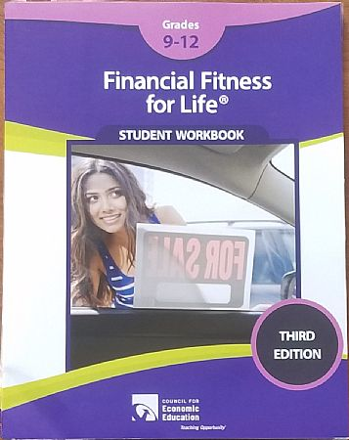
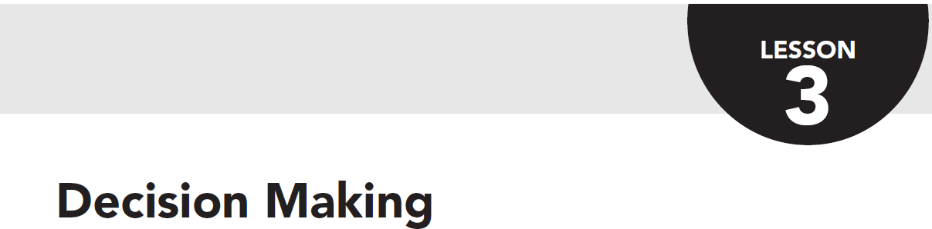

Financial Fitness for Life, Chapter 3:
Decision Making
11/5/2020
Lynne Farrell Stover stoverlf@jmu.edu

Slide 2
EconEdLink Membership
You can now access CEE’s professional development webinars directly on EconEdLink.org! To receive these new professional development benefits, become an EconEdLink member. As a member, you will now be able to:
Automatically receive a professional development certificate via e-mail within 24 hours after viewing any webinar for a minimum of 45 minutes
Register for upcoming webinars with a simple one-click process
Easily download presentations, lesson plan materials and activities for each webinar
Search and view all webinars at your convenience
Save webinars to your EconEdLink dashboard for easy access to the event
You may access our new Professional Development page here

Slide 3
Professional Development Certificate
To earn your professional development certificate for this webinar, you must:
Watch a minimum of 45-minutes and you will automatically receive a professional development certificate via e-mail within 24 hours.
Accessing resources:
You can now easily download presentations, lesson plan materials, and activities for each webinar from EconEdLink.org/professional-development/

Slide 4
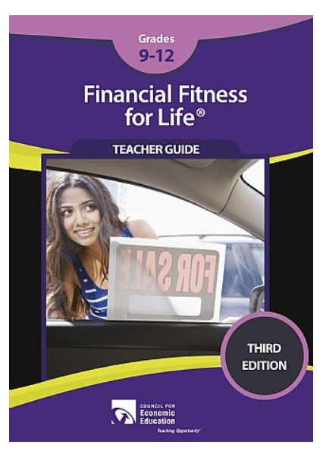
https://store.councilforeconed.org/

Slide 5
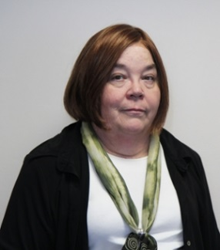
Welcome!
Lynne Stover is a Teacher Consultant at the James Madison University Center for Economic Education. Prior to this, she spent thirty-three years in public education where she enjoyed various teaching assignments including classroom teacher, gifted education specialist, and librarian. She is the author of over fifty educational articles and eight teacher resource books including From the Big Screen to the Classroom: Using Movies to Teach in the Content Areas (Pieces of Learning, 2016).

Slide 6

Agenda
In this session we will:
Review National and State Standards related to decision making.
Discuss the lesson’s features and applicability to classroom instruction.
Learn to use the PACED Decision Making Model for effective problem solving.
Participate in the three main sections of the featured lesson.
Brainstorm various decision-making scenarios that deal with current events.

Slide 7

State Standards
Economics and Personal Finance Standards of Learning
EPF.1 The student will demonstrate knowledge of basic economic concepts and structures by
a) describing how consumers, businesses, and government decision makers face scarcity of resources and must make trade-offs and incur opportunity costs;
b) explaining that choices often have long-term unintended consequences;
c) describing how effective decision making requires comparing the additional costs (marginal costs) and additional benefits (marginal benefits);

Slide 8
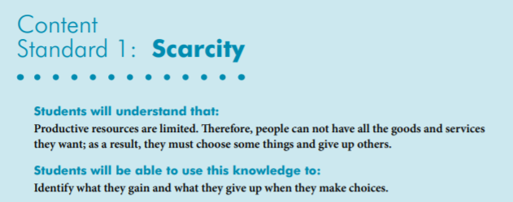
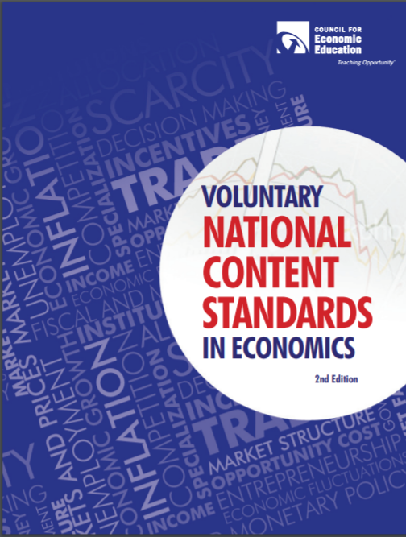
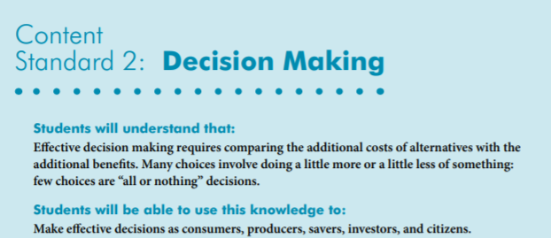
National Standards

Slide 9
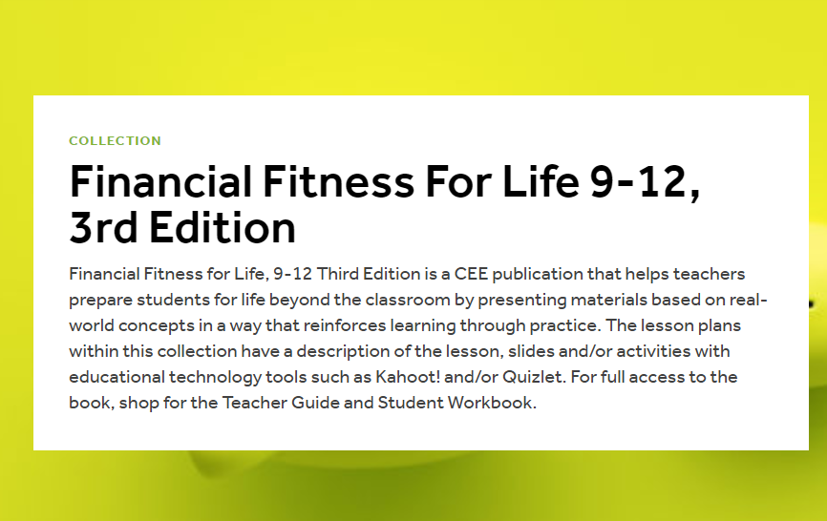
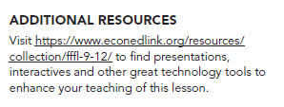
Browse chapter highlights at https://www.econedlink.org/resources/collection/fffl-9-12/

Slide 10
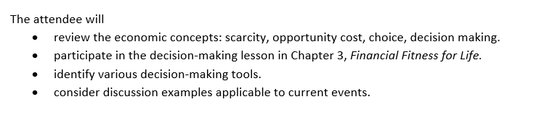
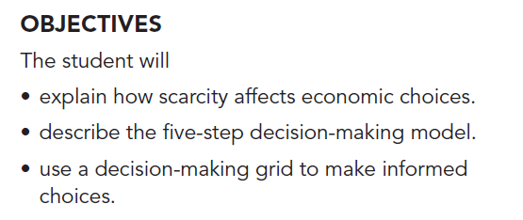
Objectives
Webinar Objectives
Student Objectives

Slide 11
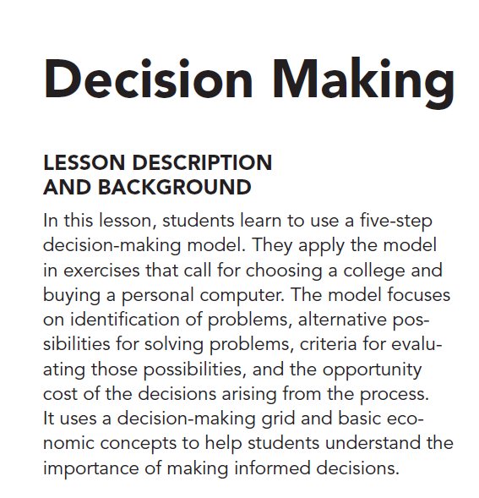



Slide 12
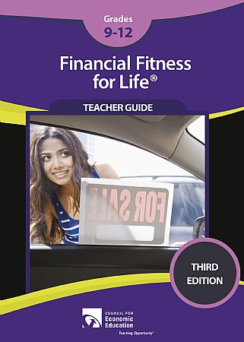
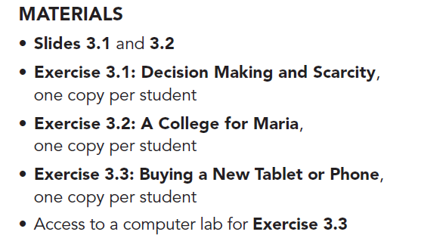
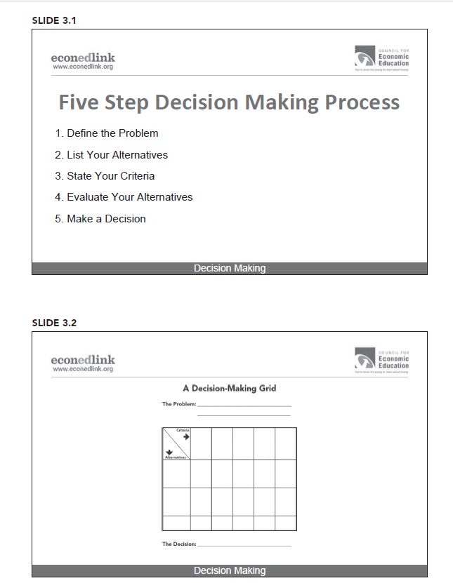
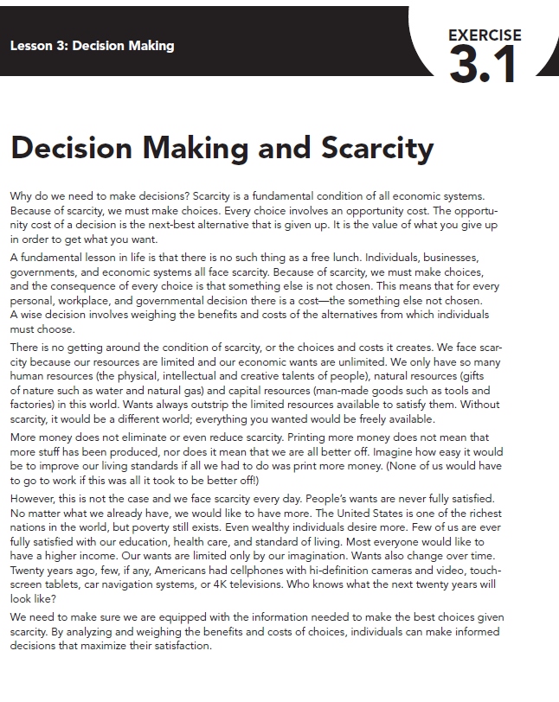
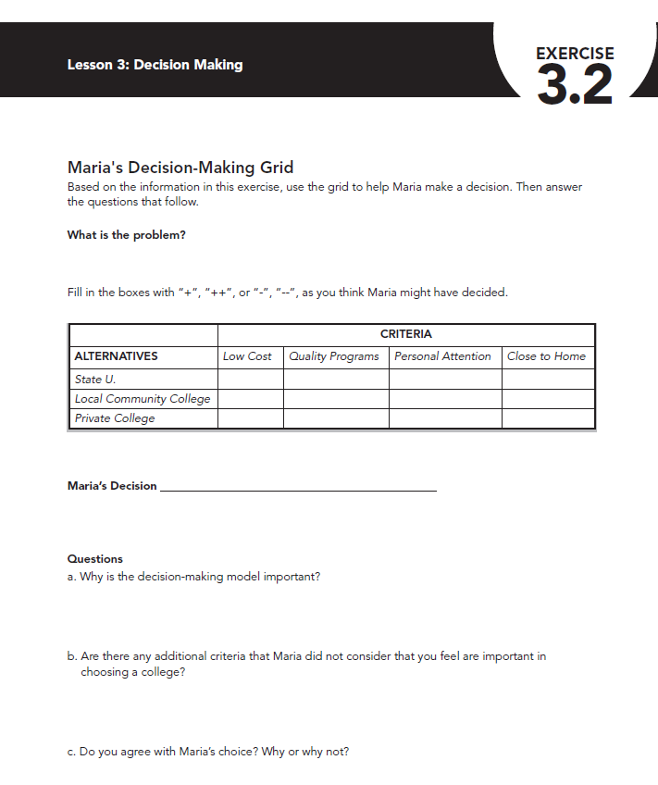
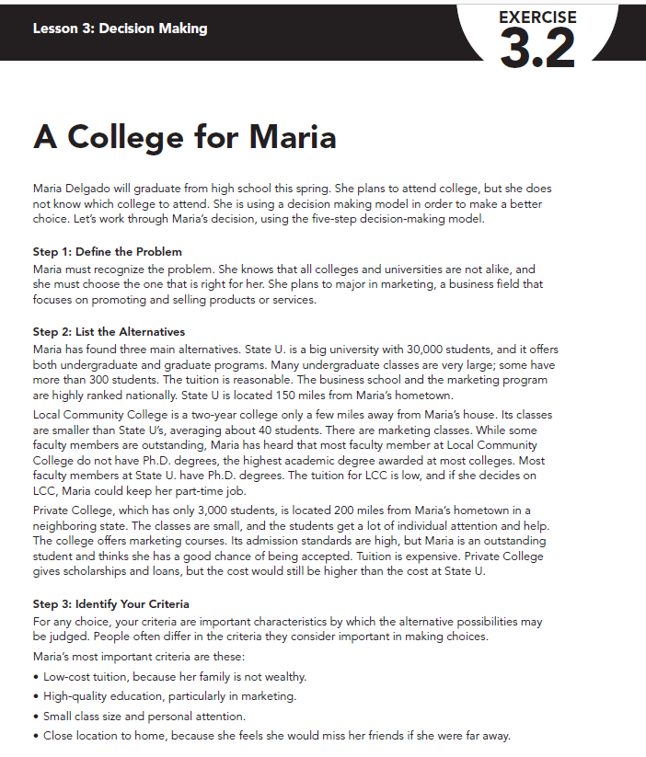
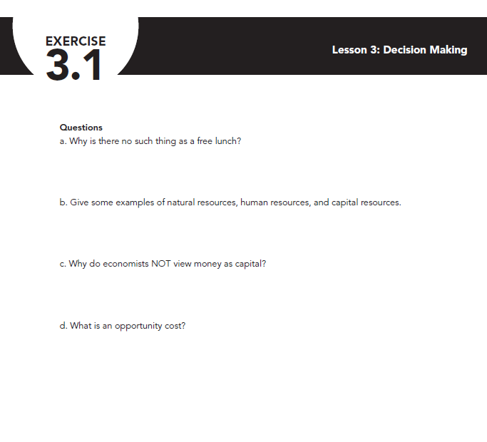
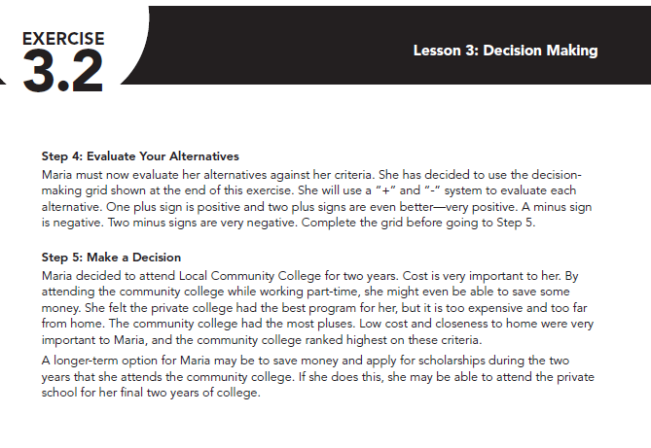

Slide 13
Let’s Do the Lesson!

Slide 14
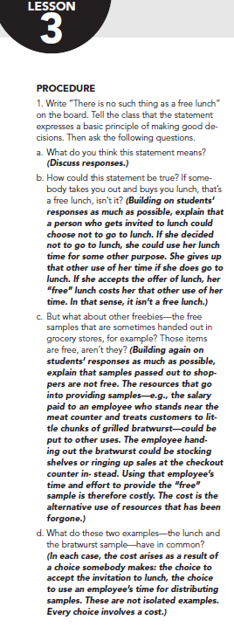

There’s no such thing as
a free lunch.

Slide 15

Class Discussion
How is this statement true?
1. If someone invites you out to lunch, it’s a free lunch isn’t it?
2. What about free samples at grocery stores? Are they really free? (Note: You may want to preface this with “in the pre-pandemic world.”)
3. What do these two examples have in common?
4. Current “freebies” to add to the discussion: free flu shots, free face masks, free COVID testing…

Slide 16
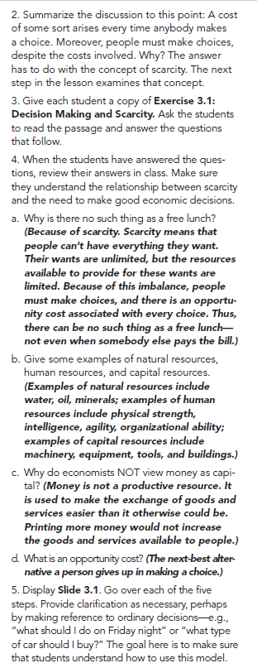
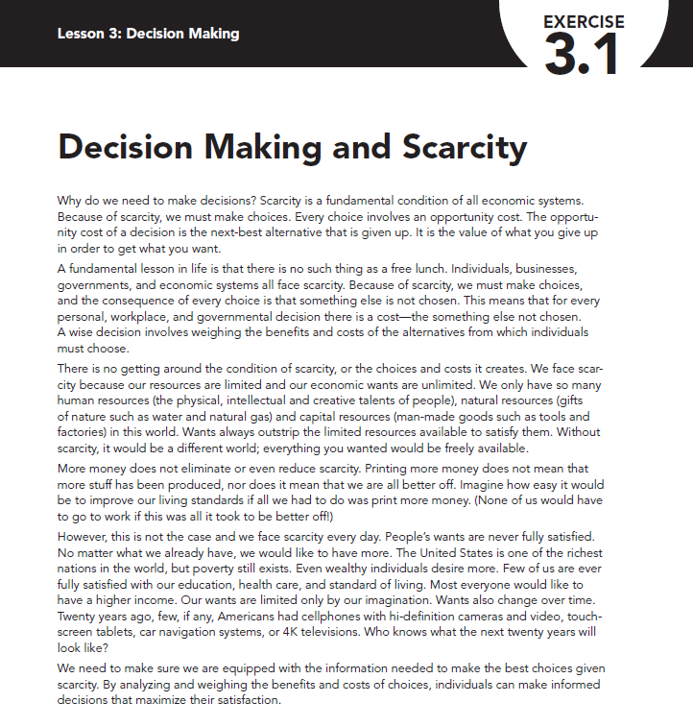
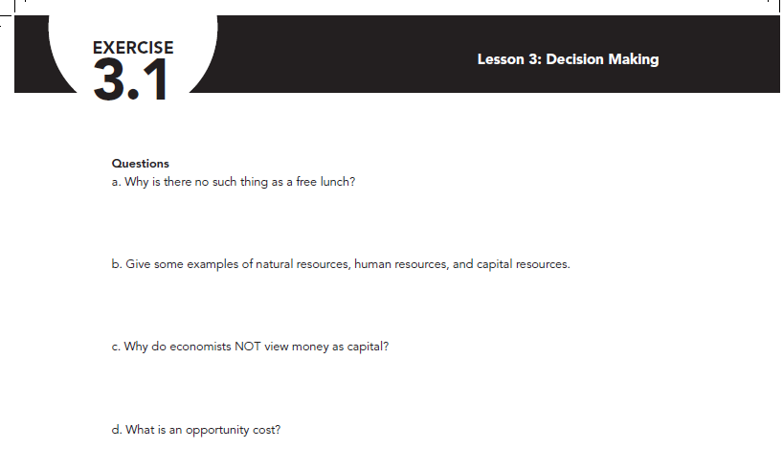
Teacher Directed, Group Work, or Individual Assignment

Slide 18

Decision Making
Exercise 3.1
Questions
1. Why is there no such thing as a free lunch?
2. Give examples of natural resources, human resources, and capital resources.
3. Why do economists NOT view money as capital?
4. What is an opportunity cost?

Slide 19
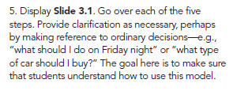
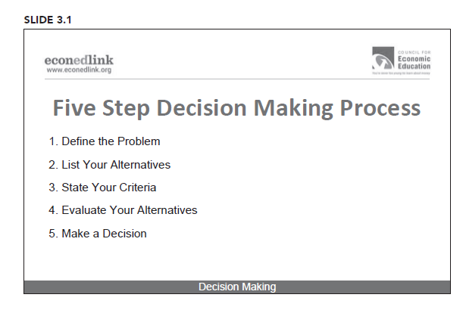

Slide 20
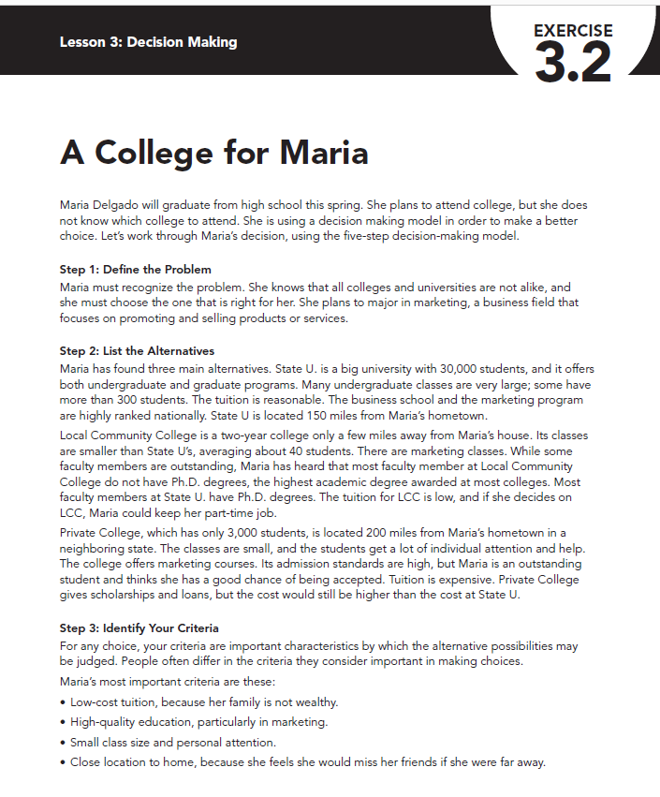
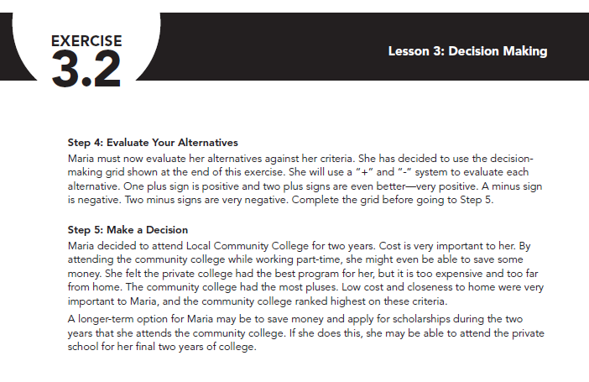


Slide 21



Slide 22


Slide 23
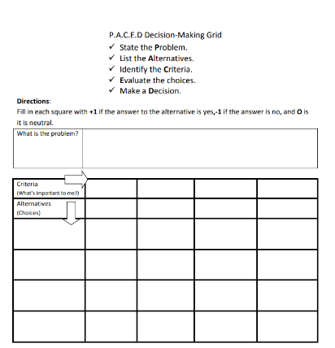
PACED Decision Model
State the problem
List the alternatives
Identify the criteria
Evaluate the alternatives
Make a decision

Slide 24
P: STATE THE PROBLEM
Problem: Where should Maria go to school?

Slide 25

A: LIST THE ALTERNATIVES
Problem: Where should Maria go to school?
Big University
Community College
Private College

Slide 26
C: STATE THE CRITERIA
Problem: Where should Maria go to school?
Low Cost Tuition
Quality
Education
Small
Class Size
Near
Home
Big University
Community College
Private College

Slide 27
E: EVALUATE THE ALTERNATIVES
Problem: Where should Maria go to school?
Low Cost Tuition
Quality
Education
Small
Class Size
Near
Home
Big University
+
+ +
-
-
Community College
+ +
+
+
+
- -
+
+
- -
Private College
Step 1, Rate On A Scale From:
++ (Best) + (Good) - (Bad) to - - (Worst)

Slide 28

E: EVALUATE THE ALTERNATIVES
Problem: Where should Maria go to school?
Low Cost
Tuition
Quality
Education
Small
Class Size
Near
Home
Big University
+
+ +
-
-
= +1
Community College
+ +
+
+
+
= +5
- -
+
+
- -
= -2
Private College
Step 2, Add up the numbers!

Slide 29
D: MAKE A DECISION
Problem: Where should Maria go to school?
Low Cost Tuition
Quality
Education
Small
Class Size
Near
Home
+
?
= +1
Big University
+ +
-
-
Community College
+ +
+
+
+
= +5
- -
+
+
- -
= -2
Private College

Slide 30

For Consideration
It might be “timely” to include another alternative for Maria to consider.
What about applying to an online college?

Slide 31
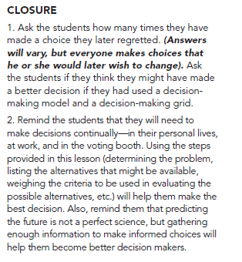

Slide 32
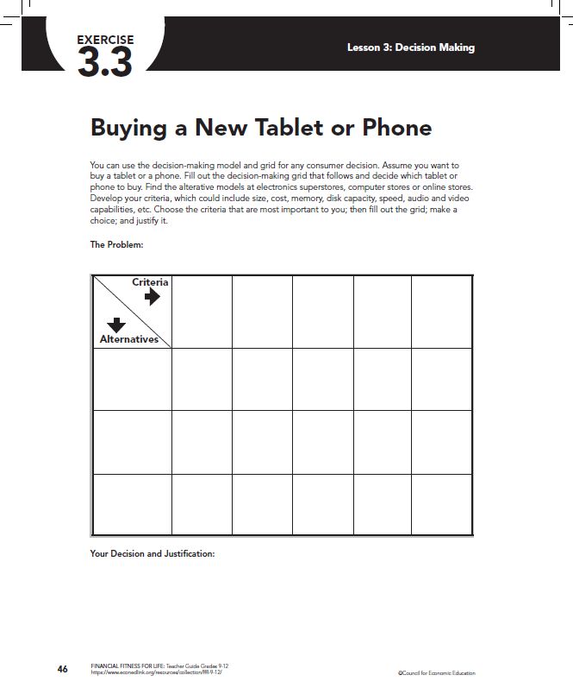

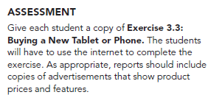

Slide 33
Assessment Questions
Everyone makes choices about their personal lives, regardless of who they are or where they live, because we live in a world of scarcity and cannot have everything we want. Therefore, we all must make choices. Name three choices you made today.
Given the same alternatives and using the same criteria, people can make very different choices. Why is this so?
What is the opportunity cost of attending college full time?
What is the opportunity cost of working full time?
How can creating a decision-making model help make choices?

Slide 34
Extension Activities

Slide 35
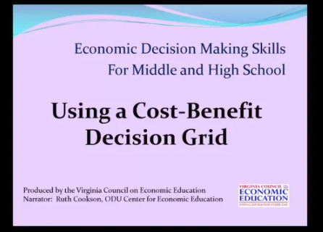
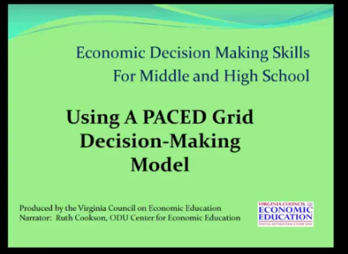
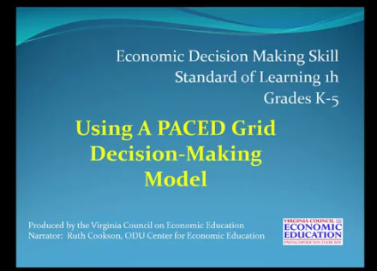
https://vimeo.com/user61747473
Instructional Videos developed by the Virginia Council on Economic Education

Slide 36

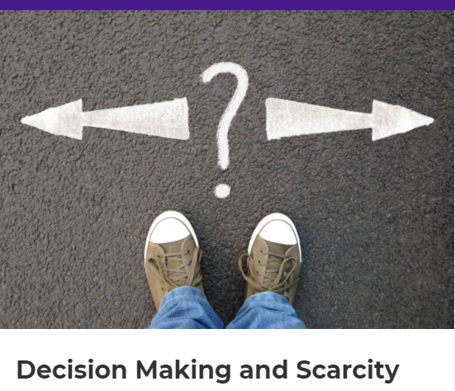
https://create.kahoot.it/share/decision-making-and-scarcity/eb64942c-5c50-4d4e-b129-8113292db267

Slide 37
References
Three instructional videos from Virginia Council on Economic Education (Ruth Cookson, ODU):
https://vimeo.com/user61747473
Three EconEdLink online slides:
https://www.econedlink.org/resources/decision-making/
EconEdLink lesson, College: Where Am I to Go? https://www.econedlink.org/resources/college-where-am-i-going-to-go/
National Content Standards in Economics resource: ihttps://www.councilforeconed.org/wp-content/uploads/2012/03/voluntary-national-content-standards-2010.pdf

Slide 38
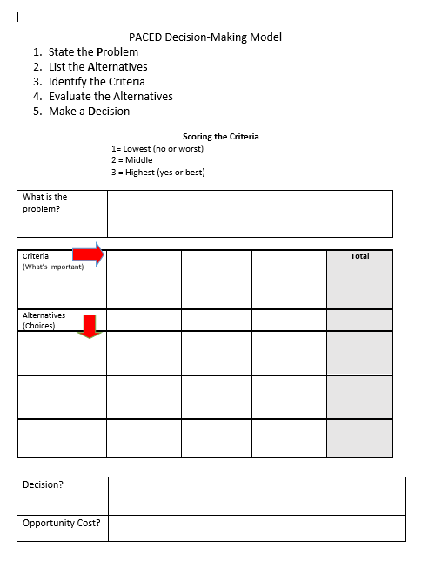
Attachments
Lesson Plan from Virginia Council on Economic Education
“Using Economic Decision-Making Models to Become Informed Decision-Makers”
Online Reference Materials Information
PACED Decision Making Model (featuring numbers)

Slide 39

CEE Affiliates
https://www.councilforeconed.org/resources/local-affiliates/

Slide 40




Thank You to Our Sponsors!

