Slide 1

Asset Building: Banking, Saving and Investing
“This year, the best investment you can make is in yourself.”
Doug Young
THE WISER CHOICE
October 2020

Slide 2
EconEdLink Membership
You can now access CEE’s professional development webinars directly on EconEdLink.org! To receive these new professional development benefits, become an EconEdLink member. As a member, you will now be able to:
Automatically receive a professional development certificate via e-mail within 24 hours after viewing any webinar for a minimum of 45 minutes
Register for upcoming webinars with a simple one-click process
Easily download presentations, lesson plan materials, and activities for each webinar
Search and view all webinars at your convenience
Save webinars to your EconEdLink dashboard for easy access to the event
You may access our new Professional Development page here

Slide 3
Professional Development Certificate
To earn your professional development certificate for this webinar, you must:
Watch a minimum of 45-minutes and you will automatically receive a professional development certificate via e-mail within 24 hours.
Accessing resources:
You can now easily download presentations, lesson plan materials, and activities for each webinar from EconEdLink.org/professional-development/

Slide 4
Objectives
Describe key investment strategies including index funds and dollar-cost averaging.
Explain the importance of diversifying an investment portfolio.
Identify obstacles to achieving financial goals. Evaluate alternatives.
Evaluate the benefits of investing early for retirement.
Explain the different types of assets.
Compare rates of risk and return on a variety of different opportunities.
Analyze different investment engines which can grow one’s money.
Understand the importance of investing and building retirement accounts young.

Slide 5
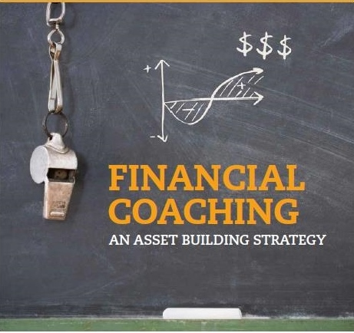
Financial Coach
Someone who will teach and help you develop and maintain healthy financial habits.
I’m not a debt consolidator, financial counselor or financial planner.

Slide 6
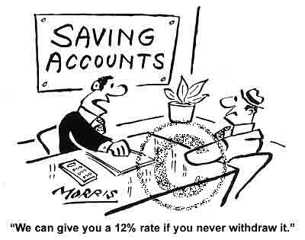
“Saving” (a verb) and “Savings” (a noun)

Slide 7

Ben Franklin says:
“By failing to prepare, you are planning to fail.”

Slide 8
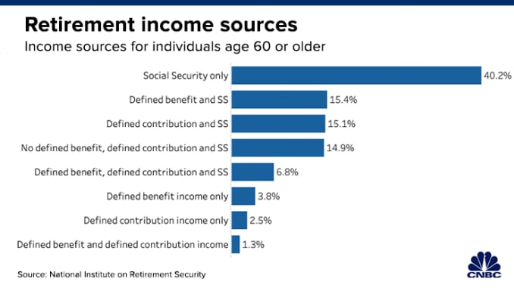

Slide 9
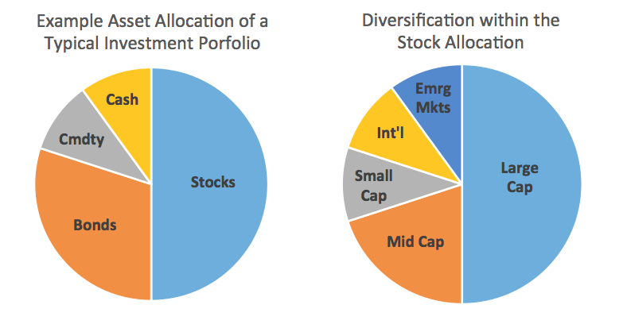
Asset Allocation and Diversification

Slide 10
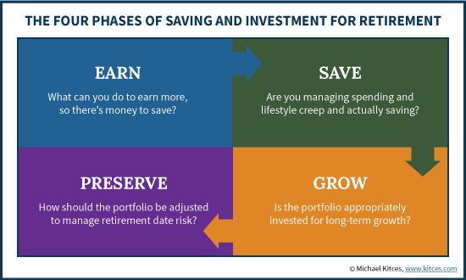
Four Stages of Saving

Slide 11
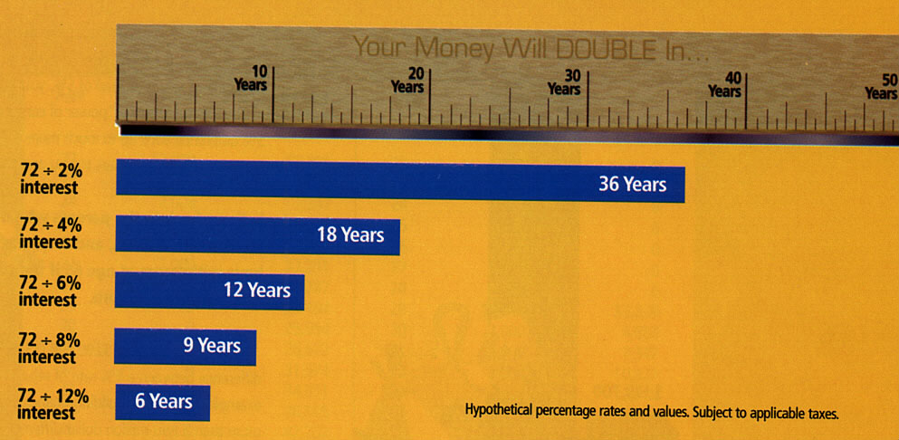
The Rule of 72
……states that 72 divided by the interest rate will result in the number of years it will take your investment to double…...
https://www.econedlink.org/resources/compound-interest-calculator/

Slide 12
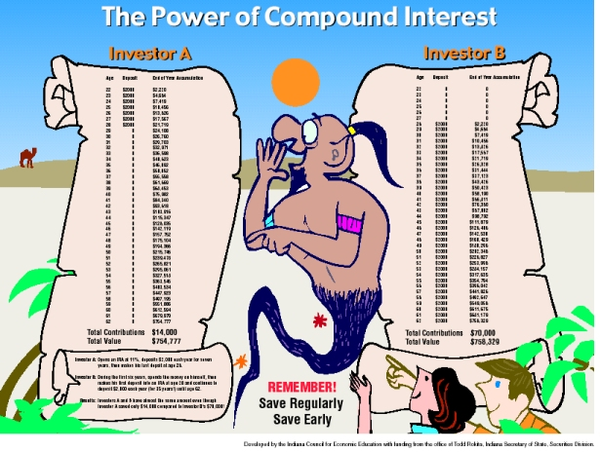
https://www.econedlink.org/resources/the-benefits-of-investing-early/

Slide 13
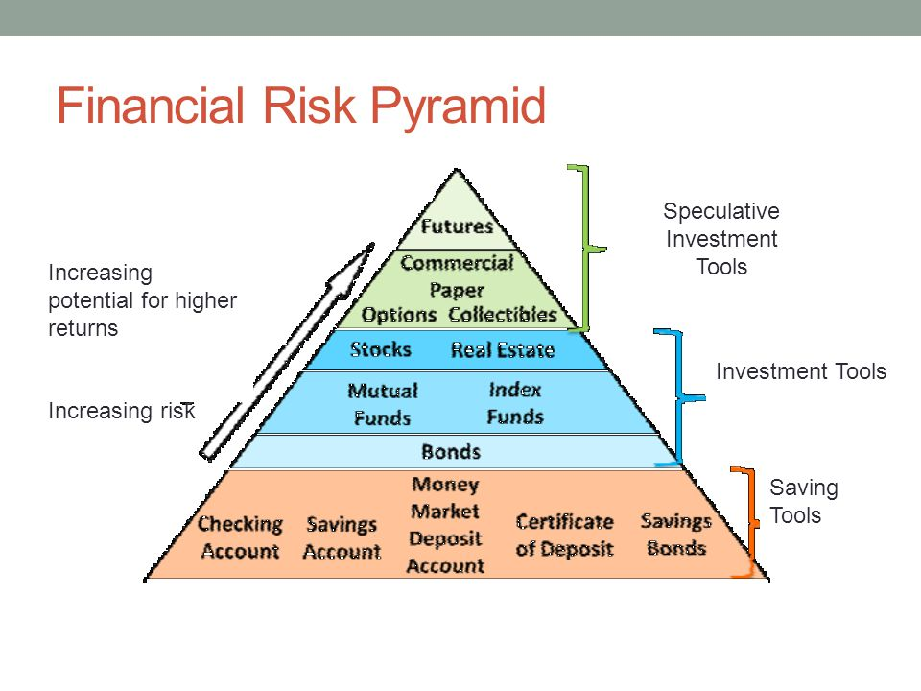

Slide 14
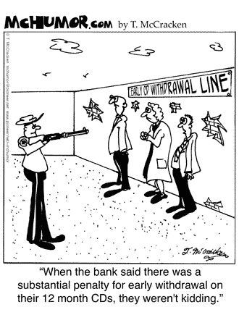
Basic Banking

Slide 15
Four Main Types of Banks
Commercial (Wells, Chase, Citi, etc.)
Savings and Loan (Sunnyside)
Credit Union (Westchester Federal)
On-Line Banks (ING)

Slide 16
Saving Tools
Cash, Savings Bonds, piggy banks, hidden spots
Bank Checking and Savings Accounts
Money Market Funds and C.D.’s
Government Bonds: Savings, Notes, Bills and Treasuries
Distributions from Tax Deferred Accounts(403b, 401K)
Life Insurance Policies (Term, Whole Life, Universal)
Income from Reverse Mortgage

Slide 17
Top 10 Secret Hiding Places For Money
The Tank: Yes, the toilet's water tank where cash, jewelry and gold coins.
The Freezer: Cold, hard cash isn't just a cliché.
The Pantry: Look inside every cereal box, flour bag and coffee can. ...
The Bookshelves: Check for those hollowed-out bibles and dictionaries
Under the Floorboards: Check for loose boards under throw rugs and new nails that look out of place,
Old Suitcases: Vintage suitcases packed with cash as many have false bottoms.
Closets: Money in shoeboxes, cigar boxes and inside the pockets and lining of old jackets.
Bureaus: Taped to the bottom or the back of furniture with chests of drawers offer unique hiding places.
Birthday cards and Church Envelopes: Many have been pre-loaded and then forgotten.
Backyard: People still bury canning jars filled with rolled up $20 bills in the yard.

Slide 18
Pros and Cons of Short Term Saving Options
Savings
Money Market
Certificate of Deposits
PROS
Unlimited withdrawals
Low minimum
Low or no fees
Access to ATM’s
Electronic transfers
CONS
Very low interest rate.
Limited monthly withdrawals
PROS Higher interest rates compared to savings and checking accounts.
Ability to write checks, make ATM withdrawals and make transfers.
CONS
High minimum deposit to avoid monthly fees.
Limited number of withdrawals per month.
PROS
Higher interest rates than savings accounts.
Interest rate doesn't change during the term of the account.
No fees when you hold your account to maturity.
CONS
Penalties for early withdrawal making funds illiquid.
No access to your deposit, ATM’s or electronic transfers.

Slide 19
U.S. Savings Bonds
Interest can vary, but you are guaranteed a minimum return.
Dominations ranging from $50 to $10,000.
Maximum purchase in one year is $5,000.
Redeemable only to the person to whom they are registered.
Earnings on savings are not tax deductible.
Notes:
U.S. savings bonds:
- Savings bonds can be purchased in denominations ranging from $50 to $10,000.
- The earnings on savings bonds are not taxable.
- You buy the bonds at a discount (a percentage of their value at maturity).
- Savings bonds are payable only to the person to whom they are registered.
- They earn interest for up to 30 years, but after one year from their issue date you can cash them for their current value.

Slide 20
Ways to Save
Buy a pre-owned or year old (20% plus savings).
Re-finance home if interest rate drops 0.5% or more.
Check with insurance agents for ways to reduce premiums on all 3 policies.
Pay cash and stay away from plastic (people spend less this way).
Negotiate when buying anything. Do your pricing homework, “Caveat Emptor”.
Have utility company energy analysis on HVOC and start a level billing plan.
Lower your water heater temperature setting. Saves a lot of money.
Have a credit card with rewards, otherwise, pay cash or get a pre-paid card.
Have a piggy bank. You will be amazed how much you will save.
Don’t rent-to-own big toys.
Re-do your cell phone account as you have probably been over paying.

Slide 21
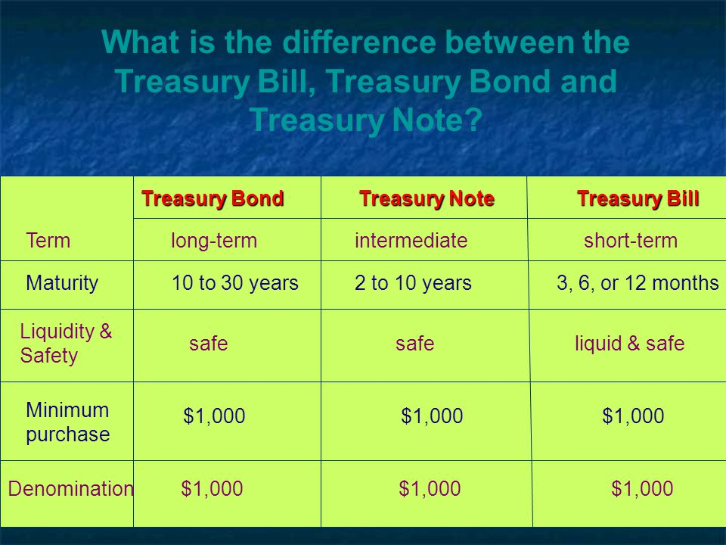

Slide 22
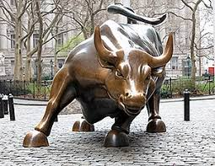
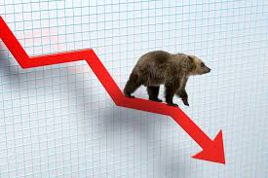



What Type of Investor Are You?

Slide 23


Questions a Financial Advisor Should Ask You
How much do you want to invest?
For how long do you want to invest?
How’s your risk tolerance (stomach)?
  Can you handle volatility over the long period of investing?
  Is this money you need or money you want!

Slide 24
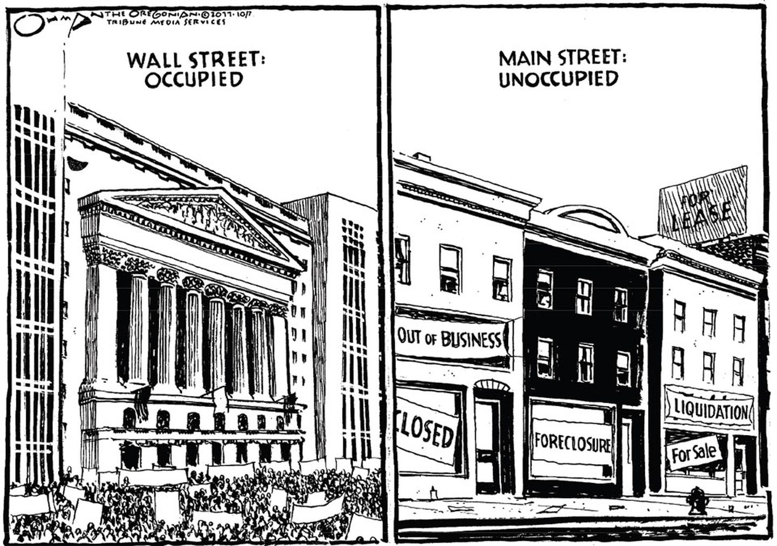
Stock Market and Risk
No guarantee that stock prices will go up or that you will make money in the market.
BE AWARE! Volatility can be bad and/or good!
Notes:
How can you increase your chances of making money in the stock market?
- Many advisors feel that stock market investments should be for the long term.
- By sticking with your investment for the long term, you may increase your chances of a solid return.

Slide 25
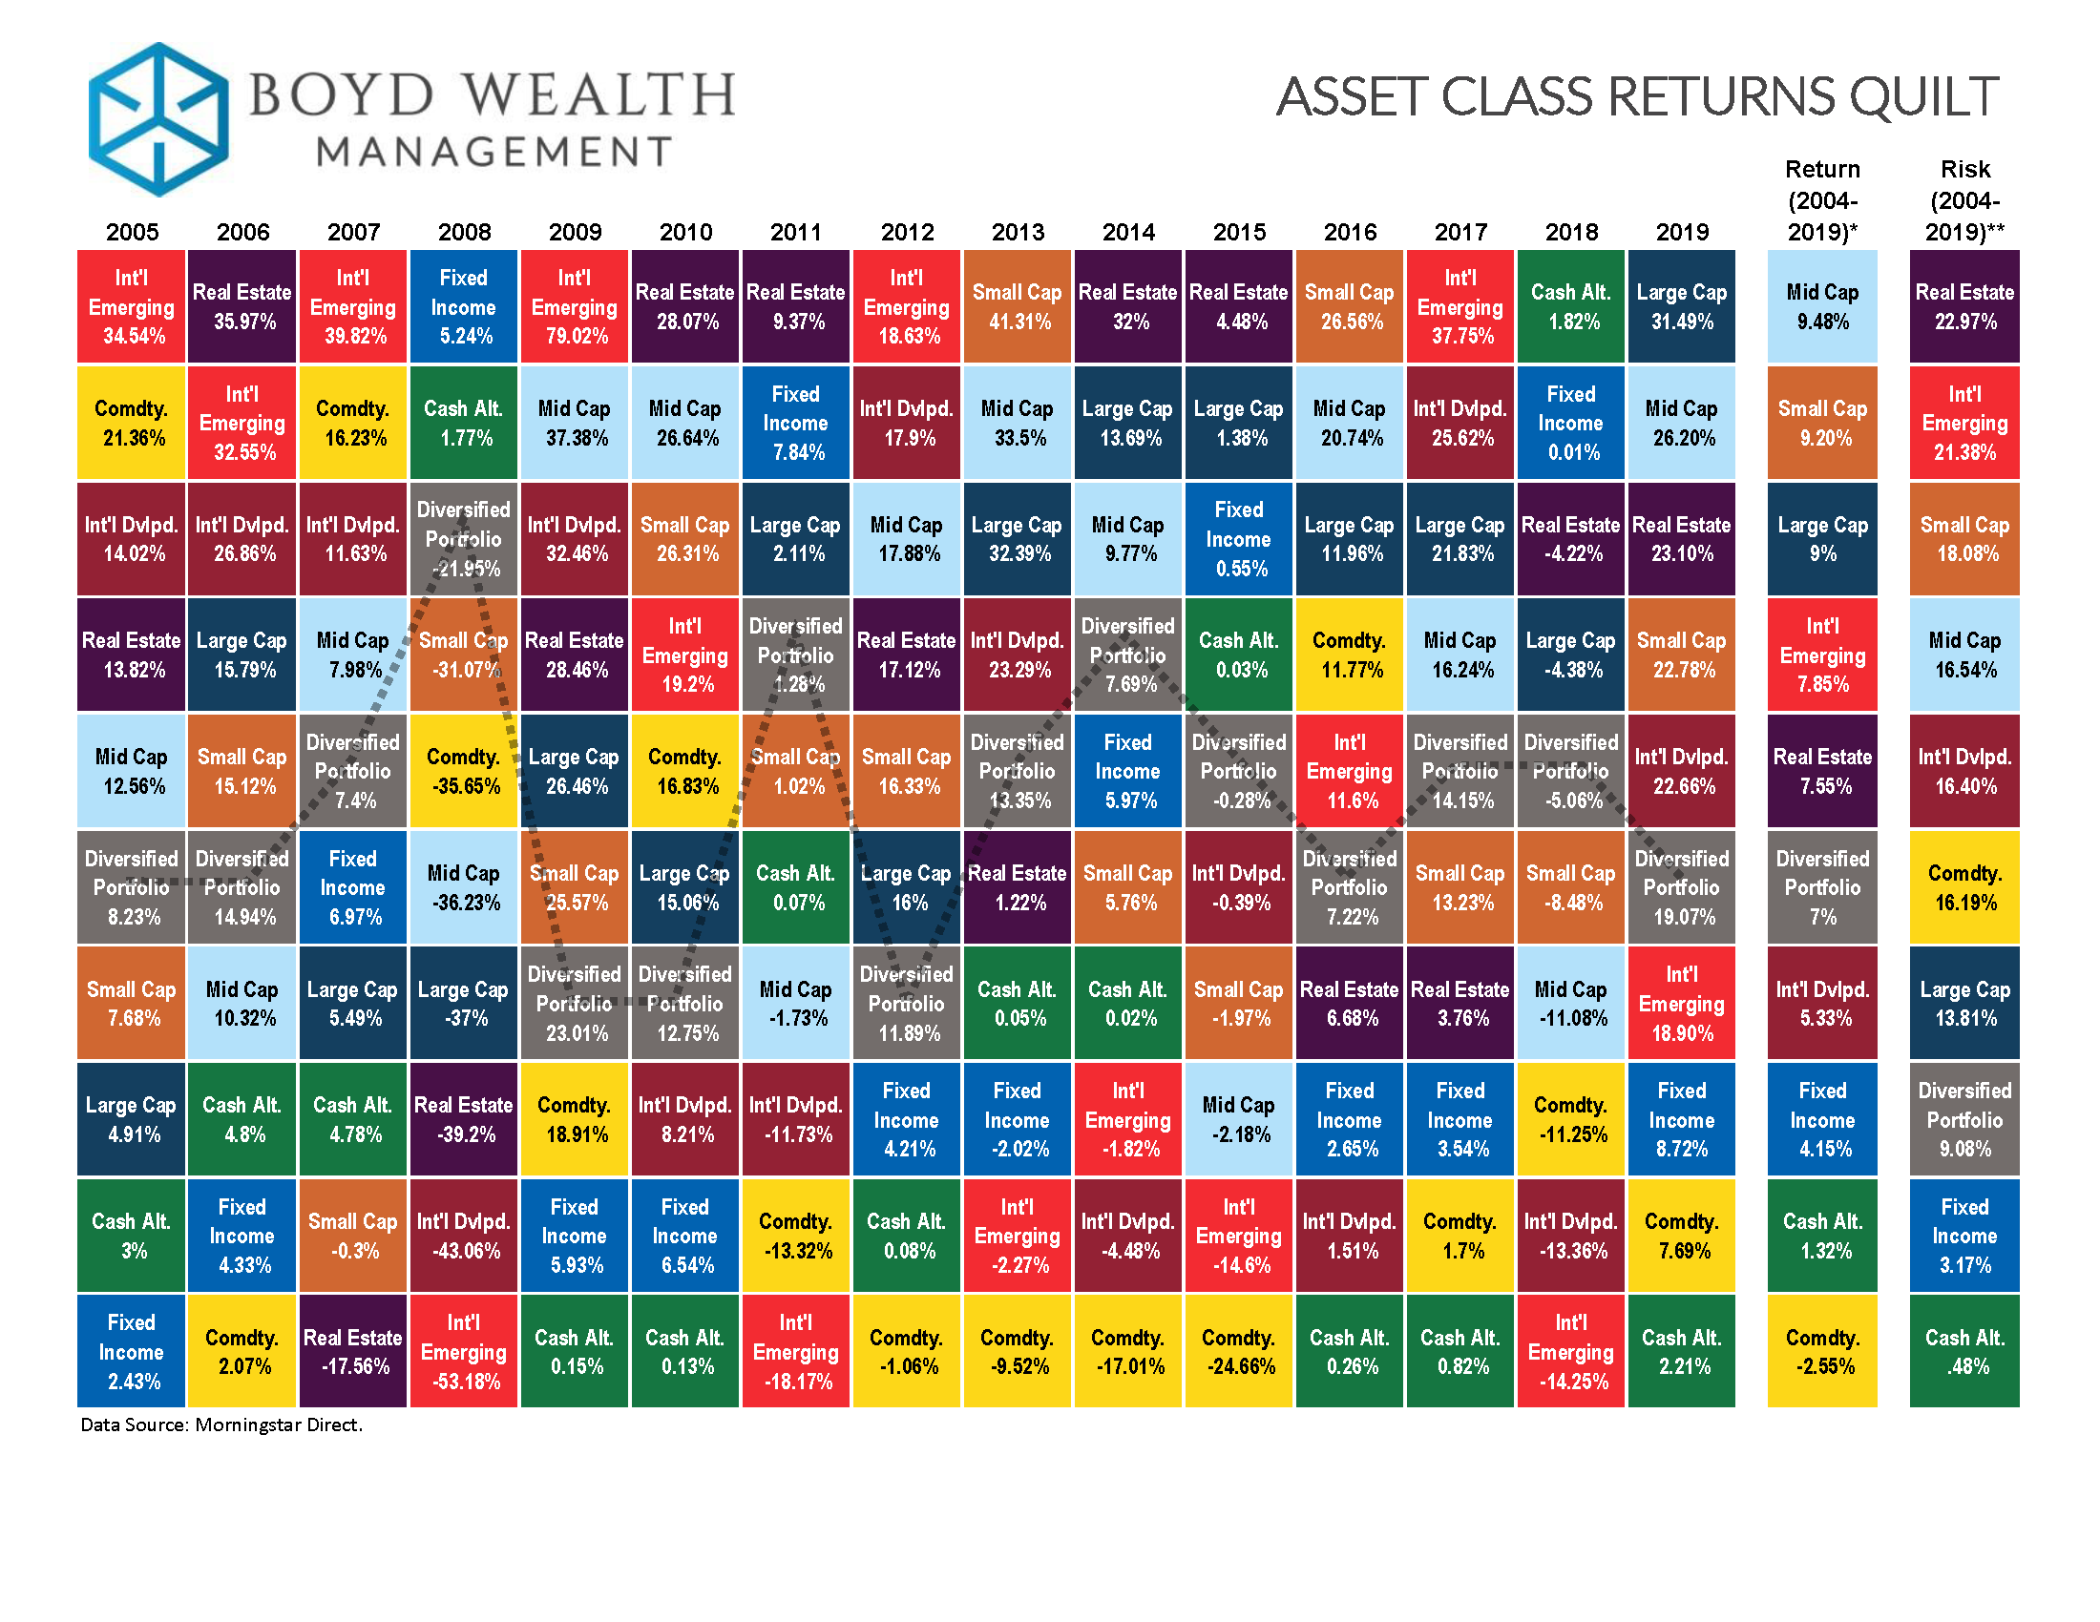

Slide 26
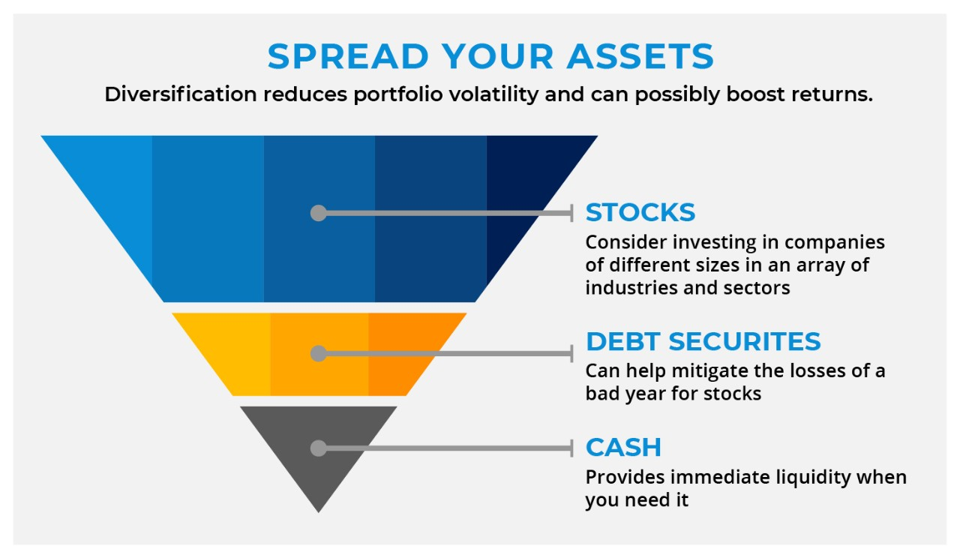
Your Financial Basket

Slide 27
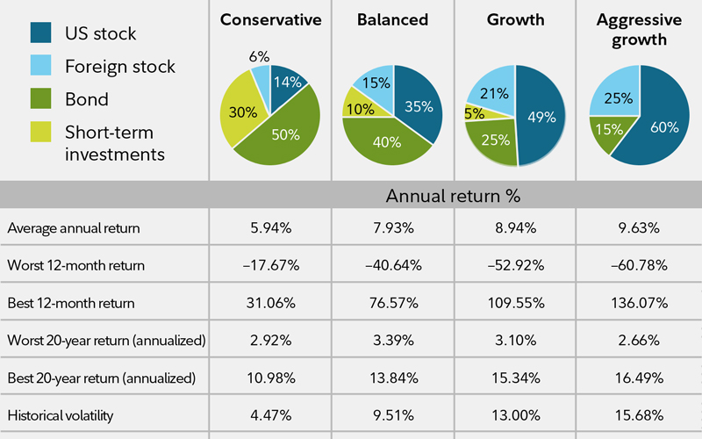
Asset Allocation as One Ages

Slide 28
Five Stages of Investing
Step One: Put-and-Take Account (a checking account). Money for immediate bills, plus a little padding for emergencies. Experts recommend that you set aside three to six months' net pay in this fund.
Step Two: Beginning to Invest. These first investments should be low-risk so you're not very likely to lose money on. Earning may be at lower rate of return, but it's worth it at this stage (compounding).
Step Three: Systematic Investing. Move on to a long range, planned and regular investing plan. Commit to invest a set dollar in safe stocks, mutual funds, etc.
Step Four: Strategic Investing. Extra money. You can begin strategic investing, which is managing your portfolio. The key here is diversification and greater asset allocation.
Step Five: Speculative Investing. Some people never get to this step, as it involves involves the highest risk factor. It's also the stage at which you stand to gain the most amount of money.

Slide 29
Investing Tools
Growth Tools (average returns over ten years)
  Annuities: 3-5% (depending on type of annuity)
  Stocks: 9.2% return
  Bonds: 5-6% return
  Mutual and Index Funds: 7.5% return
Speculative Tools (average returns over ten years)
  Options, Futures and Currency: @5.1%
  Collectibles (art, furniture, barbie dolls, Babe Ruth card): @4%
  Commodities (agriculture, energy and metals): 4.5%
  Real Estate: @10-12%

Slide 30
Bonds
U.S. Government Bonds (Treasuries):
  Exempt from state and local taxes.
  U.S. Treasury bills -- maturities from 90 days to one year
  U.S. Treasury notes (coupons) -- maturities from two to 10 years
  U.S. Treasury bonds -- maturities from 10 to 30 years
Municipal Bonds
  Many muni’s are safe from city, state and federal taxes.
Corporate Bonds
  Riskiest fixed-income securities.
  Susceptible to economic problems, mismanagement and competition.
  Pan Am and Chrysler bankruptcies of 1979 come to mind.

Slide 31
Mutual/Index Funds
Are a portfolio of stocks, bonds, and other securities.
Run by a fund manager who gets a commission.
Each investor in a fund shares in the fund’s gains, losses and expenses.
A way to “diversify” or spread out your risk.
Notes:
Mutual funds: Mutual funds are portfolios of stocks, bonds and other securities in which the public can buy shares.
Each investor in a fund shares in the fund’s gains, losses and expenses.
Many individuals invest in mutual funds to “diversify,” or spread out the risk of investing in stocks.

Slide 32
401(k)/403(b) Retirement Plans
Employer-sponsored pre-tax retirement accounts.
The 403(b) plan mirrors the 401(k) almost exactly, save for identifying the organization as a non-profit entity like a church or school
It allows an employee to dedicate a percentage of their pre-tax salary to a retirement account.
Funds are invested in a range of vehicles like stocks, bonds, mutual funds, and cash.
Some have matching deposits from the employer up to a certain percent.
Any account growth remains untaxed until proceeds are withdrawn.

Slide 33
Rookie’s Guide to Index Funds
Exchange Traded Funds (ETF’s) are:
  Similar to mutual funds spreading, buying in stock and bond markets.
  Lower cost, fuss-free, relatively conservative global investments.
How they perform?
  These hand-offs funds charge an average of only 0.15% annually.
  Actively managed funds typically charge 0.67%, but can go to 2.5%.
How to buy?
  Online, directly through a mutual fund company or your broker.
  If done online you can manage your own portfolio.
What to buy?
  Talk to your broker as there are hundred’s of index funds.
  Minimum investments sometimes apply.

Slide 34
Pitfalls of Pre-tax Retirement Savings
Best used when supplementing other investment vehicles.
Qualifying withdrawals are taxed as ordinary income.
This may put retirees into higher tax brackets.
Retirement accounts are functionally illiquid.
  Early withdrawal are both taxed and a 10% penalty.
  There are exceptions but use these funds as last resort.
Stuck with the terms of the employers plan.
  Employers dictate institution, programs and conditions.
  Employees have little input into features and fees.

Slide 35
IRA/Roth IRA
Are one of the public's most popular retirement plans for individuals.
Funding for IRA's and Roth IRA's comes directly from the account owner and no one else.
Both types of IRA plans allow a nearly unlimited number of investment options within which the account owner's contributions can be allocated.
Traditional IRA deposits result in dollar-for-dollar income tax deductions, tax-deferred growth, and fully taxable withdrawals.
Roth IRA deposits, on the other hand, do not result in a current year deduction, also accumulate untaxed, yet do not result in an increase in taxable earnings for the year in which withdrawals occurred.

Slide 36
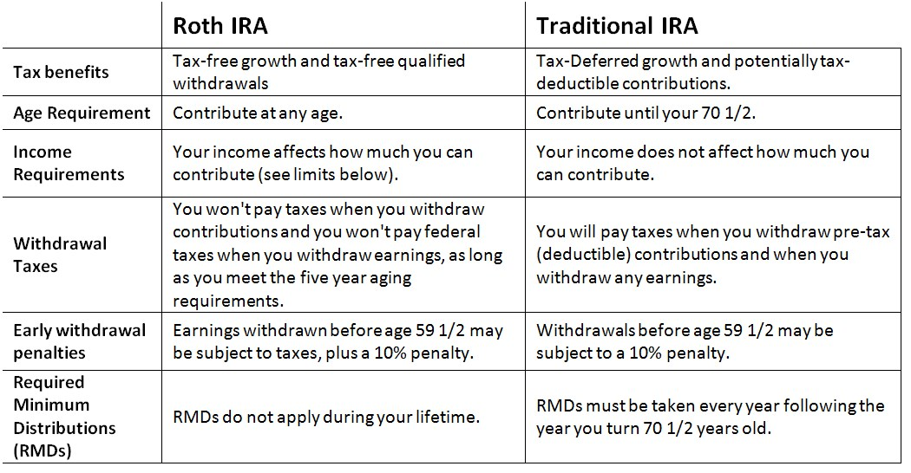
Traditional v. Roth IRA

Slide 37
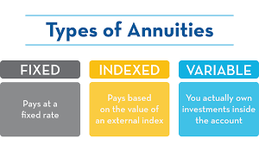
Annuities
The annuity serves as a complement to Social Security and pension plans.
An annuity works by transferring risk from owner to the insurance company.
You pay the annuity company premiums to bear this risk.
Premiums can be a single lump sum or a series of payments.
Most insurance carrier's annuity products.

Slide 38
Annuities
Advantages
Disadvantages
Security
Defer taxes
Death benefits
Flexible
Opportunities
Expensive
Slow growth
Lack of liquidity
Penalties
Tax issues

Slide 39
EconedLink Lessons
The Five Stages of Investing: https://www.econedlink.org/resources/the-five-stages-of-investing/
No Free Lunch in Investing: https://www.econedlink.org/resources/fffl-chapter-21/
Financial Investing: https://www.econedlink.org/resources/fffl-chapter-22/
Financial Management: Investing: https://www.econedlink.org/resources/financial-management-investing/
Retirement Calculator: https://www.econedlink.org/resources/retirement-calculators/
Compound Interest Calculator: https://www.econedlink.org/resources/compound-interest-calculator/

Slide 40

CEE Affiliates
https://www.councilforeconed.org/resources/local-affiliates/

Slide 41

Questions & Answers
          Doug Young
    doug.n.young@gmail.com The WISER Choice

Slide 42




Thank You to Our Sponsors!

