Slide 1
Culturally Responsive Teaching:
Building Relationship Capital through Culturally Sustaining Classrooms
By: William Anderson
Date: June 11th 2020
William_Anderson@dpsk12.org
Twitter: @Mizter_A

Slide 2
Brief Intro
Education:
Ed.D (In Progress) University of Colorado at Denver
M.Ed University of Phoenix
B.A Metropolitan State University of Denver
Experience:
12 years (and counting) H.S. Social Studies Teacher
Ed. Consultation/Advising for a variety of organizations (Local to National)

Slide 3
EconEdLink Membership
You can now access CEE’s professional development webinars directly on EconEdLink.org! To receive these new professional development benefits, become an EconEdLink member. As a member, you will now be able to:
Automatically receive a professional development certificate via e-mail within 24 hours after viewing any webinar for a minimum of 45 minutes
Register for upcoming webinars with a simple one-click process
Easily download presentations, lesson plan materials, and activities for each webinar
Search and view all webinars at your convenience
Save webinars to your EconEdLink dashboard for easy access to the event
You may access our new Professional Development page here

Slide 4
Professional Development Certificate
To earn your professional development certificate for this webinar, you must:
Watch a minimum of 45-minutes and you will automatically receive a professional development certificate via e-mail within 24 hours.
Accessing resources:
You can now easily download presentations, lesson plan materials, and activities for each webinar from EconEdLink.org/professional-development/

Slide 5
NORMS
It’s all LOVE.
Things may get uncomfortable…That’s okay.
Just consider it.
Chances are we will not solve all the problems here today.
DO NOT let the work stop here.

Slide 6
Agenda
Zen PowerPoint
Hope v. Hopelessness
More Research
Classroom Practices/Lessons
Questions/Thoughts/Concerns

Slide 7
Objectives
Learn how to create classrooms that are inclusive by honoring the students and teachers that are present.
Explore research that supports building culturally sustaining spaces.
Obtain lessons that can help create safe spaces for courageous conversations and magnify learning.

Slide 8
Assessment Questions
How is Hope showing up in your space?
How are “Good Intentions” hurting or preventing progress in your space?
How can we change our spaces to make a hard pivot from “deficit thinking” and “white gaze”?
How do you plan to make space for students to bring their WHOLE selves to your work?
Which of these lessons do you think you can implement to start your next school year?

Slide 9
“Zen PowerPoint/Slides Presentations”
A PowerPoint or slide presentation that has no words following the opening slide
Pushes the presenter to find an image(s) that can convey entire ideas
Challenges the presenter to know their content well enough that they can not use the words on a slide as support to their presentation
Gives the audience a visual to connect with the learning
Fun

Slide 10
Enemies of Hope
Notes:
“In the past three decades, however, there has been an assault on hope, particularly in our nation’s urban centers. This attack has taken place on numerous fronts, including disinvestment in schools and overinvestment in a prison industrial complex. Such policies have eroded true hope and given rise to false hope, a reactionary distortion of the radical premise of hope. Therefore, this essay begins by cautioning educators against three types of false hope often promulgated in urban schools: hokey hope, mythical hope, and hope deferred.”
Jeffrey Duncan-Andrade

Slide 11
Hokey Hope
Notes:
-“… is peddled in urban schools all the time. It is akin to what Martin Luther King Jr. (1963) referred to as “the tranquilizing drug of gradualism” (para. 5): an individualistic up-by-your-bootstraps hyperbole that suggests if urban youth just work hard, pay attention, and play by the rules, then they will go to college and live out the ‘American dream.’”
-“…this hope is ‘hokey’ because it ignores the laundry list of inequities that impact the lives of urban youth long before they get to the under-resourced schools that reinforce an uneven playing field.”
Jeffrey Duncan-Andrade

Slide 12
Mythical Hope
Notes:
“Mythical hope is a profoundly ahistorical and depoliticized denial of suffering that is rooted in celebrating individual exceptions. These individuals are used to construct a myth of meritocracy that simultaneously fetishizes them as objects of that myth.”
"Ultimately, mythical hope depends on luck and the law of averages to produce individual exceptions to the tyranny of injustice, and thus it denies the legitimacy of the suffering of the oppressed.”
Jeffrey Duncan-Andrade

Slide 13
Hope Deferred
Notes:
“Many teachers feel overwhelmed by the challenges urban youth face in their lives and consider themselves ill-equipped to respond with a pedagogy that will develop hope in the face of such daunting hardships. They are liberal-minded enough to avoid ‘blaming the victim,’ turning instead to blaming the economy, the violence in society, the lack of social services, the ‘system.’”
“These teachers have a critique of social inequality but cannot manifest this critique in any kind of transformative pedagogical project (Solórzano & Delgado-Bernal, 2001). They ‘hope’ for change in its most deferred forms: either a collective utopia of a future reformed society or, more often, the individual student’s future ascent to the middle class.”
Jeffrey Duncan-Andrade

Slide 14
Critical Hope: Enemies of Hopelessness
Notes:
Tupac Shakur (The Rose that Grew from Concrete, 1999) referred to young people who emerge in defiance of socially toxic environments as the “roses that grow from concrete.” Concrete is one of the worst imaginable surfaces in which to grow, devoid of essential nutrients and frequently contaminated by pollutants. Any growth in such an environment is painful because all of the basic requirements for healthy development (sun, water, and nutrient-rich soil) must be hard-won.

Slide 15
Material Hope
Notes:
“Material hope is one element of the critical hope that teachers can cultivate in their students, and it comes from the sense of control young people have when they are given the resources to ‘deal with the forces that affect their lives’” (Syme, 2004, p. 3).
“It seems like a simple point, but teachers who want to build material hope must understand that quality teaching is the most significant ‘material’ resource they have to offer youth. The best of the research in our field defines ‘quality’ in teaching by our ability to produce student growth across assessment measures (grades, social development, test scores, student engagement, etc.). To accomplish this, we have to bust the false binary that suggests we must choose between an academically rigorous pedagogy and one geared toward social justice.”
“The most effective urban educators, in every discipline at every grade level, connect the academic rigor of content areas with their students’ lives (Duncan-Andrade, 2007). If we are serious about giving our children hope, we must reflect on how to connect our pedagogy to the harsh realities of poor, urban communities.”
Jeffrey Duncan-Andrade

Slide 16
Socratic Hope
Notes:
“West (2001) describes ‘Socratic sensibility’ as the understanding of both Socrates’ statement that ‘the unexamined life is not worth living’ and Malcolm X’s extension that the ‘examined life is painful.’ Socratic hope requires both teachers and students to painfully examine our lives and actions within an unjust society and to share the sensibility that pain may pave the path to justice.”
“To show the sermon, rather than preach it, is the essence of Socratic hope.”
Jeffrey Duncan-Andrade

Slide 17
Audacious Hope
Notes:
“The stockpiling of resources in privileged portions of the population so that they may be ‘immune’ to suffering, while heaping the unnatural causes of socially toxic environments onto others, creates undeserved suffering while simultaneously delegitimizing it. In the face of these conditions, critical hope is audacious in two ways. First, it boldly stands in solidarity with urban communities, sharing the burden of their undeserved suffering as a manifestation of a humanizing hope in our collective capacity for healing. Second, critical hope audaciously defies the dominant ideology of defense, entitlement, and preservation of privileged bodies at the expense of the policing, disposal, and dispossession of marginalized ‘others.’
“We cannot treat our students as ‘other people’s children’ (Delpit, 1995)—their pain is our pain.”
“Too many of us try to create classroom spaces that are safe from righteous rage, or, worse, we design plans to weed out children who display it. The question we should be grappling with is not how to manage students with these emotions, but how to help students channel them. The way I take on this challenge is by thinking about my classroom as a micro-ecosystem. Ecologists would tell me that to build a healthy micro-ecosystem, I need to understand the principle of interdependency—in short, that both pain and healing are transferable from person to person inside the classroom.”
“All my students are indigenous to my classroom and therefore there are no weeds in my classroom.” 3 From this perspective, the decision to remove a child, rather than to heal her, is not only bad for the child but is also destructive to the social ecosystem of the classroom.”
Jeffrey Duncan- Andrade

Slide 18
A Pause for the Cause

Slide 19
“Good intentions not good enough”
Notes:
“One of the most dangerous dimensions of prevailing educational hegemony in the U.S. and, increasingly, across the western world, is a culture of pragmatism. Exacerbated by a flood of education policy that requires assessment of student, teacher, and administrator performance on the basis of standardized test scores, the culture of pragmatism dissuades deeply theoretical or philosophical discourses among educators in favor of discourses focused on immediate, practical strategies and resources. I find, for example, that educators who attend my workshops increasingly show resistance to activities and discussions aimed at deepening theoretical understanding and consciousness.”
Paul Gorski

Slide 20
Deficit Thinking
Notes:
“An unwillingness to undertake change can often reflect attitudes of complacency on the part of educators, that their school is doing an adequate job in educating its students, or resignation that they can do no more to educate them more effectively (Finnan & Swanson, 2000). Such assumptions often lead to efforts to superimpose programs designed for historically successful students and families on students and on families from low-income and culturally/linguistically diverse (CLD) communities.”
SHERNAZ B. GARCÍA & PATRICIA L. GUERRA

Slide 21
White Settler Colonial Gaze
Notes:
"One thing ‘urban,’ ‘diverse,’ ‘minority,’ ‘underserved,’ ‘at-risk’ and so many terms our fields and society use to name students of color have in common is their avoidance of the prominence of race, racialization, and racism. This erasure – and it is an erasure – is no coincidence. It is part of a schooling system, of which educational research is part, which continues to perpetuate beliefs in the superiority of White, middle-class, monolingual, cis-hetero-patriarchal-ableist ways of being at the expense of all others.”
“Erasure and deficiency-based naming in our fields can be understood through what Tuck (2009) has called damage-centered research. The history and ongoing practice of such research have been waged for centuries against Indigenous, Black, and other people of color by the academic settler colonial project (Smith, 1999; Tuck & Yang, 2014, 2018). Tuck (2009) provides a way forward through her conception of desire-based research, which ‘accounts for the loss and despair, but also the hope, the visions, the wisdom of lived lives and communities’” (p. 417).
Django Paris

Slide 22
A Pause for the Cause

Slide 23
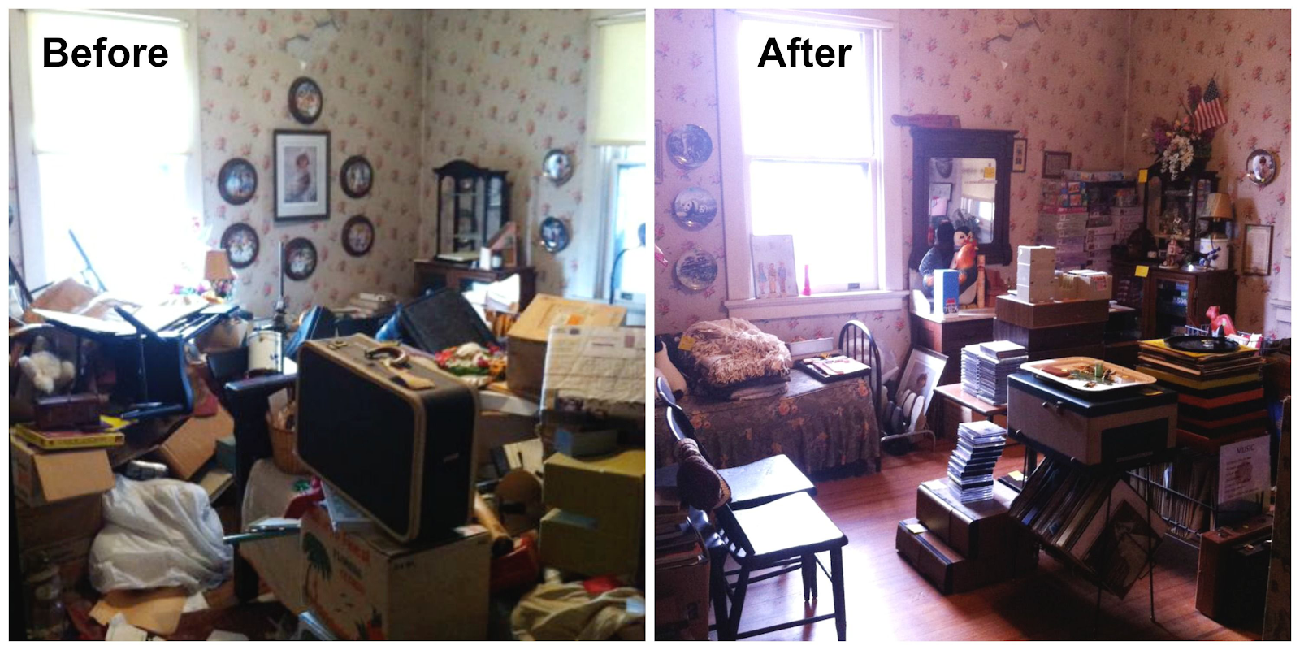
Notes:
Making space for students

Slide 24

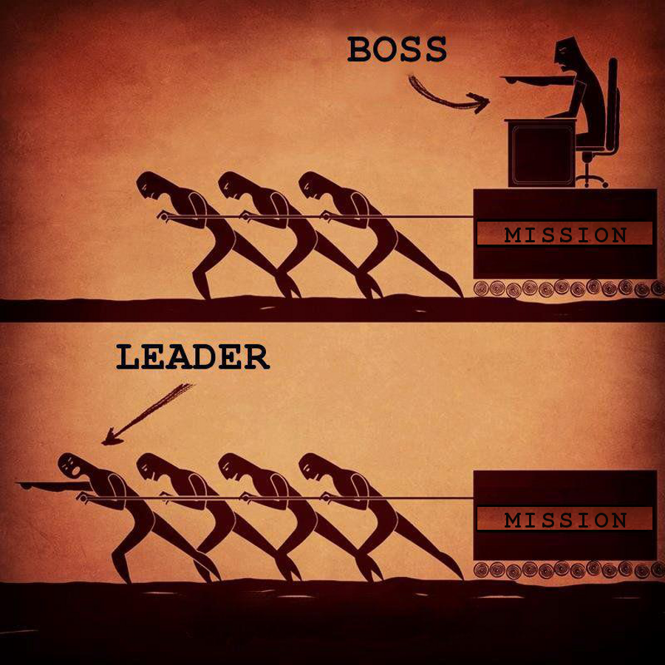
Notes:
Must Haves…

Slide 25



Who Am I?

Slide 26
Need to Know

Slide 27
Where I’m From
Poem
Notes:
Questions to follow the presentation of student Where I’m From poems

Slide 28
Struggle/Solace

Slide 29
References
Duncan-Andrade, J. (2009). Note to educators: Hope needed when growing roses in concrete. Harvard Education Review, 79(2), 1-13.
García, S., & Guerra, P. (2004). Deconstructing deficit thinking: Working with educators to create more equitable learning environments. Education and Urban Society, 36(2), 150-168.
Gorski, P. (2007). Good intentions are not enough: A decolonizing intercultural education. Hamline University, 1-15.
Paris, D. (2019). Naming beyond the white settler colonial gaze in educational research. International Journal of Qualitative Studies in Education, 32(2), 217-224.

Slide 30
A Final Pause for the Cause
William Anderson
William_Anderson@dpsk12.org
@Mizter_A

Slide 31

CEE Affiliates
https://www.councilforeconed.org/resources/local-affiliates/

