Slide 1
Using Mint in Financial Education, Pt. 2:
Classroom Activities
Presented by
October 14th 2020
Dr. Ruben Rivera, Director of Professional Development
&
Jared Davidove
Senior Manager, Strategic Education Partnerships

Slide 2
EconEdLink Membership
You can now access CEE’s professional development webinars directly on EconEdLink.org! To receive these new professional development benefits, become an EconEdLink member. As a member, you will now be able to:
Automatically receive a professional development certificate via e-mail within 24 hours after viewing any webinar for a minimum of 45 minutes
Register for upcoming webinars with a simple one-click process
Easily download presentations, lesson plan materials and activities for each webinar
Search and view all webinars at your convenience
Save webinars to your EconEdLink dashboard for easy access to the event
You may access our new Professional Development page here

Slide 3
Professional Development Certificate
To earn your professional development certificate for this webinar, you must:
Watch a minimum of 45-minutes and you will automatically receive a professional development certificate via e-mail within 24 hours.
Accessing resources:
You can now easily download presentations, lesson plan materials, and activities for each webinar from EconEdLink.org/professional-development/

Slide 4



Ruben Rivera, PhD
Director of Professional Development
Council for Economic Education
Jared Davidove
Sr. Manager, Strategic Education Partnerships
Intuit
Rrivera@Councilforeconed.org
Jared_Davidove@intuit.com
Notes:
Ryan Slide
Jared bio -
Jared leads Intuit’s Financial Readiness program aiming to empowering students to make smart money decisions and own their financial futures. As an Innovation Catalyst with deep expertise in Personal Finance Jared serves as a Board Member for the Jump$tart Coalition, a committee member for the NY State Comptroller on Personal Finance, and has been tasked with designing the Congressional Award’s first ever Personal Finance Program.”
Elaine bio -

Slide 5
Agenda
Recap Mint by Intuit, pt.1
Explore three activities from Mint by Intuit
Explore resources for synchronous and asynchronous learning.
Navigate Mint by Intuit web based application
Q&A

Slide 6
Goals
Learn how to use Mint by Intuit and adapt it to your synchronous or asynchronous setting.
Use Mint activities with Google Docs and incorporate them into Google Classroom.
Explore additional tools to increase student engagement.
Create lessons and activities using Mint.

Slide 7
Ground Rules
Please mute your mic
Type questions into the chat during non Q&A
During Q&A be careful not to talk over one another
Be present
HAVE FUN!

Slide 8
Recap:
Mint by Intuit, pt. 1
Objective
Teachers will be able to:
– Use lessons from EconEdLink to demonstrate credit usage and credit scores.
– Explore lessons from Intuit Education.
– Obtain an overview of the Mint Simulation platform.
Description
In collaboration with Intuit, teachers will be able to review materials and lessons using Mint simulations. Supplemental content from Financial Fitness For Life, EconEdlink and Intuit Education can be used to teach about credit usage and credit scores.
https://www.econedlink.org/resources/mint-by-intuit-pt-1/
Notes:
Here’s our goals for today’s webinar: Read screen

Slide 9

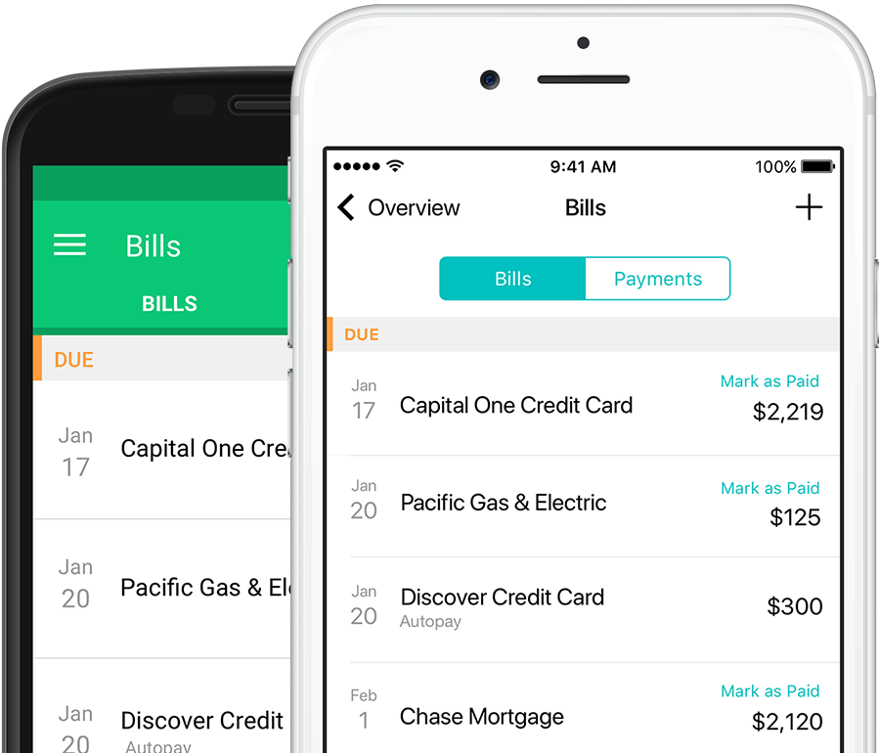
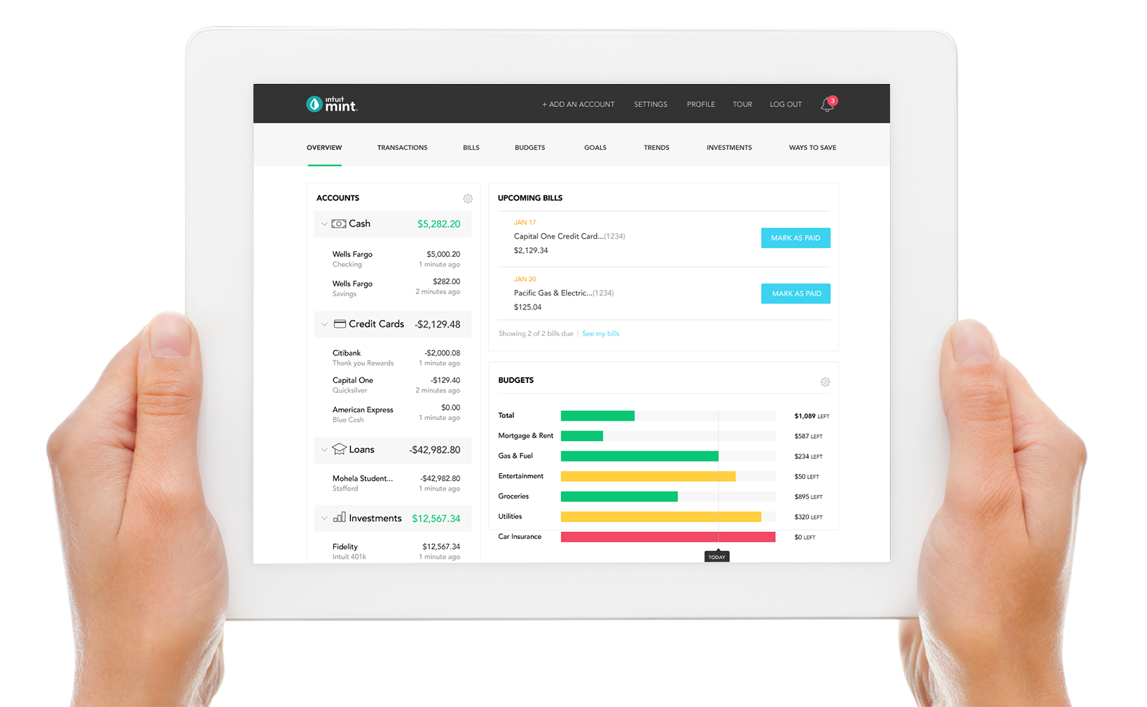

Your fictional financial life, in one place that’s easy to understand
Easily create budgets
Set life goals and monitor your progress
Track and pay bills
Understand your credit score and receive tips for improvement
Analyze and develop spending behaviors

Slide 10
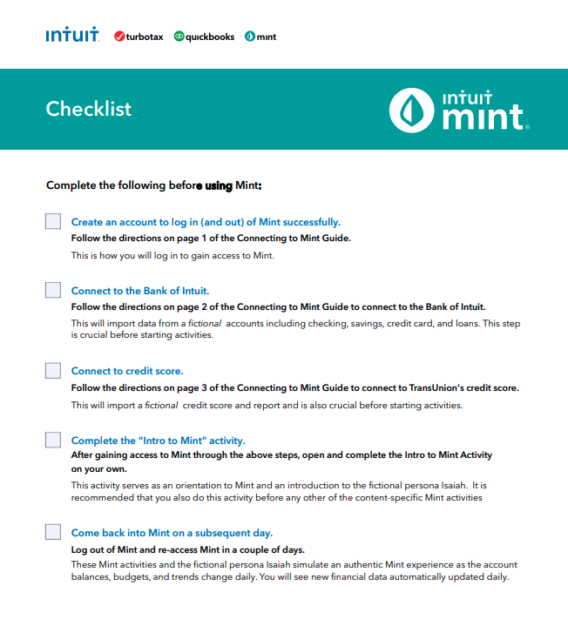
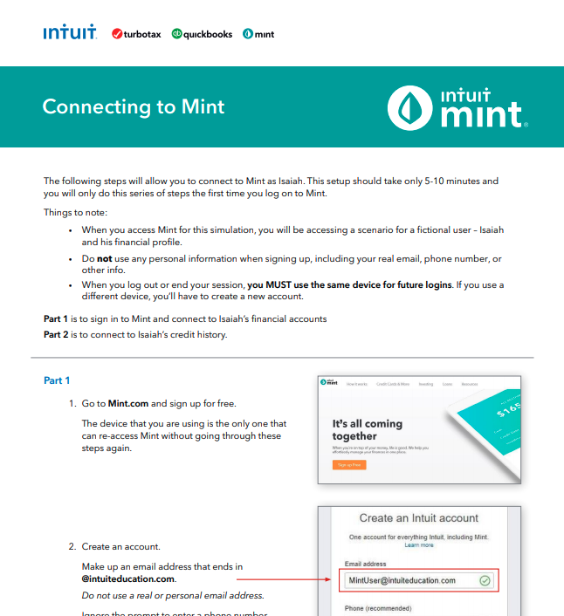
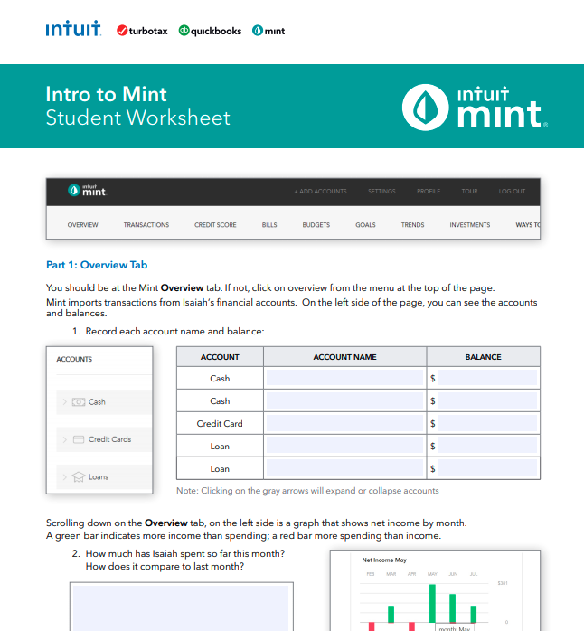
Materials for Mint Activity
Teacher Checklist
How-to Guide
Intro Simulation

Slide 11
Activity 1: Mint Overview Tab
Objective: Students will be able to:
Learn how to navigate digital financial budgets
Explore different tabs that provides information about their financial accounts
Learn the difference between cash, credit cards, loans, Investments, and properties.
Time: 45 minutes
Procedures:
Tell students that that this activity will focus on the difference tools various banking applications include. As you may be aware your personal bank account has some of these features and students will learn how to navigate these tools so they can become acquainted with tools provided by banking institutions.
Have students go to www.Mint.com and sign up for free. Students should be able to complete the following tasks:
Notes:
Here’s our goals for today’s webinar: Read screen

Slide 12
Activity 1: Mint Overview Tab
Vocabulary Words -
Cash
Credit
Debit
Loan
Savings
Checking
Expenses
Income
Notes:
Here’s our goals for today’s webinar: Read screen

Slide 13
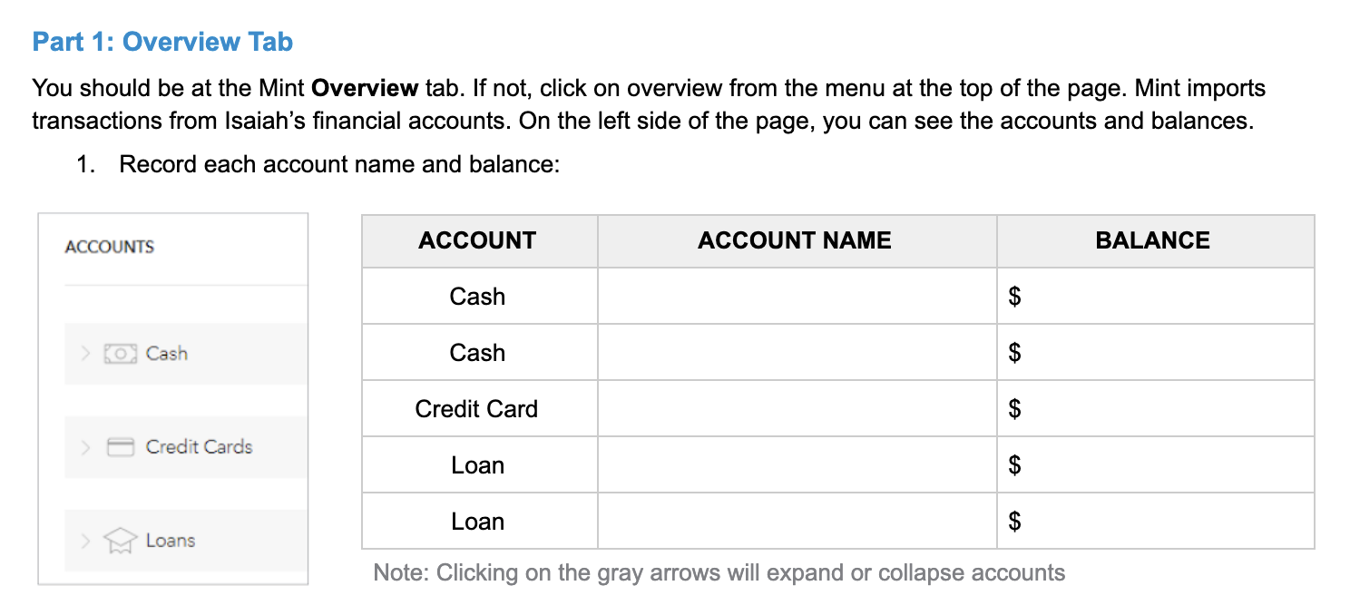
Activity 1: Mint Overview Tab
Exercise 1.1
Notes:
Here’s our goals for today’s webinar: Read screen

Slide 14
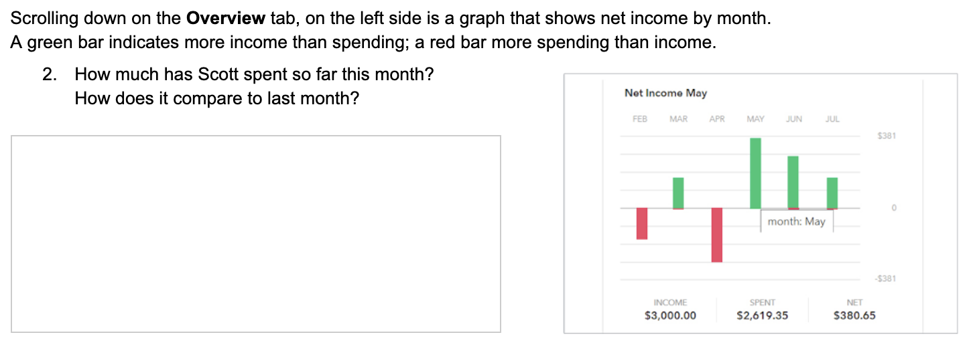
Activity 1: Mint Overview Tab
Exercise 1.2
Notes:
Here’s our goals for today’s webinar: Read screen

Slide 15
Activity 2: Transactions
Objective -
Students will be able to:
Learn about transactions.
Learn about different account types.
Learn how to track needs and wants.
Time: 2 X 45 minute classes.
Procedures:
Tell students that that this activity will focus on learning about transactions. With debit cards and credit cards, a consumer is able to track their transactions in their accounts. A good practice for all smart consumers is to track their accounts on a weekly basis so they can protect their finances and learn about their spending habits. Have students explore Isaiah's account and ask them to take notes on anything that stands out.
Notes:
Here’s our goals for today’s webinar: Read screen

Slide 16
Activity 2: Transactions
Vocabulary Words -
Transaction
Accounts
Account Categories
Account Descriptions
Amounts
Notes:
Here’s our goals for today’s webinar: Read screen

Slide 17
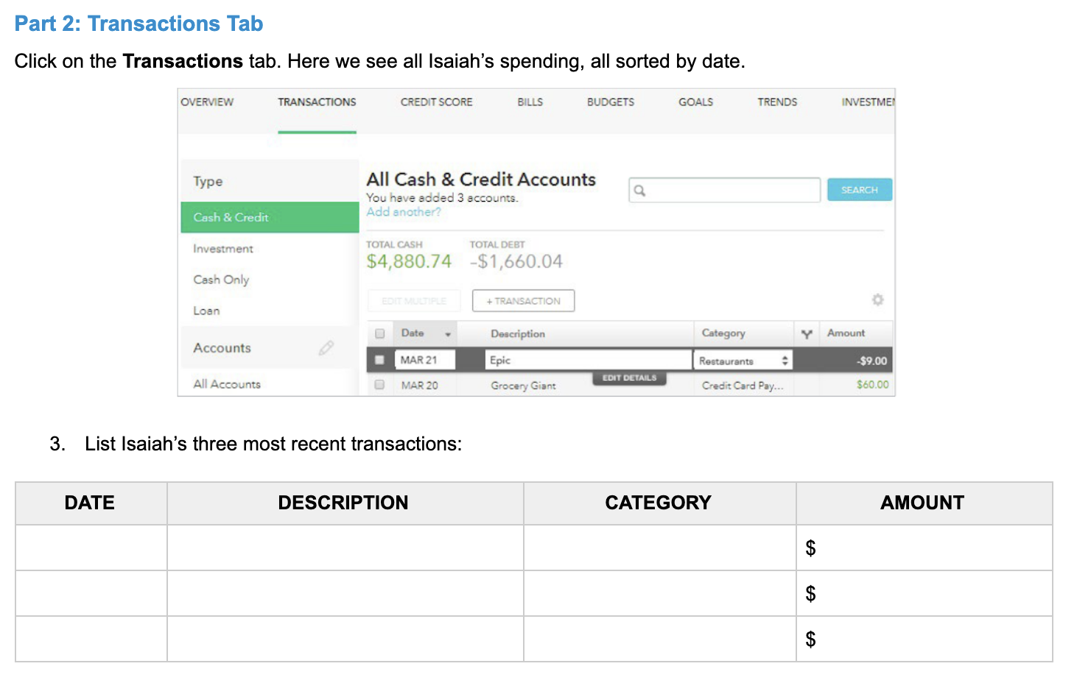
Activity 2: Transactions
Exercise 2.1
Notes:
Here’s our goals for today’s webinar: Read screen

Slide 18
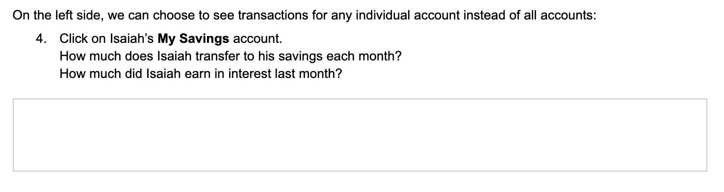
Activity 2: Transactions
Exercise 2.2
5. Ask students the following question:
If you were Isaiah's financial coach, what advice would you give Isaiah for him to save an extra $50 a month? How could Isaiah save an additional $1000 a year?
Notes:
Here’s our goals for today’s webinar: Read screen

Slide 19
Activity 2: Transactions
Exercise 2.3
6. Extended learning or additional exercises:
Using the +TRANSACTION feature.
This feature allows for you or the student to add transactions. You can create a range of activities by having students add different types of transactions (bills, cash, expenses, etc.)
Ex:
Calculate Isaiah's current budget by adding the following transactions.
On 10.1.20 Isaiah sold his Iphone X for $375
On 10.3.20 Isaiah added HBO MAX to his Amazon Prime account. He has a monthly bill of $14.99 + tax.
On 10.5.20 there was a clearance sale on Aeropostale and spent $74.39 on clothing.
On 10.9.20 the new Playstation 5 was launched and Isaiah was able to reserve it. He spent a total of $524.23.
What is Isaiah's current balance?
Notes:
Here’s our goals for today’s webinar: Read screen

Slide 20
Activity 3: Trends
Objective -
Students will be able to:
Learn about consumer behavior and science
Learn about cost benefit analysis
How to use graphs and pie charts to track spending.
Time: 3 X 45 minute classes.
Procedures:
Tell students that that this activity will focus on learning about graphs, pie charts and trends. Let students know they are financial detectives and they need to learn more about Isaiah's spending behavior. Have students explore the “trends” tab and tell them to investigate the spending, income, and net income. Have students share their findings.
Notes:
Here’s our goals for today’s webinar: Read screen

Slide 21
Activity 3: Trends
Vocabulary
Consumer Science
Trends
Merchant
Debts
Net Worth
Assets
Notes:
Here’s our goals for today’s webinar: Read screen

Slide 22
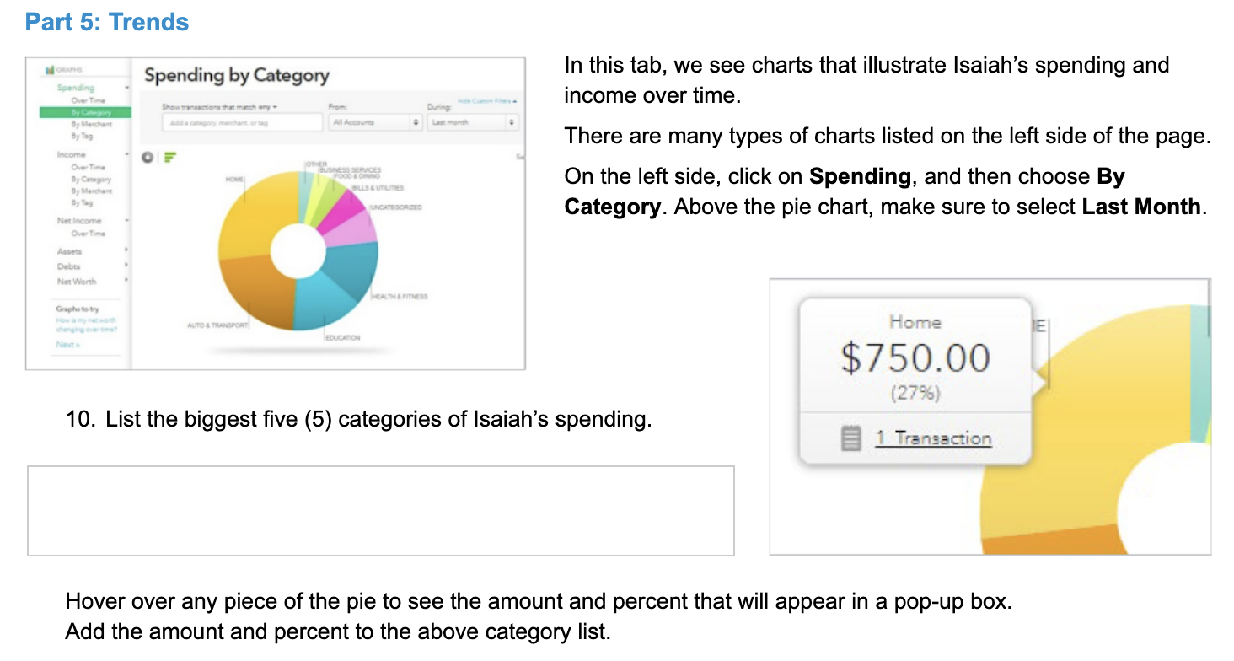
Activity 3: Transactions
Exercise 3.1
Notes:
Here’s our goals for today’s webinar: Read screen

Slide 23
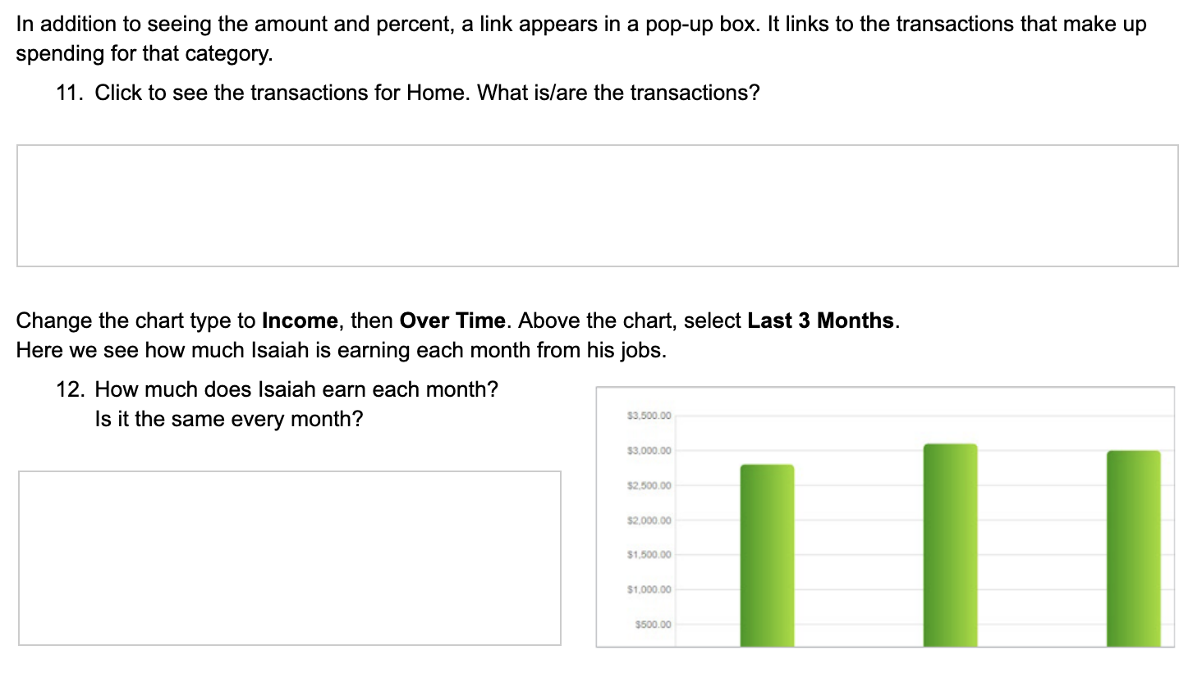
Activity 3: Transactions
Exercise 3.2
Notes:
Here’s our goals for today’s webinar: Read screen

Slide 24
Activity 3: Trends
Exercise 3.3
Consumer science is focusing on how people make decisions, in the prepurchase phase, about products, and rarely, participants taste the food in such studies, whereas the core element of the sensory science is the consumption and the sensory impressions of food (Grunert, 2015).
Using the Graph and Pie Chart:
Isaiah is trying to understand what he is doing right and wrong with his income. He wants to learn about his spending and income over the last 60 days. Using quantitative data, provide a 400 word explanation that informs Isaiah about his spending behavior. Use the data in the form of percentages and time to give Isaiah details about his spending behavior.
Notes:
Here’s our goals for today’s webinar: Read screen

Slide 25
There is so much more you can do.

Slide 26
Activity 4: Customize
Independent Work
Have students enter their weekly budgets or create a budget for students.
Have students enter income, expenses, allowances, etc. and have them download those activities as CSV or Excel files.
Students can submit their work as assignments or independent activities.
Create :
Sample budgets
Sample expenses
Sample loans
Sample investments
Sample Bills
Notes:
Here’s our goals for today’s webinar: Read screen

Slide 27


Slide 28

CEE Affiliates
https://www.councilforeconed.org/resources/local-affiliates/

Slide 29




Thank You to Our Sponsors!

