Slide 1
What is U.B.I.: Progressive Capitalism or Democratic Socialism?
Doug Young
November 17, 2020

Slide 2
Professional Development Certificate
To earn your professional development certificate for this webinar, you must:
Watch a minimum of 45-minutes and you will automatically receive a professional development certificate via e-mail within 24 hours.
Accessing resources:
You can now easily download presentations, lesson plan materials, and activities for each webinar from EconEdLink.org/professional-development/

Slide 3
EconEdLink Membership
You can now access CEE’s professional development webinars directly on EconEdLink.org! To receive these new professional development benefits, become an EconEdLink member. As a member, you will now be able to:
Automatically receive a professional development certificate via e-mail within 24 hours after viewing any webinar for a minimum of 45 minutes
Register for upcoming webinars with a simple one-click process
Easily download presentations, lesson plan materials, and activities for each webinar
Search and view all webinars at your convenience
Save webinars to your EconEdLink dashboard for easy access to the event
You may access our new Professional Development page here

Slide 4
National Standards
STANDARD 1: SCARCITY . . . .Productive resources are limited. Therefore, people cannot have all the goods and services they want; as a result, they must choose some things and give up others.
STANDARD 2: DECISION MAKING . . . . Effective decision making requires comparing the additional costs of alternatives with the additional benefits. Many choices involve doing a little more or a little less of something: few choices are “all or nothing” decisions.
STANDARD 3: ALLOCATION . . . . Different methods can be used to allocate goods and services. People acting individually or collectively must choose which methods to use to allocate different kinds of goods and services.
STANDARD 4: INCENTIVES . . . . People usually respond predictably to positive and negative incentives.
STANDARD 10: INSTITUTIONS . . . . Institutions evolve and are created to help individuals and groups accomplish their goals. Banks, labor unions, markets, corporations, legal systems, and not-for-profit organizations are examples of important institutions. A different kind of institution, clearly defined and enforced property rights, is essential to a market economy.

Slide 5
New York State Standards
http://www.nysed.gov/common/nysed/files/sslearn.pdf
The study of economics requires an understanding of major economic concepts and systems, the principles of economic decision making, and the interdependence of economies and economic systems throughout the world.
Economics requires the development and application of the skills needed to make informed and well-reasoned economic decisions in daily and national life.
Economics requires the development and application of the skills needed to make informed and well-reasoned economic decisions in daily and national life.

Slide 6
Objectives/Agenda
Discuss if capitalism and the modern welfare state is punitive to specific groups of our populace.
Show how poverty, income inequality and unemployment have impacted more and more people each year causing a divided populace around economic and political issues.
Question the feasibility of every adult or only certain sectors of our populace receive a monthly stipend to hopefully alleviate poverty, unequal income distribution and other social ills.
Analyze the pros and cons of a U.B.I. program (whether the program is feasible for our society?).
Interpret graphs and charts so students can see how data figures into decision-making.
Discuss the trade-offs of such a program versus other need-based social programs already operating.
Reflect on the plus and minuses of the U.B.I. overall, which local, state and some national leaders are looking at as a way to solve economic, political and social inequality.

Slide 7
The Coronavirus Generation
While the coronavirus was initially said to spare the young, that no longer appears to be true medically, and economically it never was — certainly not for the 10 million children below the poverty line and even larger numbers just above it. With hunger rising, classrooms closing and parental stress surging, the pandemic is a threat to low-income children of epochal proportions, one that could leave an entire generation bearing its scars.
DeParle, Jason. “The Coronavirus Generation,” The New York Times. Sunday, August 23,2020. https://www.nytimes.com/2020/08/22/sunday-review/coronavirus-poverty-child-allowance.html?action=click&module=Opinion&pgtype=Homepage

Slide 8
The Corona Pandemic and Americans
Health care is not the same for all people specifically, people of color and undereducated.
Median white worker made 28% more than the typical Black worker.
35% more than the median Latino worker in the last quarter of 2019.
Prior to the Pandemic:
Median wealth of white families was more than $100,000.
Median wealth of Black families was approximately $10,000.
Most women of color live in poverty, are overrepresented in low-paying occupations, and are far more likely to lack access to sick leave and health care benefits.
They are paid 66 cents for every dollar that is paid to white men, and Latinas make even less at 58 cents for every dollar white men make.

Slide 9
EconEdLink Lessons
Broad Social Goals of an Economy
https://www.econedlink.org/resources/broad-social-goals-of-an-economy/
Income Inequality
https://www.econedlink.org/resources/incBurkey)ome-inequality/
Income: It Ain’t Where You Start, It’s What You Got, and Where You End
https://www.econedlink.org/resources/income-it-aint-where-you-start-its-what-you-got-and-where-you-end/
Distribution of Income
https://www.econedlink.org/resources/distribution-of-income/

Slide 10
Why is U.B.I. Now an Issue?

Slide 11
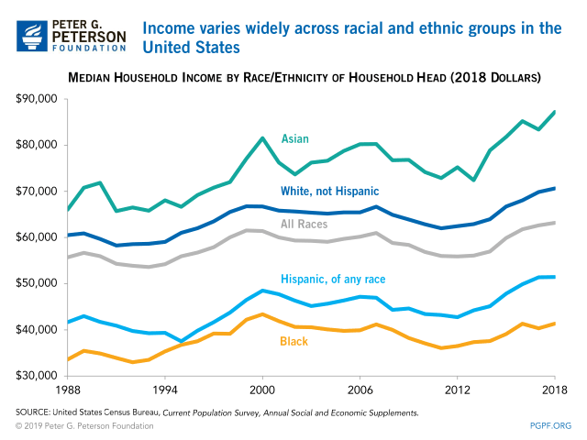

Slide 12
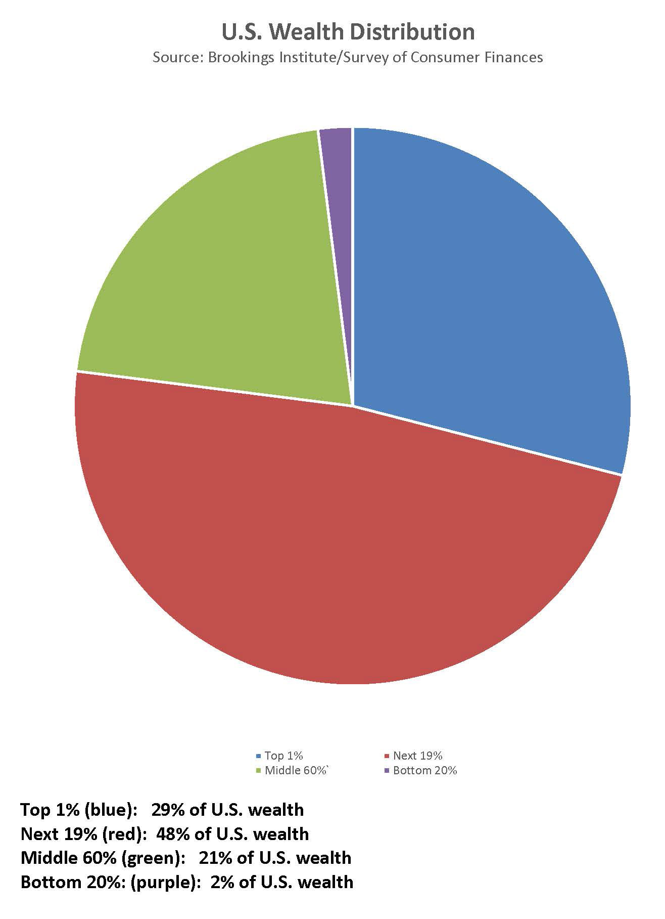
What is Meant by “the Top 1%”?
The typical American household has a net worth of about $97,300.
The richest 20% of the US population, has a household net worth of nearly $500,000.

Slide 13
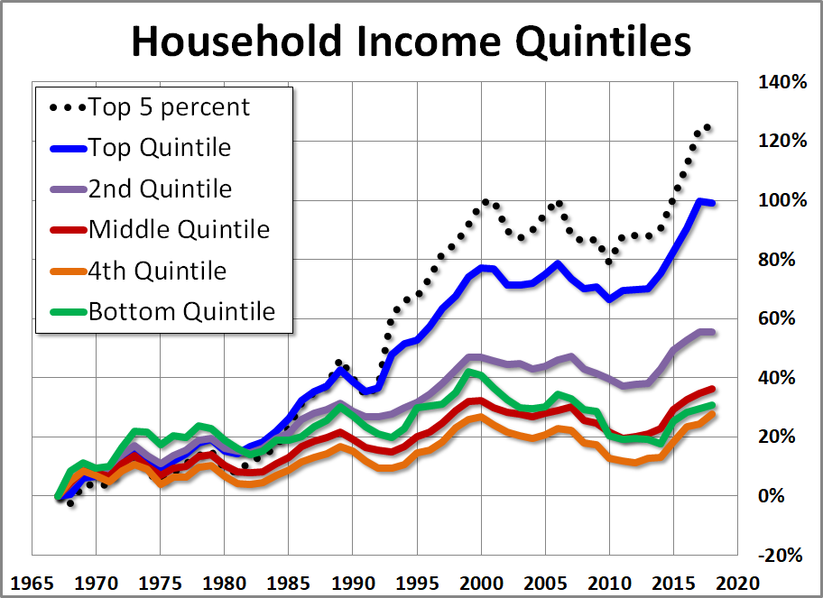

Slide 15
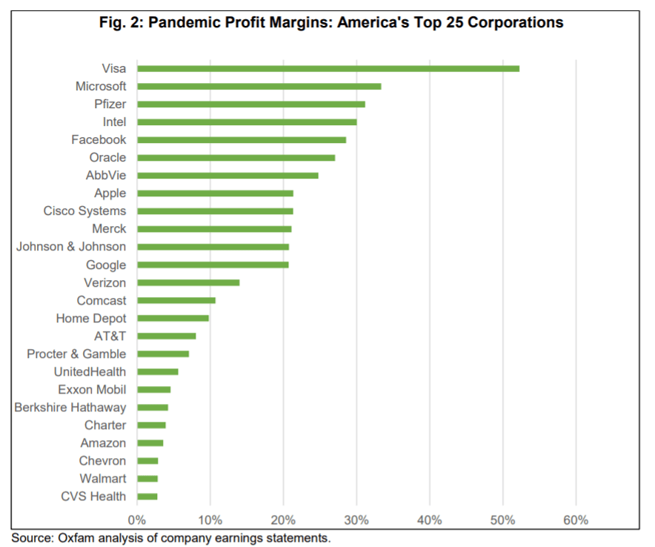

Slide 16
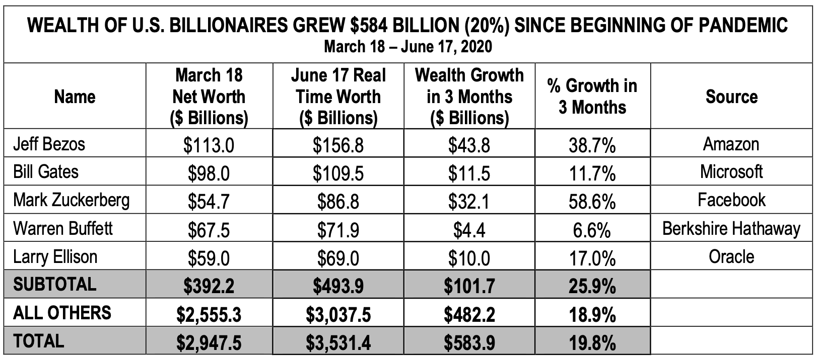

Slide 17
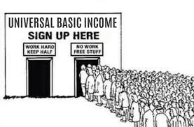
Is a Universal Basic Income
Progressive Capitalism or Democratic Socialism?
What do Thomas Paine, Dr. Martin Luther King, Jr., Richard Nixon, Pope Francis and Andrew Yang have in common?
All believe an infusion of money would be a good way to fight poverty.
Many say “Bring It On” given the pandemic, job losses, racism and increasing poverty…
But is it an idea that all people in our country can embrace?

Slide 18
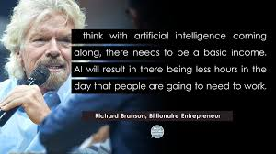
A U.B.I. Policy Is Not New!

Slide 19
Introductory Activity: What Is a Universal Basic Income?
Create a “What I Know, ”What I Want to Know,” and “What I Have Learned” chart.
Create groups of 4-5 students with their own sheet of newsprint on which to record info.
The teacher should create a similar chart on his/her white board, overhead, etc.
Start by asking the groups to put down everything they “Know” about the U.B.I. in the “K” column.
Ask students what they want to learn about the topic. Record answers in the ”W” column.
After finishing the “W “column, show them the following clip: https://www.esldebates.com/can-universal-basic-income-make-life-better-for-everyone/
After viewing the clip, answer the following questions with answers going into the “L” column.

Slide 20
What is a Universal Basic Income?
A program giving all people a minimal income based on government policy.
A tool for racial and gender equity, attacking poverty and improve one’s life.
It is unconditional, with no strings attached and no work requirements.
It is meant to supplement, rather than replace, the existing social safety net.
A guaranteed income empowers recipients to:
address their most urgent needs
provides a cushion for unpredictable expenses, shocks, and volatility
Seems like a positive idea but there are a lot of questions unanswered:
Is it “money” for all?
Is it really the solution to all our problems?

Slide 21
Why a Universal Basic Income?
Why should our society choose U.B.I. over our current welfare system?
A U.B.I. would allow our government to put money directly into people’s hands instantly.
Less time wasted on bureaucracy. Direct deposits into accounts (Cares Act).
Would ensure that everyone is included, that and no one is excluded.
Everyone who needs help will get help without having to jump over any hurdles.
The pandemic has given us a glimpse into the vast inequities of our current safety net system.
People need to feel secure in their financial positions before they can thrive.
VP Elect Kamala Harris (D-CA), Bernie Sanders (I-VT.) and Ed Markey (D-MA.) proposed legislation that would send a $2,000 monthly check to everyone who makes less than $120,000.
This check would not stop once the pandemic ends.
The impact people on welfare, food stamps and retirees living solely on social security.
According to the Roosevelt Institute, a U.B.I. would expand the USA’s GDP by $2.5 trillion.
Will we, one day, be able to say with confidence that we’ve eradicated poverty?

Slide 22
Possible Add-ons for U.B.I. to Fight Poverty and Income Inequality

Slide 23
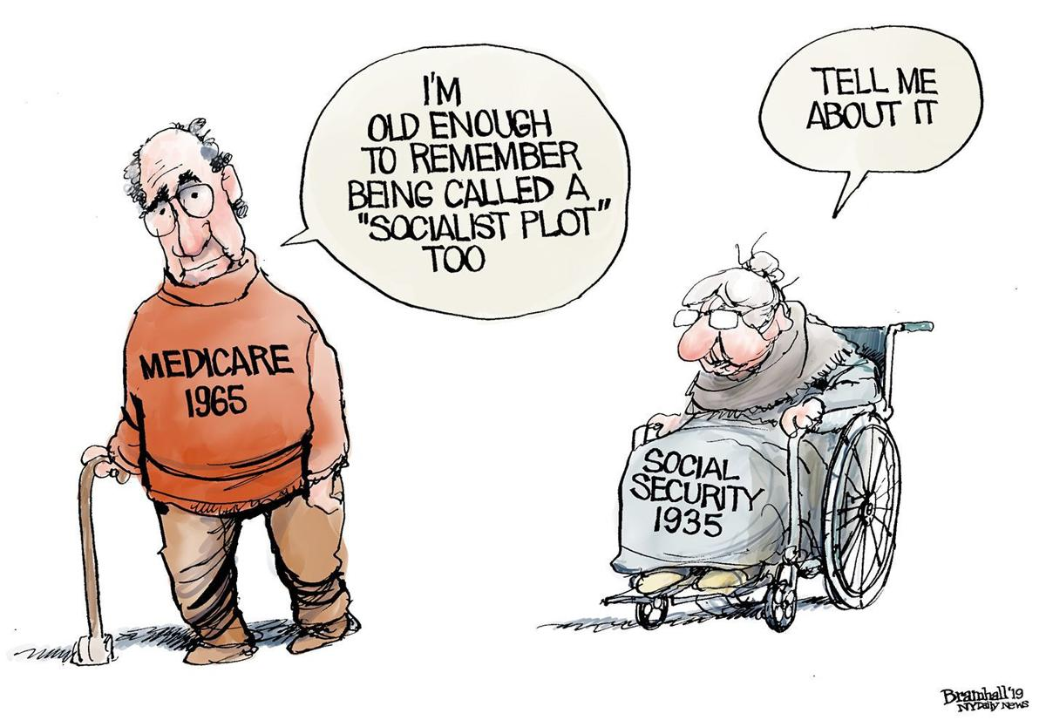
Let’s Talk Socialism and Progressive Capitalism

Slide 24
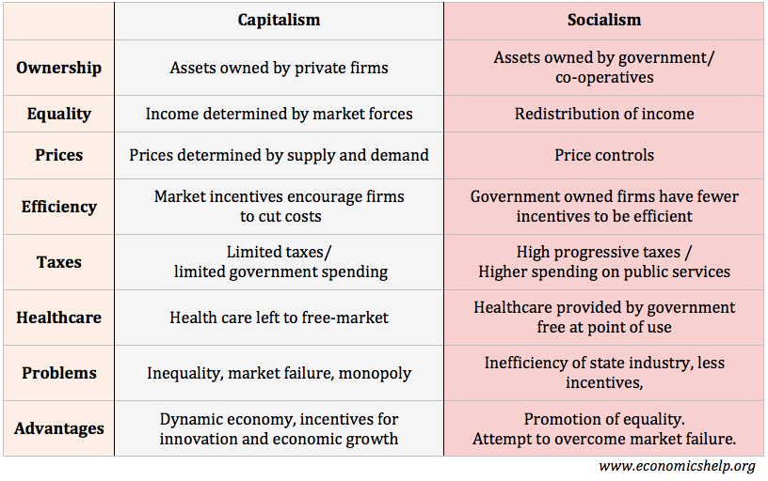
Comparative Economic Systems

Slide 25
Defining: Progressive Capitalism and Democratic Socialism
E. J Dionne: "Code Red: How Progressives And Moderates Can Unite To Save Our Country.” E.J. is an American journalist, political commentator and columnist for The Washington Post.
“They (young people) did not live through the Cold War, . . . they did not live through the era of the Soviet Union, of Stalinism, of the kind of repression they became to be associated with communism and then, by extension, with socialism. That's how many older Americans look at socialism. But moreover, young people have lived through a time when capitalism itself has not worked as the wonderful job-producing, income producing — broad income-producing — mechanism that lovers of capitalism claim for it. It ran into severe problems. It has created some really broad inequalities going back really to the ‘90s, early 1980s, some might measure it even into the 1970s.”
Charlene Carruthers: Author of "Unapologetic. Charlene is a Black feminist activist and author whose work focuses on leadership development.
“We want big, bold changes. We actually want nothing short of transformation. What you're seeing and hearing on the streets, and maybe not as much as the cameras have gone away, are people calling for a transformation. They're calling for a country that actually prioritizes people over property.”

Slide 26
The Many Faces of Socialism
10 Happiest Countries in 2019
Norway
Iceland
The Netherlands
Switzerland
Sweden
New Zealand
Canada
Austria
Socialist Countries in 2019
Russia
Cuba
South Korea
China
Vietnam
Portugal
Nicaragua
Nepal

Slide 27
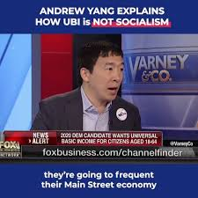
Can a U.B.I. Help Solve Our “Inequality and Poverty” Problems?
https://www.facebook.com/andrewyang2020/videos/U.B.I.-is-not-socialism/696609334106595/

Slide 28
Takeaways from Andrew Yang Clip
Arguments for U.B.I.
A guaranteed income of $1,000/month can quickly stop extreme poverty.
All people are valued and should be allowed to live with dignity.
Also an answer to mass unemployment once I.T. and A.T. impact job market.
It is a simpler system to the currently expensive social programs (SNAP, etc.).
It can free people to do things they want to do without worrying about money.
You can base need on incomes as has been done in the past with other programs.
Arguments against U.B.I.
Fear many people will stop working and live a poorer quality of life with U.B.I. money.
It will encourage people to become lazy and not pay taxes.
Over many years a country’s population will lose its ambition on a collective level.
It will cost more than regular social programs in existence.
Those who are working will have to pay more in tax to pay for U.B.I. income.
54% of U.S. adults oppose the U.B.I. policy of $1,000/month, 45% favor the proposal.

Slide 29
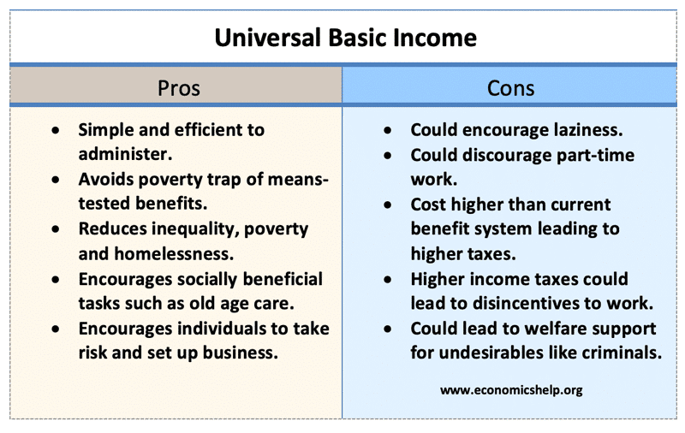

Slide 30
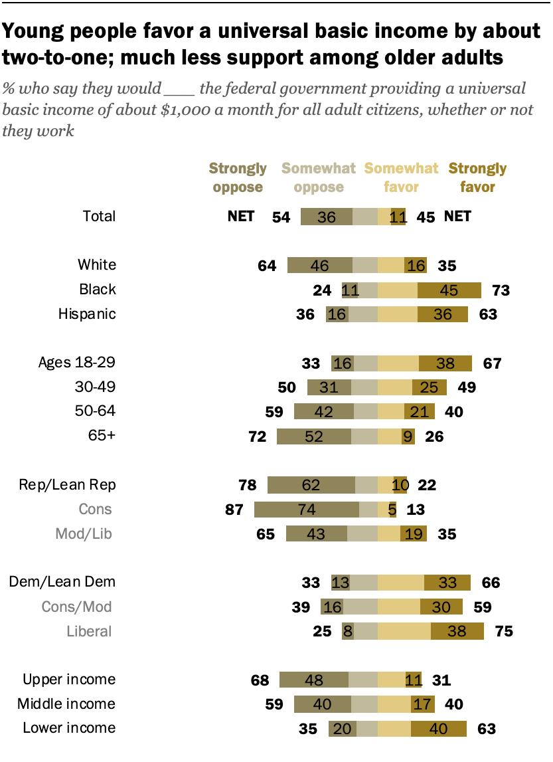

Slide 31
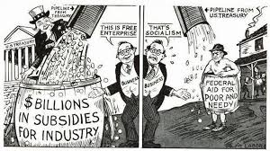
The Corona Bill Fight in Congress:
The Stalled “Heroes Bill”

Slide 32
U.B.I. and the COVID-19 Pandemic
We may not get a U.B.I. but how about a hybrid program which might make a difference..
If we are going to fight poverty, improve the lives of our children, we need to act.
Calls for “Gradualism” versus a “Big Bold Changes.” Blue v. Red Blowback?
House passed a child allowance subsidy as part of the Heroes Act. It sits on McConnell’s desk.
If funded, predictions are child poverty would be reduced by @ 50% among children of color.
Is a U.B.I. program “Progressive Capitalism” or Democratic Socialism”? What we know:
Most rich countries and some states (Maine, Alaska) do more than we do for their children.
Even brief stays on poverty can cause children lifelong harm.
Subsidizing the incomes of poor families leads their children to better health, more schooling and higher earning as adults.
Children with access to SNAP have a 18% higher rate of graduation than those that don’t.

Slide 33
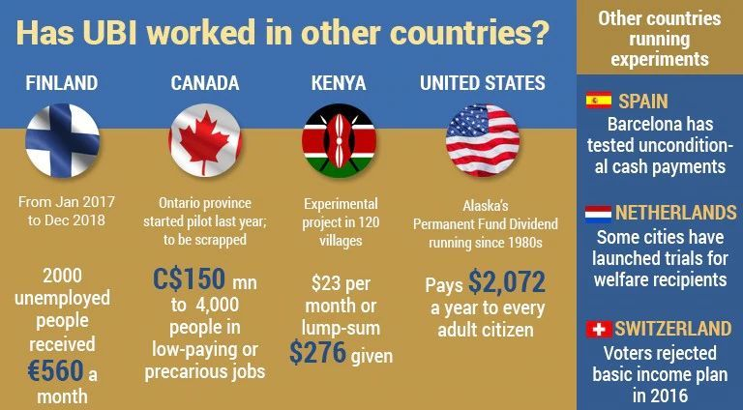
U.B.I. Programs in Other Countries
Not all programs are the same, and not all have continued to operate.
17 countries offer child allowance payments to families with children.
.
https://www.esldebates.com/should-governments-pay-a-basic-income/

Slide 34
Current Model Programs Challenging Economic and Racial Injustice
The Cherokee Indians in rural North Carolina
Compton, California’s U.B.I. Experiment
“Mayors for a Guaranteed Income”

Slide 35
Cherokee Indians and their U.B.I. Plan
Each adult in the tribal households were given $4,000 each year.
Greatest impact of this program was on poverty level within the tribe:
Money provided better health care and education.
Less crimes, drug abuse, anxiety and depression.
The National Academies of Science Engineering and Medicine found:
Brief stays in poverty can cause children lifelong harm, especially the young.
Subsidizing the incomes of poor families leads children on average to better health, more schooling and higher earnings as adults.
Giving poor parents money to improves their children’s chances has been vigorously contested and until recently difficult to prove.

Slide 36
Compton and Its U.B.I. Plan
In Compton, CA about 1 of 5 residents live below the poverty line.
30% are Black, and 68% are Latino with an unemployment rate of 21.9%+.
The “Compton Pledge”: To challenge the racial and economic injustice plaguing both welfare programs and economic systems.
Starting in October 2020, a group of pre-certified residents (800) will receive monthly payments ranging from $300-$600 every month over a 2 year period.
Money for the program, (over $2.5 million), has come from private donations.
Goal: Provide a “Beacon of Hope” for people so they can live with dignity.
Payments to participants through direct deposit, transfers or pre-paid cards.
In addition, participants will have access to financial, legal and counselling services.

Slide 37
U.S. Cities (24+) Implementing a U.B.I.
Stockton, CA
Newark, NJ
Columbia, SC
Los Angles, CA
New Orleans
St. Paul. MN
Seattle, WA
Providence, RI
Madison, WI
Patterson, NJ
Gainesville, FL
Tacoma, WA
Atlanta, GA
Long Beach, CA
Hudson, NY
Holyoke, MA
Philadelphia, PA
Jackson, MS
Ithaca, NY
Mt. Vernon, NY
Shreveport, LA
Oakland, CA
Pittsburg, PA
Richmond, VA

Slide 38
“Mayors for a Guaranteed Income”
Advocates for a U.B.I. at the local, state and federal level.
Goal: Attack the wealth and income inequality plaguing our country.
Even prior to the pandemic, people who were working two and three jobs still could not afford basic living necessities.
COVID-19 has further exposed the economic fragility of most families and has disproportionately impacted Black and Brown people.
This is our New Deal moment: everyone deserves an income floor through a guaranteed income.
Mayors for a Guaranteed Income: www.mayorsforagi.org.

Slide 39
Summative Assessments
Should Governments Pay A Basic Income?
https://www.esldebates.com/should-governments-pay-a-basic-income/
Videos on U.B.I. with discussion questions.
Students create their own pro and con lists and discuss.
Can Universal Basic Income Make Life Better for Everyone?
https://www.esldebates.com/can-universal-basic-income-make-life-better-for-everyone/
Videos, vocabulary, discussion questions.
Lost of topics for debates.

Slide 40
CEE Affiliates
https://www.councilforeconed.org/resources/local-affiliates/

Slide 41
Doug Young
doug.n.young@gmail.com
The WISER Choice

Slide 42
Thank You to Our Sponsors!

