Slide 1
Microeconomics 205
Monopoly, Monopolistic Competition and Oligopoly
Presented by Amanda Stiglbauer
June 30, 2020
Amanda.Stiglbauer@moore.sc.edu

Slide 2
EconEdLink Membership
You can now access CEE’s professional development webinars directly on EconEdLink.org! To receive these new professional development benefits, become an EconEdLink member. As a member, you will now be able to:
Automatically receive a professional development certificate via e-mail within 24 hours after viewing any webinar for a minimum of 45 minutes
Register for upcoming webinars with a simple one-click process
Easily download presentations, lesson plan materials, and activities for each webinar
Search and view all webinars at your convenience
Save webinars to your EconEdLink dashboard for easy access to the event
You may access our new Professional Development page here

Slide 3
Professional Development Certificate
To earn your professional development certificate for this webinar, you must:
Watch a minimum of 45-minutes and you will automatically receive a professional development certificate via e-mail within 24 hours.
Accessing resources:
You can now easily download presentations, lesson plan materials, and activities for each webinar from EconEdLink.org/professional-development/

Slide 4
Agenda
Market Structure Simulation (Virtual Version)
Market Structures Matching Pairs
Collaboration – Monopoly
Monopoly Mini-Lesson
Monopolistic Competition & Activities
Oligopoly Intro, Games and Clips

Slide 5

Objectives
I can differentiate the characteristics of imperfectly competitive market structures.
I can describe activities to help teach monopoly, oligopoly and monopolistic competition.

Slide 6
National Standards
Standard 9: Competition and Market Structure
Competition among sellers usually lowers costs and prices, and encourages producers to produce what consumers are willing and able to buy. Competition among buyers increases prices and allocates goods and services to those people who are willing and able to pay the most for them.

Slide 7

Monopoly

Slide 8

Pure Monopolies
Single Seller
No close substitutes
“Price Maker”
Blocked Entry
Examples:
  De Beers diamonds
  Professional sports teams
  Utilities
  Cable
  Taxis*
  lottery
  Patents on prescriptions
  Small, isolated communities
  Natural monopolies – downward sloping ATC (economies of scale)

Slide 9

RIP MR.DARP
October 30 - Today

Slide 10

Monopolist’s MR<D
Because monopolist must set a lower price to obtain greater sales, marginal revenue is less than price for every level of output except the first.
  Lower price applies to all units sold.
  Think about it this way: MR decreases for all units sold previously because you must charge same price for all.

Slide 11
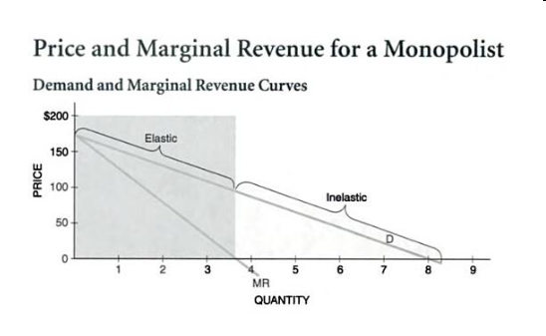

Slide 12
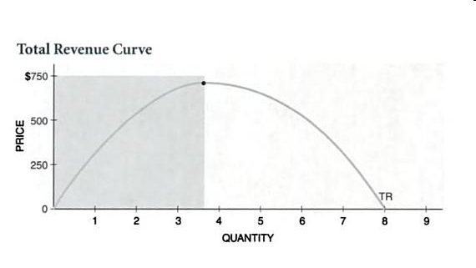

Slide 13
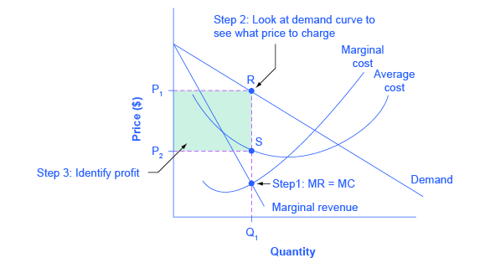
Graphing Monopoly

Slide 14
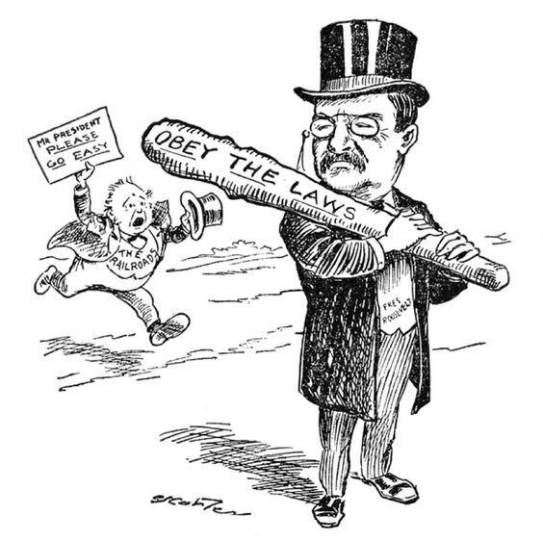
Ways to Deal With Monopolies
  Do Nothing
  Break Up Using Anti-Trust Regulation
  Publically own
  Price Regulation
    Price ceiling
    Socially optimal price/fair return price

Slide 15

Price Discriminating Monopolists
A monopolist who charges different prices to different buyers.
Why would a monopolist do this? To increase profit!
Legal examples:
  Airlines
  Movie theaters
  Cell phone companies
  Golf courses
  Hotels
  Textbook companies

Slide 16
Additional Resources for Monopoly
Monopoly Overview – MR University
Price Discrimination – MR University
Monopoly and Imperfect Competition – Crash Course
AP Micro – Monopoly Lesson Plan - EconEdLink

Slide 17

Monopolistic
Competition

Slide 18
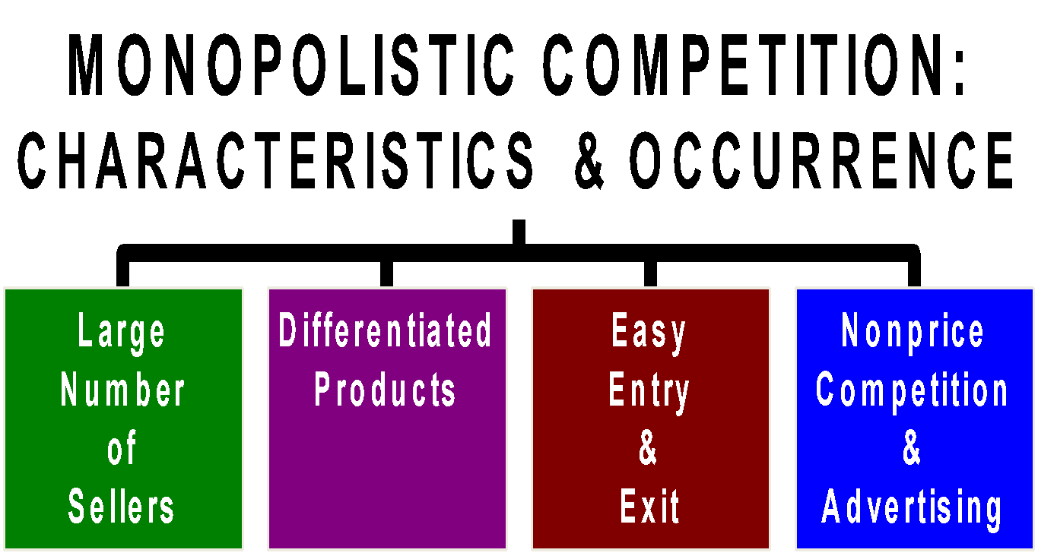

Slide 19
Monopolistic Competition
Like Monopoly | Like Perfect Competition | Unique
- Downward sloping demand and marginal revenue - Some control over price | - Normal profits in the long run - Easy entry and exit - Large number of sellers | - Non price competition and advertising - Differentiated products

Slide 20
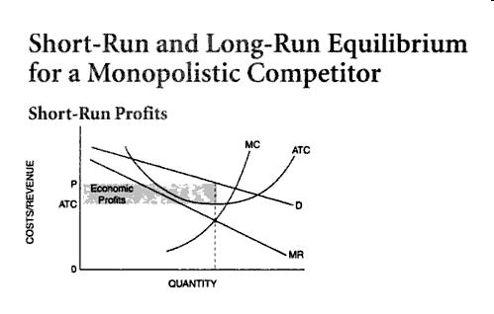

Slide 21
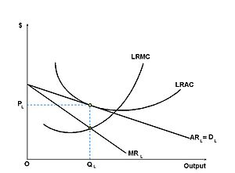
Long Run Equilibrium

Slide 22
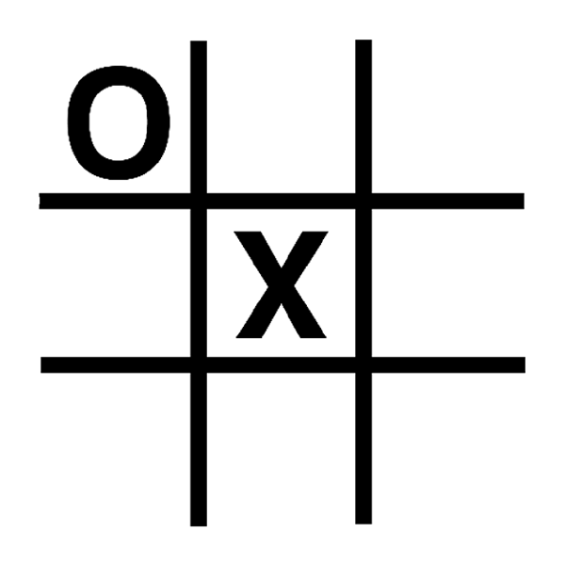
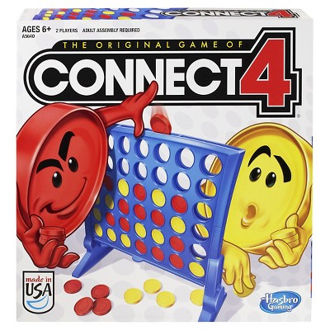
Activities to Introduce Oligopoly
Play Tic-Tac-Toe with a partner
Play Connect 4

Slide 23

Oligopoly

Slide 24
Characteristic | In Oligopolies….
# of Firms | Few large producers
Products | Homogenous or differentiated
Barriers to Entry | Yes--significant Economies of scale (requires large capital expenditures to enter)
Profit Potential (SR and LR) | Yes -supernormal profits possible in SR and LR
Price Setting Power | Price maker BUT must consider possible reaction of rivals (interdependence)
Non-price competition | Some use advertising
Efficiency | No!
Examples | Airlines, Banks, Cigarettes, Beer, Household appliances, Breakfast Cereal

Slide 25
Oligopoly
Interdependent behavior – profits depend on others
Businesses are best off when they collude (make an agreement about price/quantity)
Cartel: group of firms acting in unison to produce a monopoly outcome
Game theory: Study of how people act in strategic situations. “Do unto others BEFORE they do to you”
Prisoner’s Dilemma: Game between two prisoners that illustrates why cooperation is difficult to maintain, even when mutually beneficial.
Dominant Strategy: best for a player, no matter what the other does BUT STILL MUST CONSIDER WHAT OTHER PLAYER IS DOING TO DETERMINE YOUR DOMINANT STRATEGY

Slide 26
Oligopoly Resources
EconMovies – The Dark Knight
Golden Balls
Oligopoly and Game Theory – Crash Course

Slide 27

CEE Affiliates
https://www.councilforeconed.org/resources/local-affiliates/

