Slide 1
Just How Powerful Is the Fed Chair? Presented by Amanda Stiglbauer November 2, 2020 Amanda.Stiglbauer@moore.sc.edu

Slide 2
EconEdLink Membership
You can now access CEE’s professional development webinars directly on EconEdLink.org! To receive these new professional development benefits, become an EconEdLink member. As a member, you will now be able to:
Automatically receive a professional development certificate via e-mail within 24 hours after viewing any webinar for a minimum of 45 minutes
Register for upcoming webinars with a simple one-click process
Easily download presentations, lesson plan materials and activities for each webinar
Search and view all webinars at your convenience
Save webinars to your EconEdLink dashboard for easy access to the event
You may access our new Professional Development page here

Slide 3
Professional Development Certificate
To earn your professional development certificate for this webinar, you must:
Watch a minimum of 45-minutes and you will automatically receive a professional development certificate via e-mail within 24 hours.
Accessing resources:
You can now easily download presentations, lesson plan materials, and activities for each webinar from EconEdLink.org/professional-development/

Slide 4
Agenda
Collaboration Board – Most Powerful Person in the World
Content Delivery – Role of the Fed Chair
EdPuzzle – What is the Federal Reserve
Why Does Fed Policy Matter?
Fed Power Rating Intro – Ben Bernanke
Chair the Fed Activity and Debrief
Time to Climb – Debrief

Slide 5
Who are the most powerful people in the world? Why?

Slide 6
Objectives
Explain how the tools of the Federal Reserve are used to influence monetary policy.
Judge the power of the Chair of the Federal Reserve Bank.
Evaluate how the Fed’s tools are used to alter interest rates, aggregate demand and the inflation rate.

Slide 7
National Standards
List corresponding Nat'l Content Standards in Economics from >
https://www.councilforeconed.org/wp-content/uploads/2012/03/voluntary-national-content-standards-2010.pdf

Slide 8
Who is the Fed Chair and how does one become “Head of the Fed”?
Fed was established in 1913 by the Federal Reserve Act
Outlines who is eligible to become chair
Member of the Board of Governors
Appointed by the President
Testifies before the Committee on Banking, Housing, and Urban Affairs
Confirmed by Senate
Appointed to a four-year term (may serve multiple)
Currently Jerome “Jay” Powell

Slide 9
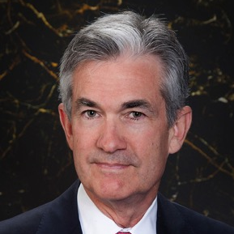
Who is Jay Powell?
Current Fed Chair, appointed by President Donald Trump
Took office February 5, 2018
Member of the Board of Governors since May 2012
Academic experience: AB in politics from Princeton University (1975), law degree from Georgetown University (1979)
First Fed Chair since Paul Volcker to not have a Ph.D. in Economics
Notes:
The current chair, Jay Powell, is pictured, but the teacher can draw upon examples from previous chairs as well, as the background may be useful during the jigsaw portion of the lesson.

Slide 10
Who is Jay Powell?
Work Experience:
Visiting scholar at the Bipartisan Policy Center in Washington, D.C. (focusing on federal and state fiscal issues)
Assistant Secretary and Undersecretary of the Treasury under President George H.W. Bush
Lawyer and Investment Banker in New York City
What do we know so far?
It seems Jay Powell may be inclined to roll back some of the banking regulations that were implemented after the 2008 financial crisis.
Increased interest rates several times until the COVID-19 pandemic

Slide 11
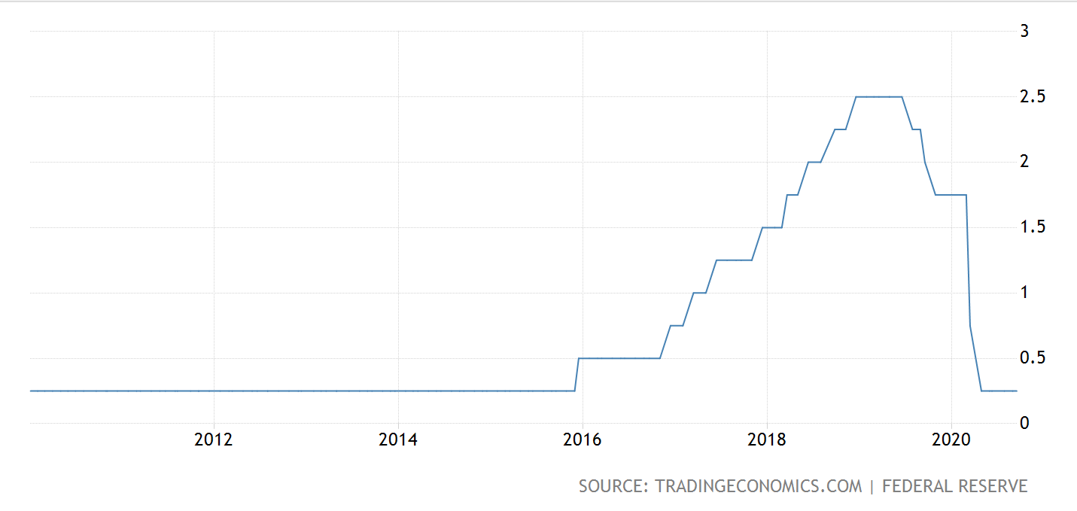
U.S. Federal Funds Rate Since 2016
Notes:
https://tradingeconomics.com/united-states/interest-rate

Slide 12
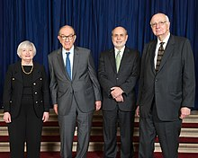
What exactly is the Fed Chair?
Official Title: Chair of the Board of Governors of the Federal Reserve System
Public face of the Federal Reserve Bank and the U.S. Economy
Charged with conducting monetary policy that:
Keeps inflation in check and promotes economic growth
Guides Federal Open Market Committee, which guides policy on interest rates
Supervises and regulates commercial banks
Maintains financial stability
Important player in the international community of central banks
Notes:
Continue to discuss the role of the chair as the public face of the U.S. economy and the Federal Reserve Bank, important spokesperson in the international community of central bankers, and his/her role in conducting monetary policy and regulating the U.S. banking system.

Slide 13
How exactly does the Fed Chair influence monetary policy?
Tools of the Fed
Open Market Operations
Reserve Requirement
Discount Rate
Notes:
As the lesson progresses, examine the ways the Federal Reserve influences monetary policy--open market operations, changes in the reserve requirement and discount rate.

Slide 14
Why does this matter?
The Fed can stimulate the economy by:
decreasing reserve requirement, decreasing discount rate, buying bonds
The Fed can rein in inflation by: increasing reserve requirement, increasing discount rate, selling bonds
Interest Rates
Aggregate demand
Interest Rates
Aggregate demand
Notes:
“Why Does it Matter?” to discuss how changes in the reserve requirement, discount rate, and open market operations influence aggregate demand and interest rates. When interest rates decline, this encourages the public to engage in more interest sensitive consumption. Lower interest rates prompt consumers and businesses to make more “big ticket” purchases, as the cost of borrowing declines. The Fed may choose to pursue this type of expansionary monetary policy when the economy is facing recession and unemployment in an effort to stimulate economic activity and increase aggregate demand. Conversely, the Fed may choose to increase interest rates when the economy is threatened with inflation or overheating. This is termed contractionary monetary policy, and can be accomplished by increasing the reserve requirement, increasing the discount rate, and selling bonds/securities. As interest rates rise and money is taken out of the economy, aggregate demand declines. In addition, consumers and businesses are less inclined to borrow money for interest sensitive purchases as interest rates rise.

Slide 15
Why are interest rates and aggregate demand important?
Notes:
Invite students to discuss why interest rates and aggregate demand are important in the U.S. economy.

Slide 16
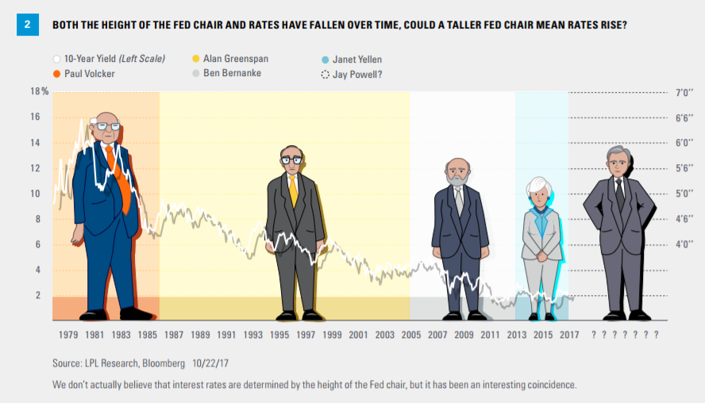
How much power can a Fed Chair wield?

Slide 17
Fed Chair Power Rating Activity
Students will investigate how much power a Fed Chair possesses. Sports fans often assign a power rating to teams and players to measure their strength. Students will research some of the most recent chairs of the Federal Reserve and assign them power ratings to express how truly influential they have been in the United States economy.
Prerequisites
Offensive Acumen
Defensive Strength
Notes:
https://www.econedlink.org/wp-content/uploads/2019/03/Fed-Chair-Power-Rating-Activity.pdf

Slide 18
Ben Bernanke
https://www.federalreservehistory.org/people/ben-s-bernanke
https://www.npr.org/2014/01/27/266753602/bernankes-fed-legacy-a-tenure-full-of-tough-decisions
Notes:
https://www.federalreservehistory.org/people/ben-s-Bernanke
https://www.npr.org/2014/01/27/266753602/bernankes-fed-legacy-a-tenure-full-of-tough-decisions

Slide 19
Ben Bernanke
Strengths
Weaknesses

Slide 20
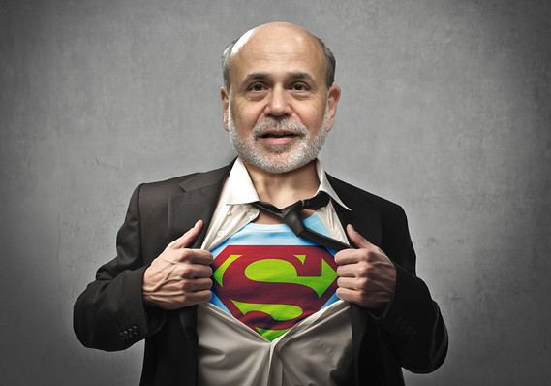
Assigning Ben Bernanke a Power Rating

Slide 21
Chair the Fed Activity
Record the Federal Funds Rate, Unemployment Rate, and Inflation Rate.
Did you get reappointed?
What was your biggest challenge?

Slide 22
Assessment Questions
Who is the current chair of the Federal Reserve Bank? (Jerome Powell)
What can the fed to do to stimulate the economy?
Increase the interest rate
Lower the interest rate
Increase taxes
Lower taxes
Which of these is not a tool of the Fed?
Taxation
Federal funds rate
Discount Rate
Open Market Operations
The Fed Chair is:
Appointed by the President
Appointed by the President and approved by the Supreme Court
Appointed by the President and approved by the Senate
An elected official
If the Fed wants to rein in inflation, it would most likely..
Increase the interest rate
Lower the interest rate
Increase taxes
Lower taxes

Slide 23
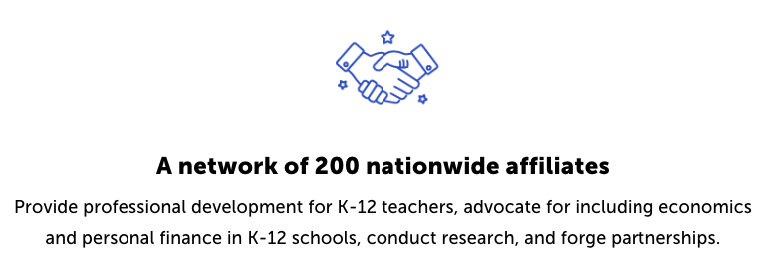
CEE Affiliates
https://www.councilforeconed.org/resources/local-affiliates/

Slide 24
Thank You to Our Sponsors!

