Slide 1
Financial Fitness For Life Chapter 7: Uncle Sam Takes a Bite Presented by Ruben A Rivera Thursday, September 16th 2020 rrivera@councilforeconed.org

Slide 2
EconEdLink Membership
You can now access CEE’s professional development webinars directly on EconEdLink.org! To receive these new professional development benefits, become an EconEdLink member. As a member, you will now be able to:
Automatically receive a professional development certificate via e-mail within 24 hours after viewing any webinar for a minimum of 45 minutes
Register for upcoming webinars with a simple one-click process
Easily download presentations, lesson plan materials and activities for each webinar
Search and view all webinars at your convenience
Save webinars to your EconEdLink dashboard for easy access to the event
You may access our new Professional Development page here

Slide 3
Professional Development Certificate
To earn your professional development certificate for this webinar, you must:
Watch a minimum of 45-minutes and you will automatically receive a professional development certificate via e-mail within 24 hours.
Accessing resources:
You can now easily download presentations, lesson plan materials, and activities for each webinar from EconEdLink.org/professional-development/

Slide 4
Agenda
Review the Financial Fitness for Life Series
Explore Chapter 7: Uncle Sam Takes a Bite
Explore activities, lessons, and assessments using FFFL
Explore the IRS website for additional tools, lessons, and materials
I will provide additional materials for extended learning for asynchronous or synchronous learning

Slide 5
About me
Director of Professional Development at the Council for Economic Education
Personal finance, taxation, business, and entrepreneurship teacher in grades 6-12
College Access and Success Manager
Community School Director at the NYCDOE
Over 15 years experience in taxation
Follow me on linkedIn

Slide 6
Objectives
In this lesson, students will:
Learn the difference between gross income and net income.
Identify some of the common types of benefits provided by employers.
Learn how to calculate marginal tax rates
Differentiate between standard deductions and itemized deductions.

Slide 7
Financial Fitness for Life (9-12)
Financial Fitness for Life (3rd edition) helps you prepare students for life beyond the classroom by presenting lessons and activities based on real-world economics and personal finance concepts.
Updated lesson plans with slides
1 new lesson plan for Paying Post-Secondary Education
17 ready-to-use EdTech tools
6 new activities using real-world tools in partnership with Intuit
Notes:
Here’re our goals for today’s webinar: Read screen

Slide 8
Financial Fitness for Life (9-12)
Teachers who attend at least 3 webinars of their choice will receive a copy of Financial Fitness for Life: Grades 9–12 Teacher Guide and Student Workbook (a $60.90 value!).
Once you’ve attended at least 3 webinars, please fill out the form below and upload your certificates of completion:
https://forms.gle/irHTaEC6YwMtX4tE8
*The free workbooks giveaway only applies to educators residing in the United States and its territories.
Notes:
Here’s our goals for today’s webinar: Read screen

Slide 9
National & State Standards
National Financial Literacy Standards:
Standard 1 Earning Income, Grade 12, Benchmark 7
Standard 1 Earning income, Grade 12, Benchmark 8
Common Core State Standards:
CCSS.ELA-Literacy.W.9-10.9
CCSS.ELA-Literacy.L.0-10.6;CCSS.ELA-Literacy.L.11-12.6
CCSS.ELA-Literacy.RH.9-10.4;CCSS.ELA.-Literacy.RH.11-12.2

Slide 10
Materials
This lesson Includes:
PPT presentation slides
Exercise 7.1: What are All These Deductions from My Paycheck?
Exercise 7.2: What’s Your Bracket? Activity
Exercise 7.3: Tax-Saving Strategies Activity
Additional Resources (TurboTax, EconEdLink.org, IRS resources)

Slide 11
Assessment Questions/Statements
What is Gross Income?
What is Net Income?
What is a filing status?
State at least 3 tax-saving strategies.
What does FICA stand for?

Slide 12
Lesson 7: Uncle Sam Takes a Bite
7.1 – What Are All These Deductions from my paycheck?
Scenario:
Real World Scenario

Slide 13
Lesson 7: Uncle Sam Takes a Bite
7.1 – What Are All These Deductions from my paycheck?
Vocabulary Words:
Gross Pay: Gross pay is the total amount of money an employee earns before any deductions are made.
Net Pay: Net pay is the amount left after all deductions for taxes and benefits payments are taken out of the gross pay. Net pay is sometimes called take-home pay.
Payroll Deduction: A payroll deduction is an expense that can be subtracted from an individual or married couple’s gross income.
Tax Deduction: Is a deduction that lowers a person’s tax liability by lowering their taxable income.

Slide 14
Lesson 7: Uncle Sam Takes a Bite
7.1 – What Are All These Deductions from my paycheck?

Slide 15
Lesson 7: Uncle Sam Takes a Bite

Slide 16
Lesson 7: Uncle Sam Takes a Bite
Notes:
FICA : Federal Insurance Contributions Act
https://www.ssa.gov/thirdparty/materials/pdfs/educators/What-is-FICA-Infographic-EN-05-10297.pdf

Slide 17
Lesson 7: Uncle Sam Takes a Bite
Notes:
FICA : Federal Insurance Contributions Act
https://www.ssa.gov/thirdparty/materials/pdfs/educators/What-is-FICA-Infographic-EN-05-10297.pdf

Slide 18
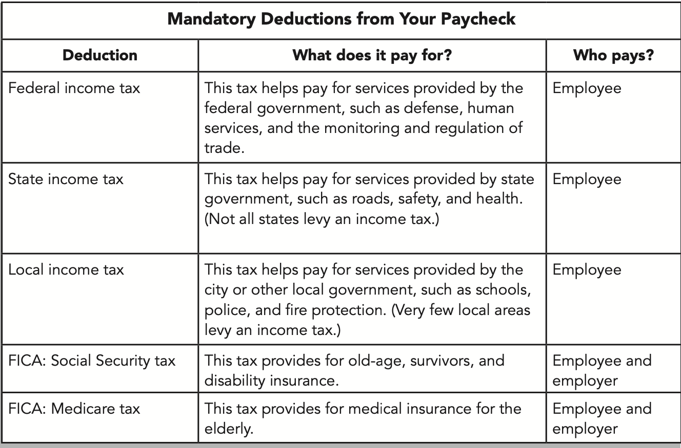
Lesson 7: Uncle Sam Takes a Bite

Slide 19
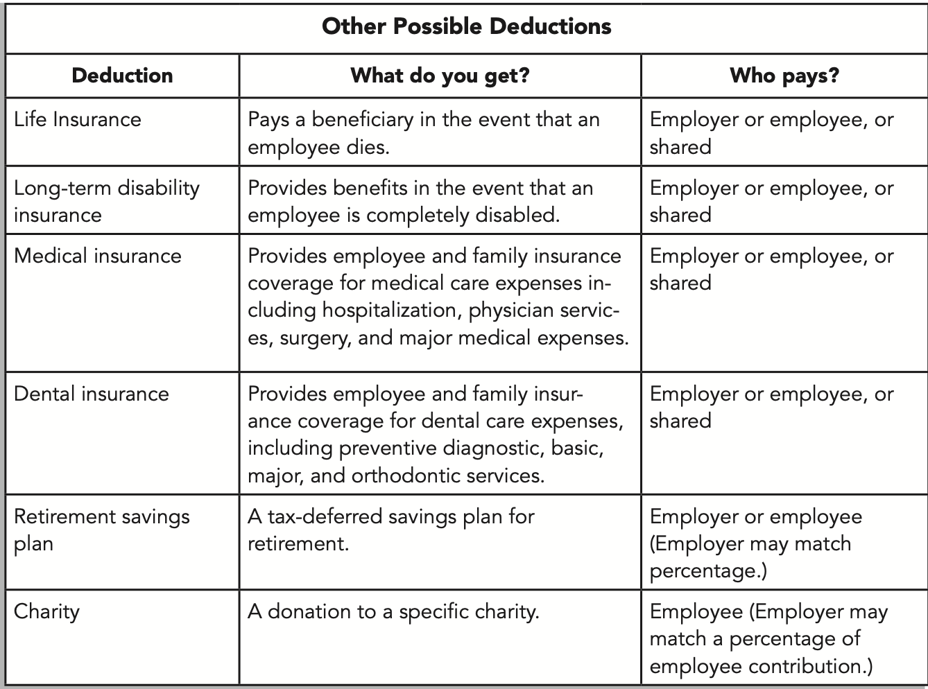
Lesson 7: Uncle Sam Takes a Bite

Slide 20
Lesson 7: Uncle Sam Takes a Bite
7.2 – Tax Brackets
Side note:
There are THREE basic types of taxes: progressive, regressive, and proportional. ..
Progressive taxes: Increases as income increases
Regressive taxes: is the same rate for everyone (such as sales tax on food and clothing.
Proportional tax: Stays the same whether income increases or decreases (such as a flat tax).

Slide 21
Lesson 7: Uncle Sam Takes a Bite
7.2 – Tax Brackets
What’s your bracket?
To illustrate marginal taxes and progressive taxes, let’s examine the following scenario.
Miquel and Anna Green have been married for almost five years and have no children. They both have good jobs, with a combined income of $84,000. They enjoy living in a rental near downtown but hope to eventually buy a home. Based on their current circumstances, they have decided to use the standard deduction of $24,000 allowed for a married couple when paying their federal income tax.

Slide 22
Lesson 7: Uncle Sam Takes a Bite
7.2 – Tax Brackets
Filing Status?
It’s important to use the right filing status when you filing taxes. The status you choose can affect the amount of tax you owe for the year. It may even determine if you must file a tax return. Keep in mind that your marital status on Dec. 31 is your status for the whole year. Sometimes more than one filing status may apply to you. If that happens, choose the one that allows you to pay the least amount of tax. A filing status is based on your personal situation and helps you file taxes at the end of year.
Dependent: A dependent is a qualifying person who entitles a taxpayer to claim a dependent-related tax benefit on a tax return. They must pass the IRS dependent test.
Notes:
https://www.investopedia.com/terms/d/dependent.asp
https://apps.irs.gov/app/vita/content/globalmedia/table_2_dependency_exemption_relative_4012.pdf

Slide 23
Lesson 7: Uncle Sam Takes a Bite
7.2 – Tax Brackets
Filing Status? Here’s a list of the five filing statuses:
Single. This status normally applies if you aren’t married. It applies if you are divorced or legally separated under state law.
Married Filing Jointly. If you’re married, you and your spouse can file a joint tax return. If your spouse died in 2015, you can often file a joint return for that year.
Married Filing Separately. A married couple can choose to file two separate tax returns. This may benefit you if it results in less tax owed than if you file a joint tax return. You may want to prepare your taxes both ways before you choose. You can also use it if you want to be responsible only for your own tax.
Head of Household. In most cases, this status applies if you are not married, but there are some special rules. For example, you must have paid more than half the cost of keeping up a home for yourself and a qualifying person. Don’t choose this status by mistake. Be sure to check all the rules.
Qualifying Widow(er) with Dependent Child. This status may apply to you if your spouse died during 2013 or 2014 and you have a dependent child. Other conditions also apply.

Slide 24
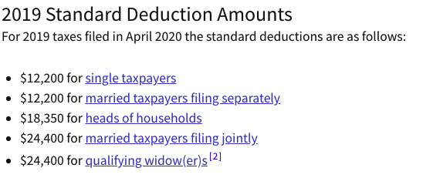
Lesson 7: Uncle Sam Takes a Bite
7.2 – Tax Brackets
What is the Standard Deduction?
Depending on your income and filing status, the standard deduction is the portion of income not subject to tax that can be used to reduce your tax bill as long as you do not itemize your deduction (more on that later).

Slide 25
Lesson 7: Uncle Sam Takes a Bite
7.2 – Tax Brackets
What’s your bracket?
To illustrate marginal taxes and progressive taxes, let’s examine the following scenario.
Miquel and Anna Green have been married for almost five years and have no children. They both have good jobs, with a combined income of $84,000. They enjoy living in a rental near downtown but hope to eventually buy a home. Based on their current circumstances, they have decided to use the standard deduction of $24,000 allowed for a married couple when paying their federal income tax.
Use the following tax table to calculate the amount of federal income tax they would be responsible to pay on their income. Show your calculations in completing the exercise and answer the questions below.

Slide 26
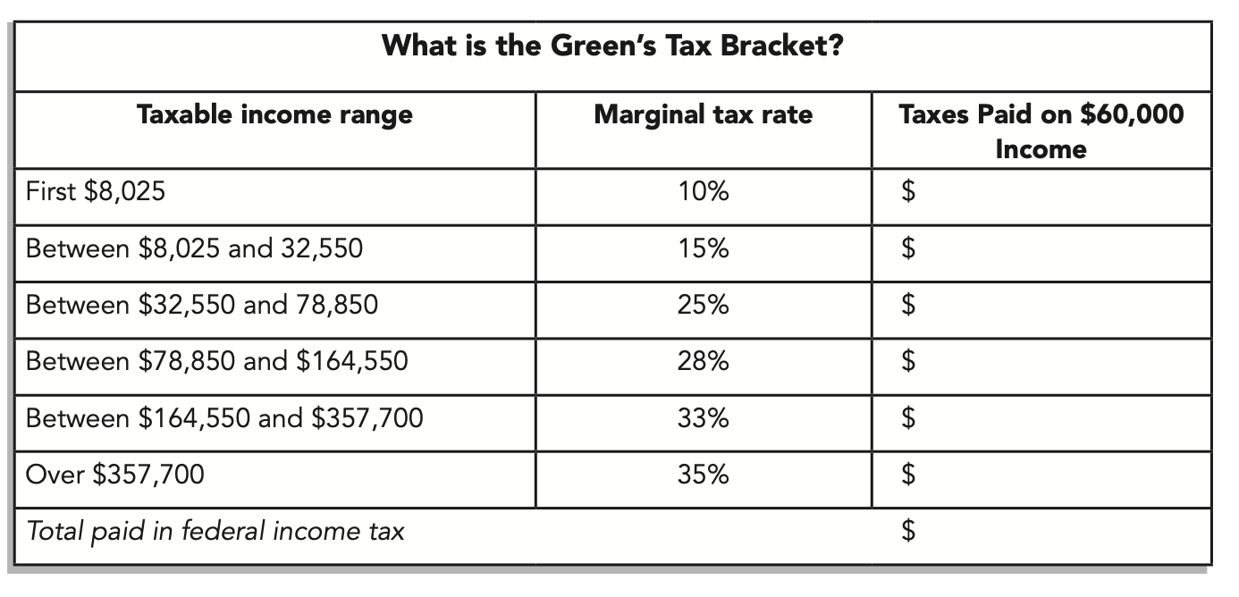
Lesson 7: Uncle Sam Takes a Bite
7.2 – Tax Brackets
What’s your bracket? Calculate Miguel and Anna’s tax bracket at $84,000 with a standard deduction of $24,000.

Slide 27
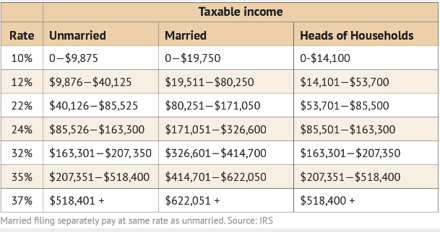
Lesson 7: Uncle Sam Takes a Bite
7.2 – Tax Brackets
2020 Tax Bracket by Status (tax brackets may change each year)

Slide 28
Lesson 7: Uncle Sam Takes a Bite
7.3 – Tax-Saving Strategies
Although Miquel and Anna chose to use the standard deduction, other tax payers may use another option called “itemizing”. The standard deduction is just that: the same for everyone. However, not everyone has the same income or possible deductions.
Itemizing can be a better option for those who have total deductions greater than the standard amount. The Internal Revenue Service provides special income tax forms, called Form 1040, Schedule A, that allows individuals to list each of their deductions. Some of these deductions include the interest paid on a home mortgage or other real estate, medical expenses, some educational expenses, certain work-related expenses, childcare expenses, and funds put into retirement accounts.
While paying personal income tax is part of having a paycheck, following are some most common strategies you can use to reduce your tax burden and increase your take home pay.

Slide 29
Lesson 7: Uncle Sam Takes a Bite
7.3 – Tax-Saving Strategies
Imagine you have a $40,000 annual salary (including your standard deduction).
Lowering your taxable income-
If your employer provides benefits such as health insurance or a retirement account, you may be required to make a percentage of the payment for them. Those payments are deducted from your gross income and may be used to reduce your overall taxable income. In other words, you may subtract those payments from your gross income and use the reduced amount to calculate your taxes.
Ex: You invest in a $2500 Flexible Spending Account (FSA).

Slide 30
Lesson 7: Uncle Sam Takes a Bite
7.3 – Tax-Saving Strategies
Imagine you have a $40,000 annual salary (including your standard deduction).
2. Maximizing your retirement account -
Many employers offer a 401(k) or other similar retirement plan for their employees. In most cases, they will match whatever amount you pay into that account each month, up to a certain percentage of your income. The payments you make into that retirement account is subtracted from your taxable income. The more you put into the retirement plan, the more your taxable income is reduced. Imagine saving on taxes and also getting your employer to help pay for your retirement!
Ex: You paid $1000 towards a 401K for the entire year.

Slide 31
Lesson 7: Uncle Sam Takes a Bite
7.3 – Tax-Saving Strategies
Imagine you have a $40,000 annual salary (including your standard deduction).
3. Opening an IRA-
An IRA is the short name for an Individual Retirement Account at banks and other financial institutions. Depending upon your income, you may be able to use the payments made to your IRA as a tax deduction.
Ex: You paid $1000 towards an IRA for the entire year.

Slide 32
Lesson 7: Uncle Sam Takes a Bite
7.3 – Tax-Saving Strategies
Imagine you have a $40,000 annual salary (including your standard deduction).
4. Keeping good financial records-
Some of the purchases or donations you make during the year may also be used as tax deductions. These include charitable and religious contributions, special shoes or uniforms, medical expenses, child care, and a variety of others. Using these expenses as de- ductions may help you save money on your income taxes. However, you need to maintain accurate records of your donations and expenses to take advantage of these deductions.
Ex: You donated $3000 towards your place of worship or charitable organization.

Slide 33
Lesson 7: Uncle Sam Takes a Bite
7.3 – Tax Savings Strategies
What’s your bracket? Calculate the tax bracket at $40,000.
= $802.50
= $3,678.75
= $1,862.50
Total: $6,343.75

Slide 34
Lesson 7: Uncle Sam Takes a Bite
7.3 – Tax Savings Strategies
What’s your bracket? Calculate the tax bracket at $40,000 with $7,500 of deductions from your tax saving strategies. Taxable income = $32,500
= $802.50
= $3,671.25
= None
At $32,500, total: $4,473.70
At $40K Total: $6,343.75
Difference: $1,870.05

Slide 35
Lesson 7: Uncle Sam Takes a Bite
7.3 – Tax Savings Strategies
Sample activity: You are (filing status), (career choice and company) and have an annual salary of (Research your annual salary), you also have (tax-saving strategy). Calculate your total federal taxes.
= $______________
= $______________
= $______________
= $______________
= $______________
= $______________

Slide 36
Tools
Interactive Tax Assistant
Intuits TurboTax simulation
IRS Website for additional lessons and materials
Paystub Generator

Slide 37
Lesson 7: Uncle Sam Takes a Bite
Additional Resources:
https://apps.irs.gov/app/understandingTaxes/index.jsp
https://www.irs.gov/publications/p501#en_US_2019_publink1000220957
Tax Tables:
https://www.irs.gov/pub/irs-pdf/i1040tt.pdf
https://www.tax.ny.gov/pdf/current_forms/it/it201i.pdf#page=49

Slide 38
CEE Affiliates
https://www.councilforeconed.org/resources/local-affiliates/

Slide 39
Thank You to Our Sponsors!

Slide 40
The Conference is your pathway to learn about the opportunities to incorporate personal finance and economics into your K-12 classroom and to exchange ideas with hundreds of peers.
Register by August 15, 2020 to receive the early bird special discount: $79 Early Bird ($99 thereafter)
Register Today >>>
https://www.councilforeconed.org/events/conference

