Slide 1
Economics 102
Opportunity Cost, Cost-Benefit, Marginal Analysis, and Comparative Advantage
Presented by Amanda Stiglbauer
May 14, 2020
Amanda.Stiglbauer@moore.sc.edu

Slide 2
EconEdLink Membership
You can now access CEE’s professional development webinars directly on EconEdLink.org! To receive these new professional development benefits, become an EconEdLink member. As a member, you will now be able to:
Automatically receive a professional development certificate via e-mail within 24 hours after viewing any webinar for a minimum of 45 minutes
Register for upcoming webinars with a simple one-click process
Easily download presentations, lesson plan materials, and activities for each webinar
Search and view all webinars at your convenience
Save webinars to your EconEdLink dashboard for easy access to the event
You may access our new Professional Development page here

Slide 3
Professional Development Certificate
To earn your professional development certificate for this webinar, you must:
Watch a minimum of 45-minutes and you will automatically receive a professional development certificate via e-mail within 24 hours.
Accessing resources:
You can now easily download presentations, lesson plan materials, and activities for each webinar from EconEdLink.org/professional-development/

Slide 4
Agenda
Roll Call – Personal Pros and Cons of “New Normal”
Immigration Activity – Costs and Benefits
Cost Benefit Analysis of COVID-19
Thinking at the Margin Activity
Flood Clean Up Activity
Comparative and Absolute Advantage
  Calculating opportunity cost
  Interactive Stations Activity
Gimkit!

Slide 5
Objectives
Explain the concepts of opportunity cost, marginal thinking, cost-benefit-analysis, and comparative advantage.
Use activity based approaches to teach opportunity cost, cost-benefit analysis, and comparative advantage.

Slide 6
National Standards
Standard 2: Decision Making
  Effective decision making requires comparing the additional costs of alternatives with the additional benefits. Many choices involve doing a little more or a little less of something: few choices are “all or nothing” decisions.
Standard 3: Allocation
  Different methods can be used to allocate goods and services. People acting individually or collectively must choose which methods to use to allocate different kinds of goods and services.

Slide 7
Albert Einstein
Albert Einstein was a famous scientist. He was born in Germany but he didn’t like the schools, so he immigrated to Switzerland when he was 16. He invented many things. When he was visiting the United States in 1933, the Nazi party took over Germany. Einstein renounced his German citizenship and stayed in the United States. What was Einstein’s incentive for wating to stay in the United States?

Slide 8
Sergey Brin
Sergey Brin was born in Moscow, Russia (formerly the Soviet Union) in 1973. He is well-known today as co-founder of Google. When he was six years old, his family left the country because of anti-Semitism. He grew up in Maryland and went to the University of Maryland where he majored in mathematics and computer science. He then went to Stanford to work on a Ph.D. in computer science. He met Larry Page and together they built Google. What was Brin’s family’s incentive for coming to the United States?

Slide 9
Arnold Schwarzenegger
Arnold Schwarzenegger was the Governor of California and an actor famous for his roles as “The Terminator.” He grew up on a farm in Austria. He dreamed of coming to the United States. He worked to become a champion bodybuilder because he thought if he won “Mr. Universe” he would be able to go to America. What was his incentive for becoming a great bodybuilder? What do you think was his incentive for coming to the United States?

Slide 10
Hamdi Ulukaya
CEO of Agro Farma, came from Turkey to learn English and go to college at Albany State University. His family ran a dairy in Turkey. He didn’t think the yogurt sold in America was as good as the yogurt back home. When in 2005 he saw a dairy in upstate New York being sold, he bought it. In 2007, he started making Greek yogurt there. He chose the brand name Chobani because that word means “shepherd” in Turkish. By the end of 2011, Chobani was selling over $250 million worth of yogurt per year. What incentives did he have to come to the U.S.?

Slide 11
Costs and Benefits of Immigration
What were the costs of coming to the U.S.? (What did they give up?) | What were the benefits of coming to the U.S.? (What did they gain?)

Slide 12
Cost Benefit Analysis: Tradeoffs
No containment policies
  Reduced economic activity
  More coronavirus deaths
  Non-coronavirus deaths
Stringent containment policies
  Dramatically reduced economic activity
  Fewer coronavirus deaths
  Non-coronavirus deaths(?)
???
Analysis of Containment Policies
Reduced economic activity < value of additional deaths

Slide 13
Cost – Benefit Analysis
BENEFITS of social distancing:
  $5 million/life and 600,000 lives saved ($3.0 trillion)
  Long term health issues avoided: 2 million at $500,000 ($1 trillion)
  Total Benefit of Social Distancing: $4.0 Trillion
COSTS of “Shelter in Place” or “Lockdown”
  There are about 70+ workdays in a quarter (plus March).
  The cost of a “lockdown” is roughly $1.3 Trillion
Benefit: $4.0 trillion > Cost: $1.3 trillion

Slide 14
Amanda receives an email from her daughter’s dance studio that they will be reopening next week with limited capacity. She needs to notify the teachers if Harper plans to dance at the studio or continue with online dance instruction. Harper has company tryouts on June 1 and a recital June 1 – 4. Does Amanda have a choice in this situation?
Alternatives | Possible Costs | Possible Benefits | Rank (at the end)
Rank Alyssa’s alternatives.
Alyssa’s best choice would be ________________________.
Based on this choice, Alyssa’s opportunity cost was:

Slide 15
Amanda receives an email from her daughter’s dance studio that they will be reopening next week with limited capacity. She needs to notify the teachers if Harper plans to dance at the studio or continue with online dance instruction. Harper has company tryouts on June 1 and a recital June 1 – 4. Does Amanda have a choice in this situation?
Alternatives | Possible Costs | Possible Benefits | Rank (at the end)
Send Harper to all in person dance classes | Contracting virus or spreading it to others | In person attention of instructors
Rank Amanda’s alternatives.
Amanda’s best choice would be ________________________.
Based on this choice, Amanda’s opportunity cost was:

Slide 16
Amanda receives an email from her daughter’s dance studio that they will be reopening next week with limited capacity. She needs to notify the teachers if Harper plans to dance at the studio or continue with online dance instruction. Harper has company tryouts on June 1 and a recital
June 1 – 4. Does Amanda have a choice in this situation?
Alternatives | Possible Costs | Possible Benefits | Rank
Send Harper to all in person dance classes | Contracting virus or spreading it to others | In person attention of instructors
Allow Harper to attend classes when the studio is only running one class | Contracting virus or spreading it to others | Some in person attention of instructors
Rank Amanda’s alternatives.
Amanda’s best choice would be ________________________.
Based on this choice, Amanda’s opportunity cost was:

Slide 17
Amanda receives an email from her daughter’s dance studio that they will be reopening next week with limited capacity. She needs to notify the teachers if Harper plans to dance at the studio or continue with online dance instruction. Harper has company tryouts on June 1 and a recital
June 1 – 4. Does Amanda have a choice in this situation?
Alternatives | Possible Costs | Possible Benefits | Rank
Send Harper to all in person dance classes | Contracting virus or spreading it to others | In person attention of instructors
Allow Harper to attend classes when the studio is only running one class | Contracting virus or spreading it to others | Some in person attention of instructors
Continue Zoom classes only | Less one-on-one attention | Safety and piece of mind; no chance to compromise health

Slide 18
Amanda receives an email from her daughter’s dance studio that they will be reopening next week with limited capacity. She needs to notify the teachers if Harper plans to dance at the studio or continue with online dance instruction. Harper has company tryouts on June 1 and a recital
June 1 – 4. Does Amanda have a choice in this situation?
Alternatives | Possible Costs | Possible Benefits | Rank
Send Harper to all in person dance classes | Contracting virus or spreading it to others | In person attention of instructors | 3
Allow Harper to attend classes when the studio is only running one class | Contracting virus or spreading it to others | Some in person attention of instructors | 2
Continue Zoom classes only | Less one-on-one attention | Safety and piece of mind; no chance to compromise health | 1
Rank Amanda’s alternatives.
Amanda’s best choice would be ________________________.
Based on this choice, Amanda’s opportunity cost was:

Slide 19
Alyssa desperately wanted to attend the Beyonce concert with her friends. Unfortunately, she could not get a ticket for the night on which her friends were going to the concert. She said she had no choice but to stay home with her family and watch TV. Did Alyssa have a choice?
Alternatives | Possible Costs | Possible Benefits | Rank (at the end)
Rank Alyssa’s alternatives.
Alyssa’s best choice would be ________________________.
Based on this choice, Alyssa’s opportunity cost was:

Slide 20
Create your OWN scenario! Do you have a choice?
Alternatives | Possible Costs | Possible Benefits | Rank (at the end)
Rank YOUR alternatives.
YOUR best choice would be ________________________________________.
Based on this choice, YOUR opportunity cost was:

Slide 21
Flood Clean-Up Exercise:
Practicing Marginal Analysis
% pollution reduction | Total social value of clean-up | Total cost of clean-up
0% | 0 | 0
25% | $500,000 | $75,000
50% | $750,000 | $175,000
75% | $865,000 | $290,000
100% | $875,000 | $590,000
Completely
polluted
Completely
clean

Slide 22
Marginal Analysis:
Weighing the additional costs and additional benefits of making a decision.
If the marginal (additional/change in) benefit of an action is greater than (or equal to) the marginal (additional/change in) cost, DO IT!
If the marginal cost of an action is greater than the marginal benefit, DON’T DO IT!

Slide 23
Flood Clean-Up Exercise:
Practicing Marginal Analysis
% pollution reduction | Total social value of clean-up | Marginal benefit | Total cost of clean-up | Marginal cost
0% | 0 |  | 0
25% | $500,000 |  | $75,000
50% | $750,000 |  | $175,000
75% | $865,000 |  | $290,000
100% | $875,000 |  | $590,000
Completely
polluted
Completely
clean

Slide 24
Flood Clean-Up Exercise:
Practicing Marginal Analysis
% pollution reduction | Total social value of clean-up | Marginal benefit | Total cost of clean-up | Marginal cost
0% | 0 |  | 0
25% | $500,000 |  | $75,000
50% | $750,000 |  | $175,000
75% | $865,000 |  | $290,000
100% | $875,000 |  | $590,000
Completely
polluted
$500,000
$75,000
$250,000
$100,000
$115,000
$115,000
Completely
clean
$10,000
$300,000

Slide 25

Think about your household…
Who cooks dinner?
Who does the yard work?
Who manages the budget?
Who pays the bills?

Slide 26
Comparative and Absolute Advantage
Absolute Advantage
Comparative Advantage
The ability of one person/group to produce more of a good or service with fixed resources.
For example, if Madeline can bake 10 pies in an hour and Charlie can bake 12 pies in an hour, Charlie has an absolute advantage in baking because he can produce more pies per hour than Madeline.
The absolute advantage goes to the who is better at producing the good in question; however, absolute advantage does not tell the entire story.
To determine how resources should be used, we must investigate the concept of comparative advantage.
The ability of one person/group to produce a good or service at a lower opportunity cost than another person/group.
In other words, the person/group with the comparative advantage is giving up the least amount of resources.
When calculating opportunity cost there are 2 methods:
  outputs (with fixed inputs)
  inputs (with fixed outputs)

Slide 27
Calculating Opportunity Cost and Determining Comparative Advantage
Determining comparative advantage requires calculating opportunity costs.
When calculating opportunity costs with Outputs, use the “Other Over” formula (output and other both start with “O”). The “Other Over” formula is:
Output = Other
This
When calculating opportunity costs with Inputs, use the “This over That” formula (Input and this both have “I” in their spellings). The “This over That” formula is:
Input = This
That

Slide 28
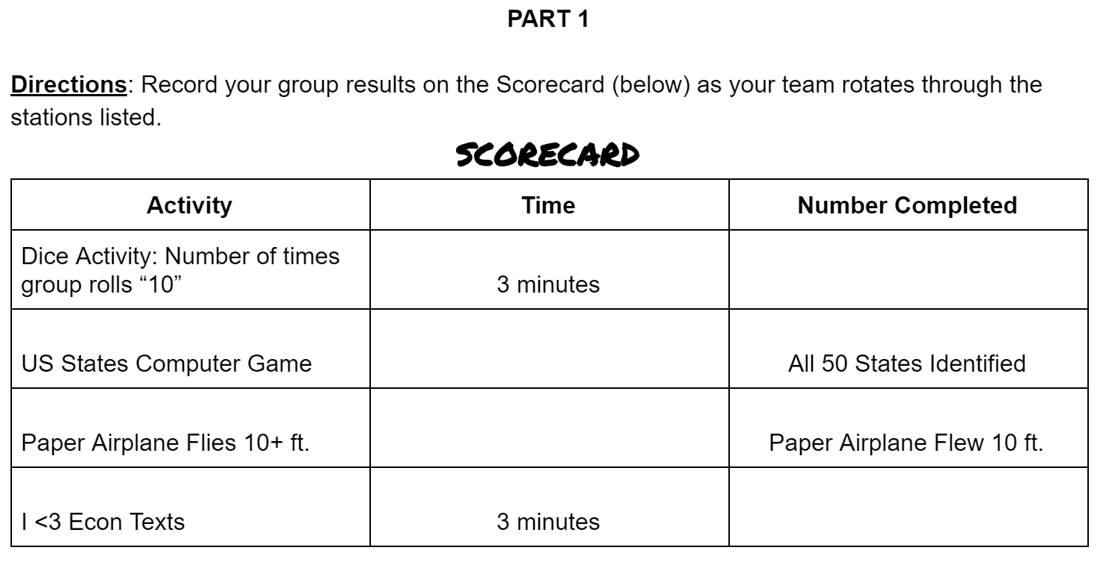
Absolute and Comparative Advantage Activity

Slide 29
Output Example
 | Team 1 | Team 2
Texts
Dice
Output Example
Who has the absolute advantage in sending texts? Rolling “10” on dice?
Who has the comparative advantage in sending texts? Rolling “10” on dice? Why might this be different than absolute advantage?

Slide 30
Input Example
 | Team 3 | Team 4
Map
Paper Airplane
Input Example
1. Who has the absolute advantage on completing the map? Paper airplane flying 10ft.?
2. Who has the comparative advantage in completing the map? Having the paper airplane fly 10 ft.? Why might this be different than absolute advantage?

Slide 31
Assessment Questions
What is the opportunity cost when a student decides to attend college?
Should you do all you can to earn a perfect grade of 100 on your next economics exam?
How is cost-benefit analysis used in decision making?
How is marginal analysis used in decision making?
What is the difference between comparative and absolute advantage?

Slide 32

CEE Affiliates
https://www.councilforeconed.org/resources/local-affiliates/

