Slide 1
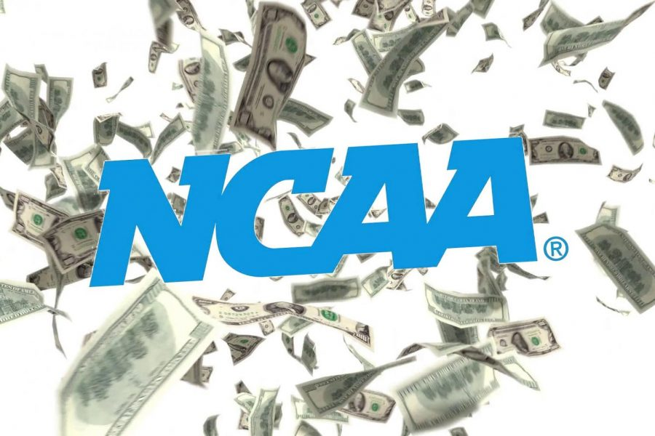
Economics of College Sports
How the NCAA Became A Powerhouse
John Kruggel
Associate Director for Program
JMU Center for Economic Education
10/20/2020 kruggejb@jmu.edu

Slide 2
EconEdLink Membership
You can now access CEE’s professional development webinars directly on EconEdLink.org! To receive these new professional development benefits, become an EconEdLink member. As a member, you will now be able to:
Automatically receive a professional development certificate via e-mail within 24 hours after viewing any webinar for a minimum of 45 minutes
Register for upcoming webinars with a simple one-click process
Easily download presentations, lesson plan materials and activities for each webinar
Search and view all webinars at your convenience
Save webinars to your EconEdLink dashboard for easy access to the event
You may access our new Professional Development page here

Slide 3
Professional Development Certificate
To earn your professional development certificate for this webinar, you must:
Watch a minimum of 45-minutes and you will automatically receive a professional development certificate via e-mail within 24 hours.
Accessing resources:
You can now easily download presentations, lesson plan materials, and activities for each webinar from EconEdLink.org/professional-development/

Slide 4

CEE Affiliates
https://www.councilforeconed.org/resources/local-affiliates/

Slide 5
Agenda
Where Sports and Econ meet
Rise of NCAA
Competition and the NCAA
Revenue for the NCAA
Pay for student-athletes
PACED decision-making and the NCAA
COVID’s impact on college sports

Slide 6
Objectives
I Can:
Identify how the NCAA resembles a cartel.
Critique the role of the NCAA in paying student athletes.
Understand how to use the PACED Decision- Making Model.
Recognize the role COVID has played in college athletics.

Slide 7
National Standards
Standard 2: Decision Making:
Effective decision making requires comparing the additional costs of alternatives with the additional benefits. Many choices involve doing a little more or a little less of something: few choices are “all or nothing” decisions.
Standard 4: Incentives:
People usually respond predictably to positive and negative incentives.

Slide 8
Key Terms
Cartel: An organization created from a formal agreement between a group of producers of a good/service to regulate supply in order to regulate or manipulate prices.
Trade-offs: All of the alternatives given up when making a choice.
Opportunity cost: The single next best alternative when making a choice.

Slide 9

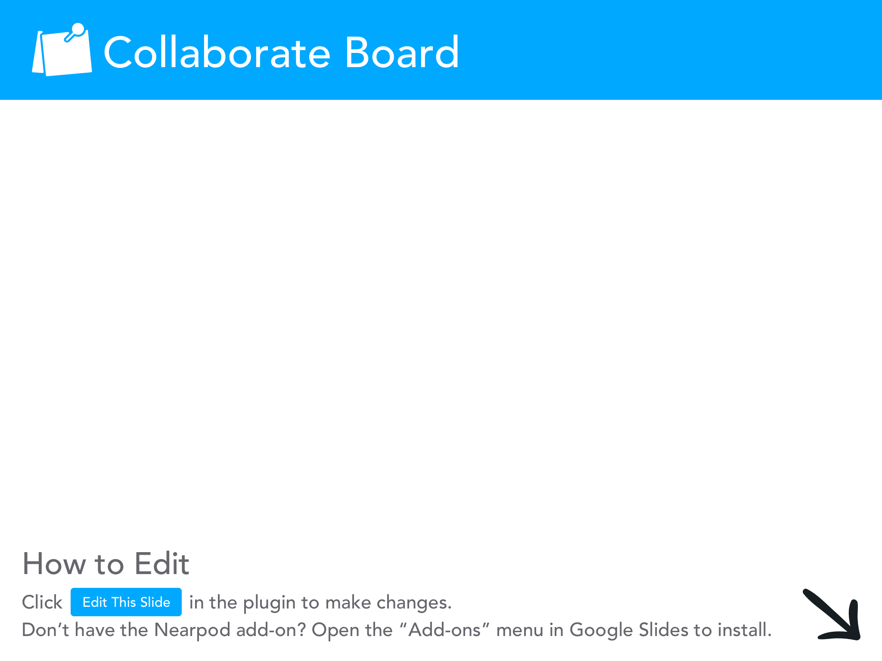

Slide 10
Where Sports & Economics Meet
How many TV shows/radio stations/newspaper columns/websites/social media sites are dedicated to sports?
How many shows are dedicated to Walmart or Pepsi?
“According to Forbes.com, the total revenues generated by the four largest North American sports leagues (basketball, baseball, football and hockey) totaled about $32.15B in 2017, which would rank 89th among the Fortune 500 list of largest revenue-generating companies.” --Leeds et al pg. 4
This is 1/16th of Walmart’s revenue and ½ of PepsiCo
Entire industries are built around sports (management, advertising, communications, etc.) BECAUSE SPORTS GETS PEOPLE’S ATTENTION.

Slide 11
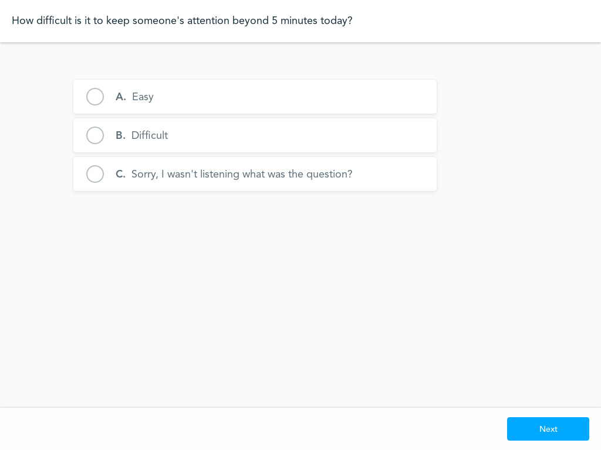
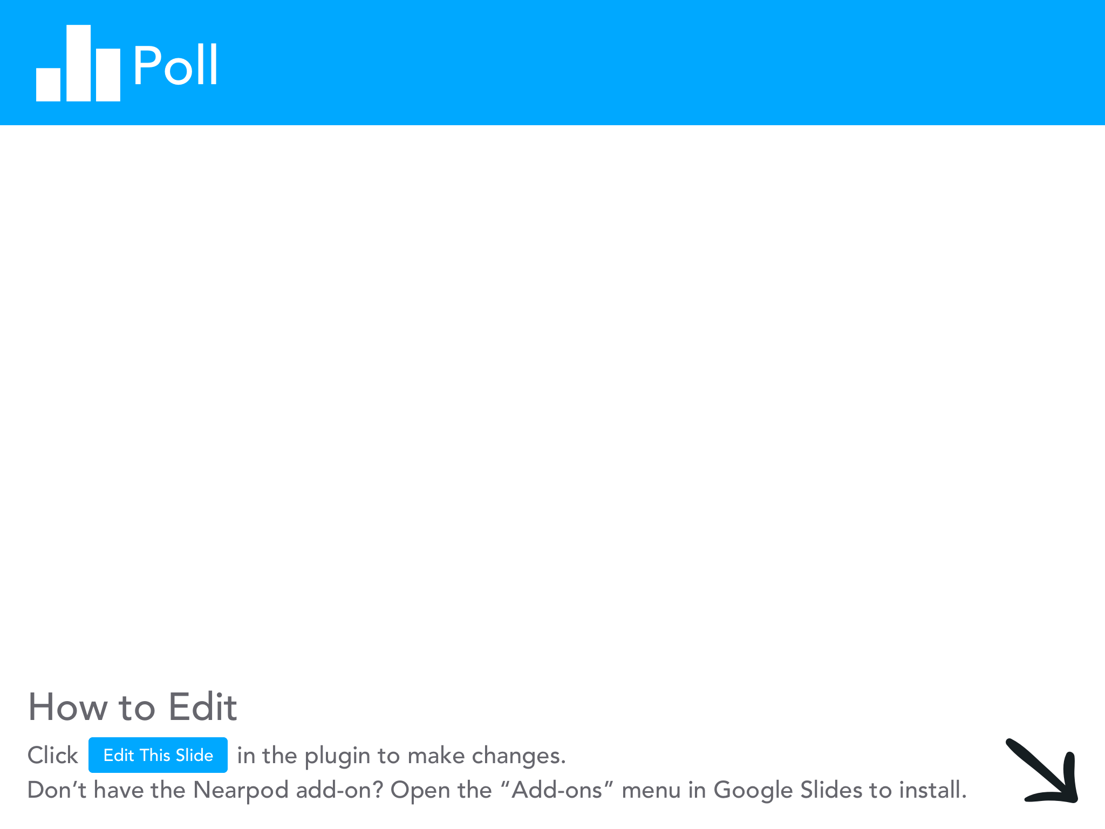

Slide 12
The Rise of the NCAA
The NCAA originated with the rise of college football in the late 1800s.
Students formed clubs to play each other. Each college had their own rules making it difficult to play each other. (points values, # of players, etc.)
  1905: 18 students were killed and 159 were seriously injured. Teddy Roosevelt warned the 3 powerhouse teams (Harvard, Yale, Princeton) to regulate football or it would be banned.
1910: NCAA was formed.
  Economists have referred to the NCAA as an incidental cartel: it didn’t start out as a cartel, but has evolved to become one. The NAIA is their main competitor.

Slide 13


Slide 14
Characteristics of a Cartel Displayed by the NCAA
The NCAA is a collection of schools that have come together to regulate intercollegiate athletics. They coordinate schools’ activities to fix the market price, assign output levels, divide revenue, erect barriers to entry by outside producers, all classic cartel activities. (Leeds et al 338)
Another item to consider, they also suppress wages of student athletes.
However, the NCAA was not originally formed to monopolize the market….thus, the incidental cartel title

Slide 15
NCAA Divisions
1973: D1, D2, D3 created.
1978: D1 splits into 1-A and 1-AA in part to drive up the revenue from football games on TV.
D1-A (FBS) rules: MUST have 16 varsity sports, offer 200 scholarships (worth AT LEAST $4M) & have average home football attendance of 15,000 over a 2-year period.
1998: BCS created. Technically outside of NCAA’s supervision (funding?)

Slide 16
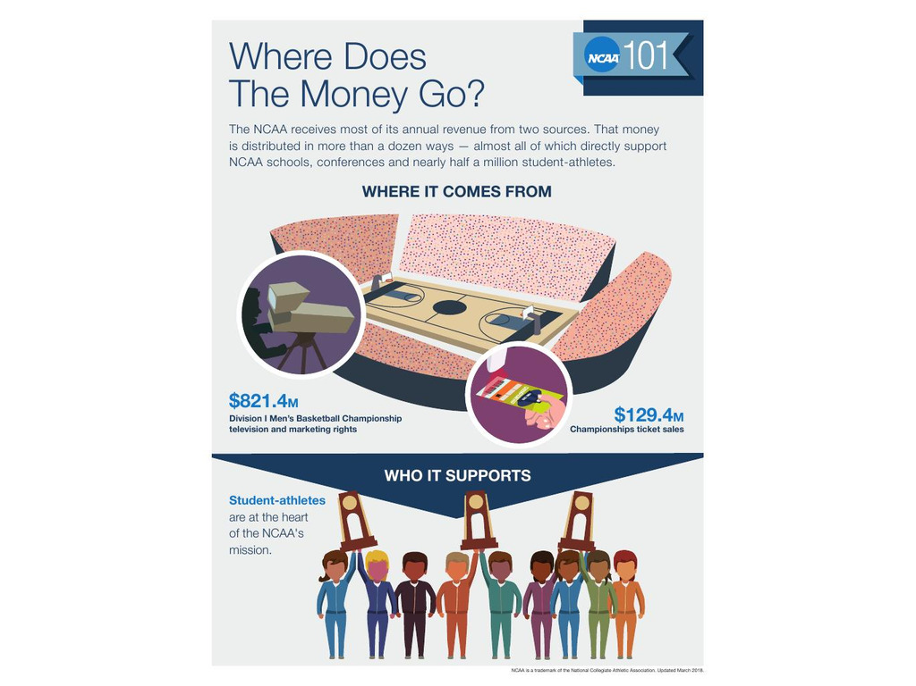
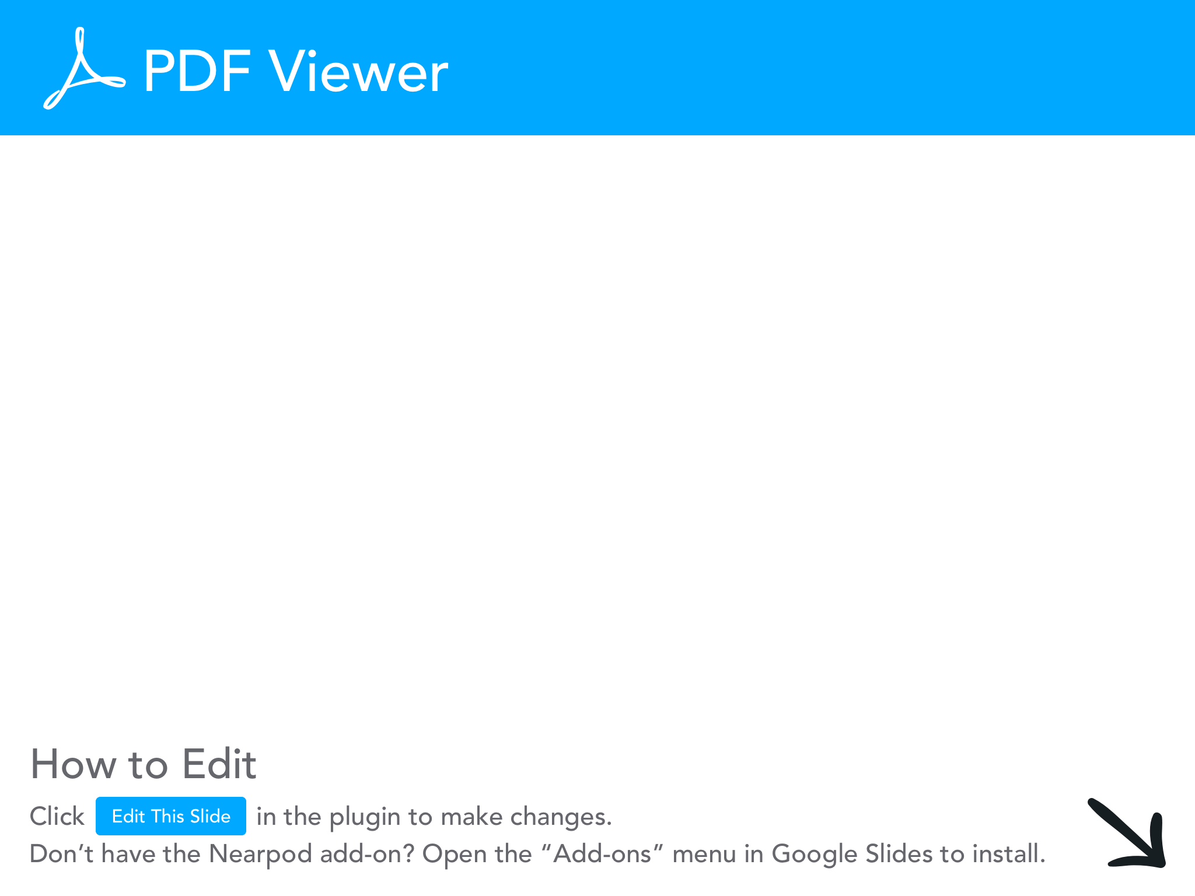

Slide 17
NCAA Revenue
The NCAA reported a revenue of $1.1B for 2017 (It’s a non-profit organization).
The NCAA gets most of its revenue from the NCAA basketball tournament.
  Television rights earned the NCAA $821.4M and ticket sales brought in another ~$130M.
The NCAA gets NO MONEY from the College Football Playoffs, that money goes directly to the conferences.
Also, many conferences have created their own TV networks and arrangements with networks for the majority of their games.

Slide 18
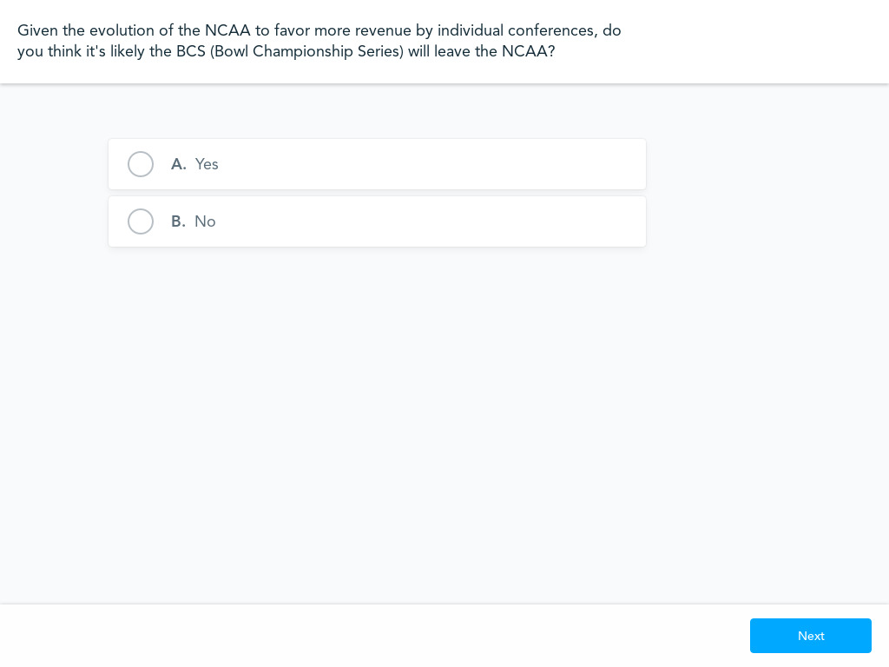

Slide 19
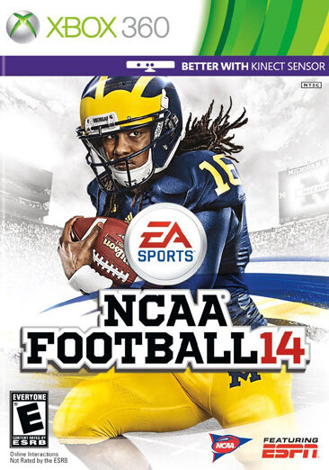
EA Sports
If you are my age, you probably played some version of the EA Sports NCAA games.
EA made ~$1.3B from its NCAA football game alone.
Why doesn’t EA make those games anymore?
  The last EA Sports game (NCAA Football) was released in the summer of 2013).

Slide 20
Ed O’Bannon
Ed O’Bannon played NCAA basketball for UCLA (forward from 1991-’95)
In 2009, O’Bannon sued the NCAA, Electronic Arts and Collegiate Licensing Co. over the revenue generated by his name, image and likeness.
  More athletes joined as the case grew.
Main point of the case:
  The NCAA was colluding and working with schools to prevent athletes from profiting from their name, image and likeness.
In 2013, EA paid a $40M settlement to almost 30,000 athletes due to this case.

Slide 21
O’Bannon, cont’d
In 2015, O’Bannon won his case against the NCAA.
  Decision stated NCAA didn’t have to pay athletes, they are not employees. BUT individual leagues COULD expand benefits to athletes. (Cost of Attendance).
In 2016, US Supreme Court declined to hear NCAA case.

Slide 22
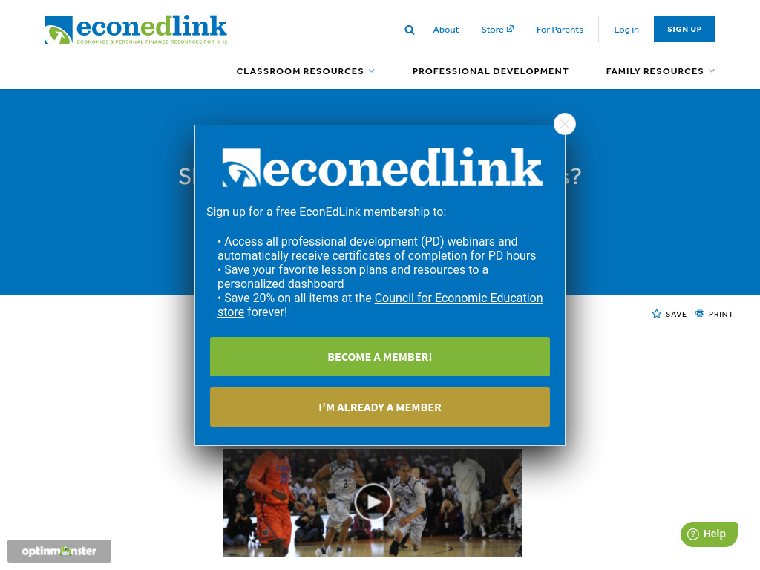
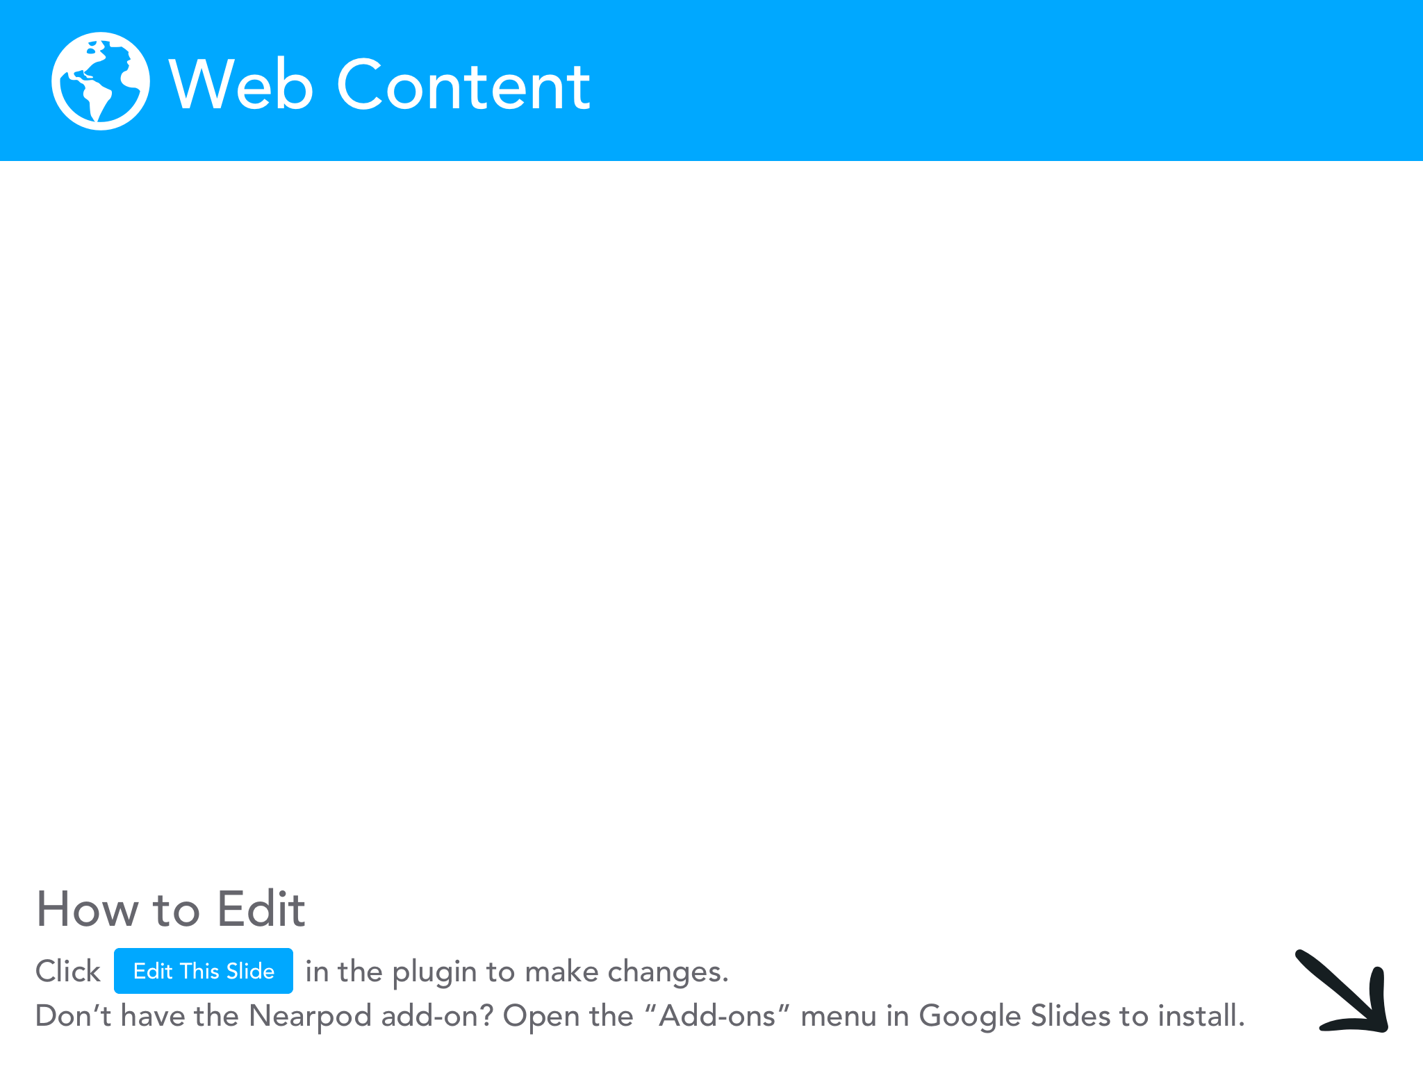

Slide 23
“Pay” of Student-Athletes
Student-athletes are not paid…..YET
  Cost of attendance was added in 2015 in an effort to offset student hardship.
    This includes: transportation costs, supplies and daily expenses while at school (additional $2,500-$4,000 per scholarship)
    What about Chase Young paying for tickets to the Rose Bowl?
Many argue they can use their time in college to invest in academic and athletic skills, that’s their pay.

Slide 24
Evidence...
So, if part of the “pay” for student-athletes is their academic preparation, what does the evidence show?
  Student-athletes in football and men’s basketball do not have the same academic preparation as non-athletes.
    Changes made in admission requirements has offset this (in some studies).
  Male athletes in general underperform academically at both major sports powers and academically oriented institutions.
  Women show no such ill-effects.

Slide 25
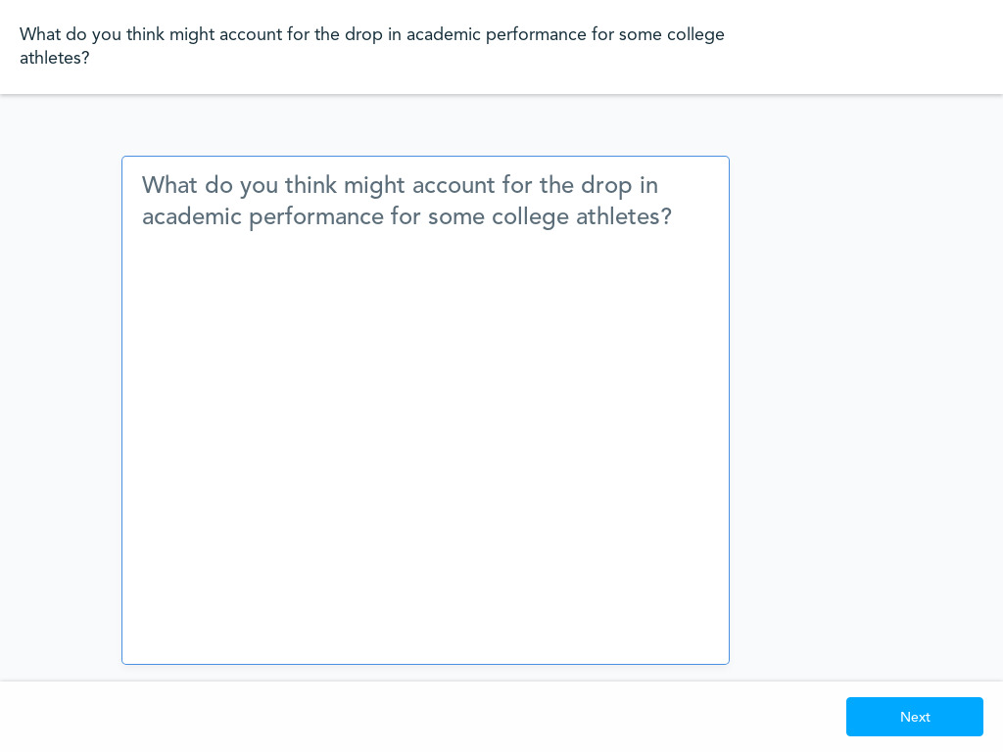
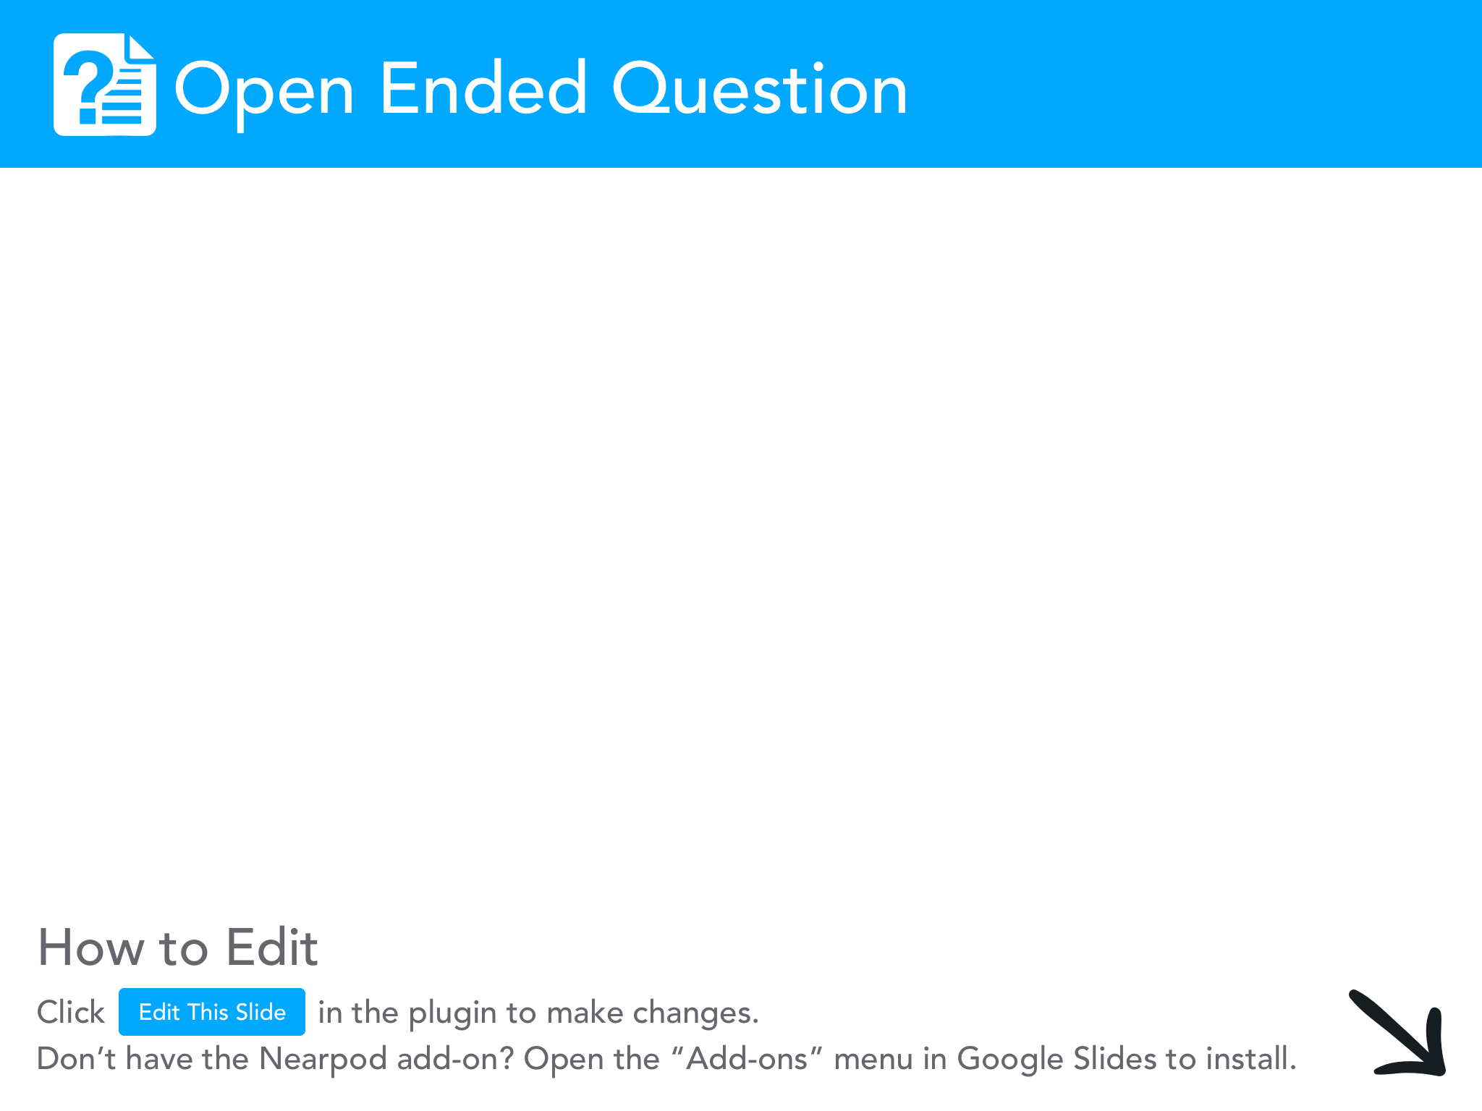

Slide 26
New Rules
In September 2019, California signed the Fair Pay for Play Act into law.
  Florida, South Carolina, New York, Colorado all either had laws in their legislature or were working on their laws. There was even a law being proposed in Congress.
On October 29th 2019, the NCAA Board of Governors responded by voting unanimously to direct their 3 divisions to allow athletes to enter into contracts with corporations and other parties to receive compensation for their personal brand or celebrity.

Slide 27
Power 5
Average payout for EACH Power 5 league (in millions) per SB Nation in 2018:
SEC: $40.9
Big Ten: $34.8
Big 12: $34.8
Pac-12: $29
ACC: $27
  Note: these are averages received PER SCHOOL in each of these conferences!
  More on this later with COVID….

Slide 28
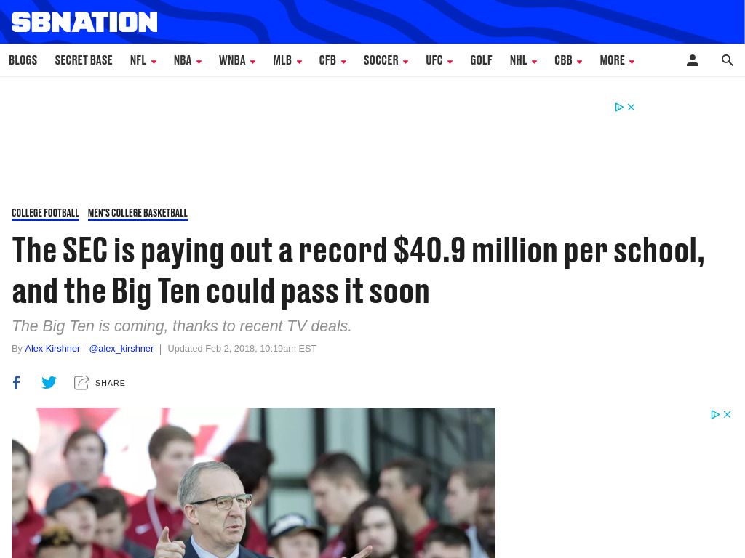

Slide 29


Slide 30
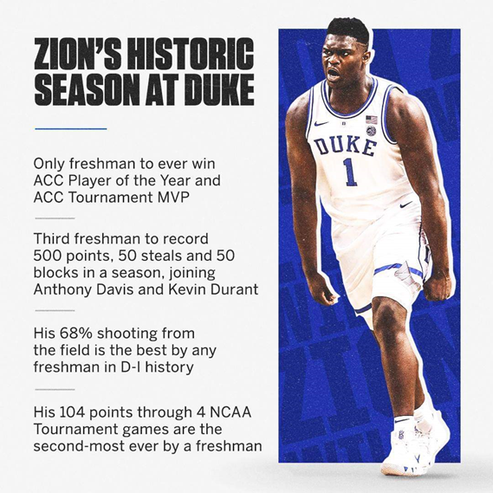
Decision-Making
Zion Williamson was widely considered to be the best player in all of men’s college basketball.
Many believed he was ready for the NBA and could have skipped the NCAA if the NBA rules were different.
BUT, like everyone, Zion did have other options….

Slide 31
PACED Model
Problem: Should Zion have skipped the NCAA?
Alternatives: Does he have any?
NCAA
Europe
NBA “G League” (now paying athletes $7,000-$25,000/month)
Criteria: What should Zion consider with each alternative?
Evaluate:
Decide:

Slide 32
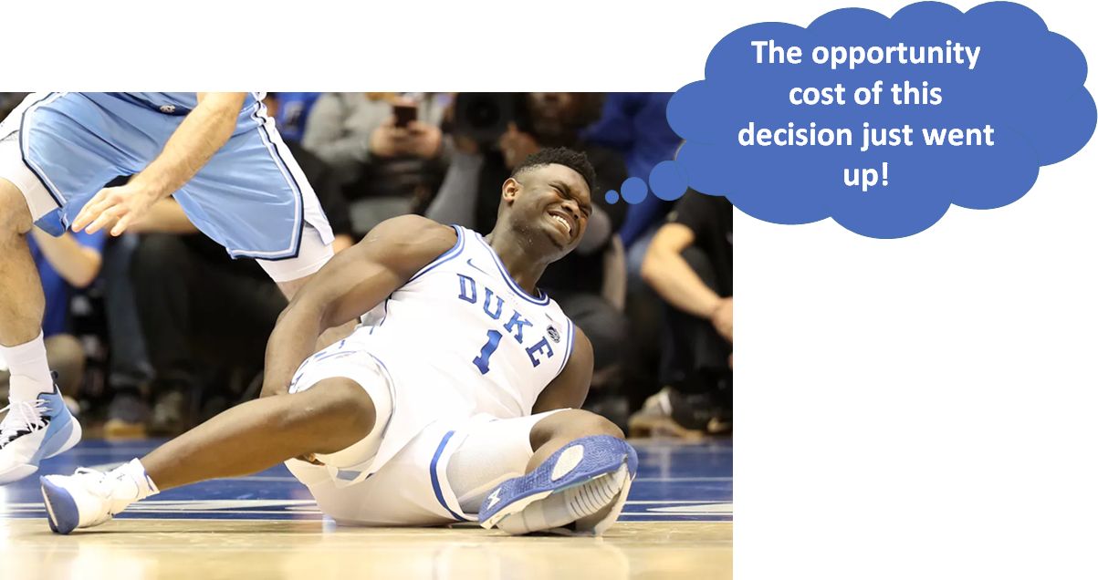

Slide 33
COVID’s Impact
Loss in revenue will lead to non football or basketball sports being cut.
  Stanford is cutting 11 sports for next year.
NCAA on the ropes? Given their main source of income is the March Madness tournament (which was cancelled) it stands to question whether or not they can survive much longer (especially if COVID’s impact lasts through Q2 of 2021).
Big Ten and Pac-12 back on for football, but COVID is starting to hit football teams…..so…..
Increase in student voice?
Will Notre Dame stay in the ACC?
What will happen with student scholarships?

Slide 34
COVID Fines
The SEC (not the NCAA) has started to threaten to withhold conference revenue sharing for schools who don’t comply with COVID protocols ($100,000/offense).
Suspensions may be the next step.
This comes after criticism from the Texas A&M/Florida game.
  Dan Mullen said the crowd played a role in Florida’s loss and wanted to “Pack the Swamp” with 90,000 fans for the LSU game.
  Florida had 19 players test positive.
  The crowd for the A&M game was trending on social media…

Slide 35
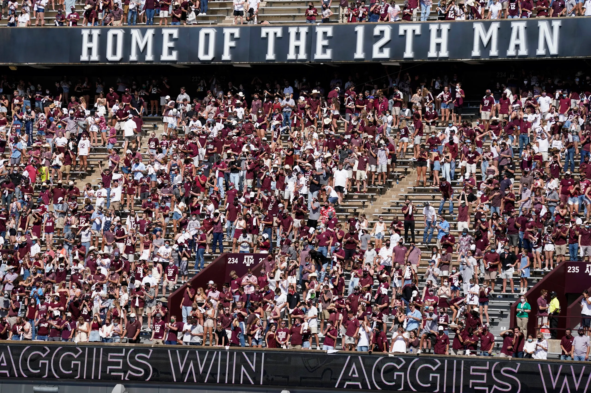
USA Today pic

Slide 36
Local Money
Recent studies are suggesting colleges (and some local businesses) will also be hurt by the loss in fans for college football games.
Parking fees
Concessions
Local restaurants (Ann Arbor doubles in population every home game)
  HOWEVER, most sports economists argue the revenue generated for local economies due to games is drastically over-inflated. So, maybe this is an inflated risk

Slide 37
Thanks!
Questions?
Thank you all for attending, hopefully your MB › MC!
Are there any questions?

Slide 38




Thank You to Our Sponsors!

