Slide 1
Economics 101
Scarcity, Micro & Macroeconomics
Presented by: Amanda Stiglbauer
Blythewood High School, SC
May 7, 2020
Amanda.Stiglbauer@moore.sc.edu

Slide 2
EconEdLink Membership
You can now access CEE’s professional development webinars directly on EconEdLink.org! To receive these new professional development benefits, become an EconEdLink member. As a member, you will now be able to:
Automatically receive a professional development certificate via e-mail within 24 hours after viewing any webinar for a minimum of 45 minutes
Register for upcoming webinars with a simple one-click process
Easily download presentations, lesson plan materials, and activities for each webinar
Search and view all webinars at your convenience
Save webinars to your EconEdLink dashboard for easy access to the event
You may access our new Professional Development page here

Slide 3
Professional Development Certificate
To earn your professional development certificate for this webinar, you must:
Watch a minimum of 45-minutes and you will automatically receive a professional development certificate via e-mail within 24 hours.
Accessing resources:
You can now easily download presentations, lesson plan materials, and activities for each webinar from EconEdLink.org/professional-development/

Slide 4

Agenda
Scarcity & Opportunity Cost Activity
Econ Content & Kahoot
Micro & Macro Economics
  Political Cartoons
  News Headlines
Productive Resources
  Push Ups and Texts
  Video Clips

Slide 5

Objectives
I can:
  Understand the fundamental principles of economics.
  I can use current events and other activities to build student engagement and understanding of economic principles.

Slide 6
National Standards
Standard 1: Scarcity
Productive resources are limited. Therefore, people cannot have all the goods and services they want; as a result, they must choose some things and give up others.

Slide 7


Peter Pan & Tinkerbell take you to Neverland!
Suppose that everything disappears . . . except you and a few friends.
You have 1 minute to write a list of everything you want to take to Neverland
Notes:
7

Slide 8
Peter Pan & Tinkerbell take you to Neverland!
Tinkerbell’s New Rule:
You can only take two items
Suppose that everything disappears . . . except you and a few friends.
You have 1 minute to write a list of everything you want to take to Neverland
Notes:
8

Slide 9

Why Can’t You Have It All?
What limits your decision on what to take to Neverland?
Time constraint –
1 min for the list
Physical constraint –
Only take two items
Notes:
9

Slide 10
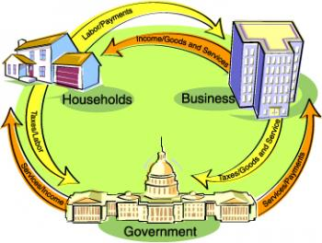
ECONOMICS:
The social science
concerned with the
efficient use of limited
or scarce resources to
achieve maximum
satisfaction of human wants.

Slide 11

Why?
Purpose of the candy exercise?

Slide 12

It’s all about choices!

Slide 13
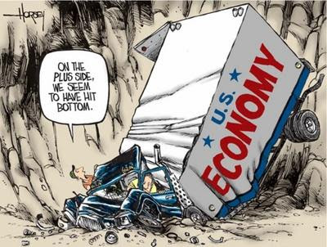


Two branches of Economics
Macroeconomics
Microeconomics
Larger scale, economy as a whole
Government policy
Unemployment, inflation
Choices made by individuals, households, businesses (firms)
Small scale

Slide 14
Basic Economic Concepts
Kahoot
Scarcity
Choice
Opportunity Cost
Incentives
Productive Resources
Microeconomics
Macroeconomics

Slide 15

Political Cartoon Analysis
1 – Give the literal
meaning of this cartoon.
2 – Explain the cartoon’s
symbolism.
3 – How does it describe
scarcity, choice, opportunity cost?
4- Does the cartoon best illustrate microeconomics or macroeconomics? Why?

Slide 16
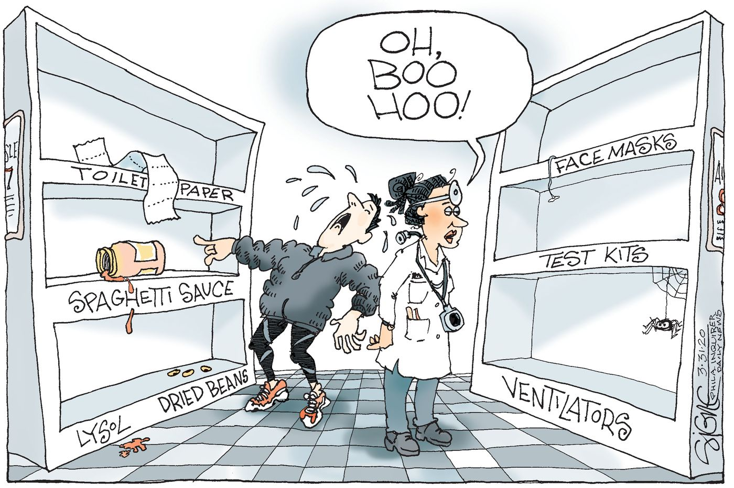

Slide 17
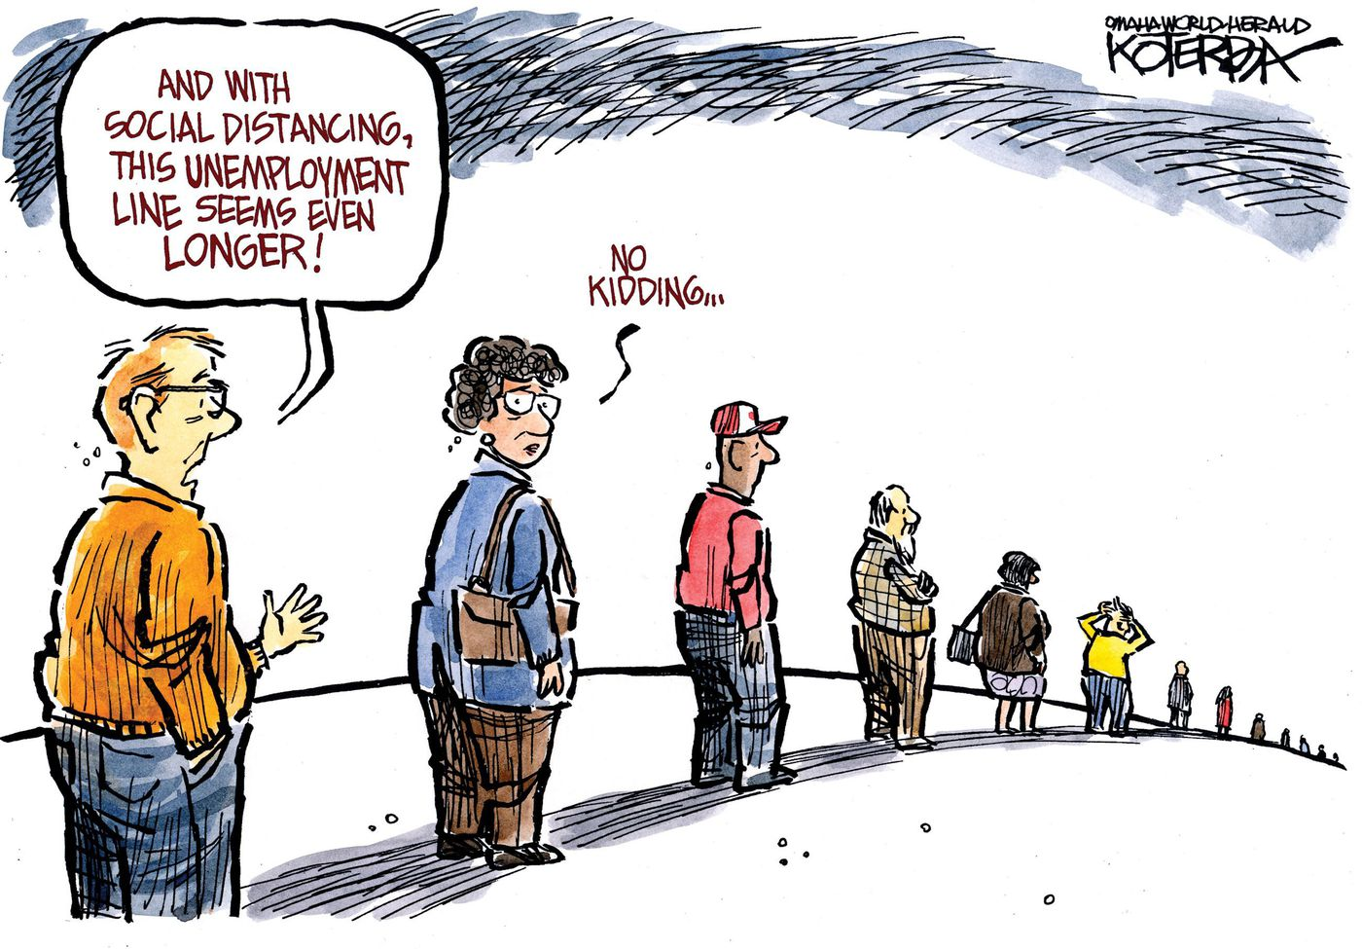

Slide 18
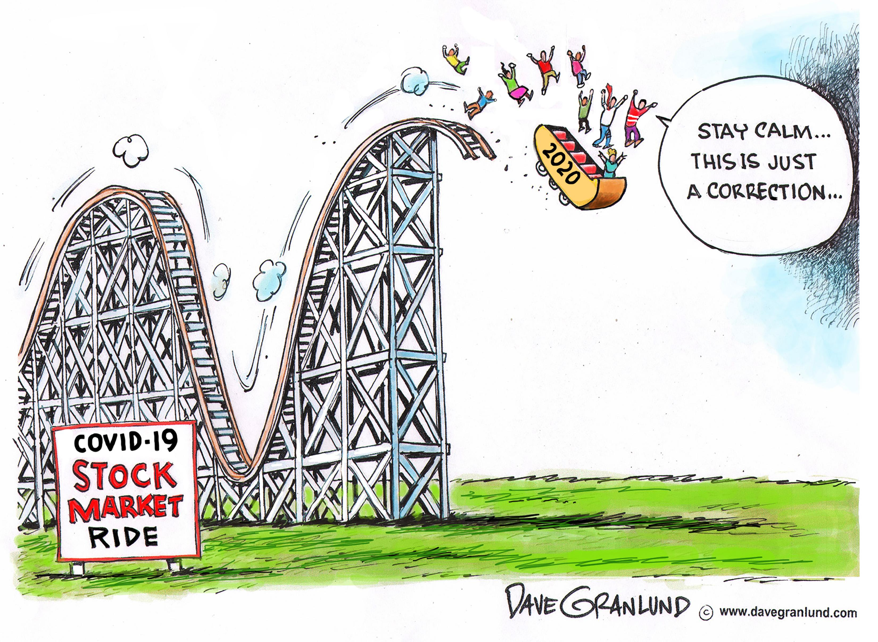

Slide 19
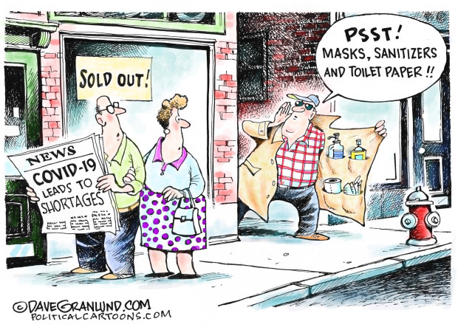

Slide 20
Scarcity Isn’t Optional
Resources (including time) are limited and human wants and needs are unlimited – so we are always constrained
Fact: All Resources are limited
  Land (57,506,000 sq mi. & not even all habitable!)
  Labor (7.8 billion souls x 24 hrs a day)
  Capital ($$ less than ∞, trust me ☺)
  Entrepreneurship (not everybody is Jeff Bezos)
Notes:
20

Slide 21
Although we cannot have it ALL, we can have SOME of it….
BUT scarcity forces us to choose!!!
  What shall we have?
  How shall we produce it?
  Who will get it?
Notes:
21

Slide 22
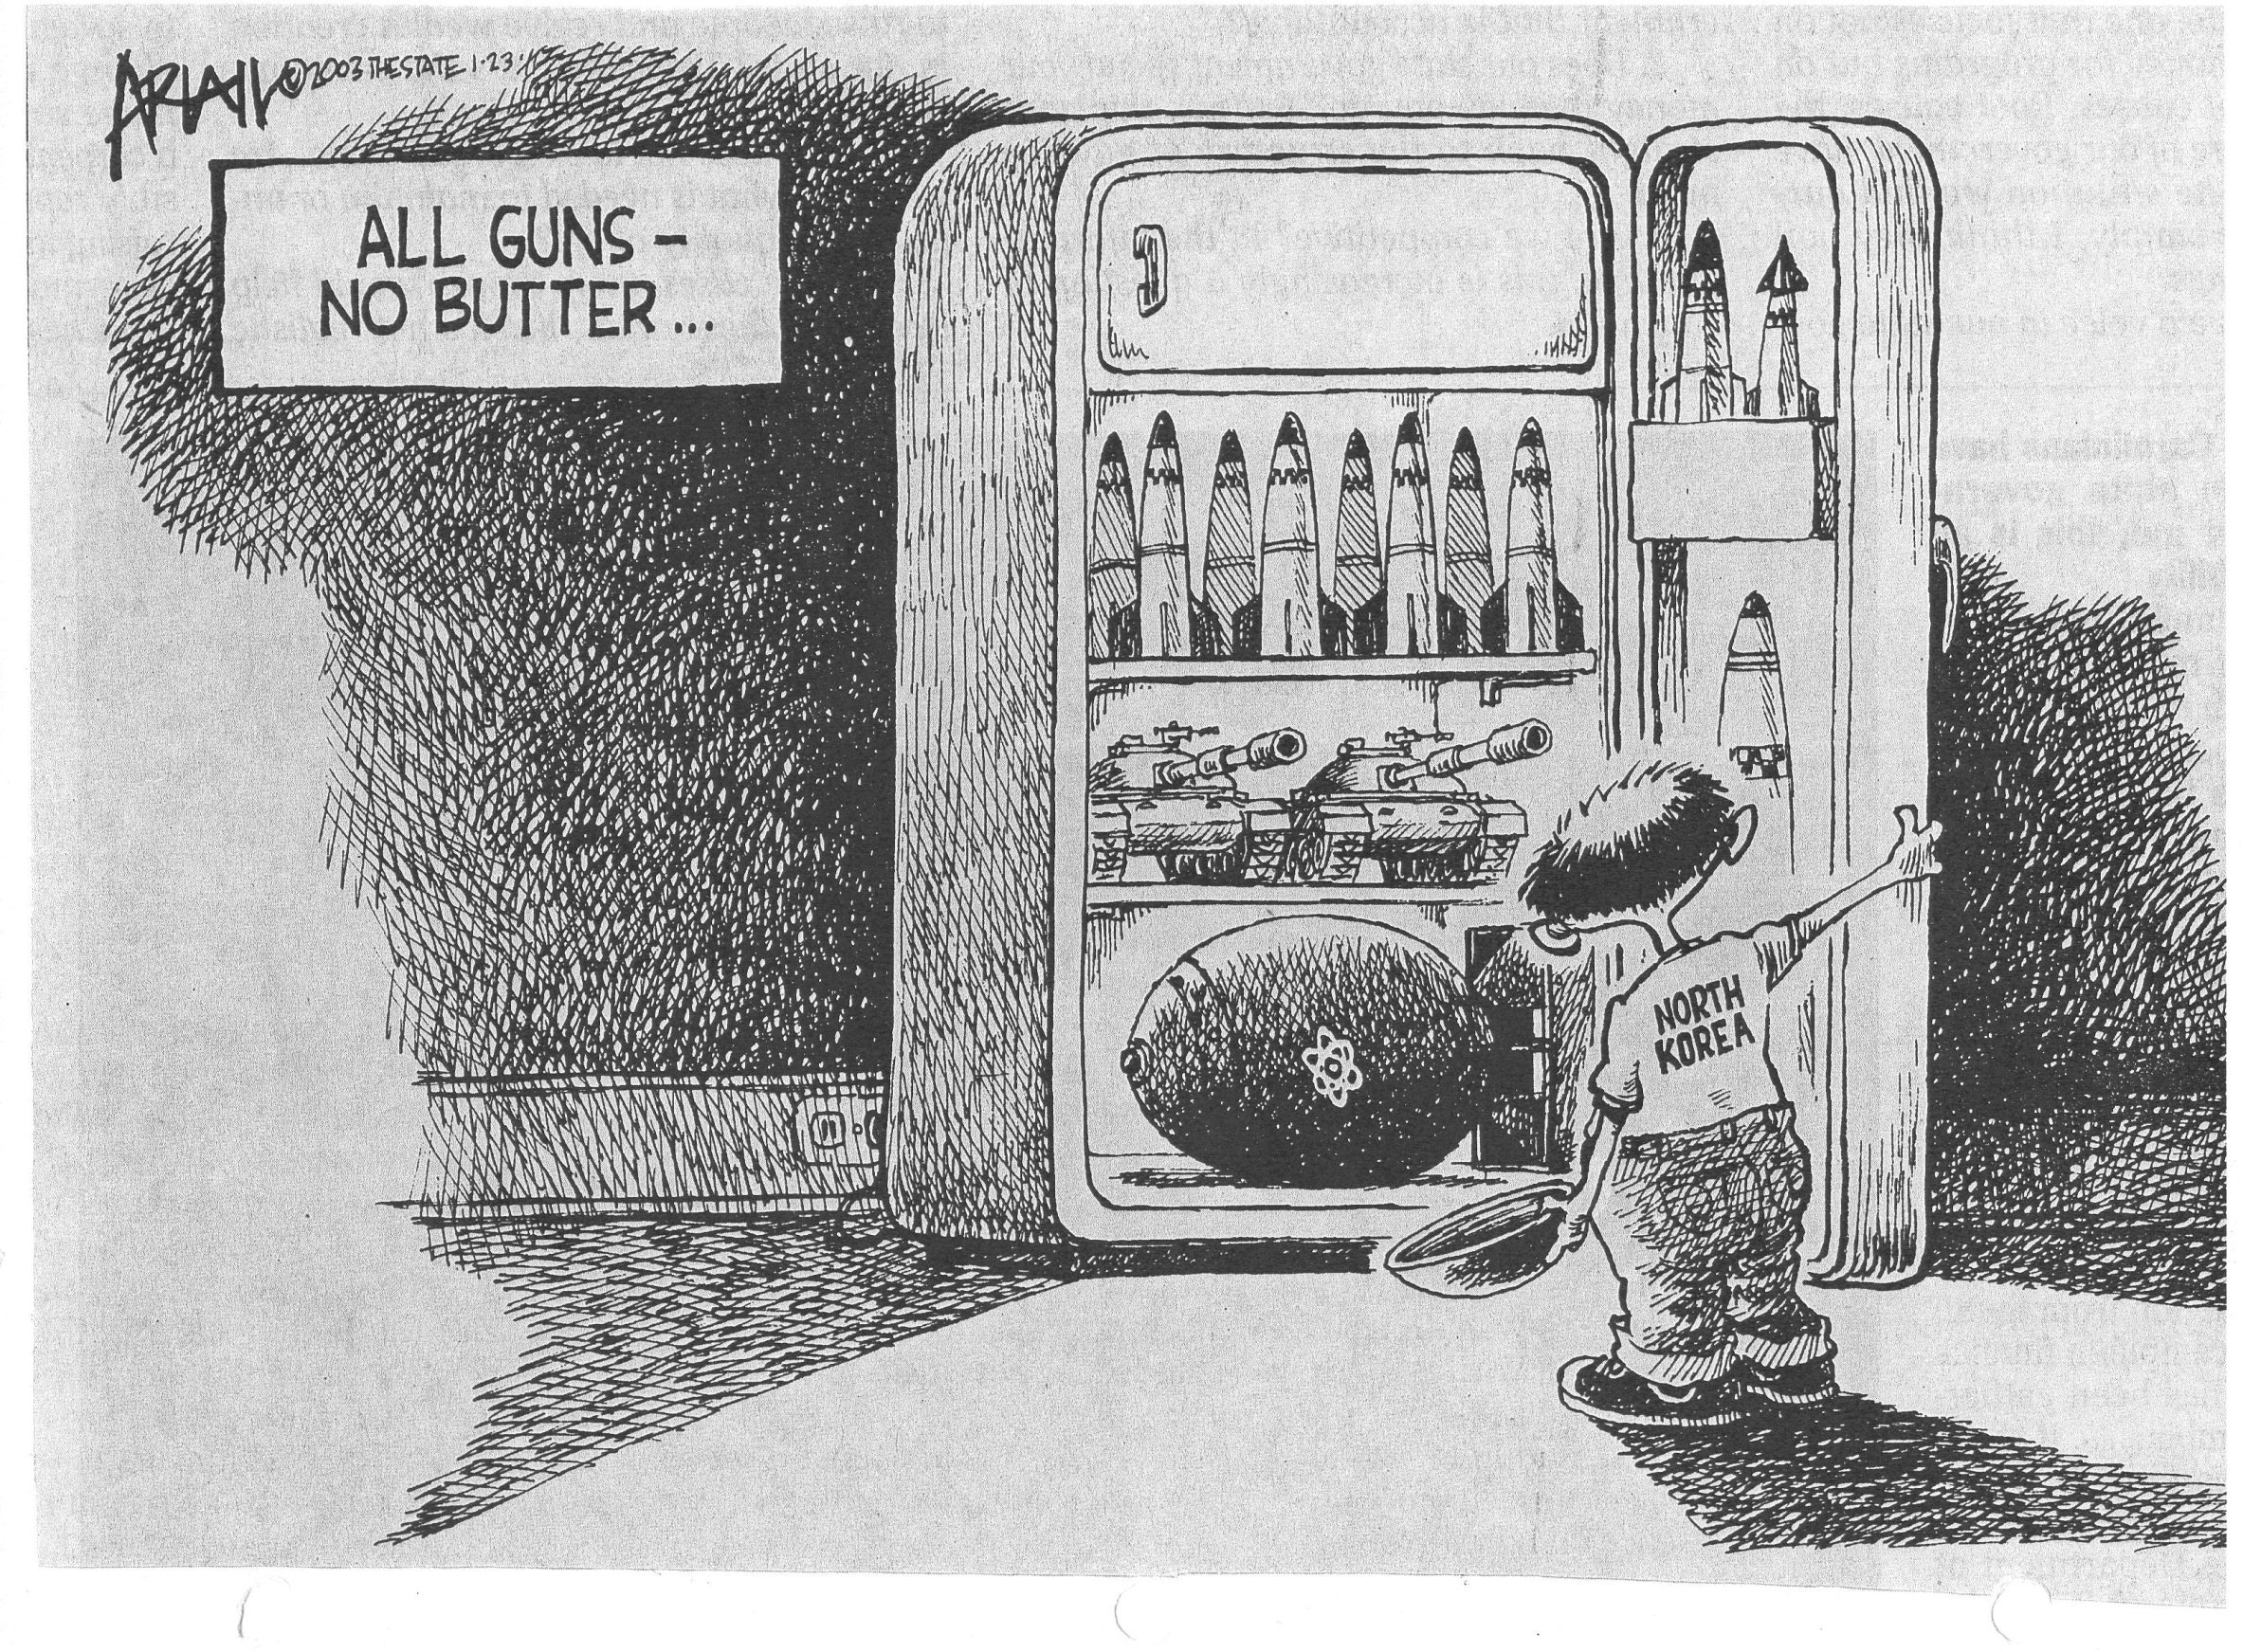

Slide 23


Texts & Push Ups
An introduction to the Production Possibilities Frontier

Slide 24
Teams of 4
Round | Texts | Push-Ups
1
2
3
4
5
Push Upper
Texter
Counter: Count Push Ups & Texts
Recorder

Slide 25
I <3 Econ
Limited Resource: Time
Round 1: Push-ups (30 seconds)
Round 2: Push-ups (20 Seconds)
Texting (10 Seconds)
Round 3: Push-ups (15 Seconds)
Texting (15 seconds)
Round 4: Push-ups (10 Seconds) Texting (20 Seconds)
Round 5: Texting Only (30 Seconds)
Push-ups
Texts

Slide 26


Concrete Pouring in Mali: http://www.youtube.com/watch?v=EYg-cHe79hI

Slide 27
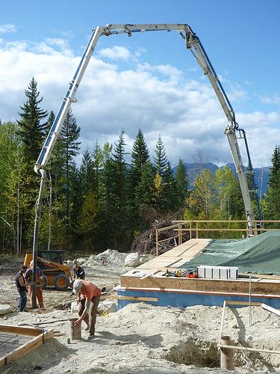
American concrete pour:
https://www.youtube.com/watch?v=9I680M9Mt8c

Slide 28
Bangladeshi Bricklayer :
http://www.youtube.com/watch?v=xaO3Z4G4Jso&feature=related

Slide 29
Assessment Questions
Kahoot Link Here
What is economics?
Which branch of economics studies the decision making process of individuals and business firms?
What are society’s productive resources? Give examples of each.
What is the next best alternative given up when a decision is made?

Slide 30

CEE Affiliates
https://www.councilforeconed.org/resources/local-affiliates/

