Slide 1
Personal Finance for Educators, Pt. 1: Budgeting and Debt Management
Doug Young
CEO - Financial Coach
October 7, 2020

Slide 2
EconEdLink Membership
You can now access CEE’s professional development webinars directly on EconEdLink.org! To receive these new professional development benefits, become an EconEdLink member. As a member, you will now be able to:
Automatically receive a professional development certificate via e-mail within 24 hours after viewing any webinar for a minimum of 45 minutes
Register for upcoming webinars with a simple one-click process
Easily download presentations, lesson plan materials and activities for each webinar
Search and view all webinars at your convenience
Save webinars to your EconEdLink dashboard for easy access to the event
You may access our new Professional Development page here

Slide 3
Professional Development Certificate
To earn your professional development certificate for this webinar, you must:
Watch a minimum of 45-minutes and you will automatically receive a professional development certificate via e-mail within 24 hours.
Accessing resources:
You can now easily download presentations, lesson plan materials, and activities for each webinar from EconEdLink.org/professional-development/

Slide 4
Objectives and Agenda
Preparing today for your financial future.
Identifying the players who deal with debt and try to help people.
Establishing your “net worth” and building a budget.
Setting personal financial goals.
Attacking debt and building economic empowerment.
How saving can help you build wealth.
Finding money within your existing finances and budget.
Credit reports and scores: How to deal with them.
What are my next steps to financial security?

Slide 5
Who’s Who When Dealing with Debt!
Financial Counselor – Certified professionals helping people get out of debt, build up an emergency fund and catch up on bills that have gone unpaid.
Financial Planner – Certified professionals people turn to meet big financial goals like buying a home, paying for children’s college or saving for retirement.
Financial Consolidator – A person who can help you take out one, large loan and consolidate all of your personal debt and spread the loan out to pay off a personal debt, credit cards, student loans, auto, and medical. “Cavet Emptor”.
Financial Coach - A financial coach is someone who will help you understand the basics of personal finance and help you develop and maintain healthy financial habits. They typically work with clients who want to save money, create a budget, pay off debt or improve their financial status.

Slide 6
Quiz: Is a Financial Time Bomb Looming?
Americans retiring are in the worse financial shape since President Carter.
The median income of the American family is $45,372.
The average personal debt of the American family is $93,060.
The vast majority of Americans have under $1,000 saved for emergencies.
The average credit card balance is $3,200 with most American holding 12 cards.
Typical American household has an average of $8,863 in a savings bank.
Avg. Social Security yearly wage payout is $12,036/year at age 65.
50% are paying off debt for health care, mortgage, credit, education, etc.
During the “Great Recession,” many saw a 15-20% drop in the NYSE and froze their accounts.
80% of families (55 -70) lack the funds to maintain their S.O.L. in retirement.
Many will stay on present job to age 65 or take menial jobs as senior citizens.

Slide 7
Answers
Americans retiring are in the worse financial shape since Harry Truman was President.
The median income of the American family is $61,372.
The average personal debt of the American family is $93,060.
The vast majority of Americans have under $1,000 saved for emergencies.
The average credit card balance is $6,200 with the typical American holding 4 credit cards.
Typical American household has an average of $8,863 in a savings bank.
Avg. Social Sec. yearly wage payout is $18,036 per year with most taking it at age 62.
50% are paying off debt for health care, mortgage, loans, credit card, education, etc.
During the “Great Recession”, many saw a 20-40% drop in the NYSE and froze their accounts.
40% of families(55 -70) lack sufficient funds to maintain their S. O. L. in retirement.
Many will stay on present jobs to age 70 or take menial jobs as senior citizens.

Slide 8
Needs and Wants
What is the difference…
Needs are things you use or require every day.
Wants are things you would love to have but can live without.

Slide 9
Good Debt and Bad Debt
Good Debt: Car loan and home. Save to buy special wanted item. Things I need and can afford.
Bad Debt Things I want, not need. Things that make me feel good (conspicuous spending). Have no long term value or growth potential.
Borrow strategically will help you meet long term goals.
“What Is My Net Worth?”

Slide 11
Ben Franklin says:
“By failing to prepare, you are planning to fail.”
Six Steps to Retirement

Slide 12
1. Determining When to Retire
The closer your retirement date, the less aggressively you need to invest.
If you don't reduce your equity exposure as you near your retirement date, you risk entering a bear market in the years before retirement.
On the flip side, not investing aggressively while you're younger means your accounts won't grow as well as they otherwise would.
Both outcomes might leave you w/o enough money during your retirement.
Younger workers may feel retirement planning premature – but it’s vital.
The date you pick is a target, and it's not set in stone.
Be flexible throughout the years if your life changes unexpectedly.
Major life events may force you to update your plan.

Slide 13
2. Income Sources
Do you have a pension?
At what age will you take Social Security?
How much money will you receive each month?
Audit your present retirement income sources:
Pension and Social Security
Tutoring, secondary job
Other retirement income sources:
403b, 401k, Roth IRA, annuities, royalties!
RMD, rental income, trust, dividends and capital gains, etc..

Slide 14
3. Assessing Expenses
How much you spend during retirement also matters.
Absence of monthly deductions (mortgage, car loan, state income taxes) will affect your monthly costs.
If you don't have many income sources, you'll cover your expenses by tapping your investment accounts.
Studies show that a 50% stock/50% bond portfolio, with a 4% each year will sustain your funds over a 30 years.
You'll want to keep your expenses low enough that your withdrawals don’t exceed that amount.

Slide 15
4. Adjusting for Inflation
Inflation means that costs of goods and services tend to increase.
Remember your grandparents complain about how everything costs more now today than when they were young, that's inflation.
Adjust the amount of money you'll need each year.
Inflation usually runs about 2% annually but can fluctuate.
Remember to compound that figure for every year in retirement.
That number may not seem like much year to year.
Over 20 years retired, expect the price of most goods and services to double.

Slide 16
5. Determining Asset Allocation
Asset allocation determines asset classes and distribution of money
It is the driving force behind how much your accounts will grow.
Conservative investing, may not grow your funds enough.
You could fall short of your retirement goal.
If too aggressive, you get swamped by market volatility.
Many sell out of their investments and fail to meet retirement goals.
Your asset allocation model will take into account your risk-taking ability, with special attention paid to your personal feelings about volatility and your past reactions to market declines.

Slide 17
6. Making Up for Gaps
After taking all of this into account, you'll come up with one of three scenarios:
You're saving more than enough and can splurge some during retirement!
Your money will last long enough in retirement, given your life expectancy.
You end up with a gap. Income generated is less than your expenses, and you won't have enough money to live off of during your entire retirement.
If you find yourself in the latter scenario, you can still make up for the gaps.
Part-time during retirement can supplement your income.
Winnow down expenses before you stop working can also improve this gap
You can also consider tweaking your asset allocation.
Investing in more stocks will help your accounts grow. Can you handle the extra risk?
No matter what, you absolutely must track your progress and make changes as needed.
A successful retirement is within reach. It takes time, diligence and action to make that dream comes true.
Achieving that goal starts with having a plan.

Slide 18
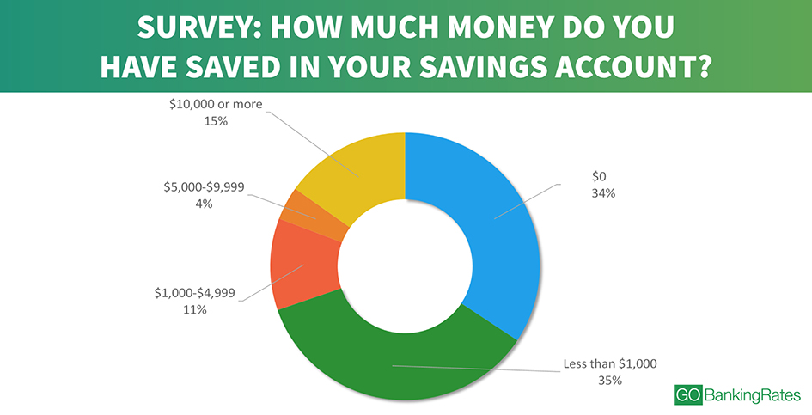

Slide 19
Financial Wellness Score
1. What do you feel is the level of your financial stress today?
1 2 3 4 5 6 7 8 9 10
2. How satisfied are you with your present financial situation?
1 2 3 4 5 6 7 8 9 10
3. How do you feel about your present financial situation?
1 2 3 4 5 6 7 8 9 10
4. How often do you worry about being able to meet normal monthly living expenses?
1 2 3 4 5 6 7 8 9 10
5. How confident are you that you could find the money to pay for a $1000 financial emergency?
1 2 3 4 5 6 7 8 9 10
6. How often does this happen to you? You want to go to eat, go to a movie or do something else and don’t go because you can’t afford to?
1 2 3 4 5 6 7 8 9 10
7. How frequently do you find yourself just getting by living paycheck to paycheck?
1 2 3 4 5 6 7 8 9 10
8. How stressed do you feel about your personal finances in general?
1 2 3 4 5 6 7 8 9 10

Slide 20
Interpreting Your Financial Wellness
To determine your score, add up the total number you circled and divide by 80.
Score | Descriptive Terminology
1.0 | Overwhelming financial distress/lowest financial well-being
2.0 | Extremely high financial distress/extremely low financial well-being
3.0 | Very high financial distress/very poor financial well-being
4.0 | High financial distress/poor financial well-being
5.0 | Average financial distress/average financial well-being
6.0 | Moderate financial distress/moderate financial well-being
7.0 | Low financial distress/good financial well-being
8.0 | Very low financial distress/very good financial well-being
9.0 | Extremely low financial distress/extremely high financial well-being
10.0 | No financial distress/highest financial well-being
The average mean score is 5.7 for the general population.
Thirty percent of the people scored between 1 and 4 while
Forty-two percent scored between 7 and 10.
Twenty-eight per cent were at 5 and 6 on the continuum.

Slide 21
Why Americans Are Under-Prepared For Retirement
29% have reduced or stopped saving for retirement due to the pandemic.
9% have withdrawn from retirement funds, delaying long-term goals.
21% of Americans haven't saved anything for retirement.
Almost 35% of millennials don't know how much to save!
Around 44% of millennials feel that student loans left them in a financially precarious situation for years.
39%+ believe credit card debt has affected their ability to save for retirement.
While Americans wish to retire by 50, most end up working till 65 or even 70.
Only 18% of people saving for retirement feel they'll have enough savings.
On average, they contribute only 3-5% of annual savings, whereas the recommended savings should be 10% of all earnings.
Only 31% above 65 use a Financial Advisor.
Social Security could run to run out or reductions in payments by 2034.
Newsweek, August 23, 2020

Slide 22
Dreaming About Your Goals “A goal without a plan is just a wish.”
Financial goals are personal benchmarks that you set throughout life.
Knowing your goals can help you save for them.
Goals can be added or changed as life’s situations change.
Put an approximate price tag on these and/or your financial goals.
How much for a bachelor/bachelorette party, wedding, etc.?
How much for a down payment on a car?
How much to pay for college in five years?
New heater, tires, head gasket on car, etc.?
What are some of your needs?
https://www.balancepro.net/pdf/MMP.pdf

Slide 23
Building wealth is like building a brick wall.
Needs and Wants
Why do I want it?
Does this match my values?
How important is this to me?
Set realistic goals.
Work to accomplish each step.
Prior to moving to the next step.
One brick on top of the other,
Make sure the wall is solid,
Add another brick.

Slide 24
Kick Start Your Way to Empowerment
Set goals.
short, medium and long term.
Have goals/objectives is half the battle
Create a budget.
Identify how much you spend and where.
Figure out where you can cut to start saving.
Appoint a family CFO (Chief Family Officer).
This is a family project not a one person goal.
If single, find an advisor or friend to help you.
Establish monthly budget meetings.
Review your plan and make adjustments, if needed.
If your income changes or expenses rise, make adjustments.

Slide 25
A Realistic Goal: Be “SMART”
Specific – Specific enough to suggest action. Save enough money to get a refrigerator, not just save money.
Measurable – Need to know when you’re close or achieved your goal. A refrigerator costs $600, and you have $300 already saved.
Attainable – Your goal need to be reasonable and possible. Can I save enough money to arrive at my goal within one year.
Relevant – Goal needs to make common sense and fits your needs. You don't need to save money for 18 pairs of shoes.
Time-related – Set a definite target date. Repairman says I need a new fridge in the next six months.

Slide 26
Adjusting Your Goals and Plan
If the amount you’re now saving falls short of what you need to save to reach your goals, ask these questions of yourself.
What is most important to you?
Are you paying yourself first?
Are you putting away 10% of after-tax income.
Can you increase your savings by earning more or spending less?
Did you set reasonable goals?
Could you delay the target date of any of your goals?
You need to re-evaluate your spending plan annually.
A budget is simply a priority list.
Following it allows you to use your money to satisfy your needs.
Don’t be afraid to re-adjust as needed but don’t cut your savings.

Slide 27
Why Create a Budget?
Short-term Goals – Accomplish within 1 year
Holiday gifts
Vacation
Paying off a credit card
Buying a new TV
Mid-term Goals - Accomplish within 1 - 5 years
Paying off all you credit cards
Purchasing a new car
Remodeling your kitchen
Saving for orthodontic work
Long-term Goals - Accomplish 5 years or longer
Buying a new home
Saving for a child’s education
Saving for retirement

Slide 28
Balance Financial Fitness Program: Money Management Planner
A guide to help you take control of your finances.
You can examine your past finances to create a plan for all future spending and savings.
A review of your expenses and spending habits will enable you to design a realistic monthly budget.
Be prepared to make some changes, if those habits have kept you from achieving your financial goals.
Worksheets:
Financial Goals
Net Worth
Essential Expenses
Discretionary Expenses
Monthly Income
Unsecured Debt (How to attack debt)
Weekly Expenses

Slide 29
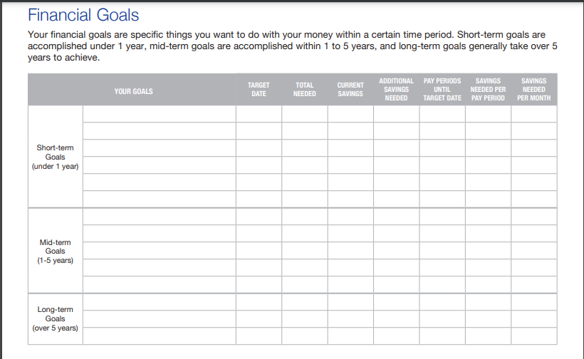

Slide 30
Why Can’t I Pay Bills or Save?
Easy credit tempts people to buy or charge.
Credit card balances can and get out of control.
Large amounts of disposable income are needed to pay them off.
Understand the difference between:
Good debt: car loan and home
Bad debt: Credit card purchases for wanted items.
To evaluate any progress with your goals, you must determine what your overall financial picture looks like today.
Determine your “Net Worth” to begin making SMART spending changes.
“Net Worth” = Total owned (assets) minus total owed (debt)

Slide 31
Danger Signs of Financial Trouble
Paying only minimum or missed payments on charge accounts.
Consolidating debts by borrowing from high interest lenders
Depending on overtime to cover monthly bills
Finding it impossible to save money
Withdrawing funds from savings to cover bills
Borrowing from friends and relatives to pay basic expenses

Slide 32
Do I Need a Credit Card?
Credit Scores are important because . . .
Employment opportunities
Lower insurance rates & interest expense
Easier access to additional credit
Building A Credit Score
Take out a car loan
Take out a credit card/store card and use it
Make timely payments
Take out a “credit builder” loan
Improving A Credit Score
Make payments on time
Pay off Liens, Judgments and Collections
Monitor Credit Lines

Slide 33
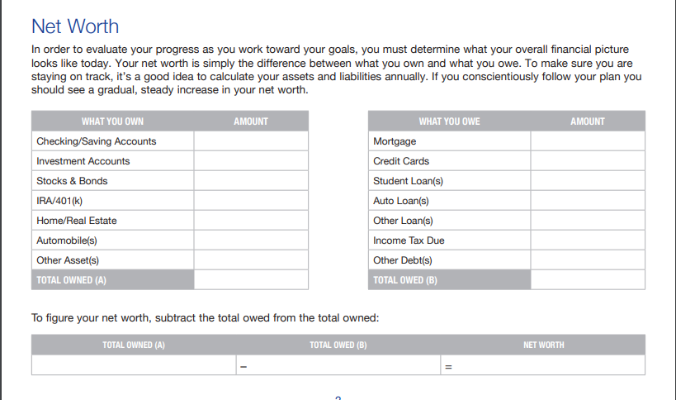

Slide 34
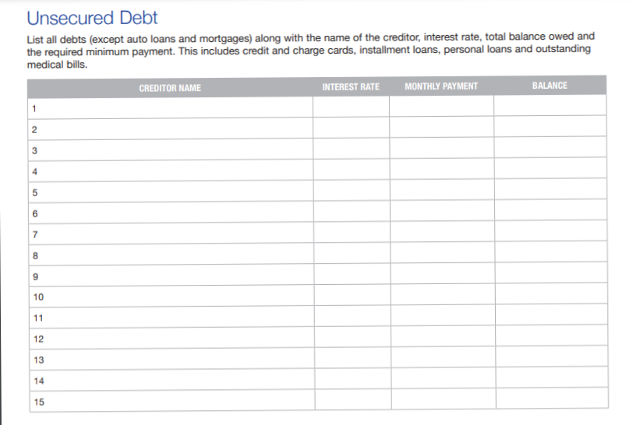
Subsidized Stafford College Loan*
2.75%
$200.00
$25,000.00
Mortgage
4%
$1,500.00
$200,000.00
Car Loan
8%
$250.00
$5,000.00
Macy’s
19.8%
$50.00
$700.00
Chase Travel Card
24.9%
$10.00
$2055.00
Chase Private Student Loan
3.2-14.5%
$100.00
$2000.00

Slide 35
Budgeting and Finance Planning
Better Money Habits
https://www.econedlink.org/resources/collection/better-money-habits/

Slide 36
What Makes Up a Budget?
Net Income – the amount you bring home after deductions (taxes, pension, etc.) Could include alimony, pension, social security , rental income, other)
Essential Living Expenses
Housing, utilities, food, transportation
Insurances (auto, life, home or apt., health)
Savings, tax payments (property, quarterly?)
Discretionary Expenses
Personal (barber/hairdresser, clothing, laundry, cosmetics, etc.
Entertainment (dining, sports, vacation, leisure activities)
Miscellaneous (pet care, alcohol, education, gifts, etc.)
Debt
Credit cards & store cards
Bank and personal loans (student, etc.)
Savings
Emergency fund (should be 4-6 months of liquidity)

Slide 37
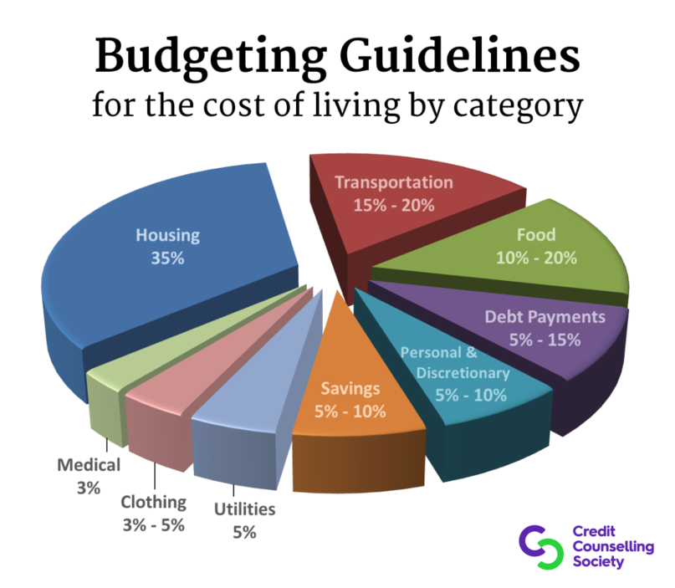
https://www.kiplinger.com/tool/spending/T007-S001-budgeting-worksheet-a-household-budget-for-today-a/index.php

Slide 38
Household Budget Worksheet
Target amounts for each expense.
Don’t inflate or underestimate your expenses.
Use take home pay as a basis of income.
Use a budget worksheet to develop a balanced budget.
Goal is to have disposable income of 5-10% of your total income.
Talk over with entire family why and how your are budgeting.
All (entire family) must buy into the process to succeed.

Slide 39
ChexSystems www.chexsystems.com
The ChexSysten is a nationwide specialty consumer reporting agency under the federal Fair Credit Reporting Act (FCRA).
Been denied an account? ChexSystems was used in the decision.
You are entitled to a free copy of your consumer report, at your request, once every 12 months.
You may request a copy of your consumer disclosure report online, fax, text messaging, or by mail.
They will send your report to you, free of charge, via U.S. mail within five business days of receiving your request.

Slide 40
How to Follow a Budget
Track spending for a month.
Gather all receipts/check book/file folder.
Set target amounts for each category.
Review expenses, determine what can be reduced or eliminated.
Budget for weekly/daily expenses.
Set “GOALS”

Slide 41
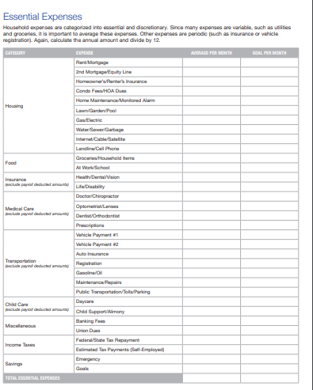

Slide 42
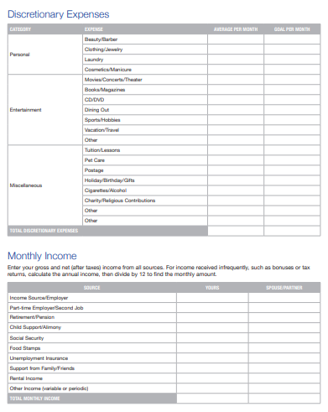

Slide 43
Five Ways to Erase Debt!
Borrow.
Find a new job.
Get a second job.
Check your State website for “Unclaimed Funds.”
Find money in your existing budget.
Develop a Ponzi or Madoff scheme.

Slide 44
Painful Daily Decisions
Grocery shop once a week
Cut that daily spurge (coffee, after work cocktail, etc.)
Brown bag it at lunch
Give up the bottle (put a filter on your faucet)
Sell your junk (itaggit.com – blue book on junk)
Buy your drugs through mail order plans
Sell your books (cash4books.net, sellbackyourbook.com)
Buy seasonal fruit and vegetables, organic costs more.
Buy a cheaper car (monthly bill, car insurance, gas)
Buy “scratch and dent” products (groceries and appliances)
Use the library for your DVD’s
Don’t go for walks in the malls, don’t buy on the internet
Trade in electronics (wireflytradeins.com, tigerdirect.cexchange.com)
Redeem your savings bond which probably no longer earn interest

Slide 45
Cutting Your Debt - Insurances!
Look at your insurance amounts, deductibles and coverages. Insurance rates are tied to credit scores, Direct billing can save 5% on your premium, Bundle your insurances: multiple policies usually cost less.
Auto
Get rid of collision on cars over a certain age.
Ask about discounts: safe driving, honor roll discounts, etc.
Shop for better auto insurance rates.
Home
Look at your homeowner’s deductible.
Are you still paying for PMI. Equity in house can cancel PMI.
Mortgage insurance is costlier than PMI.
Life
Term, Universal, Whole Life – Cost and fees!
How much do you need?
Health
Health scores are used for policies (credit score plus claims).
Hospitals use them for charity or assistance programs

Slide 46
Financial Savings
Look for tag sales in expensive neighborhoods for needed goods.
Ask your landlord to re-negotiate your rent.
Try to get a loan modification for home, condo, co-op.
Get a Con-Ed energy audit and level billing.
Get your extra cash at the grocery or CVS stores.
Dump your cable company unless they give you the “Triple Play”.
Telephones - Get rid of the land phone!
Negotiate a better deal with your cell phone rep.
Tell them your thinking about canceling. Is there an incentive to stay?
Don’t use ATM machines unless they are your banks.
Beware of hidden costs using plastic cards. All have them.

Slide 47
Leisure Costs Savers
Catch the early show at the movies.
Get the early bird specials at restaurants.
Deals at www.restaurant.com
Save on groceries: mygrocerydeals.com, couponmom.com,
fatwallet.com, coolsavings.com, freeshipping.com
Look for free concerts in NYC or County.
Get free mulch from the Town or make your own compost.
Do lunch, not dinner if you want to go out.
Discounts: AAA, AARP, “NYSUT Member Benefits”
Avoid fast food restaurants, they are not cheap or healthy for yourself or your budget.
Take a low cost continuing education course at your local school (language class, food, travel, web design, etc.).

Slide 48
Who Is Filing Bankruptcy?
http://www.totalbankruptcy.com/

Slide 49
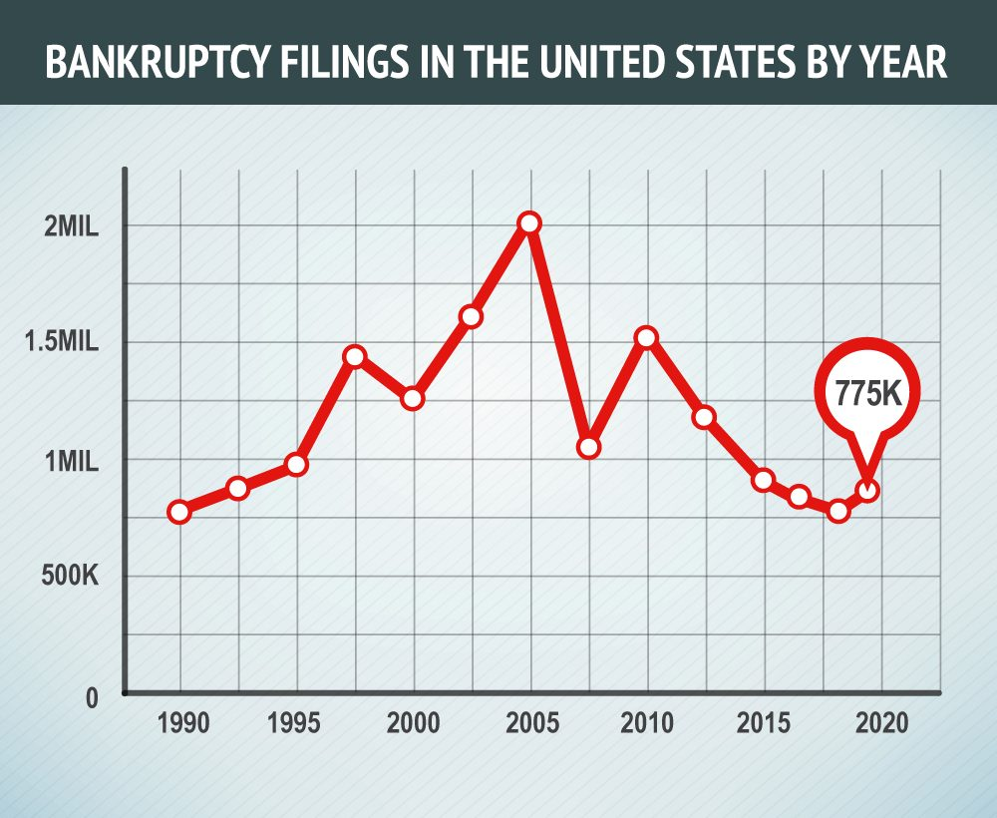

Slide 51
About Bankruptcy
Bankruptcy is a court proceeding.
Bankruptcy remains on your credit report for 10 years.
Each debt that was discharged remains on your report for seven years.
You should hire an attorney to file bankruptcy.
Types
Chapter 7 – A bankruptcy trustee sells the debtor's nonexempt assets and uses the proceeds of such assets to pay holders of claims (creditors). This may result in liens and/or loss of property.
Chapter 11 – Chapter 11 is used primarily by larger companies that want to continue doing business throughout the bankruptcy process and after it is completed.
Chapter 13 - a reorganization where the debtors forms a plan that lasts from three to five years during which they make regular payments to bankruptcy court and pays down a portion of their total unsecured debt.

Slide 52
Why People Go Bankrupt
Medical Expenses - 66.5% of bankruptcies.
Job Loss - ​Whether due to layoff, termination or resignation.
Poor or Excess Use of Credit:
credit card bills or installment debt (car payment, etc.).
Car and other loan payments spiraling out of control.
Divorce or Separation
Legal fees can be astronomical in some cases.
Division of marital assets, child support, and/or alimony.
Unexpected Expenses
Loss of property due to theft or casualty,
Earthquakes, floods or tornadoes for which the owner is not insured can force some into bankruptcy.
Homeowners must take out separate coverage to be covered from certain events

Slide 53
Reasons Not to File for Bankruptcy
It won’t wipe the slate clean.
Student debt is the number one culprit.
Government by law can garnish pay, income tax returns, etc.
You could neglect the real issue: mismanagement of money.
It could hurt your job perspectives.
Employers may want to check your credit report.
Bankruptcy can be on your credit report for seven to 10 years.
You could become homeless.
The option to buy a home could be off the table for seven to 10 years
May also lead to a future filled with declined rental applications.
Credit will become more expensive and limited.
You’ll have to work hard to raise your credit score.
You’ll likely face limited access to credit and very high interest rates.

Slide 54
Debt and Credit Repair
Create a letter to deal with creditors, and fix errors in your credit report, as well as build and maintain good credit going forward.
Get bill collectors off your back, and finances under control.
Sample letters from NOLO for a fee (visit your library):
Request to Creditor to Remove Inaccurate Information
Offer to Settle Debt with a Reduced Lump Sum Payment
Notice to Debt Collector to Not Contact Debtor at Work
Notice to Terminate Joint Account
Offer to Pay Debt in Installments (Full or Discounted Amount)
Credit Repair Kit
Notice to Stop Payment of Check

Slide 55
Thank you!
Questions & Answers
Doug Young
doug.n.young@gmail.com
The WISER Choice

Slide 56
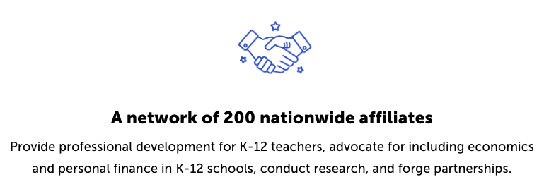
CEE Affiliates
https://www.councilforeconed.org/resources/local-affiliates/

Slide 57
Thank You to Our Sponsors!

