Slide 1
Financial Fitness for Life, Chapter 22: Financial Investing
Presented by
Matthew Gherman
October 22, 2020 mgherman@schools.nyc.gov

Slide 2
EconEdLink Membership
You can now access CEE’s professional development webinars directly on EconEdLink.org! To receive these new professional development benefits, become an EconEdLink member. As a member, you will now be able to:
Automatically receive a professional development certificate via e-mail within 24 hours after viewing any webinar for a minimum of 45 minutes
Register for upcoming webinars with a simple one-click process
Easily download presentations, lesson plan materials, and activities for each webinar
Search and view all webinars at your convenience
Save webinars to your EconEdLink dashboard for easy access to the event
You may access our new Professional Development page here

Slide 3
Professional Development Certificate
To earn your professional development certificate for this webinar, you must:
Watch a minimum of 45-minutes and you will automatically receive a professional development certificate via e-mail within 24 hours.
Accessing resources:
You can now easily download presentations, lesson plan materials, and activities for each webinar from EconEdLink.org/professional-development/

Slide 4

https://store.councilforeconed.org/

Slide 5
Agenda
To examine lessons and activities to improve students’ understanding of exploring financial instruments for investment

Slide 6
Objectives
Students will be able to:
define key investment terms such as stocks, bonds and mutual funds.
describe key investment strategies including index funds and dollar-cost averaging.
summarize the costs and benefits of investing in stocks, bonds, and mutual funds.
explain the importance of diversifying an investment portfolio.

Slide 7
National Standards
Standard 5 Financial Investing, Grade 12, Benchmark 3 – Expenses of buying, selling, and holding financial assets decrease the rate of return from an investment.
Standard 5 Financial Investing, Grade 12, Benchmark 4 – Buyers and sellers in financial markets determine prices of financial assets and therefore influence the rates of return on those assets.
Standard 5 Financial Investing, Grade 12, Benchmark 5 – An investment with greater risk than another investment will commonly have a lower market price, and therefore a higher rate of return, than the other investment.
Standard 5 Financial Investing, Grade 12, Benchmark 6 – Shorter-term investments will likely have lower rates of return than longer term investments.

Slide 8
State Standards
CCSS.ELA-Literacy.W.9-10.9, CCSS.ELA Literacy. W.11-12.9 – Draw evidence from literary or informational texts to support analysis, reflection, and research.
CCSS.ELA-Literacy.L.9-10.6; CCSS.ELA Literacy. L.11-12.6 – Acquire and use accurately general academic and domain specific words and phrases, sufficient for reading, writing, speaking, and listening at the college and career readiness level; demonstrate independence in gathering vocabulary knowledge when considering a word or phrase important to comprehension or expression.
CCSS.ELA-Literacy.W.9-10.7, CCSS.ELA Literacy. W.11-12.7 – Conduct short as well as more sustained research projects to answer a question (including a self generated question) or solve a problem; narrow or broaden the inquiry when appropriate; synthesize multiple sources on the subject, demonstrating understanding of the subject under investigation.

Slide 9
Motivation
Investing is a lot like relationships
Everyone is an expert
Everyone gives you unsolicited advice
Always ask: Does the person eat their own cooking? when giving advice
“Be yourself, everyone else is already taken” – Oscar Wilde

Slide 10
Motivation, cont’d
“Look at yourself first” questions (slide 22.1)
What are my goals?
How much money will I need to achieve these goals?
How much money do I have? How much will I have in the future?
When do I need the money?
How much risk can I take?
What am I willing to give up now to have what I want in the future?
What steps are needed to help achieve my goals?
How will these goals help me have a better life?

Slide 11
Risk Tolerance Quiz
Complete the risk tolerance quiz
Calculate your score
Talk and turn/write a reflection of your score

Slide 12
Video #1: Stocks
Investopedia: https://www.youtube.com/watch?v=JrGp4ofULzQ
TD Ameritrade: https://www.youtube.com/watch?v=hE2NsJGpEq4
Questions:
a) What is the difference between a stock and a stockholder?
b) What happens to the value of the stock held by the stockholder when the value of the company increases?
c) What would happen to the value of the stock if the value of the company decreases?

Slide 13
Video #2: Bonds
Investopedia: https://www.youtube.com/watch?v=tuBDGjSh7ms
TDAmeritrade: https://www.youtube.com/watch?v=IuyejHOGCro
Questions:
a) What is a bond?
b) Why would a government sell bonds?
c) Why would anyone want to buy a government bond?
d) Why would a business sell bonds? (To raise money for growth and expansion instead of borrowing from a bank.)

Slide 14
Exercise 22.1: Stocks and Bonds Article
Summary Questions:
  List two differences between stocks and bonds?
  Give one reason that you might want to buy a stock.
  Give one reason that you might want to buy a bond.
  What determines the prices for stocks and bonds?
  What is a “blue chip” stock?
  What is the purpose of the SEC?

Slide 15
Transition
Remind students that making good choices about individual stocks and bonds requires having good information.
Explain that finding ways to “pool” their money with other investors can help reduce their risk when making choices— which is the purpose of mutual funds.
Tell students the following video will help explain mutual funds before they complete Exercise 22.2: Building a Portfolio.

Slide 16
Mutual Funds Video
https://www.youtube.com/watch?v=-bLeRnOHq-8
https://www.youtube.com/watch?v=ngfKXvfzC74
Questions:
  How would you define a mutual fund?
  The video mentioned a few types of mutual funds: balanced, energy, emerging markets, and funds of funds. Would the potential risk and potential rate of return be the same for all of these mutual funds?

Slide 17
Transition to “Skit” Exercise
Tell students the goal of investing is to build a portfolio (a collection of investments) that allows them to reach their financial goals.
Remind students that most of them will have some type of retirement plan with their employers and be required to make choices about investing the funds, even if it the idea of investing seems difficult to envision now.
Tell students they will be participating in a skit to help them better understand how to build a good portfolio. Ask for seven student volunteers to perform the parts in the skit and give each of them the script. Distribute a copy of the student handout for Exercise 22.2 to each student.
Ask students to make notes about the various terms listed in the activity as they listen to the skit. At the “commercial break,” review the terms in Part 1. At the end of the skit, review the terms in Part 2 and tell students to answer the questions at end of the exercise.

Slide 18
Skit Follow Up Questions
Why is it important to diversify your portfolio?
List two questions you should ask before investing.
When should you re-evaluate your portfolio?

Slide 19
Rule of 72
How long do you think it realistically takes to double your money?
Read Exercise 22.3 and answer the following questions:
  George has $700 in an account earning 10 percent. How long will it take to double his money?
  Jay wants his money to double in eight years. What interest rate does he need to earn?
  Gennie wants to buy a home in five years. She needs a $10,000 down payment. At what interest ate will her $5,000 double in five years?

Slide 20
Bingo Exercise
Ask them to use the 24 terms listed on the exercise to complete their bingo cards by randomly placing one term in each of the empty squares on their card.
Each term must not be used more than once, and they should be randomly distributed so that no two students have the same card.

Slide 21
Closing Discussions
Remind students that investing can seem complex and hard to understand.
Also explain that the types of investment assets available may change over their lifetime but understanding the basic terms, options, and strategies presented in this lesson will help make the process less intimidating.
Also remind them that thoughtful investing requires more than knowing terms and reciting strategies. It requires self-examination, which includes paying careful attention to their financial goals, their tolerance for risk, and their timeline for needing the funds they invest.

Slide 22
Assessment
Ask students to write down three things they learned from this lesson. Have them circle one of those three and write a brief paragraph explaining why it is important for them to understand that concept before they start investing.

Slide 23
Expansion: Quotes
“Put your money where your mouth is” – Warren Buffet
“Don’t put all of your eggs in one basket” vs. “put all of your eggs in one basket and watch them grow.”
“Do you know the only thing that gives me pleasure? It's to see my dividends coming in” – John D. Rockefeller
“I don’t throw darts at a board” – Gordon Gekko (Fictional character but still good advice)

Slide 24
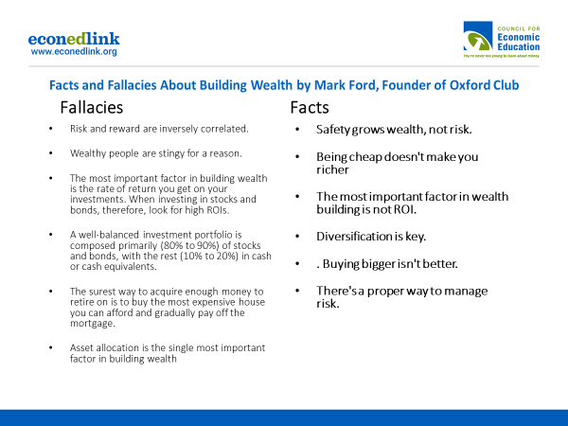

Slide 25
Expansion: How to Calculate What You'll Need to Retire
Estimate Your Retirement Lifespan
Determine Your Retirement Salary
  At a minimum, you should plan on needing 80% of your current income, but an even better rule of thumb is 85%
  If you have $800,000 saved you have $40,000 for 20 years
  Plan and Budget
  Account for Complications
Save 10% of your gross income toward retirement

Slide 26
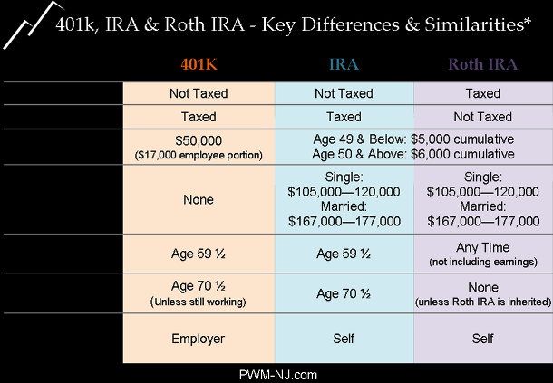
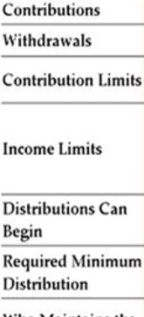
=

Slide 27
Follow Up Assignment #1
https://www.daveramsey.com/blog/the-truth-about-budgeting by Dave Ramsey
https://www.youtube.com/watch?v=yRr0_gJ-3mI: by Warren Buffet
Choose 1 piece of advice that connected with you for each. In 3-4 sentences, explain:
What were your opinions, thoughts on this advice?
How can you incorporate this advice as you look toward the future

Slide 28
Follow Up Assignment #2
If you had $1,000 how would you use that to begin investing? Which stocks would you choose and in what quantity? Explain in one full paragraph. Look at finance.yahoo.com to see how much they are.
Alternate: break $1,000 into $100 each month giving different stocks to look at: 1) general, 2) high risk, 3) dividend, 4) banking, 5) inelastic, 6) durables, 7) perishables 8) blue chip, 9) international, 10) Mineral/Precious Metal

Slide 29

CEE Affiliates
https://www.councilforeconed.org/resources/local-affiliates/

Slide 30
Thank You to Our Sponsors!

