Slide 1
Bring Personal Finance to Life w/ FFFL and Intuit
Presented by:
Jared Davidove
Sr. Manager, Strategic Education Partnerships
Ruben Rivera, Phd.
Director of Professional Development

Slide 2



Ruben Rivera, PhD
Director of Professional Development
Council for Economic Education
Jared Davidove
Sr. Manager, Strategic Education Partnerships
Intuit
Notes:
Ryan Slide
Jared bio -
Jared leads Intuit’s Financial Readiness program aiming to empowering students to make smart money decisions and own their financial futures. As an Innovation Catalyst with deep expertise in Personal Finance Jared serves as a Board Member for the Jump$tart Coalition, a committee member for the NY State Comptroller on Personal Finance, and has been tasked with designing the Congressional Award’s first ever Personal Finance Program.”
Elaine bio -

Slide 3


Financial Fitness For Life
Financial Fitness for Life (3rd edition) helps you prepare students for life beyond the classroom by presenting lessons and activities based on real-world economics and personal finance concepts.
Updated lesson plans with slides
1 new lesson plan for Paying Post-Secondary Education
17 ready-to-use EdTech tools
6 new activities using real-world tools in partnership with Intuit

Slide 4
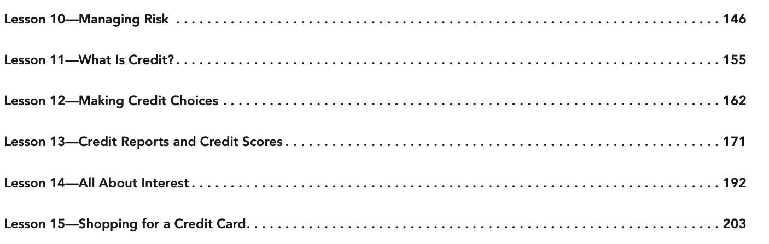
Financial Fitness For Life

Slide 5
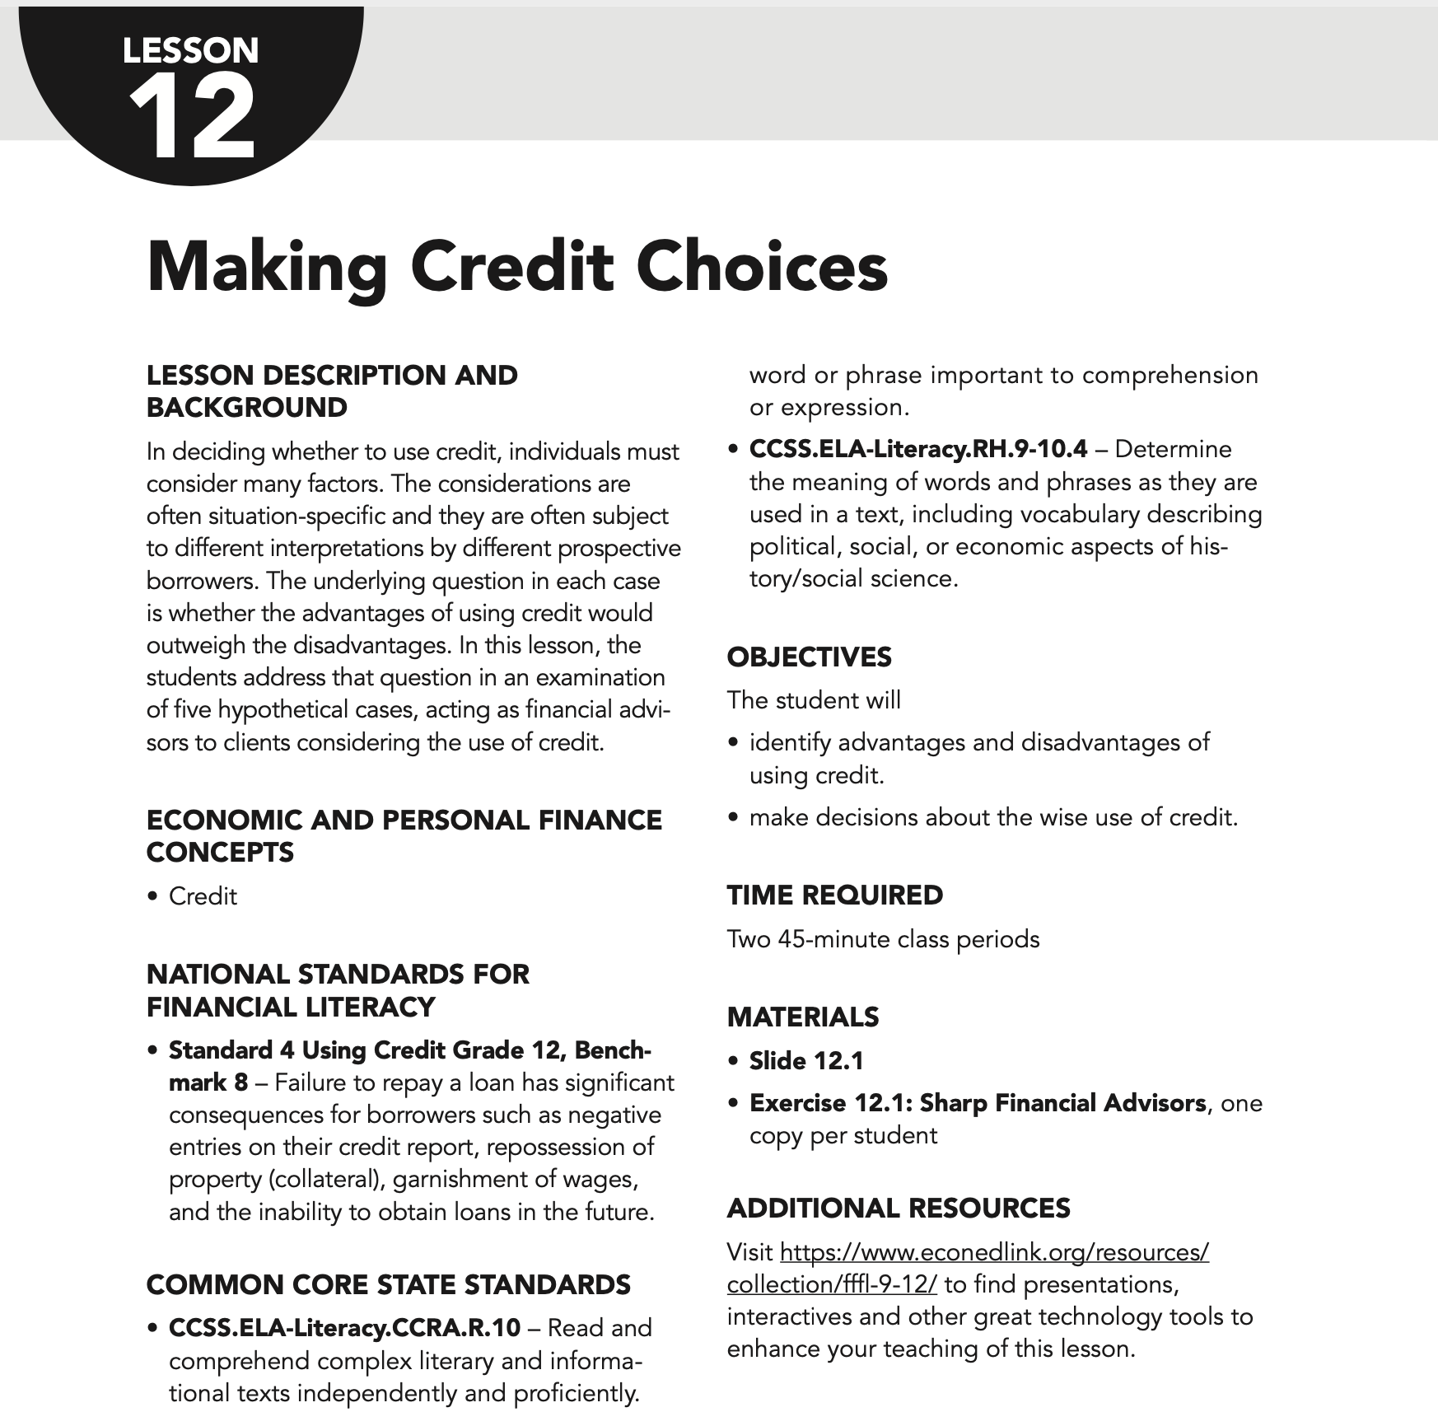
Lesson 12: Making Credit Choice
Includes:
4 lessons + activities using Mint

Slide 6
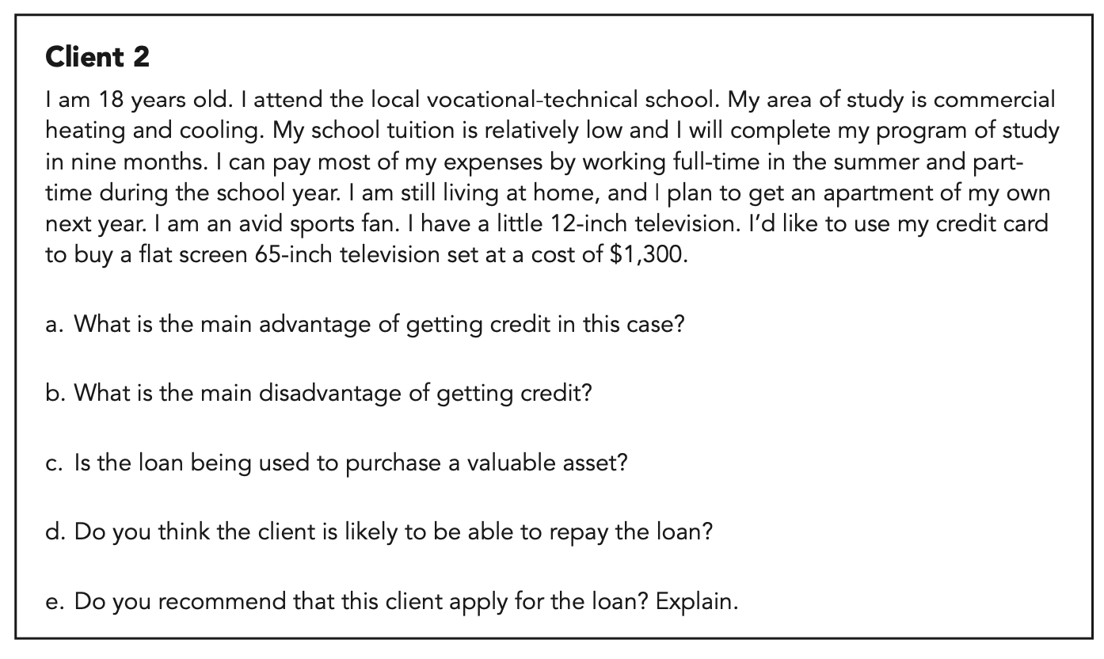
Lesson 12: Making Credit Choice
Sample Exercise

Slide 7

Get
Financial Fitness for Life
AT NO COST!

Slide 8
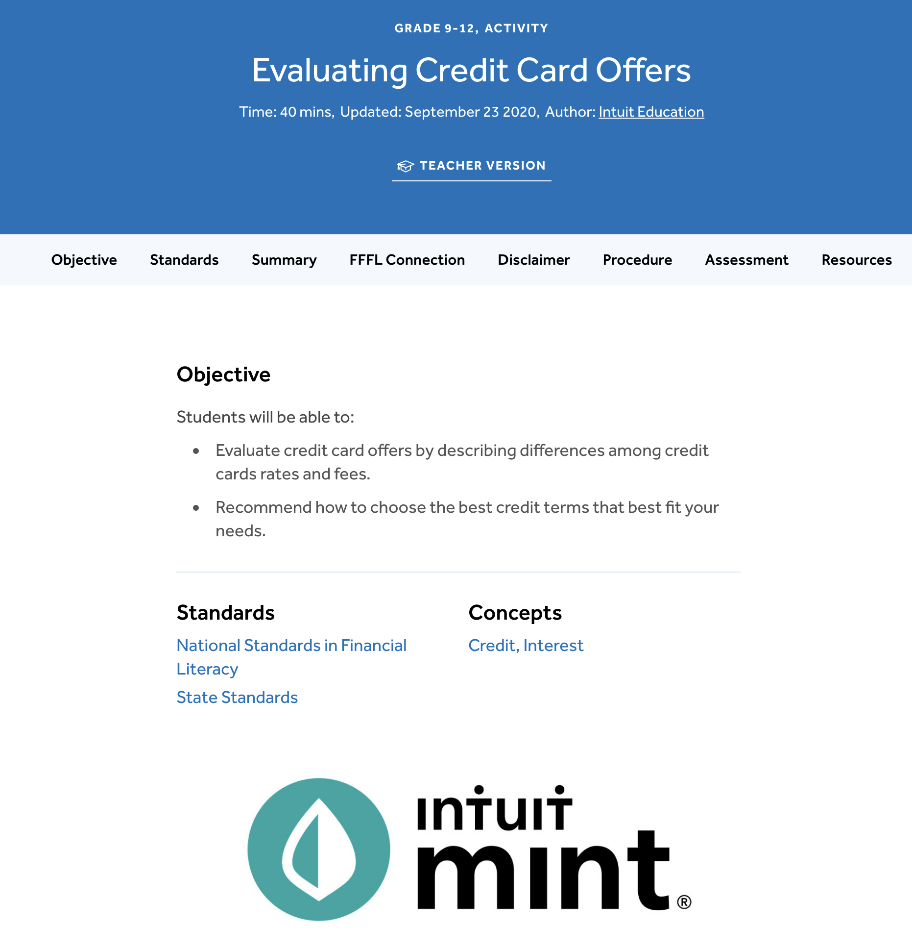
EconEdLink.org
Resource

Slide 9
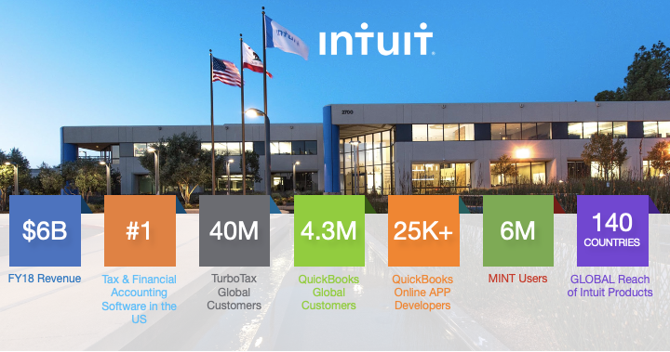


Slide 10
Financial Readiness foundational principles
Awareness
Communication
Confidence
CURRICULUM
Ability to Understand and comprehend the knowledge of how money works
FINANCIAL LITERACY
FINANCIAL EMPOWERMENT
CONTENT
CERTIFIED EXPERTS
FINANCIAL CAPABILITY
FINANCIAL
BEHAVIOR
Ability to develop and create positive financial behavior to empower future financial well-being
Ability to apply your knowledge and skill to make sound financial decisions
Notes:
Use this divider when using Title Option 2

Slide 11
Financial Readiness Metrics
90%
81%
91%
96%
25%
23%
20%
N/A
Student confidence to manage their personal finances
Willingness to discuss personal finance with their parents
Educator confidence
teaching personal finance
Students wanting Mint and/or TurboTax as part of their curriculum
US National Averages
After going through Intuit simulations or trainings

Slide 12

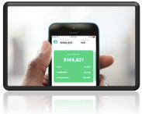

What is Mint?
Your fictional financial life, in one place, that’s easy to understand
Easily create personalized budgets
Set short and long term goals
Ability to track monthly bills
Analyze and develop smart spending behaviors
Understand your credit score and ways to improve
Business Insiders #1 budgeting app 2018, 2019, 2020
Notes:
Use this divider when using Title Option 2

Slide 13
Mint Curriculum & Simulation Demo

Slide 14
Q&A | THANK YOU!

