Slide 1
Economic Indicators
Unemployment, Inflation and RGDP
Presented by
Date
Professional Email
Matthew Gherman
July 2, 2020
mgherman@schools.nyc.gov

Slide 2
EconEdLink Membership
You can now access CEE’s professional development webinars directly on EconEdLink.org! To receive these new professional development benefits, become an EconEdLink member. As a member, you will now be able to:
Automatically receive a professional development certificate via e-mail within 24 hours after viewing any webinar for a minimum of 45 minutes
Register for upcoming webinars with a simple one-click process
Easily download presentations, lesson plan materials, and activities for each webinar
Search and view all webinars at your convenience
Save webinars to your EconEdLink dashboard for easy access to the event
You may access our new Professional Development page here

Slide 3
Professional Development Certificate
To earn your professional development certificate for this webinar, you must:
Watch a minimum of 45-minutes and you will automatically receive a professional development certificate via e-mail within 24 hours.
Accessing resources:
You can now easily download presentations, lesson plan materials, and activities for each webinar from EconEdLink.org/professional-development/

Slide 4
National Standards
12th Grade Benchmarks
18.1 Gather current and historical data on unemployment, inflation and real GDP and describe why the annual changes may differ.
18.3: A business cycle involves fluctuations of real GDP, unemployment and inflation
18.3 List possible causes of recent recessions and recent expansions.
18.4: Fluctuations of real GDP around its potential level occur when overall spending declines, as in a recession, or when overall spending increases rapidly, as in recovery from a recession or in an expansion.
18.4 Select a particular business cycle in U.S. history and identify its phases as well as the long run trend in real GDP around this cycle.

Slide 5
New York Standards
12.E4a Policy makers establish economic goals related to economic indicators, including the Gross National Product (GNP), Gross Domestic Product (GDP), Consumer Price Index (CPI), employment and interest rates, and aggregate supply and demand
12.E4b The president and Congress determine fiscal policy by establishing the level of spending and taxing in the annual budget. Some tax programs are designed to provide incentives to individuals and businesses that influence private sector spending, saving, and investment.

Slide 6
Agenda
Today we are going to examine the three main economic indicators and for each:
  1) What they are
  2) How they are measured and reflect economic health
  3) Potential Accuracy Issues
  4) Assessment Activity

Slide 7
Motivation
How do we measure our health?
a) What are the indicators?
b) Why is this an indicator?
c) What are the symptoms something is wrong?
d) Example of an index:
://www.youtube.com/watch?v=5RXRr8PKunk

Slide 8
Historical Circumstances
Full Employment Act (1946) and Humphrey-Hawkins Act (1978)
  Discussion Question: What is the significance of 1946 that Congress would push to create legislation that makes it the government’s job to oversee economic health?
Congressional Acts which establishes goals for the economy and it is the federal government's job to promote and monitor these goals:
full employment -- unemployment rate of under 4%
price stability -- average level of prices stay the same -- 0-2% (inflation rate) - measure average prices of a basket of goods
steady economic growth (spending and production on newly produced goods and services) measure the "real"* gross domestic product (RGDP) and RGDP Growth Rate - (3-4%)
  *real = adjusted for inflation - most accurate reading over "nominal" or raw number

Slide 9
Unemployment Rate
Handouts and Activities:
- Unemployment Handout
- CEE Macro Handbook Unemployment Activity Sheets (Mix and Match Exercises)
- AP Practice Questions

Slide 10
Labor Force Participation Rate
Before we measure the unemployment rate, we first have to measure who is "participating in the economy...“
Labor Force: All work eligible adults (ages 16-65) who are working (employed) or not working, but actively seeking work (unemployed).
The labor force excludes retired people, those too young to work, anyone not actively seeking employment).
In other words, out of the adult population, how many people are participating in the economy.

Slide 11
How do we know if someone who is actively seeking work?
seeking employment = collecting unemployment benefits
unemployment benefits run out = no longer actively looking = no longer participating. People not actively looking for work, yet are able to are not counted in the labor force and are called the discouraged or hidden unemployed.
Why would they be called the hidden unemployed/discouraged unemployed?

Slide 12
The labor force participation rate (LFPR)
[Number in labor force/adult population (16-65)]
X100 = LFPR

Slide 13
Unemployment Rate
Out of the people participating, how many are unemployed? This measures the percentage of work eligible adults not employed.
(Number of unemployed)/(Labor Force) X100 = Unemployment Rate

Slide 14
In order to get an accurate reading of the economy, why must we compare the unemployment rate to the labor force participation rate?
Unemployment Rate decreases as Labor Force Participation Rate increases represents that more people are working because their is more participation in economy.
Unemployment Rate decreases as the Labor Force Participation Rate decreases may represent that there is not an increase in employment, but rather the percentage is decreasing because less people are participating in economy (counted unemployed is decreasing but hidden unemployed is increasing).

Slide 15
Types of Unemployment
1) Structural: Mismatches between skills and openings
(ex - replaced by technology, lack of education, welders in Cleveland but jobs in Dallas)
2) Frictional: People who are between jobs.
(ex: just out of school or scheduled to start a new job next month, quit and moved and now looking) can include Seasonal unemployment or people hired for a portion of year
***There is naturally structural and frictional unemployment at any give
time, which is why the natural rate of unemployment or Full Employment is considered 4%.
3) Cyclical: people who lose their jobs due to a recession - negative growth in the economy
4) Discouraged or Hidden unemployed: People who are able to work, but don't pursue employment. Not considered part of the labor force.

Slide 16
Interesting problems with the unemployment rate
BLS survey style
60,000 households broken into geographic and demographic factors
Hidden unemployed
Part time = employed

Slide 17
Assessment Questions
Which of the following people would be considered cyclically unemployed?
a. A person who quits work to find another job
b. A person who stayed home to raise his children and now
starts looking for a job
c. A person who was laid-off due to cut backs
d. A person who is qualified to teach but is driving a bus until a teaching job is available
e. A person who works two part-time jobs but is looking for a full-time job

Slide 18
Assessment Questions
Of the following, which is the best example of structural unemployment?
a. a computer programmer who quits her job to move to a warmer climate
b. a construction worker who loses his job in the winter
c. an auto worker who loses her job during a recession
d. a steel worker who is replaced by a robot
e. a toy maker who worked for a company that closed because consumers did not buy its toys

Slide 19
Assessment Questions
Which of the following is a positive as opposed to a normative economic statement about unemployment?
a) the unemployment rate for teenagers has been historically higher
than the unemployment rate for adults
b) unemployment is the most serious economic problem facing the
country today
c) If part-time workers were counted as fully employed, the
unemployment rate would be a more accurate measure of
unemployment
d) government should be willing to provide incomes for those who are
not able to provide for themselves
e) trade barriers should be eliminated to promote free trade

Slide 20
Assessment Questions
When an economy is experiencing a recession and
unemployment, this would be located on which
point of a Production Possibilities Curve?
a. a point along the production possibilities curve
b. a point outside the production possibilities curve
c. a point inside the production possibilities curve
d. a shift to the right of the production possibilities curve
e. a shift to the left of the production possibilities curve

Slide 21
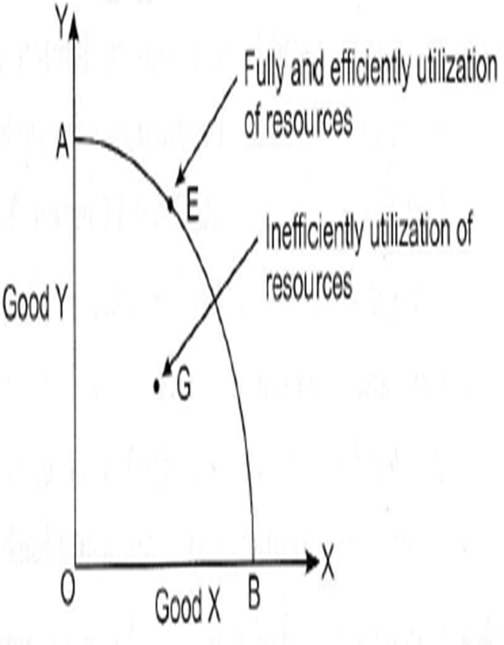
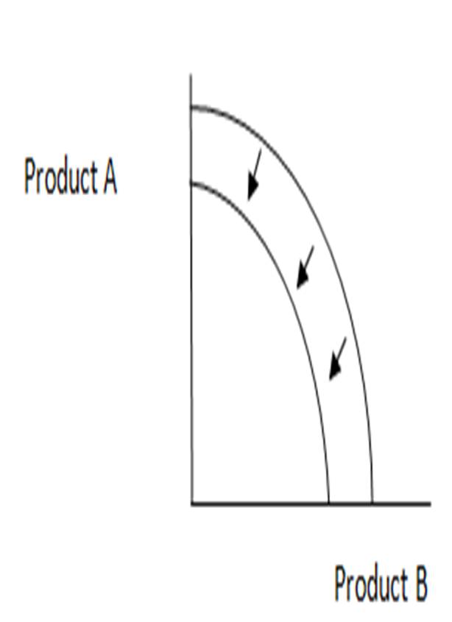
G = have the resources, but not using them
Ex – have people, but not using them
Long Term/Permanent Decrease in quality/quantity of resources

Slide 22
INFLATION

Slide 23
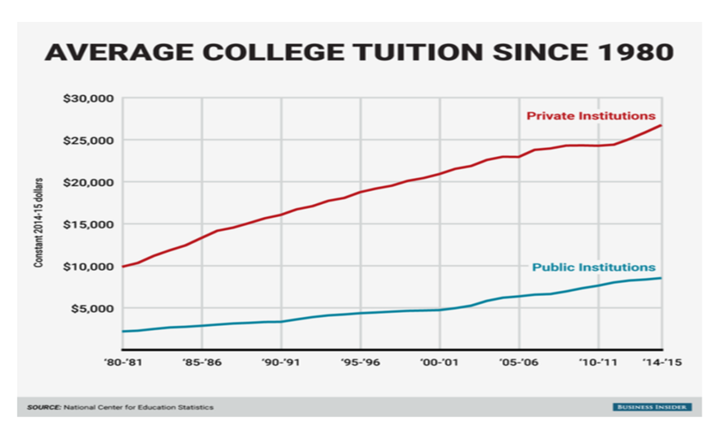
Motivation: Loans, Interest Rates, Cost of College

Slide 24
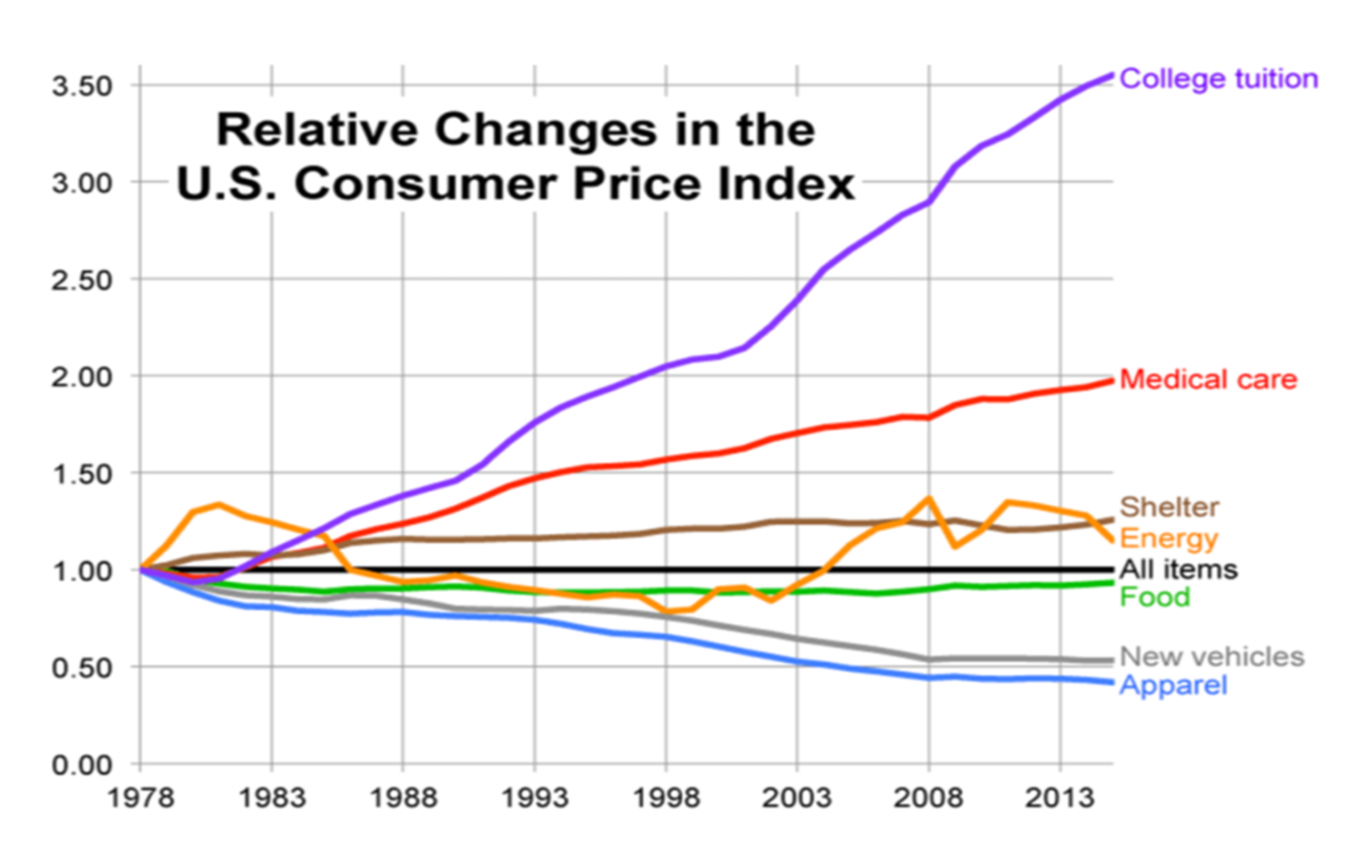
Motivation: Loans, Interest Rates, Cost of College

Slide 25
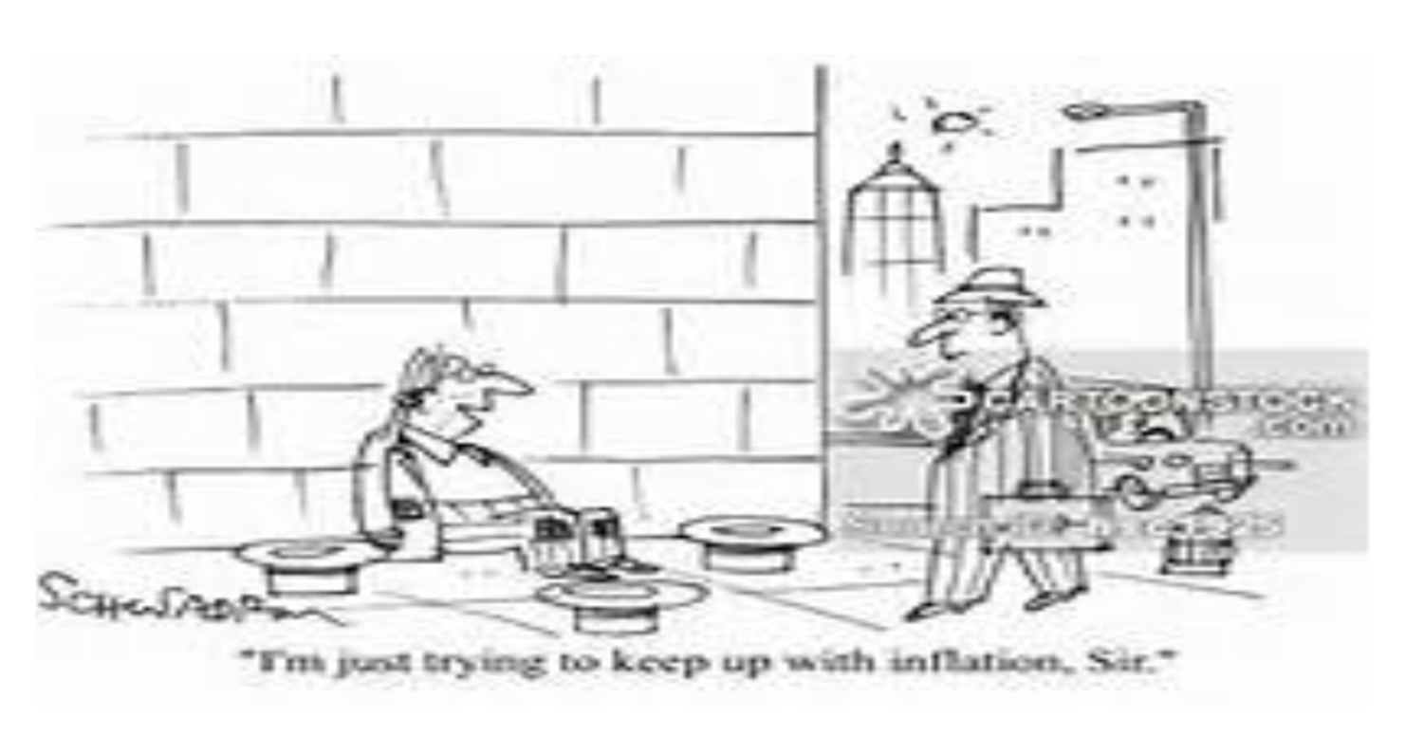

Slide 26
Handouts and Activities
1) Student loans and interest rates
2) Introduction to formulas – what is being measured?
3) Causes with graphical analysis
4) Breakdown of effects with T-Charts
5) AP Practice Questions

Slide 27
How is it measured?
Price Stability
CPI
Market Basket
Inflation Rate

Slide 28
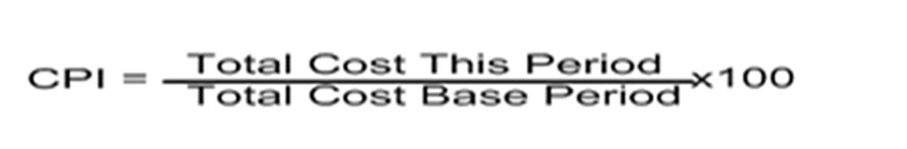
Consumer Price Index
Price stability measures the change in the price level.
The price level measures the average change over time in the prices paid by urban consumers for a market basket (collection of goods) of consumer goods and services (how much it would cost today, for last year’s goods). This is also known as the Consumer Price Index.
300 goods and services broken into different categories and weighted.

Slide 29
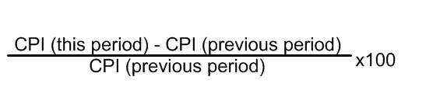
Inflation Rate
The rate of change of one period to another period is known as the inflation rate.
When inflation increases or decreases this is referred to as a change in the price level.
This is percentage change in the market basket/price. index.

Slide 30
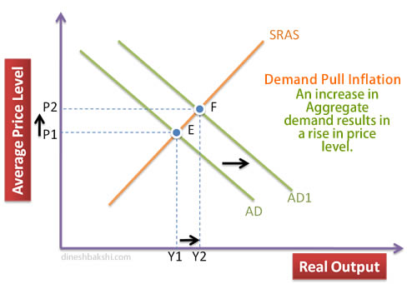
What are the causes?
Demand Pull
Increase in total spending (AD) in the economy
Not necessarily bad at first
Increase in ability and willingness to spend = increase in production and rise in prices
Becomes bad when too much money starts to chase too few goods and services…Spending is greater than production

Slide 31
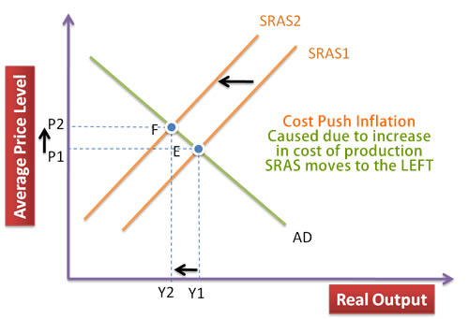
Causes
Cost-Push Inflation
Bad
Increase in the cost of resources
Increase in expectation of prices
Decrease in businesses ability and willingness to produce
Decrease in production leads to higher prices and more unemployment
STAGFLATION! Worst economic condition

Slide 32
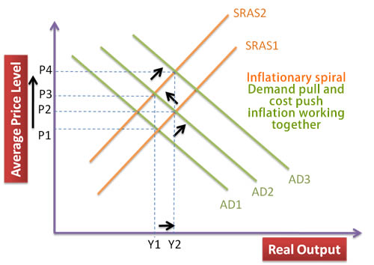
The Inflation “Spiral”
Self-sustaining upward trend in general price levels due to interaction of demand pull and cost push inflation
“Wage-price spiral”
High cost of living prompts demands for higher wages
This pushes production costs up forcing firms to increases prices
This in turn triggers calls for fresh wage increases ... and so on

Slide 33
Effects
Main Effect: “Erosion Formula”
Real (true value/adjusted for inflation value)
Nominal (on paper/unadjusted value)
Real _____ = nominal ______ - inflation rate

Slide 34
Effects Graphic Organizer
Use the handout reading to complete activity
Banks | Consumers | Businesses | Government and International
Inflation Tax | Real = nominal – inflation Erodes purchasing power Erodes Savings Erodes Fixed income Erodes wage gains Erodes Bond Values Expected vs. unexpected inflation | Unit of Account Effect Menu Costs Elastic Businesses lose money | Inflation Temptation Depreciation of currency Lack of foreign capital

Slide 35
Bonds
https://www.youtube.com/watch?v=IuyejHOGCro
For bonds, assume:
  1) bonds’ interest rate is non-variable (does not change);
  2) bonds are traded like stocks – they can increase and decrease in value.
Bonds are “IOU’s” from the government, corporations and the Federal Reserve. People give these entities loans and are paid back after a certain period of time (called a maturity date) with the principal (initial amount) plus a yearly compounded interest. For example, a $1,000 5% bond over the course of 5 years = year 1: 1,050; year 2: 5% interest of$1,050 = $1,152 and so forth up until year 5.
OR
the bond rate (or coupon rate) creates a yearly income; so a $1,000 bond with a 5% coupon rate will give you an income of $50 per bond.

Slide 36
Assessment Questions
If your nominal wage doubles at the same time as prices double, your real wage will
a. increase
b. decrease
c. not change
d. double
e. be impossible to determine

Slide 37
Assessment Questions
If inflation causes people to frequently convert their dollars into other assets, the economy experiences what type of cost?
a. price level
b. shoe-leather
c. menu
d. unit-of-account
e. monetary

Slide 38
Assessment Questions
AP Free Response
(d) Given the increase in the expected rate of inflation from part (b),
  (i) will the nominal interest rate on new loans increase, decrease, or remain unchanged?
  (ii) will the real interest rate on new loans increase, decrease, or remain unchanged?
  3 (e) Assume that the nominal interest rate is 8 percent. Borrowers and lenders expect the rate of inflation to be 3 percent, and the growth rate of real gross domestic product is 4 percent. Calculate the real interest rate.

Slide 39
Real gross domestic product

Slide 40
Motivation
How do you measure success for yourself?
Should you compare yourself to other people to measure
success?
How do nations measure success?
Should they compare themselves to other nations to measure
success?

Slide 41
Handouts and Activities
1) What is GDP?
2) What is counted/How is it calculated?
3) Other approaches to measuring healthy
spending
4) Formula Practice

Slide 42
Definition
RGDP is the total value dollar of spending on all newly produced goods and services made within a nation’s borders (these include both domestic and foreign companies within the border).
- Why do we count both foreign and domestic production within our borders?

Slide 43
Flow Chart: Is it Counted?
Is it a good/service?
Is it a good/service made AND sold this year?
Is it a good/service made in the nation?

Slide 44
Expenditure Approach (Total Spending Approach)
GDP = C + I + G + X
C = Consumption Expenditures on goods and services by households
I = Investment Spending by firms (capital, inventory and real estate)
(Capital Equipment) and what is spent to stock the shelves/spending on production
G = Government purchases
(Government is acting as a Consumer)
Nx = net exports (exports - imports)

Slide 45
Sidestep: Stocks
What are stocks:
https://www.youtube.com/watch?v=fn3y1hNVgA4
The Stock Market for beginners:
https://www.youtube.com/watch?v=EIFtc0DWKxU

Slide 46
Handout: Stocks and the Macro-Economy
Investment Spending = businesses spending on capital
Personal Finance Investment = not counted
Value of stocks not counted
Broker fees are counted (service)
Stock Market is used as an indicator of economic confidence
During economic downturns, durable goods suffer the most as do their stocks. Service industries and perishable goods suffer less

Slide 47
Items not counted in RGDP
1) Secondhand sales
2) Purely financial transactions (such as stocks)
3) Intermediate sales - example: tomatoes for ketchup.
4) Underground economy/blackmarket
5) Transfer payments from government to people (i.e. - social security, etc.)
6) Self service, non-market activity
7) Items not made this year

Slide 48
Interesting Stat Websites
http://www.indexq.org/economy/gdp.php
http://www.netplaces.com/economics/keeping-score-the-gross-domestic-product/counted-or-
not.htm
Tradingeconomics.org

Slide 49
Secondary Approaches
What do we do with this number to measure success?
www.usdebtclock.org

Slide 50
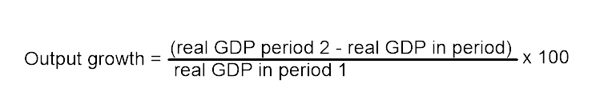
Output Growth Rate
Output growth: measures the percentage change in spending on production (GDP) from one period (year or quarter to the next)
Most important measure: by what % are we growing?
3-4% ideal/steady growth
1-2%= slow growth
negative percentage = negative growth - two consecutive quarters of negative growth = recession

Slide 51
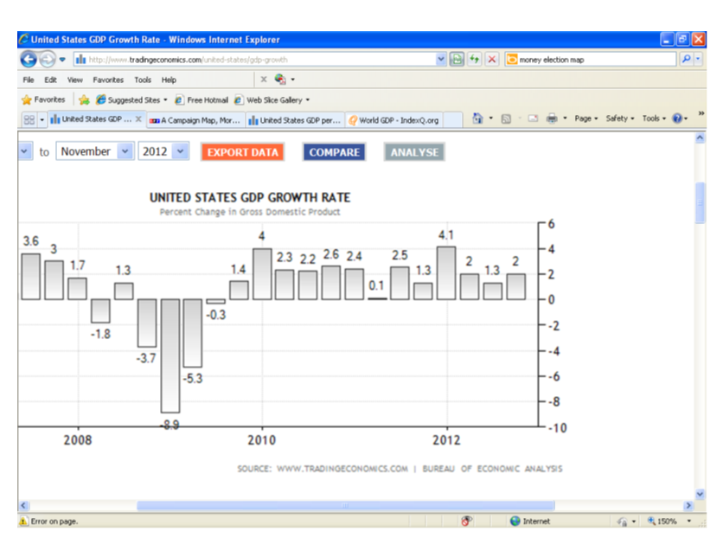

Slide 52
Gross National Product
GNP: similar to GDP except GNP includes production by American workers abroad and excludes production by foreign workers in America. It is the dollar value produced by a country’s citizens.
WHICH TO USE? GDP gives us a better representation of what is happening within our own circular flow model.

Slide 53
RGDP Per Capita
GDP per capita measures how much is produced per person within a country’s borders and represents the average value of all of the goods produced in the economy.
This equates to the “Standard of Living” of a nation: when you divide how much is produced/earned divided by the population – this gives the basic standard of living (how well people live). The average amount spent on goods/services or the average income.
Formula = Real GDP divided by Population.

Slide 54
National Income Approach
Add up the Circular Flow Model
The US "National Income and Expenditure Accounts" divide incomes into five categories:
1) Wages, salaries, and supplementary labor income
2) Corporate profits
3) Interest and miscellaneous investment income
4) Farmers’ income
5) Income from non-farm unincorporated businesses

Slide 55
What is the difference between Real and Nominal GDP? Why do we need to make a distinction between the two?
Nominal: Raw value
Real: Adjusted for inflation
Are we spending more because we are producing more or are we spending more because the dollar isn’t going as far?
Inflation: Spending increases, but production decreases or remains constant
Healthy: Increase in spending is related to an increase in production

Slide 56

What is the RGDP Deflator?
GDP can also be used to determine inflation:
GDP Deflator measures the level of price change in the economy based on GDP
Nominal GDP is “deflated” to create Real GDP
Size difference in “balloons” is % change in prices

Slide 57
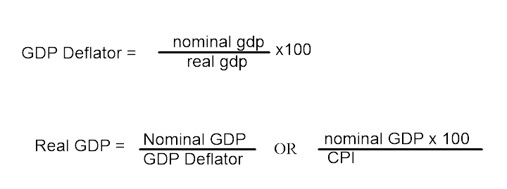
GDP DEFLATOR FORMULAS

Slide 58
RGDP Deflator vs. CPI
RGDP DEFLATOR
CPI
  Entire economy
  (C + I + G + Nx)
  Includes capital goods
  Does not include imports
  Urban consumer
  Only Consumer goods
  Includes imports

Slide 59
Problems in calculating
Lots of other spending in the economy
Outsourcing, GNP vs. GDP
GDP per capita as an average can be misleading

Slide 60
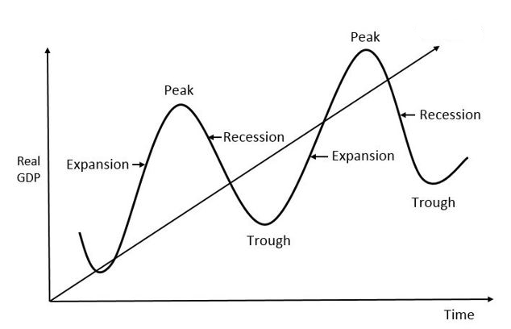
The Business Cycle

Slide 61
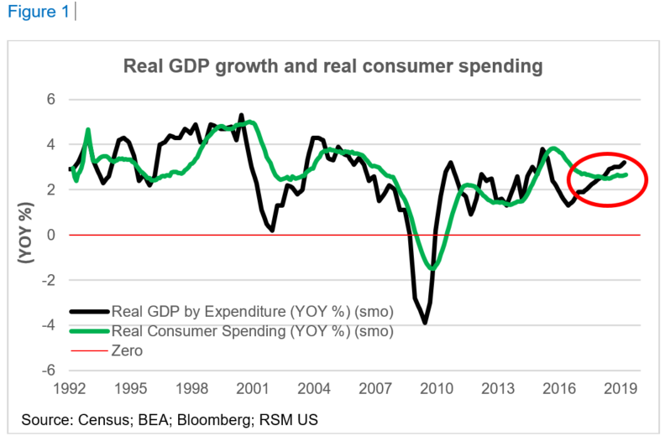

Slide 62
American Business Cycle and Economic Indicator Project
For each indicator, read the headlines, overview and compare its progress graphically.
Answer the following questions in one full T.E.A.L. paragraph (5-7 sentences, using at least specific data from 3 indicators for each question) each:
1) The Great Recession lasted from 2007-2009. Using indicators, how would you describe the severity of the recession?
2) How would you judge America’s short-term and long-term recovery from the Great Recession?
3) What part of the business cycle is America in now? How would you describe the current health of the American economy?
4) What policies would you recommend President Donald Trump and Congress to do to maintain a healthy economy?

Slide 63

CEE Affiliates
https://www.councilforeconed.org/resources/local-affiliates/

