Slide 1

Financial Fitness for Life, Chapter 2:
The Economic Way of Thinking
Presented by
Tawni Hunt Ferrarini, PhD
Dec 10, 2020
Tferrarini@Lindenwood.edu * Tawni.org

Slide 2
EconEdLink Membership
Access CEE’s professional development webinars directly on EconEdLink.org! To receive these new professional development benefits, become an EconEdLink member. As a member, you will:
Automatically receive a professional development certificate via e-mail within 24 hours after viewing any webinar for a minimum of 45 minutes
Register for upcoming webinars with a simple one-click process
Easily download presentations, lesson plan materials and activities for each webinar
Search and view all webinars at your convenience
Save webinars to your EconEdLink dashboard for easy access to the event
Access our new Professional Development page here

Slide 3
Professional Development Certificate
To earn your professional development certificate for this webinar, you must:
Watch a minimum of 45-minutes and you will automatically receive a professional development certificate via e-mail within 24 hours.
Accessing resources:
You can now easily download presentations, lesson plan materials, and activities for each webinar from EconEdLink.org/professional-development/

Slide 4
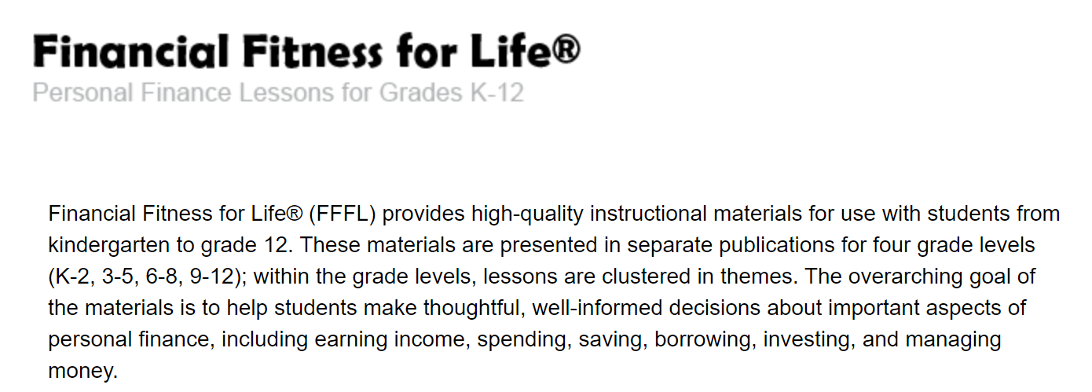
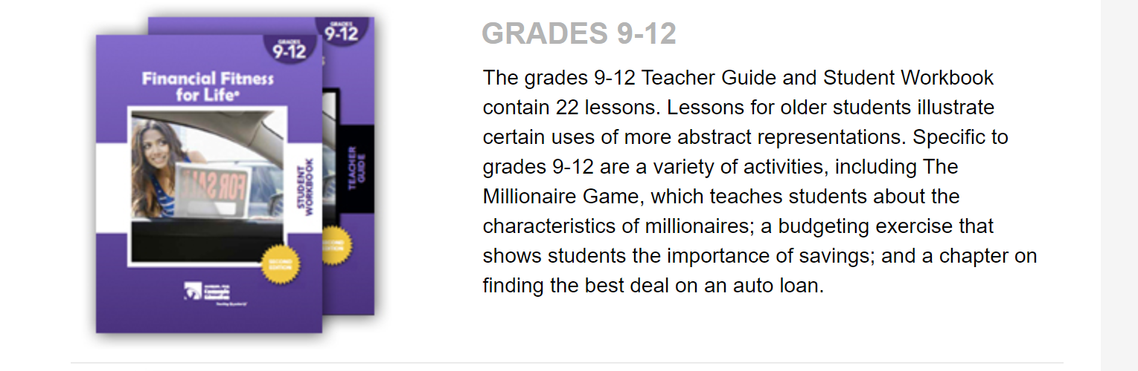

Slide 5

https://store.councilforeconed.org/

Slide 6
Agenda
Welcome
Featured concepts and Six (6) core principles of economics applied to personal finance
Applied through the Seven (7) online practices for good teaching
Case studies
Once over lightly
Conclusion and references
Thanks to you and our sponsors

Slide 7
Featured Concepts
Featured focus on
The power of CHOICE
The factor of OPPORTUNITY COST
Voluntary exchange or TRADEOFFS
Intended and unintended CONSEQUENCES

Slide 8
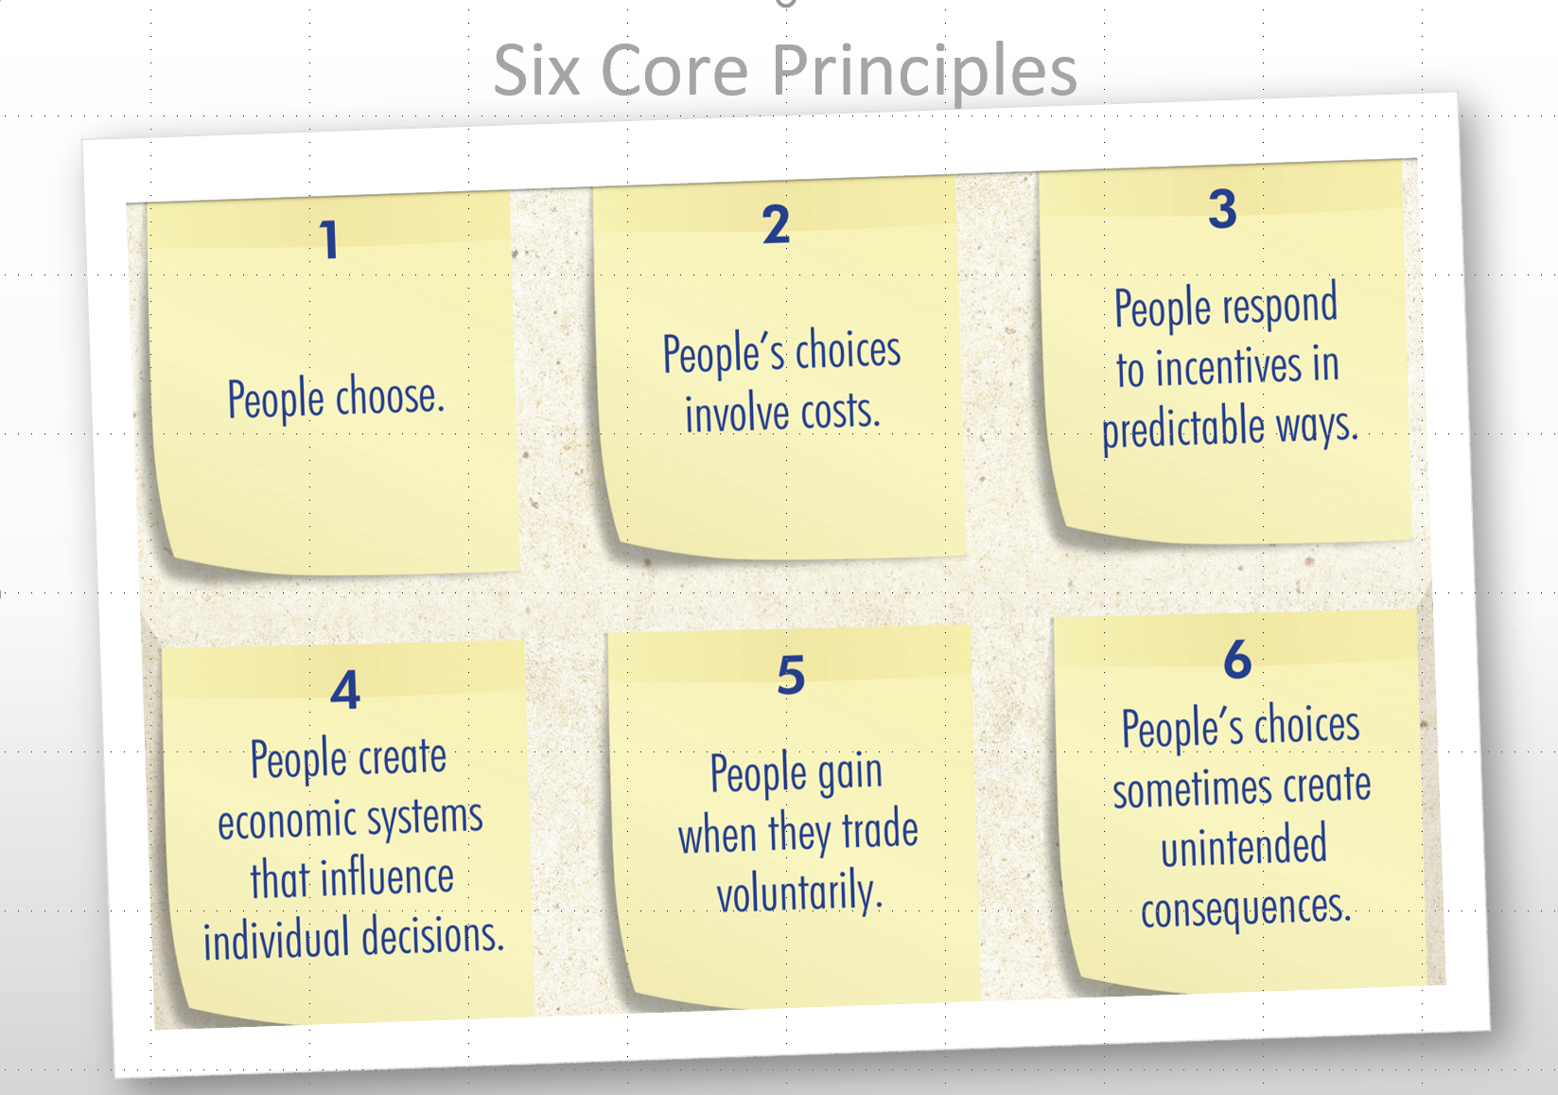
Concepts Applied

Slide 9
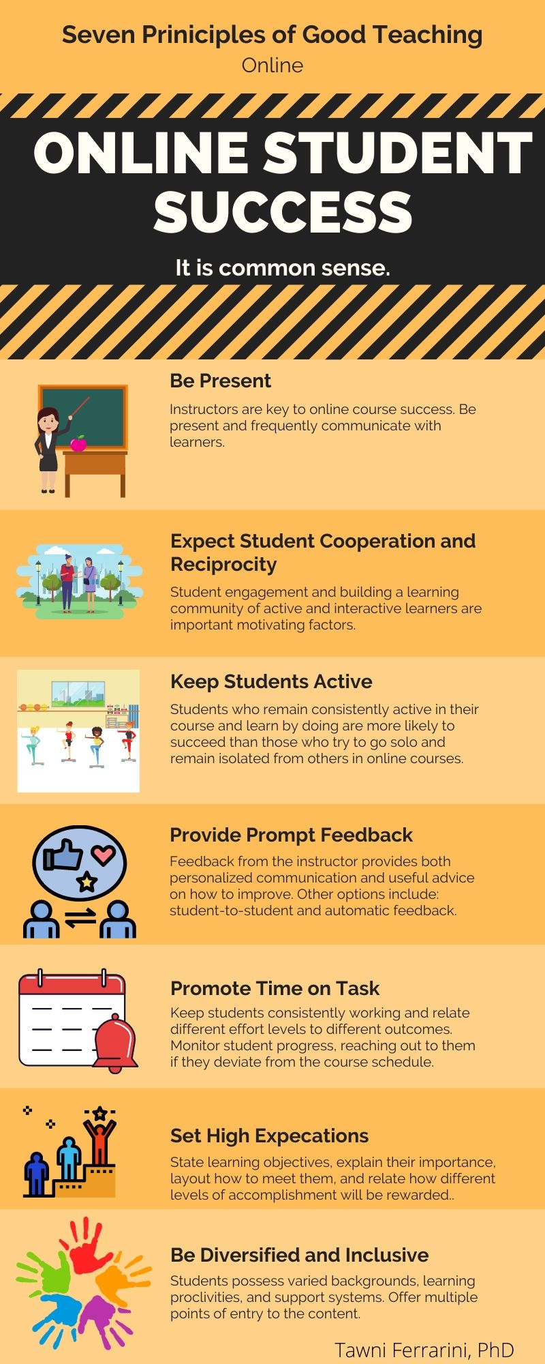

Teaching Framework
Good Online Teaching Practices
peardeck.com (Level 1, $0)

Slide 10
2 Ways to Experience this Session
Choice 1: PASSIVE
Sit back and passively listen to the webinar while taking notes
Choice 2: ACTIVE
Actively participate in the webinar and learn-by-doing using PearDeck

Slide 11
Lesson Objectives
List the 6 core principles of economics
Apply them to matters related to practical personal finance
Analyze the tradeoff between financial decisions made today relative to outcomes in the future
Analyze the intended and unintended consequences
Evaluate their impact on ability to live comfortably and securely over time

Slide 12
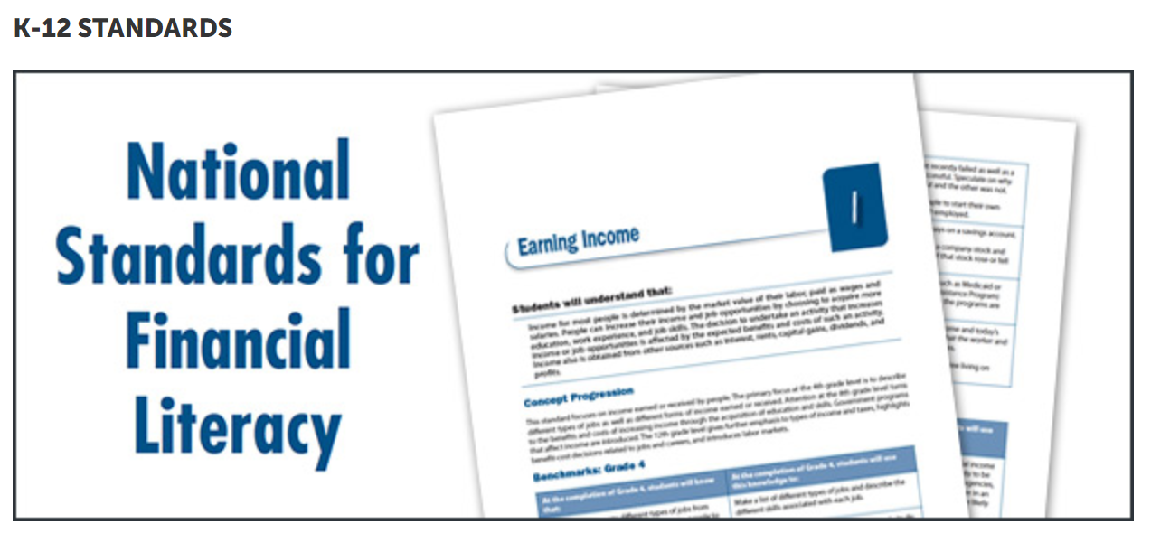
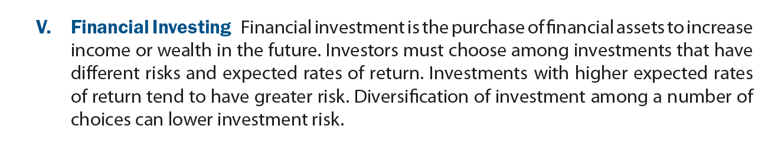
National Standards
https://www.councilforeconed.org/resource/national-standards-for-financial-literacy/

Slide 13
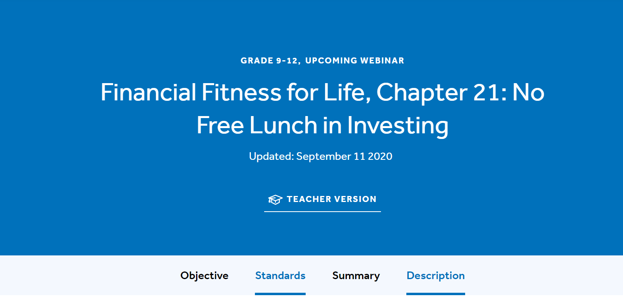
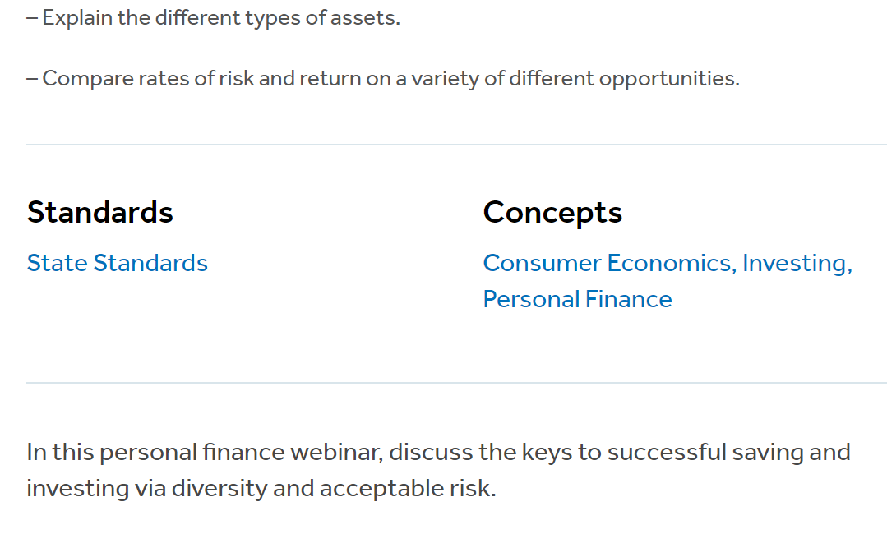
State Standards
Connect to regional and state standards at EconEdLink.org
Search for “Risk and Return”
Choose a lesson
Click on State Standards
NYSed.gov

Slide 14
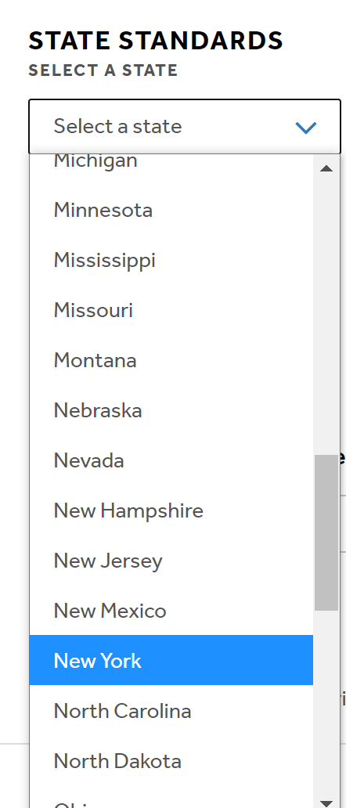
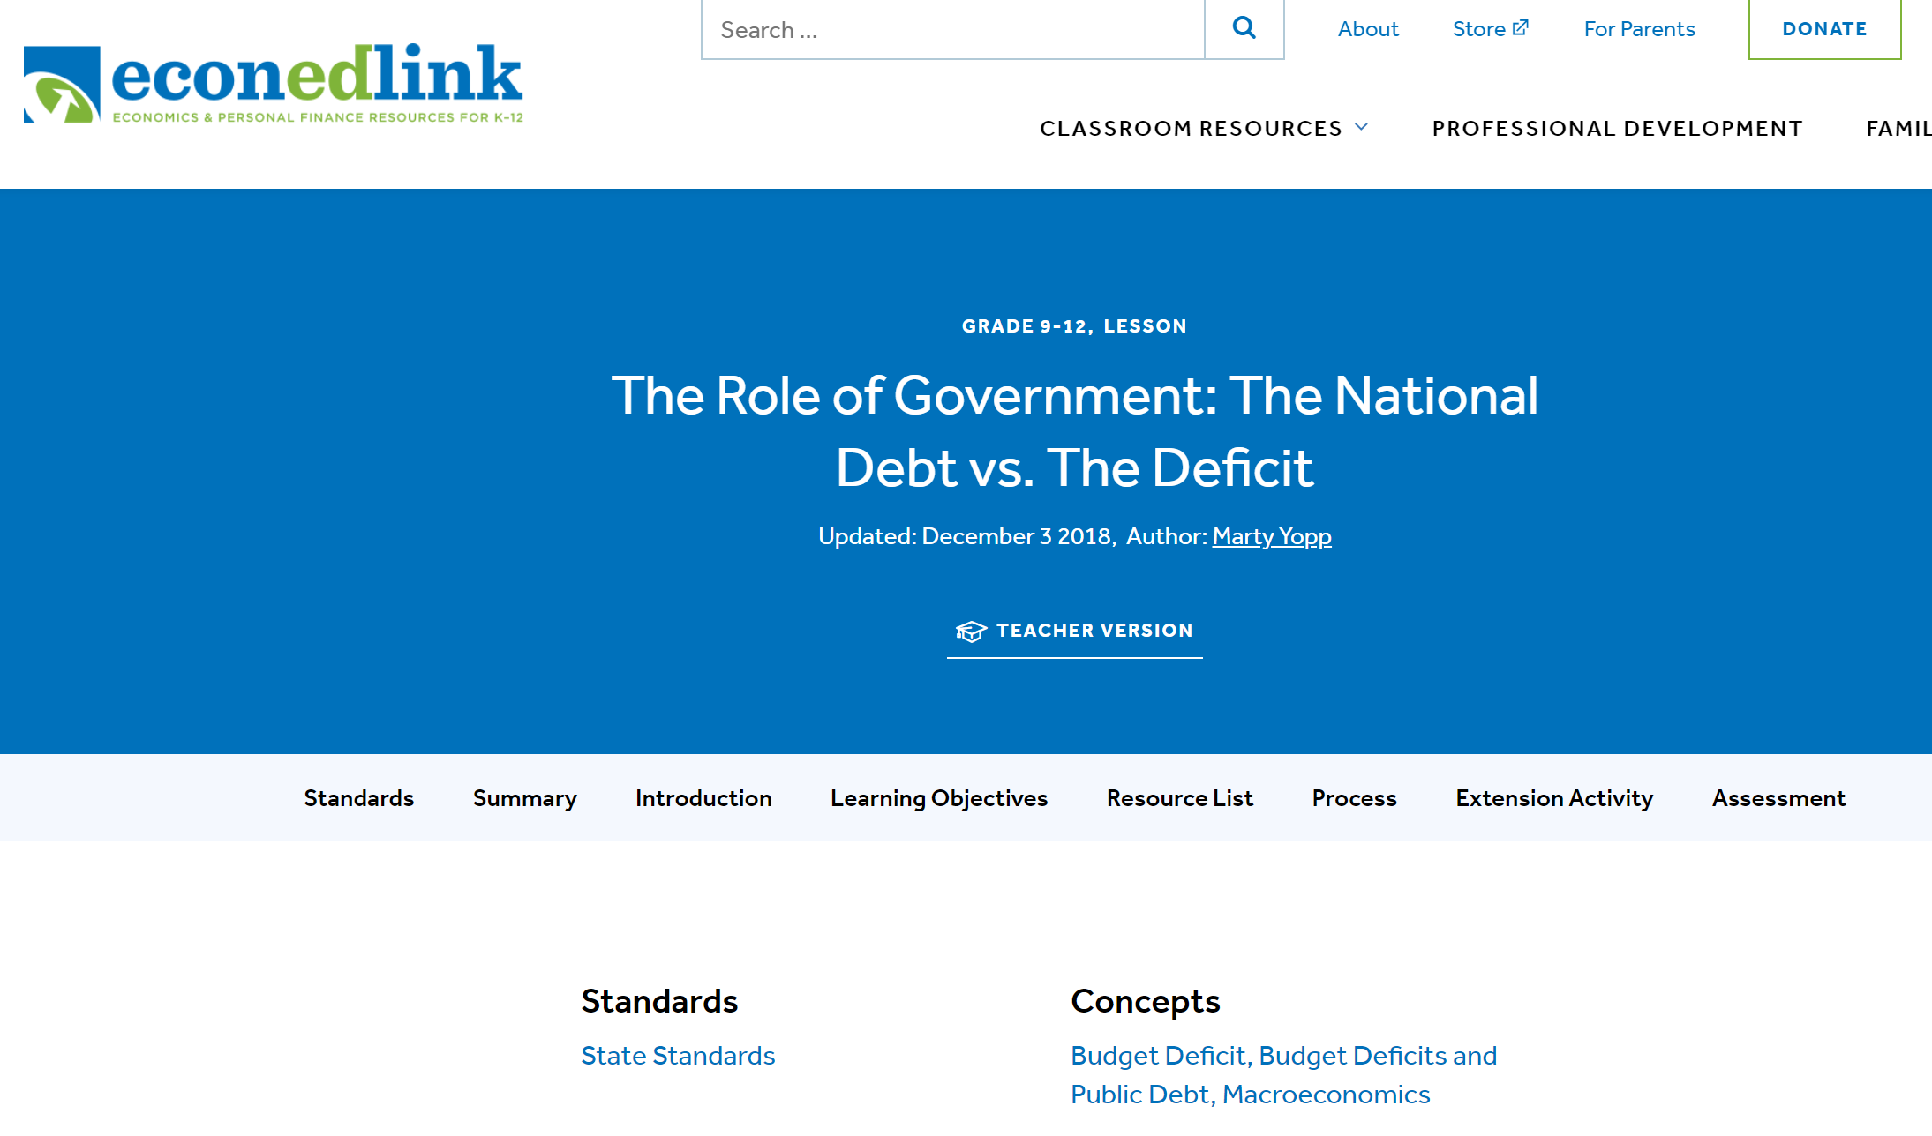
State Standards
Connect to regional and state standards at EconEdLink.org
Search for “Risk and Return”
Choose a lesson
Click on State Standards
NYSed.gov

Slide 15

Bell Ringer
Describe a choice that you made today that stands out…
SEE BITMOJI. TAKE ACTION!!!!

Slide 16
Active Learning
Activities will lead you to do the following:
  Identify the relevancy of economics applied to practical personal finance
  Establish the relationship between choices and living today relative to the future
  Discuss the link between different choices and their opportunity costs (or opportunities foregone)
  Describe choices, alternatives, and expected outcomes
  Investigate how to use decision-making based on sound economic reasoning to plan for life of comfort and security

Slide 17

Decision
Comfortable and secure living, in this framework, starts with strategic decision-making. (We are setting aside catastrophes, disabilities, and other disasters.)

Slide 18

24/7: You choose!

Slide 19


Breakfast
Healthy
Not So Healthy

Slide 20



After school
Homework
Entertainment

Slide 21


Time to go to bed
Burn the “midnight oil”
Early to bed; early to rise

Slide 22

EDUCATION AND CHOICES

Slide 23

Describe the choice associated with finishing high school
Alternative 1 (Finish)
Move up the employment ladder, making yourself more valuable to employers and other individuals while improving your income earning potential
Alternative 2 (Don’t Finish)
Join the labor group with the highest unemployment and lowest annual salaries

Slide 24
Did You Know?
Each level of education involves a money cost and an opportunity cost.

Slide 25
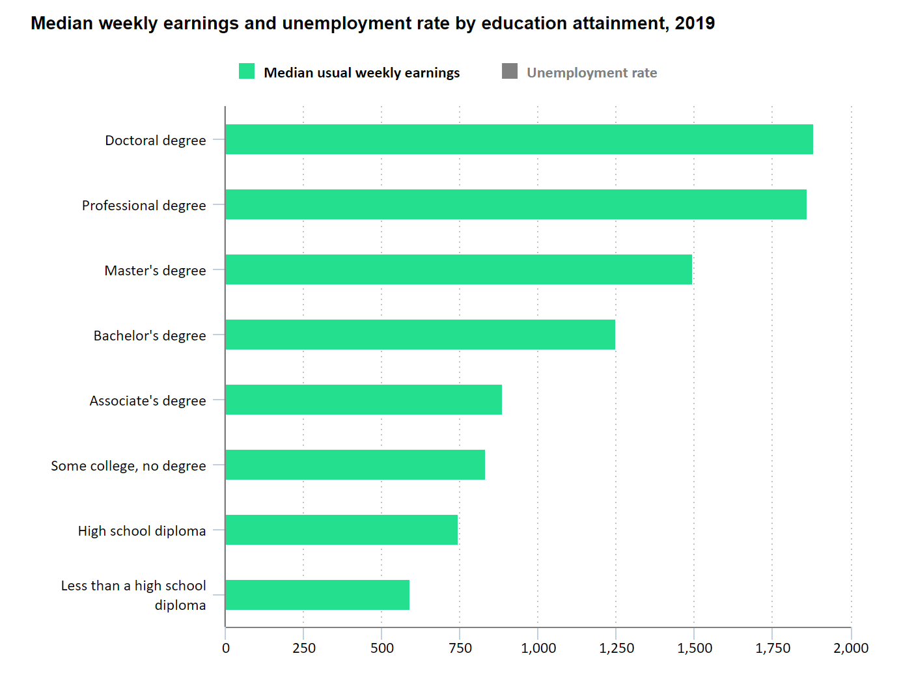
Slide 2.2 Educational Choices
People choose their educational paths from K-8 to high school to some college to college and on.
"Learn more, earn more: Education leads to higher wages, lower unemployment," Career Outlook, U.S. Bureau of Labor Statistics, May 2020.

Slide 26

There is no “free lunch” in education
There is no free lunch in education!
Educational return is the expected additional income associated with earning degrees, receiving certificates and having professional experiences.
Risk is the uncertainty that the investment in human capital will involve gains but also losses.

Slide 27
Magic – Describe how would you use $1,000 right now if it fell from the sky.
Choose only one thing…

Slide 28
When people choose…
They proceed with those choices in which their perceived benefits are greater than the “costs.”
Every choice has an opportunity cost.
Even though there was no money cost, choosing to use the $1,000 for one thing involved giving up another.
Opportunity costs and “choice” tradeoffs matter!

Slide 29



Case Study
Meet the Robinson and Murray families. They are similar in numerous ways:
Same household income and education
Same neighborhood
Adults are about the same age
There are two children per household

Slide 30
Choosing Strategically
Let’s consider the tool of choice.
Let’s analyze how it can help families live financially secure and comfortable lives.
Consider the case study involving these two families.

Slide 31
The Robinsons
Budget with the Golden Rule: spending less than they earn each month
Drive pre-driven vehicles and try to wear “gently-used” clothes
Eat most meals at home
Earned while they learned and avoided taking on heavy student debt
Have placed $100,000 into their retirement account and are fully taking advantage of their employers’ contributions and seizing tax advantages
Have established savings plans to help their children with educational expenses
Continue to participate in educational opportunities through professional workshops, virtual networking and seize opportunities to build up their resumes with the hope of differentiating themselves so they are more attractive for promotions, pay raises and retention during periods of high unemployment

Slide 32
The Robinsons plan to turn their $100,000 into $200,000 in ten years. How can they do this?
Invest it in an investment portfolio that promises an average rate of return of 7%
The stock market index funds have historically generated 7 percent in returns. See the Rule of 70 for details on the power of compounding interest.
Warning: there have been ups and downs in these returns! So, proceed strategically. Well-diversified investments have positive expected returns, on average. They also have risks.

Slide 33
The Murrays
Switched majors several times while in college and took on large amounts of student debt in the process
Do not budget
Chose a mortgage with a lower monthly payment and relatively high interest over a 30-year period; took out a second mortgage
Drive new cars, wear only name brand clothes and dine at restaurants frequently
Regularly max out their credit cards and willingly pay interest on them
Prefer to spend their weekends relaxing or traveling
Have no savings for retirement and hope their children will get athletic or scholastic scholarships to fund college

Slide 34

Fast forward… 10 years
The Murrays argue the Robinsons are the “wealthier” family because they (the Murrays) had no choice.
How do you respond based on your review of this case? Provide one response.

Slide 35
Wealth: What Is It?
Having assets (including more money in savings)
Taking on fewer liabilities (lower mortgage payments, smaller credit card balances, lower car loans and manageable student loan debt)
Differences in wealth are strongly associated with different choices and their present and future-value
So, yes, the Robinsons are wealthier. They made strategic choices, budgeted, and planned for a future of secure and comfortable living over time.

Slide 36
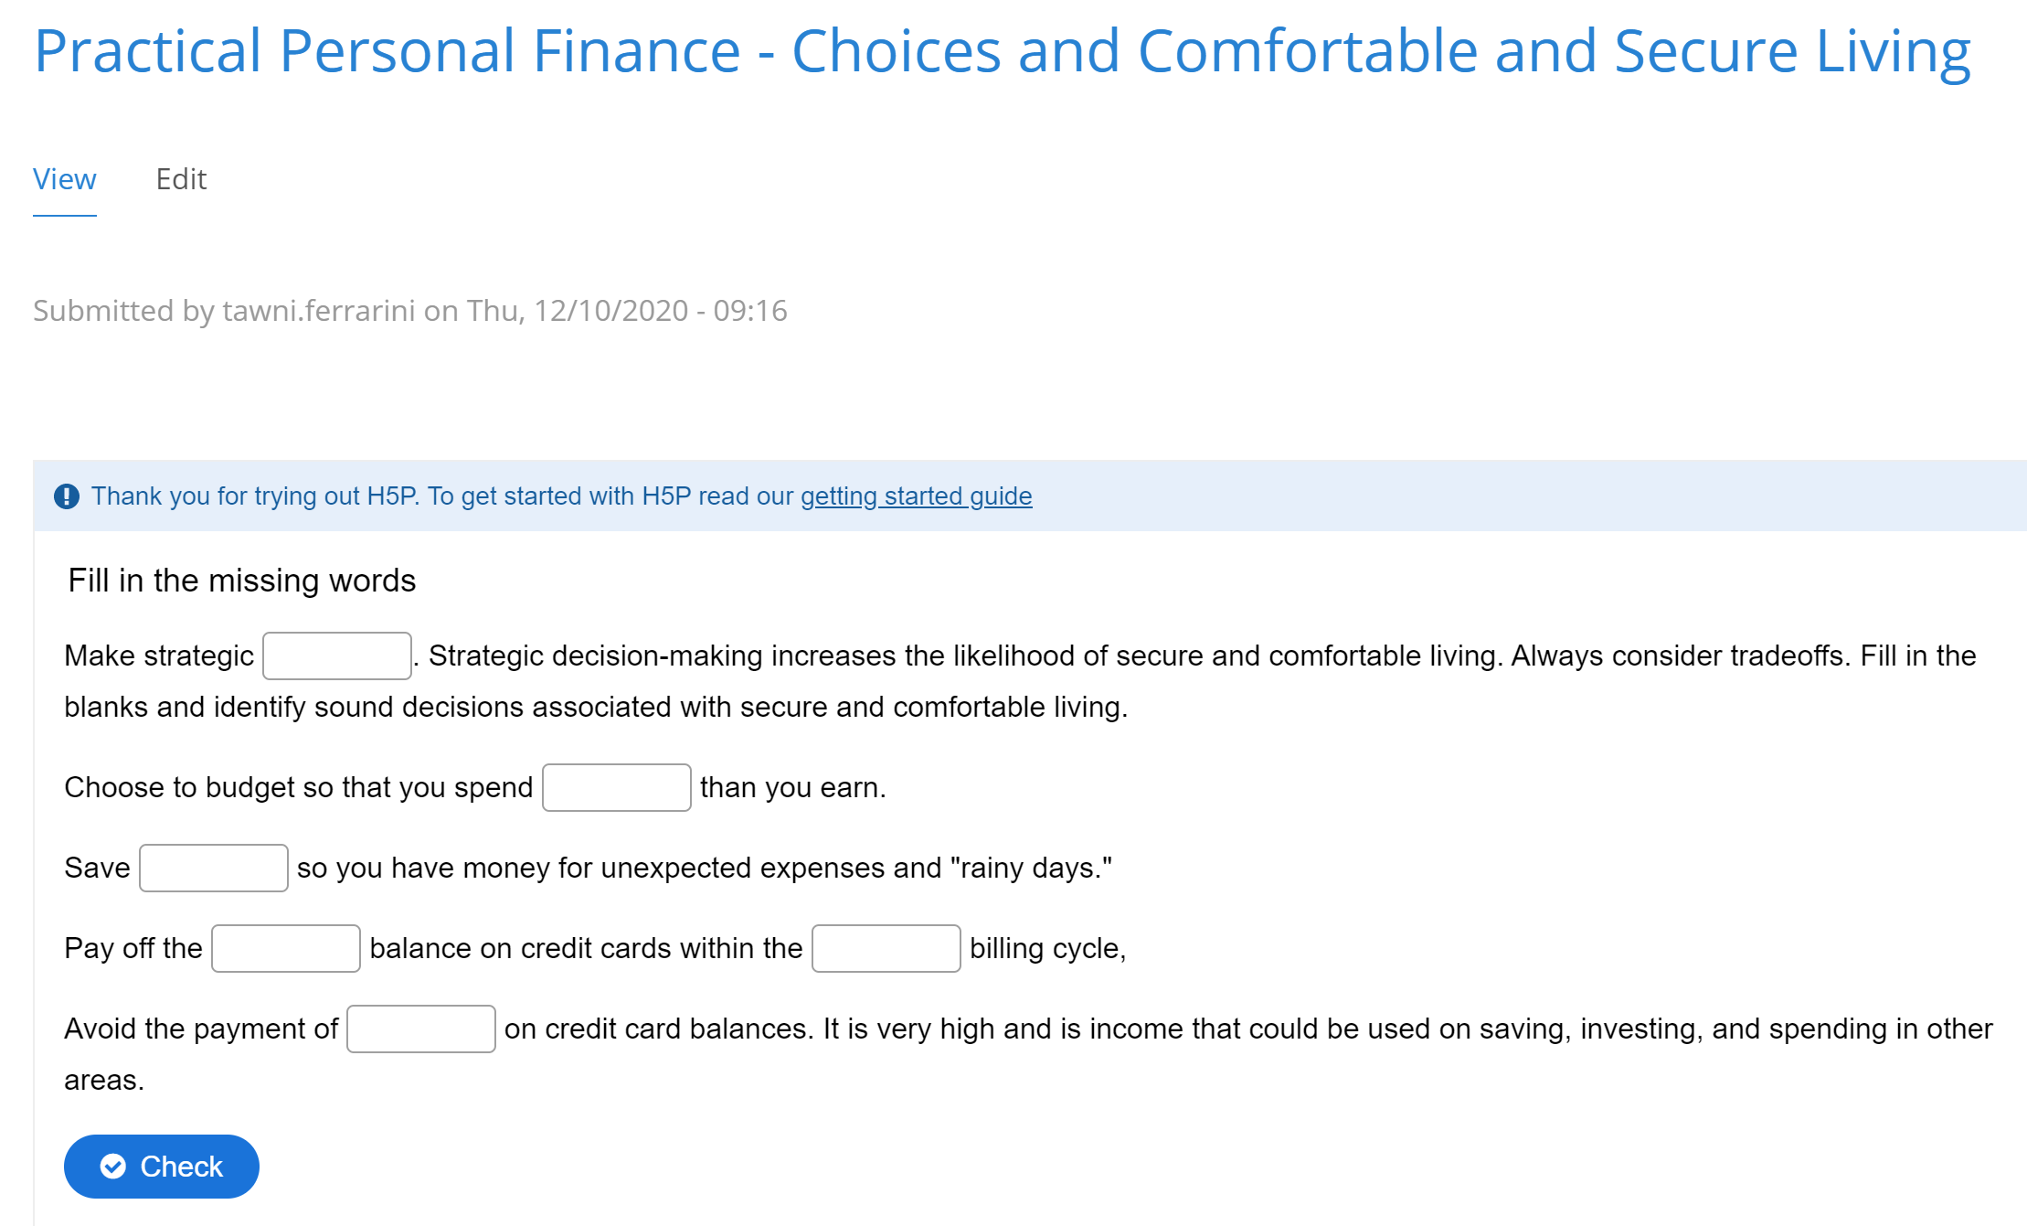
Choices: Sound

Slide 37
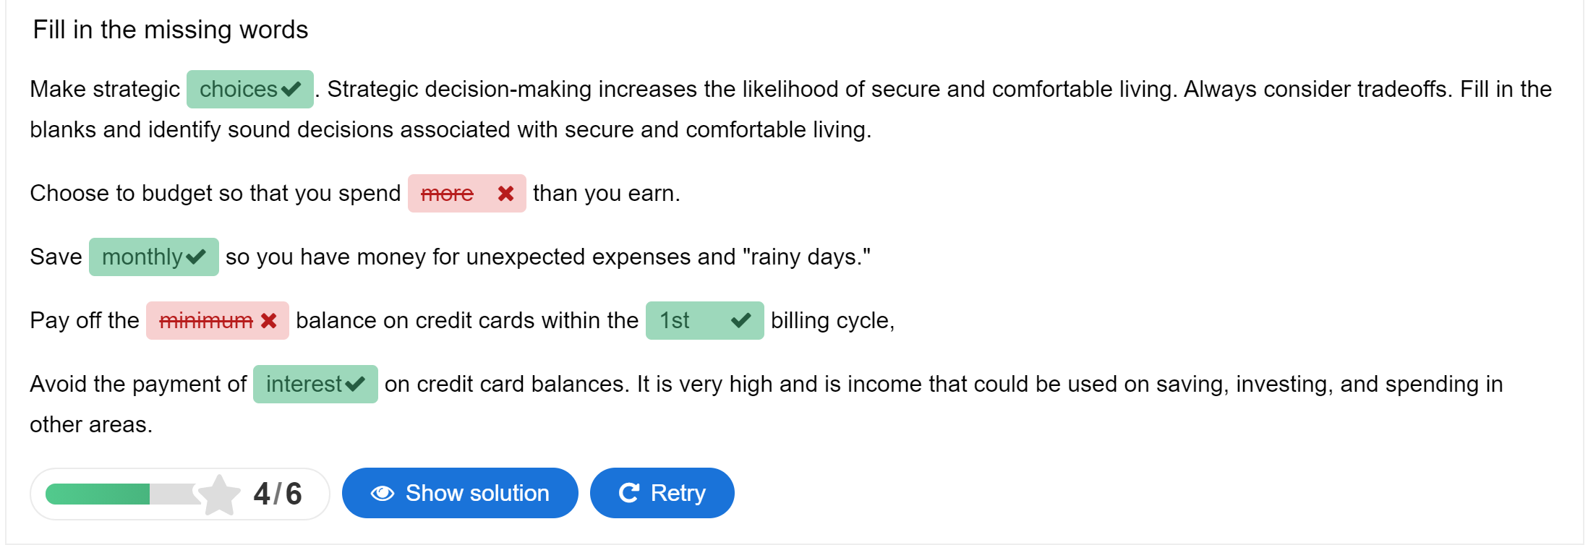
Choices: Sound

Slide 38
Systems Matter
The U.S. economic system relies on choices, incentives and markets...
In a market system, individuals are free to start a business, get an education, choose an occupation and buy or not buy a variety of goods and services.
Each decision comes with a benefit, money cost, and an opportunity cost.

Slide 39

Circle the Healthy/Wealthy Choice
Save or not save for a rainy day
Buy a premium cup of coffee or bring your own to work
Buy a new car, buy a used car or walk to work if you’re six blocks away
When dining out, use a credit card when you can’t pay it off in full or use Venmo
Earn an associate’s degree for a high demand occupation without debt or a four-year degree in low demand career with huge debt

Slide 40
The Opportunity Cost for Each Family
For the Robinsons, the opportunity cost of managing their money and furthering their education is having less time to relax, less time to go out to dinner, and so on.
For the Murrays, the opportunity cost of relaxing and going out to dinner is not managing their money or furthering their education.
Making good choices involves comparing the benefits and costs of decisions.
The Robinsons choose financially healthier and more practical lives. These choices are more likely to help them grow their wealth, reduce their financial anxiety and lead more secure lives, on average, than the choices of the Murrays.
The financial decisions of today have future consequences tomorrow.

Slide 41
Rapid Review
Every choice made affects other opportunities.
There are tradeoffs.
Sometimes they are not revealed until the future.
Education yourself. Be informed. Devise a plan to live comfortably and securely.

Slide 42
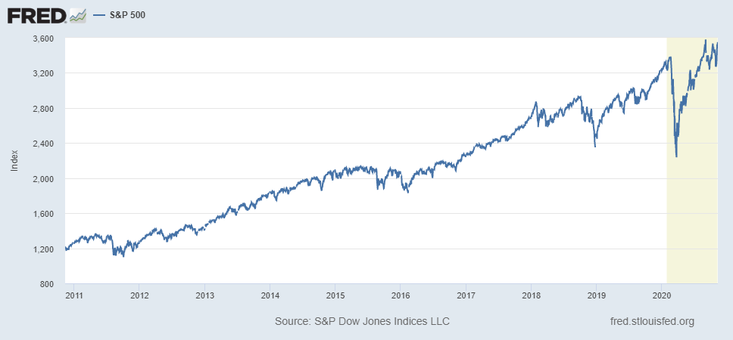
S&P 500 Before/After Pandemic

Slide 43
S&P 500 Before/After Pandemic
Spend less than you earn and build up savings to invest
Be diversified across investments, recognizing the risks and returns
Buy and hold
  $1,000 would have dropped to $660 if sold in March 2020
  $,1000 would have returned to $1,000 if held until August 2020
  $1,010 (est) if held until Sept 2020

Slide 44
References
Financial Fitness for Life and EconEdLink.org
Audio NPR U.S. Credit Card Debt Hits All-Time High, And Overdue Payments Rise For Young People
Interactives (Virtual classroom activities, preparatory interactives, or follow-up reinforcements) H5P Practical Personal Finance - Sound Choices Associated with Comfortable and Secure Living
Learning Activity Suggestions Critical Review of Podcast ** Short Essay Assignment Summarizing the Tradeoffs of Different Budgets ** NGPF Budgeting Case Studies
Videos Living Paycheck to Paycheck? Try The Zero-Based Budgeting Method Where Every Dollar Counts (03:26)
Data FRED St. Louis, FED (Current) ** MeasuringWorth.com (Historic Data)
Notes:
rhttps://www.investopedia.com/terms/b/bureau_of_public_debt.asp
https://h5p.org/
https://www.treasurydirect.gov/govt/resources/faq/faq_publicdebt.htm#DebtMakeup
https://www.pgpf.org/national-debt-clock
https://www.pewresearch.org/fact-tank/2019/07/24/facts-about-the-national-debt/

Slide 45

CEE Affiliates
https://www.councilforeconed.org/resources/local-affiliates/

Slide 46




Thank You to Our Sponsors!

Slide 47

Happy Holidays!
Tawni Hunt Ferrarini, PhD
Tferrarini@Lindenwood.edu * Tawni.org

