Slide 1

December 16, 2020
Dr. Cheryl Ayers cheryl@mru.org
Globalization, Robots & You: Helping Students Navigate the Future

Slide 2
EconEdLink Membership
You can now access CEE’s professional development webinars directly on EconEdLink.org! To receive these new professional development benefits, become an EconEdLink member. As a member, you will now be able to:
Automatically receive a professional development certificate via e-mail within 24 hours after viewing any webinar for a minimum of 45 minutes
Register for upcoming webinars with a simple one-click process
Easily download presentations, lesson plan materials and activities for each webinar
Search and view all webinars at your convenience
Save webinars to your EconEdLink dashboard for easy access to the event
You may access our new Professional Development page here

Slide 3
Professional Development
Certificate & Resources
To earn your professional development certificate for this webinar, you must:
Watch a minimum of 45-minutes and you will automatically receive a professional development certificate via e-mail within 24 hours.
Accessing resources:
You can now easily download presentations, lesson plan materials, and activities for each webinar from EconEdLink.org/professional-development/

Slide 4

Today’s Objectives
Review best practices for teaching secondary economics.
Experience Globalization, Robots & You curriculum for helping students make more informed career and education decisions.
Preview other Marginal Revolution University (MRU) resources for teaching secondary economics.

Slide 5
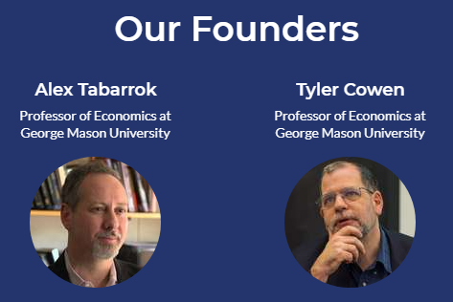
About Us
Marginal Revolution University (MRU)
Online, video-based, nonprofit, economic education platform founded in 2012 by GMU professors Drs. Tyler Cowen and Alex Tabarrok for teachers, students, and lifelong learners worldwide

Slide 6
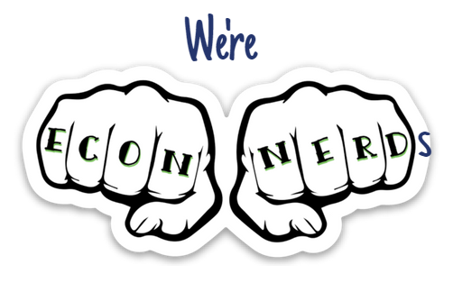
About Us
Our Vision
Economics has the power to positively change the way people view and live in the world because there’s an inner economist in all of us.
Our Mission
To provide a FREE world-class economic education to everyone, everywhere by:
Developing your inner economist with engaging, thought-provoking ways of looking at everyday problems
Entertaining you so you actually want to learn economics (no boring lectures!)
Thinking on the margin: one idea + one person at a time = “Marginal Revolution”
Notes:
Economics is the study of how to get the most out of life. We’re passionate about changing the world through economic education!

Slide 7
Effective Economics Instruction

Slide 8
Pedagogical Content Knowledge (PCK)
“Ways of representing and formulating a subject that make it
comprehensible to others” (Shulman, 1986)
Pedagogical
Content
Knowledge
Content Knowledge
Pedagogical Knowledge

Slide 9

Pedagogical Content Knowledge (PCK)
in Economics
curriculum connections
economic reasoning skills
citizenship preparation
active learning
student relevance
Content Knowledge
Pedagogical Knowledge
A First Step toward a Practice-based Theory of Pedagogical Content Knowledge in Secondary Economics (Ayers, 2018)
Notes:
Curriculum connections = economics globalization connected to world geography and personal finance
Economic reasoning skills = cost-benefit analysis and PACED applied to universities and careers
Citizenship preparation = global citizenship responsibilities
Active learning = interactive games and websites
Student relevance = future income and lifestyle

Slide 10
CTE
Social Studies English, Science Math
Personal Finance Controversial Issues
LIFE 101
Economics
Concepts Principles Reasoning Skills
Real-world
Critical
Thinking
Skills
3 Economic Reasoning Tools
- cost-benefit analysis chart
- PACED-O decision-making model
- economic way of thinking principles
Teaching Students to ‘Think Like Economists’ as Democratic Citizenship Preparation
(Ayers, 2019)
Notes:
3 Economic Reasoning Tools perfect for Globalization curriculum, too.

Slide 11
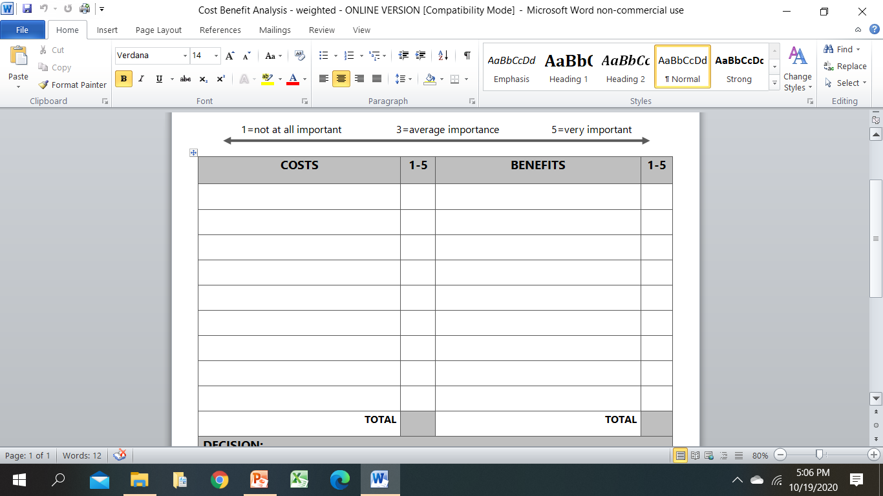
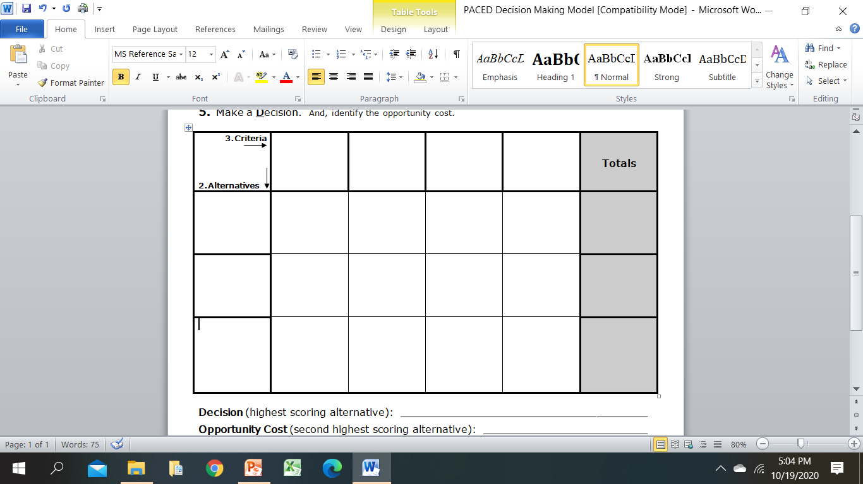
3 Economic Reasoning Skills/Tools Learning Outcomes
sharpening critical thinking and critical literacy skills
entertaining multiple perspectives
gaining a deeper, nuanced understanding of subject-specific content
making students’ thinking explicit for assessment purposes
achieving a inter/multidisciplinary understanding of current events
using evidence to draw conclusions and make generalizations
articulating and defending positions using content vocabulary
laying the groundwork for authentic discussions and civil debates
casting informed votes
analyzing and synthesizing primary and secondary sources
comparing/contrasting historical, cultural, and political perspectives
explaining cause-and-effect relationships
practicing citizenship skills such as collaborating, compromising, and reaching consensus
thinking like an economist for authentic disciplinary learning (like historical thinking)
making more productive and prosperous workplace and everyday life decisions

Slide 12
Globalization, Robots & You
Curriculum Unit

Slide 13
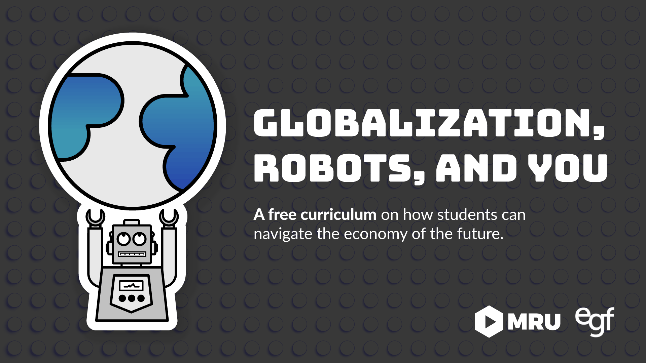
5-day curriculum (in-class and online versions) of videos, active learning, and games in
Google Docs for easy editing!
What is globalization and what is its history?
How is globalization impacting the world?
What is the effect of globalization on my life?

Slide 14
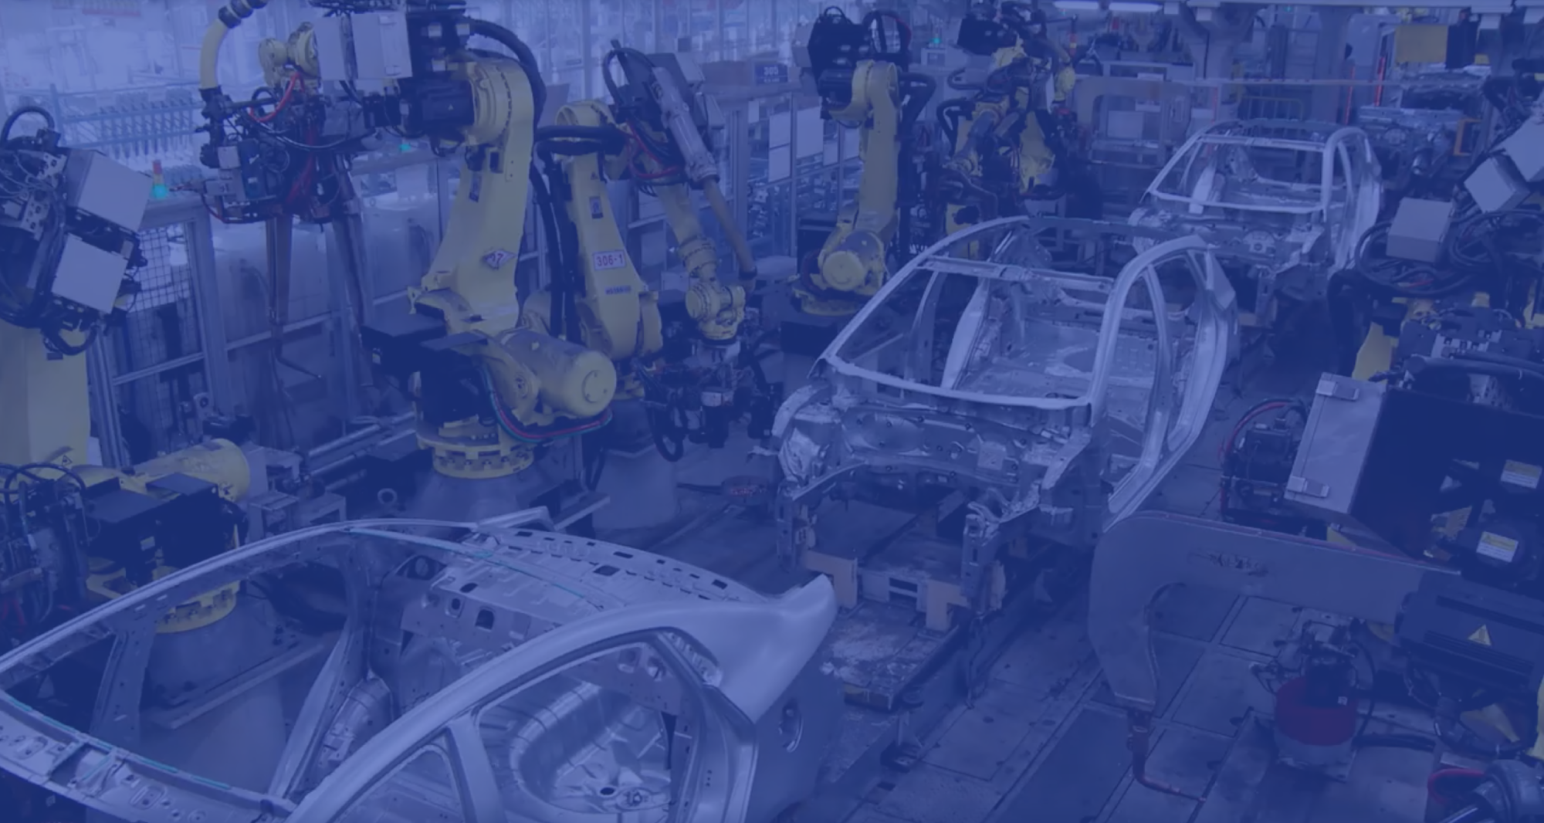
Make more informed decisions about education and careers based on the projected impact of globalization and automation on the U.S. economy’s rapidly changing workforce

Slide 15
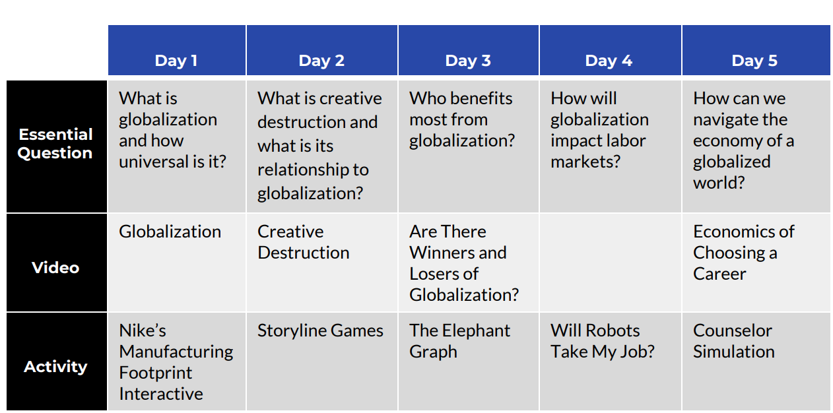
Notes:
Day 1 = Global supply chain in making Avengers and Nikes
Day 2 = Fall of Kodak and rise of Instagram + Storyline Game that shows effects of creative destruction
Day 3 = Video and elephant graph that shows global wage growth among different groups
Day 4 = Storyline Game that shows wage growth of HS and college grads over time & Will Robots Take My Job due to automation
Day 5 = Video on labor market supply and demand on education/career choices + Culminating Project

Slide 16
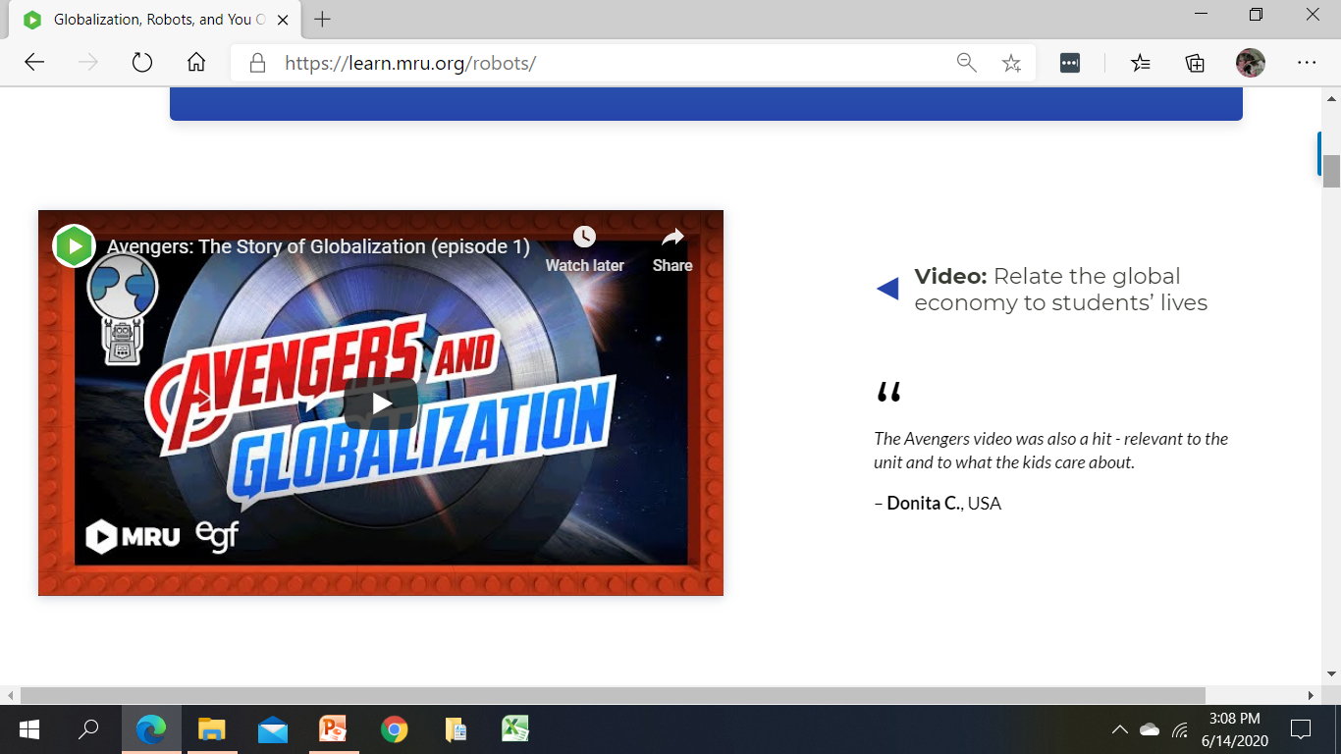
Day 1
https://mru.org/courses/everyday-economics/avengers-story-globalization
https://www.youtube.com/watch?v=PPZZQ0fmI2Y
Notes:
Globalization 1.0: Trade within areas
Globalization 2.0: Innovations in transportation during the Industrial Revolution - trade was good, but information was slow
Globalization 3.0: Recent innovations in communications and information technology - Information Revolution where information and communication opened countries up to the global supply chain
Globalization 4.0: AI

Slide 17
Day 2
Quiz/Poll Time!
What are both Kodak and Polaroid examples of?
The desire of people to hold on to old technologies.
Powerful companies that only increased profits due to creative destruction.
The painful side of creative destruction.
The need for automation in the workforce.
Notes:
7/28/20 Kodak just signed a deal to make pharmaceutical ingredients at rock bottom prices to help keep US drug prices low – creative reconstruction!

Slide 18

c) The painful side of creative destruction.

Slide 19
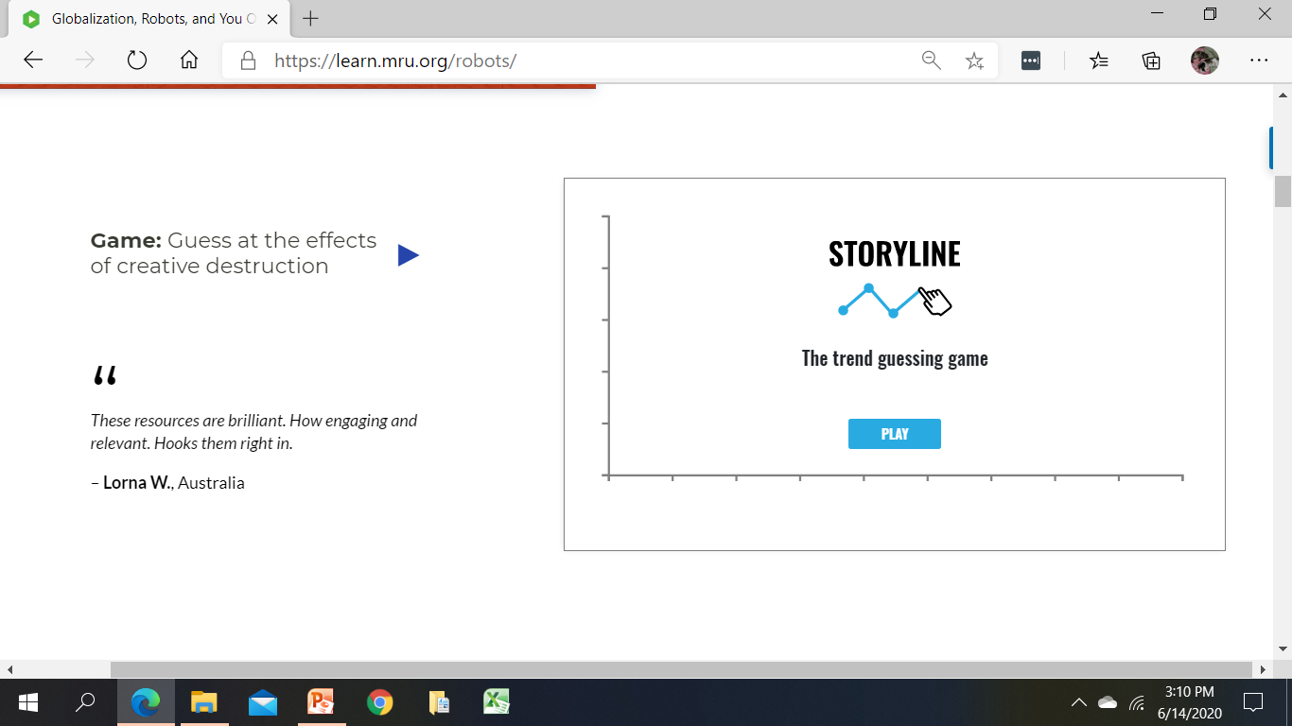
Creative Destruction: Technology and Trade
Storyline Game https://play.storylinegame.com/play?quiz=MRU%20Day%201
Days 2, 4
Notes:
-Storyline, an online tool that allows students to make educated guesses about economic trends and then reveals the correct trendline….to demonstrate creative destruction. Explain hint can be used before or after trendline.
-CONTENT IDEAS: Inflation and changes in demand
-PEDAGOGY IDEAS: Ask students to take a screenshot of game and write historical narrative of what they were thinking when they drew the line; give historical clues to consider for each decade; redraw and explain changes

Slide 20
Let’s look at the data! https://willrobotstakemyjob.com/
Day 4
Quiz/Poll Time!
Which job is most likely to be automated and replaced by a robot?
  Teacher
  Accountant
  Plumber
  Engineer
Notes:
Accountant – 94%

Slide 21
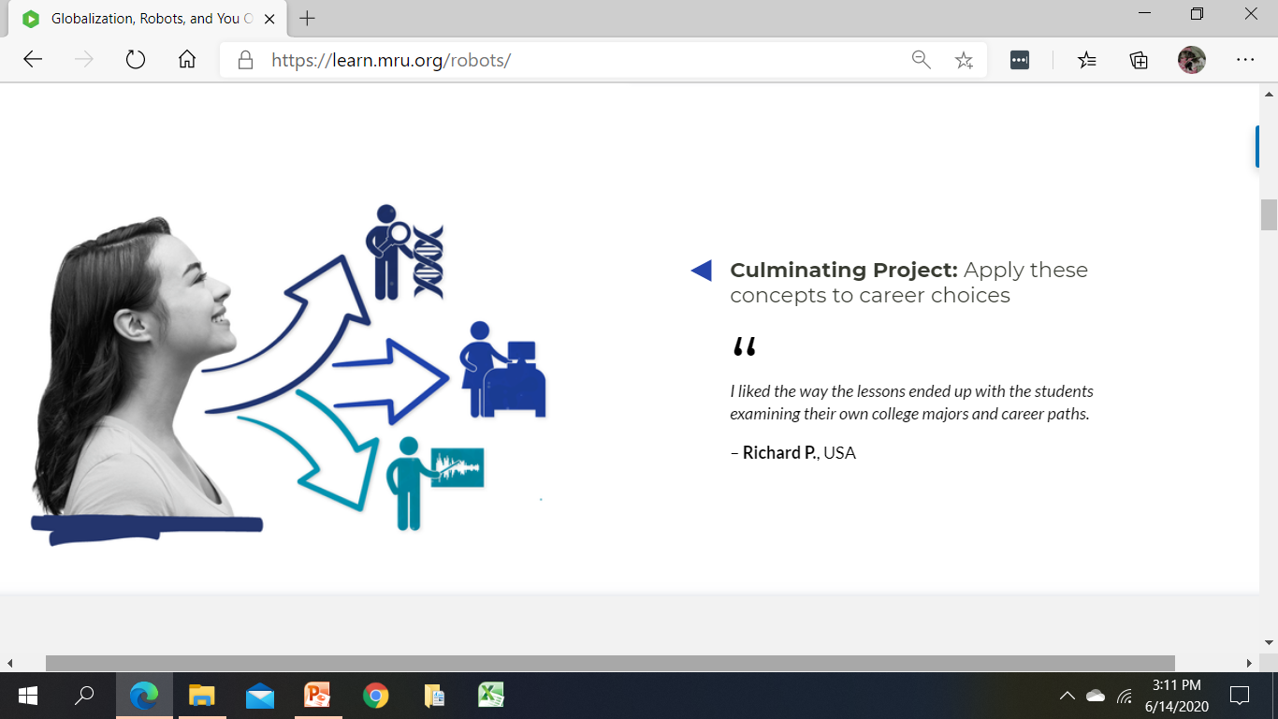
Day 5

Slide 22
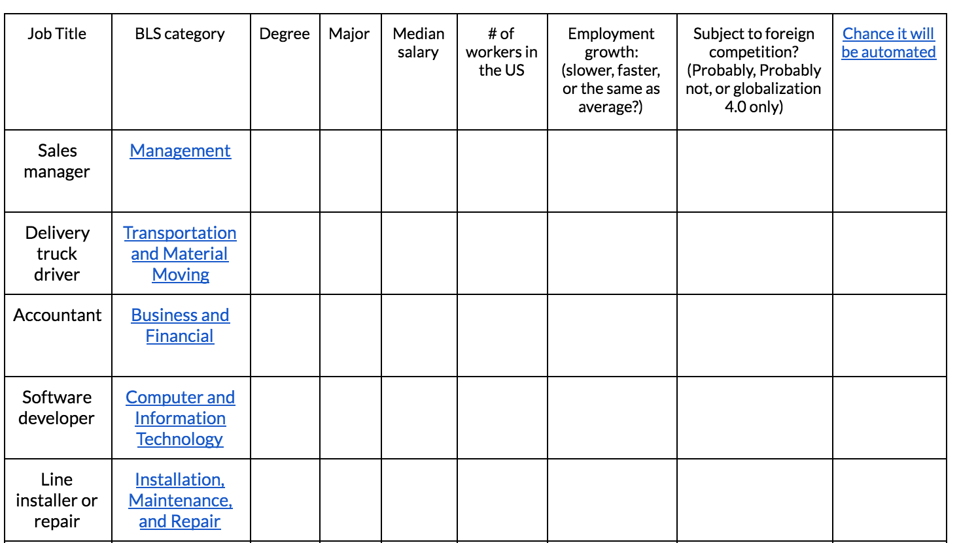

Slide 23
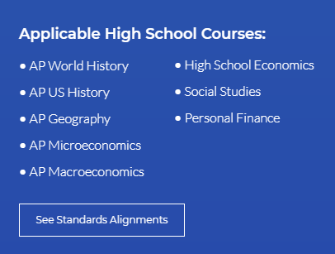
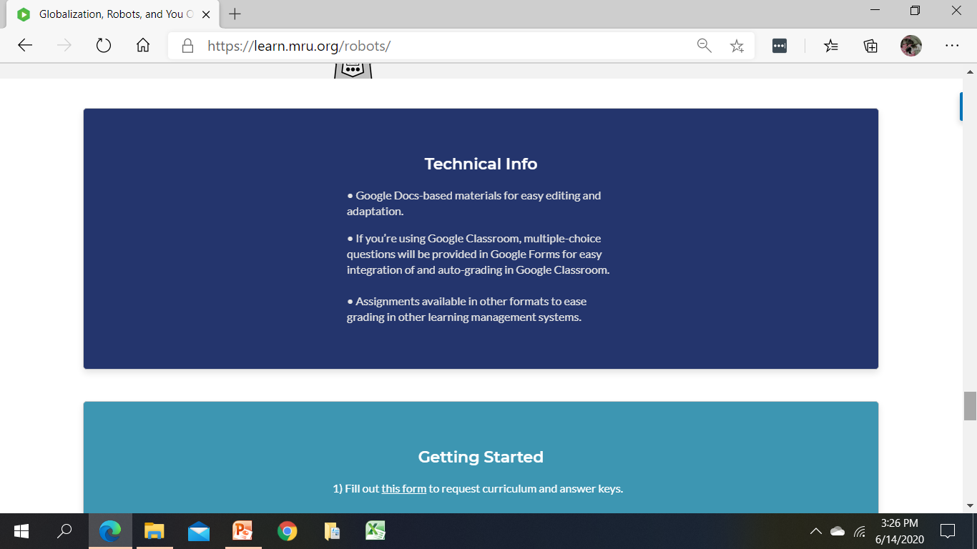

Slide 24
Question or Comments?

Slide 25
FREE MRU
Economic Resources

Slide 26
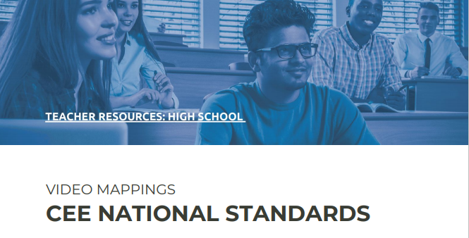
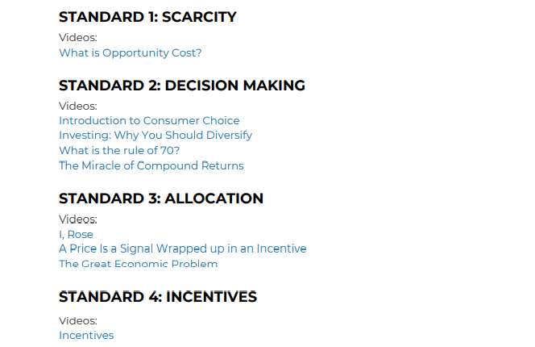
Videos Aligned to CEE Standards
EdPuzzle Videos: https://edpuzzle.com/channel/5cf6f1059dc78f411126ed9f

Slide 27
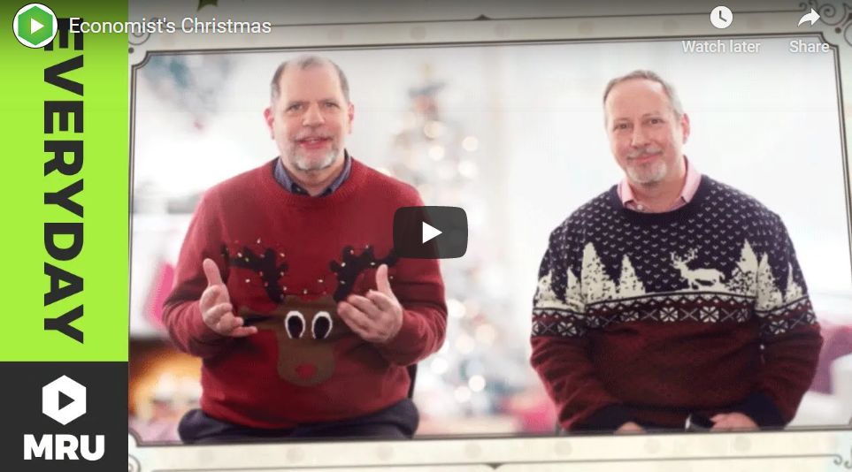
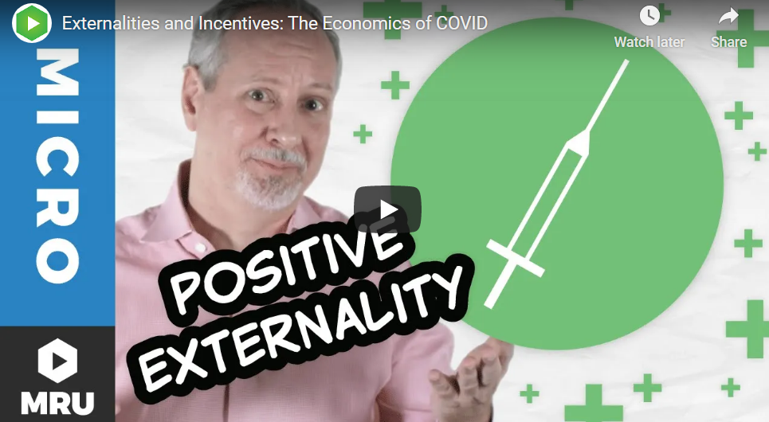
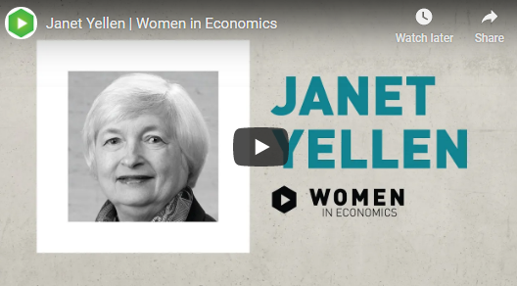
Seasonal Videos

Slide 28
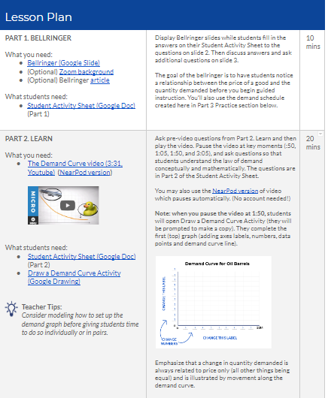
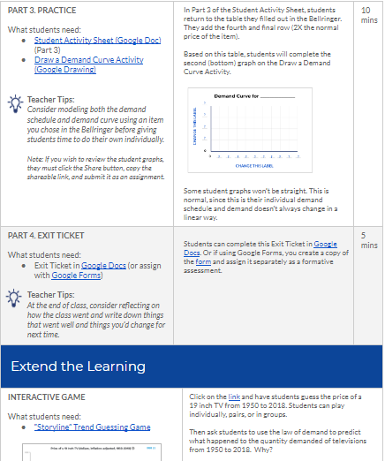
Law of Demand
Lesson

Slide 29

EconInBox

Slide 30
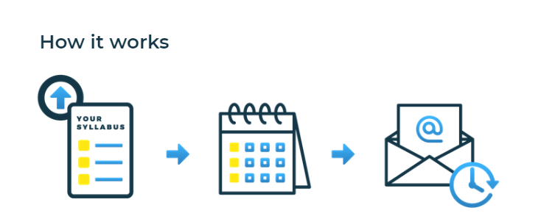
EconInBox
Curated Current Events Emails
Sign up
Send course outline
Receive
just-in-time resources
https://www.econinbox.com/

Slide 31
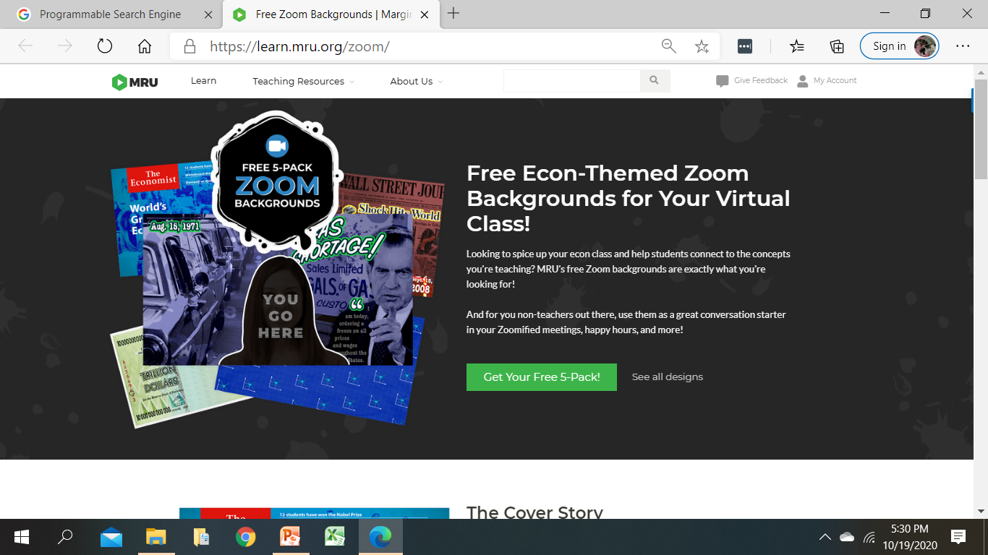
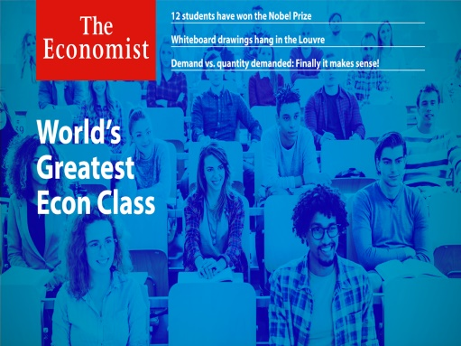
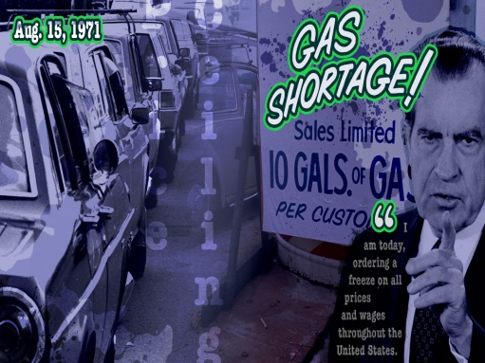
Zoom Backgrounds
https://learn.mru.org/zoom/

Slide 32
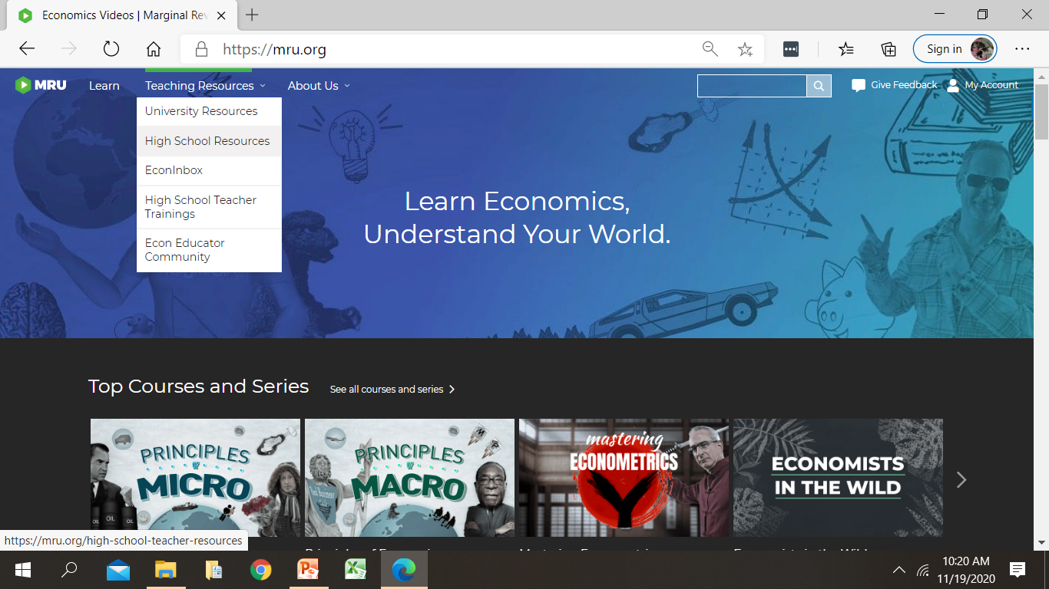
Website Exploration
https://mru.org Teaching Resources High School Resources

Slide 33
Questions
or Comments?

Slide 34
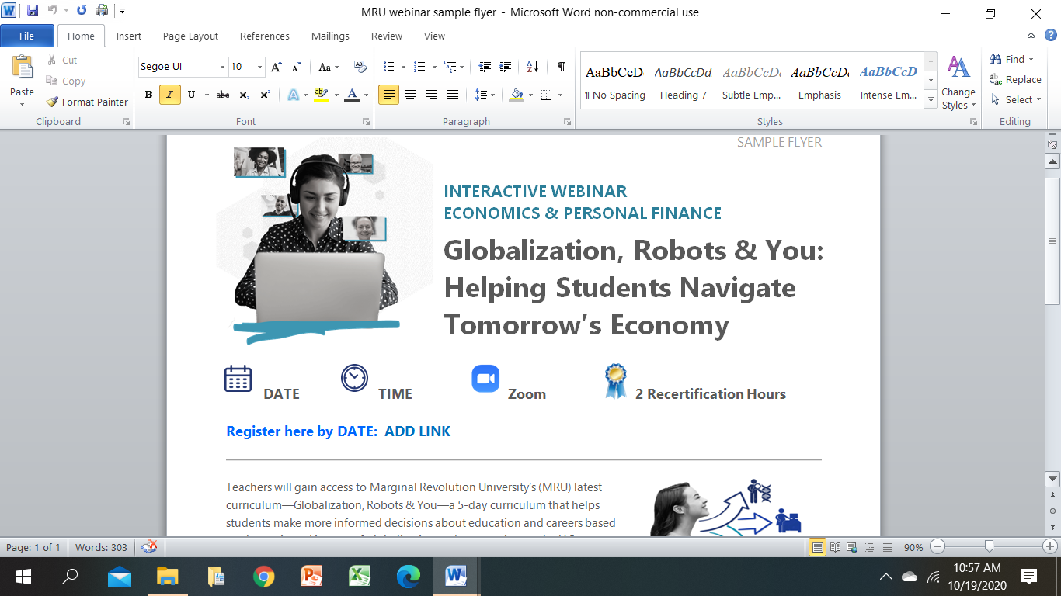
Wrap-Up
Posted on EconEdLink PD Webpage (please share with colleagues)
MRU Videos aligned with CEE National Standards
Informational flyer recapping MRU resources
This PPT presentation
Spring 2021 CEE-MRU Webinars
MRU Statewide Webinars
Statewide Online Courses (non-streaming video files)
Finding Equilibrium: Supply Meets Demand Unit Women in Economics
Notes:
Happy to align MRU videos to any state’s economic learning standards

Slide 35
Opt-In
Go to MRU.ORG/CEE2
  Globalization, Robots & You curriculum
  Updates on new videos, lessons, and activities
Notes:
Just released videos:
Externalities & Incentives: Economics of COVID
Women in Economics: Christina Romer

Slide 36


Thank you!
Questions/Feedback
Cheryl ♦ cheryl@mru.org
Stay Connected
@MRevUniversity
facebook.com/mrevuniversity
Join our Teaching Online Econ Facebook Community at COMMUNITY.MRU.ORG

Slide 37

CEE Affiliates
https://www.councilforeconed.org/resources/local-affiliates/

Slide 38




Thank You to Our Sponsors!

