Slide 1
The Value of Human Life: What Does Economics Have To Do With It? Presented by Kathleen Brennan December 1, 2020 kbrennan@mountsaintmary.org

Slide 2
EconEdLink Membership
You can now access CEE’s professional development webinars directly on EconEdLink.org! To receive these new professional development benefits, become an EconEdLink member. As a member, you will now be able to:
Automatically receive a professional development certificate via e-mail within 24 hours after viewing any webinar for a minimum of 45 minutes
Register for upcoming webinars with a simple one-click process
Easily download presentations, lesson plan materials and activities for each webinar
Search and view all webinars at your convenience
Save webinars to your EconEdLink dashboard for easy access to the event
You may access our new Professional Development page here

Slide 3
Professional Development Certificate
To earn your professional development certificate for this webinar, you must:
Watch a minimum of 45-minutes and you will automatically receive a professional development certificate via e-mail within 24 hours.
Accessing resources:
You can now easily download presentations, lesson plan materials, and activities for each webinar from EconEdLink.org/professional-development/

Slide 4
Agenda
Cost-benefit analysis
Historical perspective of regulatory analysis
Examples of regulation

Slide 5
Objectives
Understand how benefit cost analysis is done
Recognize the need to value “lives” when evaluating regulatory policy
Examine measures of the value of a statistical life (VSL)
Understand limitations of VSL
Apply VSL in the context of Covid-19

Slide 6
National Standards
Standard 1: Scarcity- productive resources are limited; choices must be made
Standard 2: Decision Making- effective decision-making requires the comparison of additional costs with additional benefits
Standard 16: Role of Government and Market Failure- there is an economic role for government in a market economy whenever the benefits of a government policy outweigh its cost.
https://www.councilforeconed.org/wp-content/uploads/2012/03/voluntary-national-content-standards-2010.pdf

Slide 7
State Standards
New York Social Studies: Standard 4 Economics- Students understand the nature of scarcity and how nations of the world make choices which involve economic and social costs and benefits.
New Jersey Social Studies: N.J.A.C.6 A:8-5.1 (a) 1.iv and v
http://www.nysed.gov/curriculum-instruction
https://www.nj.gov/education/cccs/2020/2020%20NJSLS-SS.pdf

Slide 8
Principles of Economics
People face tradeoffs.
The cost of something is what you give up to get it.
Rational people think at the margin.
People respond to incentives.
Trade can make everyone better off.

Slide 9
Principles of Economics
Markets are usually a good way to organize economic activity.
Governments can sometimes improve economic outcomes.
The standard of living depends on a country’s production.
Prices rise when a government prints too much money.
Society generally faces a short-run tradeoff between inflation and unemployment.
Source: Principles of Economics, Gregory Mankiw

Slide 10
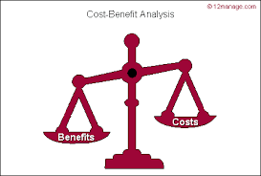
Cost-Benefit Analysis (CBA)
Good decision-making requires weighing all the costs of an action/choice against all the benefits.

Slide 11
History of CBA
Introduced by French engineer, Jules Dupuit, in the 1840’s
Used in 1930’s to evaluate federal water projects in the United States
Used to analyze policies affecting transportation, public health, defense, education, and the environment.

Slide 12
Cost-Benefit Analysis and Public Policy
There are two main purposes for using cost-benefit analysis:
To determine if a policy is sound, justifiable, and feasible by figuring out whether its benefits outweigh its costs.
To determine a baseline for comparing alternative policies

Slide 13
Steps in CBA
Identify all costs and benefits
Quantify costs/benefits using a monetary value
Discount the costs and benefits back to a common time period
Assess whether benefits > costs
Perform sensitivity analysis

Slide 14
A complication….
The valuation of many benefits and costs is intuitively obvious, while others, particularly those that deal with the benefit of saving human lives, present problems.
How do you put a price tag on saving a human life?

Slide 15
Some History…
Up until the late 1970’s, it was believed that “life was too sacred to value.”
The Rand Corporation could not evaluate a defense program that involved a high rate of casualties since they did not know how to value the lives of the serviceman who would be killed.

Slide 16
A criterion problem…
The cost of a bomb, parachute, or training program was easy.
What was the “value” of the crew who would potentially be lost?

Slide 17
The 1960’s - 1970’s

Slide 18
The 1980’s
Benefit-cost analysis for all “major rules” was specifically required and mandated selecting the regulatory option that minimizes net costs and maximizes net benefits, unless otherwise precluded from doing so by applicable law.
See: Executive Order 12291

Slide 19
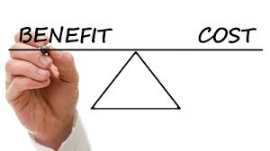
Today
Cost-benefit analysis is required for any major regulation that costs more than $100 million per year.

Slide 20
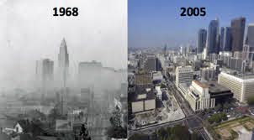
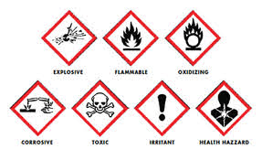
How do you accurately measure the benefits of…

Slide 21
Example: Air pollution control
Benefits
Reduced damage to exposed materials
Diminished health risks to citizens
Improved visibility
Increased jobs for those manufacturing pollution control equipment
Costs
Increased cost of firm’s product
Potential plant closures
Laid off workers
Decrease planned investment

Slide 22
A Hypothetical Case
Assume: a pollutant cause excess mortality of 1,000 deaths per year in the population at risk…
Reducing emissions by 50% would cost $5 million and excess mortality would be decreased to 500 deaths per year.
Reducing emissions by 100% would cost $500 million and would reduce excess mortality to zero.

Slide 23
A Hypothetical Case (Part 2)
Level of Control (percentage) | Cost of control (dollars) | Marginal Cost | Excess Mortality (deaths per year) | Marginal Benefit
No control | 0 | - | 1,000 | -
50 | $5,000,000 | $5,000,000 | 500 | 500 lives saved
100 | $500,000,000 | $495,000,000 | 0 | 500 lives saved

Slide 24
Insurance and Human Capital Approaches
Present value of economic loss:
- lost earnings
- services
- medical expenses
Approximately: $300,000 (1982 $)
$800,000 (today)

Slide 25
A Hypothetical Case (Part 3)
Level of Control (percentage) | Cost of control (dollars) | Marginal Cost | Excess Mortality (deaths per year) | Marginal Benefit | Marginal Benefit ($300,000 per life)
No control | 0 | - | 1,000 | - | -
50 | $5,000,000 | $5,000,000 | 500 | 500 lives saved | $150,000,000
100 | $500,000,000 | $495,000,000 | 0 | 500 lives saved | $150,000,000
Marginal Benefits > Marginal Costs at 50% control, but not at 100% control

Slide 26
1982 Regulation to Label Hazardous Chemicals
Benefits
Costs
4750 lives @ $300,000 per life
$1.4 billion
Labeling, ink, etc.
$2.6 billion
Benefits < Costs

Slide 27
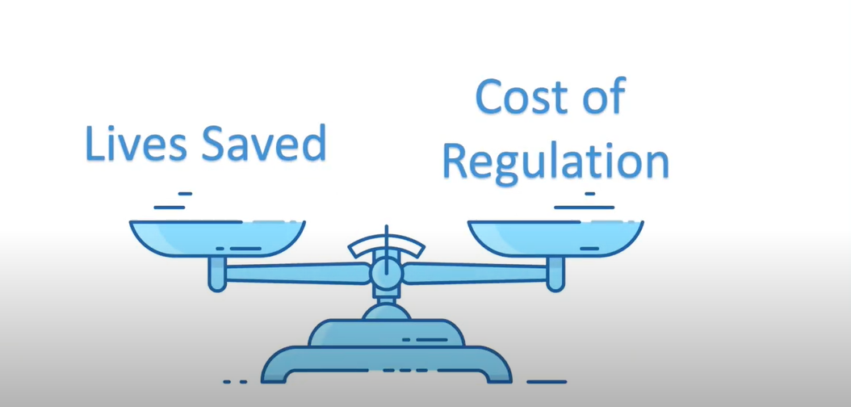

Slide 29
Economists’ Approach
1968- Thomas Schelling, “The Life You Save May Be your Own”
1978- Warren Prunella (Canisius College), Flammability Standards
1981- Kip Viscusi (Vanderbilt), Risk and Uncertainty
2020- Tom Kniesner (Ohio State), Health Economics
2020- Lisa Robinson (Harvard), Center for Decision Science

Slide 30
Willingness to Pay Measures
Labor Market Studies
Compensating wage differentials to accept higher risk of death
Contingent Valuation Studies
Ask people directly would they would pay for a change in the risk of death
Averting Behavior Studies
Use data on seatbelt use, smoke detector and bike helmet purchases

Slide 31
Value of a Statistical Life (VSL)
Concept of a Statistical Life
Reduce the risk of death by 1/1000 for each of 1,000 people saves one statistical life
How much would individuals be willing to pay?
If each of 10,0000 people are willing to pay $1,000 for a 1/1000 risk reduction
The value of a statistical life is 10,000 X $1,000 = $10 million

Slide 32
Problems with VSL
One estimate doesn’t necessarily fit all:
How does age affect VSL?
Does wealth or income affect the estimates?
Does morbidity prior to death affect VSL?

Slide 33
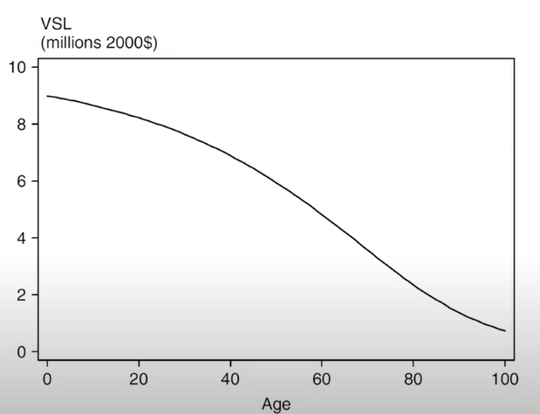
From J.E. Aldy and W.K. Viscusi (2007)

Slide 34
Cost- Benefit Analysis of Covid-19

Slide 35
Is Social Distancing Worth the Economic Cost?

Slide 36
The Economic Cost of Covid-19
Cutler and Summers: National Bureau of Economic Research- 11/16/20

Slide 37
The Economic Cost of Covid-19
Cutler and Summers, National Bureau of Economic Research- 11/16/20

Slide 38
Back to Our Beginning Principles
What trade-offs do we face with Covid-19?
2. Are we able to identify and estimate all the costs?
3. Are rational people thinking at the margin?
7. Can the government improve the outcome?

Slide 39
Conclusion

Slide 40
References
https://www.marketplace.org/2020/04/23/how-much-is-a-human-life-worth/
https://www.marketplace.org/2019/03/20/how-value-life/
https://www.nber.org/news/economic-cost-covid-19
https://www.theregreview.org/2020/08/05/robinson-covid-19-uncertainties-value-statistical-life/
https://www.benefitcostanalysis.org/covid-19_benefit_cost_analysis.php
https://www.nytimes.com/2020/05/11/upshot/virus-price-human-life.html
https://www.wired.com/story/how-much-is-human-life-worth-in-dollars/
https://www.theregreview.org/2020/08/05/robinson-covid-19-uncertainties-value-statistical-life/

Slide 41
CEE Affiliates
https://www.councilforeconed.org/resources/local-affiliates/

Slide 42
Thank You to Our Sponsors!

